Slide 1

Lombard Reflex Test
PRESENTED BY :- SOURAV KUMAR
3RD SEMESTER

Slide 2
SUBTOPICS
INTRODUCTION
PRINCIPLE
PROCEDURE
DAIGNOSIS
REFERENCES
AND
QUESTIONS

Slide 3
INTRODUCTION
The origin of Lombard effect dates back one hundred years. In 1911 Etienne Lombard, a French otolaryngologist discovered the psychological effect of speech produced in the presence of noise (Lombard, 1911).
The Lombard effect or Lombard reflex is the involuntary tendency of speakers to increase their vocal effort when speaking in loud noise to enhance the audibility of their voice.
As this effect is involuntary in nature , it is used as a means to detect malingering in those simulating hearing loss.

Slide 4
PRINCIPLE
Speakers monitor their vocal intensity primarily by means of auditory feedback. When masking is applied to their ears and their thresholds are raised, it is normal for people to speak more loudly in an effort to monitor their voices. This is called the Lombard voice reflex.
Theoretically, there should be no change in vocal intensity unless the noise is well above the speaker’s threshold
This effect includes not only loudness but also other acoustic features such as pitch, rate, and duration of syllables.
This compensation effect maintains the auditory signal-to-noise ratio of the speaker's spoken words.

Slide 5
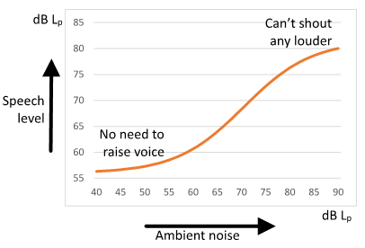

Slide 6
PROCEDURE
The Lombard test can be accomplished in a variety of ways, but the basic procedure may be described as follows:-
The patient is asked to read a passage, during which the clinician monitors the level of the patient’s speech on the VU meter of the audiometer.
Noise is introduced into both of the patient’s earphones and its intensity is raised while the audiologist watches the VU meter (and listens) for changes in the patient’s vocal level.

Slide 7
DIAGNOSIS
An exaggerated hearing loss is suspected if the patient’s speech level is raised by a noise that is lower than the patient’s admitted thresholds.
An organic hearing loss is confirmed if the patient’s speech is raised by a noise that is higher than the patient’s pure tone audiometry thresholds.

Slide 8
REFERENCES
Essentials of Audiology, 4th edition by Stanley A. Gelfand
Handbook of Clinical Audiology, 7th edition by Jack Katz, Marshall Chasin, Kristina English, Linda Hood, Kim Tillery.
Introduction to Audiology, ELEVENTH EDITION ,Frederick N. Martin ,John Greer Clark
https://en.wikipedia.org/wiki/Lombard_effect
https://www.intechopen.com/books/speech-technologies/the-influence-of-lombard-effect-on-speech-recognition

Slide 9


Slide 10


