Slide 1
DOERFLER-STEWART TEST
-Geeta Alimchandani

Slide 2
Contents
Introduction
Principle
Procedure
Diagnosis
Result
Conclusion
reference

Slide 3
INTRODUCTION
The Doerfler-Stewart test (Doerfler and Stewart, 1946) was one of the earliest tests for the detection of functional hearing loss. The purpose of the test is to detect the presence of functional hearing loss. The test has also been administered in the monaural mode in order to detect the presence of unilateral functional hearing loss.
THIS TEST REQUIRES DUAL CHANNEL AUDIOMETER AS IT USES IPSILATERAL MASKING

Slide 4
PRINCIPLE
The basic principle of the Doerfler-Stewart test is the disruption by noise of the loudness yardstick employed by functional hearing loss subjects to present consistent audiologic results. The more the noise and procedure confuses the patient, the more effective the test in detecting the presence of functional hearing loss.
The noise should be saw tooth noise (Doerfler & Stewart, 1946) which is psychologically more disruptive than other noises (Doerfler & Epstein, 1956).
Stimuli used must be spondees.

Slide 5
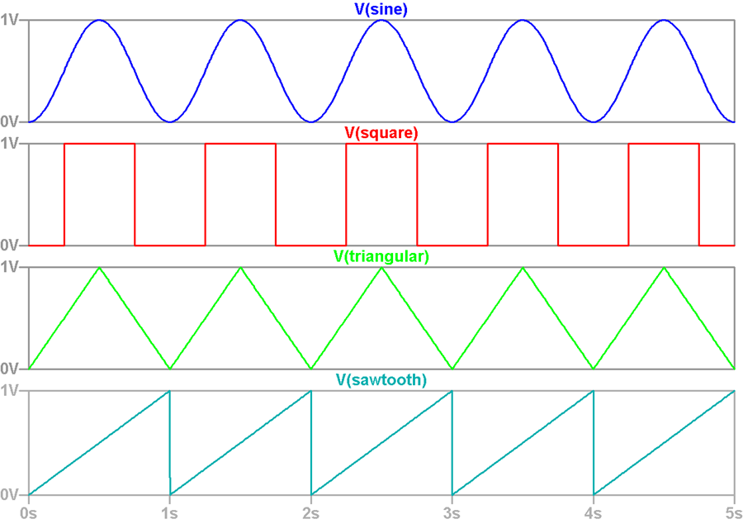
The sawtooth wave (or saw wave) is a kind of non-sinusoidal waveform. ... While a square wave is constructed from only odd harmonics, a sawtooth wave's sound is harsh and clear and its spectrum contains both even and odd harmonics of the fundamental frequency.

Slide 6
PROCEDURE
Obtain SRT1 using the binaural ascending mode,
Calculate the SRT₁ + 5 dB value
Introduce 0 dB HL of noise, bilaterally, and increase the noise intensity in 5 dB steps until the patient can no longer repeat the spondaic words presented at the SRT₁ + 5 dB level. This level of noise is called the noise interference level (NIL).
Continue presenting the spondaic words at the SRT₁ + 5 dB level with the noise increasing above NIL in 5-dB steps until a noise level equivalent to NIL + 20 dB is reached. One spondaic word per noise level is presented.

Slide 7
5. With the noise level at NIL + 20 dB, presented spondaic words, one per level, with the intensity of speech decreasing in 5-dB steps until the level equivalent to SRT₁ – 15 dB is reached.
6. With the speech at the SRT₁ – 15 dB levels, decrease the noise in 10-dB steps, giving one spondaic word per level, until the lower limit of the audiometer is reached.
Repeat step 1 to get the SRT₂.
Obtain the noise-detection threshold (NDT) using the binaural ascending mode and 5-dB increments.

Slide 8
9. Calculate the following difference measures:
  SRT₁ – SRT₂
  SRT₁ – NDT
  SRT₂ – NDT
  SRT₁ + 5 – NIL,
  NDT – NIL

Slide 9
DIAGNOSIS
These normatives were:
-4 to 5 dB for the SRT (1)SRT (2) measure;
17 to 15 dB for the SRT (1) - NDT and SRT (2) -NDT measures;
-18 to 3 dB for the SRT (1) + 5 - NIL measure; and
-31 to 12 dB for the NDT - NIL measure.

Slide 10
RESULT
IF THE THRESHOLDS ARE NOT IN THE NORMATIVE RANGE IT IS FUNCTIONAL HEARING LOSS ,
IF IN THE NORMATIVE RANGE ORGANIC HEARING LOSS IS PRESENT

Slide 11
CONCLUSION
THE TEST IS NOT WIDELY USED BUT WAS ONE OF THE PRIMARY TESTS TO RULE OUT FUCTIONAL HEARING LOSS .

Slide 12
Reference
Rintelman, W. F., Schwan, S. A, & Blakley, B. W. (1991). Pseudohypacusis. Otolaryngologic Clinics of North America , 24 (2), 381-390.
Silman, S., & Silverman, C. A. Functional hearing impairment. In S. Silman, & C. A. Silverman, Auditory diagnosis: Principles and applications (pp. 137-157). New York: Academic press, Inc.
Stach, B. A. (1998). Clinical audiology: an introduction. Singular publishing group, Inc.
Articles from North American Clinics of otolaryngology

Slide 13
Thank you

