Slide 1

Low level pb word test
Presented by- Sourav kumar

Slide 2
content
Introduction
Stimulus
Procedure
Result
references

Slide 3
INTRODUCTION
Most audiologists tend to perform speech recognition testing at 30 to 40 dB above the SRT.
A better approach is to ensure audibility of the speech signal through most of the frequency range to ensure that scores reflect maximum performance levels which often necessitate somewhat higher intensities.
Normally, low word recognition scores are expected at low sensation levels.
This test is same as PIPB function test but with some modification

Slide 4
Stimulus
Pb word
That property by which a group of words used in the measurement of hearing has the various phonemes occurring at approximately the same frequency at which they occur in ordinary conversation in that language; phonetically balanced word lists are used in determining the discrimination score
example – sheep, knock,kite ring, match….. etc.

Slide 5
Procedure
First audiologist place the client in audiometric room .
Audiologist instruct the patient to repeat the word he or she hear from the headphone
Then audiologist gives a list of pb word to patient 5 db above the admitted threshold and note down the result.
Then the procedure is repeated with different pb word list at different intensity level like wise 10db sensation level, 20 db SL, 28db SL, 32db SL, 40 dB SL and a record is maintained.

Slide 6
RESULT
It is frequently observed that unusually high word recognition scores can be obtained on patients with non-organic hearing loss at levels slightly above their admitted threshold.
A high score in presence of low sensation level is indicator of non organic hearing loss.
A high score in presence of f higher sensation level is indicator of organic hearing loss .

Slide 7
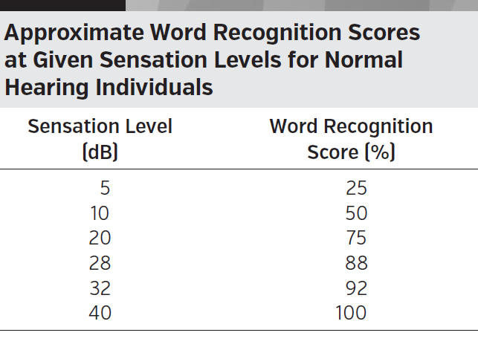

Slide 8


Slide 9
REFERNCE
Hand book of clinical audiology - 7th edition jack katz

Slide 10


