Slide 1
Swinging story test and pulse tone methods
Jay Mehta
Sushant salunkhe

Slide 2
Swinging story test

Slide 3
CONTENTS
INTRODUCTION
PROCEDURE
STIMULI
CONCLUSION
REFERENCE

Slide 4
INTRODUCTION
This test is done to rule out functional hearing loss.
In unilateral hearing loss a story is presented to both the ears or either ear in parts and patient is asked to repeat.
A subject feigning deafness would be able to repeat the complete story without gaps.

Slide 5
PROCEDURE
A story is read to a patient in two portions
One directed above the threshold of the normal ear 10 dB above the SRT through one channel, other portions below the threshold of the “poorer ear”10 dB below the SRT, and portions are presented through both channels simultaneously.
Although this can be done using monitored live voice, an easier method is to use a prerecording. On completion of the recording the patient is simply asked to repeat the story.

Slide 6
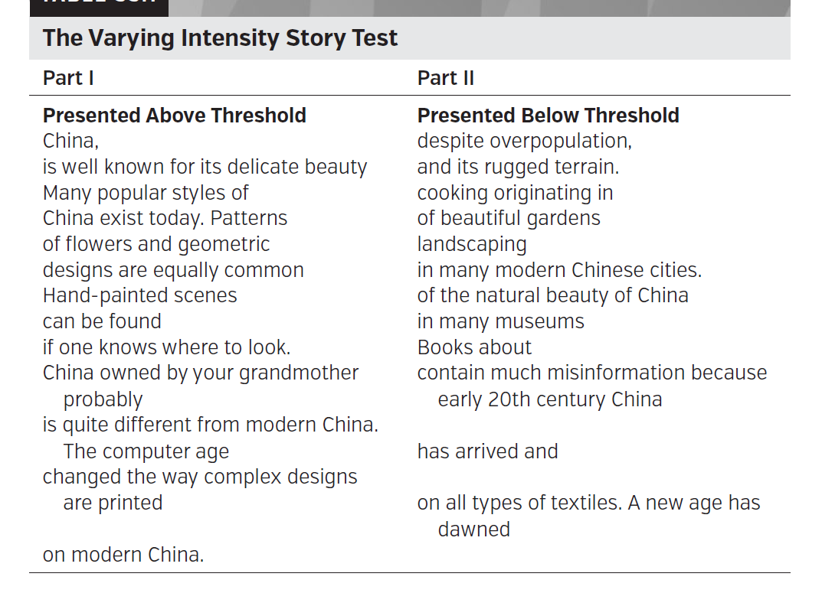
stimuli

Slide 7
Conclusion
Repetition of information directed to the good ear or both ears is to be expected. Any remarks from the bad ear column must have been heard below the patient’s admitted threshold for speech and is the prove that the threshold for that ear has been exaggerated.
All that can be determined from a positive result is that hearing is better in the poorer ear than what the patient has volunteered, providing evidence of nonorganic hearing loss.

Slide 8
Varying Intensity Story Test
A major revision of SWINGING STORY TEST is called the Varying Intensity Story Test (VIST) (Martin et al., 1998b). Two main advantages to the VIST are that it can be used in one or both ears (not limiting it to unilateral cases) and that it comes close, in many cases, to approximating the auditory threshold for speech.
To perform the VIST, patients are advised that they will hear a story one time , following which they will be asked to respond to a series of 10 written questions. Part I of the story is presented at 10 dB SL and Part II is presented at 30 to 50 dB below the admitted SRT. The test is considered to be positive if questions resulting from information supplied only from Part II are answered correctly. The interpretation is that the SRT can be no poorer than the level used for Part II. The VIST was shown to work well on subjects simulating nonorganic hearing loss but it remains to be verified on true nonorganic cases.

Slide 9
One of the advantages of a modification of the swinging story test is that the theme changes when the bad ear column is included or excluded, adding to the complexity of the challenge to the patient with nonorganic hearing loss. Because the patient must concentrate on the story and commit it to memory, it is less likely that the individual will be able to remember which material was presented to the bad ear.

Slide 10
Pulse tone methods
Pulse-Count Methods Some tests may be carried out by presenting a number of puretone pulses in rapid succession and asking the patient to count and recall the numbers of pulses that were heard. The intensity of the tones may be varied above and below the admitted threshold of the tone in one ear (Ross, 1964) or above the threshold in one ear and below the threshold in the other ear (Nagel, 1964). If the originally obtained thresholds are valid the patient should have no difficulty in counting the pulses. Inconsistency should occur only if all the tone pulses are above threshold and the patient has to sort out the number of louder ones from the number of softer ones. This can be very difficult to do. A major advantage to this test is that it can be carried out quickly using any kind of puretone audiometer.

Slide 11
Any Question?

Slide 12
REFERENCE
Handbook of clinical audiology [seven edition] [ jack katz]
https://www.ncbi.nlm.nih.gov/pmc/articles/PMC5531993/

Slide 13

THANK YOU

