Slide 1
Binaural interaction tests
Presented by:- geeta Alimchanadani and Thummar Manasvi from 2nd year B.ASLP
Submitted to:- muneer sir

Slide 2
Introduction
The 2005 ASHA technical report on central auditory processing disorder (CAPD) identified binaural interaction as one of the main central processes that may need to be assessed as part of the evaluation for a CAPD, particularly if the referring complaint or clinical information indicates that there may be a deficit in this domain ( eg- difficulty with sound localisation or hearing in background noise).

Slide 3
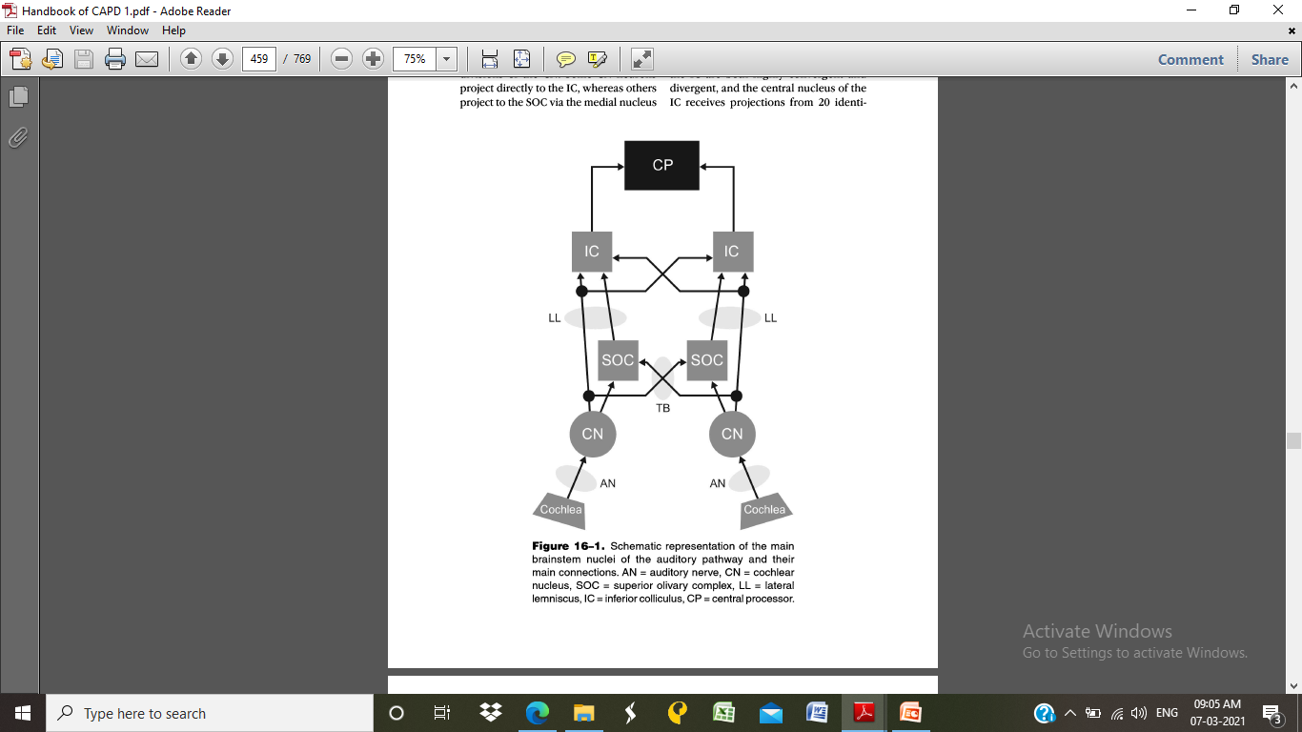

Slide 4
MASKING LEVEL DIFFERENCE
Masking level difference (MLD) refers to the difference in intensity (dB) between signal detection thresholds in two binaural masking paradigms, which differ in phase attributes.
The masking paradigms are termed as
-Homophasic
- Anaphasic

Slide 5
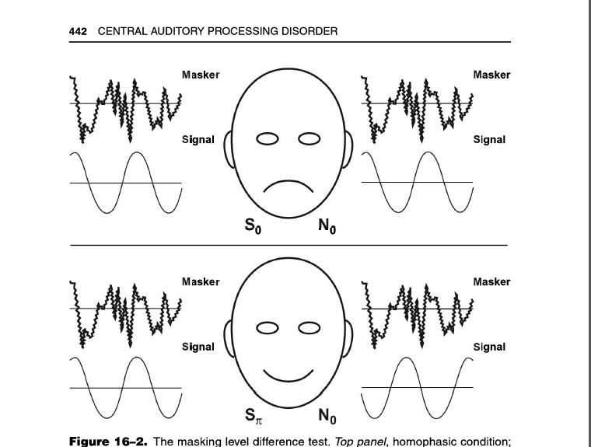

Slide 6

Masking level differences can be obtained for either pure tones or speech.Several clinical audiometers are programmed for speech or tone MLD
MLD is usually obtained for a 500 hz tone and a narrow band masker that centres around that test frequency.
A bekesy type tracking method can be used to track.
Currently it includes 3 interval paradigms , each trial consists of 3 stimuli deliveredc sequentially (masker - masker) + ( S0 or pie (180) – masker ) The child is asked to pick the odd one out

Slide 7
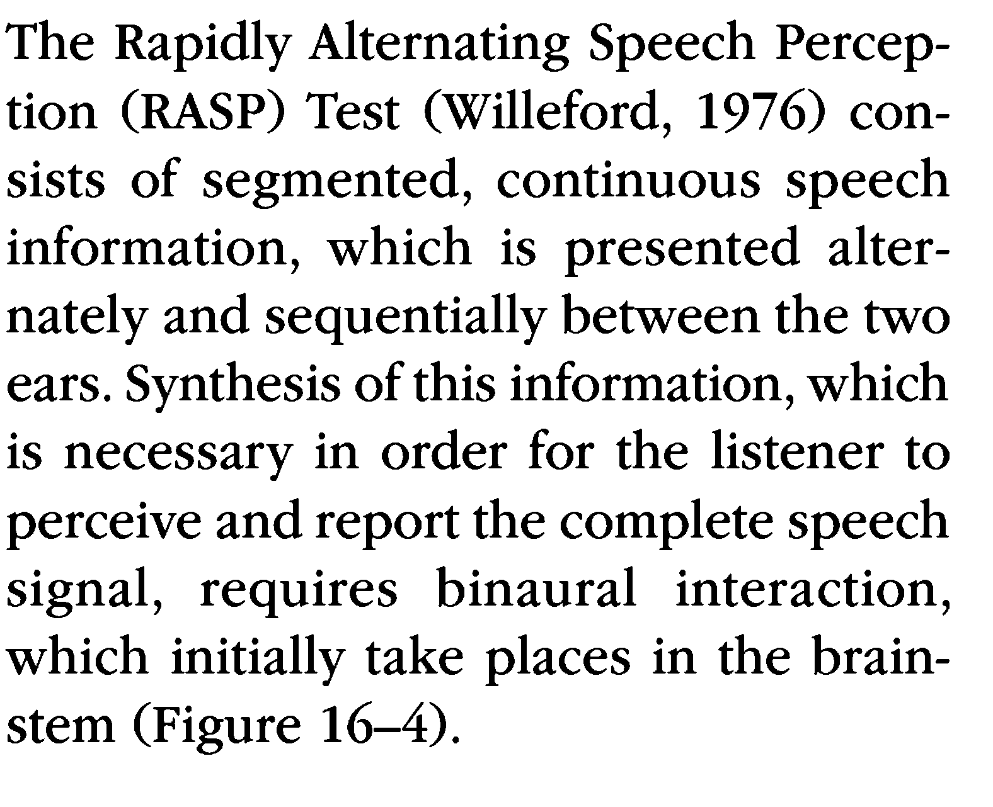
RASP

Slide 8
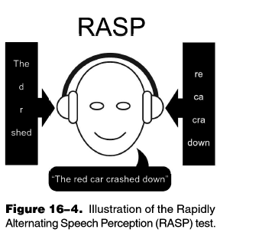

Slide 9
BFT(binaural fusion test)
The binaural fusion test (BFT) involves presentation of different segments of band-pass filtered speech to the two ears with a low-band-pass filtered speech stimulus presented to one ear and a high- band-pass filtered presentation of the same speech stimulus to the other ear (i.e., dichotic presentation).

Slide 10
The patient must fuse the information from each channel in order to report the word .katz and Ivey (1994) proposed that these tests should be more aptly termed "binaura resynthesis"since the listener must combine simultaneous and complementary segments from the two ears into one composite item, rather than fuse or join equal signals into one midline image.

Slide 11
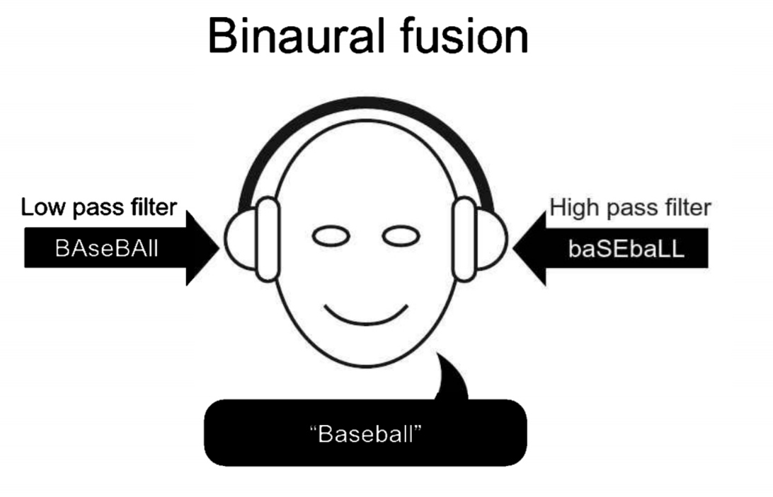
Probably the most well-known test of binaural fusion was included in Will- eford's (1977) test battery.
Figure 16-5. Illustration of the binaural fusion paradigm

Slide 12
In this BFT, 20 spondees filtered through a low-band- pass (500-700 Hz) filter and a high-band- pass (1900–2100 Hz) filter are presented at 30 dB SL referenced to the listener's 500 Hz threshold (low-band) and 2000 Hz threshold (high-band) (Willeford, 1977) (Figure 16-5).
Interpretation for an Indicated Disorder
Subjects with a central auditory processing (CAP) disorder have marked difficulty on this task under all test conditions .

Slide 13
They have difficulty with both single and binaural presentations.
The score for binaural presentation may increase as sensation level (SL) increases above 30 dB SL re: PT threshold, but it will not reach the 75th percentile.
Interpretation for Normals
Normals have difficulty with each track when presented monaurally, especially with the high band.

Slide 14
However, normals are able to integrate the two bands together when presented simultaneously.
Scores progressively increase as sensation level (SL) increases. Normal performance is 75% or better.
Numerous five-year-olds perform within normal limits .
Older adults perform normally in the absence of processing difficulties.

Slide 15
Listening in Spatialized Noise (LisN)
Test Description
Binaural interaction may also be assessed using the recently developed Listening in Spatialized Noise-Continuous Discourse Test and subsequent version of Listening in Spatialized Noise-Sentences which shows a good correlation with MLDS (Cameron et al., 2006).

Slide 16
The test represents a new and different approach to assessing binaural interaction and is administered by special computer soft- ware via headphones and produces a virtual three-dimensional auditory envi- ronment.
The three-dimensional effect is achieved by processing the speech stimuli with head-related transfer functions (HRTFS), so that the target sentences in LİSN-S are perceived as coming from directly in front of the listener (0° azi- muth), while the competing speech (chil- dren's stories) is manipulated in respect to its location (0° versus + 90° azimuth).

Slide 17
In addition, the vocal quality of the speaker(s) is manipulated (same as, or different to, the speaker of the target sen- tences).
Thus, four listening conditions exist, same voice target and competing speech at 0° azimuth (SVO), same voice at + 90° azimuth (SV90), different voices at0° azimuth (DVO), and different voices at + 90° azimuth (DV90).

Slide 18
The listener's perfor- mance in each of the listening conditions is measured in dB (signal-to-noise-ratio; SNR) and the speech reception threshold is thus adaptively determined.
Further- there are three derived "advantage" that include talker advantage, spatial advantage, and total advantage, that represent the benefit in dB gained when the maskers contain either vocal (DV0), spatial (SV90), or both vocal and spatial cues (DV90), compared with the more, measures, baseline (SV0) condition in this figure.

Slide 19
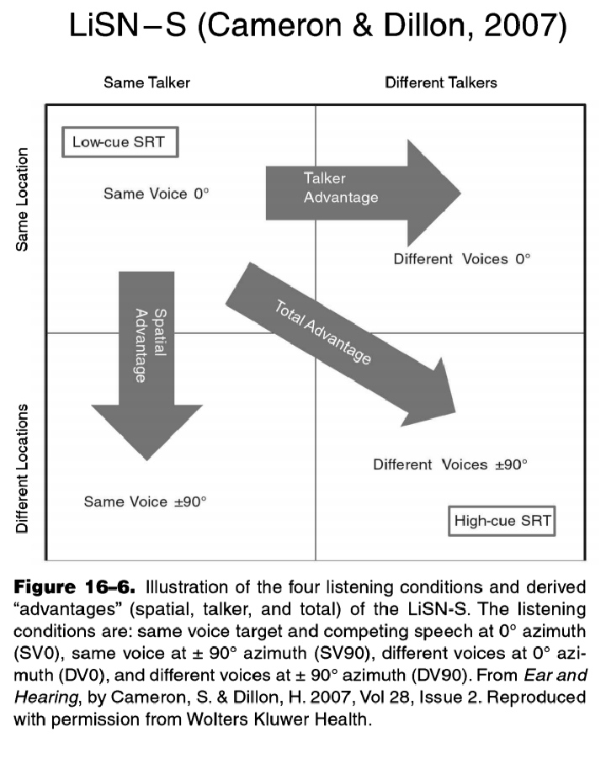

Slide 20
Results
There were no significant differences between the CAPD, LD, or control groups on the conditions of the LISN-S where both the target and maskers emanated from 0° azimuth (low-cue SRT, p= 0.978; talker advantage, p =0.307).
However, there were significant differences between groupson the performance measures where the maskers were separated from the target by + and -90°. Post hoc tests revealed that there were no significant differences between the LD group and controls on any of these measures.

Slide 21
There were, however, significant differences between the CAPD group and the controls on all the conditions where the maskers were spatially separated from the target (high-cue SRT, p =0.001; spatial advantage, p <0.0001; total advantage, p<0.0001).
The LISN-S did not correlate significantly with any test in the traditional test battery, nor were the nonspatial and spatial performance measures of the LISN-S correlated.

Slide 22
Any doubts?

Slide 23
Reference
Handbook of Central auditory processing disorder; volume1; Frank E. Musiek , phD

Slide 24
Thanks

