Slide 1
Organization Development and Reinventing the Organization
Dr. S Chatterjee

Slide 2
Learning Objectives
Define OD and recognize need for change.
Describe culture and understand its impact.
Understand the psychological contract.
Describe five stages of OD.

Slide 3
Challenges for Organizations
Change avalanching down on us.
Tomorrow’s world different from today’s.
Organizations need to adapt to change.
Organizations in continuous interaction with external forces.

Slide 4
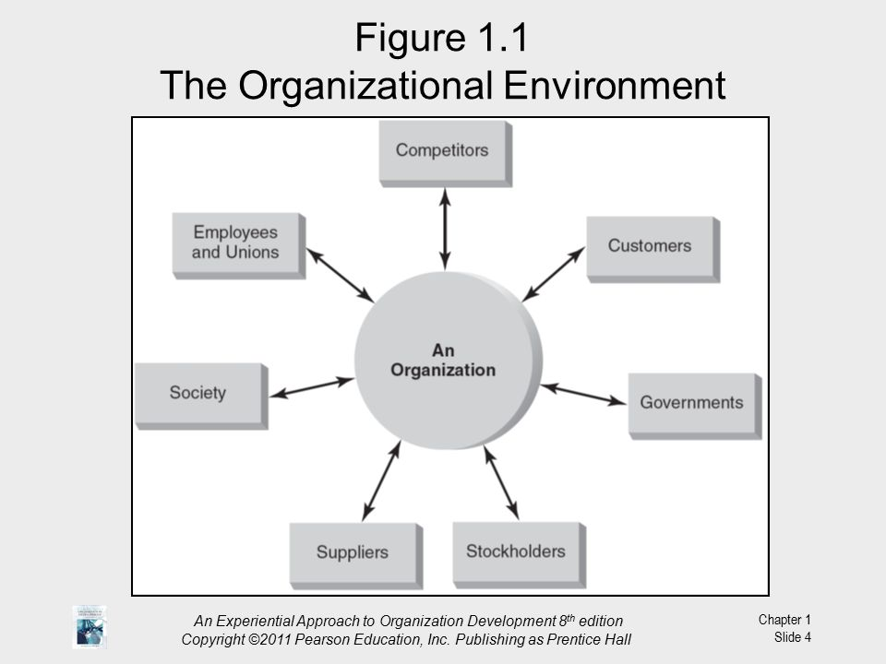

Slide 5
What Is OD?
Long-range efforts and programs.
Aimed at improving organization’s ability to survive.
OD changes problem-solving and renewal processes.

Slide 6
OD Is:
Planned.
Organization wide.
Managed from top.
Increases organization effectiveness.
Planned interventions.
Uses behavioral science knowledge.

Slide 7
The Characteristics of OD
Planned change.
Collaborative approach.
Improve performance.
Humanistic values.
Systems approach.
Scientific approaches.

Slide 8
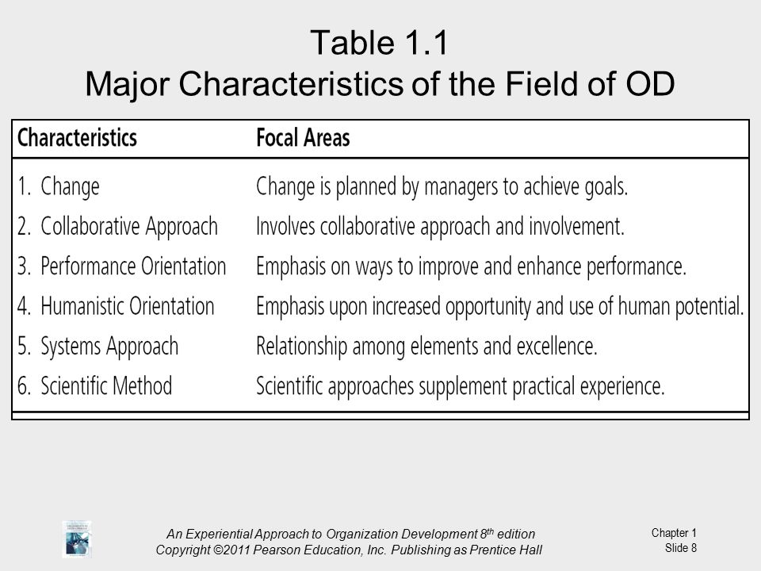

Slide 9
Why OD?
Most cited reasons for beginning change program:
The level of competition.
Survival.
Improved performance.

Slide 10
Primary Goals of Change Programs
Change the corporate culture.
Become more adaptive.
Increase competitiveness.

Slide 11
Factors Leading to Emergence of OD
Need for new organizational forms.
Focus on cultural change.
Increase in social awareness.

Slide 12
The Only Constant Is Change
Change is a moving target.
Today's managers need new mind-set.
Flexibility.
Speed.
Innovation.
Constantly changing conditions.

Slide 13
Successful Firms Share These Traits
Faster.
Quality conscious.
Employee involvement.
Customer oriented.
Smaller.

Slide 14
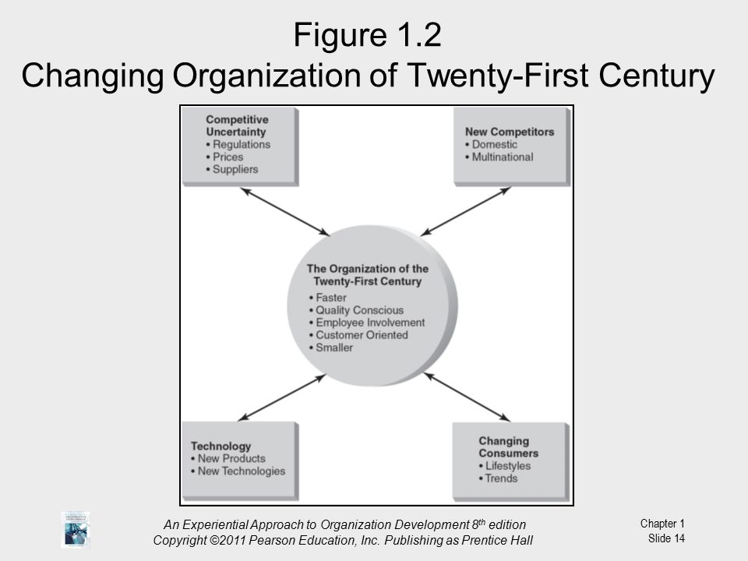

Slide 15
Evolution of OD
Evolved since the late 1940s.
NTL Laboratory-Training methods.
Survey research and feedback.

Slide 16
Who Does OD?
OD practitioners consist of:
-Specialists.
-Those applying OD in daily work.
OD specialists are:
-Internal practitioners – from within the organization.
-External practitioners – from outside the organization.
Managers apply OD principles and concepts.
Activities include:
-Team leaders developing teams.
-Building learning organizations.
-Implementing total quality management.
-Creating boundary less organizations.

Slide 17
Organization Culture
A system of shared meanings including:
Language
Dress
Patterns of behavior
Value system
Feelings
Attitudes
Interactions
Group norms

Slide 18
Norms
Organized and shared ideas.
What members should do and feel.
How behavior is regulated.

Slide 19
Types of Norms
Pivotal norms:
-Essential to accomplishing organization’s objectives.
Peripheral norms.
-Support and contribute to pivotal norms.
-Not essential to organization’s objectives.

Slide 20
Socialization Process
Process that adapts employees to culture.
New employees become aware of norms.
Employees encounter culture.
Individuals understand power, status, rewards, sanctions.

Slide 21
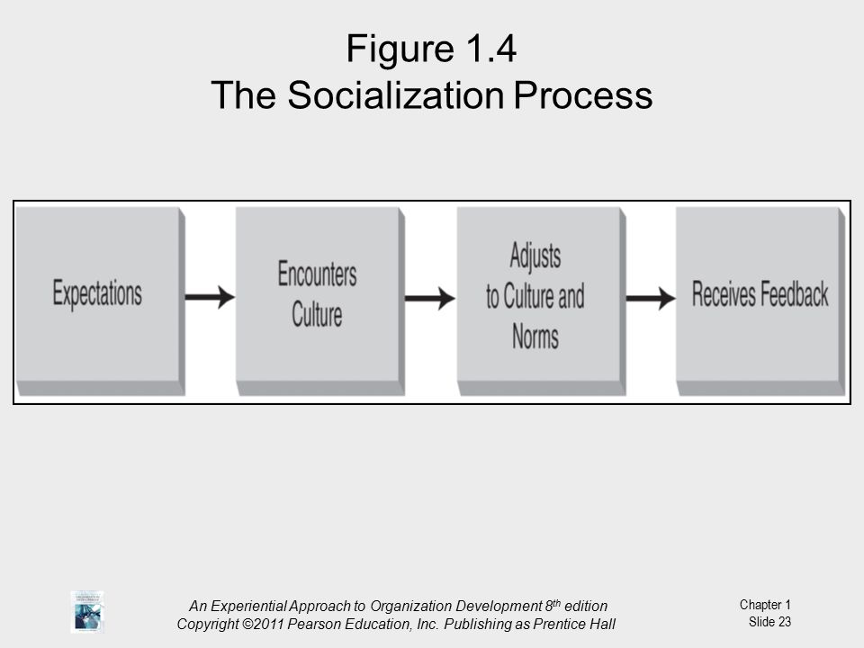

Slide 22
Adjustment to Cultural Norms
Rebellion
-Rejection of all values and norms.
Conformity.
-Acceptance of all values and norms.
Creative individualism.
-Acceptance of pivotal values.
-Rejection of others.

Slide 23
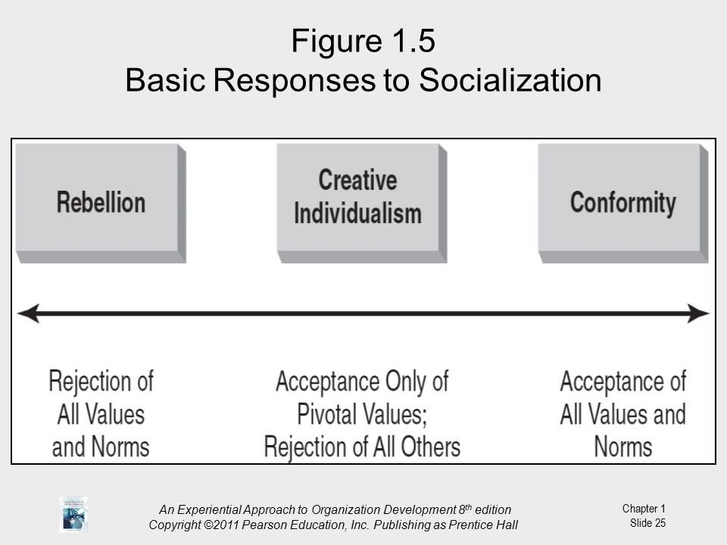

Slide 24
Psychological Contract
Unwritten agreement between individuals and organization.
Open-ended so issues may be renegotiated.

Slide 25
A Model for Change
OD is continuing process.
Emphasis on viewing organization as total system.
System consists of interacting and interrelated elements.

Slide 26
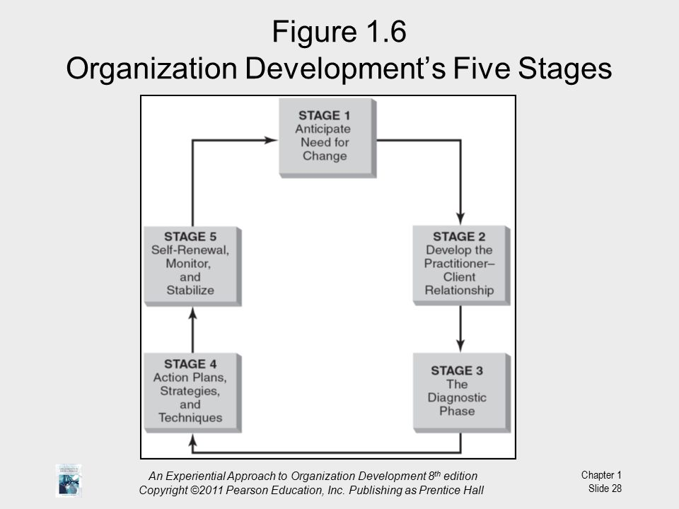

Slide 27
Five-stage Model for OD Process
Stage One: “Anticipating Need for Change”
Someone recognizes need for change.
Must be felt need for change.
Stage Two: “Develop Practitioner-Client Relationship”
Practitioner enters system.
Good first impressions important.
Practitioner establishes trust and open communication.

Slide 28
Stage Three: “The Diagnostic Phase”
Practitioner and client gather data.
Objective to: Understand client’s problems, Identify causes and Select change strategies.
Stage Four: “Action Plans, Strategies, and Techniques”
Series of interventions, activities, or programs.
Aimed at increasing effectiveness.
Programs apply OD techniques.
Stage Five: “Self-Renewal, Monitor, and Stabilize”
As program stabilizes, need for practitioner decreases.
Monitor results.
Stabilize change.
Gradual disengagement of practitioner.

Slide 29
Thank You

