Slide 1
Resource driven strategy for HRM, Human resource system- its macro and micro dimensions.
Dr.S Chahtterjee

Slide 2
Index
Introduction
Resource based model
Application of resource-based view of SHRM
Limitation of resource-based view
Human resources system
Function of HRS
Dimentions of HRS
Macro level HRP
Micro level HRP

Slide 3
Introduction
Resource – based view:- Strategy creation built around the further exploitation of core competencies and strategic capabilities.
Core Competences:- Distinctive skills and knowledge, related to product, service or technology, that can be used to gain competitive advantage.

Slide 4
Resource based Model
The VRIO framework:
Value
Rarity
Inimitability
Organization

Slide 5
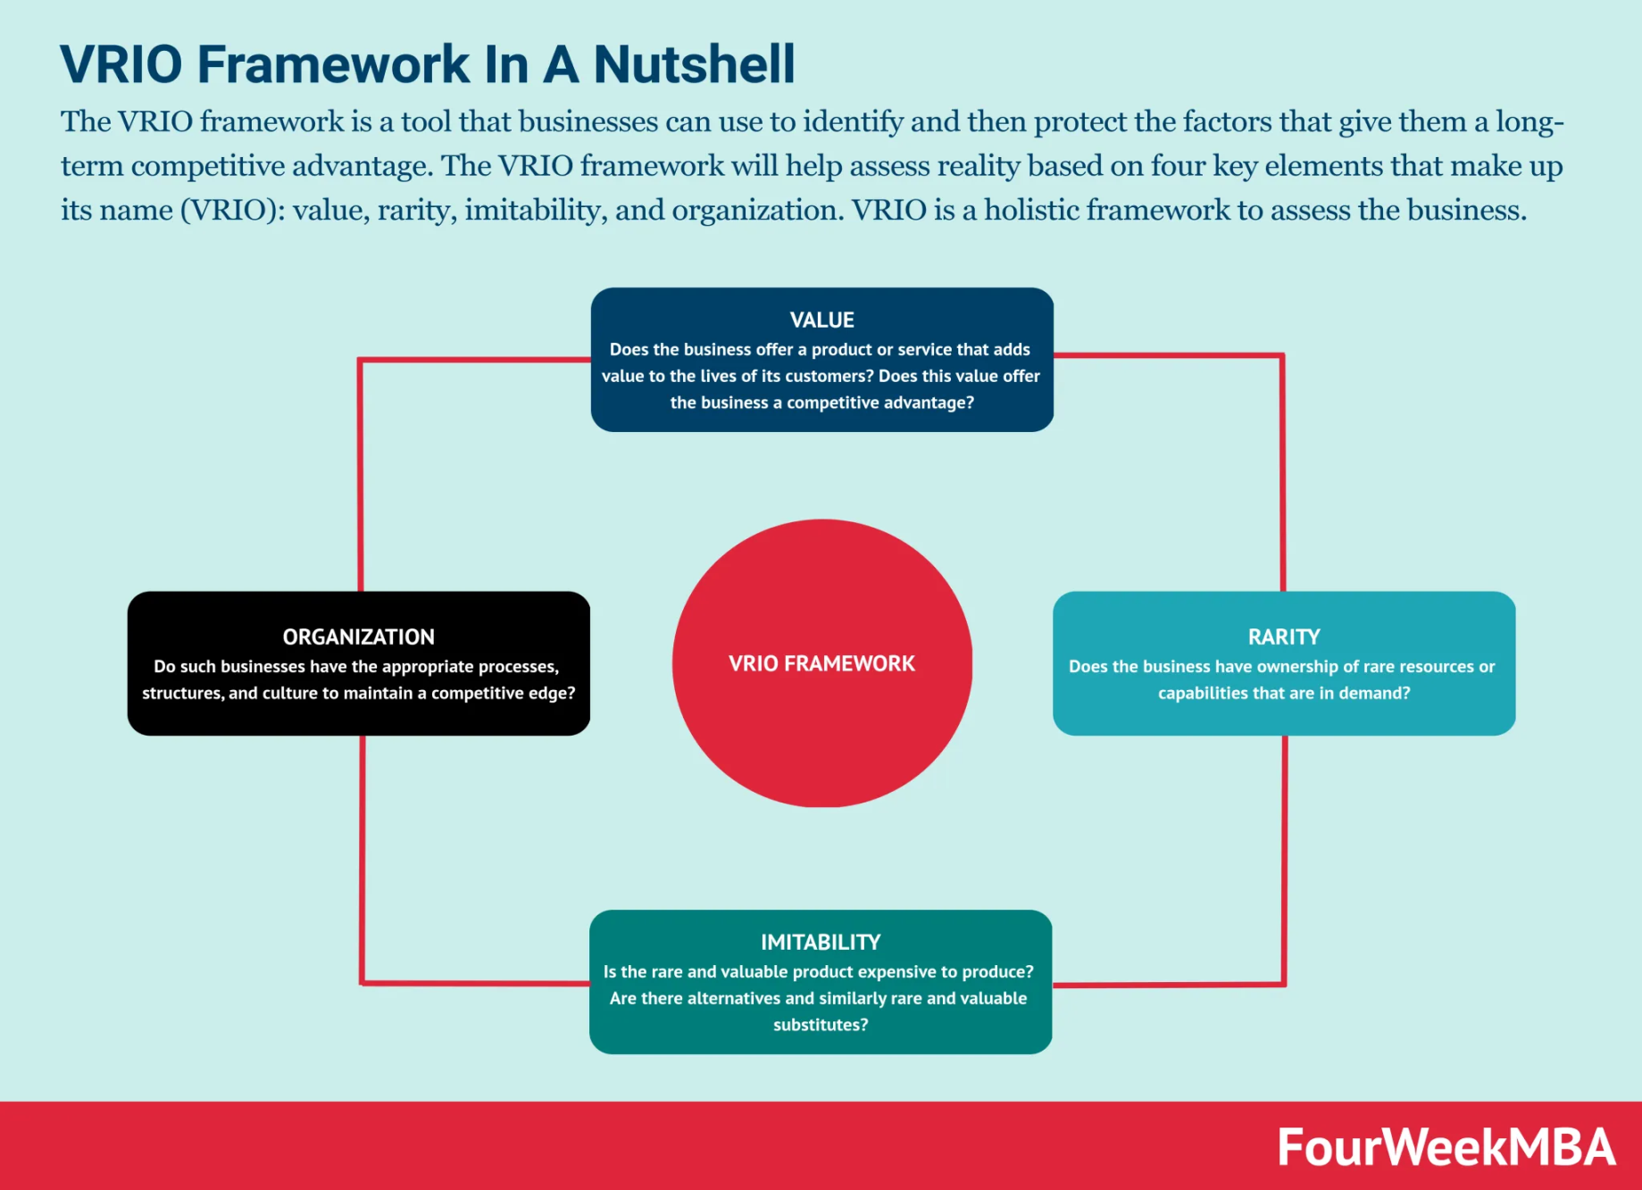

Slide 6
The VRIO framework
Value
How the HR function can create value to reduce cost such as reduction cost, such as reduction in headcount and the introduction of flexible working practices.
How they might increase revenue, as the business as efficiency, also as customer selection, customer retention and customer referral, means through enhanced customer service and customer added value.
Which HR contribute the most to sustainable competitive advantage.

Slide 7
Rarity
The HR Executive needs to consider how to develop and exploit rare characteristics of a firm’s human resources to gain competitive advantage.

Slide 8
Inimitability
If an organization’s human resources add value and are rare, they can provide competitive advantage in the short – term, but if other firms can imitate these characteristics, then over time competitive advantage may be lost and replaced with competitive parity.

Slide 9
Organization
To ensure that the HR function can provide sustainable competitive advantage, the VRIO framework suggests that organizations need to ensure that they are organized so that they can capitalize on the above, adding value, rarity and inimitability.

Slide 10
Application of resource-based view of SHRM
The resource – based view of SHRM has recognized that both human capital and organizational processes can add value to an organization; however, they are likely to be more powerful when they mutually reinforce and support one another.

Slide 11
Limitation of the resource-based view
The resource-based view represents a paradigm shift in strategic HRM thinking by focusing on the internal resources of the firm as a key source of sustainable competitive advantage, rather than focusing on the relationship between the firm and the external business context.
Human resources, as scarce, valuable, organization-specific and difficult to imitate resources, therefore become key strategic assets.

Slide 12
What is Human Resource System
HR system is tool that allows HR information to be stored, processed and reported upon. From non-automated systems, such as spreadsheets and databases, to automated systems like dedicated HR software solutions; there are many different options to choose from to suit all requirements and budgets.
Can also be called HRIS(Human resources information system),

Slide 13
Functions of Human resource system
Retaining staff
Hiring
Onboarding & Offboarding
Administration
Managing payroll
Tracking and Managing employee benefits
HR planning
Recruiting/Learning management
Performance management and appraisals
Employee self-service
Scheduling and rota management
Absence management
Leave management
Reporting and analytics
Employee reassignment
Grievance handling by following precedents

Slide 14
Dimensions of HRS
The HRS is divided into two dimensions, which are as follows:
Macro- Level HRP
Micro-Level HRP

Slide 15
Macro-level HRP
At the macro level, HRP focuses on aligning human resources administration with the organization’s mission and overall strategic plan.
Often called HR strategic planning or organizational design and development, macro HRP examines employee management policies and procedures and their effect on human resources management.

Slide 16
Objective of Macro-level HRP
Recruitment,
Performance evaluation,
Compensation and benefits,
Employment law compliance,
Labour relations
Workplace safety.

Slide 17
Micro level HRP
Macro level HRP drives Micro level HRP
Which develops and implements the tactics needed to help the organisation achieve its strategic objectives.
Ensures that the business has the appropriate number of employees with the appropriate mix of knowledge, skill and abilities in the proper areas and departments.

Slide 18
Objectives
Demand forcating
Manpower supply analysis
Manpower planning

Slide 19
Demand forecasting
Demand forecasting uses historical and current operations data to identify future needs.
Analysing the current workforce to identify potential shortage and surpluses in various job categories.

Slide 20
Manpower supply analysis
Scanning the current labour market to determine the workforce available and analysing any gaps between the kind of workforce needed with what is available.

Slide 21
Manpower planning
Set priorities and develop plans for employee recruitment, retention and development and workforce reductions.

Slide 22


