Slide 1
FORMS OF WARD
Dr. Medha Wadhwa
Associate Professor
Department of Management

Slide 2
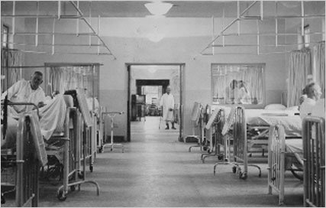
NIGHTINGALE WARD

Slide 3
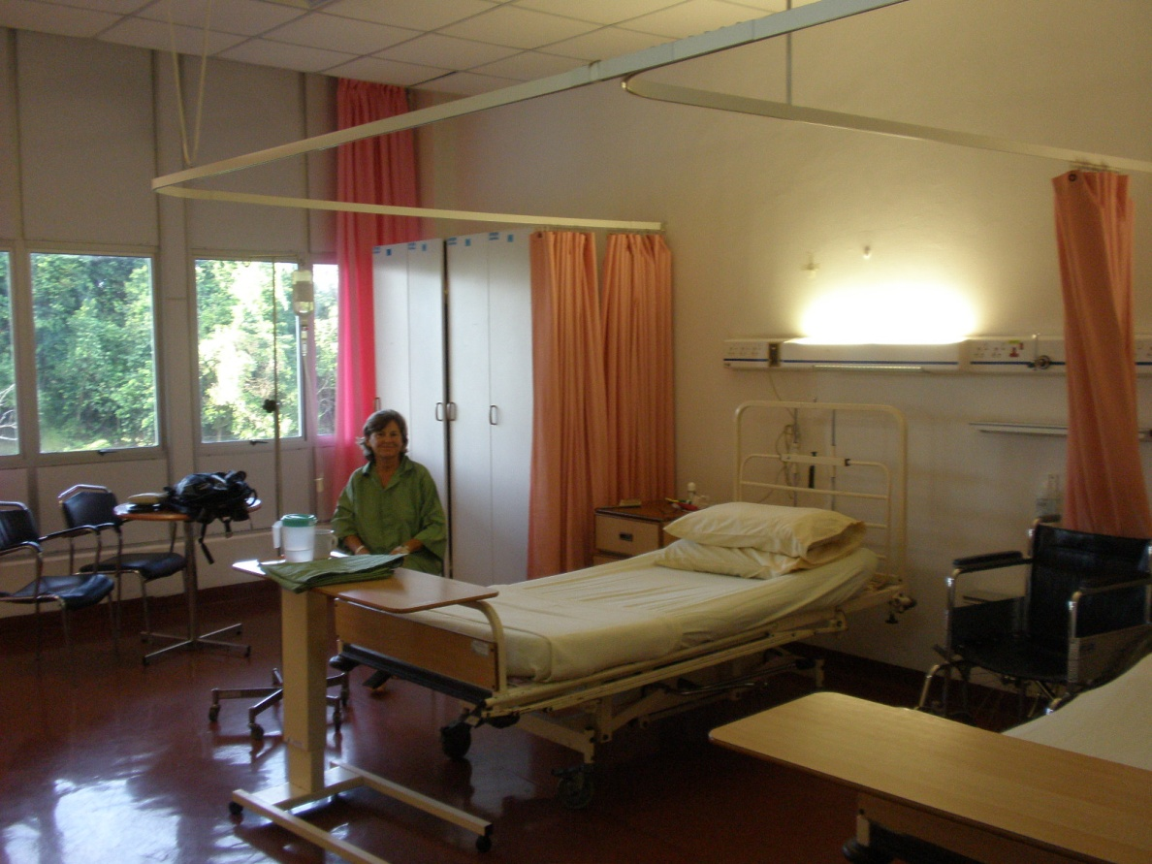

Rig’s Pattern Ward

Slide 4
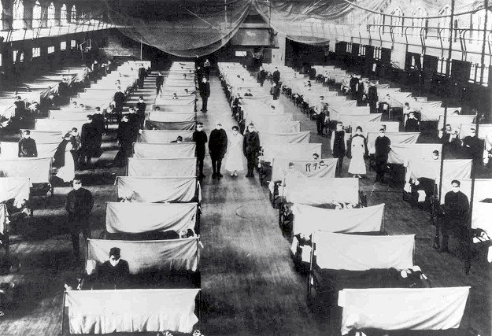
Racing Track Ward

Slide 5
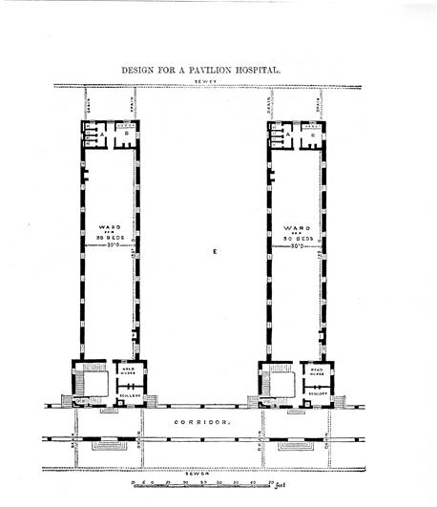
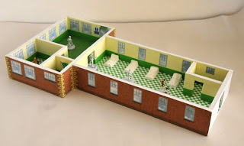
T shaped Ward

Slide 6


Single Straight Corridor Ward

Slide 7
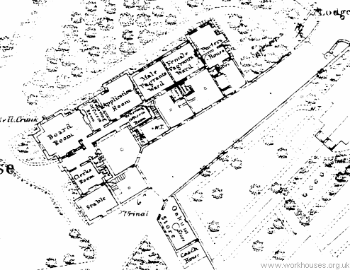
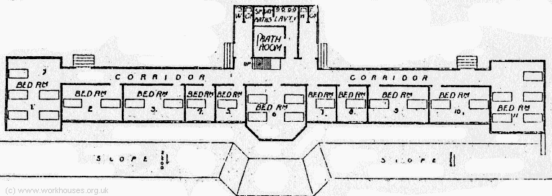
L shaped Plan

Slide 8
H Shaped Plan
Ward
Ward
SUPPORT SERVICES
Ward
Ward

Slide 9
E Shaped Plan
SUPPORT SERVICES
WARD
WARD
WARD

Slide 10
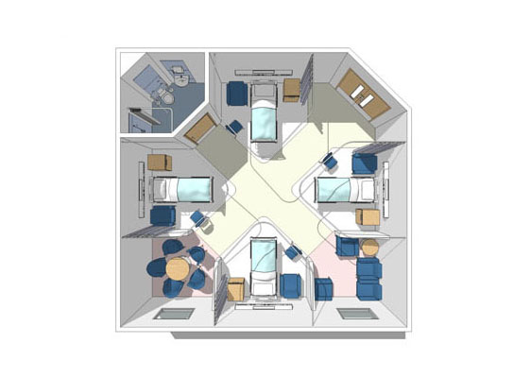
Cruciform Plan

Slide 11
Central Corridor Multiple Rib Pattern
Ward
Ward
Ward
Ward
Ward
Ward

Slide 12


