Slide 1

RETT SYNDROME
Cyril Sajan
PharmD

Slide 2
Introduction
A rare genetic mutation affecting brain development in girls.
Rett Syndrome is estimated to affect 1 in every 10,000 to 15,000 live female births in all racial and ethnic groups worldwide.
Most cases are random, spontaneous mutations; < 1% of recorded cases are inherited or passed from one generation to the next.
Girls with the typical clinical picture of Rett syndrome are usually born at term after an uneventful pregnancy and delivery.
Boys are rarely affected.

Slide 3
Etiology
Usually Rett syndrome is caused by a mutation in the methyl CpG binding protein 2 ( MECP2 ) gene. The MECP2 gene is involved in the production of a protein called methyl-cystine binding protein 2 ( MeCP2) which is needed for brain development and acts as a biochemical switch that can either increase gene expression or tell other genes when to turn off and stop producing their own unique proteins. The MECP2 gene does not function normally in Rett syndrome so that structural abnormal forms or inadequate amounts of the protein are produced and can cause other genes to have abnormal gene expression.

Slide 4
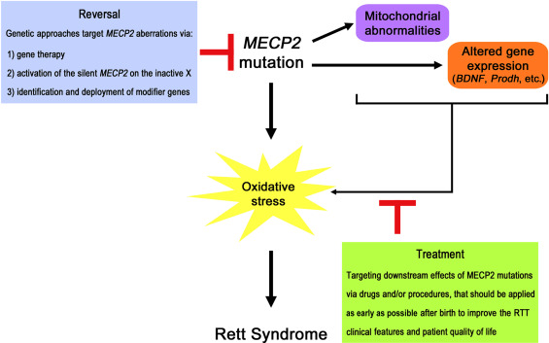
Pathophysiology

Slide 5
Usually Rett syndrome is caused by a mutation in the methyl CpG binding protein 2 (MECP2) gene. The MECP2 gene is involved in the production of a protein called methyl-cytosine binding protein 2 (MeCP2), which is needed for brain development and acts as a biochemical switch that can either increase gene expression or tell other genes when to turn off and stop producing their own unique proteins. The MECP2 gene does not function normally in Rett syndrome; structurally abnormal forms or inadequate amounts of the protein are produced and can cause other genes to have abnormal gene expression.
Rett syndrome is not always caused by an MECP2 mutation but may be caused by partial gene deletions, mutations in other genes (eg, CDKL5 and FOXG1 genes) that affect brain development in atypical Rett syndrome, mutations in other parts of the MECP2 gene, and possibly other genes that have not yet been identified.

Slide 6
Clinical Features
Rett Syndrome is a rare condition that affects the brain growth and development.
Crying and irritability
Difficulty crawling or walking
Loss or decline of speech skills
Loss of eye contact
Weak or floppy muscle tone
Movement disorders
Slowed head growth
Epilepsy

Slide 7
Later Stages
In their early teenager years, children who have rett Syndrome might experience
Lower
Slowing of developmental regression
Movement disorders
Joint deformities
Sleep Disorder

Slide 8
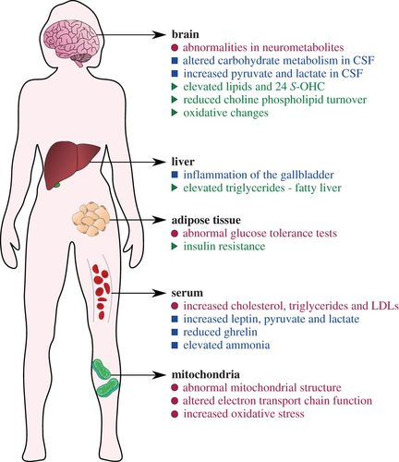

Slide 9
Stages of Rett Syndrome
Stage I: early onset. Signs and symptoms are subtle and easily overlooked during the first stage, which starts between 6 and 18 months of age and can last for a few months or a year. Babies in this stage may show less eye contact and start to lose interest in toys. They may also have delays in sitting or crawling.
Stage II: rapid deterioration. Starting between 1 and 4 years of age, children lose the ability to perform skills they previously had. This loss can be rapid or more gradual, occurring over weeks or months. Symptoms of Rett syndrome occur, such as slowed head growth, abnormal hand movements, hyperventilating, screaming or crying for no apparent reason, problems with movement and coordination, and a loss of social interaction and communication.
Stage III: plateau. The third stage usually begins between the ages of 2 and 10 years and can last for many years. Although problems with movement continue, behavior may have limited improvement, with less crying and irritability, and some improvement in hand use and communication. Seizures may begin in this stage and generally don't occur before the age of 2.
Stage IV: late motor deterioration. This stage usually begins after the age of 10 and can last for years or decades. It's marked by reduced mobility, muscle weakness, joint contractures and scoliosis. Understanding, communication and hand skills generally remain stable or improve slightly, and seizures may occur less often.

Slide 10
Diagnosis Tool
Blood tests
Urine tests
Imaging tests such as magnetic resonance imaging (MRI) or computerized tomography (CT) scans
Hearing tests
Eye and vision exams
Brain activity tests (electroencephalograms, also called EEGs)

Slide 11
Treatment
Although there is no cure for Rett syndrome, there are treatments that can improve symptoms. And children should continue these treatments for their entire life.
The best options available to treat Rett syndrome include:
Standard medical care and medication
Physical therapy
Speech therapy
Occupational therapy
Good nutrition
Behavioral therapy
Supportive services

Slide 12
Regular medical care. Management of symptoms and health problems may require a multispecialty team. Regular monitoring of physical changes such as scoliosis and GI and heart problems is needed.
Medications. Though medications can't cure Rett syndrome, they may help control some signs and symptoms associated with the disorder, such as seizures, muscle stiffness, or problems with breathing, sleep, the gastrointestinal tract or the heart.
Physical therapy. Physical therapy and the use of braces or casts can help children who have scoliosis or require hand or joint support. In some cases, physical therapy can also help maintain movement, create a proper sitting position, and improve walking skills, balance and flexibility. Assistive devices may be helpful.
Occupational therapy. Occupational therapy may improve purposeful use of the hands for activities such as dressing and feeding. If repetitive arm and hand movements are a problem, splints that restrict elbow or wrist motion may be helpful.
Speech-language therapy. Speech-language therapy can help improve a child's life by teaching nonverbal ways of communicating and helping with social interaction.
Nutritional support. Proper nutrition is extremely important for normal growth and for improved mental, physical and social abilities. A high-calorie, well-balanced diet may be recommended. Feeding strategies to prevent choking or vomiting are important. Some children and adults may need to be fed through a tube placed directly into the stomach (gastrostomy).
Behavioral intervention. Practicing and developing good sleep habits may be helpful for sleep disturbances.
Support services. Academic, social and job-training services may help with integration into school, work and social activities. Special adaptations may make participation possible.

Slide 13
Alternative medicine
A few examples of complementary therapies that have been tried in children with Rett syndrome include:
Music therapy
Massage therapy
Hydrotherapy, which involves swimming or moving in water
Animal-assisted therapy, such as therapeutic horseback riding

Slide 14
References
https://medlineplus.gov/genetics/condition/rett-syndrome/
https://rarediseases.info.nih.gov/diseases/5696/rett-syndrome
GARD (Genetic and Rare Disease Information Centre

