Slide 1

Guideline ppt on Ulcerative colitis
Made By :Dr. Cyril Sajan
Assistant Professor , SVDU

Slide 2
INFLAMMATORY BOWEL DISEASE
Refers to two chronic diseases that cause inflammation of the intestine: Ulcerative colitis and Crohn's disease.
Ulcerative colitis is a diffuse non- specific inflammatory disease of the large intestine of unknown cause, primarily affecting the mucosa, characterized by erosions and/or ulcerations. The disease is characterized by repeated cycles of relapses and remissions, occasionally accompanied by extra-intestinal manifestations.

Slide 3
Epidemiology of Ulcerative Colitis
Ulcerative colitis is more common in the Western and Northern hemispheres with highest incidence in USA and UK.
In the Past 2 decades , its incidence increased in Middle east and Asia and may be due to westernization of diet .
Ulcerative colitis is slightly more common in women than in men. Age of onset around 15- 25 years, although the disease can occur in people of any age. Ulcerative colitis is uncommon in persons younger than 10 years.

Slide 4
Etiology of Ulcerative Colitis
The exact etiology of ulcerative colitis is unknown, but certain factors have been found to be associated with the disease, include genetic factors, immune system reactions, environmental factors, nonsteroidal anti-inflammatory drug (NSAID) use, low levels of antioxidants, psychological stress factors, and consumption of milk products.
The incidence of UC is lower in non-smokers than in smokers.
Ingestion of animal fat can increase the occurrence of UC.
A history of appendectomy is correlated negatively with the occurrence of UC.

Slide 5
Pathophysiology
A variety of immunologic changes have been documented in UC. T cells accumulate in the lamina propria of the diseased colonic segment. these T cells are cytotoxic to colonic epithelium. This change is accompanied by an increase in the population of B cells and plasma cells, with increased production of immunoglobulin G (IgG) and immunoglobulin E (IgE).
Ant colonic antibodies have been detected in patients with UC. A small proportion of patients with ulcerative colitis have smooth muscle and ant cytoskeletal antibodies.
Microscopically, acute and chronic inflammatory infiltrate of the lamina propria, crypt branching, and villous atrophy are present in ulcerative colitis. Microscopic changes also include inflammation of the crypts of Lieberkühn and abscesses. These findings are accompanied by a discharge of mucus from the goblet cells, the number of which is reduced as the disease progresses. The ulcerated areas are soon covered by granulation tissue. Excessive fibrosis is not a feature of the disease. The undermining of mucosa and an excess of granulation tissue lead to the formation of pseudo polyps.

Slide 6
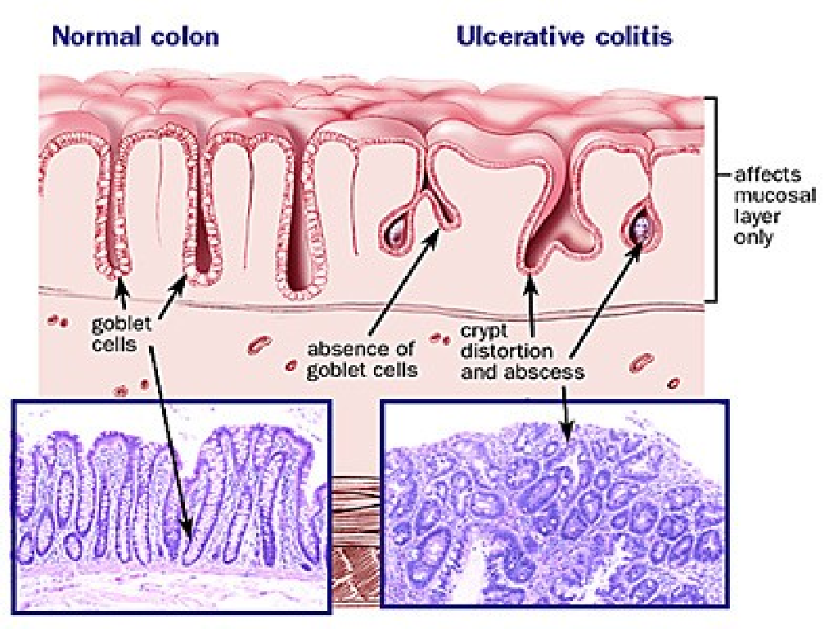

Slide 7
Clinical Presentation
A major symptom of UC is bloody diarrhea, occasionally accompanied by abdominal pain.
UC should be suspected in cases with a history of persistent or repetitive mucous bloody stool/bloody feces.
Patients with UC often have no abnormal findings on physical examination, but anemia, weight loss, abdominal tenderness and fresh bleeding on digital rectal examination are occasionally seen.

Slide 8
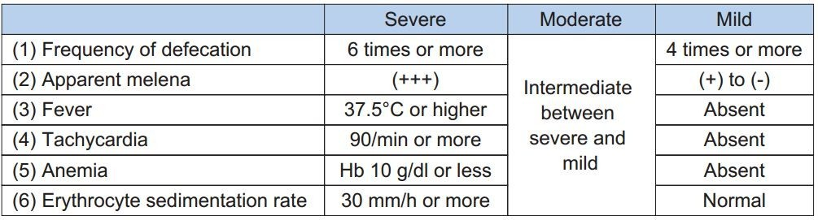
Classification of ulcerative colitis by severity

Slide 9
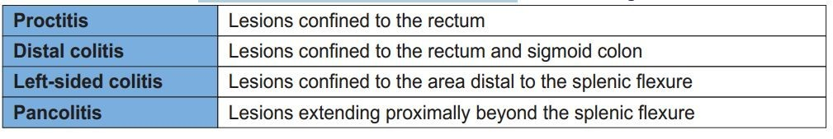
Classification by the extent of the lesions

Slide 10
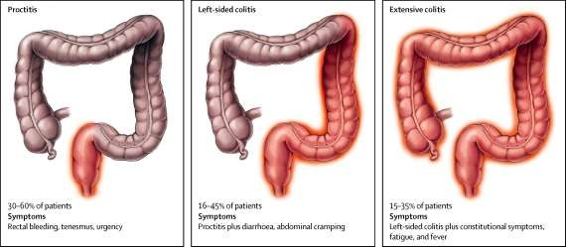
Classification
According to disease extent (Montreal classification), Silverberg et al.,
  E1 – Proctitis: Distal to rectosigmoid junction
  E2 – Left-sided: Limited distal to splenic flexure
  E3 – Pancolitis/Extensive: involvement proximal to splenic
flexure.

Slide 11
Diagnosis
Diagnosis depends on
  Clinical features
  Laboratory parameter
  Imaging
  Colonoscopy
  Histopathology

Slide 12

Clinical features:
Depends on extent and severity
  Rectal bleeding (> 90%)
  Loose stool (> 6 weeks)
  Rectal urgency
  Tenesmus
  Mucopurulent exudate
  Nocturnal defecation
  Crampy abdominal pain

Slide 13

Proctitis:
  Rectal bleeding
  Rectal urgency
  Mucus discharge
  Tenesmus
  Severe constipation
Extra-intestinal manifestation
  Arthropathy
  Ocular
  Dermatological
  Hepato-biliary
Systemic symptoms:
  Weight loss
  Fever
  Tachycardia
  Nausea
  Vomiting

Slide 14

History
  Symptoms
  Family history
  Travel history
  Drug history
Examination
  Anemia
  Pulse
  Blood pressure
  Height, weight
  Abdomen: Distension, tenderness, Bowel sound
  Perianal: inspection, DRE(Digital renal Examination)

Slide 15
Initial
CBC – Hb- , PC(Pyruvate carboxylase)-
Electrolytes
Liver function test
Renal function test
Iron profile
Vitamin-D level
CRP (C-reactive protein)
Faecal Calprotectin

Slide 16
Exclusion of infective diarrhoea including C. difficile
  Stool RME (Routine Microscopy Examination)
  Stool culture
  Toxin A & B
Colonoscopy/Sigmoidoscopy
Histopathology

Slide 17
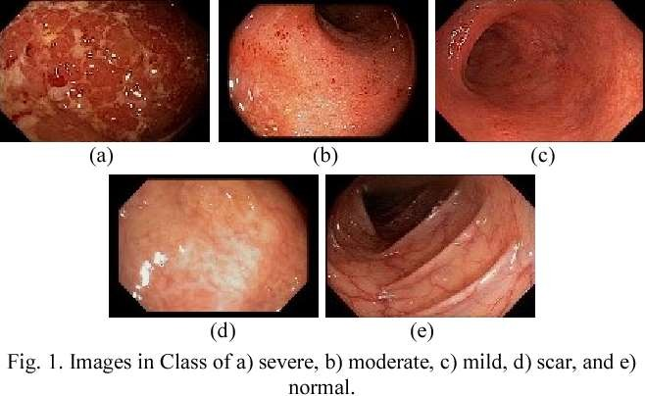

Slide 18
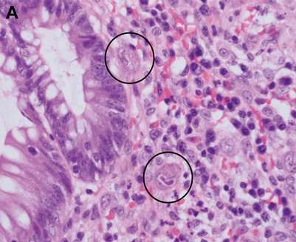
In relapse or treatment refractory UC
Test for C. difficile (Clostridium) and CMV(Cytomegalovirus)
C. difficile infection
  Stool for c. difficile toxin
  Pseudo membrane are usually absent (0-13%)
CMV
  Biopsy
  Histopathology:
multiple inclusion body
  Immunohistochemistry(IHC) (> 2 CMV +ve cells)
  PCR in blood

Slide 19
Biomarker
pANCA
ASCA
F. calprotectin – most sensitive in activity, Dx & treatment response

Slide 20
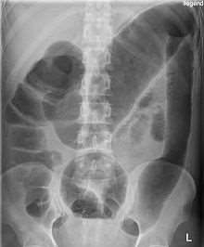
Acute severe colitis at admission
  CBC
  ESR, CRP
  Electrolytes
  LFT
  Stool RME, C/S, C. difficile toxin
Plain X–ray abdomen
  Exclude dilation >5.5 cm
  Disease extent
Toxic megacolon
Predictors of poor treatment response (mucosal islands, > 2 gas filled loops of small bowel)

Slide 21
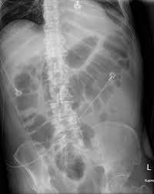
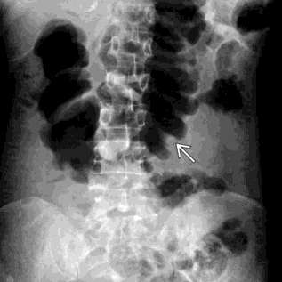
Thumb printing
Mucosal island

Slide 22
Acute severe colitis at admission
Flexible sigmoidoscopy
  Confirm diagnosis
  Exclude infection – CMV
  Preparation: unprepared bowel. Phosphate enema can be used
  Full colonoscopy is not recommended
  After active disease has been controlled in newly diagnosed patient full colonoscopy should carried out to see extent and to exclude CD

Slide 23
▪ Massive Hemorrhage
▪ Perforation
▪ Toxic megacolon (transverse colon with a diameter of more than 5.0 cm to 6.0 cm with loss of haustration)
▪ Malabsorbtion
▪ Obstruction

Slide 24

5-Aminosalicylic Acids
Sulfasalazine Olsalazine Balsalazide Asacol
Rowasa Enema Pentasa
Canasa Suppository

Slide 25
5-Aminosalicylic Acids
▪ The mainstay treatment of mild to moderately active Ulcerative Colitis and Crohn's Disease
• 5-ASA may act by
- Blocking the production of prostaglandins and leukotrienes
▪ 5-ASA absorbed in small intestine
- Do not reach colon
- Hence need delivery system
- 2 types of delivery systems
▪ pH dependent resin or semi permeable membrane
▪ 5-ASA +bond (like sulfasalazine)

Slide 26
Benefits
▪ Well-tolerated
▪ Few side effects
▪ Relatively inexpensive
▪ Oral or Rectal
▪ Safe for all ages & pregnancy
Risks
▪ Not helpful in severe disease
▪ side effects
- skin rashes
- Fever
- Arthralgia
- Agranulocytosis
- Pancreatitis
- Hepatitis
- Male infertility

Slide 27
▪ Topical corticosteroids can be used as an alternative to 5- ASA in ulcerative proctitis or distal Ulcerative Colitis.
▪ Oral prednisone or prednisolone is used for moderately severe Ulcerative Colitis or Crohn's Disease,( for about 1 month) in doses ranging up to 60 mg per day.
▪ IV is warranted for patients who are sufficiently ill to require hospitalization; the majority will have a response within 7 to 10 days.

Slide 28
Benefits
▪ Induces remissions in UC and CD
▪ Inexpensive
▪ Oral or rectal
Risks
▪ No long-term benefits
▪ Numerous side effects
– Cushingoid changes
– Hypertension
– Diabetes
– Osteoporosis
– Acne
– Cataracts
– Depression
– Growth retardation

Slide 29
▪ No proven maintenance benefit in the treatment of either Ulcerative Colitis or Crohn's Disease.
▪ Budesonide:
– less side effects,
– its use is limited to patients with distal ileal and right- sided colonic disease

Slide 30
Immunosuppressive Agents
▪ These agents are generally appropriate for patients in whom the dose of corticosteroids cannot be tapered or discontinued.
▪ Azathioprine & 6-MP
– The most extensively used immunosuppressive agents.
– The mechanisms of action unknown but may include
suppressing the generation of a specific subgroup of T cells.
– The onset of benefit takes several weeks up to six months.

Slide 31
▪ Long-term (maintenance) treatments for UC or CD
▪ Can treat fistulas in CD over long-term
▪ Primarily for patients unable to get off steroids
▪ Requires continuous monitoring of blood tests

Slide 32


Benefits
▪ “Steroid-sparing” in UC and CD
▪ Long-term maintenance
▪ Relatively inexpensive
Risks
▪ Can lower blood counts and “immunity”
▪ Requires long-term monitoring
▪ Occasional allergies
– Pancreatitis
– Fever

Slide 33
Maintenance Therapies for Ulcerative Colitis
▪ Aminosalicylates
▪ Azathioprine/6-MP

Slide 34
Immunosuppressive Agents
▪ Methotrexate
– Effective in steroid-dependent active Crohn's Disease and in maintaining remission.
– Potential side effects and risks include nausea, vomiting, infections, bone marrow suppression, liver inflammation,.
▪ Cyclosporine
– Severe Ulcerative Colitis not responding to IV steroid &need urgent proctocolectomy.
– 50% of the responders will need surgery within a year.

Slide 35

Benefits
▪ Effective in severe UC
▪ Works rapidly
Risks
▪ Renal insufficiency
▪ Seizures
▪ Hypertension
▪ Electrolytes abnormalities

Slide 36
Anti-TNF Therapy: Infliximab
▪ Monoclonal antibody, binds soluble TNF.
▪ Prompt onset, effects takes 6 weeks to max of 6m.
▪ Indicated in fistulizing Crohns, refractory Crohn's Disease and refractory Ulcerative Colitis

Slide 37


Benefits
▪ Induces and maintains remissions in CD
▪ Rapidly relieves symptoms & fistula drainage
▪ Steroid-sparing
▪ Effective even when other therapies fail
Risks
▪ Reactions to intravenous infusions
▪ Development of antibodies and loss of response
▪ Reactivation of TB
▪ Expensive

Slide 38
Goals of Therapy for UC
▪ Inducing remission
▪ Maintaining remission
▪ Restoring and maintaining nutrition
▪ Maintaining patient’s quality of life
▪ Surgical intervention (selection of optimal time for surgery)

Slide 39
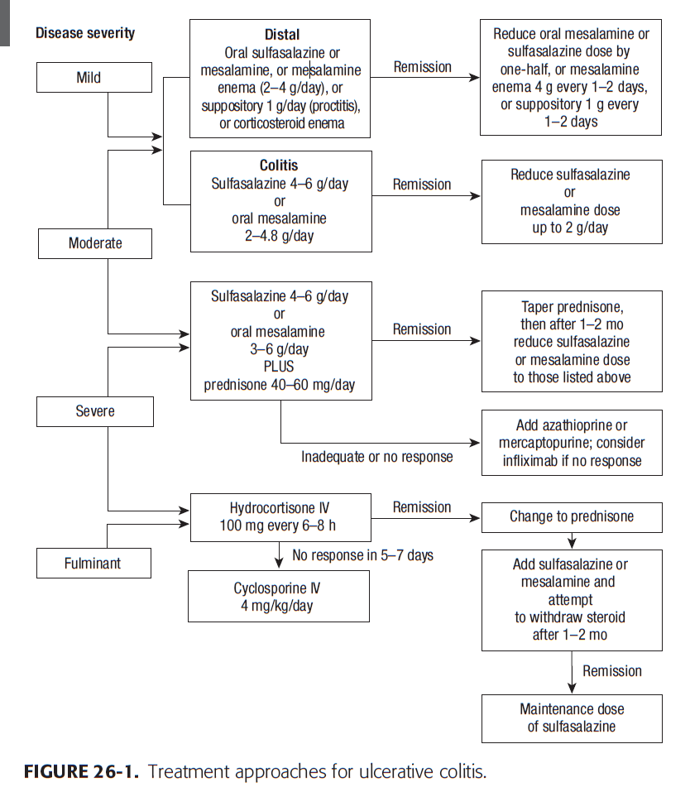

Slide 40
Newer Medication for UC
Tofacitinib (Xeljanz)
Xeljanz belongs to a class of medications known as Janus kinase (JAK) inhibitors. These drugs block the enzyme JAK, which activates cells of the immune system to produce inflammation.
Xeljanz has been approved since 2012 to treat rheumatoid arthritis (RA), and since 2017 to treat psoriatic arthritis (PsA). In 2018, the FDA also approved it to treat people with moderate-to-severe UC who haven’t responded to TNF blockers.
This drug is the first long-term oral treatment for moderate-to-severe UC. Other drugs require an infusion or injection. Side effects from Xeljanz include high cholesterol, headache, diarrhea, colds, rashes, and shingles.

Slide 41
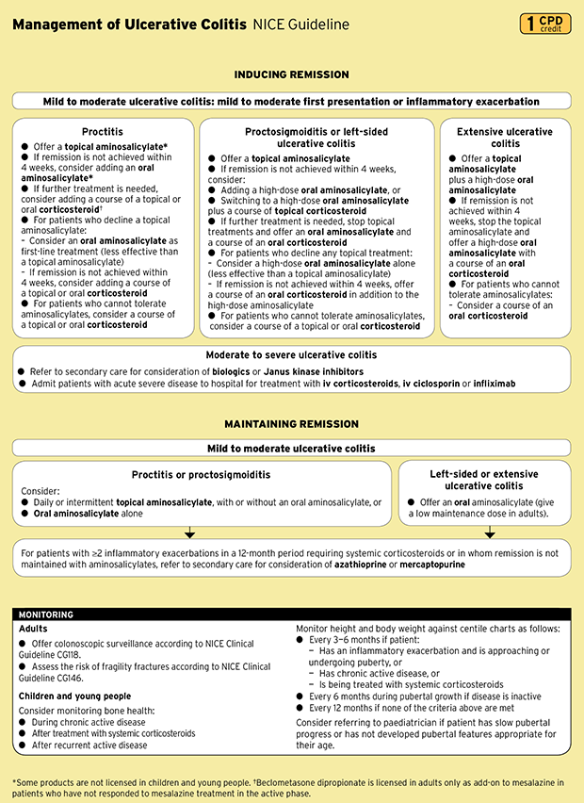
NICE Guidelines

Slide 42
THANK YOU

