Slide 1
MUCORMYCOSIS
Dr. VIDHYA SIVADAS
Pharm.D

Slide 2
INTRODUCTION
Mucormycosis is a general term for a group of uncommon infections cause by a fungus (fungal infection).
These infections are usually acquired when spores from the molds are breathed in (inhaled) or, less commonly, enter the body through a cut in the skin.
Mucormycosis is an aggressive, life-threatening infection that occurs in people whose immune system doesn’t function well (immune-compromised) including people with uncontrolled diabetes mellitus, people who have low levels of neutrophils, a type of white blood cell that helps the body fight off infection and heal itself (neutropenia), or people whose immune system is being suppressed by medications (immunosuppression) as part of their treatment for blood cancer (hematological malignancy), hematopoietic stem cell transplantation, or solid-organ transplant.
The infection is not contagious; it cannot be spread from one person to another. Prompt diagnosis and early treatment are critical.
Treatment usually consists of antifungal medications and surgery.

Slide 3
EPIDEMOLOGY
Mode of spread- inhalation or inoculation of the sporangiospores in the skin or mucosa.
It is ubiquitous.
Some studies found seasonal incidence- more in autumn.
In developed country- only in immunocompromised state.
In developing country- sporadic, more common in uncontrolled diabetes and trauma.
However, incidence of mucormycosis seems to be on rise.
For decades the fatility rate remains to be >40% despite of the aggressive surgical and medical management.
In patients with haematological malignancy, it is >60-90%

Slide 4
ETIOLOGY
(Pathogens causing mucormycosis)
The term mucormycosis is frequently used interchangeably with zygomycosis.
The latter term referred to infections caused by fungi of the former phylum Zygomycota (comprising Mucorales, Entomophthorales, and others), which became obsolete with phylogenetic reanalysis of the kingdom Fungi.
Today, mucormycosis describes infections caused by fungi of the order Mucorales. The most frequently reported pathogens in mucormycosis are:
Rhizopus (47%), Mucor (18%), and Rhizomucor (4%);
Uncommon: Cunninghamella (7%), Absidia (5%), Saksenea (5%), and Apophysomyces (5%)

Slide 5
TYPES
Rhino-Orbito-cerebral (sinus and brain)-mucormycosis is an infection in the sinuses that can spread to the brain. This form of mucormycosis is most common in people with uncontrolled diabetes and in people who have had a kidney transplant.
Pulmonary (lung) mucormycosis is the most common type of mucormycosis in people with cancer and in people who have had an organ transplant or a stem cell transplant.
Gastrointestinal mucormycosis is more common among young children than adults, especially premature and low birth weight infants less than 1 month of age, who have had antibiotics, surgery, or medications that lower the body’s ability to fight germs and sickness.
Cutaneous (skin) mucormycosis: occurs after the fungi enter the body through a break in the skin (for example, after surgery, a burn, or other type of skin trauma). This is the most common form of mucormycosis among people who do not have weakened immune systems.
Disseminated mucormycosis occurs when the infection spreads through the bloodstream to affect another part of the body. The infection most commonly affects the brain, but also can affect other organs such as the spleen, heart, and skin.
Isolated renal- cases in india and china

Slide 6
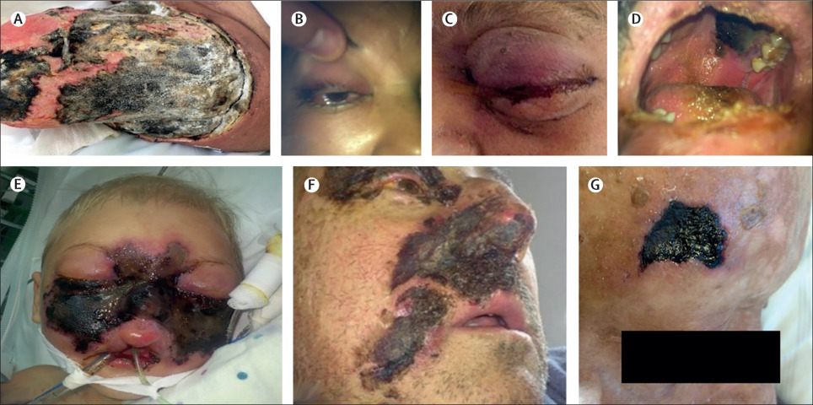
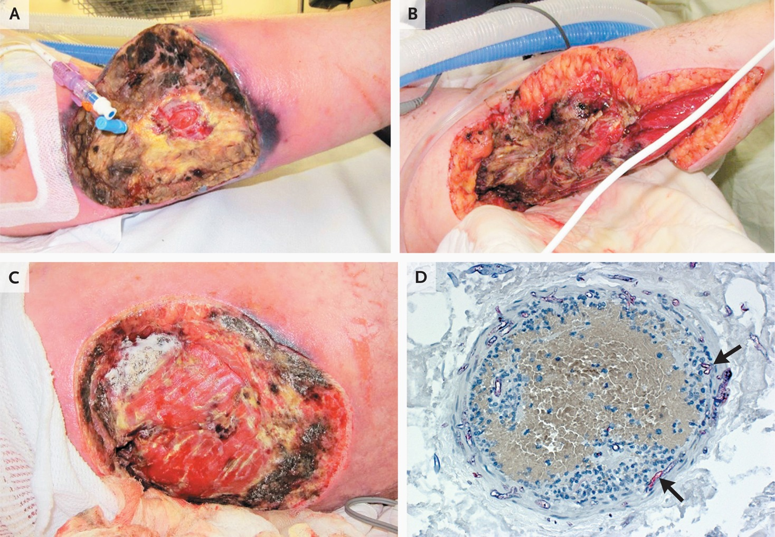
Rhino-Orbito-cerebral mucormycosis
Cutaneous (skin) mucormycosis

Slide 7
RISK FACTORS
Diabetes, especially with diabetic ketoacidosis
Cancer
Organ transplant
Stem cell transplant
Neutropenia (low number of white blood cells)
Long-term corticosteroid use
Injection drug use
Too much iron in the body (iron overload or hemochromatosis)
Skin injury due to surgery, burns, or wounds
Prematurity and low birthweight (for neonatal gastrointestinal mucormycosis)

Slide 8
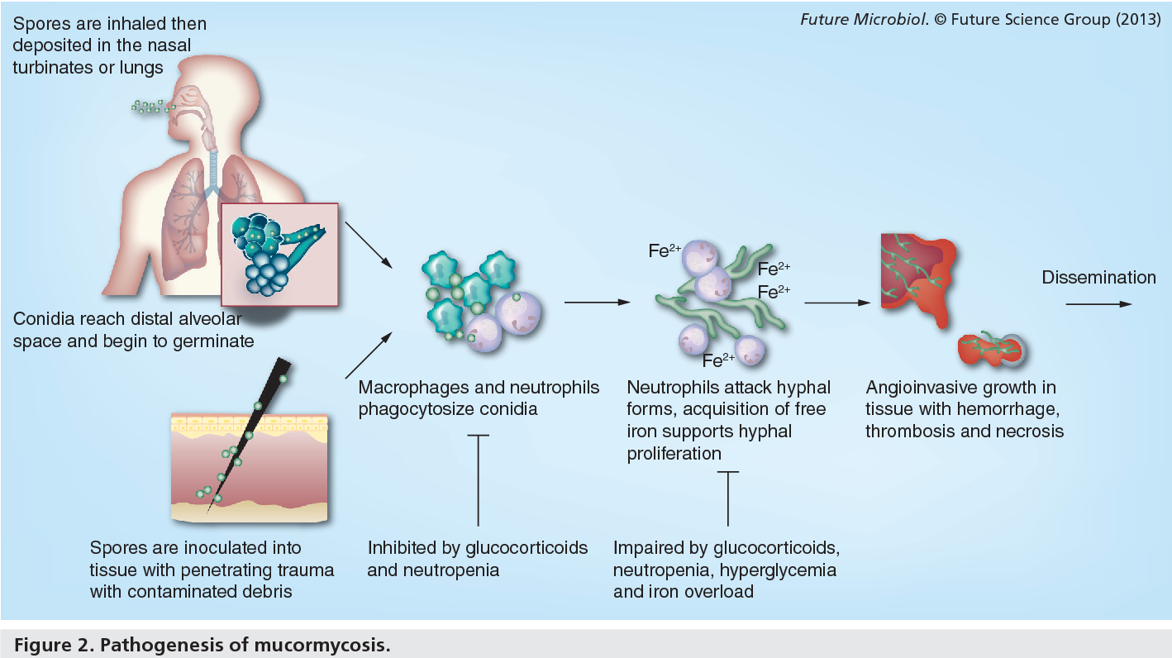
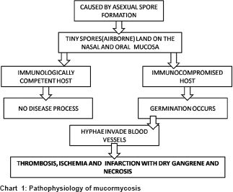
PATHOPHYSIOLOGY

Slide 9
CLINICAL PRESENTATION
Symptoms of rhinocerebral (sinus and brain) mucormycosis include: One-sided facial swelling, Headache, Nasal or sinus congestion, Black lesions on nasal bridge or upper inside of mouth that quickly become more severe, Fever
Symptoms of pulmonary (lung) mucormycosis include: Fever, non-productive Cough, Chest pain, Shortness of breath
Cutaneous (skin) mucormycosis can look like blisters or ulcers, and the infected area may turn black. Other symptoms include pain, warmth, excessive redness, or swelling around a wound.
Symptoms of gastrointestinal mucormycosis include: Abdominal pain, Nausea and vomiting, Gastrointestinal bleeding
Disseminated mucormycosis typically occurs in people who are already sick from other medical conditions, so it can be difficult to know which symptoms are related to mucormycosis. Patients with disseminated infection in the brain can develop mental status changes or coma.

Slide 10
DIAGNOSIS
Healthcare providers consider your medical history, symptoms, physical examinations, and laboratory tests when diagnosing mucormycosis.
Healthcare providers who suspect that you have mucormycosis in your lungs or sinuses might collect a sample of fluid from your respiratory system to send to a laboratory.
Your healthcare provider may perform a tissue biopsy, in which a small sample of affected tissue is analyzed in a laboratory for evidence of mucormycosis under a microscope or in a fungal culture.
You may also need imaging tests such as a CT scan of your lungs, sinuses, or other parts of your body, depending on the location of the suspected infection.

Slide 11
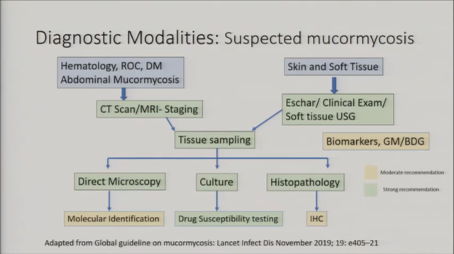
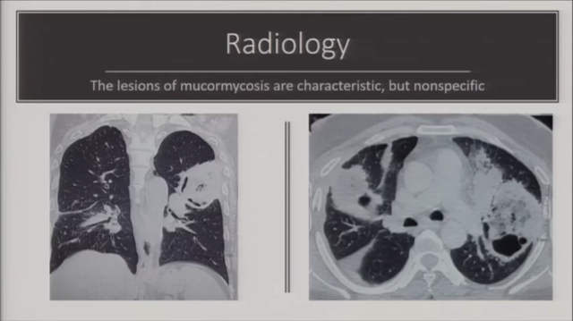
Reverse halo- sign
Thick wall cavitory lesions

Slide 12
Lab based testing: under development
Specific serologic markers are currently not available.
Use of galactomannan to exclude mucormycosis is moderately recommended.
Certain rhizopus species yield positive BDG results.
ELISA and LFIA able to detect.

Slide 13
TREATMENT
4 IMPORTANT STEPS
Early diagnosis
Reversal of underlying presdisposing factor
Surgical debriment where applicable
Prompt antifungal treatment
Diabetic ketoacidosis requires insulin and volume repletion with intravenous fluids.
Neutropenia associated with hematologic malignancy and its treatment should be reversed, if possible, with the use of colony-stimulating factors and the withdrawal of cytotoxic chemotherapy.
Wean glucocorticosteroids and other immunosuppressive drugs.
Interrupt deferoxamine therapy; hydroxypyridine chelating agents may be substituted for deferoxamine

Slide 14
ANTIFUNGAL THERAPY
In current practice, amphotericin B and isavuconazole are the two antifungal agents licensed by the US Food and Drug Administration (FDA) for the primary therapy of mucormycosis.
First-line treatment- amphotericin derivative, preferably the liposomal form of amphotericin B to minimize nephrotoxicity. Other options include amphotericin B deoxycholate, isavuconazole, and posaconazole.
COMBINATION THERAPY ADVANTAGES- More rapid fungicidal activity and lower risk of resistance.
DISADVANTAGES- Risk for antagonism, additive or synergistic toxicity, more drug-drug interactions, and higher cost.
Liposomal and lipid complex amphotericin B- 5 mg/kg/d up to 7.5-10 mg/kg/d to treat mucormycosis.
higher doses, however, has been associated with rates of nephrotoxicity up to 40% without a concomitant mortality benefit. CNS disease.

Slide 15
Amphotericin B deoxycholate
used to treat mucormycosis, particularly when other formulations prove too costly.
The typical dose is 1-1.5 mg/kg/d. The total dose given over the course of therapy is usually 2.5-3 g. High doses of this drug are required, and nephrotoxicity may result.
Monitor the renal function of patients taking amphotericin B; doubling of serum creatinine over the baseline levels is an indication for changing to liposomal amphotericin B.
In addition, careful monitoring and repletion of serum electrolytes (eg, potassium, phosphorus, magnesium) should be performed when administering any formulation of amphotericin B

Slide 16
Isavuconazole
A novel triazole antifungal agent that was approved for the treatment of mucormycosis in March 2015.
The prodrug isavuconazonium sulfate is rapidly metabolized by serum butylcholinesterase to the active form, isavuconazole (ISZ)
Initial dosing is isavuconazonium sulfate 372 mg (isavuconazole 200 mg) every 8 hours for 6 doses, followed by maintenance with 372 mg once daily.
Advantages over other triazoles
wider spectrum of antifungal activity.
Excellent oral bioavailability not reliant on food intake or gastric pH and is also available in an intravenous formulation, which does not contain the nephrotoxic solubilizing agent cyclodextrin.
Switching between oral and IV forms does not require dose adjustment.
ISZ displays linear and predictable pharmacokinetics with minimal CYP3A4 interactions, reducing or eliminating the need for therapeutic drug monitoring.
Unlike voriconazole, ISZ does not cause phototoxicity, increased risk of squamous cell carcinoma, or visual disturbance.

Slide 17
Posaconazole
Another triazole antifungal, has been shown to be superior to fluconazole or itraconazole as prophylaxis against invasive mold infection (both aspergillosis and mucormycosis) in patients with hematologic malignancy who have neutropenia or GVHD.
Used for off-label salvage treatment of mucormycosis in patients intolerant to amphotericin B.
FORMS AVAILABLE- oral suspension, delayed-release tablet, an intravenous formulation is also available.
300-mg tablet twice on day 1 followed by 300 mg orally once daily with or without food.
Rickerts et al reported that liposomal amphotericin B plus posaconazole was successful in the treatment of disseminated mucormycosis in a patient who could not undergo surgery
Also been used as step-down therapy after the initial administration and control of the disease with liposomal amphotericin B.

Slide 18
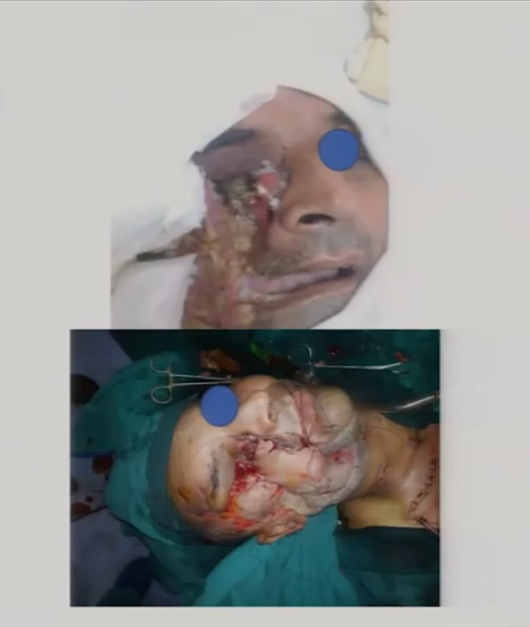
Surgical Intervention
Debridement of necrotic tissue in combination with medical therapy is mandatory for patient survival.
For rhinocerebral mucormycosis
surgical care includes drainage of the sinuses and may require excision of the orbital contents and involved brain. Repeated surgery may be required.
Excise pulmonary lesions if they are localized to a single lobe.
Excise cutaneous lesions entirely, and resect any GI masses.

Slide 19
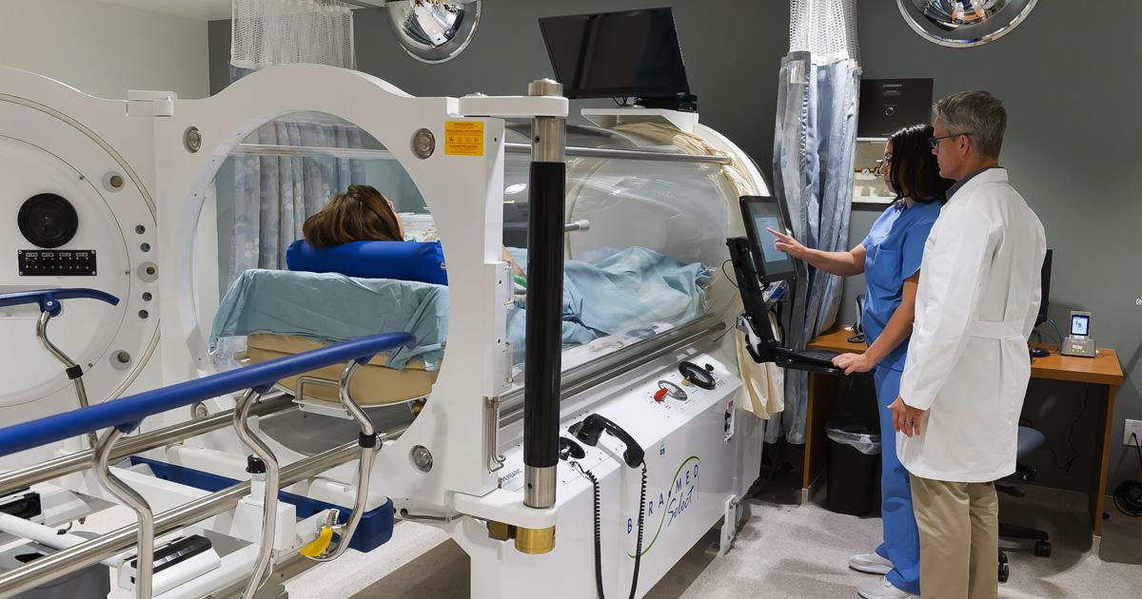
Adjunctive Therapies
Hyperbaric oxygen therapy after surgical debridement has been used, especially in cases of cutaneous disease and rhinocerebral disease in diabetics.
High oxygen concentrations may improve neutrophil function, inhibit the growth of Mucorales, and improve wound healing.
Colony-stimulating factors have been used to enhance immune responses, specifically in neutropenic patients, as have interferon-gamma and white blood cell transfusions
iron chelators without xenosiderophore activity (eg, deferasirox)
Newer agents such as deferasirox were hypothesized to decrease the risk of mucormycosis via iron starvation

Slide 20
Duration of Therapy and Long-Term Monitoring
Ongoing clinical surveillance and diagnostic imaging are required to ensure complete resolution of mucormycosis and to detect relapse.
The duration of therapy is highly individualized.
Successful courses of amphotericin B typically last 4-6 weeks.
Primary or salvage isavuconazole therapy may be continued for several months given its higher tolerability compared with amphotericin.
Repeated surgical debridement of necrotic tissue identified by follow-up head computed tomography (CT) scan or magnetic resonance imaging (MRI) is often indicated.
For patients who successfully complete therapy for mucormycosis and who subsequently require immunosuppressive treatments (eg, chemotherapy in a patient with cancer), whether daily oral posaconazole or isavuconazole should be given as secondary prophylaxis against disease relapse is unknown.

Slide 21
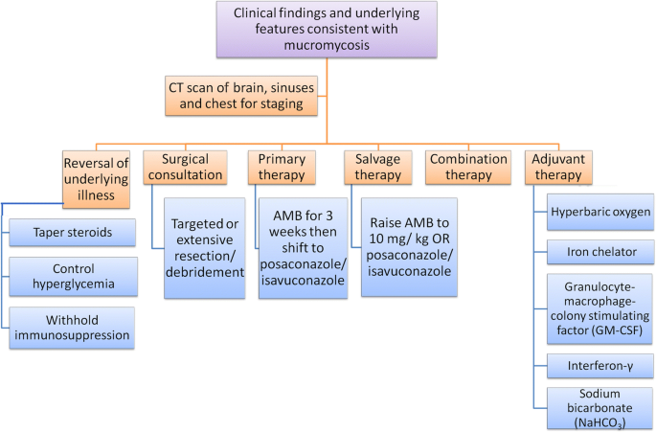

Slide 22
Pediatric Mucormycosis Treatment & Management
Underlying comorbidities such as hyperglycemia, acidosis in diabetic patients, nutritional problems, neutropenia, lymphopenia, and immunosuppression must be addressed.
The drug of choice for treating mucormycosis is amphotericin B, with a dosage of 1-1.5 mg/kg/d. Liposomal amphotericin B at dosages higher than these have also been used to treat disseminated disease. Some authors have suggested doses as high as 10-15 mg/kg. A term neonate who was diagnosed with facial mucormycosis after liver and small bowel transplantation survived after wide excision and 26 weeks of treatment with liposomal amphotericin B.
Azoles (eg, fluconazole, itraconazole) are not helpful in the treatment of mucormycosis. Among relatively new triazoles, posaconazole is effective against mucormycosis. This agent has an oral formulation and undergoes liver metabolism. Posaconazole may be effective compared with other azoles against molds, including mucormycosis. Studies are being conducted to evaluate combination antifungal therapies.

Slide 23
Hyperbaric oxygen has been noted to reduce the morbidity and mortality when given in combination with medical and surgical therapy, with a 50% survival rate.
Surgical debridement should be undertaken early in the course of the illness, especially in cases of rhinocerebral mucormycosis. Instilling amphotericin B into abscess cavities after debridement has been suggested. Repeat surgery may be necessary to effectively eliminate all necrotic tissue in patients who survive. Reconstructive surgery is inevitable for those who have disfigurement due to severe rhinocerebral mucormycosis.

Slide 24
PREVENTION
Protect yourself from the environment. It’s important to note that although these actions are recommended, they haven’t been proven to prevent mucormycosis.
  Try to avoid areas with a lot of dust like construction or excavation sites. If you can’t avoid these areas, wear an N95 respirator (a type of face mask) while you’re there. Avoid direct contact with water-damaged buildings and flood water after hurricanes and natural disasters.
  Avoid activities that involve close contact to soil or dust, such as yard work or gardening. If this isn’t possible,
    Wear shoes, long pants, and a long-sleeved shirt when doing outdoor activities such as gardening, yard work, or visiting wooded areas.
    Wear gloves when handling materials such as soil or manure.
    To reduce the chances of developing a skin infection, clean skin injuries well with soap and water, especially if they have been exposed to soil or dust.
Antifungal medication. If you are at high risk for developing mucormycosis (for example, if you’ve had an organ transplant or a stem cell transplant), your healthcare provider may prescribe medication to prevent mucormycosis and other mold infections. Doctors and scientists are still learning about which transplant patients are at highest risk and how to best prevent fungal infections.

Slide 25
References
Global guideline for the diagnosis and management of mucormycosis: an initiative of the European Confederation of Medical Mycology in cooperation with the Mycoses Study Group Education and Research Consortium
Medscape
CDC

Slide 26
THANK YOU

