Slide 1
Nipah Virus
Dr.VIDHYA SHIVDAS
PHARM D

Slide 2
Introduction
NiV infection is an emerging zoonotic disease , that is it can spread between animals and people. According to WHO guidelines, South-East Asia Region has a high case fatality rate estimated to range between 40 and 75%; however, this rate can vary by outbreak depending on local capabilities for epidemiological surveillance and clinical management.
NiV was first recognized in 1998-1999 during an outbreak among pig farmers in Malaysia and Singapore. No subsequent outbreaks have been reported in Malaysia or Singapore since 1999. NiV was first recognized in India and Bangladesh in 2001; since then, nearly annual outbreaks have occurred in Bangladesh
In India, three outbreaks in human were reported from Siliguri (2001) and Nadia (2007), West Bengal and in kozhikode and malappuram districts of kerala in may 2018 , but here the strain was different from the one identified in 1999.

Slide 3
Virus associated with hendra virus
Genus – henipavirus
Family- paramyoxiviridae
Sub family- paramyoxivirinae
Virus name originated from Sungai Nipah, a village in malaysia.
Nipah virus is classified internationally as a biosecurity level (BSL) 4 agent

Slide 4
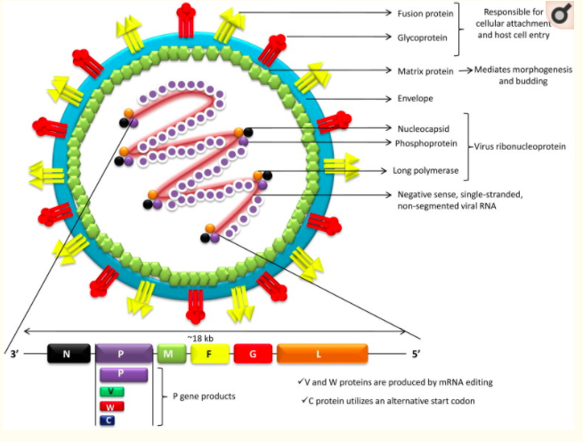
Structure of Nipah virus

Slide 5
NiV and HeV are enveloped, single-stranded, negative-sense RNA viruses which constitute the Henipavirus (HNV) genus in the Paramoxyviridae family.
The RNA genome, from the 3´-5´, contains consecutive arrangement of six genes, viz., nucleocapsid (N), phosphoprotein (P), matrix (M), fusion glycoprotein (F), attachment glycoprotein (G) and long polymerase (L).
NiV infects its host cells via two glycoproteins, i.e. G and F proteins. The G glycoprotein mediates attachment to host cell surface receptors and the fusion (F) protein makes fusion of virus-cell membranes for cellular entry.

Slide 6
Epidemiology and Etiology
Agent: NiV is a highly pathogenic paramyxovirus.
Natural Reservoir: Fruit bats of Pteropus gcnus are the natural reservoir of NiV. Pig is an amplifying host. It may become infected after consumption of partially bat eaten fruits that dropped in pigsties (as was evident in the Malaysia outbreak in 1998).
Environmental Factors: Seasonality was strongly implicated in NiV outbreaks in Bangladesh and India. All of the outbreaks occurred during the months from December to May (winter to spring).
Mode of Transmission: Transmission of Nipah virus to humans may occur after direct contact with infected bats, infected pigs, or from other Nipah virus infected people.

Slide 7
Routes of transmission of Nipah virus have also been identified from its natural reservoir to human through drinking of raw date palm sap contaminated with NiV. However, human to human transmission has been attributed as one of the major modes of transmission in the epidemic in Siliguri and in Kozhikode (Kerala on May, 20 1 8), India.
Incubation period: it varies from 4-21 days.

Slide 8
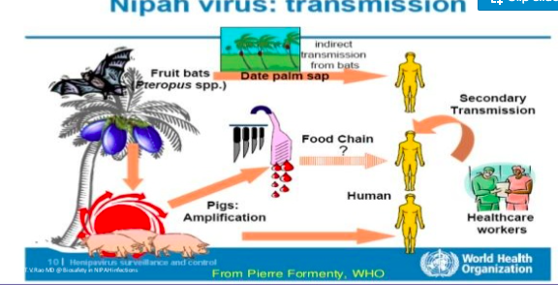
Transmission

Slide 9
Pathogenesis.
The exact pathogenesis mechanism of Nipah infection is still not very clearly documented. Nipah infection primarily involves the blood vessels in the form of vasculopathy and vasculitis resulting in perivascular cellular infiltration, inflammation and necrosis.
Due to high viremia it is very likely that several cytokines and chemokines are released causing vascular damage. Severity of the clinical symptoms and organ involvement are host likely dependent on the extent of vascular damage.
Post-mortem evaluation in one of the cases has revealed gross cerebral and pulmonary oedema. Cross-section of the brain and lungs showed evidence of gross pulmonary haemorrhage and cerebral congestion.

Slide 10
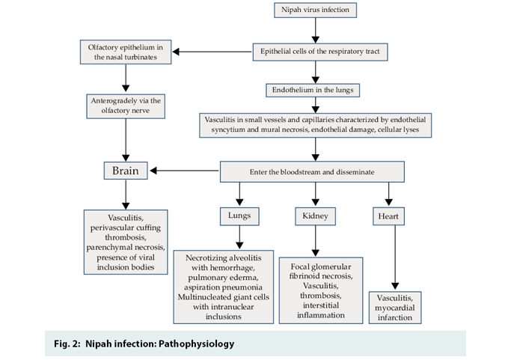

Slide 11
Pathological findings include :
Vasculopathy and necrotizing vasculitis
Cerebral oedema, with vascular congestion and focal haemorrhages.
Pulmonary oedema with or without associated diffuse alveolar damage and haemorrhage.
Neurons adjacent to vasculitic vessels may show eosinophilic infiltration and nuclear viral inclusions.
In relapse cases, histopathology revealed cerebral oedema, inflammation, endothelial syncytia, thrombosis and parenchymal necrosis.

Slide 12
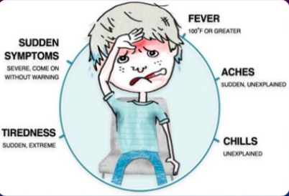
Clinical features and Symptoms
Incubation period of Nipah infection is from 4 to 21 days. Initially non specific symptoms may be fever, headache, dizziness and vomiting. The hallmark of Nipah viral inflection is the acute onset of following symptoms.
1. Moderate to high grade fever
2. Headache
3. Vomiting
4. Cough
5. Breathlessness
6. Change in behaviour/sensorium
7. Seizures/abnormal movement
8. Myalgia
9. Fatigue

Slide 13
Human infections range from asymptomatic infection to acute respiratory infection (mild, severe), and fatal encephalitis.
Infected people initially develop symptoms including fever, headaches, myalgia (muscle pain), vomiting and sore throat. This can be followed by dizziness, drowsiness, altered consciousness, and neurological signs that indicate acute encephalitis. Some people can also experience atypical pneumonia and severe respiratory problems, including acute respiratory distress. Encephalitis and seizures occur in severe cases, progressing to coma within 24 to 48 hours.
The incubation period (interval from infection to the onset of symptoms) is believed to range from 4 to 14 days. However, an incubation period as long as 45 days has been reported.
Most people who survive acute encephalitis make a full recovery, but long term neurologic conditions have been reported in survivors. Approximately 20% of patients are left with residual neurological consequences such as seizure disorder and personality changes. A small number of people who recover subsequently relapse or develop delayed onset encephalitis.
The case fatality rate is estimated at 40% to 75%. This rate can vary by outbreak depending on local capabilities for epidemiological surveillance and clinical management.

Slide 14
In the Siliguri outbreak, the patients initially had fever (100%), headache and myalgia (57%), vomiting (19%), altered sensorium (confusion to coma, 97%), respiratory symptoms (tachypnea to acute respiratory distress, 51%), and involuntary movcments or convulsions (43%).
In the outbreak of Nipah virus disease in Kerala it was noted that most of the patients presented with moderate to high grade fever, headache often severe, vomiting and general weakness along with myalgia. Cough and breathlessness were also one of the presenting complaints seen in the majority of the patients.
Breathlessness often progressed rapidly resulting in overt respiratory failure requiring use of supplementary oxygen and at times ventilator support.

Slide 15
Respiratory failure requiring ventilator support was risk factors for high mortality.
Behavioural changes were often one of the initial presenting features before development of altered sensorium and unconsciousness.
In a significant number of patients, the disease rapidly progresses to coma within five to seven days. Few cases may also show signs of cerebellar dysfunction.
Few patients also developed myocarditis, heart failure and pulmonary oedema often associated with or without cardiogenic shock. Coagulopathy may be seen in some of the cases with thrombocytopenia and raised d-Dimer.

Slide 16
Post Nipah infection complications:
Psychiatric complications may be seen after full recovery. If the neurological signs and symptoms of encephalitis develop after more than 10 weeks of the initial exposure, it is known as late-onset encephalitis. Long term complication are seen in some case in the form of relapse of encephalitis months to years after recovery.

Slide 17
Initial signs and symptoms of Nipah virus infection are nonspecific, and the diagnosis is often not suspected at the time of presentation. This can hinder accurate diagnosis and creates challenges in outbreak detection, effective and timely infection control measures, and outbreak response activities
DIAGNOSIS
Nipah virus infection can be diagnosed with clinical history during the acute and convalescent phase of the disease. The main tests used are real time polymerase chain reaction (RT-PCR) from bodily fluids and antibody detection via enzyme-linked immunosorbent assay (ELISA).
Other tests used include polymerase chain reaction (PCR) assay, and virus isolation by cell culture.

Slide 18
.
Laboratory Diagnosis
Laboratory diagnosis of a patient with a clinical history of NiV can be made during the acute and convalescent phases of the disease by using a combination of tests.
Laboratory confirmation of NiV infection either by:
i) lgM antibody against NiV identified in serum or CSF,
ii) NiV RNA identified by RT-PCR from respiratory secretions, urine or cerebrospinal fluid, or
iii) Isolation of NiV from respiratory secretions, urine or cerebrospinal fluid or other tissue specimens

Slide 19
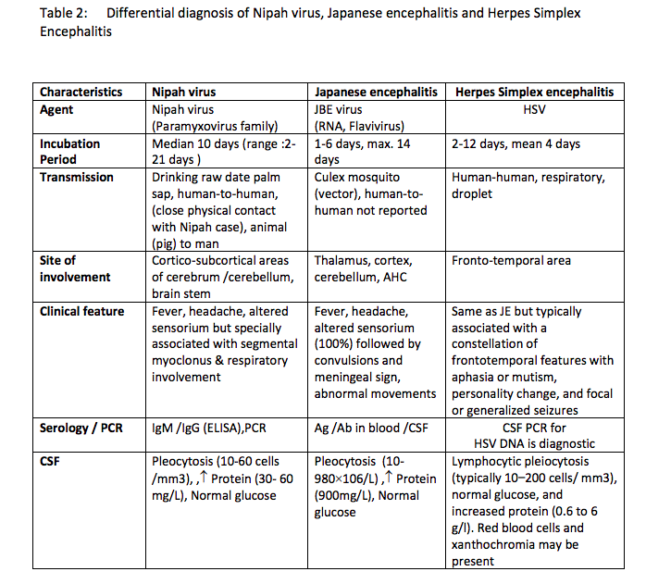

Slide 20
Treatment
There is no confirmed effective specific treatment for NiV infection in humans till date. The guiding principles are:
Early implementation of infection control precautions will minimize nosocomical/ household spread of disease.
Active surveillance, contact tracing and early identification and follow up of persons at risk. Provision for dedicated isolation facilities for patients must be created so that laboratory confirmed Nipah cases as well as suspect cases are either kept in individual isolation rooms or cohorted (separate ward for keeping confirmed and suspect cases) in a well ventilated isolation ward with beds kept at-least one metre apart.

Slide 21
Community contacts and hospital contacts who have gone back to the community are kept in home quarantine. Hospital staff may be kept in home quarantine or in separate individual isolation room facility in a hospital.
Suspect and probable cases should be hospitalized in isolation facility as described above.
There should be dedicated doctors, nurses and paramedics well trained in hospital infection control practices and following the standard, contact and droplet precautions to attend to the suspect or confirmed cases . Reinforce standard infection control precautions for all those entering the room must use hand washing practices, high efficiency masks, gowns, goggles, gloves, cap and shoe cover.

Slide 22
Imaging and laboratory investigations are to be Ignited till such time laboratory reports are available. This would reduce the risk of transmission of disease among Health Care Workers.
The isolation facility should have portable X Ray machine, ventilators, large oxygen cylinders, pulse oxymeter and other supportive equipments.
Adequate quantities of PPE, disinfectants and medications are to be ensured.
No accompanying relative or friends of the patient is to be allowed in isolation facility. Restrict number of visitors and those allowed to visit should be provided with full protection through PPE.
The commonly touched surfaces in the isolation ward should be cleaned with freshly prepared disinfectant (5% Sodium Hypochlorite) every 4 hours. Hand sanitizers should be provided at every bed post and exit part of the isolation rooms.

Slide 23
General management
Symptomatic and Supportive treatment should be started immediately in all clinically suspected cases. Maintain airway, breathing and circulation (ABC).
Ensure patient isolation (preferably in a separate ward/room).
Institute barrier nursing, e.g., personal protection using masks, gloves, gowns, shoe covers and hand-washing with soap and water before and after handling /visiting patients.

Slide 24
Symptomatic and supportive treatment:
a. Patient is advised to drink plenty of fluids.
b. Fluid maintenance and electrolyte balance. Fluid restriction, after initial resuscitation, is advisable in order to avoid fluid overload/ complication
c. Nasogastric tube feeding/ parenteral nutrition may be instituted, if necessary.
d. Paracetamol is suggested for fever, myalgia and headache. Salicylate / aspirin is strictly contra-indicated in any Nipah patient due to its potential complications.
e. The cases would be constantly monitored for clinical / radiological evidence of lower respiratory tract infection and for hypoxia (respiratory rate, oxygen saturation, level of consciousness).

Slide 25
f. Patients with signs of tachypnoea, dyspnoea, respiratory distress and oxygen saturation less than 90 per cent should be supplemented with oxygen therapy. Types of oxygen devices to be used would depend on the severity of hypoxemia. It can be started from oxygen cannula, simple mask, partial re-breathing mask (mask with reservoir bag) and non re-breathing mask. Disposable cannula only should be used for Oxygen inhalation. In children, oxygen hood or head boxes can be used.’
g. Oropharyngeal or endotracheal suction when used should mandatorily be done using a closed suction circuit to avoid dispersal of aerosol in the environment.
h. Patients with severe pneumonia and acute respiratory failure (Sp02 <90% and Pa02 <60 mmHg with oxygen therapy) must be supported with mechanical ventilation. Invasive mechanical ventilation is preferred choice.

Slide 26
Non invasive ventilation is an option when mechanical ventilation ls not available.
i. Anticonvulsants e.g., intravenous diazepam, phenobarbitone, phenytoin or levetiracetam may be used in the standard recommended doses. Mannitol could be used in case of raised Intracranial tension.
j. Suspected cases does not require antibiotic therapy. Antibacterial agents should be administered, if required, as per locally accepted clinical practice guidelines.
k. Patients requiring Vasopressors for shock may be started on noradrenalin infusion with or without dobutamine in cases with significant cardiac dysfunction.

Slide 27
Drug therapy:
Ribavirin:
As currently there are no strong evidence of proven therapy, it is advisable to administer Ribavirin to all confirmed cases of Nipah virus infection as per the available limited in vitro and in vivo evidences, subject to approval of Drug
Controller General of India IDCG, Ribavirin is not a proven treatment for Nipah, and has only single open label trial evidence from Malaysia. But the benefit was significant with 36% reduction in mortality.

Slide 28
Dose for Ribavirin
For Adults -
2000 mg loading (10 tab of 200mg)
Day 1-4 - 1000 mg 6hrly (5 tabs of200 mg each 4 times daily for 4 days - 80 tablets)
Day 5- 1 0- 500 mg 6hrly (200 mg each tablet 3 tab - 3 tab - 2 tab - 2 tab at 6hrs gap daily for 6 more days - 60 tablets)
For Children -
Loading dose of 30mg/kg, Thereafter for Day 1- 4 give 15 mg/kg 6hrly
Day 5- Day 10 , give 7.5 mg/kg 6 hrly.

Slide 29
Parentral dose ofRibavirin-
IV Ribavirin
loading dose of 30 mg/ kg then 1 5 mg / kg every six hourly for 4 days then 7.5 mg / kg every eight hourly for 6 days.
Ribavirin should be diluted in 150 ml of 0.9% Normal Saline and infused slowly.
Adverse reactions of Ribavirin:
Serious reactions can include haemolytic anaemia, neutropenia, thrombocytopenia, aplastic anaemia, teratogenicity, sevcrc depression, suicidal ideation , pulmonary toxicity, pancreatitis, diabetes, hyperthyroidism, myocardial infarction, arrhythmias, colitis, retinal haemorrhage, retinal thrombosis. or rarely, hypersensitivity reactions.
Common Reactions can include fatigue, headache, fever, rigors. Myalgias, anxiety, irritability, insomnia, alopecia, nausea, vomiting, anorexia, dizziness. impaired concentration, cough, rash. But most adverse drug reactions are in long term therapy not common as in short temp therapy.

Slide 30
Newer experimental drugs:
(i) Favipravir has recently been shown to be elective against Nipah viral infections in animal model.
(ii) Immunomodulating drugs have not been found to be beneficial in treatment of ARDS or sepsis associated multi organ failure. High dose corticosteroids in particular have no evidence of benefit and there is potential for harm.
Post Exposure Prophylaxis:
There is no evidence to support the role of ribavirin as post-exposure prophylactic treatment for Nipah fever.

Slide 31
Human monoclonal antibody:
Human Monoclonal antibodies targeting ae viral glycoproteins(anti-G Mab or anti-F Mab) against Hendra and Nipah have been shown since 2009 to be highly effective for post-exposure protection on experimental animal. lts use in emergency setting is subject to approval of DCG1.
Vaccine: There is currently no approved vaccine that protects against Nipah virus.

Slide 32
Discharge Policy
Nipah confirmed patients should be discharged only after full recovery and the RT- PCR test is negative on the throat swab/ blood sample. However, on discharge, patient is advised to remain in isolation at home till 21 days after the date of positive test. This shall be monitored by the community surveillance team.
Suspected cases kept under isolation must not be discharged before confirmation of negative result.

Slide 33
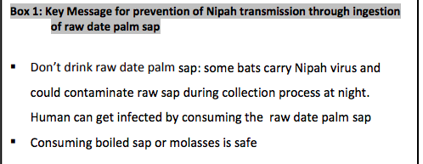
prevention

Slide 34
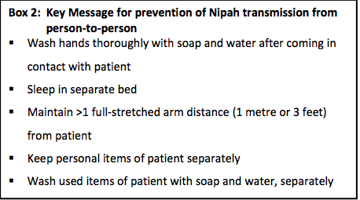

Slide 35
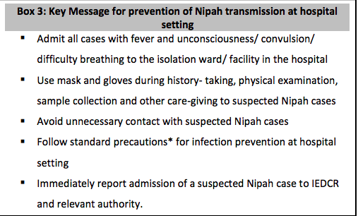

Slide 36
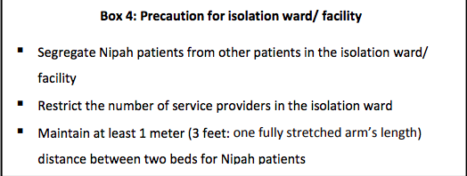

Slide 37
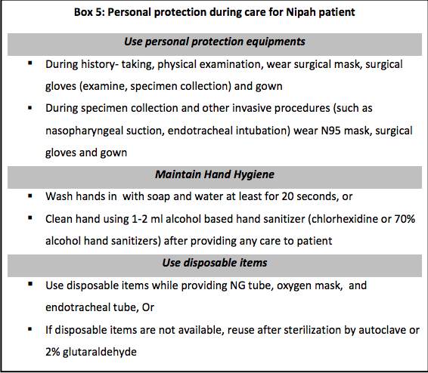

Slide 38
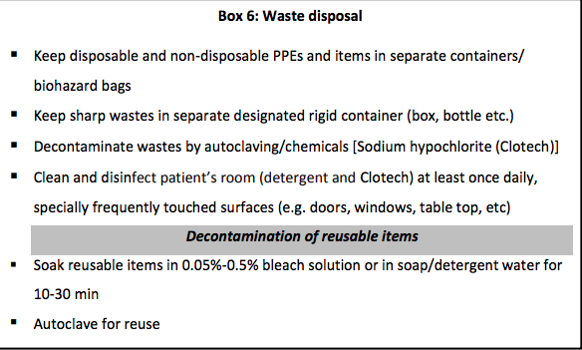

Slide 39
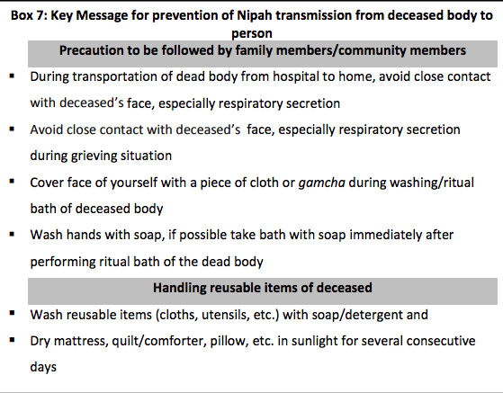

Slide 40
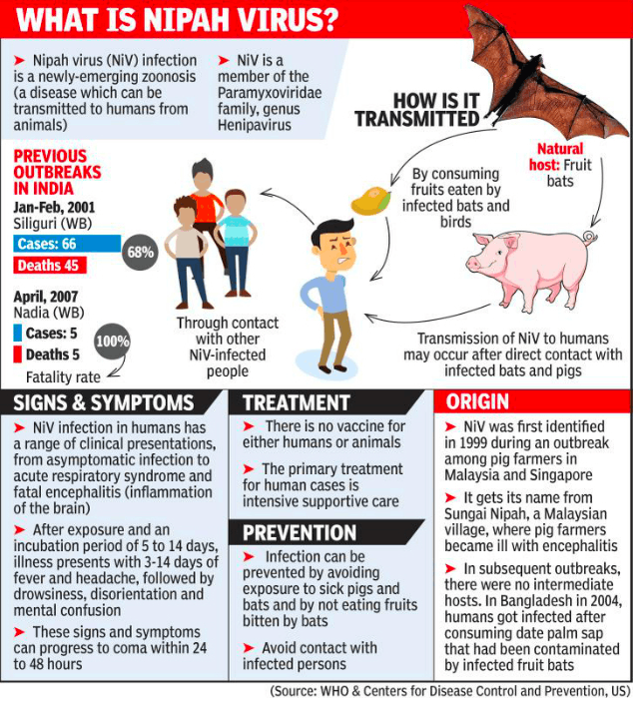
summary

Slide 41
REFERENCE
NIPAH VIRUS GUIDELINES –
National Centre for Disease Control (NCDC)
https://ncdc.gov.in/index4.php?lang=1&level=0&linkid=113&lid=228
WHO
https://www.who.int/westernpacific/health-topics/nipah-virus-infection

Slide 42
THANK YOU

