Slide 1
Principles of Cell Injury and Adaptation
Dr. VIDHYA
PHARM D

Slide 2
Cell injury is defined as a variety of stresses a cell encounters as a result of changes in its internal and external environment.
The cellular response to stress may vary and depends upon the following:
  The type of cell and tissue involved.
Extent and type of cell injury
ETIOLOGY OF CELL INJURY:
Genetic causes
Developmental defects:
Errors in morphogenesis
Cytogenetic (Karyotypic) defects: chromosomal abnormalities
Single-gene defects:
Mendelian disorders
Multifactorial inheritance disorders

Slide 3
2. Acquired causes
Hypoxia and ischaemia
Physical agents
Chemical agents and drugs
Microbial agents
Immunologic agents
Nutritional derangements
Aging
Psychogenic diseases
Iatrogenic factors
Idiopathic diseases.
  Oxygen deprivation: HYPOXIA
    Ischemia (loss of blood supply).
    Inadequate oxygenation (cardio respiratory failure).
    Loss of oxygen carrying capacity of the blood (anemia or CO poisoning).

Slide 4
    PHYSICAL AGENTS:
    Trauma
    Heat
    Cold
    Radiation
  CHEMICAL AGENTS AND DRUGS:
    Endogenous products: urea, glucose
    Exogenous agents
    Therapeutic drugs: hormones
    Nontherapeutic agents: lead or alcohol.
  INFECTIOUS AGENTS:
    Viruses
    Rickettsiae
    Bacteria
    Fungi
    Parasites
  Abnormal immunological reactions:
The immune process is normally protective but in certain circumstances the reaction may become deranged.
    Hypersensitivity to various substances can lead to anaphylaxis or to more localized lesions such as asthma.
    In other circumstances the immune process may act against the body cells – autoimmunity.

Slide 5
  Nutritional imbalances:
    Protein-calorie deficiencies are the most examples of nutrition deficiencies.
    Vitamins deficiency.
    Excess in nutrition are important causes of morbidity and mortality.
    Excess calories and diet rich in animal fat are now strongly implicated in the development of atherosclerosis.
    Obesity alone leads to an increased vulnerability to certain disorders, such as atherosclerosis, coronary heart disease, diabetes mellitus.
  Aging:
    Programmed aging whereby after a defined number of divisions the cell undergoes terminal differentiation.
    Development of an increasing population of cells irreversibly committed to senescence and death.

Slide 6
MORPHOLOGY OF CELLULAR INJURY:
CELLS REACT TO ADVERSE INFLUENCES:
Cellular adaptation
  Hyperplasia
  Hypertrophy
  Atrophy
  Metaplasia
  Dysplasia
Reversible injury
  intracellular edema,
  fatty change,
  hyaline change,
  Amyloidosis
  Mucoid degeneration

Slide 7
Irreversible injury and dying
Necrosis, gangrene followed by pathological calcification

Slide 8
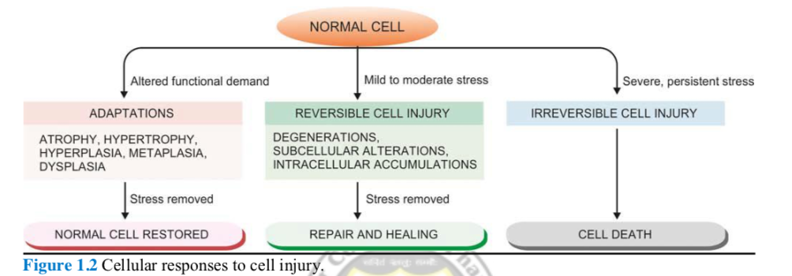

Slide 9
CELLULAR ADAPTATION:
  Adaptations are reversible changes in the size, number, phenotype, metabolic activity, or functions of cells in response to changes in their environment
Cells must constantly adapt, even under normal conditions, to changes in their environment.
These physiological adaptations usually represent responses of cells to normal stimulation by hormones or endogenous chemical substances.
For example, as in the enlargement of the breast and induction of lactation by pregnancy.
Types of Adaptation:
Pathologic adaptations may share the same underlying mechanisms, but they provide the cells with the ability to survive in their environment and perhaps escape injury.
Cellular adaptation is a state that lies intermediate between the normal, unstressed cell and the injured, overstressed cell.
Cellular Adaptation: Cell can adapt themselves by undergoing 5 different conditions
Hyperplasia
Hypertrophy
Atrophy
Metaplasia
Dysplasia

Slide 10
Hyperplasia: An increase in the number of cells in an organ or tissue, which may then have increased volume.
Types of Hyperplasia- Physiological:
Hormonal (influence of hormonal stimulation)
  Hyperplasia of the female breast epithelium at puberty or in pregnancy.
  pregnant uterus
  Normal endometrium after a normal menstrual cycle.
  Prostatic hyperplasia in old age.
Compensatory- hyperplasia occurring following removal of part of an organ or a contra lateral organ in paired organ.
Regeneration of the liver following partial hepatectomy
Regeneration of epidermis after skin abrasion
Following nephrectomy on one side, there is hyperplasia of nephrons of the other kidney.
Types of Hyperplasia- Pathological
Excessive stimulation of hormones or growth factors
  Endometrial hyperplasia
  Wound healing - of granulation tissue due to proliferation of fibroblasts and endothelial cells.
  Skin warts from hyperplasia of epidermis due to human papilloma virus.
  Pseudocarcinomatous hyperplasia of the skin.

Slide 11
2. Hypertrophy:
An increase in the size of cells, and with such change, an increase in the size of the organ.
Types:
Physiologic: physiologic growth of the uterus during pregnancy involves both hypertrophy and hyperplasia.
Pathologic causes: increased workload, hormonal stimulation and growth factors stimulation.
  Hypertrophy of heart the most common stimulus is chronic hemodynamic overload.
The relationship between hyperplasia and hypertrophy: Although hypertrophy and hyperplasia are two distinct processes, frequently both occur together, and they well be triggered by the same mechanism.

Slide 12
Atrophy: Acquired loss of size due to reduction of cell size or number of parenchymatous cells in an organ.
Types: Physiologic or Pathological
Physiologic atrophy: A normal process of aging in some tissues, which could be due to loss of endocrine stimulation or arteriosclerosis.
  Atrophy of lymphoid tissue in lymph nodes, appendix and thymus.
  Atrophy of gonads after menopause.
  Atrophy of brain with aging.
Pathologic atrophy:
  Starvation atrophy.
  Ischaemic atrophy
  Disuse atrophy.
  Neuropathic atrophy.
  Endocrine atrophy
  Pressure atrophy.
  Idiopathic atrophy

Slide 13
Metaplasia: Metaplasia is a reversible change in which one adult cell type is replaced by another adult cell type.
Causes:
  Changes in environment
  Irritation or inflammation
  Nutritional.
Types of Metaplasia: There are basically 2 types of metaplasia:
EPITHELIAL METAPLASIA
  Squamous metaplasia: changes in bronchus, uterine endocervix, gallbladder, prostate, renal pelvis and urinary bladder
vitamin A deficiency: squamous metaplasia in the nose, bronchi, urinary tract, lacrimal and salivary glands
  Columnar metaplasia: Intestinal metaplasia in healed chronic gastric ulcer and Barrett’s oesophagus
MESENCHYMAL METAPLASIA
  Osseous metaplasia.
  Cartilaginous metaplasia.

Slide 14
DYSPLASIA: disordered cellular development. It is also referred to as atypical hyperplasia. Epithelial dysplasia is characterised by cellular proliferation and cytologic changes
Increased number of layers of epithelial cells
Disorderly arrangement of cells from basal layer to the surface layer
Loss of basal polarity i.e. nuclei lying away from basement membrane
Cellular and nuclear pleomorphism
Increased nucleocytoplasmic ratio
Nuclear hyperchromatism
Increased mitotic activity.
The two most common examples of dysplastic changes are the uterine cervix and respiratory tract

Slide 15
Types of Cell Injury: Reversible and Irreversible:
Reversible injury: If the ischaemia or hypoxia is of short duration, the effects are reversible on rapid restoration of circulation. The sequential changes in reversible cell injury are as under:
  Intracellular edema,
  Fatty change,
  Hyaline change,
  Amyloidosis,
  Mucoid Degeneration,
  Pathologic Pigments
Irreversible Injury:- Persistence of ischaemia or hypoxia results in irreversible changes in structure and function of the cell (cell death)
  Increased cell volume.
  Ruptured lysosome.
  Damaged cell membrane.
  Lysed ER
  Aggregate cystoskeleton.
  Mitochondrial Swelling and Calcification.

Slide 16
Reversible Injury-
  Intracellular Edema/ Intracellular Accumulation:
Also known as cloudy swelling.
Accumulation of watery fluid in cells.
Commonest and earliest form of cell injury
Caused by bacterial toxins, chemicals, poisons, burns, high fever, and intravenous administration of hypertonic glucose or saline.
Impaired regulation of sodium and potassium at the level of cell membrane

Slide 17
MORPHOLOGY OF REVERSIBLE CELL INJURY
Common examples of morphologic forms of reversible cell injury are as under:
1. Hydropic change
2. Hyaline change
3. Mucoid change
4. Fatty change (discussed under intracellular accumulations)

Slide 18
HYDROPIC CHANGE
Hydropic change means accumulation of water within the cytoplasm of the cell. Other synonyms used are cloudy swelling (for gross appearance of the affected organ) and vacuolar degeneration (due to cytoplasmic vacuolation). Hydropic swelling is an entirely reversible change upon removal of the injurious agent.
Etiology
This is the commonest and earliest form of cell injury from almost all causes. The common causes include acute and subacute cell injury from various etiologic agents such as bacterial toxins, chemicals, poisons, burns, high fever, intravenous administration of hypertonic glucose or saline etc.
Pathogenesis
Cloudy swelling results from impaired regulation of sodium and potassium at the level of cell membrane. This results in intracellular accumulation of sodium and escape of potassium. This, in turn, is accompanied with rapid flow of water into the cell to maintain iso-osmotic conditions and hence cellular swelling occurs. In addition, influx of calcium too occurs.

Slide 19
2. HYALINE CHANGE
The word ‘hyaline’ or ‘hyalin’ means glassy (hyalos = glass). Hyalinisation is a common descriptive histologic term for glassy, homogeneous, eosinophilic appearance of proteinaceous material in haematoxylin and eosin-stained sections and does not refer to any specific substance. Though fibrin and amyloid have hyaline appearance, they have distinctive features and staining reactions and can be distinguished from non-specific hyaline material. Hyaline change is seen in heterogeneous pathologic conditions and may be intracellular or extracellular.
Intracellular Hyaline
Intracellular hyaline is mainly seen in epithelial cells. A few examples are as follows:
1. Hyaline droplets in the proximal tubular epithelial cells due to excessive reabsorption of plasma proteins in proteinuria.
2. Hyaline degeneration of rectus abdominalis muscle called Zenker’s degeneration, occurring in typhoid fever. The muscle loses its fibrillar staining and becomes glassy and hyaline.
3. Mallory’s hyaline represents aggregates of intermediate filaments in the hepatocytes in alcoholic liver cell injury.
4. Nuclear or cytoplasmic hyaline inclusions seen in some viral infections.
5. Russell’s bodies representing excessive immunoglobulins in the rough endoplasmic reticulum of the plasma cells.

Slide 20
Extracellular Hyaline
Extracellular hyaline commonly termed hyalinisation is seen in connective tissues. A few examples of extracellular hyaline change are as under:
1. Hyaline degeneration in leiomyomas of the uterus.
2. Hyalinised old scar of fi brocollagenous tissues.
3. Hyaline arteriolosclerosis in renal vessels in hyper tension and diabetes mellitus.
4. Hyalinised glomeruli in chronic glomerulonephritis.
5. Corpora amylacea seen as rounded masses of concentric hyaline laminae in the enlarged prostate in the elderly, in the brain and in the spinal cord in old age, and in old infarcts of the lung.
3. MUCOID CHANGE
Mucoid means mucus-like. Mucus is the secretory product of mucous glands and is a combination of proteins complexed with mucopolysaccharides. Mucin, a glycoprotein, is its chief constituent. Mucin is normally produced by epithelial cells of mucous membranes and mucous glands, as well as by some connective tissues such as ground substance in the umbilical cord. By convention, connective tissue mucin is termed myxoid. Both epithelial and connective tissue mucin are stained by alcian blue. However, epithelial mucin stains positively with periodic acid-Schiff (PAS), while connective tissue mucin is PAS negative but is, instead, stained positively with colloidal iron.

Slide 21
a) Epithelial Mucin
Following are some examples of functional excess of epithelial mucin:
Catarrhal inflammation of mucous membrane (e.g. of respiratory tract, alimentary tract, uterus).
Obstruction of duct leading to mucocele in the oral cavity and gallbladder. o Cystic fibrosis of the pancreas.
Mucin-secreting tumours (e.g. of ovary, stomach, large bowel etc).
b) Connective Tissue Mucin
A few examples of disturbances of connective tissue mucin or myxoid change are as under:
1. Mucoid or myxoid change in some tumours e.g. myxomas, neurofi bromas, fibroadenoma, soft tissue sarcomas etc.
2. Dissecting aneurysm of the aorta due to Erdheim’s medial degeneration and Marfan’s syndrome.
3. Myxomatous change in the dermis in myxoedema.
4. Myxoid change in the synovium in ganglion on the wrist.

Slide 22
  4 . Fatty change: There is the accumulation of fat in non-fatty cells. Also known as steatosis.
Morphologic change:
Gross features: The organ enlarges and becomes yellow, soft, and greasy. M/S: A Fatty change appears as clear vacuoles within parenchymal cells.
Fatty change (Liver): Since this organ plays a central role in fat metabolism. The accumulation of fat in toxic conditions can be very dangerous. Depending upon the cause and amount of accumulation, fatty change may be mild and reversible, or severe producing irreversible cell injury and cell death.
Causes: Conditions with excess fat
Obesity
Diabetes mellitus
Congenital hyperlipidaemia

Slide 23
Liver cell damage:
Alcoholic liver disease (most common)
Starvation
Protein calorie malnutrition
Chronic illnesses (e.g. tuberculosis)
Acute fatty liver in late pregnancy
Hypoxia (e.g. anaemia, cardiac failure)
Hepatotoxins (e.g. carbon tetrachloride, chloroform, ether, aflatoxins and other poisons)
Drug-induced liver cell injury (e.g. administration of methotrexate, steroids, CCl4, halothane anaesthetic, tetracycline etc)
Reye’s syndrome
Fatty change (Heart): It occurs in two patterns, Prolonged moderate hypoxia causes intracellular deposits of fat, grossly apparent bands of yellowed myocardium alterations with bands of darker, red-brown, uninvolved myocardium (tigered effect) and Profound hypoxia or diphtheritic myocarditis, the myocardial cells are uniformly affected.
Fatty change (Kidney): In most cases fatty change is confined to the epithelium of the convoluted tubules,but in severe poisoning it may affect all structures including the glomerule.

Slide 24
Causes:
Poisons. e. g. carbon tetrachloride, phosphorus (liver)
Chronic alcoholism (liver)
Infections
Congestive cardiac failure
Severe anaemia, Diabetes mellitus and Malnutrition and wasting disease
Irreversible Injury: Cell death is a state of irreversible injury. It may occur in the living body as a local or focal change: autolysis, necrosis and apoptosis. The changes that follow it: gangrene and pathologic calcification

Slide 25
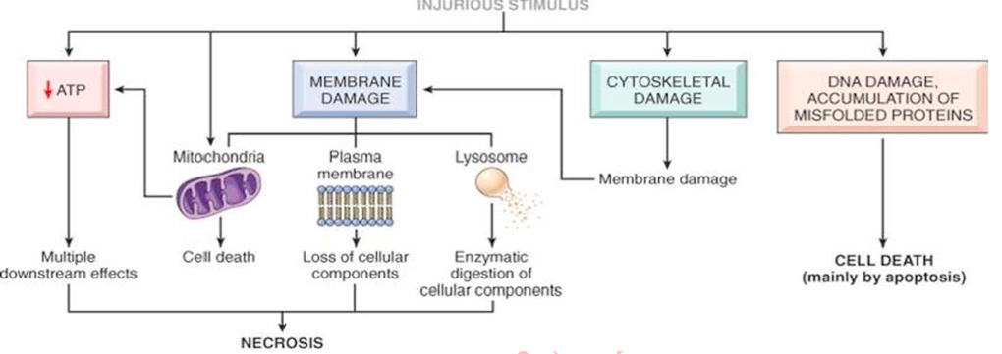

Slide 26
PATHOGENESIS OF ISCHAEMIC AND HYPOXIC INJURY
Reversible Cell Injury
If the ischaemia or hypoxia is of short duration, the effects may be reversible on rapid restoration of circulation e.g. in coronary artery occlusion, myocardial contractility, metabolism and ultrastructure are reversed if the circulation is quickly restored.
1. Decreased generation of cellular ATP: Damage by ischaemia from interruption versus hypoxia from other causes
All living cells require continuous supply of oxygen to produce ATP which is essentially required for a variety of cellular functions (e.g. membrane transport, protein synthesis, lipid synthesis and phospholipid metabolism). ATP in human cell is derived from 2 sources:
Firstly, by aerobic respiration or oxidative phosphorylation (which requires oxygen) in the mitochondria.
Secondly, cells may subsequently switch over to anaerobic glycolytic oxidation to maintain constant supply of ATP (in which ATP is genera ted from glucose/glycogen in the absence of oxygen).

Slide 27
Ischaemia due to interruption in blood supply as well as hypoxia from other causes limit the supply of oxygen to the cells, thus causing decreased ATP generation from ADP:
In ischaemia from interruption of blood supply, aerobic respiration as well as glucose availability are both compromised resulting in more severe and faster effects of cell injury. Ischaemic cell injury also causes accumulation of metabolic waste products in the cells.
On the other hand, in hypoxia from other causes (RBC disorders, heart disease, lung disease), anaerobic glycolytic ATP generation continues, and thus cell injury is less severe. However, highly specialised cells such as myocardium, proximal tubular cells of the kidney, and neurons of the CNS are dependent solely on aerobic respiration for ATP generation and thus these tissues suffer from ill-effects of ischaemia more severely and rapidly.

Slide 28
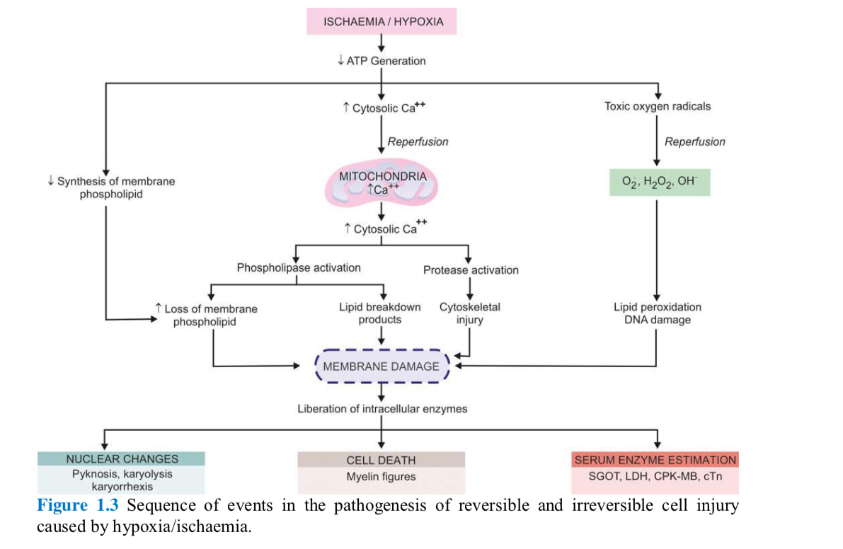

Slide 29
2. Intracellular lactic acidosis: Nuclear clumping
Due to low oxygen supply to the cell, aerobic respiration by mitochondria fails first. This is followed by switch to anaerobic glycolytic pathway for the requirement of energy (i.e. ATP). This results in rapid depletion of glycogen and accumulation of lactic acid lowering the intracellular pH. Early fall in intracellular pH (i.e. intracellular lactic acidosis) results in clumping of nuclear chromatin.
3. Damage to plasma membrane pumps: Hydropic swelling and other membrane changes
Lack of ATP interferes in generation of phospholipids from the cellular fatty acids which are required for continuous repair of membranes. This results in damage to membrane pumps operating for regulation of sodium-potassium and calcium as under:
i) Failure of sodium-potassium pump
ii) Failure of calcium pump

Slide 30
4. Reduced protein synthesis: Dispersed ribosomes
As a result of continued hypoxia, membranes of endoplasmic reticulum and Golgi apparatus swell up. Ribosomes are detached from granular (rough) endoplasmic reticulum and polysomes are degraded to monosomes, thus dispersing ribosomes in the cytoplasm and inactivating their function. Similar reduced protein synthesis occurs in Golgi apparatus.
Irreversible Cell Injury
Persistence of ischaemia or hypoxia results in irreversible damage to the structure and function of the cell (cell death).
Two essential phenomena always distinguish irreversible from reversible cell injury
Inability of the cell to reverse mitochondrial dysfunction on reperfusion or reoxygenation.
Disturbance in cell membrane function in general, and in plasma membrane in particular.

Slide 31
In addition, there is further reduction in ATP, continued depletion of proteins, reduced intracellular pH, and leakage of lysosomal enzymes into the plasma.
These biochemical changes have effects on the ultrastructural components of the cell
CALCIUM INFLUX: MITOCHONDRIAL DAMAGE
As a result of continued hypoxia, a large cytosolic influx of calcium ions occurs, especially after reperfusion of irreversibly injured cell. Excess intracellular calcium collects in the mitochondria disabling its function. Morphological changes are in the form of vacuoles in the mitochondria and deposits of amorphous calcium salts in the mitochondrial matrix.
ACTIVATED PHOSPHOLIPASES: MEMBRANE DAMAGE
Damage to membrane function in general, and plasma membrane in particular, is the most important event in irreversible cell injury. Increased cytosolic influx of calcium in the cell activates endogenous phospholipases. These, in turn, degrade membrane phospholipids progressively which are the main constituent of the lipid bilayer membrane

Slide 32
3. Intracellular proteases: Cytoskeletal damage
The normal cytoskeleton of the cell (microfilaments, micro tubules and intermediate filaments) which anchors the cell membrane is damaged due to degradation by activated intracellular proteases or by physical effect of cell swelling producing irreversible cell membrane injury.
4. ACTIVATED ENDONUCLEASES: NUCLEAR DAMAGE
DNA or nucleoproteins are damaged by the activated lysosomal enzymes such as proteases and endonucleases. Irreversible damage to the nucleus can be in three forms:
i) Pyknosis:
Condensation and clumping of nucleus which becomes dark basophilic.
ii) Karyorrhexis:
Nuclear fragmentation in to small bits dispersed in the cytoplasm.
iii) Karyolysis:
Dissolution of the nucleus. Damaged DNA activates proapoptotic proteins leading the cell to death.

Slide 33
5. LYSOSOMAL HYDROLYTIC ENZYMES: LYSOSOMAL DAMAGE, CELL DAMAGE AND PHAGOCYTOSIS
The lysosomal membranes are damaged and result in escape of lysosomal hydrolytic enzymes. These enzymes are activated due to lack of oxygen in the cell and acidic pH. These hydrolytic enzymes: (e.g. hydrolase, RNAase, DNAase, protease, glycosidase, phos phata se, lipase, amylase, cathepsin etc) on activation bring about enzymatic digestion of cellular components and hence cell death. The dead cell is eventually replaced by masses of phospholipids called myelin figures which are either phagocytosed by macrophages or there may be formation of calcium soaps. Liberated enzymes just mentioned leak across the abnormally permeable cell membrane into the serum, the estimation of which may be used as clinical parameters of cell death. For example, in myocardial infarction, estimation of elevated serum glutamic oxaloacetic transaminase (SGOT), lactic dehydrogenase (LDH), isoenzyme of creatine kinase (CK-MB), and cardiac troponins (cTn) are useful guides for death of heart muscle.

Slide 34
CELL DEATH

Slide 35
Cell death occurs by two distinct processes:
1. Apoptosis
2. Necrosis.
APOPTOSIS
Apoptosis is defined as the natural or programed death of the cell under genetic control. Originally, apoptosis refers to the process by which the leaves fall from trees in autumn (In Greek, apoptosis means ‘falling leaves’). It is also called ‘cell suicide’ since the genes of the cell play a major role in the death. This type of programmed cell death is a normal phenomenon and it is essential for normal development of the body. In contrast to necrosis, apoptosis usually does not produce inflammatory reactions in the neighboring tissues.
Functional Significance of Apoptosis:
Plays a vital role in cellular homeostasis. About 10 million cells are produced everyday in human body by mitosis. An equal number of cells die by apoptosis. This helps in cellular homeostasis
. Useful for removal of a cell that is damaged beyond repair by a virus or a toxin
An essential event during the development and in adult stage.
Examples:
i. A large number of neurons are produced during the development of central nervous system. But up to 50% of the neurons are removed by apoptosis during the formation of synapses between neurons
ii. Apoptosis is responsible for the removal of tissues of webs between fingers and toes during developmental stage in fetus

Slide 36
Activation of Apoptosis
Apoptosis is activated by either withdrawal of positive signals (survival factors) or arrival of negative signals. Withdrawal of positive signals Positive signals are the signals which are necessary for the long-time survival of most of the cells. The positive signals are continuously produced by other cells or some chemical stimulants. Best examples of chemical stimulants are: i. Nerve growth factors (for neurons)
ii. Interleukin-2 (for cells like lymphocytes).
The absence or withdrawal of the positive signals activates apoptosis. Arrival of negative signals Negative signals are the external or internal stimuli which initiate apoptosis. The negative signals are produced during various events like:
1.Normal developmental procedures
2. Cellular stress
3. Increase in the concentration of intracellular oxidants
4. Viral infection
5. Damage of DNA
6. Exposure to agents like chemotherapeutic drugs, X-rays, ultraviolet rays and the death- receptor ligands.

Slide 37
Apoptotic Process
Cell shows sequence of characteristic morphological changes during apoptosis, viz.:
i) Activated caspases digest the proteins of cytoskeleton and the cell shrinks and
becomes round
ii) Because of shrinkage, the cell losses the contact with neighboring cells or surrounding
matrix
iii) Chromatin in the nucleus undergoes degradation and condensation
iv) Nuclear membrane becomes discontinuous and the DNA inside nucleus is cleaved into
small fragments
v) Following the degradation of DNA, the nucleus breaks into many discrete
nucleosomal units, which are also called chromatin bodies
vi) Cell membrane breaks and shows bubbled appearance
vii) Finally, the cell breaks into several fragments containing intracellular materials
including chromatin bodies and organelles of the cell. Such cellular fragments are
called vesicles or apoptotic bodies
viii) Apoptotic bodies are engulfed by phagocytes and dendritic cells.

Slide 38
NECROSIS
Necrosis (means ‘dead’ in Greek) is the uncontrolled and unprogramed death of cells due to unexpected and accidental damage. It is also called ‘cell murder’ because the cell is killed by extracellular or external events. After necrosis, the harmful chemical substances released from the dead cells cause damage and inflammation of neighboring tissues.
Causes for Necrosis
Common causes of necrosis are injury, infection, inflammation, infarction and cancer. Necrosis is induced by both physical and chemical events such as heat, radiation, trauma, hypoxia due to lack of blood flow and exposure to toxins.

Slide 39
Necrotic Process
Necrosis results in lethal disruption of cell structure and activity. The cell undergoes a series of characteristic changes during necrotic process, viz.
i) Cell swells causing damage of the cell membrane and appearance of many holes in the
membrane
ii) Intracellular contents leak out into the surrounding environment
iii) Intracellular environment is altered
iv) Simultaneously, large amount of calcium ions are released by the damaged mitochondria
and other organelles
v) Presence of calcium ions drastically affects the organization and activities of proteins in
the intracellular components
vi) Calcium ions also induce release of toxic materials that activate the lysosomal enzymes
vii) Lysosomal enzymes cause degradation of cellular components and the cell is totally
disassembled resulting in death
viii) Products broken down from the disassembled cell are ingested by neighboring cells.

Slide 40
Types of Necrosis: Morphologically, there are five types of necrosis:
Coagulative
Liquefaction
Caseous
Fat
Fibrinoid
COAGULATIVE NECROSIS: It’s a form of tissue necrosis in which the component cells are dead but the basic tissue architecture is preserved for at least several days
Most common type of necrosis. Mostly from sudden cessation of blood flow (ischaemia). Less often from bacterial and chemical agents.
LIQUEFACTION (COLLIQUATIVE) NECROSIS: Due to ischaemic injury and bacterial or fungal infections,degradation of tissue by the action of powerful hydrolytic enzyme.The common examples are infarct brain and abscess cavity

Slide 41
CASEOUS NECROSIS: It is found in the centre of foci of tuberculous infections.
It combines features of both coagulative and liquefactive necrosis. Term "caseous" (cheese- like) is derived from the friable yellow-white appearance of the area of necrosis
FAT NECROSIS: Refers to focal areas of fat destruction. Acute pancreatic necrosis, traumatic fat necrosis commonly in breasts.
FIBRINOID NECROSIS: Characterised by deposition of fibrin-like material this has the staining properties of fibrin. It is encountered in various examples of immunologic tissue injury, immune complex vasculitis, autoimmune diseases

Slide 42
PATHOLOGIC CALCIFICATION

Slide 43
Deposition of calcium salts in tissues other than osteoid or enamel is called pathologic or heterotopic calcification. Two distinct types of pathologic calcification are recognised:
Dystrophic calcification is characterised by deposition of calcium salts in dead or degenerated tissues with normal calcium metabolism and normal serum calcium level.
Metastatic calcification, on the other hand, occurs in apparently normal tissues and is associated with deranged calcium metabolism and hypercalcaemia.
ETIOPATHOGENESIS:
The two types of pathologic calcification result from distinctly different etiologies and mechanisms.
DYSTROPHIC CALCIFICATION
As apparent from definition, dystrophic calcification may occur due to 2 types of causes:
1) Calcification in dead tissue.
2) Calcification of degenerated tissue.

Slide 44
Calcification in dead tissue
Caseous necrosis in tuberculosis is the most common site for dystrophic calcification. Living bacilli may be present even in calcified tuberculous lesions, lymph nodes, lungs, etc.
Liquefaction necrosis in chronic abscesses may get calcified.
Fat necrosis following acute pancreatitis or traumatic fat necrosis in the breast results in deposition of calcium soaps.
Infarcts may sometimes undergo dystrophic calcification.
Thrombi, especially in the veins, may produce phleboliths.
Haematomas in the vicinity of bones may undergo dystrophic calcification.
Microcalcification in breast cancer detected by mammography.

Slide 45
Calcification in degenerated tissues
Dense old scars may undergo hyaline degeneration and subsequent calcification.
Atheromas in the aorta and coronaries frequently undergo calcification
Stroma of tumours such as uterine fibroids, breast cancer, thyroid adenoma, goitre etc show calcification.
Goitre of the thyroid may show presence of calcification in areas of degeneration
Cysts which have been present for a long time may show calcification of their wallse.g. epidermal and pilar cysts.
Pathogenesis of dystrophic calcification
It involves phases of initiation and propagation as follows:
a) Initiation: Following cell injury (i.e. degeneration or necrosis), there is membrane damage and release of membrane phospholipids. Phosphatases associated with phospholipids generate phosphate ions. It is also known that there is excess uptake of calcium by injured mitochondria in degeneration and necrosis. Thus, calcium and phosphate so generated from these mechanisms form precipitates of calcium phosphate.
b) Propagation: Simultaneously, some structural changes occur in calcium and phosphate groups which result in further propagation of deposits and form mineral crystals.

Slide 46
METASTATIC CALCIFICATION
Since metastatic calcification occurs in normal tissues due to hypercalcaemia, its causes would include either of the following two groups of causes:
1) Excessive mobilisation of calcium from the bone.
2) Excessive absorption of calcium from the gut.
1) Excessive mobilisation of calcium from the bone
These causes are more common and include the following:
a) Hyperparathyroidism which may be primary such as due to parathyroid adenoma, or secondary such as from parathyroid hyperplasia, chronic renal failure etc.
b) Bony destructive lesions such as multiple myeloma, metastatic carcinoma.
c) Hypercalcaemia as a part of paraneoplastic syndrome e.g. in breast cancer.
d) Prolonged immobilisation of a patient results in disuse atrophy of the bones and hypercalcaemia.
Excessive absorption of calcium from the gut
Less often, excess calcium may be absorbed from the gut causing hypercalcaemia and metastatic calcifi cation. These causes are as under:
a) Hypervitaminosis D from excessive intake or in sarcoidosis.
b) Milk-alkali syndrome caused by excessive oral intake of calcium in the form of milk and administration of calcium carbonate in the treatment of peptic ulcer.
c) Idiopathic hypercalcaemia of infancy (Williams’s syndrome).
d) Renal causes such as in renal tubular acidosis.

Slide 47
Sites of metastatic calcification
Metastatic calcification may occur in any normal tissue of the body but preferentially
affects the following organs and tissues:
1. Kidneys, especially at the basement membrane of tubular epithelium and in the tubular lumina causing nephrocalcinosis.
2. Lungs, especially in the alveolar walls.
3. Stomach, on the acid-secreting fundal glands.
4. Blood vessels, especially on the internal elastic lamina.
5. Cornea is another site affected by metastatic calcification.
6. Synovium of the joint causing pain and dysfunction.
Pathogenesis of metastatic calcification
Metastatic calcification occurs due to excessive binding of inorganic phosphate ions with elevated calcium ions due to underlying metabolic derangement. This leads to precipitates of calcium phosphate at the preferential sites, due to presence of acid secretions or rapid changes in pH levels at these sites. Metastatic calcification is reversible upon correction of underlying metabolic disorder.

Slide 48
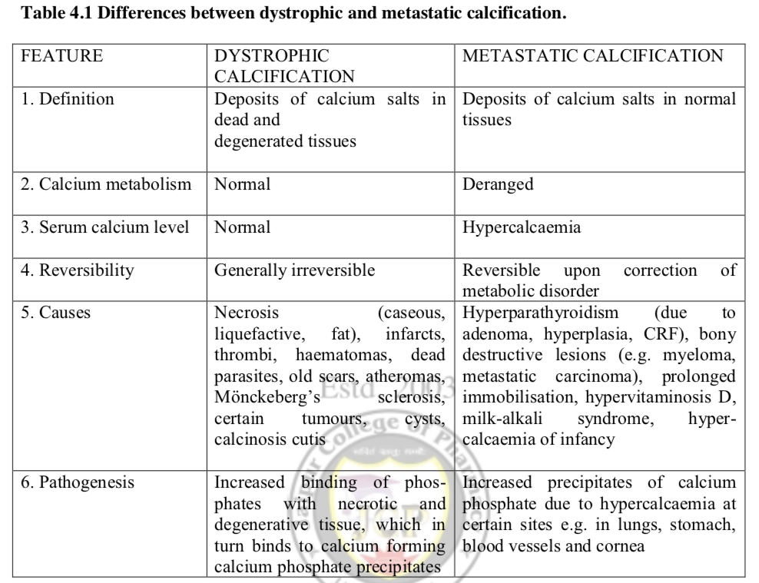

Slide 49
HOMEOSTASIS

Slide 50
Homeostasis refers to the maintenance of constant internal environment of the body . Homeostasis is the state of steady internal, physical, and chemical conditions maintained by living systems.
For the functioning of homeostatic mechanism, the body must recognize the deviation of any physiological activity from the normal limits. Fortunately, body is provided with appropriate detectors or sensors, which recognize the deviation. These detectors sense the deviation and alert the integrating center. The integrating center immediately sends information to the concerned effectors to either accelerate or inhibit the activity so that the normalcy is restored .

Slide 51
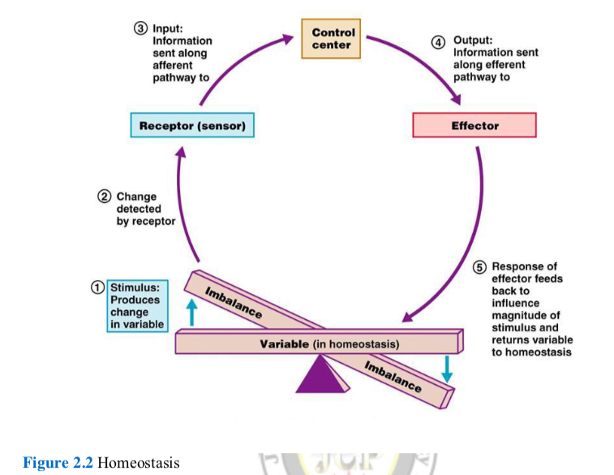

Slide 52
ROLE OF VARIOUS SYSTEMS OF THE BODY IN HOMEOSTASIS
One or more systems are involved in homeostatic mechanism of each function. Some of the functions in which the homeostatic mechanism is well established are given below:
1. The pH of the ECF has to be maintained at the critical value of 7.4. The tissues cannot survive if it is altered. Thus, the decrease in pH (acidosis) or increase in pH (alkalosis) affects the tissues markedly. The respiratory system, blood and kidney help in the regulation of pH.
2. Body temperature must be maintained at 37.5°C. Increase or decrease in temperature alters the metabolic activities of the cells. The skin, respiratory system, digestive system, excretory system, skeletal muscles and nervous system are involved in maintaining the temperature within normal limits.
3. Adequate amount of nutrients must be supplied to the cells. Nutrients are essential for various activities of the cell and growth of the tissues. These substances also form the source of energy required for various activities of the cells. Nutrients must be digested, absorbed into the blood and supplied to the cells. Digestive system and circulatory system play major roles in the supply of nutrients.
4. Adequate amount of oxygen should be made available to the cells for the metabolism of the nutrients. Simultaneously, the carbon dioxide and other metabolic end products must be removed. Respiratory system is concerned with the supply of oxygen and removal of carbon dioxide. Kidneys and other excretory organs are involved in the excretion of waste products.

Slide 53
Many hormones are essential for the metabolism of nutrients and other substances necessary for the cells. Hormones are to be synthesized and released from the endocrine glands in appropriate quantities and these hormones must act on the body cells appropriately. Otherwise, it leads to abnormal signs and symptoms.
6. Water and electrolyte balance should be maintained optimally. Otherwise it leads to dehydration or water toxicity and alteration in the osmolality of the body fluids. Kidneys, skin, salivary glands and gastrointestinal tract take care of this.
7. For all these functions, the blood, which forms the major part of internal environment, must be normal. It should contain required number of normal red blood cells and adequate amount of plasma with normal composition. Only then, it can transport the nutritive substances, respiratory gases, metabolic and other waste products.
8. Skeletal muscles are also involved in homeostasis. This system helps the organism to move around in search of food. It also helps to protect the organism from adverse surroundings, thus preventing damage or destruction.
9. Central nervous system, which includes brain and spinal cord also, plays an important role in homeostasis. Sensory system detects the state of the body or surroundings. Brain integrates and interprets the pros and cons of these information and commands the body to act accordingly through motor system so that, the body can avoid the damage.
10. Autonomic nervous system regulates all the vegetative functions of the body essential for homeostasis.

Slide 54
COMPONENTS OF HOMEOSTATIC SYSTEM
Homeostatic system in the body acts through self regulating devices, which operate in a cyclic manner (Fig. 4.1). This cycle includes four components:
Sensors or detectors, which recognize the deviation
Transmission of this message to a control center
Transmission of information from the control center to the effectors for correcting the deviation Transmission of the message or information may be an electrical process in the form of impulses through nerves or a chemical process mainly in the form of hormones through blood and body fluids.
Effectors, which correct the deviation.

Slide 55
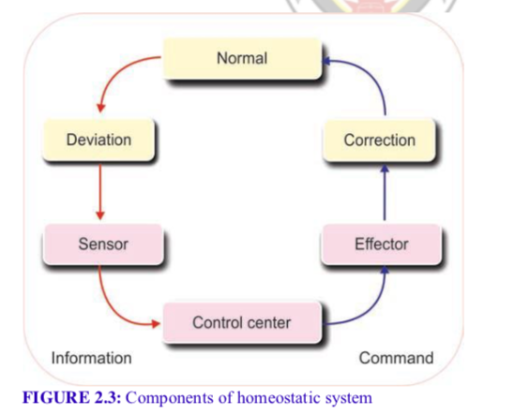

Slide 56
MECHANISM OF ACTION OF HOMEOSTATIC SYSTEM
Homeostatic mechanism in the body is responsible for maintaining the normalcy of various body systems. Whenever there is any change in behavioral pattern of any system, the effectors bring back the normalcy either by inhibiting and reversing the change or by supporting and accelerating the change depending upon requirement of the situation. This is achieved by means of feedback signals.
Feedback is a process in which some proportion of the output signal of a system is fed (passed) back to the input. This is done more often intentionally in order to control the behavior pattern of the system. Whenever any change occurs, system receives and reacts to two types of feedback:
1. Negative feedback
2. Positive feedback.
NEGATIVE FEEDBACK
Negative feedback is the one to which the system reacts in such a way as to arrest the change or reverse the direction of change. After receiving a message, effectors send negative feedback signals back to the system. Now, the system stabilizes its own function and makes an attempt to maintain homeostasis.

Slide 57
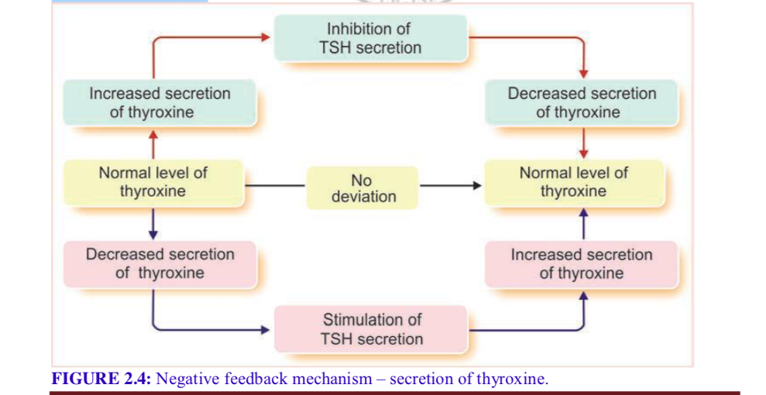

Slide 58
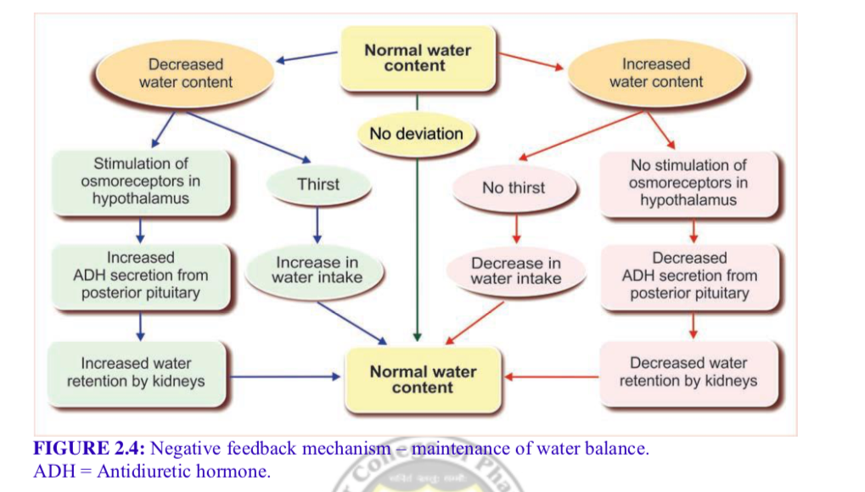

Slide 59
Many homeostatic mechanisms in the body function through negative feedback. For example, thyroid-stimulating hormone (TSH) released from pituitary gland stimulates thyroid gland to secrete thyroxine.
When thyroxine level increases in blood, it inhibits the secretion of TSH from pituitary so that, the secretion of thyroxin from thyroid gland decreases .
On the other hand, if thyroxine secretion is less, its low blood level induces pituitary gland to release TSH. Now, TSH stimulates thyroid gland to secrete thyroxine.
Another example for negative feedback mechanism is maintenance of water balance in the body.

Slide 60
POSITIVE FEEDBACK
Positive feedback is the one to which the system reacts in such a way as to increase the intensity of the change in the same direction. Positive feedback is less common than the negative feedback. However, it has its own significance particularly during emergency conditions. One of the positive feedbacks occurs during the blood clotting. Blood clotting is necessary to arrest bleeding during injury and it occurs in three stages.
The three stages are:
i. Formation of prothrombin activator
ii. Conversion of prothrombin into thrombin
iii. Conversion of fibrinogen into fibrin.
Thrombin formed in the second stage stimulates the formation of more prothrombin activator in addition to converting fibrinogen into fibrin . It causes formation of more and more amount of prothrombin activator so that the blood clotting process is accelerated and blood loss is prevented quickly. Other processes where positive feedback occurs are milk eject ion reflex and parturition and both the processes involve oxytocin secretion

Slide 61
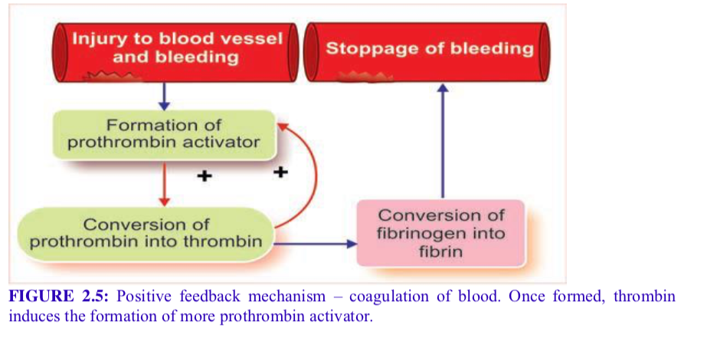

Slide 62
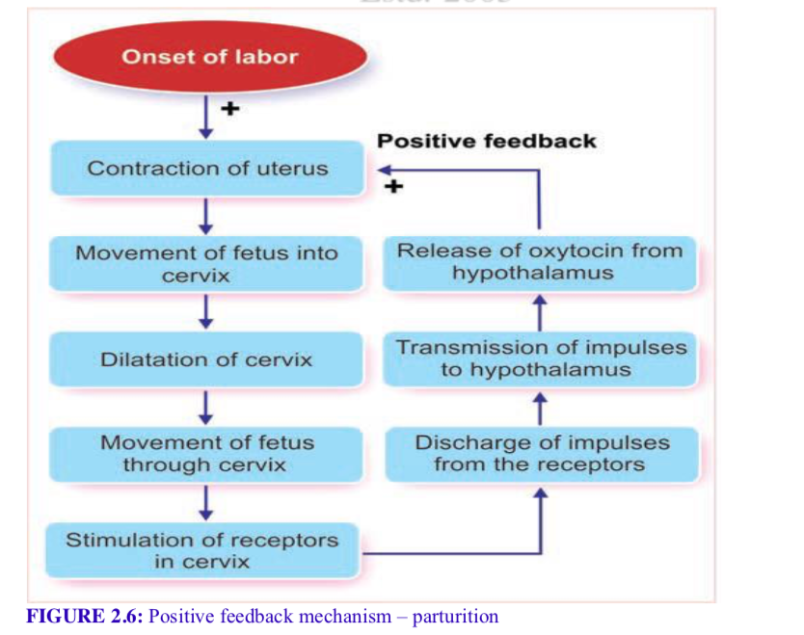

Slide 63
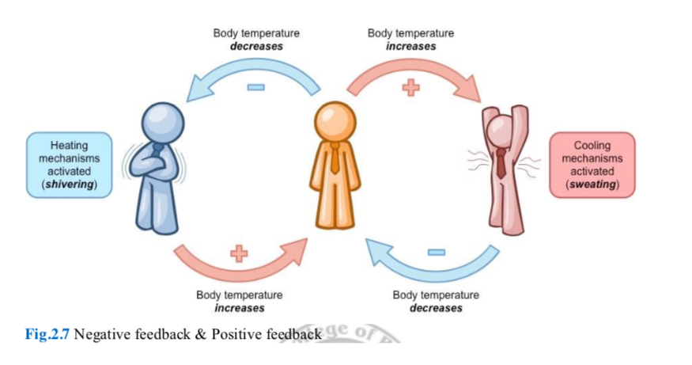

Slide 64
DISTURBANCES OF ACID-BASE STATUS

Slide 65
ACIDOSIS
Acidosis is the reduction in pH (increase in H+ concentration) below normal range. Acidosis is produced by:
1. Increase in partial pressure of CO2 in the body fluids particularly in arterial blood 2. Decrease in HCO3 – concentration.
ALKALOSIS
Alkalosis is the increase in pH (decrease in H+ concentration) above the normal range. Alkalosis is produced by:
1. Decrease in partial pressure of CO2 in the arterial blood
2. Increase in HCO3 – concentration.
The acid-base disturbances are:
1. Respiratory acidosis
2. Respiratory alkalosis
3. Metabolic acidosis
4. Metabolic alkalosis.

Slide 66
RESPIRATORY ACIDOSIS
Respiratory acidosis is the acidosis that is caused by alveolar hypoventilation. During hypoventilation the lungs fail to expel CO2, which is produced in the tissues. CO2 is the major end product of oxidation of carbohydrates, proteins and fats. CO2 accumulates in blood where it reacts with water to form carbonic acid, which is called respiratory acid.
RESPIRATORY ALKALOSIS
Respiratory alkalosis is the alkalosis that is caused by alveolar hyperventilation. Hyperventilation causes excess loss of CO2 from the body. Loss of CO2 leads to decreased formation of carbonic acid and decreased release of H+. Decreased H+ concentration increases the pH leading to respiratory alkalosis
METABOLIC ACIDOSIS
Metabolic acidosis is the acid-base imbalance characterized by excess accumulation of organic acids in the body, which is caused by abnormal metabolic processes.
Causes of Metabolic Acidosis
Lactic acid - The amount of lactic acid increases during anaerobic glycolysis in some abnormal conditions such as circulatory shock.
Ketoacids - The amount of ketoacids increases because of insulin deficiency as in the case of diabetes mellitus. In diabetes mellitus, glucose is not utilized due to lack of insulin. So, lipids are utilized for liberation of energy resulting in production of excess acetoacetic acid and beta hydroxybutyric acid.
Uric acid - The amount of uric acid increases in the body due to the failure of excretion. Normally uric acid is excreted by kidneys. But in renal diseases, the kidneys fail to excrete the uric acid. Some of the conditions when the metabolic acids increase in the body resulting in metabolic acidosis.

Slide 67
METABOLIC ALKALOSIS
Metabolic alkalosis is the acid-base imbalance caused by loss of excess H+ resulting in increased HCO3– concentration. Some of the endocrine disorders, renal tubular disorders, etc. cause metabolic disorders leading to loss of H+.
It increases HCO3– and pH in the body leading to metabolic alkalosis. Some of the conditions when excess H+ is lost and HCO3 content increases leading to metabolic alkalosis.

Slide 68
ELECTROLYTE IMBALANCE

Slide 69
Electrolyte imbalance, or water-electrolyte imbalance, is an abnormality in the concentration of electrolytes in the body. Electrolytes play a vital role in maintaining homeostasis in the body. They help to regulate heart and neurological function, fluid balance, oxygen delivery, acid–base balance and much more.
Hypernatremia
Hypernatremia means that the concentration of sodium in the blood is too high. An individual is considered to be having high sodium at levels above 145 mEq/L of sodium.
Causes
There are three types of hypernatremia each with different causes. The first is dehydration along with low total body sodium. This is most commonly caused by heatstroke, burns, extreme sweating, vomiting, and diarrhea. The second is low total body water with normal body sodium. This can be caused by diabetes insipidus, renal disease, hypothalamic dysfunction, sickle cell disease, and certain drugs. The third is increased total body sodium which is caused by increased ingestion, Conn's syndrome, or Cushing's syndrome.
Symptoms
Symptoms of hypernatremia may vary depending on type and how quickly the electrolyte disturbance developed.Common symptoms are dehydration, nausea, vomiting, fatigue, weakness, increased thirst, excess urination. Patients may be on medications that caused the imbalance such as diuretics or nonsteroidal anti-inflammatory drugs. Some patients may have no obvious symptoms at all.

Slide 70
Treatment
It is crucial to first assess the stability of the patient. If there are any signs of shock such as tachycardia or hypotension, these must be treated immediately with IV saline infusion. Once the patient is stable, it is important to identify the underlying cause of hypernatremia as that may affect the treatment plan. The final step in treatment is to calculate the patients free water deficit, and to replace it at a steady rate using a combination of oral or IV fluids. The rate of replacement of fluids varies depending on how long the patient has been hypernatremic. Lowering the sodium level too quickly can cause cerebral edema.
Hyponatremia
Hyponatremia means that the concentration of sodium in the blood is too low. It is generally defined as a concentration lower than 135 mEq/L. This relatively common electrolyte disorder can indicate the presence of a disease process, but in the hospital setting is more often due to administration of Hypotonic fluids
Causes
Hyponatremia has many causes including heart failure, chronic kidney disease, liver disease, treatment with thiazide diurectics, psychogenic polydipsia, syndrome of inappropriate antidiuretic hormone secretion
Symptoms
Many individuals with mild hyponatremia will not experience symptoms. Severity of symptoms is directly correlated with severity of hyponatremia and rapidness of onset. General symptoms include loss of appetite, nausea, vomiting, confusion, agitation, and weakness. More concerning symptoms involve the central nervous system and include seizures, coma, and death due to brain herniation. These usually do not occur until sodium levels fall below 120 mEq/L.
Treatment
Considerations for treatment include symptom severity, time to onset, volume status, underlying cause, and sodium levels. If the sodium level is <120 mEq/L, the person can be treated with hypertonic saline as extremely low levels are associated with severe neurological symptoms. In non-emergent situations, it is important to correct the sodium slowly to minimize risk of osmotic demyelination syndrome. If a person has low total body water and low sodium they are typically given fluids. If a person has high total body water (such as due to heart failure or kidney disease) they may be placed on fluid restriction, salt restriction, and treated with a diuretic. If a person has a normal volume of total body water, they may be placed on fluid restriction alone.

Slide 71
Hyperkalemia
Hyperkalemia means the concentration of potassium in the blood is too high. This occurs when the concentration of potassium is >5 mEq/L. It can lead to cardiac arrhythmias and even death. As such it is considered to be the most dangerous electrolyte disturbance.
Causes
Hyperkalemia is typically caused by decreased excretion by the kidneys, shift of potassium to the extracellular space, or increased consumption of potassium rich foods in patients with kidney failure. The most common cause of hyperkalemia is lab error due to potassium released as blood cells from the sample break down. Other common causes are kidney disease, cell death, acidosis, and drugs that affect kidney function.
Symptoms
Part of the danger of hyperkalemia is that it is often asymptomatic, and only detected during normal lab work done by primary care physicians. As potassium levels get higher, individuals may begin to experience nausea, vomiting, and diarrhea. Patients with severe hyperkalemia, defined by levels above 7 mEq/L, may experience muscle cramps, numbness, tingling, absence of reflexes, and paralysis. Patients may experience arrhythmias that can result in death.
Treatment
There are three mainstays of treatment of hyperkalemia. These are stabilization of cardiac cells, shift of potassium into the cells, and removal of potassium from the body. Stabilization of cardiac muscle cells is done by administering calcium intravenously.[3] Shift of potassium into the cells is done using both insulin and albuterol inhalers. Excretion of potassium from the body is done using either hemodialysis, loop diuretics, or a resin that causes potassium to be excreted in the fecal matter.

Slide 72
Hypokalemia
The most common electrolyte disturbance, hypokalemia means that the concentration of potassium is <3.5 mEq/L. It often occurs concurrently with low magnesium levels.
Causes
Low potassium is caused by increased excretion of potassium, decreased consumption of potassium rich foods, movement of potassium into the cells, or certainendocrine diseases. Excretion is the most common cause of hypokalemia and can be caused by diuretic use, metabolic acidosis, diabetic ketoacidosis, hyperaldosteronism, and renal tubular acidosis. Potassium can also be lost through vomiting and diarrhea.
Symptoms
Hypokalemia is often asymptomatic, and symptoms may not appear until potassium concentration is <2.5 mEq/L. Typical symptoms consist of muscle weakness and cramping. Low potassium can also cause cardiac arrythmias.
Treatment
Hypokalemia is treated by replacing the body's potassium. This can occur either orally or intravenously. Because low potassium is usually accompanied by low magnesium, patients are often given magnesium alongside potassium.

Slide 73
Hypercalcemia
Hypercalcemia describes when the concentration of calcium in the blood is too high. This occurs above 10.5 mg/dL.
Causes
The most common causes of hypercalcemia are certain types of cancer, hyperparathyroidism,hyperthyroidism,pheochromocytoma, excessive ingestion of vitamin D, sarcoidosis, and tuberculosis. Hyperparathyroidism and malignancy are the predominate causes. It can also be caused by muscle cell breakdown, prolonged immobilization, dehydration.
Symptoms
The predominant symptoms of hypercalcemia are abdominal pain, constipation, kidney stones, extreme thirst, excessive urination, nausea and vomiting.[3][10] In severe cases where the calcium concentration is >14 mg/dL, individuals may experience confusion, altered mental status, coma, and seizure.
Treatment
Primary treatment of hypercalcemia consists of administering IV fluids. If the hypercalcemia is severe and/or associated with cancer, it may be treated with bisphosphonates. For very severe cases, hemodialysis may be considered for rapid removal of calcium from the blood.

Slide 74
Hypocalcemia
Hypocalcemia describes when calcium levels are too low in the blood, usually less than 8.5 mg/dL.
Causes
Hypoparathyroidism and vitamin D deficiency are common causes of hypocalcemia.[3] It can also be caused by malnutrition, blood transfusion, ethylene glycol intoxication, and pancreatitis.
Symptoms
Neurological and cardiovascular symptoms are the most common manifestations of hypocalcemia. Patients may experience muscle cramping or twitching, and numbness around the mouth and fingers. They may also have shortness of breath, low blood pressure, and cardiac arrhythmias.
Treatment
Patients with hypocalcemia may be treated with either oral or IV calcium. Typically, IV calcium is reserved for patients with severe hypocalcemia. It is also important to check magnesium levels in patients with hypocalcemia and to replace magnesium if it is low.

Slide 75
Hypermagnesemia
Hypermagnesemia, or abnormally high levels of magnesium in the blood, is relatively rare in individuals with normal kidney function. This is defined by a magnesium concentration >2.5 mg/dL.
Causes
Hypermagnesemia typically occurs in individuals with abnormal kidney function. This imbalance can also occur with use of antacids or laxatives that contain magnesium. Most cases of hypermagnesemia can be prevented by avoiding magnesium-containing medications.
Symptoms
Mild symptoms include nausea, flushing, tiredness. Neurologic symptoms are seen most commonly including decreased deep tendon reflexes. Severe symptoms include paralysis, respiratory failure, and bradycardia progressing to cardiac arrest.
Treatment
If kidney function is normal, stopping the source of magnesium intake is sufficient. Diuretics can help increase magnesium excretion in the urine. Severe symptoms may be treated with dialysis to directly remove magnesium from the blood.

Slide 76
Hypomagnesemia: (Magnesium deficiency)
Hypomagnesemia, or low magnesium levels in the blood, can occur in up to 12% of hospitalized patients. Symptoms or effects of hypomagnesemia can occur after relatively small deficits.
  Causes
  Major causes of hypomagnesemia are from gastrointestinal losses such as vomiting and diarrhea. Another major cause is from kidney losses from diuretics, alcohol use, hypercalcemia, and genetic disorders. Low dietary intake can also contribute to magnesium deficiency.
  Symptoms
  Hypomagnesemia is typically associated with other electrolyte abnormalities, such as hypokalemia and hypocalcemia. For this reason, there may be overlap in symptoms seen in these other electrolyte deficiencies. Severe symptoms include arrhythmias, seizures, or tetany.
  Treatment
  The first step in treatment is determining whether the deficiency is caused by a gastrointestinal or kidney problem. People with no or minimal symptoms are given oral magnesium; however, many people experience diarrhea and other gastrointestinal discomfort. Those who cannot tolerate or receive magnesium, or those with severe symptoms can receive intravenous magnesium.
  Hypomagnesemia may prevent the normalization of other electrolyte deficiencies. If other electrolyte deficiencies are associated, normalizing magnesium levels may be necessary to treat the other deficiencies.

Slide 77
Hyperchloremia: (Excessesive chloride)
Causes
Hyperchloremia, or high chloride levels, is usually associated with excess chloride intake (e.g., saltwater drowning), fluid loss (e.g., diarrhea, sweating), and metabolic acidosis.
Symptoms
Patients are usually asymptomatic with mild hyperchloremia. Symptoms associated with hyperchloremia are usually caused by the underlying cause of this electrolyte imbalance.
Treatment
Treat the underlying cause, which commonly includes increasing fluid intake.
II) Hypochloremia: (Chloride Deficiency)
Causes
Hypochloremia, or low chloride levels, are commonly associated with gastrointestinal (e.g., vomiting) and kidney (e.g., diuretics) losses. Greater water or sodium intake relative to chloride also can contribute to hypochloremia.
Symptoms
Patients are usually asymptomatic with mild hypochloremia. Symptoms associated with hypochloremia are usually caused by the underlying cause of this electrolyte imbalance.
Treatment
Treat the underlying cause, which commonly includes increasing fluid intake.

Slide 78
THANK YOU

