Slide 1
Green Beauty:
The need of hour
Presented by:
Ms Niyati Shah

Slide 2
Green Beauty & its background
Green Beauty the word originally comes from the facts that green is always associated with the term natural and beauty signifies cosmetics.
The term is used to describe products using environmentally-friendly formulations, production practices or packaging methods.

Slide 3
Green Beauty
Clean Beauty
Natural Beauty
Organic Beauty

Slide 4
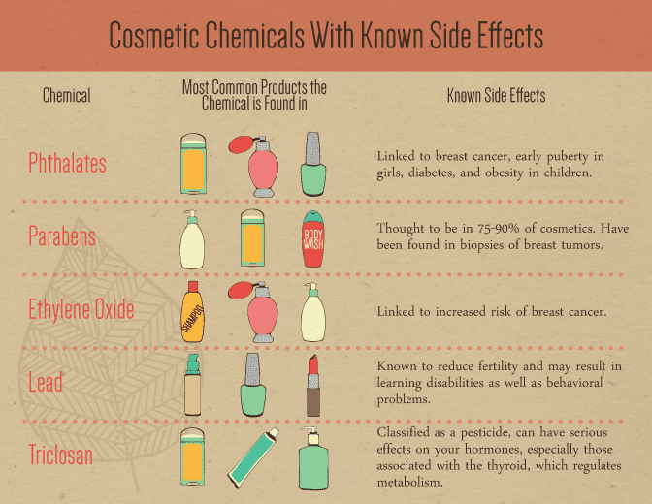

Slide 5
Rationale behind Green Beauty:
Health Consciousness
Environment Concern
Skin Care
Over all beauty

Slide 6
Benefits:
Eco-friendly
Biocompatible
Biodegradable
Non toxic
Harmless to skin

Slide 7
Literature review supporting the document :
As per the recent article published in International Journal of Recent Technology and Engineering on green beauty says youth of country is preferring green cosmetics.
Renewable and sustainability is a new trend.

Slide 8
As per a recent survey carried out on Malaysian women and documented in article “Female Consumers’ Attitude towards Natural Beauty Products: Malaysian Perspective "in International Journal of Social Sciences and Humanities Invention says about increased consciousness in women about green beauty and implementing in usage of natural cosmetics.

Slide 9
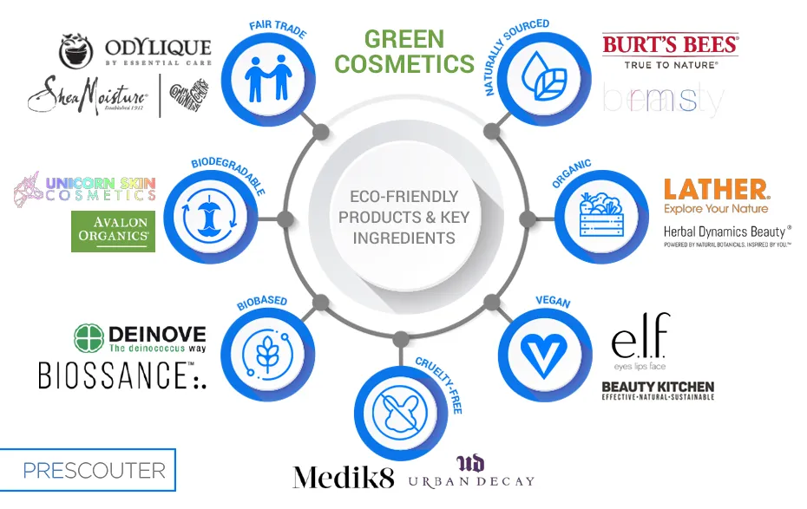

Slide 10
Ingredients used in synthetic cosmetics :
Harmful to human health
Parabens
Formaldehyde
Sulfates
Silicones
Mineral Oils and Dyes

Slide 11
As per the copyright by Kacey Culinary Nanoparticles made using natural polymers and ingredients from waste materials offer the cosmetics industry great promise in developing active beauty products for skin health that align with green economy goals, say researchers.
https://www.cosmeticsdesign-europe.com/Article/2021/09/30/Green-beauty-promise-with-sustainable-circular-nanoparticles-from-waste-material-for-skin-health?utm_source=copyright&utm_medium=OnSite&utm_campaign=copyright

Slide 12
Marketed formulations of Green beauty:
Mamaearth Anti-Hair fall Spa kit
Onion Shampoo
Onion Hair Oil
Onion Conditioner
Key Ingredients used are:
Onion Seed Oil
Plant keratin
Redensyl
Coconut
Almond

Slide 13
Other marketed formulations by different Herbal Companies:
Vasu Health Care
Mama earth
Nikir Health Care
Lotus Health Care

Slide 14
Conclusion :
With the changing needs and youth of the country moving towards the direction of organic products, youth is more concerned about the side effects of chemical cosmetics, Green beauty holds its true importance.
The need of hour is to save mother Earth from hazardous chemicals as well as human life and shift towards green beauty.

Slide 15
References :
Rajsekhar Saha International “Cosmeceuticals and herbal drugs: Practical uses”, Journal of Pharmaceutical Science Research , Vol 3 Issue 1
Green Cosmetics: The Push for Sustainable Beauty by Acme Hardesty.
The green beauty guide
Green Cosmetics: The Push for Sustainable Beauty by Kacey CULLINEY

Slide 16


