Slide 1
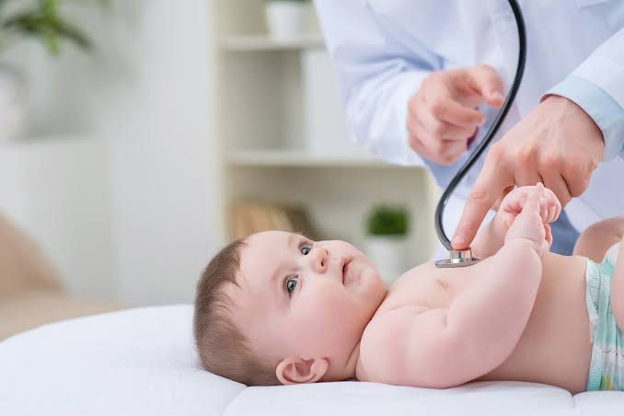
EMERGING PEDIATRIC
TECHNOLOGIES
By: Falakaara Saiyed
M.Pharm Pharmacology
Guided By: Dr. Sarika Johari

Slide 2
Introduction
Children require specialized, compassionate and comprehensive care that supports every stage of their lives.
The Food and Drug Administration (FDA) has recognized the need for medical devices for the pediatric population and is responding with initiatives that support the development of safe and effective pediatric medical devices.
Innovation will help health care providers improve their care of pediatric patients

Slide 3
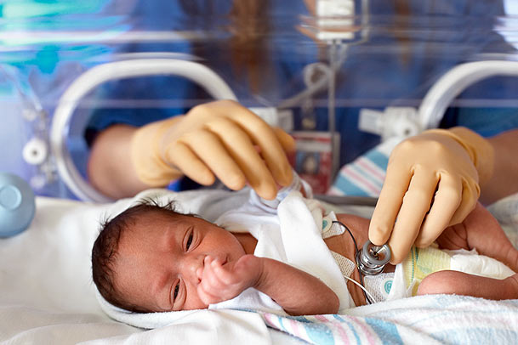
New innovative technology in the pediatric pipeline
Caring for the pediatric patient population — whether neonate, infant, child or adolescent — is complex.
The FDA has implemented initiatives to increase the availability of pediatric medical devices, including identifying barriers to the development of pediatric devices and incorporating known information about other populations to support labeling of existing devices for pediatric indications.
As a result, new products indicated for pediatric patients will continue to be released and physician and patient awareness of the availability of these products will increase, leading to greater penetration of pediatric devices and driving market growth.

Slide 4
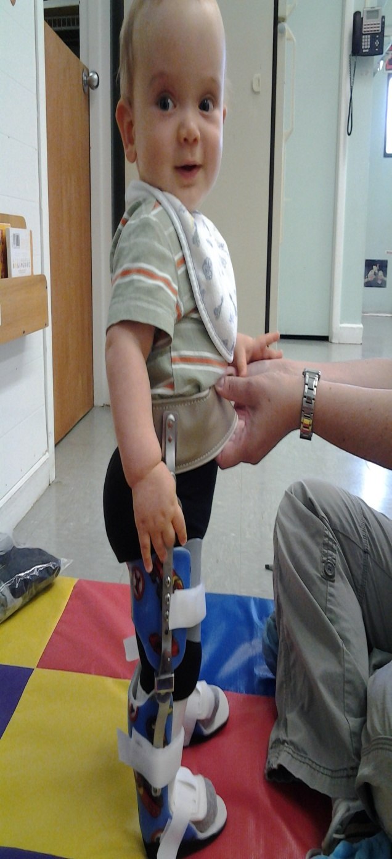
Flourish pediatric esophageal atresia device
MyoPro 2 orthosis
Currently Available Products
CGM G6
Pivo Needle-Free Blood Draw Technology
Owlet Smart Sock 2

Slide 5
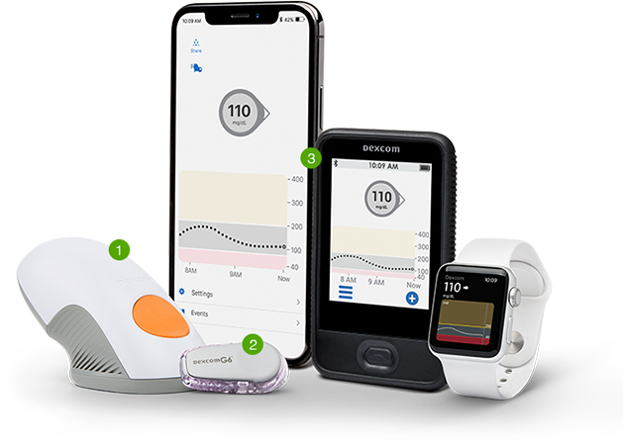
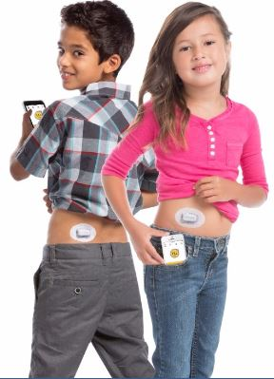
CGM G6
Continuous glucose monitor that provides real-time, dynamic glucose information every five minutes, up to 288 readings in a 24-hour period.
The device requires no fingersticks for calibration. The system consists of three parts: a small sensor that is worn on the body and is about 30 percent thinner than its predecessor; a low-profile transmitter that is incorporated into the 10-day sensor unit; and a receiver.
The monitor provides customizable alerts to warn the patient of approaching glucose highs and lows The monitor is indicated for use with patients with diabetes ages 2 and up.
The FDA cleared the device in March 2018

Slide 6
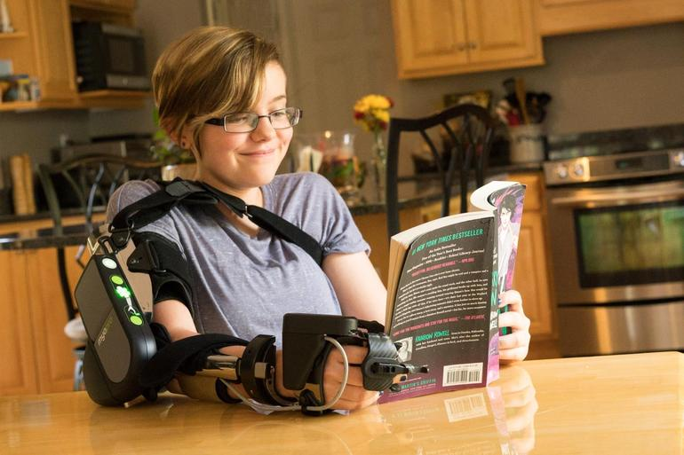
MyoPro 2 Orthosis
MyoPro 2 is a powered orthosis (brace) designed to restore function to arms and hands paralyzed or weakened by neurological or neuromuscular disease, injury or other condition
It works by reading the faint nerve signals (myoelectric signals) from the surface of the skin, then activating small motors to move the arm and hand as the user intends.
MyoPro 2 is the only product to help restore function for those who still have their arms and hands but are unable to use them.
MyoPro 2 was launched to the U.S. market in June 2017.

Slide 7
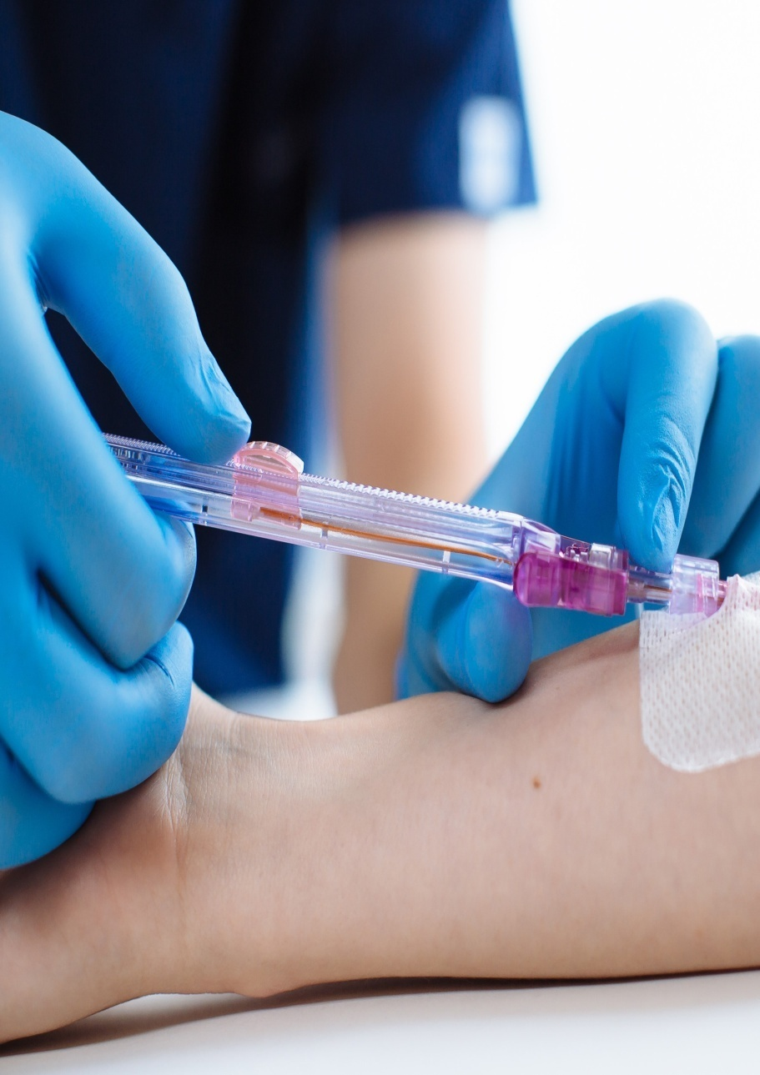
Pivo Needle-Free Blood Draw Technology
Pivo is a single-use disposable device designed to take blood samples from indwelling peripheral intravenous lines to reduce the number of needle sticks and the need for central line access for blood collection.
It is intended to help provide a more compassionate care experience for patients, a safer environment for caregivers and a more financially responsible alternative for health systems.
Cleared for use by the FDA in February 2017.

Slide 8
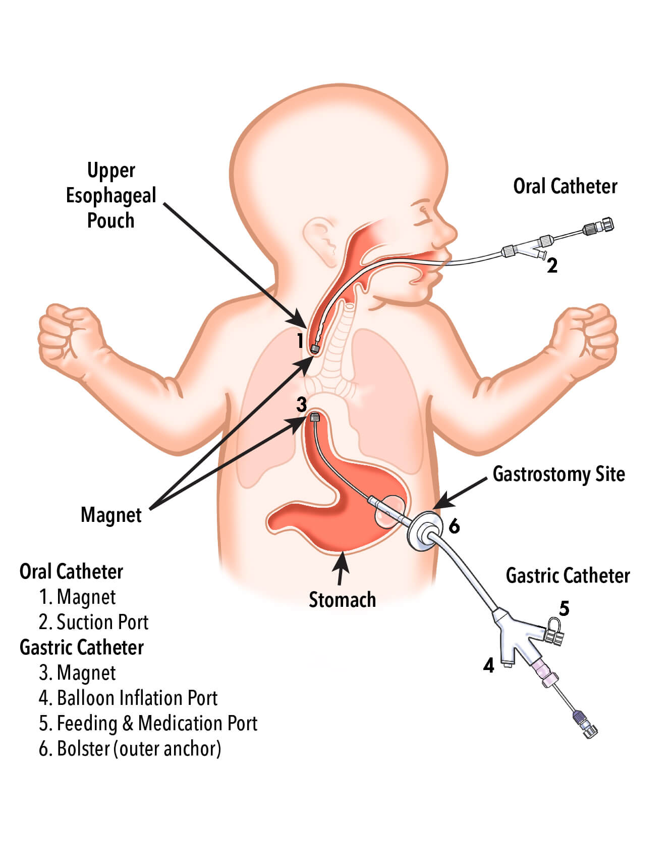
Flourish pediatric esophageal atresia device
The Flourish pediatric esophageal atresia device is used to nonsurgical repair the esophagus in infants who were born with their upper esophagus disconnected from their lower esophagus and stomach (esophageal atresia) and who are therefore unable to eat by mouth.
This device should be used only when the gap between the upper and lower portions of the esophagus is less than 4 centimeters.
The device is indicated for pediatric patients up to 1 year of age, with esophageal atresia without a tracheoesophageal fistula or with a fistula that was closed in a prior procedure.
Cleared for use by the FDA in May 2017.

Slide 9
Owlet Smart Sock 2
The Smart Sock 2 uses proven pulse oximetry technology to continuously track an infant's heart rate and oxygen levels.
The device, which is marketed for home use, incorporates a sensor into a small wrap that fits on an infant’s foot.
The information collected is accessible with a smartphone tablet. The device has a range up to 100 feet.
Cleared for use by the FDA on September 2017

Slide 10
Products in Clinical trials
Amplatzer duct occluder II AS
OtoNexus ultrasound device
Magnamosis magnetic compression anastomosis system
Dynamic spinal alignment brace

Slide 11
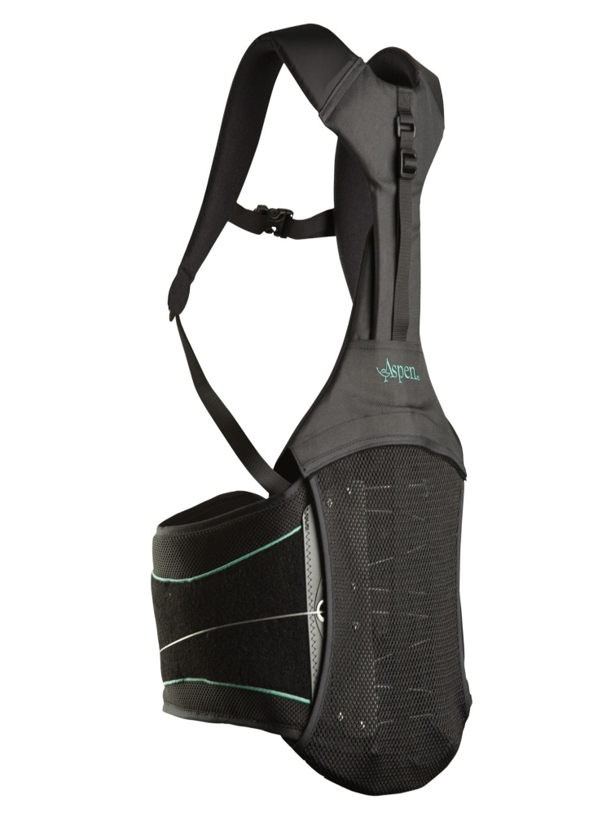
Dynamic spinal alignment brace
Applies continuous corrective pressure to the spine and allows physicians to monitor the performance of the brace remotely.
The dynamic bracing system is designed to treat adolescent idiopathic scoliosis patients.
The brace is Bluetooth enabled, providing real data on how and when it is being worn and how effective the therapy is. The pressure sensors and Bluetooth-enabled device allow doctors to adjust the pressure on the brace as needed to correct the deformities.
Still it has not been cleared by the FDA for use in the U.S.

Slide 12
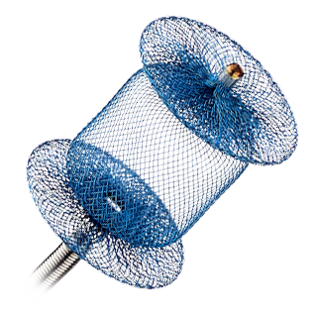
Amplatzer duct occluder II AS
The Amplatzer Duct Occluder II AS is the expansion of the occluder family designed for closure of the small patent ductus arteriosus (PDA). The ADO II AS device conforms to the smallest ducts while achieving complete closure from a pulmonary or aortic artery approach.
The device provides a nonsurgical treatment option for closing the PDA defect in newborns and preterm infants.
The wire mesh device is placed nonsurgically through a catheter inserted through the leg and guided through vessels to the heart, where it is placed to seal the duct
The ADO II AS device is currently approved for use in more than 50 countries outside the United States
It has not been cleared by the FDA for use in the U.S.

Slide 13
OtoNexus ultrasound device
A new otitis media evaluation device uses air-coupled ultrasound technology to provide the data needed to instantly and accurately assess middle ear infections, and in particular to determine when to prescribe antibiotics.
The device identifies not only the presence but also the type of infection. designed to provide, for the first time, definitive, objective diagnostic data, leading to increased accuracy, expedited diagnoses, earlier and better treatment, better patient outcomes, reduced antibiotic use and significantly reduced health care costs.
The device has still not received clearance for use in the U.S. from the FDA.

Slide 14
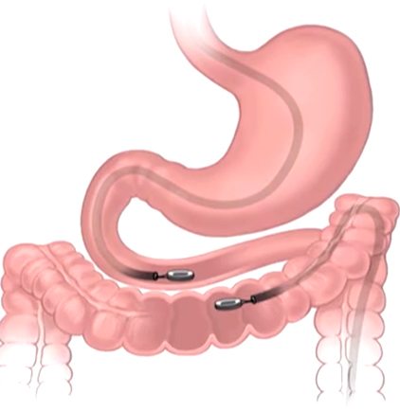
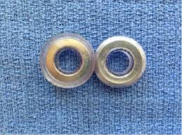
Magnamosis magnetic compression anastomosis system
Magnamosis is a device consisting of two magnets designed to connect pieces of intestine between the attractive force of the magnets – without the use of staples or sutures.
The device is supplied single- use and sterile. It is comprised of a matched pair of self- centering rare earth magnets encased in medical-grade polycarbonate.
For babies and children with congenital gastrointestinal anomalies like esophageal atresia, duodenal atresia and short bowel syndrome, the possibility of making anastomoses minimally invasive without sutures or staples offers many advantages.
The device is still not available for sale.

Slide 15
Products in Development
EOPatch
Synthetic Muscle
StethAid digital stethoscope
Perf-Fix tympanoplasty gel patch
Tabla pneumonia detector

Slide 16
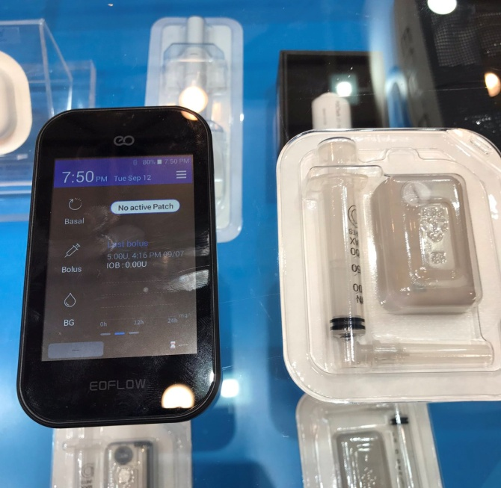
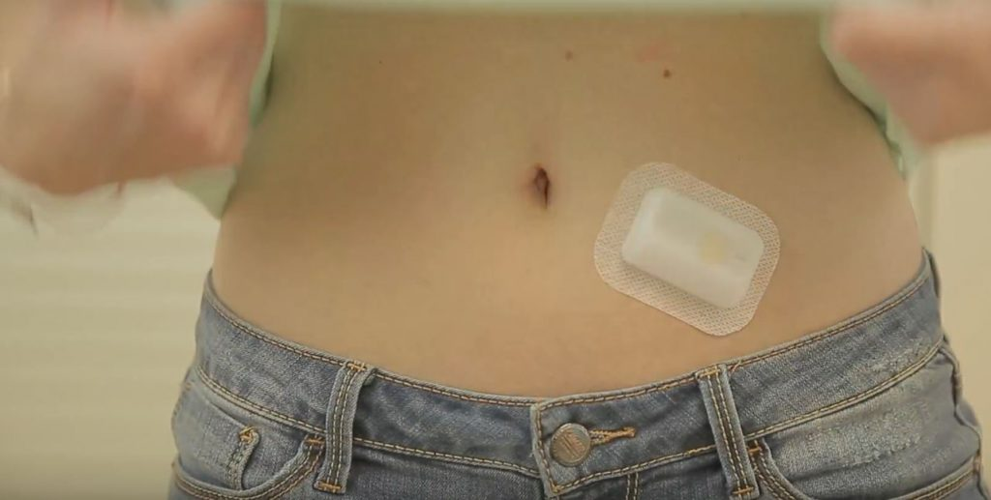
EO Patch
The EO Patch is a three-day wearable, adhesive, waterproof insulin pump.
The device incorporates a proprietary electro osmotic pumping technology that allows it to be smaller and lighter than other insulin pumps.
The smaller device size can be held by younger diabetes patients.
A recent round of funding will be used to conduct a clinical trial for regulatory approval.
It is available outside the U.S. but has not received FDA clearance.

Slide 17
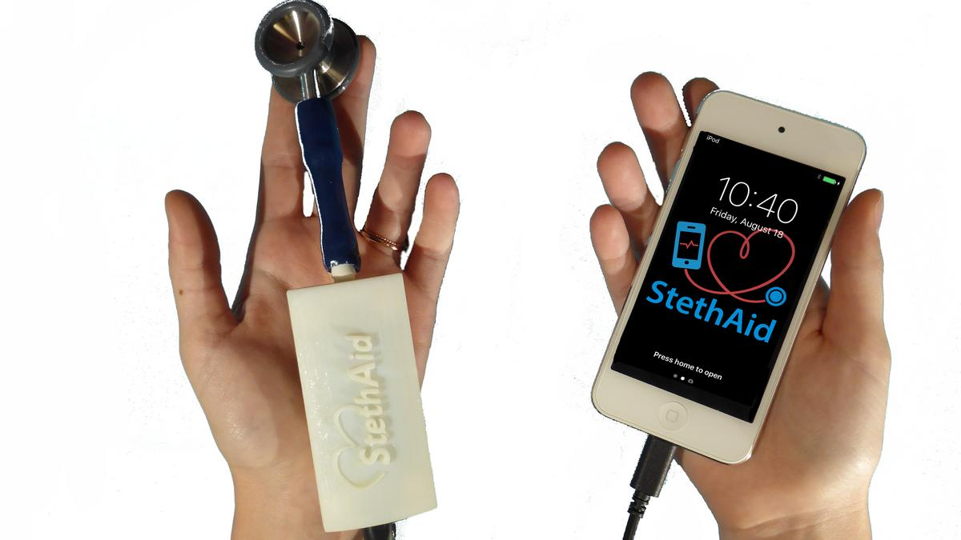
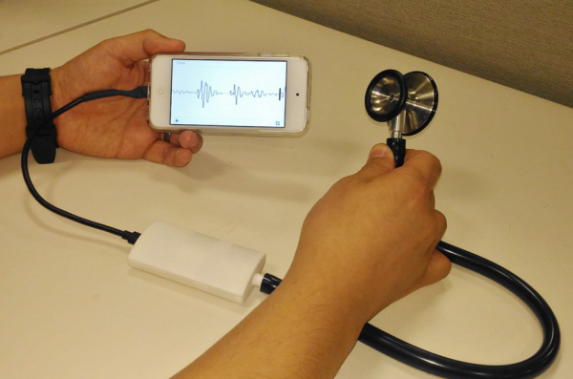
StethAid digital stethoscope
StethAid is a mobile device-based digital stethoscope that aids in the diagnosis of pediatric heart murmurs. A small box attaches to a stethoscope and wirelessly communicates with a smartphone.
An app records and analyzes the sounds in a patient’s chest and determines whether the murmur is benign or abnormal.
The algorithm will intimately focus on Still’s murmur and allow pediatricians to identify the murmur in the office setting without needing expert consultation.
The device may reduce referrals to cardiologists, reduce the financial and emotional cost of testing and provide reassurance to both families and medical personnel.
The device is under development and is not available for sale.

Slide 18
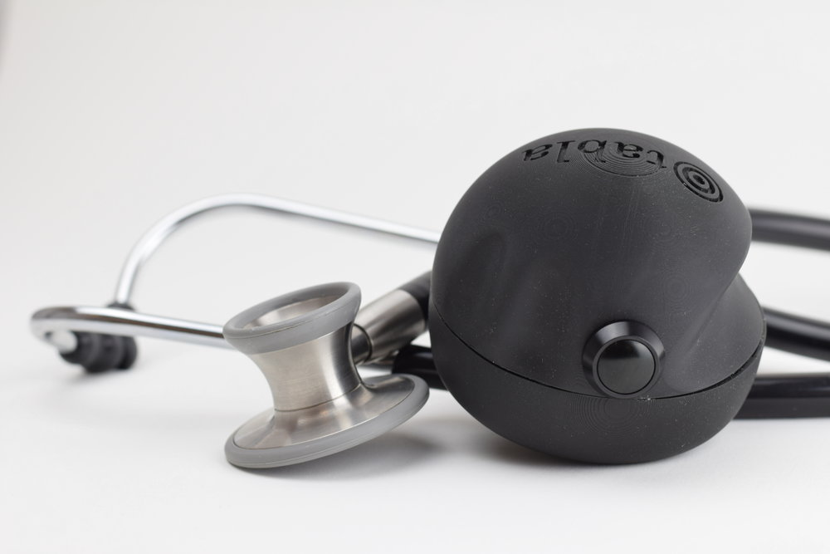
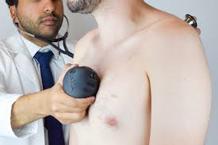
Tabla pneumonia detector
The low-cost Tabla device detects changes in sound waves during percussive physical examinations, providing a more accessible and affordable alternative to chest X-rays.
Based on the "percussion technique" of tapping on a patient's chest and listening with a stethoscope, the device makes a “swooping” sound while a doctor holds it against the front of a patient's body and records the sound with a digital stethoscope placed on the patient's back.
The design team is using machine learning to build intelligence into its smartphone app to guide the exact change in the sound depending on age, gender, height, weight and other factors.

Slide 19
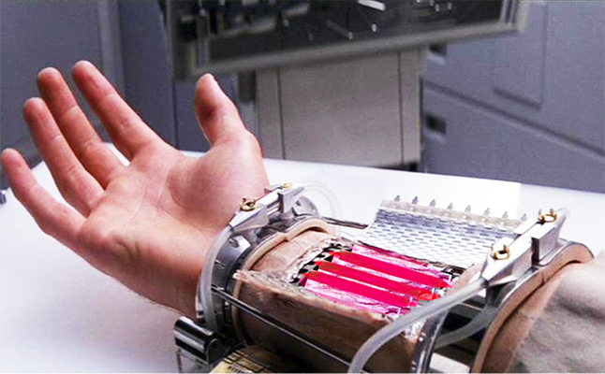
Synthetic Muscle
Ras Labs is a developer of contractile electroactive polymer called Synthetic Muscle. The polymer, an adjustable biomimetic socket liner for prosthetic limbs, is designed.
To improve the interface between a child’s prosthetic limb and the residual limb. Without using gears or motors, the polymer contracts or expands like a muscle in response to low-voltage electricity.
Objective is to show that using the biomimetic polymer to line the socket of a pediatric-sized artificial leg or other limb would provide a more snug fit during normal daily use and consequently improve a child’s quality of life
The device is not yet available for use anywhere.

Slide 20
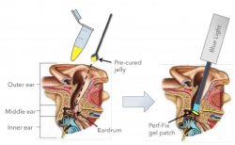
Perf-Fix tympanoplasty gel patch
Perf-Fix is a gel patch for nonsurgical eardrum repair. It can be applied in a minimally invasive procedure in an office setting within 10 minutes, without general anesthesia or margin freshening.
The gel patch is currently in development in preparation for an upcoming clinical trial scheduled to begin in late 2018.
The device is not available for sale in the U S

Slide 21
REFERENCES
“Emerging Pediatric technologies”, Pediatric Technology Watch, Vizient, Vol.1.,2018.
“Emerging Pediatric technologies”, Pediatric Technology Watch, Vizient, Vol.1.,2018.
Leveraging existing clinical data for extrapolation to pediatric uses of medical devices; guidance for industry and Food and Drug Administration staff., 2016
Pediatric medical devices, Food and Drug Administration website.
Smith WM, Riddell F, Madon M, Gleva MJ. “Comparison of diagnostic value using a small, single channel, P-wave centric sternal ECG monitoring patch with a standard 3-lead Holter system over 24 hours”, Am Heart J., 2017;185:67-73.

