Slide 1
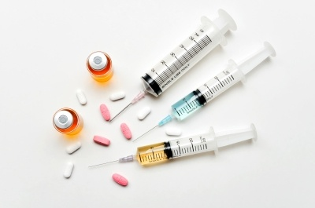

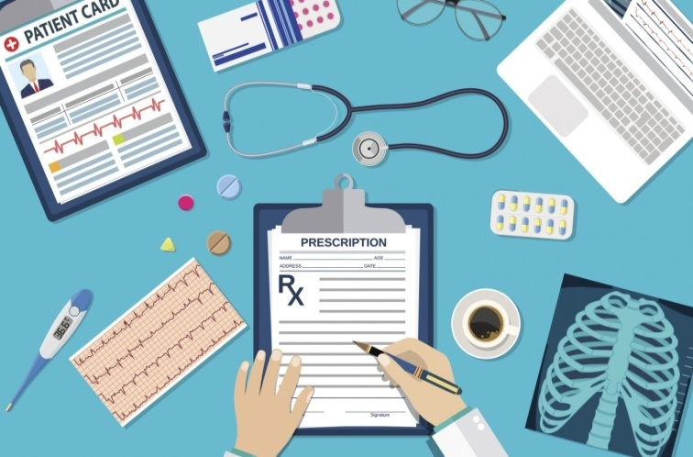

ROLE OF PHARMACIST IN INTENSIVE CARE UNIT
By:
FalakAara Saiyed
M.Pharm (Pharmacology)
Guided By:
Dr. Sarika Johari

Slide 2

Introduction
Medication management plays a crucial part in managing a critically ill patient.
When it comes to drug therapy, intensivist have plenty of decision making every day including drug selection, dosing, administration, and monitoring strategies to optimize effective pharmacotherapy.
Even though the patient receives appropriate drug, a suboptimal dose or overdosing may result in either therapeutic failure or drug toxicity.

Slide 3
Cont...
The concept of having a clinical pharmacist in an intensivist-led multidisciplinary team evolved in the early 1980s in USA.
In Today’s World Intensive Care Unit (ICU), the skills of a Critical care pharmacist addresses adverse drug events caused due to drug-related problems and medication errors. It improves the appropriateness, quality of prescribing and increases patient safety.

Slide 4


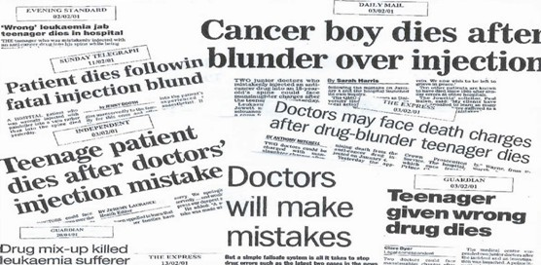
Why ADDITION OF PHARMACIST ?

Slide 5

Aims & Objective
This aims to evaluate the clinical pharmacist interventions with a focus on optimizing the quality of pharmacotherapy and patient safety.
Even though the contribution of critical care pharmacist to improve the quality of patient care is accepted worldwide, many ICUs have not recognized this important reserve.
This presentation is used to educate other healthcare professionals and administrators on impact of clinical pharmacist in the care of critically ill patients.

Slide 6
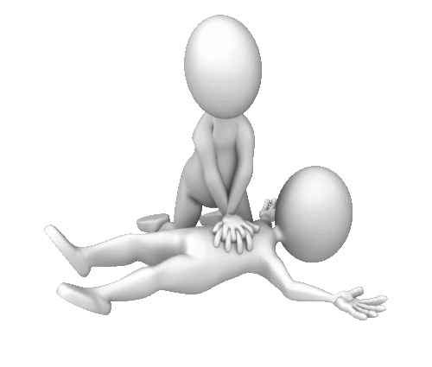

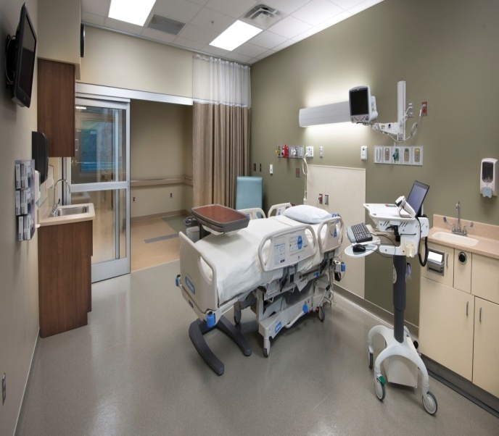
ICU (Intensive Care Unit)
ICUs are fairly large sterile areas with a high concentration of specialised, technical and monitoring equipment needed to care for critically ill patients.
The Intensive Care Unit (ICU) is a unit in the hospital where seriously ill patients are cared by specially trained staff.

Slide 7
Conditions for which Patients are Admitted to the ICU?
Patients are admitted to the ICU for a variety of reasons.
HEMORRHAGE
SEVERE MALARIA
TRAUMATIC BRAIN INJURY
ACUTE LIVER FAILURE
HYPERTENSIVE CRISIS
OPIOID POISONING
PULMONARY EMBOLISM
HEART FAILURE

Slide 8


THE TEAM
Consulting Physician
ICU Physician
Clinical Pharmacist
ICU Nurse
Nursing Aid
ICU Housekeeping

Slide 9

Clinical Pharmacist
Clinical pharmacists work directly with physicians, other health professionals, and patients to ensure that the medications prescribed for patients contribute to the best possible health outcomes.
Clinical pharmacists practice in health care settings where they have frequent and regular interactions with physicians and other health professionals, contributing to better coordination of care.

Slide 10
ROLE OF CLINICAL PHARMACIST IN ICU
1.
Participates in ward rounds as a member of the multidisciplinary critical care team to provide pharmacotherapeutic management for all ICU patients.
2.
Take medication history of the patient and medication reconciliation reviews to determine which maintenance drugs should be continued during the acute illness.
3.
Monitors the patient’s pharmacotherapeutic regimen for effectiveness and adverse drug reactions (ADR) and intervenes as needed

Slide 11
4.
Provides drug information and intravenous compatibility information to the ICU team
5.
Provides drug therapy related education to ICU team members
6.
Implements and maintains departmental policies and procedures related to safe and effective use of drugs in the ICU

Slide 12
7.
Uses the medical record as one means to communicate with other health care professionals and to document specific pharmacotherapeutic recommendations
8.
Evaluates all orders for parenteral nutrition and recommends modifications as indicated to optimize the nutritional regimen
9.
Identifies ADR and assists in their management and prevention and develops process improvements to reduce drug errors

Slide 13
10.
Documents clinical activities that include general pharmacotherapeutic monitoring, pharmacokinetic monitoring, ADEs, education & other patient care activities
11.
Provides consultation to hospital committees such as Pharmacy and Therapeutics, when critical care pharmacotherapy issues are discussed
12.
Coordinates the development and implementation of drug therapy protocols or critical care pathways to maximize benefits of drug therapy

Slide 14
Pharmaceutical Care Process
Assess the patient
Identify the problems and opportunities
Develop care plan
Implement Plan
Evaluate for Efficacy and Safety

Slide 15
Method
The observational study was carried out in the medical, surgical ICU at a tertiary care hospital.
The ICUs in the study were under the supervision of a clinical pharmacist exclusively for the critical care areas. The study was carried over a period of 1 year .
All detected drug-related problems (DRPs) and interventions were categorized based on the Pharmaceutical Care system.

Slide 16
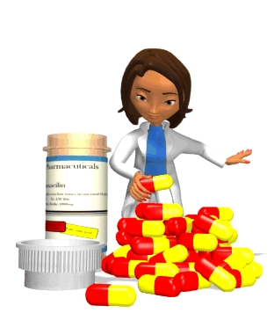
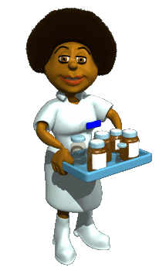
Clinical pharmacist adjusts dose of drugs in pediatric, geriatric, renal, and hepatic failure patients.
Pharmacist also involved in optimizing antibiotic usage based on patient characteristics, site of infection, pharmacokinetics, dose adjustment, and de-escalation.
Clinical pharmacist also contributes in continuing education activities through teaching programs for doctors and nurses.
This increases direct patient care practice abilities, creates awareness among intensive care team, and prevents medication errors.

Slide 17


Data collection was done by the Clinical pharmacist on a daily basis and discussed with the ICU chief at the monthly meeting.
Data analysis and results were presented as percentage and numerically coded for the ease of descriptive statistics using SPSS software

Slide 18

Results
During the study period, average monthly census of 1032 patients got treated in all three ICUs. A total of 986 pharmaceutical interventions due to drug-related problems were documented.
In results, the ADRs identified were mainly due to antibiotics which included hypersensitivity reactions, thrombocytopenia, and interstitial nephritis while the other drugs were responsible for electrolyte imbalance, hyperthermia, and nephrotoxicity.

Slide 19
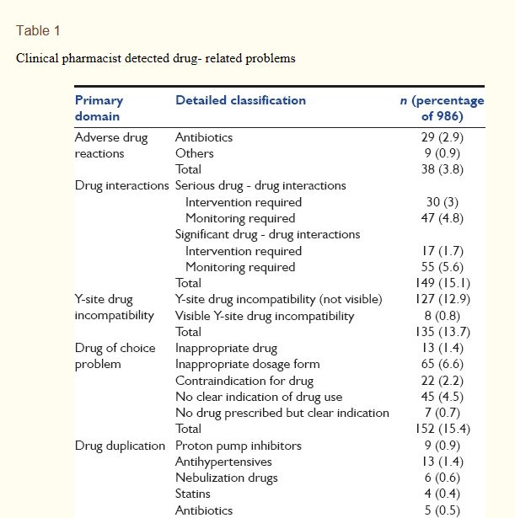
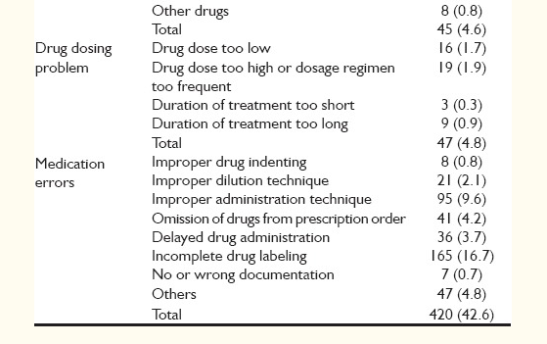
Clinical pharmacist detected drug- related problems

Slide 20
In clinical pharmacist interventions, drug-related problems were categorized.
A total of 1182 interventions were made by the clinical pharmacist for drug-related problems.
Most of the interventions took place at the drug level which was propositions for modification in therapy.
Interventions at the prescriber level comprised prescriber seeking clarification or drug information which was 10.4%.

Slide 21
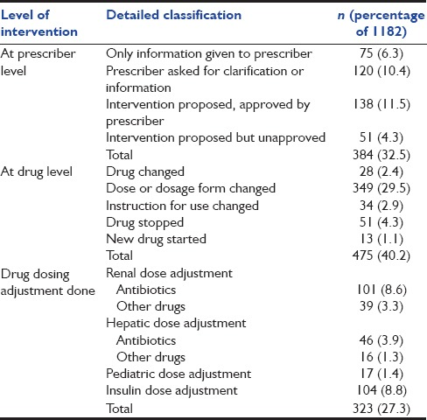
Clinical pharmacist interventions for drug-related problems

Slide 22
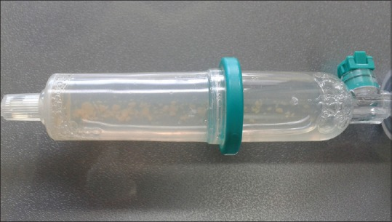
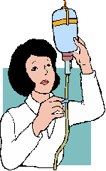
Visible drug incompatibility reported in Intensive Care Unit between cefexime and vancomycin

Slide 23

DISCUSSION
Medication errors include most commonly transcribing and administration errors which occur at the level of nurses.
Indeed, prescribing errors and errors in drug application which occur at the level of the prescriber is often neglected. It is important to have a clinical pharmacist to review the treatment charts to rectify these issues.
The importance of clinical pharmacist intervention and active participation in intensive patient care rounds have significantly better patient outcome through quality patient care.
The participation of clinical pharmacist in medical rounds improved ADR reporting and reduced the rate of preventable ADEs.

Slide 24
Desirable activities of ICU pharmacist
Includes formulating guidelines for the critically ill patients, active participation in research, and educating the ICU team.
Guidelines which have been developed and implemented by the clinical pharmacist in our ICU includes protocols for pain, sedation, delirium, stress, drug compatibility chart , drug administration, dilution guidelines, and toxicological management protocols.
Once the protocols are formulated, all the members of the ICU team are educated on how to use the protocol.
Most of these clinical pharmacist enforced protocols are nurse oriented, and hence, it becomes easy for optimizing patient care.
The effectiveness of these guidelines is under the supervision of a critical care pharmacist, and it is well studied in Western countries.

Slide 25

conclusion
Clinical pharmacist as a part of multidisciplinary team in an ICU is associated with a substantially lower rate of adverse drug event caused by medication errors, drug interactions, and drug incompatibilities.
Clinical pharmacists are essential to improve patient safety and outcome, reduce costs, and provide quality of care in critically ill patients.

Slide 26
References
Kane-Gill SL, Jacobi J, Rothschild JM. Adverse drug events in intensive care units: Risk factors, impact, and the role of team care. Crit Care Med. 2010
Smythe MA, Shah PP, Spiteri TL, Lucarotti RL, Begle RL. Pharmaceutical care in medical progressive care patients. Ann Pharmacother. 1998.
Kim MM, Barnato AE, Angus DC, Fleisher LA, Kahn JM. The effect of multidisciplinary care teams on intensive care unit mortality. Arch Intern Med.
Erstad BL, Haas CE, O'Keeffe T, Hokula CA, Parrinello K, Theodorou AA. Interdisciplinary patient care in the intensive care unit: Focus on the pharmacist. Pharmacotherapy.
Natasha TG, Carvalho CS, Correia LC, Tenorio DS, Cristina TM, Dias AO, et al. Pharmaceutical intervention assessment in the identification and management of drug interactions in an intensive care unit. J Appl Pharm Sci.

Slide 27


