Slide 1
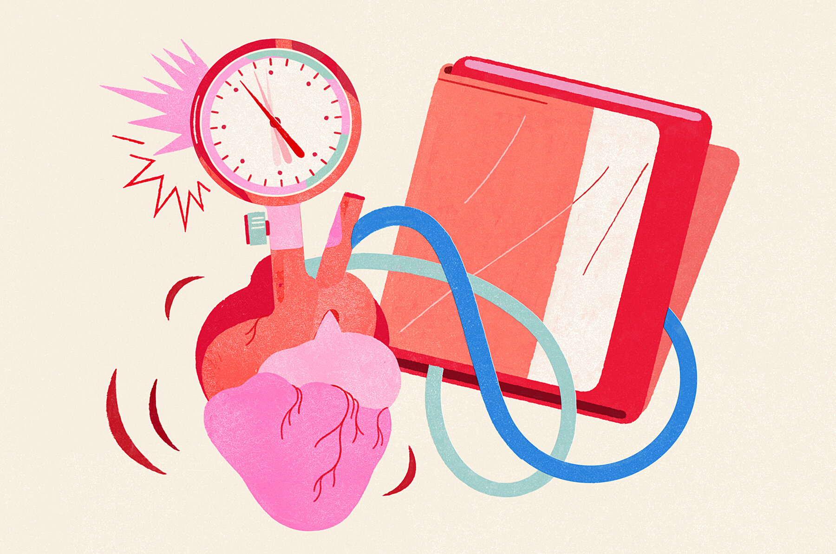
BLOOD PRESSURE
BY: SAIYED FALAKAARA
ASSISTANT PROFESSOR
DEPARTMENT OF PHARMACY
SUMANDEEP VIDYAPEETH

Slide 2
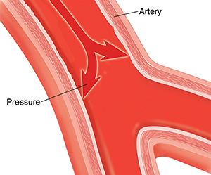
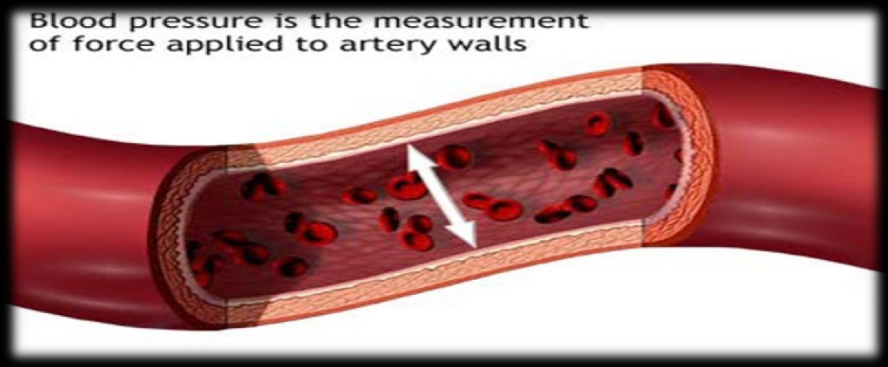
Definition
Arterial blood pressure can be defined as the lateral pressure exerted by moving the column of blood on the walls of the arteries.

Slide 3
Significance
To ensure the blood flow to various organs
Plays an important role in exchange of nutrients and gases across the capillaries
Required to form urine
Required for the formation of lymph

Slide 4
Normal values
Normal adult range can fluctuate within a wide range and still be normal
Systolic/diastolic
100/60 – 140/80
Unit - mmHg

Slide 5
Systolic blood pressure (SBP)
Defined as the maximum blood pressure in the arteries attainable during systole.
Normal 120 ± 20 mmHg
This is mainly contributed by:
Force of heart beat
Normal blood volume
Cardiac output

Slide 6
Diastolic blood pressure (DBP)
Defined as the minimum pressure that is obtained at the end of the ventricular diastole
Normal range is 60-90 mmHg
It represents a constant load on the arterial walls with little or no fluctuations at all
It is an index to the peripheral resistance and decides the filling of the coronary system

Slide 7
Pulse pressure (PP)
Denotes the difference between systolic and diastolic blood pressure
PP = SBP – DBP
120-80 = 40 mmHg

Slide 8
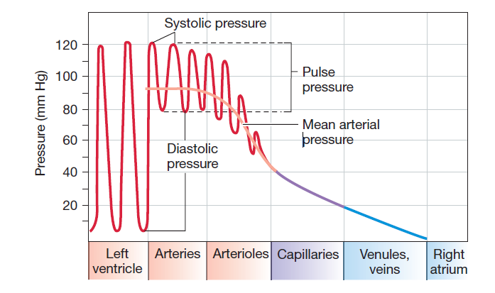
Mean Arterial Pressure (MAP)
Mean arterial pressure = DBP + 1/3rd pulse pressure
Normal range = 95 mmHg
Not the arithmetical mean but geometric mean
It is because the period of the systole is only 0.3 sec when compared to 0.5 sec of the diastole

Slide 9
PHYSIOLOGICAL FACTORS AFFECTING ARTERIAL BLOOD PRESSURE
Sex : male > female (equals at menopause)
Age : ( ) old age; atherosclerosis
Emotions : blood pressure ( ) due to neural and hormonal effects
Exercise : ( ) blood pressure elevates due to increase in venous return
Hormones : Some hormones like adrenaline, nor adrenaline and thyroid ( ) BP
Gravity : BP is higher in lower limbs than upper limbs
Stress : ( ) BP
Sleep : BP ( ) due to decrease in venous return
Pregnancy : BP ( ) due to increase in metabolism
Temperature : BP ( ) with heat due to vasodilation
BP ( ) with cold due to vasoconstriction
Obesity : BP ( )

Slide 10

Maintaining Blood Pressure within normal limits
A blood pressure between 140/80 mmHg to 159/99 mmHg is classified to as stage 1 hypertension.
Stage 2 hypertension is a pressure between 160/100 mmHg to 179/109 mmHg.
Hypertensive urgency describes a blood pressure greater than 180/110 mmHg.
Hypertensive emergency refers to a very high blood pressure that results in potentially life-threatening symptoms and end-organ damage.
Hypotension, on the other hand, is a blood pressure less than 90/60 mmHg.
It is crucial for the body to be able to adjust to acute changes in blood pressure and for the patient to receive medical treatment or lifestyle adjustments for chronic variations

Slide 11
Mechanism of maintaining normal Blood Pressure
The various mechanisms exist within the body to regulate the systemic arterial B.P These mechanisms are well inter connected and their main aim is to maintain the normal MBP within a narrow range, between 95 to 100 mm Hg. The different mechanisms available are,
1. Baroreceptor reflex
2. Chemoreceptor reflex
3. CNS Ischaemic Response
4. Antidiuretic Hormone
5. Intermediate acting arterial blood pressure regulatory Mechanism
6. Miscellaneous Mechanism

Slide 12
Baroreceptor Reflex
In response to acute changes in blood pressure, the body responds through the baroreceptors located within blood vessels. Baroreceptors are a form of mechanoreceptor that become activated by the stretching of the vessel. This sensory information is conveyed to the central nervous system and used to influence peripheral vascular resistance and cardiac output.
When the arterial pressure rises it stimulates the baroreceptors, located mainly in the carotid sinuses and in the arch of the aorta; these in turn send signals to the vasomotor center in the lower regions of the brain. From here signals pass through the autonomic nervous system to relax the heart and to dilate the peripheral blood vessels, which decrease the arterial pressure back toward normal.
There are two forms of baroreceptors.
High-Pressure Baroreceptors: Two baroreceptors are located within the high-pressure arterial system:
  The carotid baroreceptor responds to both increases and decreases in blood pressure and sends afferent signals via the glossopharyngeal nerve
  The aortic arch baroreceptor responds only to increases in blood pressure, sending its signals through the vagus nerve.
Low-Pressure Baroreceptors
Fall in arterial BP decreases inhibitory discharge from baroreceptors to cause
i. Less inhibition of vasomotor center.
ii. Less stimulation of cardiac vagal center.
→ This results in increased sympathetic and decreased parasympathetic discharge to restore blood pressure back to normal and vice versa in case of high arterial BP.
It operates between 60-200 mm Hg ranges of MBP.
It corrects 2/3rd fall in BP.

Slide 13
Chemoreceptor reflex
When the arterial pressure fails below about 80 mm Hg, the chemoreceptors located in the carotid and aortic bodies become stimulated because of poor delivery of oxygen to the chemoreceptors and because of poor removal of carbon dioxide. Signals from these are also transmitted through the vasomotor center and autonomic nervous system, in this case raising the arterial pressure toward normal
It operates between 40-100 mm Hg ranges of MBP.
It can correct approx 2/3rd of the further fall in BP.
Especially when BP <80 mm Hg, Decrease blood flow to tissues, as a result PO2 decreases& PCo2increases to carotid & aortic bodies & causes stimulation of VMC, CVC and respiratory centre & The final effect is increase in BP.

Slide 14
CNS Ischaemic Response
It operates between 15-50 mm Hg range of MBP.
It can correct 11/12th of a further fall in BP.
Especially when BP <50mm Hg, As a result CNS ischemia which lead to CO2 accumulation in VMC, which directly stimulate VMC → tremendous powerful sympathetic discharge throughout the body and final effect is increase in BP.
When the arterial pressure falls extremely low (usually below 40 mm Hg) ischemia of the vasomotor center in the medulla oblongata causes powerful signals to spread throughout the sympathetic nervous system. These constrict the peripheral vessels and enhance heart activity, thereby elevating arterial pressure back toward normal

Slide 15
Antidiuretic Hormone
Antidiuretic hormone (ADH) is a hormone synthesized in the hypothalamus. ADH is synthesized and released in response to multiple triggers which are:
High serum osmolarity, which acts on osmoreceptors in the hypothalamus
Low blood volume causes a decreased stretch in the low-pressure baroreceptors, leading to the production of ADH
Decreased blood pressure causes decreased stretch in the high-pressure baroreceptors, also leading to the production of ADH
Angiotensin II
ADH mainly functions to increase free water reabsorption in the collecting duct of the nephrons within the kidney, causing an increase in plasma volume and arterial pressure. ADH in high concentrations also causes moderate vasoconstriction, increasing peripheral resistance, and arterial pressure.

Slide 16
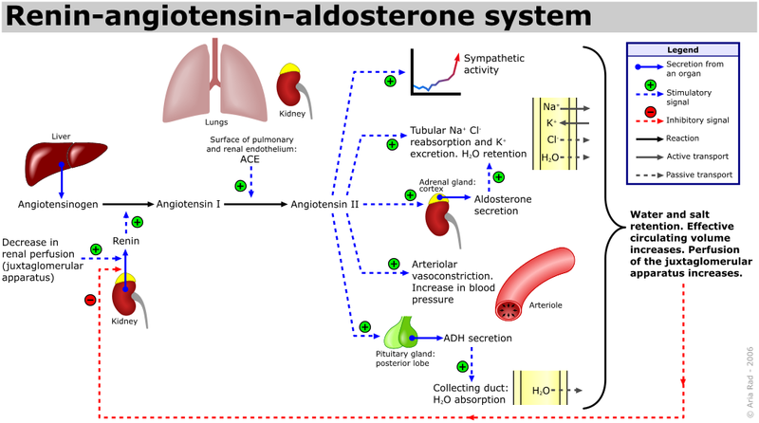
Renin-angiotensin-aldosterone system (RAAS)
The renin-angiotensin-aldosterone system (RAAS) is a critical regulator of blood volume and systemic vascular resistance.
While the baroreceptor reflex responds in a short-term manner to decreased arterial pressure, the RAAS is responsible for more chronic alterations.
It does this by increasing sodium reabsorption, water reabsorption, and vascular tone.
It is composed of three major compounds: renin, angiotensin II, and aldosterone.
These three act to elevate arterial pressure in response to decreased renal blood pressure, decreased salt delivery to the distal convoluted tubule, and/or beta-agonism.
Through these mechanisms, the body can elevate the blood pressure in a prolonged manner.
When the arterial pressure falls below 100 mm Hg the kidneys begin to form increased quantities of renin, and this in turn acts as an enzyme to split the vasoconstrictor substance angiotensin from renin substrate, one of the plasma proteins. Vasoconstriction caused by the angiotensin in turn elevates the arterial pressure back toward normal
Though the RAAS serves a critical function, it can be activated inappropriately in several conditions that may then lead to the development of hypertension. For example, renal artery stenosis results in a decreased volume of blood reaching one (or both) kidneys resulting in the juxtaglomerular cells sensing a decrease in blood volume, activating the RAAS. This can lead to an inappropriate elevation of circulating blood volume and arteriolar tone due to poor renal perfusion.

Slide 17
Intermediate acting arterial blood pressure regulatory Mechanism or intrinsic physical regulatory mechanism
They begin to act within a few minutes and reaches full function within a few hours. These mechanisms remain functional from few days to a month only.
They primarily correct any alteration in BP by altering the blood volume.
The mechanism includes.
1. Capillary fluid shift mechanism and.
2. Stress relaxation and reserve stress relaxation mechanism.

Slide 18
→ Capillary fluid shift mechanism
Since mean capillary pressure is directly proportional to arterial BP, therefore rise in arterial BP, increases hydrostatic pressure at arterial end and fluid shift out of capillaries to the interstitial fluid compartments. Thus blood volume decrease to restore BP.
Often when the arterial pressure is elevated, e.g., after a massive transfusion, the capillary pressure is also elevated. This results in rapid transudation of fluid out of the circulation into the tissue spaces; the resulting decrease in blood volume initiates a sequence of events that returns the arterial pressure back toward normal.
→ Stress relaxation and reverse stress relaxation mechanisms
Rise in arterial BP e.g. following massive slow intravenous transfusion increases perfusion pressure in blood storage organs such as veins, liver, spleen, lungs etc. This causea relaxation of blood vessels is simply by local vascular tone adjustment.
Therefore venous return & cardiac output decrease and BP returns to normal & vice versa in case of fall in arterial BP.
When the arterial pressure rises too high, or indeed when the pressure increases in any part of the circulation, the blood vessels slowly begin to stretch. a phenomenon called stress relaxation. This allows the pressure in each overly stressed segment of the circulation lo fall, thus returning the pressure toward normal.

Slide 19
Miscellaneous Mechanism
→ Role of sympathetic nerves
The kidneys are strongly supplied by sympathetic nerves & degree of sympathetic stimulation can alter renal functions tremendously.
Example: When sympathetic nerves to kidneys are stimulated for several weeks continuously, renal retention of fluid occurs to cause chronically elevated BP, as long as the sympathetic stimulation continues.
→ The Renal-Body Fluid Mechanism.
When arterial pressure falls below normal, the decreased pressure has a direct effect on the kidneys to reduce the output of water and salt. This in turn causes a progressive increase of both water and salt in the body fluids as the person continues to eat salt and to drink water. The increase in body fluid volume in turn returns the arterial pressure toward normal

Slide 20
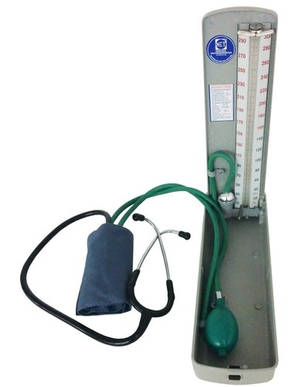
Recording of Blood pressure
Direct method :
Arterial catheter
2. Indirect method :
Stethoscope and blood pressure cuff

Slide 21
Sphygmomanometer:
→ Types:
Mercury sphygmomanometer
Aneroid equipment
Automatic equipment
→ Blood Pressure Cuff Size:
Small –children & small adults
Average
Large –overweight & large adults

Slide 22
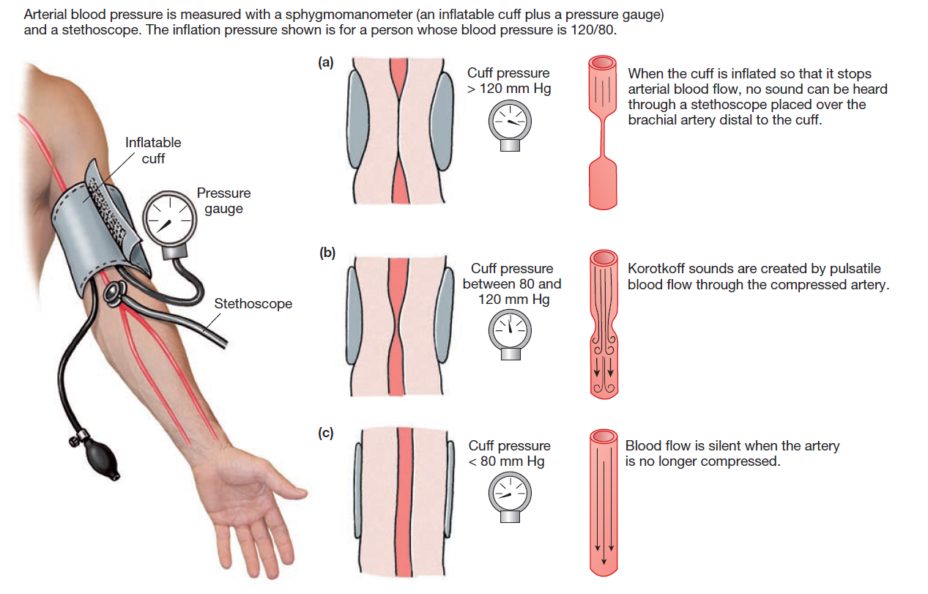
WORKING

Slide 23
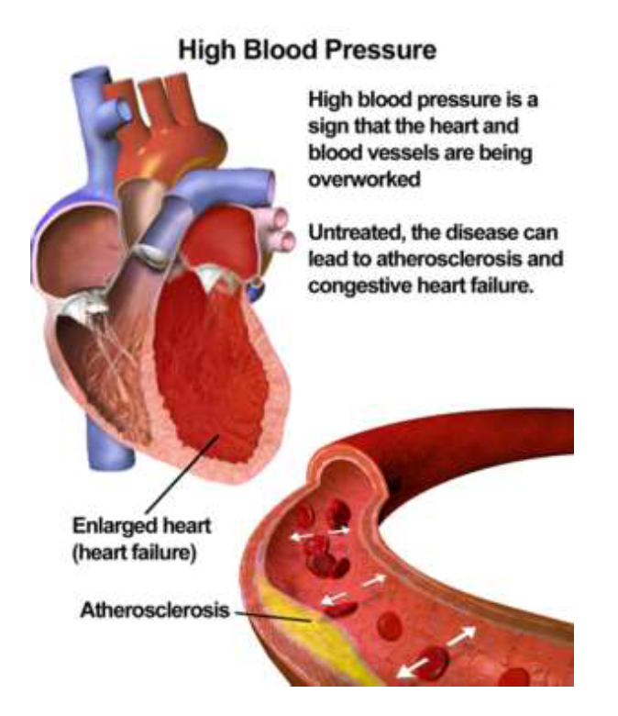
Hypertension
Hypertension ranks among the most common chronic medical conditions, characterized by a persistent elevation in the arterial pressure.
Raised blood pressure is a major risk factor for chronic heart disease, stroke, and coronary heart disease. Elevated BP is positively correlated to the risk of stroke and coronary heart disease.
Other complications include heart failure, peripheral vascular disease, renal impairment, retinal hemorrhage, and visual impairment.
Most cases of hypertension are idiopathic which is also known as essential hypertension.

Slide 24
An increase in salt intake increases the risk of developing hypertension.
A factor for the development of essential hypertension is the patient genetic ability to salt response. About 50 to 60% of the patients are salt sensitive and therefore tend to develop hypertension.
More than one billion adults worldwide have hypertension with up to 45% of the adult populace being affected with the disease. The high prevalence of hypertension is consistent across all socio-economic and income strata, and the prevalence rises with age accounting for up to 60% of the population above 60 years of age.
How to control high blood pressure
Following a healthy diet; reducing salt and fat intake and eating
plenty of fruit and vegetables
Regular physical activity
Maintaining a healthy weight
Limiting your alcohol intake
Stopping smoking
Taking BP medications if prescribed

Slide 25
Hypotension
Hypotension is a decrease in systemic blood pressure below accepted low values.
While there is not an accepted standard hypotensive value, pressures less than 90/60 are recognized as hypotensive.
Hypotension is a relatively benign condition that is under –recognized mainly because it is typically asymptomatic.
It only becomes a concern once pumping pressure is not sufficient to perfuse key organs with oxygenated blood.

Slide 26
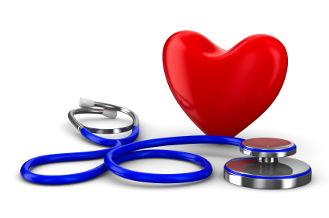
THANK YOU

