Slide 1
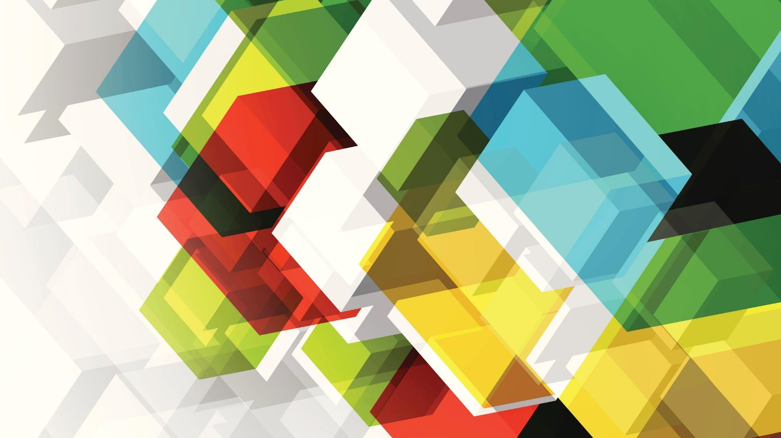
Blood Vessels
By: Saiyed Falakaara
Assistant Professor
Department of Pharmacy
Sumandeep Vidyapeeth

Slide 2
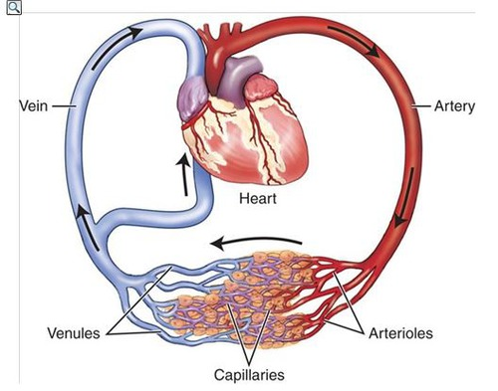
Introduction
Blood vessels form a closed system of tubes that carry blood away from the heart, transport it to the tissues of the body, and then return it to the heart.
The blood vessels of human body carry blood to every tissue and organ.
Vessels decrease in size as they move away from the heart (arteries and arterioles), ending in the capillaries, and then increase in size as they move towards the heart (venules and veins)
The largest artery in the blood is Aorta.

Slide 3
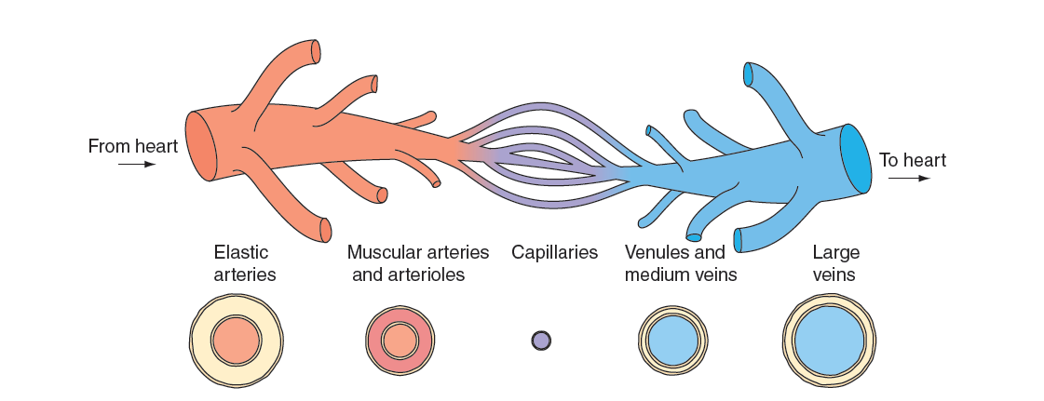
Types of blood vessels
1. Arteries
2. Arterioles
3. Capillaries
4. Venules
5. veins

Slide 4
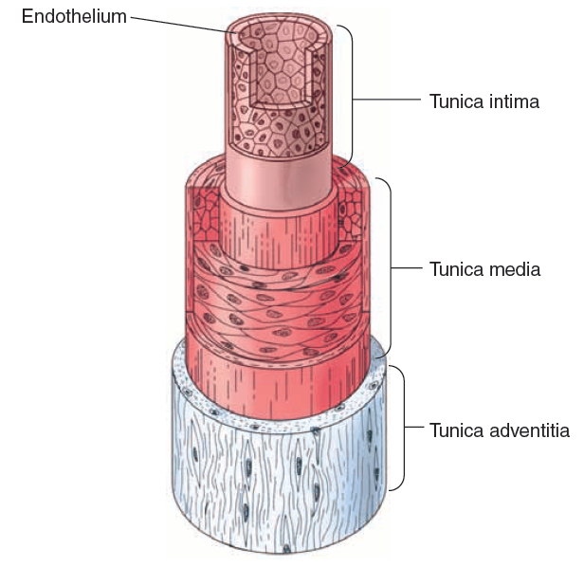
Arteries and Arterioles
Arteries are elastic vessels and are very strong, they carry blood away from the heart under high pressure.
They subdivide into thinner tubes that give rise to branched, finer arterioles.
An artery’s wall consists of three distinct layers:
Innermost tunica interna
made up of layers of simple squamous epithelium (endothelium).
It rests on a connective tissue membrane with many elastic, collagenous fibres.
The endothelium helps prevent blood clotting and may also help in regulating blood flow.
It release nitric oxide to relax the smooth muscle of the vessel.
Middle layer tunica media
Makes most of the arterial wall, including smooth muscle fibres and a thick elastic connective tissue layer.
Outer layer tunica externa (adventitia)
Thinner and mostly made up of connective tissue with irregular fibres and attached to surrounding tissues.

Slide 5
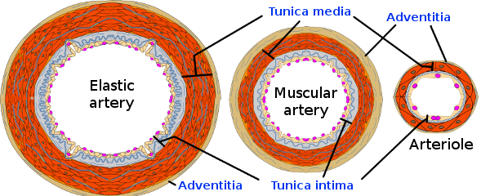
Smooth artery and arteriole muscles are innervated by sympathetic nervous system.
Vasomotor fibres receive impulses to contract and reduce blood vessel diameter (Vasoconstriction)
When inhibited, the muscle fibres relax and the vessel diameter increases (Vasodilation)
Changes in diameter of artery and arterioles greatly affect the blood flow and pressure.
Large arterioles also have three layers i8n their walls, which get thinner as arterioles lead to capillaries.

Slide 6
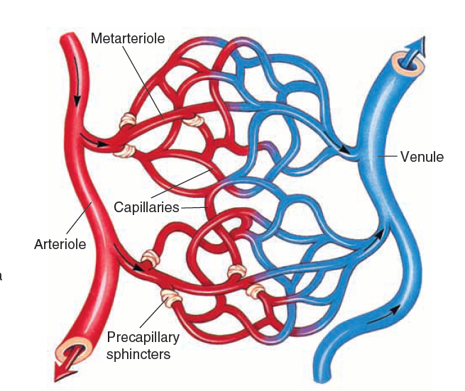
Capillaries
Smallest diameter blood vessel.
Connects the smallest arterioles to the smallest venules.
The walls of the capillaries are also composed of endothelium and form the semipermeable layer through which substances in blood are exchanged with substances in tissue fluids surrounding cells of the body.
Tissues with higher metabolic rates (such as muscles) have more capillaries than those slower metabolic rates (such as cartilage)
Some capillaries directly pass from arterioles to venules while others have highly branched network.
Pre capillary sphincters control blood distribution through capillaries. Based on the demands of the cells, these sphincters constrict or relax so that blood can follow specific pathways to meet their tissue cellular requirements.

Slide 7
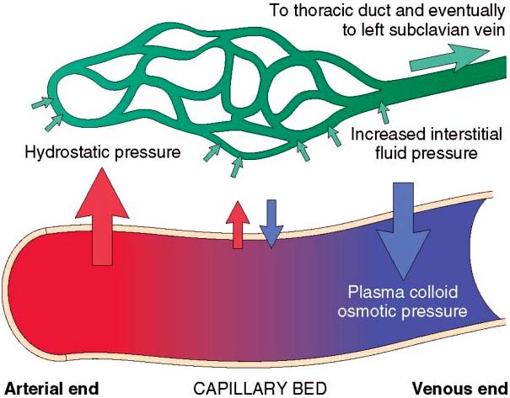
Capillary walls allow the diffusion of blood with high levels of oxygen and nutrients.
They also allow high levels of carbon dioxide and other wastes to move from the tissues into the capillaries.
Plasma protein as larger in size don't move across the capillary wall and so remain in blood.
Blood pressure is generated when capillary contracts provides force for filtration via hydrostatic pressure.
Blood pressure is strongest when leaves the heart and weaker as distance from the heart increases because of peripheral resistance between the blood and vessel walls.
Blood pressure highest in arteries >> arterioles >> capillaries
Filtration mostly occurs at the arteriolar ends of capillaries because the pressure is higher than at the venular ends. Plasma proteins trapped in capillaries create an osmotic pressure that pulls water into the capillaries called as colloid osmotic pressure.

Slide 8
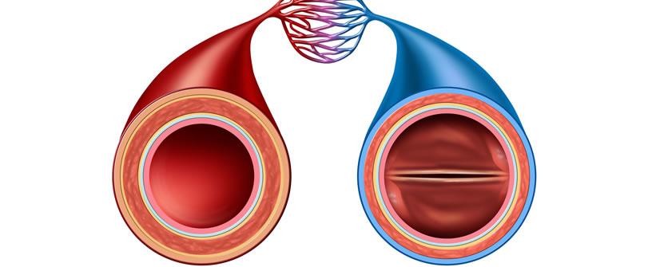
Venules and Veins
Venules are microscopic vessels that link capillaries to veins, which carry blood back to atria.
Vein walls are similar to arteries but have poorly developed middle layers. Because they have thinner walls that are less elastic than arteries, their lumens have a greater diameter.
Many veins have flaplike projecting inward from their linings. These valves often have two structures that close if blood begins to backup in the vein.
They aid in returning blood to the heart, opening if blood flow is towards the heart, but closing if it reserves.
Unlike the arteries, veins do not have sufficient pressure from the contractions of the heart to keep blood moving from them.
To keep blood flowing, the veins rely on the movement of nearby skeletal muscles, as well as the opening and closing of the valves within them. Therefore, major structural difference between veins and arteries is that arteries do not have valves.
Veins acts as reservoirs for blood in certain conditions, such as during arterial haemorrhage.
Resulting venous constrictions help to maintain blood pressure by returning more blood to the heart, ensuring an almost normal blood flow even when up to one quarter of the blood volume is lost.

Slide 9
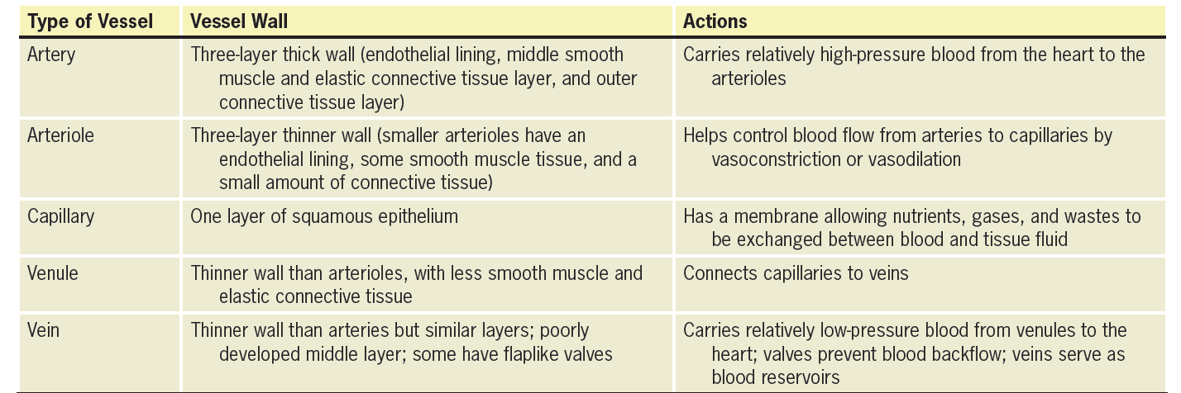
Characteristics of Blood Vessels

Slide 10
thankyou

