Slide 1
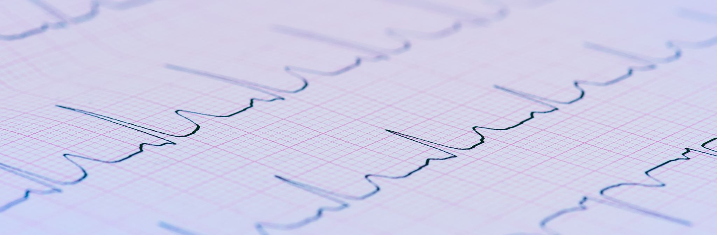
ELECTROCARDIOGRAM
(ECG)
BY: Saiyed Falakaara
Assistant Professor
Department of Pharmacy
Sumandeep Vidyapeeth

Slide 2
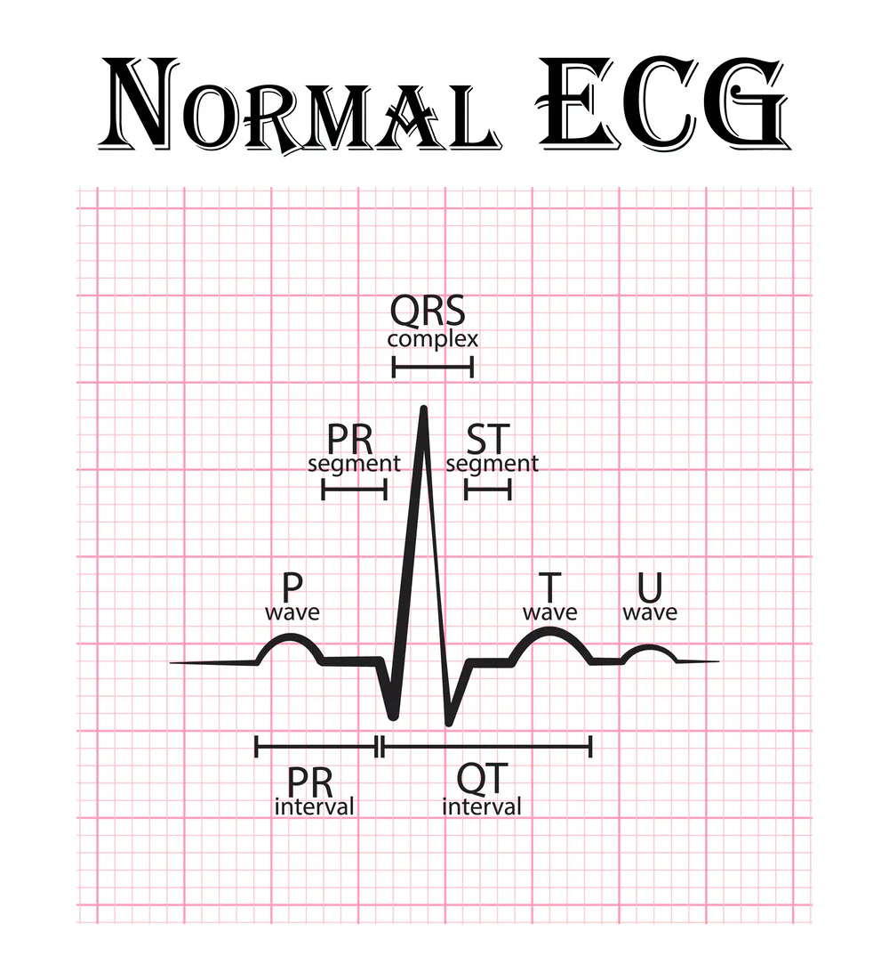
ECG
ECG is defined as “ recording of electrical activity of heart on a graph paper”.
or
Graphical representation of electrical activity of heart.
As action potentials propagate through the heart, they generate electrical currents that can be detected at the surface of the body.
An electrocardiogram abbreviated either ECG or EKG is recording of these electrical signals.
The ECG is composite record of action potentials produced by all of the heart muscle fibres during each heartbeat.
The instrument used to record the changes is an electrocardiograph.

Slide 3
Significance of ECG
ECG gives information about rate and rhythm of the heart.
The physical orientation of heart i.e. axis.
It’s a diagnostic tool for various heart conditions like hypertrophies, ischemia, infarction, arrhythmias, conduction problem, and pace maker activity.
ECG does not provide information about mechanical activity.

Slide 4
Useful in diagnosis
Cardiac Arrhythmias
Myocardial ischemia and infarction
Pericarditis
Chamber hypertrophy
Electrolyte disturbances
Drug effects and toxicity

Slide 5
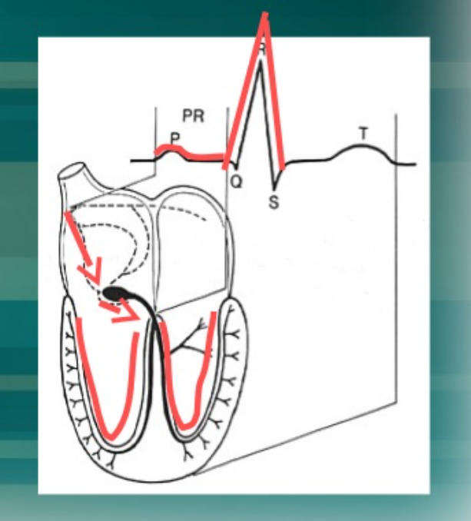
Impulse conduction and ECG
Sinoatrial node
AV node
Bundle of His
Bundle branches
Purkinje fibres

Slide 6
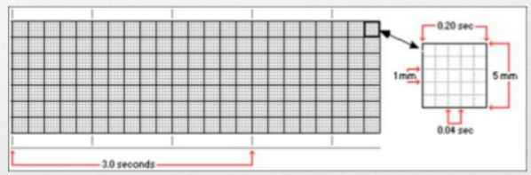
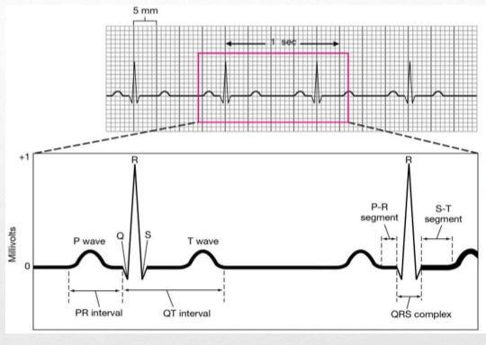
ECG Paper
This is long paper composed of small squares.
One square is 1mm wide and 1mm high.
On ECG paper there are thick lines, between two thick lines there are 5 squares.
The speed of ECG machine is 25mm per second.
The time interval of each small square can be calculated as
25 small squares are equal to 1 sec
1 small square is equal to 1/25 sec
i.e. 40seconds
Vertically the small square represent the amount of electrical potential

Slide 7
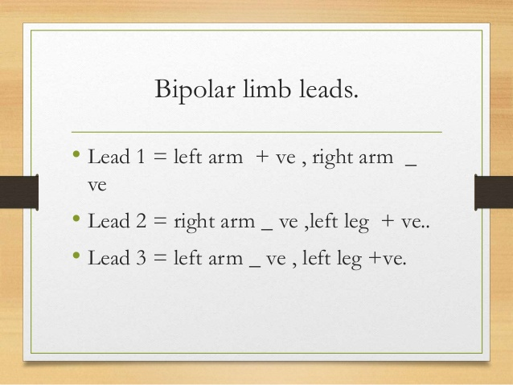
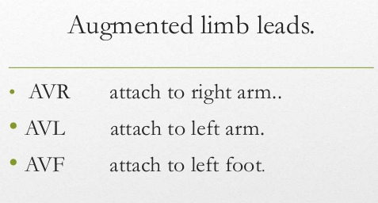
ECG leads
Leads are the electrodes which record the electrical potential of heart at different sites.
There are 12 ECG leads
A) 3 bipolar limb leads
B) 3 augmented limb leads (unipolar)
6 chest leads

Slide 8
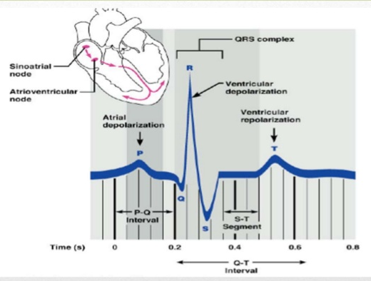
Waveforms in ECG
Positive electrode is always a reference electrode
Depolarization wave moves towards the positive electrode gives positive deflection
Depolarization wave move away from positive electrode give the negative deflection
P wave – Atrial depolarization
QRS complex – Ventricular depolarization
T wave – Ventricular repolarization

Slide 9
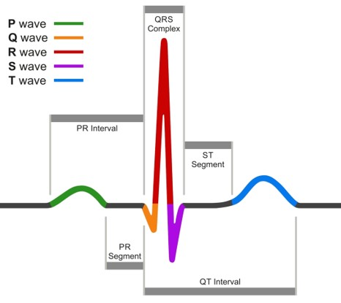
Basic Terminologies
Base line: flat, straight, and isoelectric
Waveform: deviation or movement away from baseline may be upward or downward
Segment: A line between two waves
Interval: a wave form plus a segment this shows time duration
Complex: combination of several wave form without segment

Slide 10
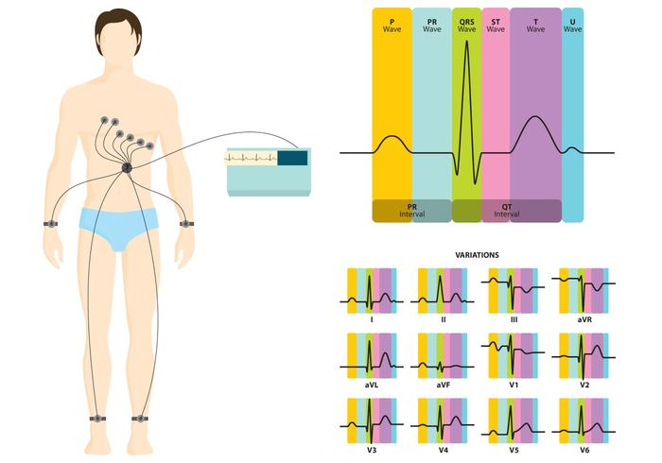
In Clinical Practice
Electrodes are positioned on the arms, and legs (limb leads) and at six positions on the chest (chest leads) to record the ECG.
The electrocardiograph amplifies the heart’s electrical signals and produces 12 different tracings from different combinations of limb and chest leads.
Each limb and chest electrode records slightly different electrical activity because of the difference in its position relative to the heart.
By comparing these records with one another and with normal records, it is possible to determine: 1. if the conducting pathway is abnormal, 2. if the heart is enlarged, 3. if certain regions of the heart are damaged, and 4. the cause of chest pain.

Slide 11
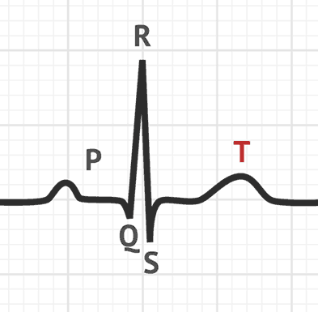
P Wave
P Wave shows atrial depolarization
Its duration is 0.1 sec (2 and half small square) and height is 2.5 mv (2 and half small square)
Presence of P waves in ECG strip shows the sinus rhythm.
→ Abnormalities of P wave:
P. pulmonale: This is tall and peaked P wave in lead 1, lead 2, and lead 3 in right atrial hypertrophy. (Pulmonary hypertension)
P. mitrale: It is biphasic or broad P wave seen in left atrial hypertrophy (mitral stenosis)
→ Inverted P wave may be present in:
a. Normally in lead V1 and V2
b. In dextro cardia
c. Incorrectly placed electrodes

Slide 12
QRS Complex
QRS Complex represent the ventricular depolarisation
Its normal duration is about 0.08 seconds (less than 2 small squares) and height is about 5-20 small squares
It is a wide complex because it mask the atrial repolarization
Q wave is first wave of this complex but often absent
Q wave present the interventricular septal depolarisation
It is the first wave in ECG with negative deflection.
Q wave greater than 1/3 the height of the R wave, greater than 0.04 sec are abnormal and may represent the old infarction

Slide 13
T wave
It represent the ventricular repolarization
It is repolarizing wave but shows the upward deflection because the part depolarized in the last is first to be polarized, that is base of heart depolarized in the last but is first to be repolarized
T wave should not be more than one third of R wave
T wave inversion represent ischemia of heart
Tall and peaked R wave is present in hyperkalemia
Flattened R waves in pericarditis and myocarditis

Slide 14
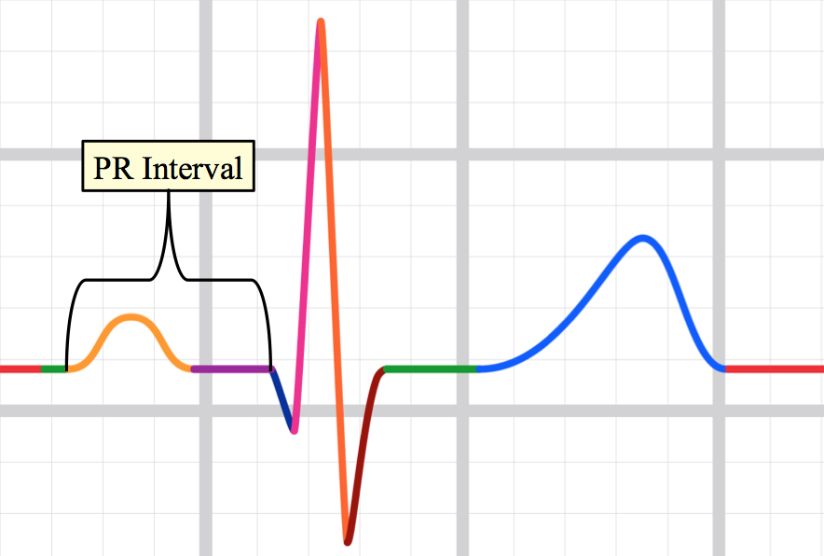
PR Interval
This is from beginning of P wave to the beginning of Q wave
Its normal duration is from 0.12 to 0.2 sec
It represent the conduction time of impulse from SA node to the ventricles and AV delay
Prolong PR interval
Prolonged PR interval shows delayed conduction from SA node to AV node
In first degree heart, 2nd degree and complete heart block
Digitalis therapy
Hyperkalemia

Slide 15
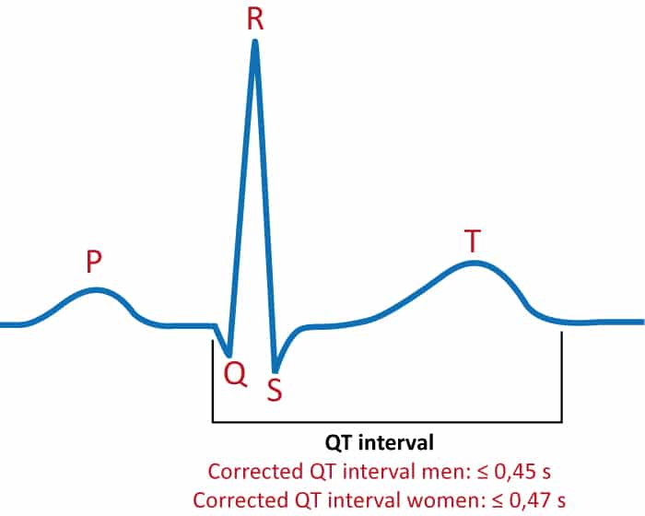
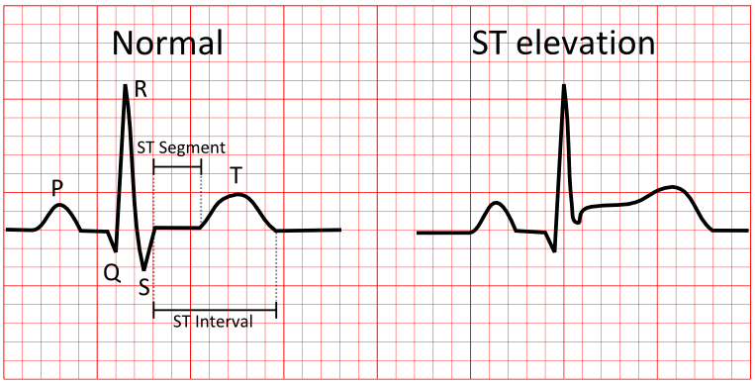
QT Interval
Measured from the beginning of Q to the end of T wave.
Its duration is about (10 small squares)
Its indicates total systolic time of ventricles
ST Segment
This segment is present between S wave and T wave
It represent the plateau phase
Its duration is 0.04 sec

Slide 16
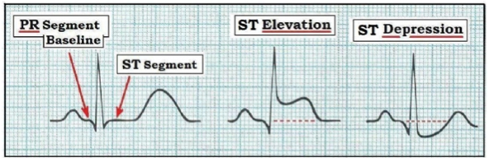
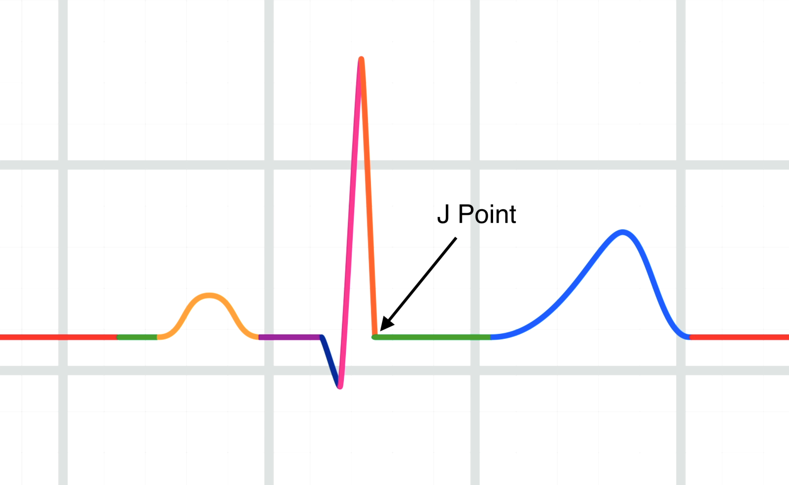
ST Segment Elevation and Depression
Elevation → seen in Myocardial Infarction and hyperkalemia
Depression → seen in Ischemia, digitalis therapy, and hypokalemia
J point
The exact point at which all the parts of the ventricles are depolarised i.e.at the just end of QRS complexes and just at the beginning of ST segment.
At the point potential of ECG is zero with no current is flowing through the heart.

Slide 17
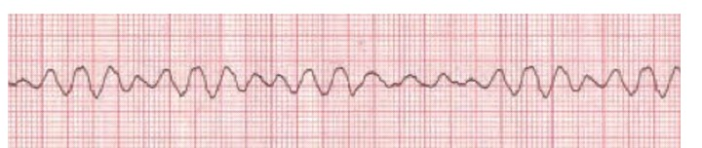
Some cardiac conditions on ECG
1. Ventricular Fibrillation.
Regularity: There is no regularity shape of the QRS complex because all electrical activity is disorganized.
Rate: The rate appears rapid, but the disorganized electrical activity prevents the heart from pumping.
P wave: There are no P waves present.
PR interval: There are no PR intervals present.
QRS complex : The ventricle complex varies

Slide 18
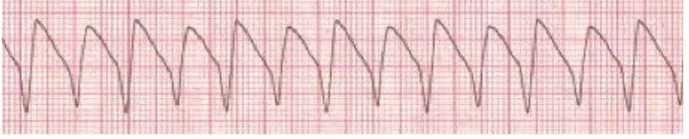
2. Ventricular Tachycardia
Regularity: R-R intervals are usual, but not always regular
Rate: The atrial rate cannot be determined, Ventricular rate is usually between 150 and 250 beats per minute
P Wave: QRS complexes are not preceded by P waves. There are occasionally P waves in the strip, but they are not associated with the ventricular rhythm.
PR interval: it is not measured since this is a ventricular rhythm.
QRS complex: it measures more than 0.12 seconds. The QRS will usually be wide and bizarre. It is usually difficult to see a separation between the QRS complex and the T Wave.

Slide 19
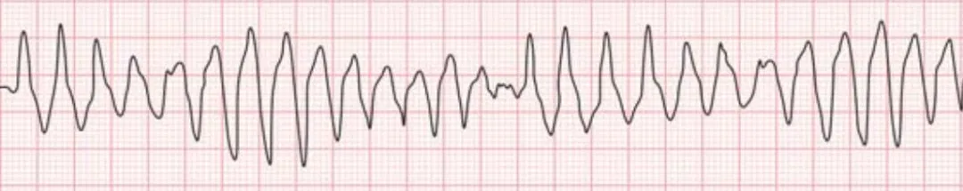
3. Torsades De Pointes (Irregular Wide Complex Tachycardia)
Regularity: there is no regularity
Rate: the atrial rate cannot be determined. Ventricular rate is usually between 150 and 250 beats per minute.
P Wave: there are no P waves present.
PR interval: there are no PR interval present.
QRS complex: the ventricle complex varies.

Slide 20
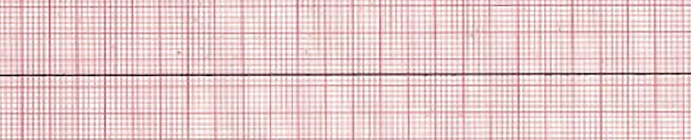
4. Pulseless Electrical Activity(PEA) and Asystole
Regularity: the rhythm will be a nearly flat line.
Rate: there is no rate.
P wave: there is no P waves present
PR interval: PR interval is unable to be measure due to no P waves being present.
QRS Complex: there are no QRS complexes present.

Slide 21
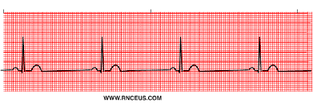
5. Sinus Bradycardia
Regularity: R-R intervals are regular, overall rhythm is regular.
Rate: the rate is less than 60bpm, but usually more than 40bpm
P wave: there is one P wave in front of every QRS. The P waves appear uniform
PR interval: measures between 0.12 and 0.20 seconds in duration. PR interval is consistent.
QRS complex: measures less than 0.12 seconds.

Slide 22
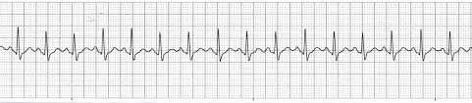
6. Sinus Tachycardia
Regularity: R-R intervals are regular, overall rhythm is regular.
Rate the rate is over 100bpm but usually less than 170bpm
P wave: there is one P wave in front of every QRS. The P wave appear uniform.
PR interval: measures between 0.12-0.20 seconds in duration. PR interval is consistent.
QRS complex: Measures less than 0.12 seconds.

Slide 23
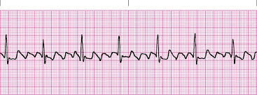
7. Atrial Flutter
Regularity: The atrial rate is regular. The ventricular rate will usually be regular, but only if the AV node conducts the impulses in a consistent manner. Otherwise, the ventricular rate will be irregular.
Rate: The atrial rate is normally between 250 to 350. Ventricular rate depends on conduction through the AV node to the ventricles.
P wave: The P waves will be well defined and have a “sawtooth” pattern to them.
PR interval: Due to the unusual configuration of P waves, the interval is not measured with atrial flutter
QRS complex: QRS measures less than 0.12 seconds

Slide 24


