Slide 1

Subject: Oral Medicine
Topic: Anatomy of Temporomandibular Joint
Dr. Akansha Budakoti
S.Lecturer
Dept. of Oral Medicine and Radiology

Slide 2
INTRODUCTION
The stomatognathic system includes : which allow mouth to open, swallow, breathe, phonate, suck and perform different facial expressions.
Structures are : temporomandibular joint, jaw and mandible, muscle tissues and tendons, dental arches, salivary glands,hyoid bone and muscles that connect it to scapula and sternum,muscles of neck.

Slide 3
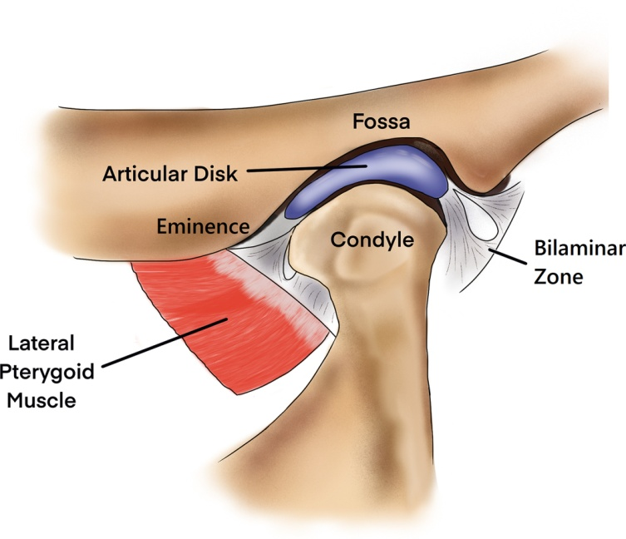
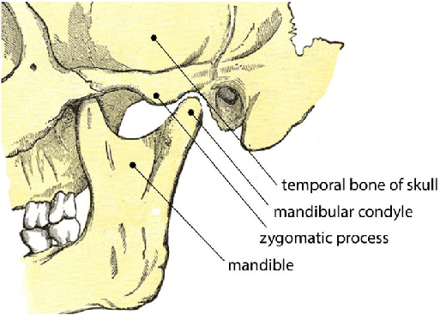
TMJ : complex movements,orthogonal planes,work in coordination with contralateral TMJ
DIARTHROSIS,GINGLYMO-ARTHROIDAL JOINT

Slide 4
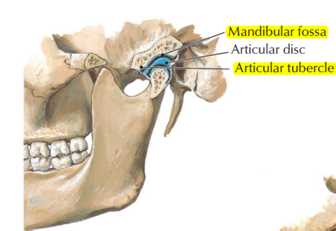
Structures
TMJ formed by :
MANDIBULAR CONDYLE
ARTICULAR DISC
MANDIBULAR FOSSA OF TEMPORAL BONE
TMJ

Slide 5
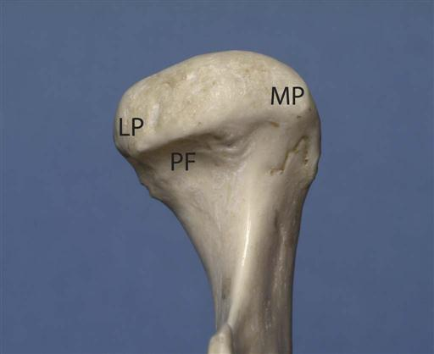
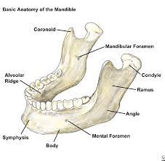
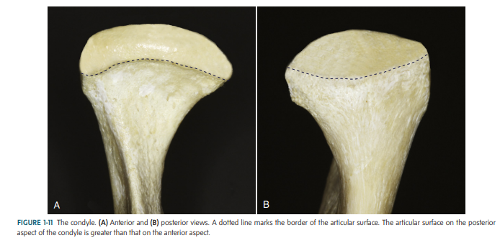
CONDYLE
First figure

Slide 6
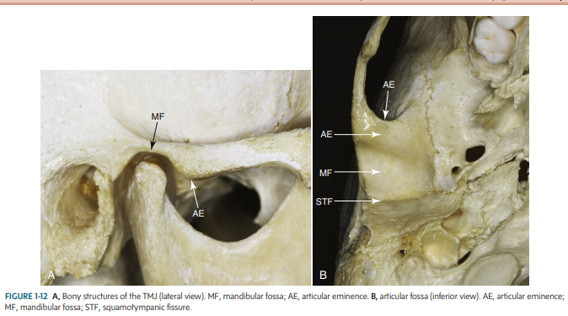

Slide 7

ARTICULAR DISC
BICONCAVE OR OVAL SHAPE
Covers condyle ,interposes below glenoid fossa
Fibro-cartilaginous disc/dense fibrous connective tissue

Slide 8
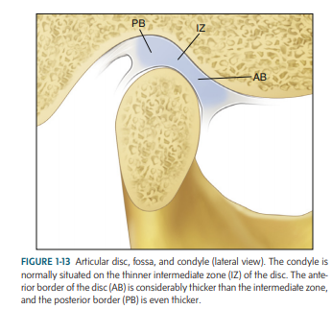

Slide 9
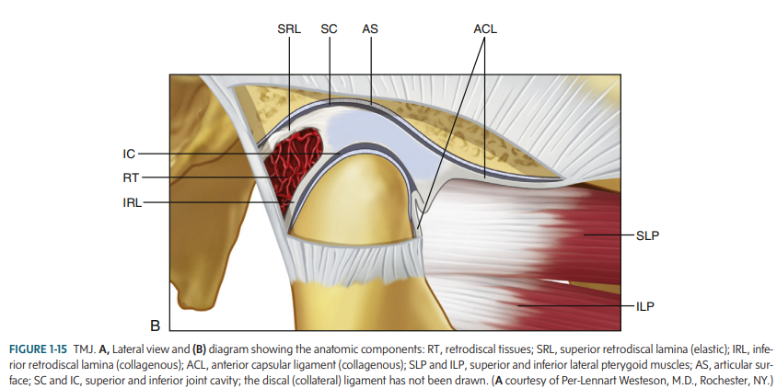

Slide 11
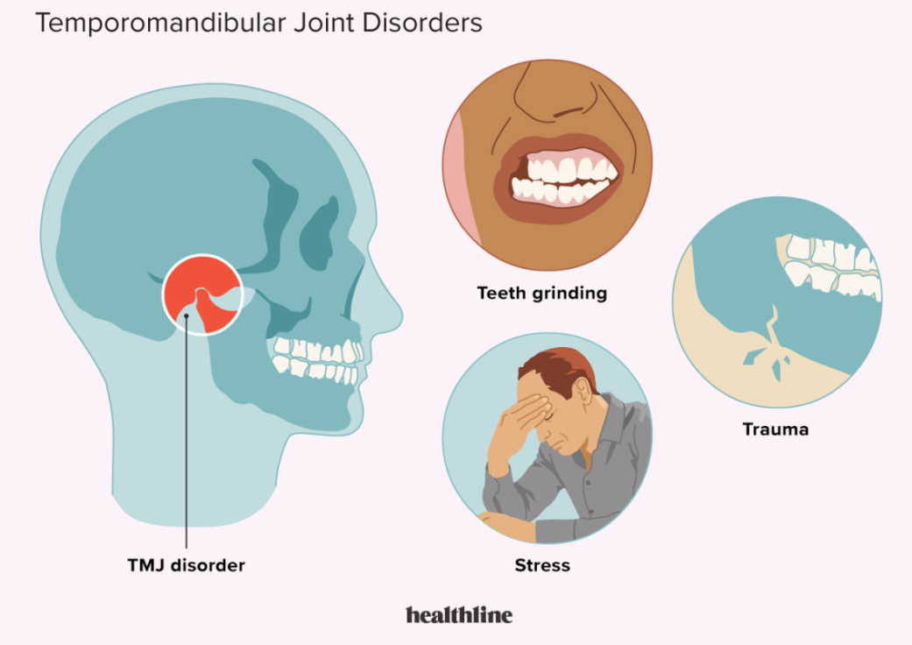
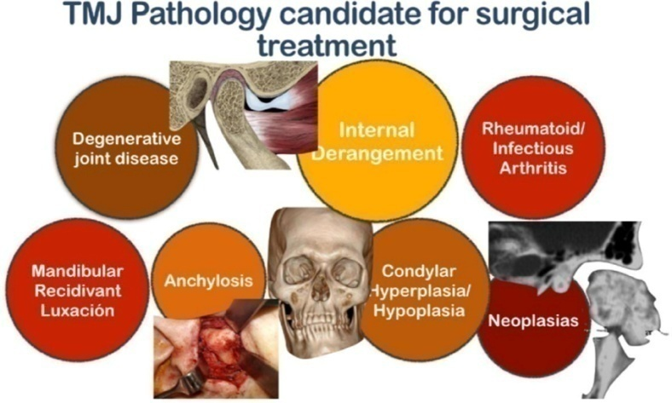
CONCLUSION

Slide 12
THANK YOU

