Slide 1
Management of long dento-facial skeletal malocclusion
Dr Harshil Joshi

Slide 2
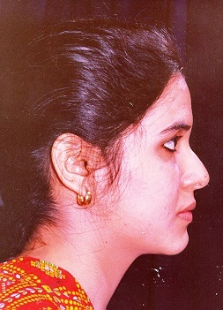

Normal Face

Slide 3
Cranio-Facial Structures
1

Slide 4
Dentofacial Deformity

Slide 5
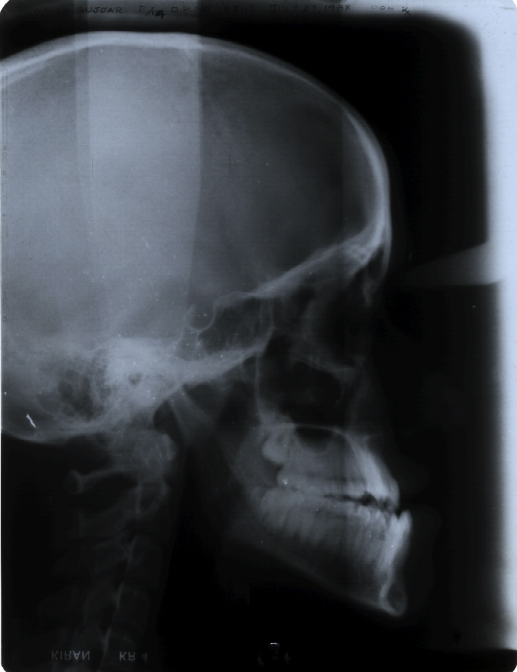
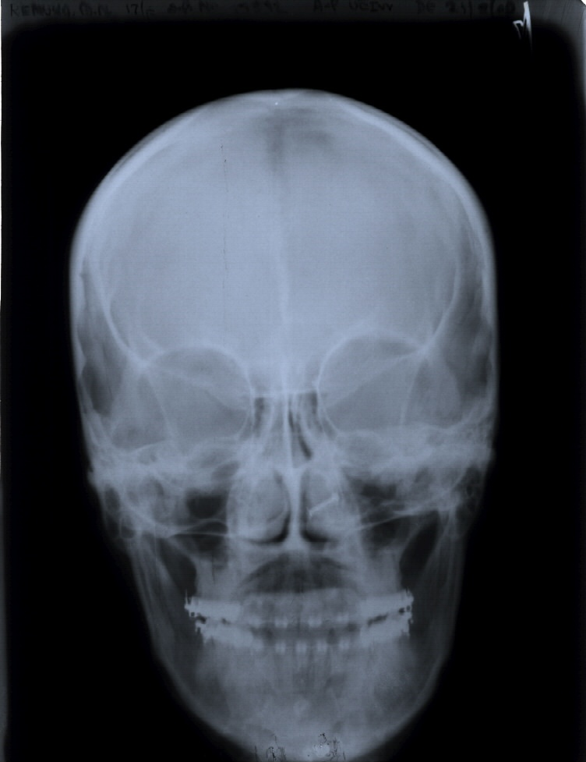
AP & Vertical
Vertical & Transverse

Slide 6
Facial Discrepancies
AP & Vertical
Vertical & Transverse

Slide 7
Sagittal Discrepancies
Skeletal Class III
    Can be caused by

Slide 8
Deficient maxillary growth
?
Syndromes
???

Slide 9
VERTICAL PLANE

Slide 10
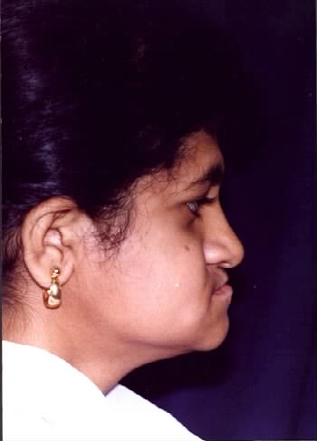
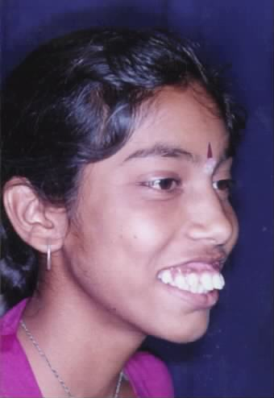
Severe skeletal discrepancies:
Vertical Maxillary Difficiency
Vertical Maxillary Excess

Slide 11
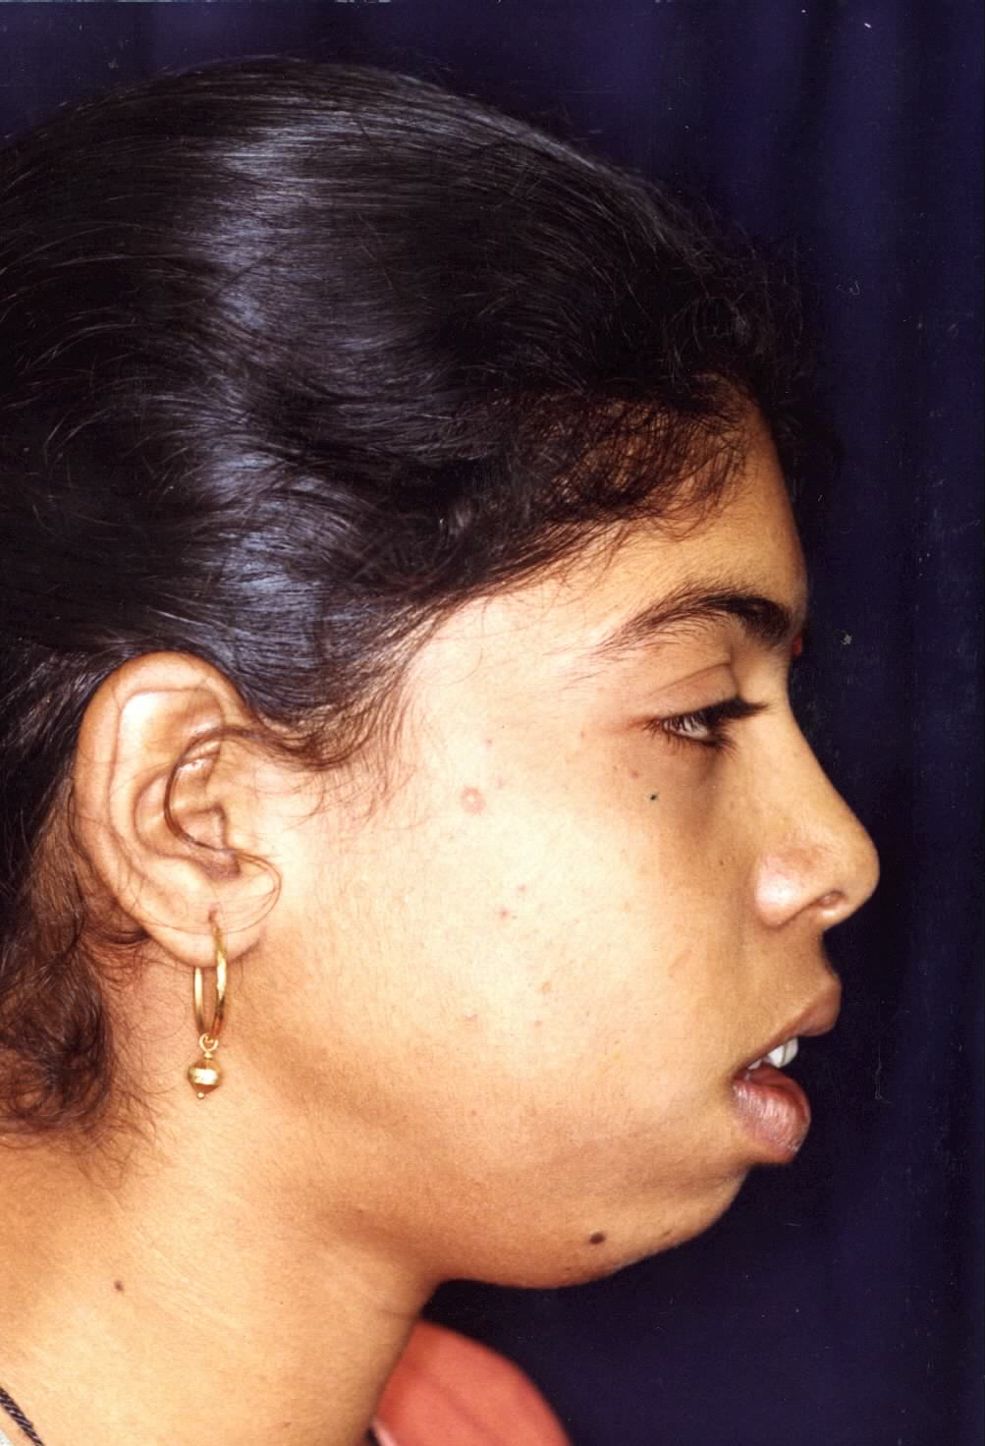
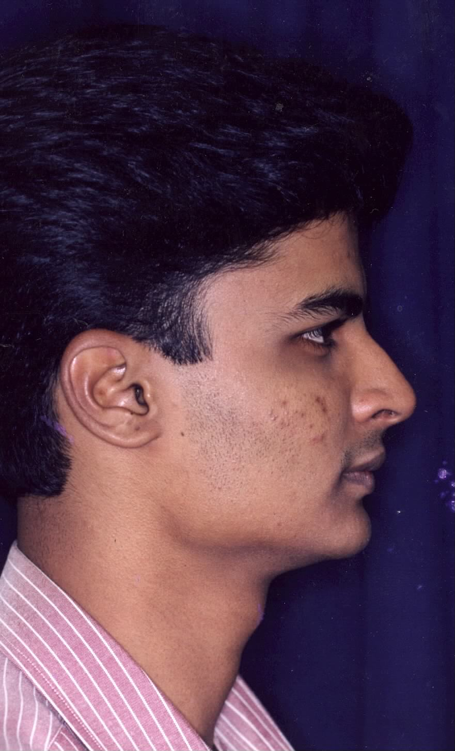
Vertical Discrepancies
2

Slide 12
Vertical Maxillary Excess

Slide 13
Excess Condylar Growth

Slide 14
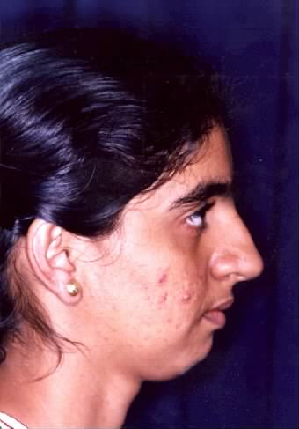
Decreased Condylar Growth

Slide 15
The maxilla
The maxilla can be moved up quite successfully but can be positioned downward with less predictability.

Slide 16
The mandible can be moved up or down anteriorly but cannot be moved down at the gonial angle with stability.

Slide 17
Long face problems are treated best by superior repositioning of the maxilla
This allows the mandible to rotate around the condyle there by reducing the mandibular plane angle and shortening the face.

Slide 18
The short face problem are treated predictably and successfully by mandibular ramus surgery that allows the mandible to move downward only at the chin,
Increases the mandibular plane angle by shortening the ramus and opening the gonial angle rather than by rotating at the condyle.

Slide 19
Maxillary Surgery
Correction of the skeletal open bite (Long face) deformity involves a Le Fort I down fracture of the maxilla, with a superior repositioning of the maxilla after removal of bone from the lateral walls of the nose, sinus, and nasal septum.
The overall face height is shorten as mandible rotates upward and forward.

Slide 20
Excellent stability of the vertical position of the maxilla is observed post surgically.
When maxilla is moved downwards to increase face height it tends to relapse back up post-surgically.

Slide 21
20% are more of the vertical change is lost
Stability can be improved by
Rigid graft material like synthetic, hydroxylapatite
Simultaneous osteotomy of the mandibular ramus

Slide 23
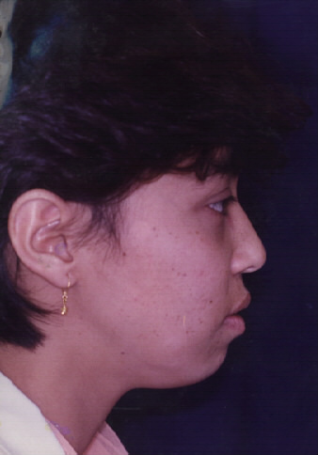
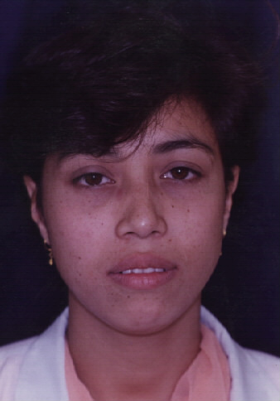
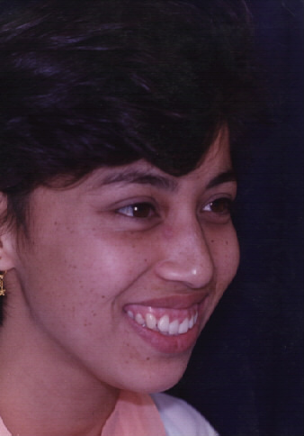
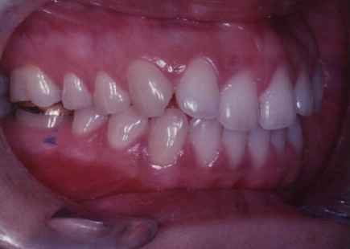
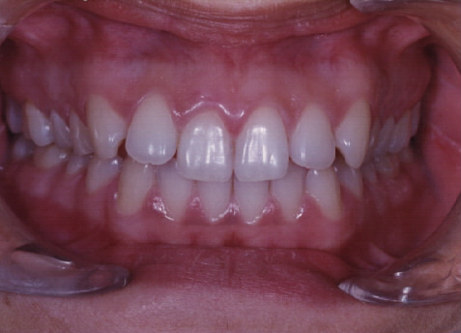
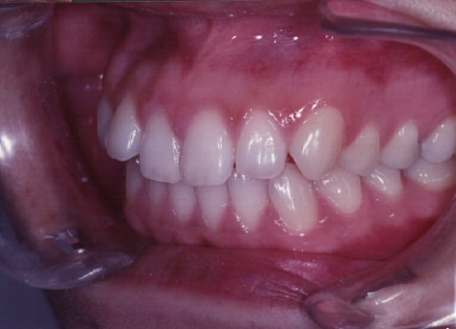
Maxillary Vertical Excess

Slide 24
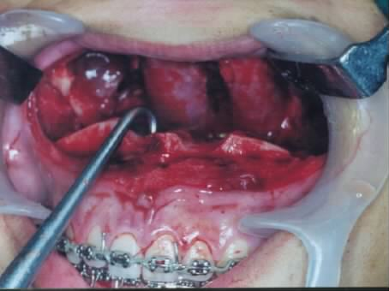
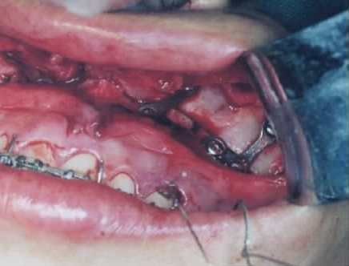
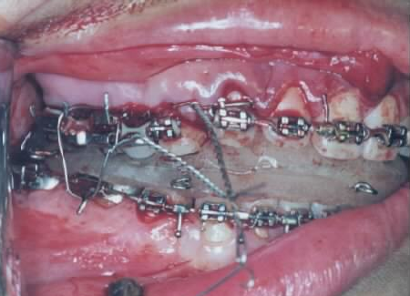
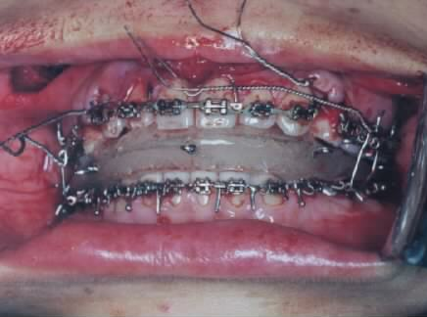
Le Fort I –
Maxillary Superior reposition

Slide 25
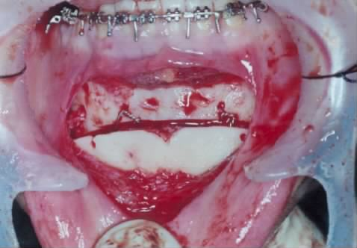
Augmentation Genioplasty

Slide 26
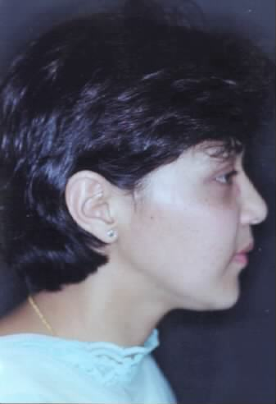
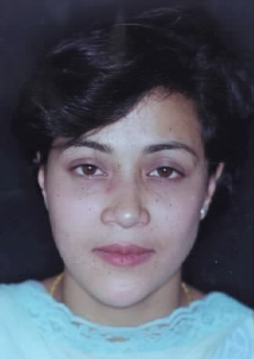
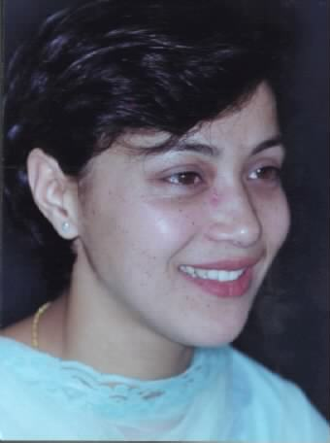
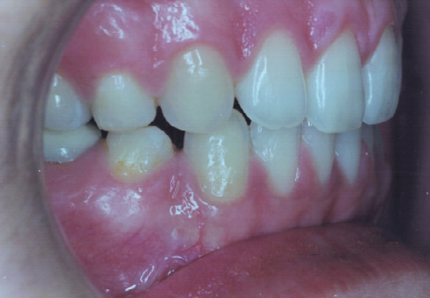
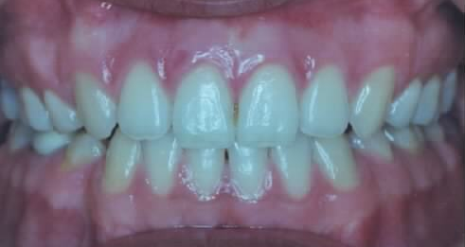
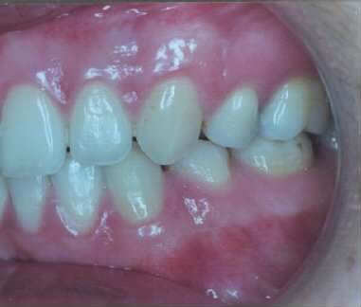

Slide 27
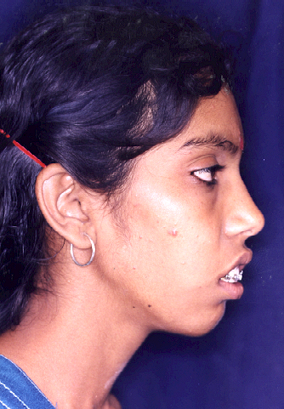
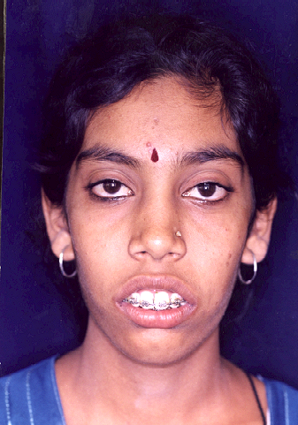
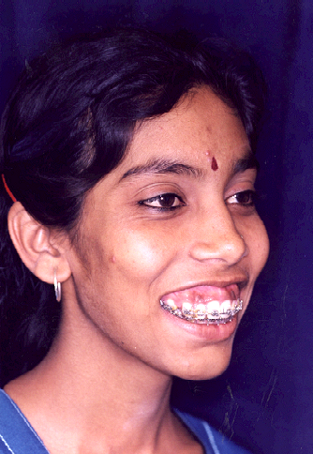
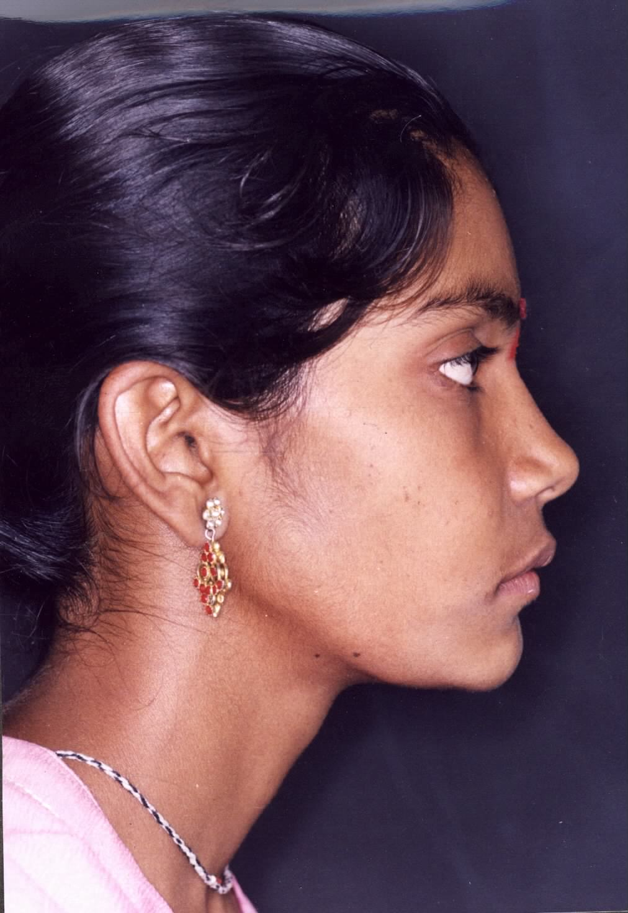
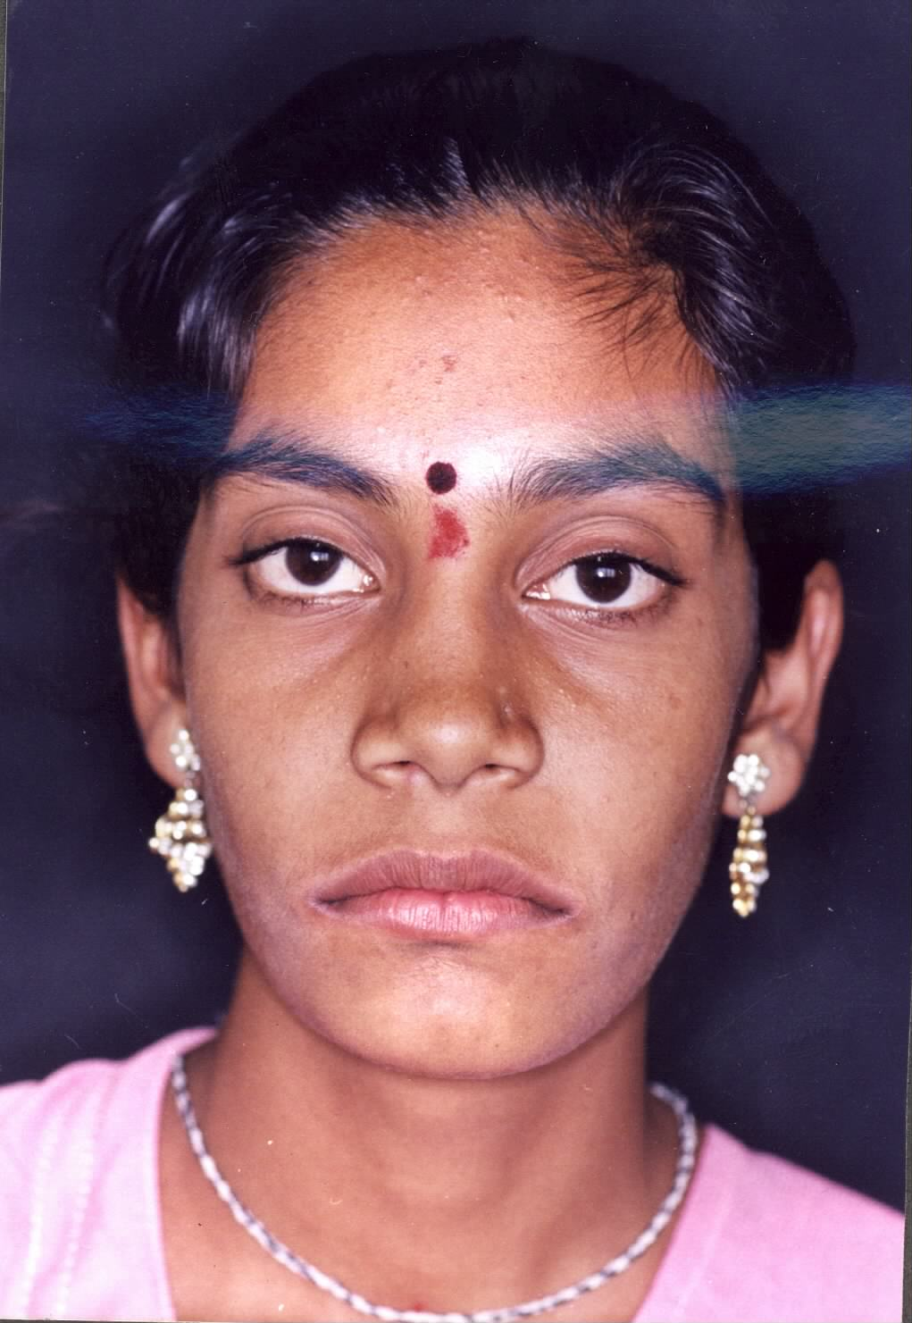

Slide 28
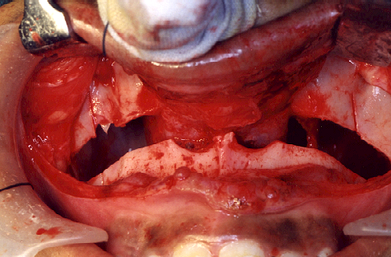
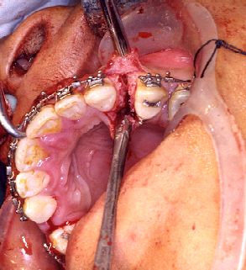
Lefort I Osteotomy
Premaxillary setback

Slide 29
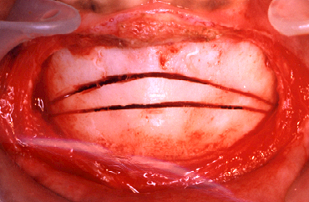
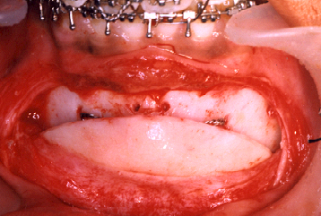
Vertical Reduction Genioplasty

Slide 30
Mandibular Surgery
Patients with long face, skeletal open bite and anterior posterior mandibular deficiency often have a short mandibular ramus
Surgery to reduce mandibular plane angle and close the open bite by rotating the mandible down posteriorly, highly unstable because of stretch in the muscles of the pterygomandibular sling.

Slide 31
Therefore, mandibular ramus surgery in open bite patient is avoided, unless it is combined with maxillary superior repositioning

Slide 32
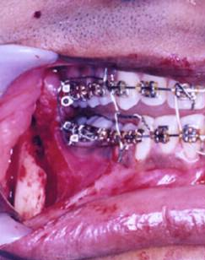
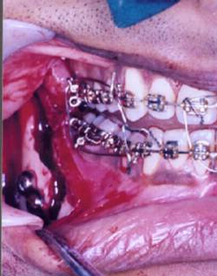
BSSO & Mandibular Advancement

