Slide 1
Type and morphology of pits and fissure and histology of fissure caries
Dr. Seema Bargale
Professor
Department of Pediatric and Preventive Dentistry
KMSDCH, SVDU

Slide 2
Contents
Introduction
Classification
Morphology
Histology of fissure caries

Slide 3
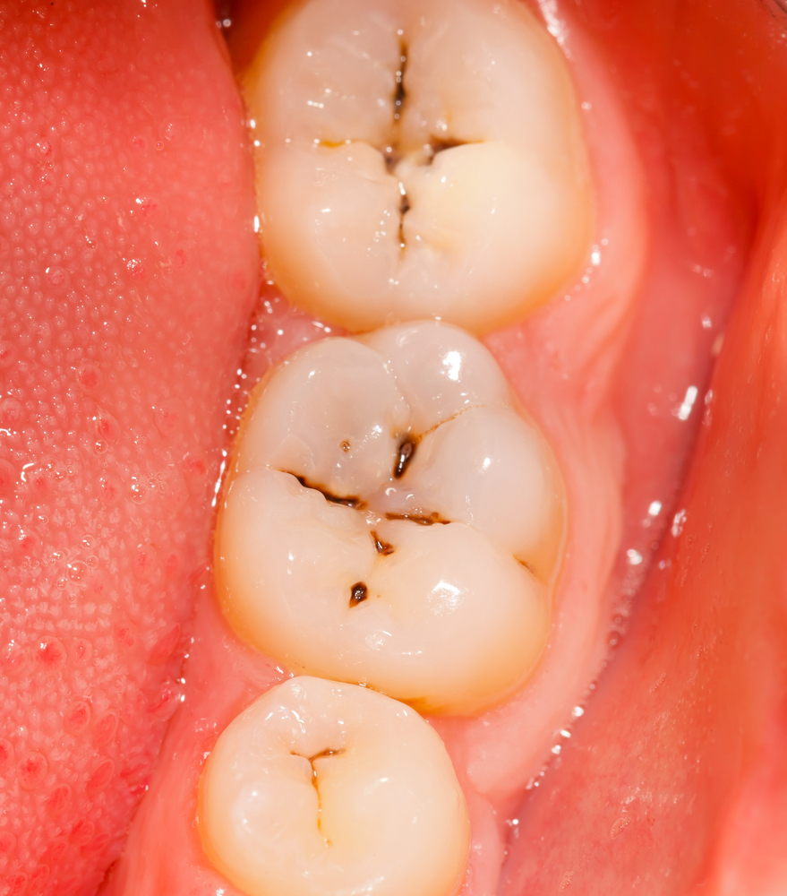
Introduction
PITS: it is defined as a small pin point depression located at the junction of developmental grooves or at terminals of those grooves. (Ash and Nelson, 1993)
FISSURE: it is defined as deep clefts between adjoining cusp. These defects occur on the occlusal surfaces of molars and premolars with tortuous configurations that are difficult to assess from the surfaces. (Orbans, 1990)

Slide 4
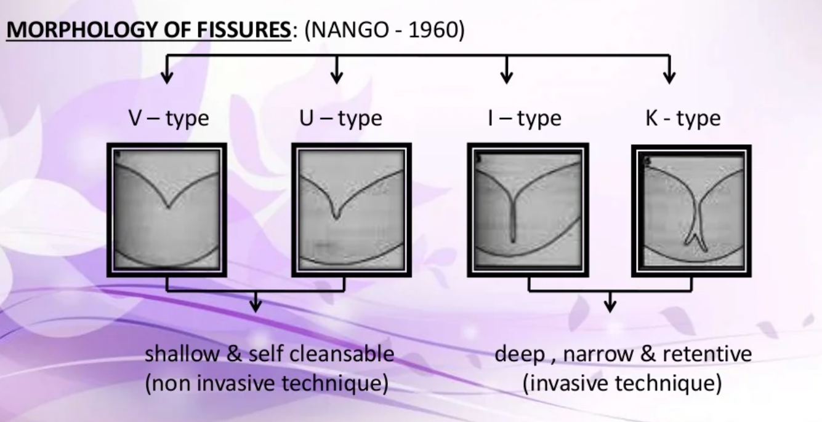
Classification

Slide 5
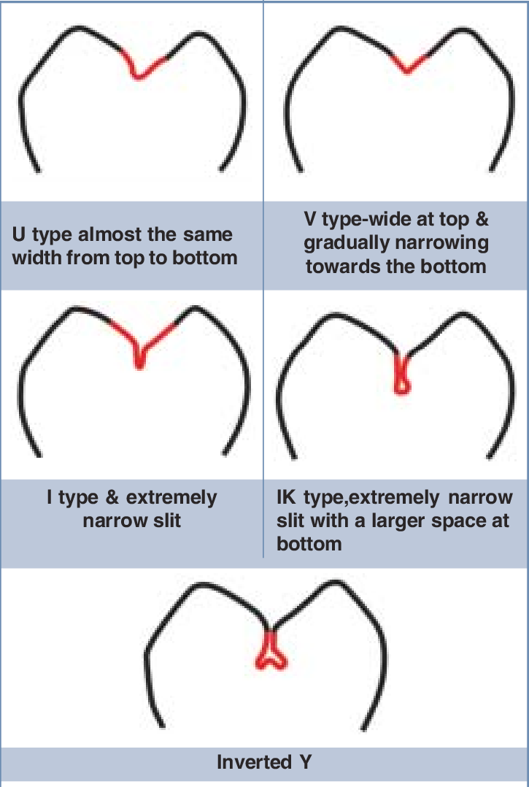

Slide 6
According to Nango’s classification based on the morphology of pits and fissures, five major types of occlusal pits and fissures are described as U, V, I, IK, and Y.
Salman conducted a study to understand the occurrence pattern of the different types of occlusal fissure morphology.
He found that V(48%) and IK(22%) have the maximum percentage
19% was for I-type fissure.
He concluded that V and U shapes(17%) (shallow fissures) have less severity of dental caries, and this finding was in accordance with that of Nagano.

Slide 7
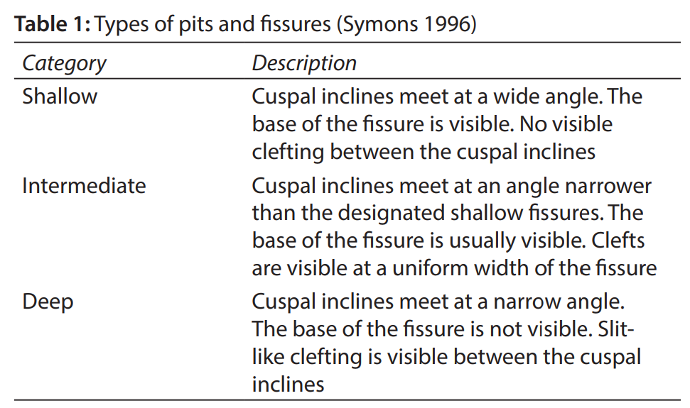

Slide 8
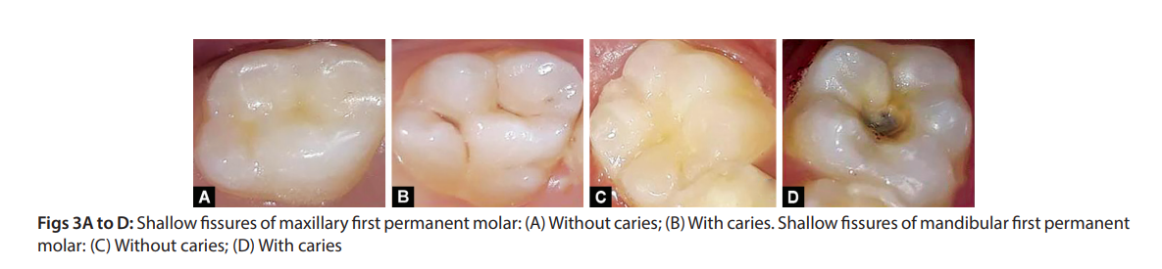
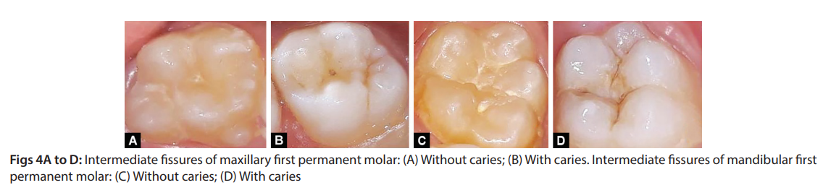
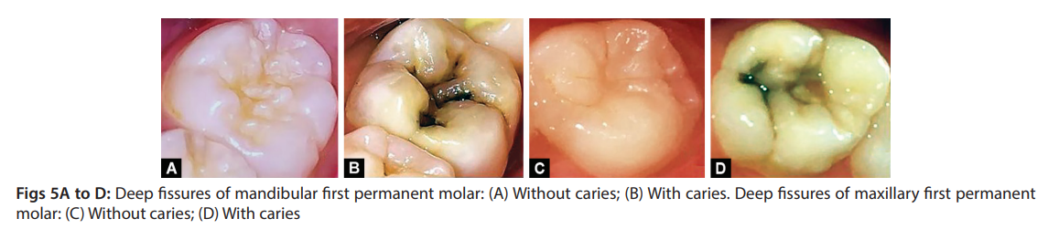

Slide 9
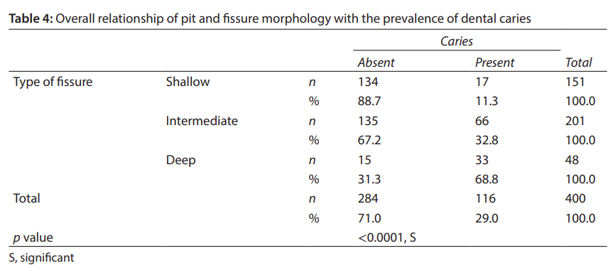
It is recommended to seal off the intermediate and deep pits and fissures in children with high risk of caries, and appropriate preventive measures should be taken. Tooth morphology can be used as an indicator to identify the children at high risk, especially in settings where resources are not adequate.

Slide 10
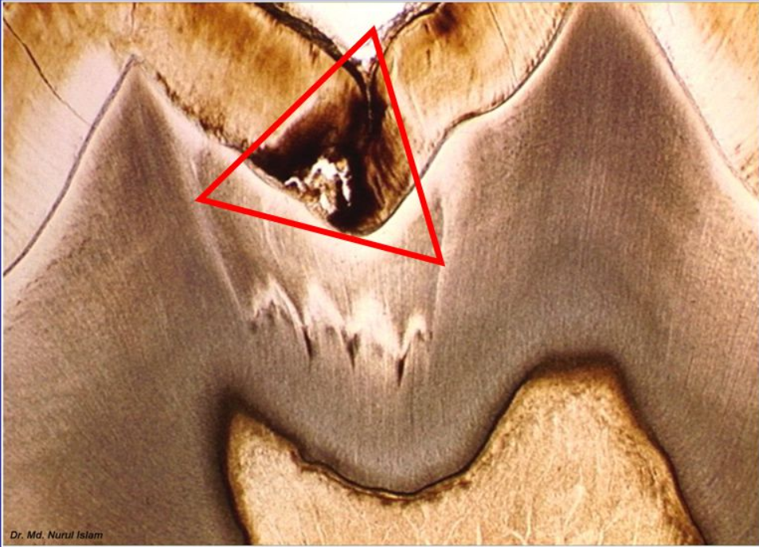
Histology of Fissure Caries
Histologically, as the lesion progress through the enamel, we see the following:
  Lesion arising from fissure walls, not base
  A conical lesion with the base towards the ADJ – the opposite of smooth surface, with the caries following the enamel rods
  Lateral spread at the ADJ – more tubules involved as base is wider
  A larger dentinal lesion

Slide 11
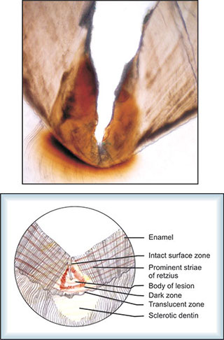
These changes are thought to be due to a combination of loss of interprismatic material, roughening of enamel rods and enhancement of Striae of Retzius.

Slide 12
Thank you

