Slide 1
BDS
Academic Year 2021-2022
Subject: Pediatric and Preventive dentistry Topic: Pit and fissure sealants – Classification and Indications
Dr. Anshula Deshpande
Professor
Dept. of Pediatric & Preventive dentistry

Slide 2
Lecture objectives
At the end of this lecture, the student should be able to:
Types and classification of pit and fissure sealants
Indications of pit and fissure sealants

Slide 3
LECTURE CONTENT
Types of pit and fissure sealants
Classification of pit and fissure sealants
Indications of pit and fissure sealants

Slide 4
Types / Classification
Pit & Fissure sealant
Resin-Based
Glass ionomer cement-based

Slide 5
Types/ Classification
Resin based
Chemical structure of monomer
Generation
Filler content
Type of curing

Slide 6
Types/ Classification
GIC based
Conventional GIC
RMGIC
Polyacid-modified resin sealants

Slide 7
Types/Classification (Resin-based)
According to chemical structures of monomers:
MMA
TEGDMA
BPD
Bis GMA
ESPE
PMU

Slide 8
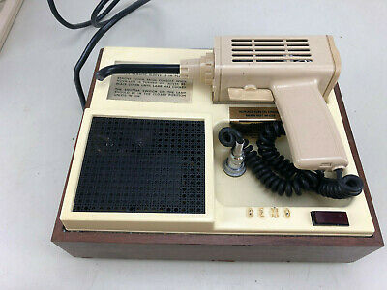
Types/Classification (Resin-based)
Based on generations:
First generation – UV light. Eg. Nuva-lite

Slide 9
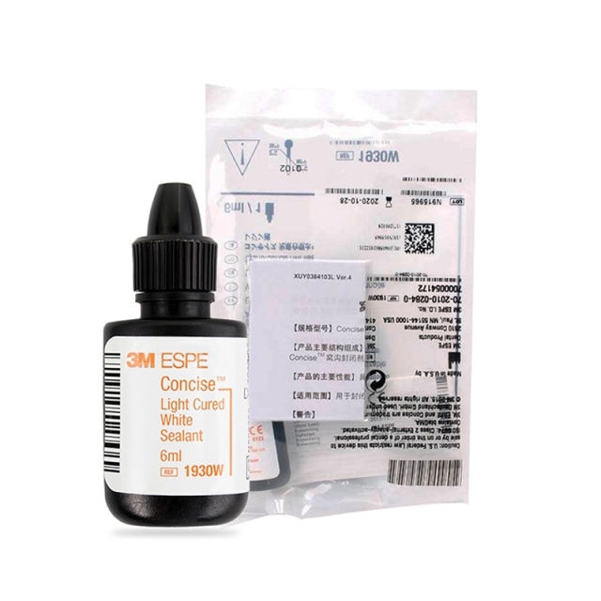
Types /Classification (Resin-based)
Based on generations:
Second generation – self-cure/chemical cure (concise white)

Slide 10
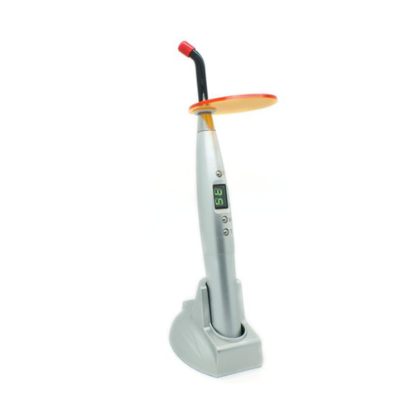
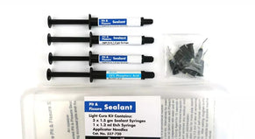
Types /Classification (Resin-based)
Based on generations:
Third generation – light cure/visible light (helioseal).

Slide 11
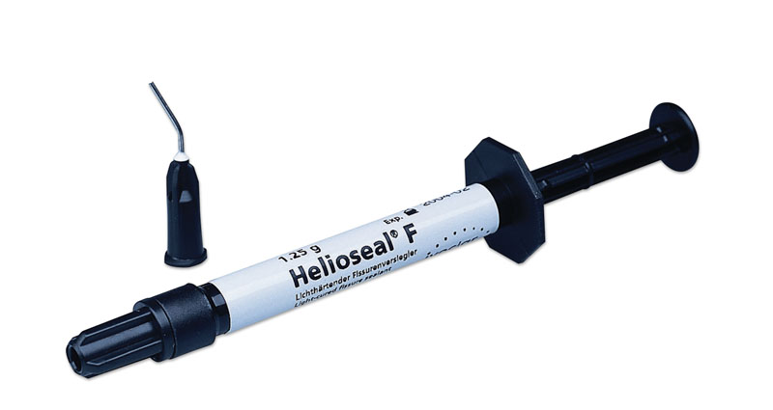
Types /Classification (Resin-based)
Based on generations:
Fourth generation – Fluoride releasing (Helioseal)

Slide 12
Types /Classification (Resin-based)
Based on Filler Content:
Unfilled :
Better flow
More retention
Abrade easily
Filled :
Resistance to wear
May need occlusal adjustments

Slide 13
Types /Classification (Resin-based)
Based on curing :
Auto-polymerising
Light cure
Based on Colour :
Coloured
Opaque
Clear

Slide 14
Indications
Stained pit & fissures with minimum appearance of decalcification or opacification.
Deep, retentive pits & fissures, which may cause wedging or catch in an explorer
No radiographic or clinical evidence of interproximal caries

Slide 15
Indications
Morphology of pit at risk of caries
Possibility of adequate isolation
Questionable enamel caries in pit and fissure
Caries free pit and fissures
If the patient desires

Slide 16
Indications
Factors associated with increased caries incidence
Routine dental care with active preventive dentistry program
Community-based sealant program.

Slide 17
Indications (AAPD guidelines 2021)
The sealant guideline panel recommends the use of sealants compared with non-use in primary and permanent molars with both sound occlusal surfaces and non-cavitated occlusal carious lesions in children and adolescents.

Slide 18
Indications (AAPD guidelines 2021)
The sealant guideline panel suggests the use of sealants compared with fluoride varnishes in primary and permanent molars, with both sound occlusal surfaces and non-cavitated occlusal carious lesions, in children and adolescents.

Slide 19
Indications (AAPD guidelines 2021)
The guidelines suggests that
  clinicians should take into account the likelihood of experiencing lack of retention when choosing the type of sealant material most appropriate for a specific patient and clinical scenario.

Slide 20
Indications (AAPD guidelines 2021)
In situations in which dry isolation is difficult,
  such as a tooth that is not fully erupted and has soft tissue impinging on the area to be sealed,
  then a material that is more hydrophilic (for example, glass ionomer) would be preferable to a hydrophobic resin-based sealant.
On the other hand, if the tooth can be isolated to ensure a dry site and long-term retention is desired, then a resin-based sealant may be preferable.

Slide 21
Are there any adverse events when using pit-and- fissure sealants?
Adverse effects are primarily associated with bisphenol A (BPA). It has been suggested that the BPA present in some sealants may have estrogen like effects.
However, AAPD does not support the transient effect of a small amount of BPA in placing patients at risk of developing caries.

Slide 22
Reading material…
Marwah N. Textbook of pediatric dentistry. JP Medical Ltd; 2018 Oct 31.
Harris NO, Garcia-Godoy F. Primary preventive dentistry. Upper Saddle River, NJ: Pearson Education; 2004.
Wright JT, Crall JJ, Fontana M, et al. Evidence-based Clinical Practice Guideline for the Use of Pit-and-Fissure Sealants. American Academy of Pediatric Dentistry, American Dental Association. Pediatr Dent 2016;38(5):E120-E36.

