Slide 1
E-content
Academic Year 2021-2022
Subject: Pediatric & Preventive Dentistry
Topic: Advances and Current Status of Pit and Fissure Sealant
Dr. Yash Shah
Senior Lecturer
Dept. of Pediatric & Preventive Dentistry

Slide 2
Content
Fluoride releasing sealants
Clear pit and fissure sealants
Colored pit and fissure sealants
Fluorescing pit and fissure sealant
Moist bonding pit and fissure sealants
Pit and fissure sealant with ACP
Hydrophilic fluorescent BPA free pit and fissure sealant
Enamel LocTM

Slide 3
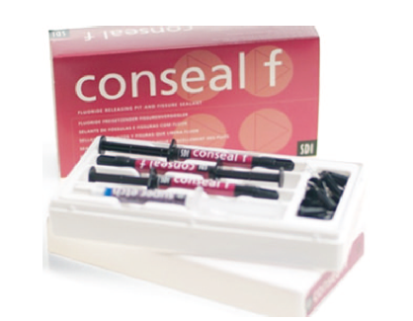
Fluoride releasing sealants
Garcia Godoy (1997)- greatest amount of fluoride release by 24 hours after mixing and the fluoride release declined sharply thereafter.
Cooley et al. (1990) and Hicks et al. (1992) conducted lab studies- fluoride release dips considerably as the days go by
Seal-Rite® (Pulpdent), FluoroShield® (Dentsply), Conceal F® (SDI).

Slide 4
Advantage:
Reduction of approximately 60% of secondary caries formation with use of fluoride releasing sealant as compared to conventional.
Primary caries formation in surface enamel adjacent to fluoride releasing sealant shows about a 35% reduction in lesion depth.

Slide 5
Authors | Formulation | Studied properties | Findings
Lee et al, 1971 | NaF or Na₂PO₃F added to polyurethane | Enamel acid solubility Fluoride release Fluoride uptake in enamel | Reduced enamel acid solubility Increased fluoride uptake Released fluoride upto 1 month
El Mehdawi, 1985 | 0.05%, 0.2%, 2% added to Nuva seal | Enamel acid solubility Fluoride release Physical properties Fluoride uptake in enamel | Decreased fluoride release over 3 week study period Increased fluoride release with highest fluoride concentration
Rock et al,1996 | Fluoroshield Vs Baseline | Fluoride release | Fluoride release twice for FluoroShield than baseline 25% total fluoride release in 2 weeks

Slide 6
Mechanism of action
(Rawls and Zimmerman- 1983)
Ion from saliva
Diffuses into resin
Exchange with fluoride ion
Diffused out and released

Slide 7
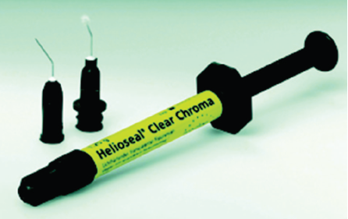
Clear pit and fissure sealants
This type of sealant is esthetic
Difficult to detect in recall visit
Helioseal®- Changes from green to white

Slide 8
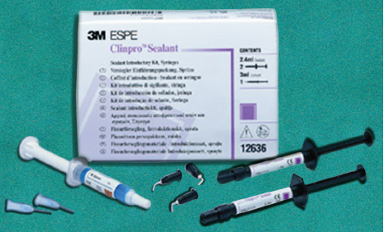
Colored pit and fissure sealants
The sealant is clear to begin with but after polymerization it changes its color.
The degree of color change is also an indicator of its setting and adequate polymerization.
Easy to see during placement and recall
Clinpro®—changes to pink on setting

Slide 9
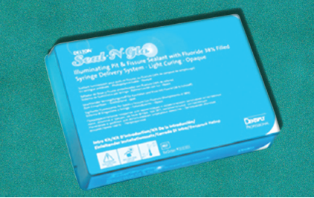
Fluorescing pit and fissure sealant
Helps in confirming placement during recall appointments.
Through the use of a UV pen light, this sealant fluoresces a blue/white color
The fluorescent glow provides clinicians with a visual verification
Easiest way to verify retention and inspect margins during patient recall appointments
Delton Seal-N-Glo (Dentsply)

Slide 10
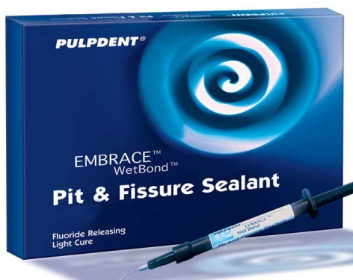
Moist bonding pit and fissure sealants
This is the first pit and fissure sealant resin that can be applied in a moist field.
Embrace WetBond incorporates di-, tri- and multifunctional acrylate monomers into an advanced acid integrating chemistry that is activated by moisture.

Slide 11
When placed in the presence of moisture, the sealant spreads over the enamel surface
Because of its unique chemistry, Embrace WetBond is miscible with water and flows into moisture-containing etched enamel and combines with it.
It forms a unique Resin Acid-integrating Network (RAIN) that improves penetration into pits and fissures and provides superior sealing of the margins.
It bonds chemically and micromechanically to the moist tooth, integrating with the tooth structure to create a strong, margin-free bond that virtually eliminates microleakage.
Its compressive strength is 3800 psi whereas the film thickness is only 12 microns thus it not only has good strength but also can be applied in thin layers.

Slide 12
Its advantages include wet bonding, tooth integrating, no marginal chipping, no need of bonding agent and contains no Bisphenol A; Bis-GMA or Bis-DMA.
Embrace WetBond™ (Pulpdent Corporation)

Slide 13
Title | Retention of Moisture-tolerant and Conventional Resin-based Sealant in Six- to Nine-year-old Children
Authors | Sachin G. Khatri, Srinivasan Raj Samuel, Shashidhar Acharya, Snehal Patil, Kavita Madan
Journal | Pediatr Dent 2015; 37(4):366-70
Level of evidence | I b
Aim | To evaluate and compare the retention rates and development of caries in permanent molars in children sealed with moisture-tolerant, resin-based (Embrace WetBond), and conventional resin-based (Helioseal) sealant over a period o f one year.
Methodology | This was a double blind, split-mouth, randomized controlled trial among six- to nine-year-olds. Sixty-eight permanent mandibular first molars in 34 children were randomly assigned to be sealed with Embrace WetBond or Helioseal sealant.
Result | The final sample was 32 children with 64 teeth. A t 12 months, 23 o f 32 (72 percent) sealants were completely retained in Embrace WetBond, whereas only 16 o f 32 (50 percent) were retained in the Helioseal group. There was a statistically significant difference in retention rates o f Embrace WetBond and Helioseal sealants a t 12 months (P<.05). A t 12 months follow-up, only two teeth developed caries in Embrace WetBond; in the Helioseal group, five teeth developed caries (two initial and three enamel caries).
Conclusion | Embrace WetBond was superior to Helioseal sealant, as Embrace exhibited higher retention and lower caries scores. Embrace WetBond can be preferred over conventional resin-based sealants for community and outreach sealant programs where use of rubber dam for moisture control is difficult to practice.

Slide 14
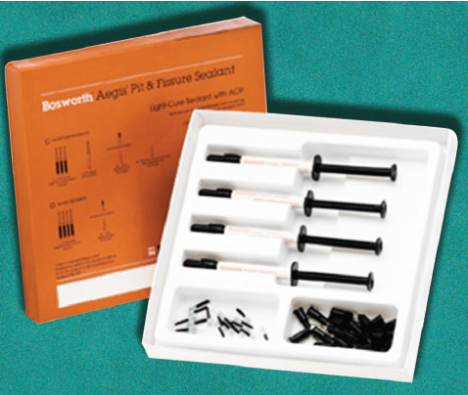
Pit and fissure sealant with ACP
It is a light-cured sealant that contains the “smart material” amorphous calcium phosphate (ACP) that is more resilient and flexible, creating a stronger, longer lasting sealant.
It only releases calcium and phosphate ions when the pH drops to 5.9.
Once the calcium phosphate is released, it will act to neutralize the acid and buffer the pH.

Slide 15
ACP acts as reinforcement to the tooth’s natural defense system only when it is needed.
It has a controlled flowability that keeps the sealant on the tooth structure while completely filling occlusal surfaces and it forms a chemical and thermal barrier protecting the tooth enamel on the occlusal surface from carious attacks.
Aegis® Pit and fissure sealant.

Slide 16
Title | Comparative evaluation of retention ability of amorphous calcium phosphate containing and illuminating pit & fissure sealants in 6-9 year old age group
Authors | Amit Kishor, Mousumi Goswami, Seema Chaudhary, Naveen Manuja, Rachita Arora, Mandeep Rallan
Journal | JISPPD 2013; 31(3): 159-65
Level of evidence | II b
Aim | The primary aim of this study is to evaluate and to compare the retention of two different pit and fissure sealants on permanent mandibular 1st molar teeth.
Methodology | Total of 110 children aged between 6-9 years were selected. In each child, Aegis with amorphous calcium phosphate sealant was applied on the permanent mandibular 1st molar of the right side while Delton the illuminating sealant was applied on the permanent mandibular 1st molar of the left side, keeping the permanent maxillary 1st molars as control. The treated teeth were evaluated for retention of sealants at 3, 6 and 12 months interval.
Result | The results were showed that retention and loss of sealant from the occlusal surfaces of the sealed teeth in both groups was maximum between 3 and 6 months.
Conclusion | Though statistically no significant difference was observed between the two groups, sealant with ACP showed better retention than the illuminating sealant.

Slide 17
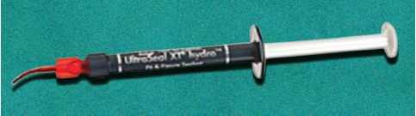
Hydrophilic fluorescent BPA free pit and fissure sealant
This is a new sealant developed which combines the best properties of nearly all sealants.
Some of its major properties are hydrophilic chemistry, advanced adhesive technology, fluorescent properties, thixotrophic viscosity, BPA-free formula.

Slide 18
Thus not only can it be used in wet environment but also is easy to place owing to thixotrophic viscosity and is easy to follow up due to fluorescence.
To prevent nay estrogenicity issues the manufacturer has kept it BPA free.
UltraSeal XT® hydro.

Slide 19
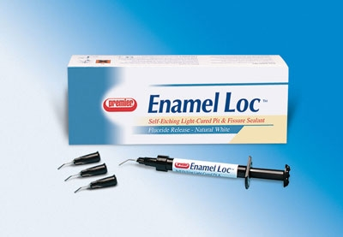
Enamel LocTM
Enamel Loc™, the world's first and only self-etching sealant
Since there is no acid-etching required, the potential for patient gagging during rinsing, from the bad taste and pungent odors, is eliminated.

Slide 20
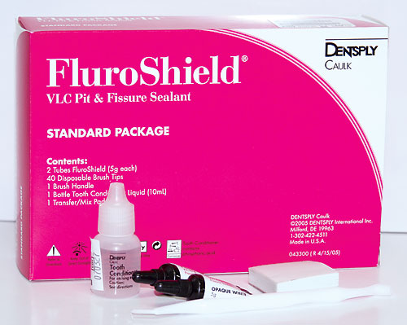
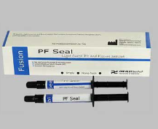
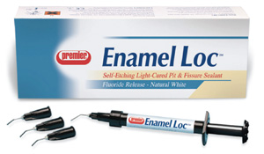
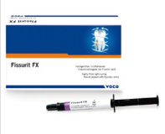
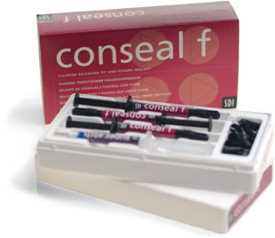

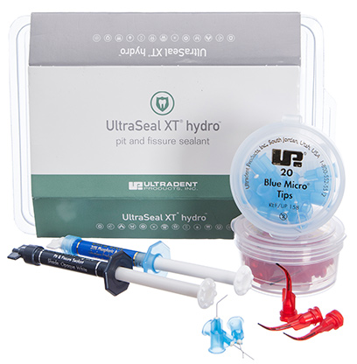
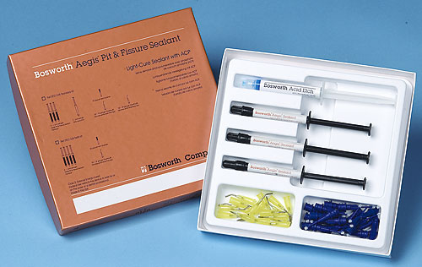
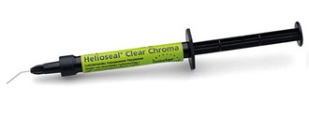
Rs. 680/-
Rs. 1658/-
Rs. 3070/-
Rs. 3500/-
Rs. 590/-
Rs. 1125/-
Rs. 1900/-

Slide 21
References
Barbara Cvikl et al, Pit and Fissure Sealants—A Comprehensive Review, Dent. J. 2018, 6, 18; doi:10.3390/dj6020018
Ramamurthy P, Rath A, Sidhu P,Fernandes B, NettemS, Muttalib K, Fee PA, Zaror C, Walsh T. Sealantsfor preventing dental caries in primary teeth. CochraneDatabaseof SystematicReviews 2018, Issue 3. Art. No.: CD012981. DOI: 10.1002/14651858.CD012981.
Cvikl B, Moritz A, Bekes K. Pit and Fissure Sealants—A Comprehensive Review. Dentistry Journal. 2018; 6(2):18.
Young, D.A.; Novy, B.B.; Zeller, G.G.; Hale, R.; Hart, T.C.; Truelove, E.L. The American Dental Association Caries Classiﬁcation System for clinical practice: A report of the American Dental Association Council on Scientiﬁc Affairs. J. Am. Dent. Assoc. 2015, 146, 79–86
Brown LJ, Selwitz RH. The impact of recent changes in the epidemiology of dental caries on guidelines for the use of dental sealants. J Public Health Dent 1995;55:274-91.
Norman o haris, franklin Garcia- godoy, primary preventive dentistry, 6th edition, Julie Levin alexander,2004
Tandon S. Textbook of Pedodontics. Second Edition. Paras, 2008.
Simonsen RJ. Pit and ﬁssure sealant: review of the literature. Pediatric Dentistry 2002;24:393–414.

Slide 22
Gray GB. An evaluation of sealant restorations after 2 years. Br Dent J 1999;186:569-75.
Babu, et al.: Pit and fissure sealants, SRM Journal of Research in Dental Sciences | Vol. 5 | Issue 4 | October-December 2014
Brown LJ, Selwitz RH. The impact of recent changes in the epidemiology of dental caries on guidelines for the use of dental sealants. J Public Health Dent 1995;55:274-91.
Limeback, H. Comprehensive Preventive Dentistry, 1st ed.; John Wiley & Sons: Hoboken, NJ, USA, 2012.
Murnseer C, Rosentritt M, Handel G. Three body wear of fissure sealants. J Dent Res 2007;86:417.
Naaman R. et al, The Use of Pit and Fissure Sealants—A Literature Review, Dent. J. 2017, 5, 34; doi:10.3390
Alhareky, M.S.; Mermelstein, D.; Finkelman, M.; Alhumaid, J.; Loo, C. Efﬁciency and Patient Satisfaction with the Isolite System Versus Rubber Dam for Sealant Placement in Pediatric Patients. Pediatr. Dent. 2014, 36, 400–404

Slide 23
Welbury, R.; Raadal, M.; Lygidakis, N. EAPD guidelines for the use of pit and fissure sealants. Eur. J. Paediatr.Dent.2004,5,179–184
Kloukos, D.; Pandis, N.; Eliades, T. In vivo bisphenol-a release from dental pit and ﬁssure sealants: A systematic review. J. Dent. 2013, 41, 659–667
Burbridge L, Nugent Z, Deery C. A randomized controlled trial of the effectiveness of a one-step conditioning agent in sealant placement: 6-month results. Int J Paediatr Dent 2006;16:424-30.
Ryge G, Snyder M. Evaluating the clinical quality of restorations. J Am Dent Assoc 1973;87:369-377.
Pediatric Dentistry Scientific Foundation & Clinical Practice- Stewart Fundamentals Of Pediatric Dentistry. Richard Mathewson 3rd Edition 1995 Quintessence Publishing Co.Inc
Kumar S. Recent Advancements in Pit and Fissure Sealants: A Monograph. Sch. J. Dent. Sci., Vol-5, Iss-11 (Nov, 2018): 524-526
Arther J. nowak,pediatric dentistry infancy through adolescence,6th edition,Elsevier,Inc.,2019

Slide 24

THANK YOU

