Slide 1
Biostatistics
DR. SWETA SINGH
Professor
Public Health Dentistry, KM Shah Dental College and Hospital
Sumandeep Vidyapeeth (Deemed to be University), Piparia, Gujarat

Slide 2
introduction
“Statistics” has origin from
  Greek word “statista” -“Statesman”
  German word “statistik”- “political state”
John Graunt (1620-1674): father of Health Statistics
Medical statistics
  Health statistics
  Medical statistics
  Vital statistics

Slide 3
Types of data
Data = collective recording of observations.
Data
Quantitative
Discrete
Ex. Number of teeth
Continuous
Ex. Ht, weight
Qualitative

Slide 4
Measures of central tendency:
The generalized concept of the "average" value of a distribution.
To condense the entire mass of data
To facilitate comparison
Typical measures of central tendency are the
  Mean ( mathematical estimate)
  Median ( positional estimate)
  Mode ( based on frequency)
The word average is a broad term that applies
to several measures of central tendency such as mean,
median, mode

Slide 5
The Mean
  Arithmetic average = (sum all values)/# of values
    Population: µ = (Σx_{i})/N
    Sample: X = (Σx_{i})/n

Slide 6
Geometric versus Arithmetic mean
Geometric mean of n positive numerical values is the nth root of the product of the n values.
Geometric will always be less than arithmetic.
Geometric better when some values are very large in magnitude and others are small.
If geometric is used, log-transform the data before analyzing.
Langley R., Practical Statistics Simply Explained, 1970, Dover Press

Slide 7
Harmonic mean
= reciprocal of the average of reciprocals of the values of the items of a series.
H.M = Rec. Rec.X₁ + Rec.X₂+….+ Rec.X_{n}
n
Has limited application
Used in time and motion study where time is variable and distance constant

Slide 8
The Median
= Mid value of series
When all the observation are arranged either in ascending order or descending order, the middle observation is known as median
In case of even number the average of the two middle values is taken
The median of an even set of data values is not necessarily a member of the set of values
The median is particularly useful if there are outliers in the data set, which otherwise tend to sway the value of an arithmetic mean.

Slide 9
The Mode
Most frequently occurring observation in a data is called mode
While there is just one value for the mean and one value for the median, there may be more than one value for the mode of a data set.
The mode tends to be less frequently used than the mean or the median.

Slide 10
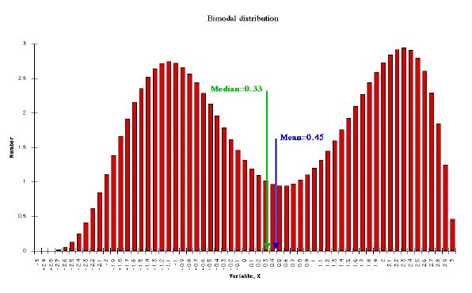
Bi-modal distributions
Bi-modal distributions can have a
  Major mode
  Minor mode
  When mode is ill defined, it can be calculated using the relation
  Mode = 3 Median – 2 Mean

Slide 11
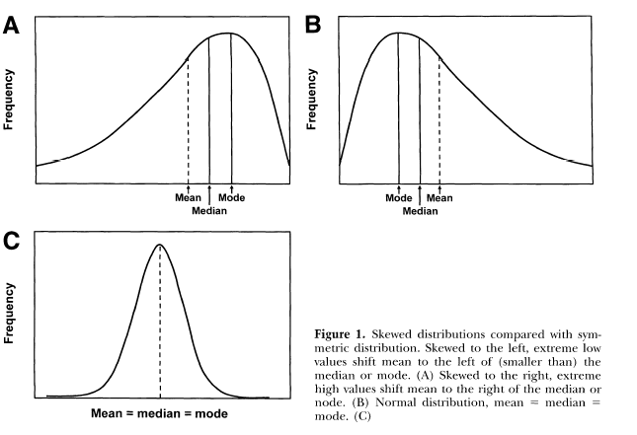

Slide 12
references
Rao sunder, Richard: An introduction to biostatistics 2nd edition 1983, Prestografik press.
Donald H. Sanders: A first course in statistics, 5th edition. Mc Graw Hill.
Mahajan BK: Methods in Biostatistics.6th edition 1997; Jaypee Brother, New Delhi 35-57.
T Bhaskararao: Methods of Biostatistics.
Jong’s Community Dental Health, 5th edition.
Dunning: Principles of Dental Public Health, 4th edition.

Slide 13
Smith F Gao, Smith J.E.; Clinical Research: 64-68.
Health Research Methodology; WHO 1992.Oxford University Press. 79-86.
Park. Textbook of social and preventive medicine. M/S Banarsidas publishers. 15th edition 1997.

