Slide 1

PRINCIPLES
OF
Atraumatic Restorative Treatment
Dr. Hemal Patel
Dept. of Public Health Dentistry
K.M. Shah Dental College & Hospital

Slide 2
CONTENTS
Introduction
Principles of ART

Slide 3
The loss of even a part of a human tooth should be considered
“a serious injury,” and that dentistry’s goal should be to
“preserve healthy, natural tooth structure”
- Miles Markley 1951

Slide 4
INTRODUCTION
Dental caries : three decades : global perspective it still is a wide spread problem.
Carious lesions - untreated in people of low
resource settings.
Untreated caries → to a stage that extraction is the ideal treatment.

Slide 5
ART : based on knowledge of
Minimal intervention,
Minimal invasion
Minimal cavity preparation for carious lesion
This procedure :
- Millions of people in less industrialized countries
- Deprived communities .

Slide 6
DEFINITION
The Atraumatic Restorative Treatment (ART) is a procedure based on removing carious tooth tissue using hand instrument alone and restoring the cavity with an adhesive restorative material.

Slide 7
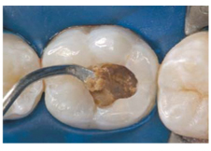
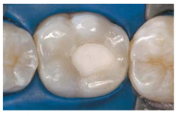
PRINCIPLES OF ART
Removing carious tooth structure using hand instrument only.
Restoring the cavity with a restorative material that sticks to the tooth

Slide 8
CONCLUSION
Atraumatic Restorative Treatment approach stands as a excellent alternative method for treating caries lesions in a diverse variety of situations, ranging from rural settings to a modern pediatric clinic.

