Slide 1
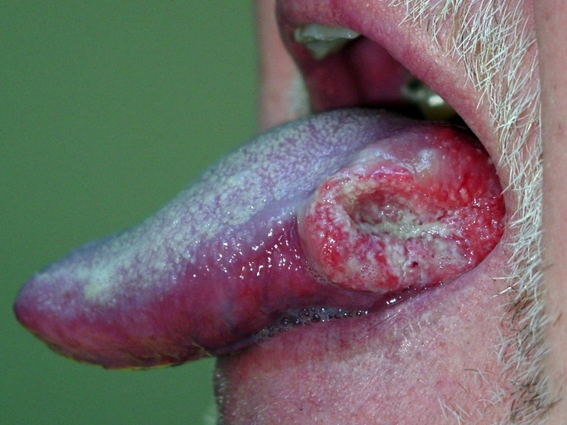
Tobacco cessation
Dr. Pulkit Kalyan
Reader
Department of Public Health Dentistry
K M Shah Dental College and Hospital

Slide 2
contents
INTRODUCTION
TYPES
CONSTITUENTS OF SMOKED TOBACCO
CARCINOGENS IN TOBACCOTOBACCO CONTROL PROGRAMMES
INITIATIVES BY WHO

Slide 3
INITIATIVES BY IDA
PREVENTION
CONCLUSION
REFERENCES

Slide 4
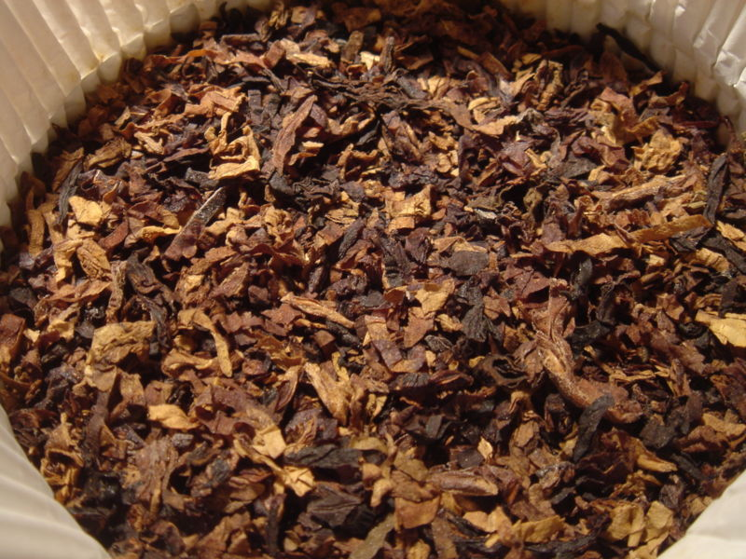
introduction
Christopher Columbus
Powdered leaves inhaled by Indians in a Y shaped cone or pipe….TOBAGO or TOBACCA .
TOBACCO….. Island named Tobago in West Indies.
Europe …. Tobacco relieved toothache.

Slide 5
Types
SMOKED TOBACCO
Bidi
Chillum
Chutta
Cigarettes
Dhumti
Gudakhu
Hookah
Hookli
SMOKELESS TOBACCO
Khaini
Mainpuri tobacco
Marwa
Mishri/Masheri
Paan
Paan masala
Gutka
Zarda
Snuff

Slide 6

Constituents of tobacco smoke
Nicotine
Tar
Nitrogen oxide
Metals
Carbon Monoxide
Radioactive compounds
Hydrogen cyanide and other ciliatoxic agents.

Slide 7
Carcinogens in tobacco
Smokeless Tobacco
Smoked Tobacco
(S)-NNN
(R)-NNN
4-(methylnitrosamino)-1-(3-pyridyl)-1-butanone (NNK)
Acetaldehyde
Acrylonitrile
4-Aminobiphenyl
Anisidine hydrochloride
Arsenic
Benzene
Hydrazine
Isoprene
N-Nitrosodiethanolamine
N-Nitrosonornicotine

Slide 8
Tobacco and oral diseases
Oral precancerous lesions
Leukoplakia
Erythroplakia
Smokeless tobacco keratosis
Oral cancers :
Squamous cell carcinomas of the
Tongue
Floor of the mouth
Lip
Gingiva
Verrucous carcinomas of the:
Buccal mucosa
Gingiva
Alveolar ridge

Slide 9
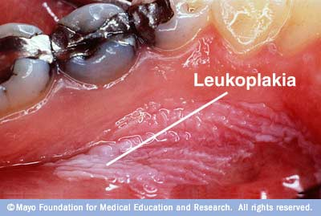
Periodontal diseases
Increased plaque and calculus depositions
Ischaemia
Gingival inflammation
Periodontal pockets
Gingival recession
Alveolar bone loss
Root caries
Peri-implantitis
Halitosis
Taste derangement
Stained teeth and restorations

Slide 10
Tobacco control programmes
National Tobacco Control Programme
The GOI ….National Tobacco Control
Chandigarh and District Tobacco Control Units in the State of Punjab are to be set up at District Head Quarters.
Prohibition of smoking in public places implemented 2nd Oct, 2008 in India.
Prohibition of advertisement, sponsorship and promotion of tobacco products.

Slide 11
Prohibition of sale of tobacco products near educational Institutions
Regulation of health warning in tobacco products packs.
Voluntary organizations like the HRIDAY-SHAN, CPAA-Cancer patients aids association, the Salaam Mumbai Foundation, Health Bridge, Voluntary Health Association of India, etc. are actively involved in tobacco control activities in India.

Slide 12
Healis ….research in tobacco control.
The Public Health Foundation of India (PHFI) has launched a multi-faceted website to create an enabling environment for tobacco control in the country.

Slide 13
Who initiatives
WHO framework convention on tobacco control
The WHO framework convention on tobacco control (WHO FCTC). It was adopted by the World Health Assembly in May 2003, and India was the eighth country to ratify it on 5 February 2004.
The success of the WHO FCTC, which as of July 2009 had more than 160 parties covering 86% of the world's population, demonstrates the global political will for making tobacco control far more comprehensive and successful.

Slide 14
The WHO has established the MPOWER package to help countries comply with the WHO FCTC. This is a package encompassing six most important and effective tobacco control policies:
Monitoring tobacco use and prevention policies
Protecting people from tobacco smoke
Offering help to people to quit tobacco use
Warning everyone about the dangers of tobacco
Enforcing ban on tobacco advertising
Promotion and sponsorship and Raising taxes on tobacco.

Slide 15
Initiatives by Ida
115 Tobacco Intervention Initiative (TII) centers across 16 states in India over the last one year and plan to increase this number to 5,000 by 2013
Private dental practitioners who are trained through a one day training program by the Association in tobacco intervention
Create a tobacco-free India by 2020.
Establishing a chain of TII centres and making the service of Tobacco Intervention accessible to all.

Slide 16
Prevention by awareness creation and knowledge dissemination
Fostering commitment to tobacco cessation by training dental professionals.
Creating a workforce of talented and skilled professionals.
Promoting timely transfer of knowledge from tobacco related research and its implications on health to the public, oral health professionals and policy-makers.

Slide 17
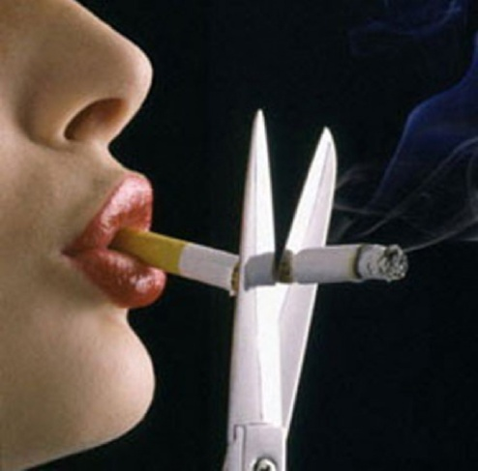
prevention
. It has been estimated that a lack of cessation services may lead to an additional 160 million global deaths among smokers by 2050.
A majority of tobacco users (nearly 70%) wish to quit the habit, but only 3–5% succeed in doing so.
The WHO in collaboration with the MHFW, GOI…13 tobacco cessation centers (TCC) in 2002.
This number has now increased to 19.

Slide 18
PRIMORDIAL PREVENTION
Health education especially in schools
PRIMARY PREVENTION
Tobacco cessation services to tobacco users who have not yet exhibited any tobacco related diseases
To be provided in clinics
Checkups & Monitoring
Enforcing policies
To be provided in community & clinics

Slide 19
SECONDARY PREVENTION
Screening of oral cancer and pre-cancerous lesions
TERTIARY PREVENTION
For heavy users and victims of tobacco related oral diseases
Disease treatment plus cessation services.
To be provided in special clinics & hospitals.

Slide 20
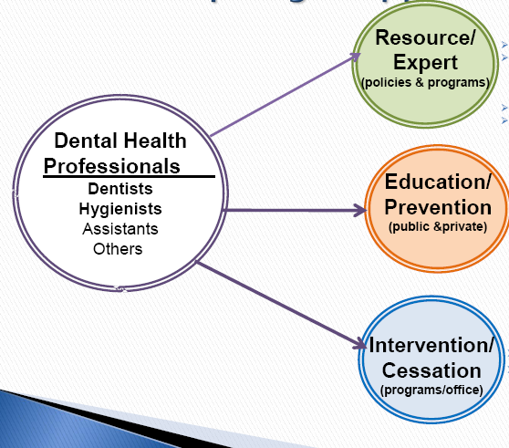
Role of dentist

Slide 21
There are 5 crucial steps in advising people to stop smoking:
Ask
Assess
Advise
Assist
Arrange

Slide 22
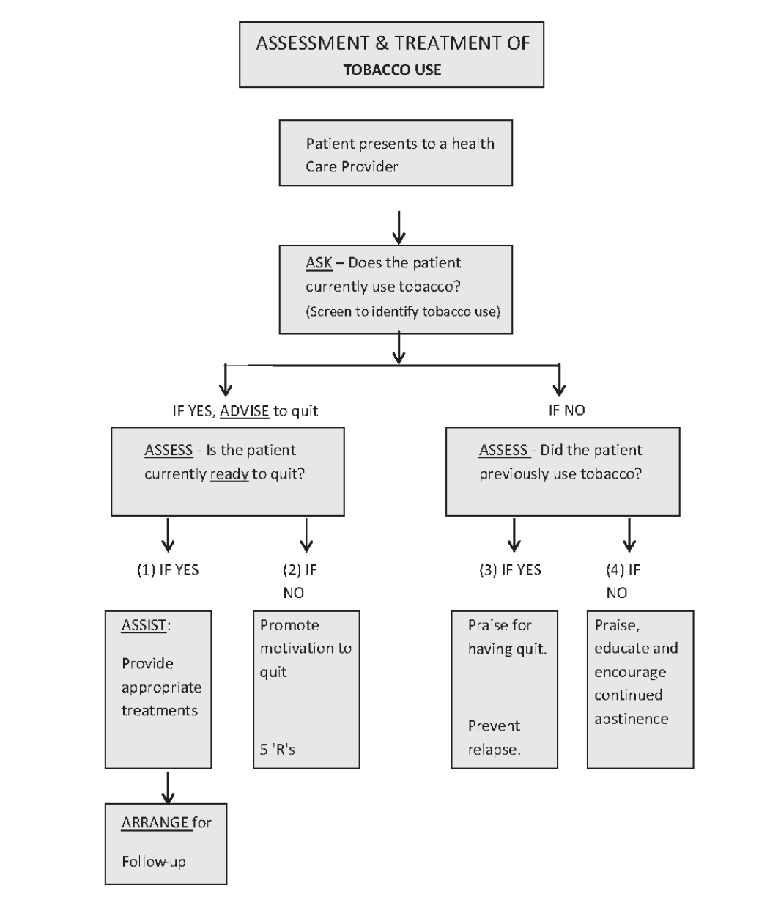

Slide 23
Counseling for those unwilling to QUIT
Relevance of Quitting
Risk
Rewards
Roadblocks
Repetition

Slide 24
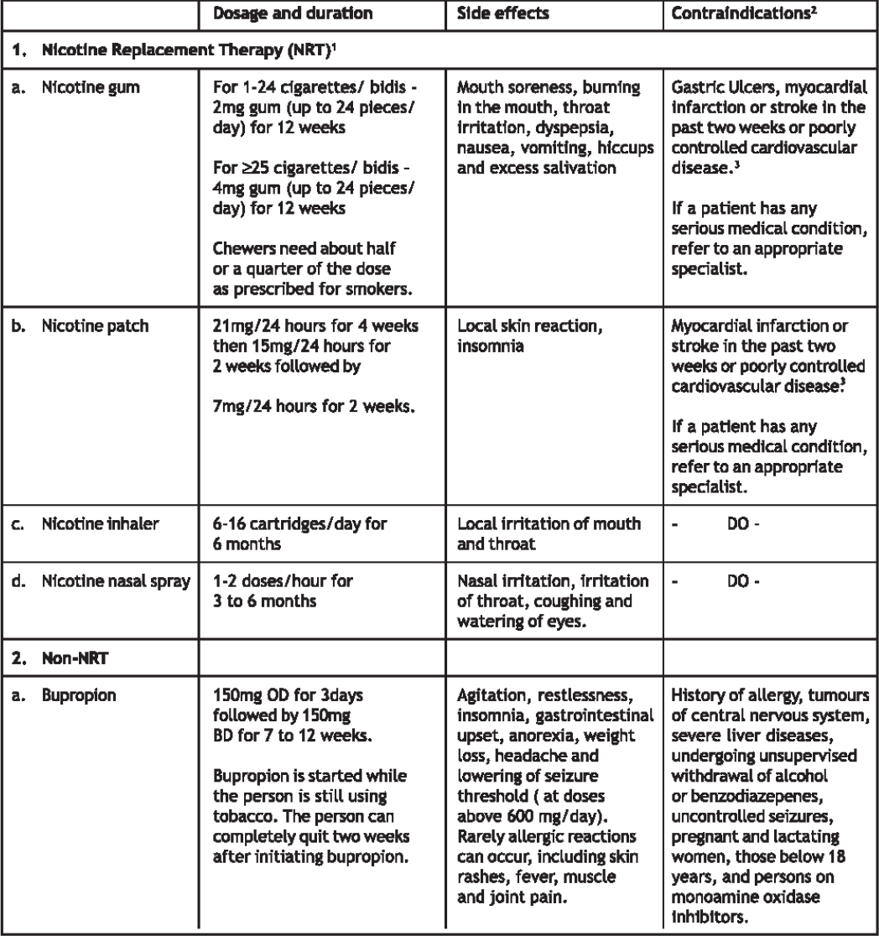

Slide 25
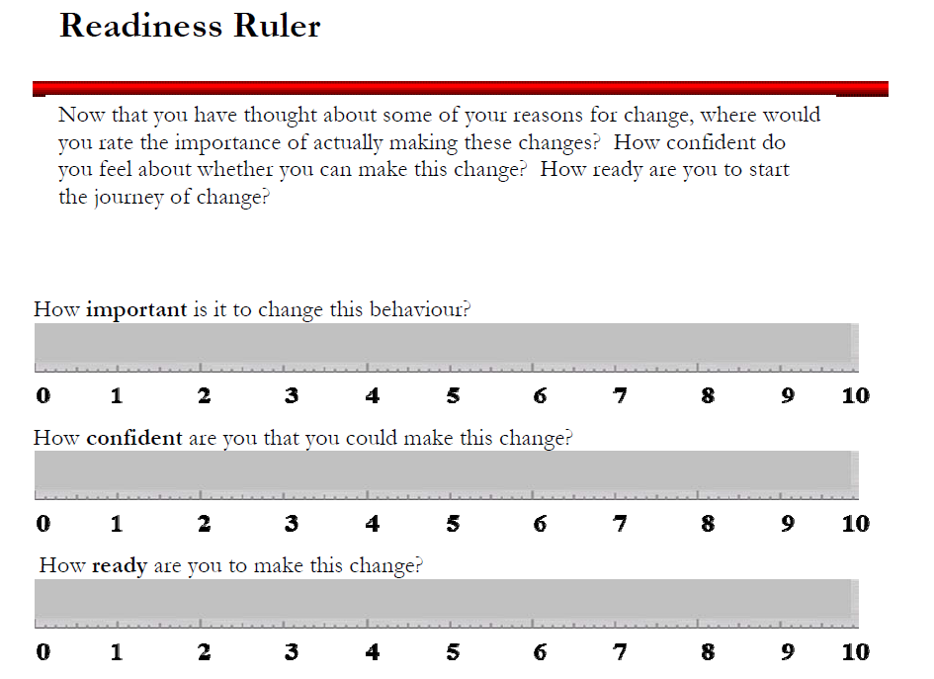

Slide 26


Slide 27
Conclusion
India’s tobacco problem is unique and intricate in its own way and demands a lot of involvement from all fronts if it has to be controlled.
Tobacco control strategies need to mainstreamed with other national programs and also calls for greater involvement and investment from various stakeholders like ministries/departments, institutions, academic/public health institutions, civil society groups, media.

Slide 28
References
Peter S. Essentials of Preventive and Community Dentistry. 4th edi Arya Medi Publishing House New Delhi India.
Johnson NW, Bain CA. Tobacco Intervention: tobacco and oral disease British Dental Journal 2000; 189: 200-206.
Bokot-Btsyiv M, Vuckovic N. Cigarette smoking as a risk factor associated with oral leukoplakia (pdf). Archive of Oncology 2002; 10 (2): 67-70.
Allard R, Johnson N, Sardella A et al. Tobacco and Oral Diseases – Report of EU Working Group, 1999. Journal of Irish Dental Association 1999; 46(1): 12-23.

