Slide 1
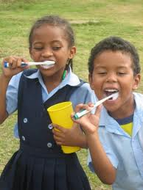
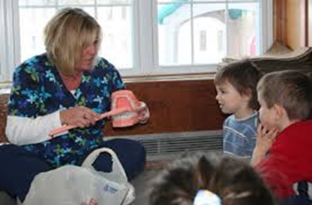
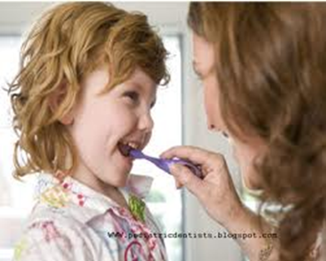

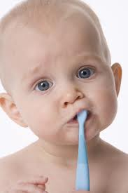
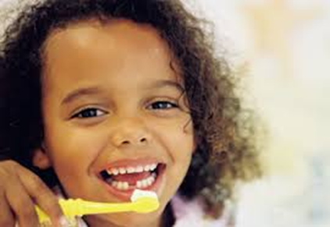
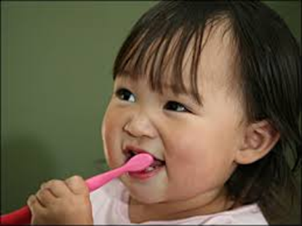
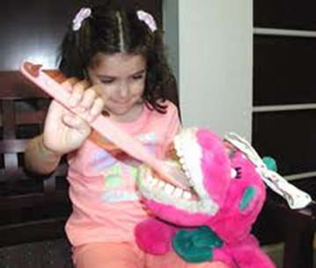
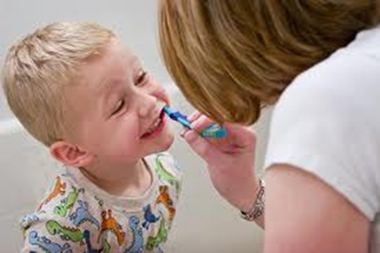
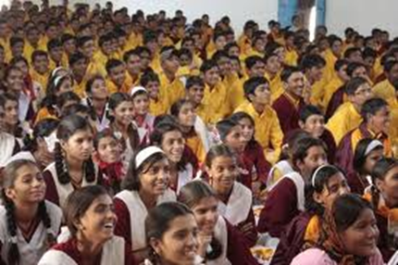
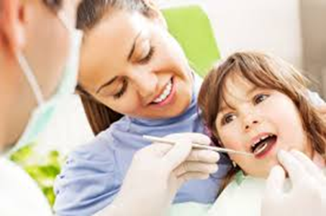
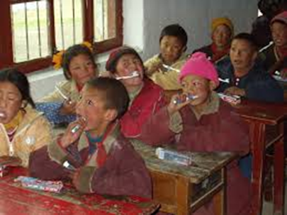
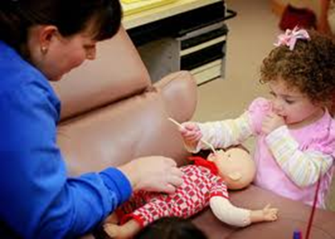
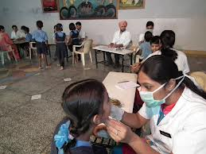
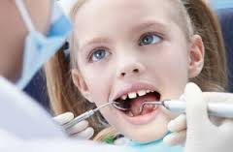
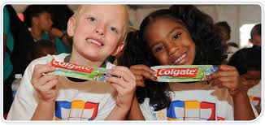

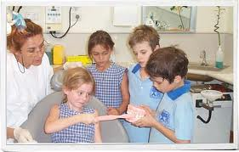

VARIOUS SCHOOL DENTAL HEALTH PROGRAMS
Dr. Pranav R. Kurup

Slide 2
SOME SCHOOL DENTAL HEALTH PROGRAMS:
“ LEARNING ABOUT YOUR ORAL HEALTH” – A PREVENTION ORIENTED
SCHOOL PROGRAM”
PRIMARY GOAL :To develop the knowledge, skills & attitudes needed for prevention of dental diseases among school children.
Teaching packet includes:
  Guide on ”dental health facts” with a section on handicapped children
  Glossary of dental health terms
  Lesson plans
  Methods & activities for parental involvement & printed material & films
EVALUATION:
It influenced the oral hygiene behaviour and provided education for same

Slide 3
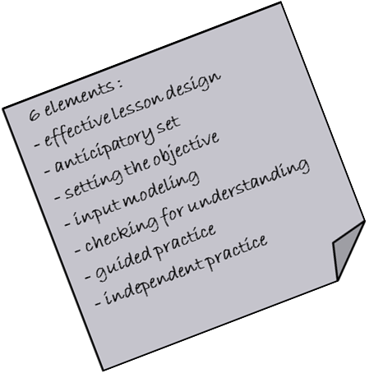
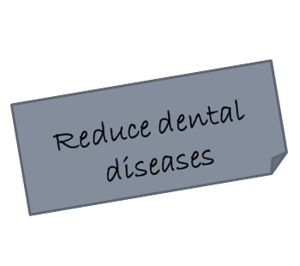
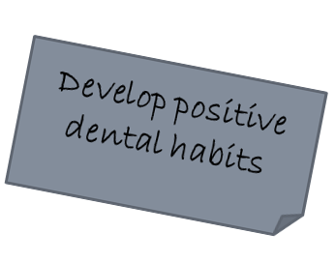
(2) TATTLE TOOTH PROGRAM – TEXAS STATEWIDE PREVENTIVE DENTISTRY PROGRAM :
Program philosophy and goals :
Three video tapes were produced :
1st videotape - familiarizes teachers with the lessons
2nd videotape - “brushing & flossing”
3rd videotape - additional background information

Slide 4
Program implementation :
16 hygienists were employed to implement it
    Program evaluation :
    Dental health knowledge was significantly increased
    Plaque level was 15 % decreased
  Health promotion activities
Book list, films & videotapes are available on a free loan
Instruction to teachers through videotapes
  Demonstration by Dental professionals
field trip to dental office

Slide 5
(3) NORTH CAROLINA STATEWIDE PREVENTIVE DENTAL HEALTH PROGRAM
19 videotapes were produced based on report by Frank E Law that defined the extent of dental disease in north Carolina
Program implementation :
Objectives:
Appropriate use of fluoride
Health education in schools
Availability of public health dental staff in all countries
Fluoridation of water supplies of 130 rural schools
Application of
dental sealants
Screening & referral
Weekly fluoride mouth rinse

Slide 6

Program evaluation :
86% reduction in dental caries after 4 years of sealant use on permanent teeth
34% reduction in decayed, missing & filled permanent teeth among children who had 8 years experience drinking fluoridated water
53 % reduction in decayed, missing & filled permanent teeth among children who had 10 years experience drinking fluoridated water

Slide 7
- focuses on assisting children from low income families
(4) HEAD START – PRE-
SCHOOL DENTAL
HEALTH PROGRAM
(5) SCHOOL HEALTH
ADDITIONAL REFERRAL
PROGRAM (SHARP)
(6) TEENAGE HEALTH
EDUCATION TEACHING
ASSISSTANT
PROGRAM
(THETA Program)
- Motivation through home visits
- Carried out by district nurses
- One to one basis of health guidance
Dental personnel
High school children
Elementary school
children
- Allows high school children to develop understanding of young children & give them career opportunities
(teach)
(teach)

Slide 8

(7) ASKOV DENTAL DEMONSTRATION :
Dental care was rendered by a group of 5 dentists of the Minnesota dept. of health
Results of a 10 year period :
28% reduction in dental caries in deciduous caries in children of age 3-5 years
34% reduction in caries in permanent teeth of children of 6-12 years old
14% reduction in permanent teeth of children 13-17 years old

Slide 9

(8) COLGATE’S BRIGHT SMILES, BRIGHT FUTURES :
Developed to teach children positive oral health habits of basic hygiene, diet & physical activity.
Things undertaken :
Instructions by dental professionals nominated by IDA
Education by audio-visual & printed literature
Free dental health care packs are distributed to encourage good oral hygiene

