Slide 1
BDS Year 4th Regular batch
Academic Year 2021-2022
Subject: Conservative Dentistry & Endodontics
Topic: Endodontic Surgery
Dr. Renu Batra
Professor
Dept. of Conservative Dentistry & Endodontics

Slide 2

CONTENTS
Introduction
Definition
History
Indication
Contraindication
Classification of Endo. surgeries
1.Trephination
2.Periradicular curretage
3. Periradicular surgery
(i) Root end resection (Apicectomy)
(ii) Root end preparation & filling
Conclusion

Slide 3
INTRODUCTION
Surgical intervention is required where endodontic treatment has failed and tooth is to be retained rather than extracted.
The percentage of success of endodontic treatment has been consistently high but failures may arise due to infection, poor access cavity preparation, inadequate instrumentation, obturation, missed canals and coronal leakage.
So if this happens, Surgical endodontics is needed to save the tooth.
Notes:
nomen [ L.] a name. general terminology: terms that denote a general structure type to which a number of specific structures belong.
nomenclature [nomen + calare to call] a classified system of names, as of anatomical structures, organisms, etc.

Slide 4
Definition-
Surgical endodontics is defined as ” Removal of tissues other than the contents of root canal to retain a tooth with pulpal or periapical involvement”

Slide 5
History
Surgical endodontics is not a recent innovation.
In 11th century, first case of endodontic surgery was performed by Abulcasis.
Root end resection was first documented in 1871 and apicectomy with retrograde cavity preparation and filling with amalgam was documented in 1890.

Slide 6
Root amputation was first introduced by Black and Inlitch in 1886 , then was dealt by Younger (1894) and Guerini (1909)
In 1930, indications for endodontic surgery were proposed.
In 1940, Triangular flap was first described by Fischer.
Neumann and Eikan descibed Trapezoidal flap in 1940.
Semilunar incision was first described by Partsch hence it is also known as Partsch incision.

Slide 7
INDICATIONS
1. Need for surgical drainage
2. Failed endodontic treatment
1. Irretrievable root canal filling material
2. Irretrievable intraradicular post
3. Calcification of the pulp space
4. Procedural errors
1. Instrument fragmentation
2. Non-negotiable ledging
3. Root perforation

Slide 8
5. Symptomatic overfilling.
6. Anatomic variations.
A. Root dilaceration.
B. Apical root fenestration.
7. Biopsy.
8. Corrective surgery.
1. Root resorptive defects
2. Root caries
3. Root resection
4. Hemi-section
5. Bi-cuspidization

Slide 9
CONTRAINDICATIONS
Poor systemic health.
Local anatomical considerations
Poor periodontal status.
Non restorable teeth

Slide 10
CLASSIFICATION OF ENDODONTIC SURGICAL PROCEDURES
I. Surgical drainage
1. Incision and drainage
2. Cortical trephination (fistulative surgery)
II. Periradicular surgery
1. Curettage
2. Biopsy
3. Root-end resection
4. Root-end preparation and filling

Slide 11
5. Corrective surgery
i. Perforation repair
a. Mechanical (iatrogenic)
b. Resorptive (internal and external)
ii. Root resection
iii. Hemisection & Bi-cuspidization
III. Replacement surgery
i. Replantation
IV. Implant surgery
1. Endodontic implants

Slide 12
Incision and drainage
In most cases drainage through the canal is all that is needed to treat the periradicular abcess of pulpal origin but there are times, when invasion of anatomic spaces has extended to a point that does not allow drainage through the tooth, and effectively remove the pus then It becomes mandatory to incise and drain the abcess.

Slide 13
PRINCIPLES:
1. Avoid severing vessels and nerves
2. Make incisions far away from the surgical
area to ensure that the wound margins are
over sound bone and there is room for
adjustments when unexpected extensions
are necessary.
3. Design the flap so that there is adequate
visibility without overexposure of bone.

Slide 14
4. The base of the flap should be the widest
portion to maintain proper circulation.
5. There should be no sharp angles on the flap
6. Vertical or oblique incision should not be
over root eminence. It is best to incise in the
trough.

Slide 15
7. Maintain the integrity of the interdental
papillae.
8. Use sharp instruments to avoid tearing the
mucoperiosteum.
9. Be gentle with the flap.
10. Do not incise close to the gingival sulcus
while using a horizontal or semilunar
incison

Slide 16
Types of incisions
Vertical incision
Sulcular incision
Semilunar incision
Modified semilunar incision
Ochsenbein-Leubke incision

Slide 17
Classification of Flaps:
1. Full mucoperiosteal flaps:
(a) Triangular (one vertical releasing incision)
(b) Rectangular (two vertical releasing incisions)
(c) Trapezoidal (broad-based rectangular)
2. Limited mucoperiosteal flaps
(a) Submarginal curved (semilunar)
(b) Submarginal scalloped rectangular (Ochsenbein-
Luebke)

Slide 18
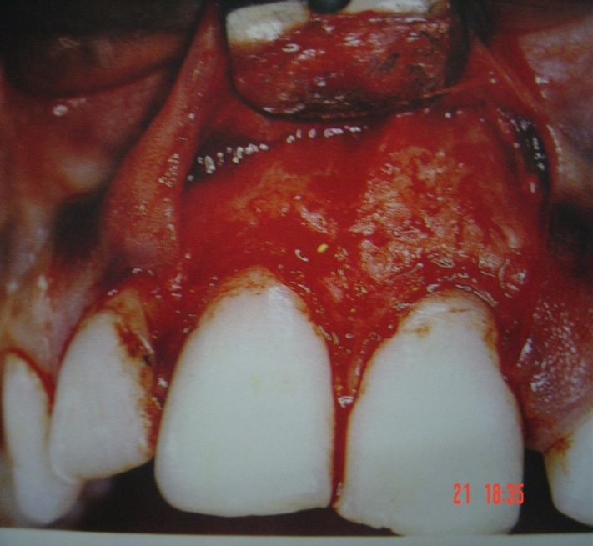
Full Mucoperiosteal Flaps.
TRIANGULAR FLAP.
The triangular flap is formed by a intrasulcular incision and one vertical releasing incision
Prof Renu Batra

Slide 19
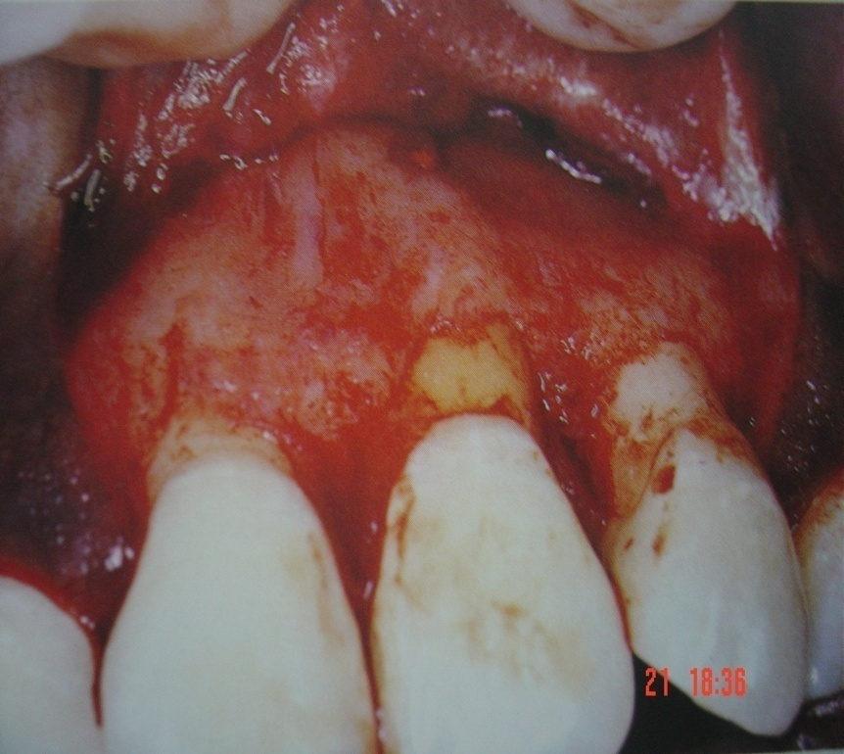
RECTANGULAR FLAP:
The rectangular flap is formed by an intrasulcular and two vertical releasing incisions.

Slide 20
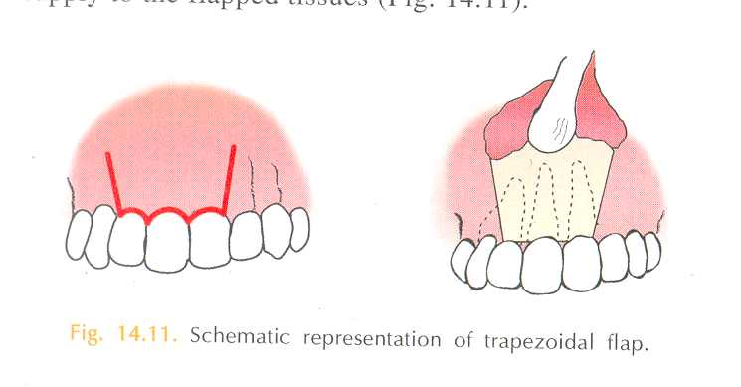
TRAPEZOIDAL FLAP:
Similar to the rectangular flap with the exception that the two vertical releasing incisions meet intrasulcular incision at an obtuse angle.

Slide 21
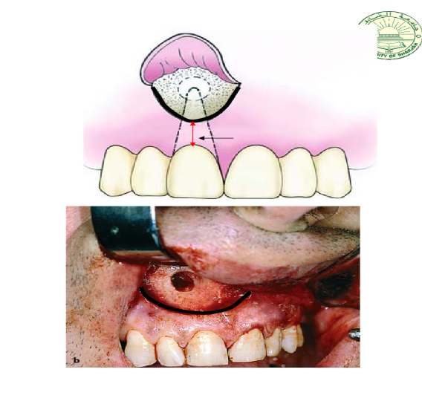
Limited Mucoperiosteal Flaps:
Submarginal Curved (Semilunar) Flap:
The submarginal or semilunar flap is formed by a curved incision in the alveolar mucosa and the attached gingiva

Slide 22
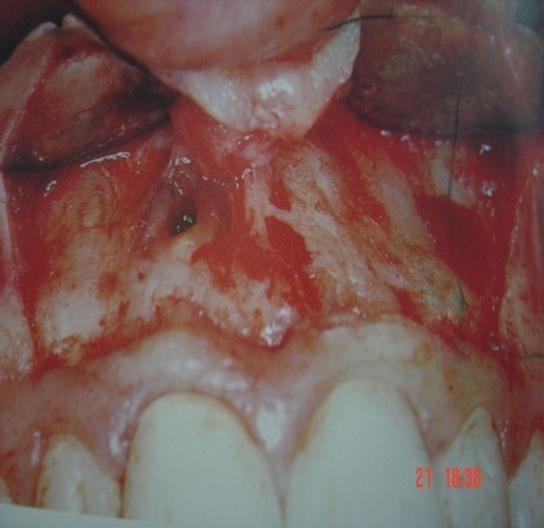
Submarginal scalloped rectangular (Luebke-ochsenbein) flap
The submarginal scalloped rectangular flap is a modification of the rectangular flap in which the horizontal incision is not placed in the gingival sulcus but in the buccal or labial attached gingiva.

Slide 23
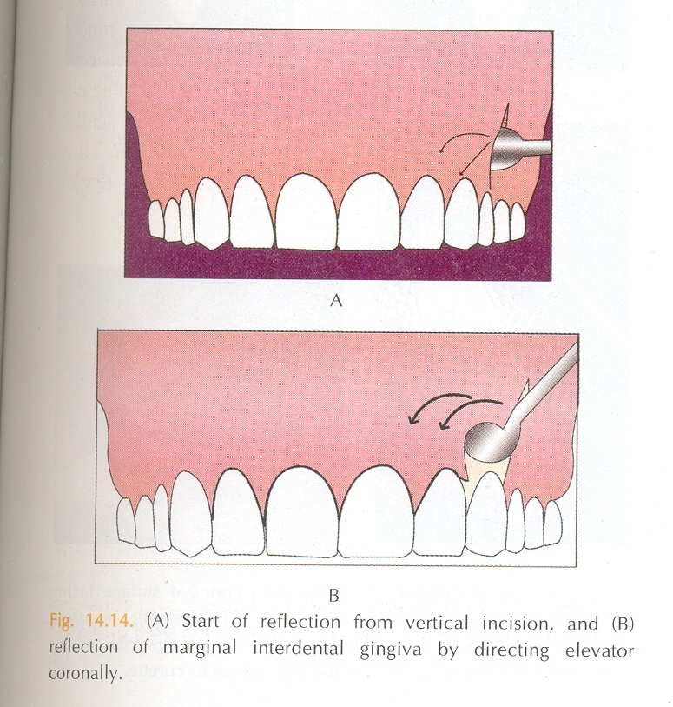
FLAP REFLECTION:
Flap reflection is the process of separating the soft tissues (mucosa and periosteum) from the surface of the bone.
The periosteal elevator is used gently to elevate the periosteum and its superficial tissues from the cortical plate.

Slide 24

After reflection of the attached gingival tissues, elevation is continued more apically lifting the alveolar mucosa along with periosteum until adequate surgical access is obtained.
A thin gauze may be used for reflection to prevent tearing of the flap.

Slide 25
OSTEOTOMY:
Osteotomy is the removal of some portion of the cortical plate to expose the root end.
Clinician should precisely locate the root end.
A number of factors should be considered to determine the location of the bony window.
The angle of the crown to the root should be assessed.

Slide 26
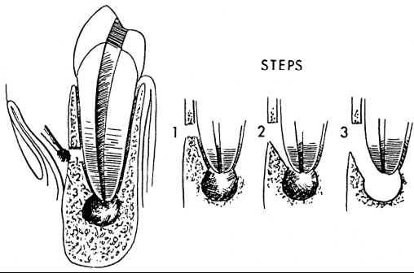
When the cortical plate is intact, locate the body of the root coronal to the apex where the bone covering the root is thinner.
Once the root has been located and identified, the bone covering the root is slowly and carefully removed with light brush strokes, working in an apical direction until the root apex is identified.

Slide 27
Trephination
Definition-
It is the perforation made through the cortical plate or apical foramen to accomplish the release of pressure in the periapical area from the accumulation of exudate within the alveolar bone.
Indications-
This technique is employed in cases of periapical abcess in which there is no swelling or drainage but much pain.

Slide 28
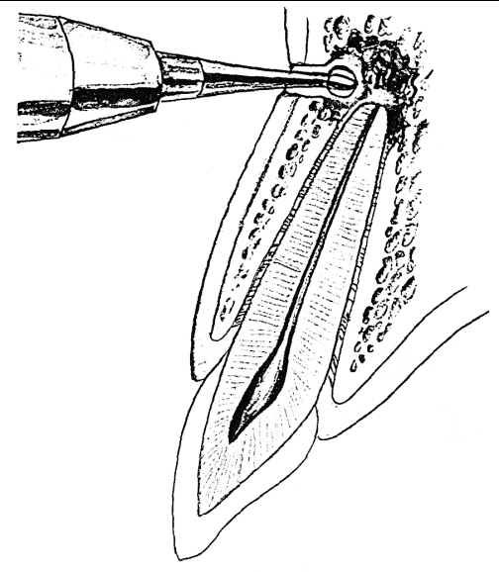
CORTICAL TREPHENATION:
Perforation of the cortical plate to accomplish the release of pressure from the accumulation of exudate within the alveolar bone.

Slide 29
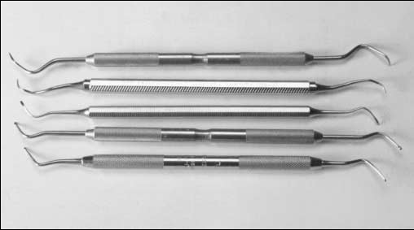
PERIRADICULAR CURETTAGE:
Involves removal of the periradicular inflammatory tissue and is best accomplished by using various sizes and shapes of sharp surgical bone curettes and angled periodontal curettes.

Slide 30
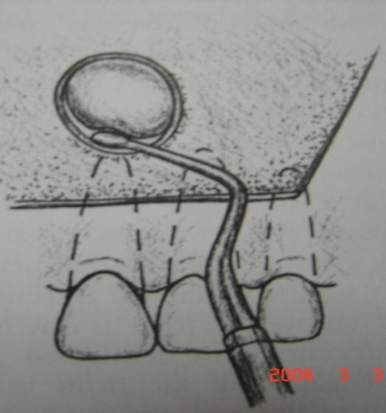
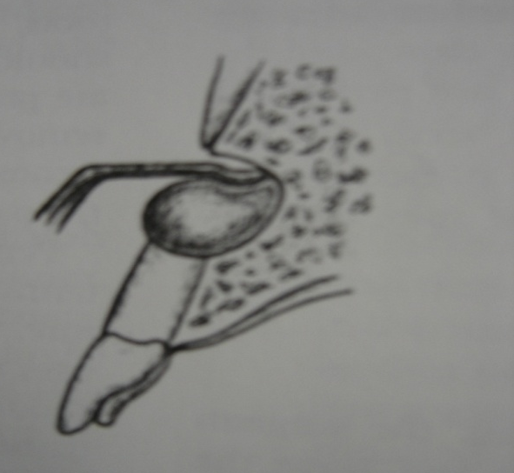
Entire tissue mass is removed by inserting the bone curette, between the soft tissue mass and the lateral wall of the bony crypt with the concave surface of the curette facing the bone.

Slide 31
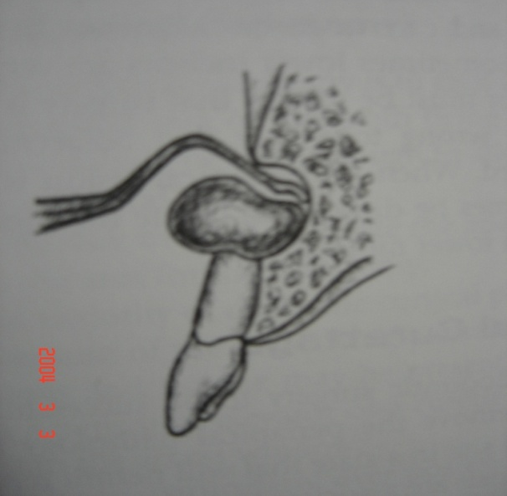
Once the soft tissue lesion has been freed along with the periphery, the bone curette should be turned with the concave portion toward the soft tissue and used in a scraping manner to free the tissue from the deep walls of the bony crypt.

Slide 32
  Average length of root resection is 3mm which
  is considered enough to eliminate the source
  of infection.
however surgeon must evaluate the patient on an individual basis.
1. Visual and operative access to the surgical site
2. Anatomy of the root (shape, length, curvature).
3. Number of canals and their position in the root

Slide 33
4. Need to place a root-end filling surrounded
by solid dentin.
5. Presence and location of procedural error
6. Presence and extent of periodontal defects.

Slide 34
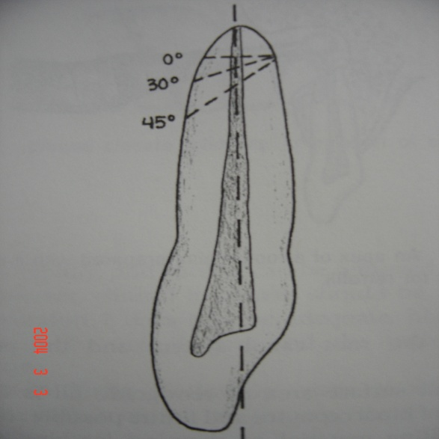
3.Angle of Root-End Resection.
It should be 30 ° -45 ° from the line perpendicular to the long axis of the tooth facing toward the buccal or facial aspect of the root.
The purpose is to provide enhanced visibility to the root end and operative access to accomplish a root end preparation.

Slide 35
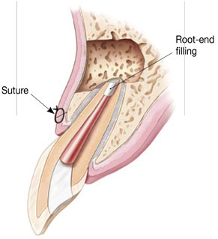
Root-End Filling:

Slide 36
Root-End Filling:
The purpose of a root-end filling is to establish a seal between the root canal space and the periapical tissues.
Suitable root-end filling material should be
(1) Able to prevent leakage of bacteria and their
biproducts into the periradicular tissues,
(2) Nontoxic & Noncarcinogenic,
(3) Biocompatible with the host tissues,
(4) Insoluble in tissue fluids,
(5) Dimensionally stable,
(6) Unaffected by moisture during setting,
(7) Easy to use

Slide 37
Materials– Past and Present
Amalgam
Cavit
IRM
Super-EBA
Composite resins
Glass ionomers
MTA (ProRoot)
Biodentin

Slide 38
REPOSITIONING AND SUTURING:
Several authors have compared the effects of continuous and interrupted suture techniques.
Their findings indicate that the interrupted suturing technique provides better flap adaptation than does the continuous technique and, therefore, is the recommended technique, and the most commonly used, for endodontic surgery.

Slide 39
Postoperative Instruction
Ask not to lift up the lip or pull back the cheek to
look at where surgery was done. This may pull the
sutures and cause bleeding.
A little bleeding from the surgical site is normal. This should only last for a few hours. There may be little swelling of the face. This should only last for a few days.

Slide 40
Place an ice bag (cold) on face where surgery was done. Leave it on for 20 minutes and take it off for 20 minutes. Do this for 6 to 8 hours.
After 8 hours, the ice bag should not be used. The day after surgery, warm saline gargle. Do this as often as possible for the next 2 to 3 days. Advice for warm saline gargle.
Rinse the mouth with 1 tablespoon of chlorhexidine mouthwash two times a day, once in the morning and once at night for 5 days.
Recall for removal of sutures after 7 days

Slide 41
CONCLUSION :
During the last 20 years, endodontics has encountered dramatic shift in the use of periradicular surgery.
Previously, periradicular surgery was commonly considered as the treatment of choice when nonsurgical treatment had failed but nowadays periradicular surgery has become very selective in contemporary dental practice.

Slide 42
References-
Text book of endodontics, Ingle 5th edition.
Textbook of oral & maxillofacial surgery By Daniel M. Laskin. Vol.2
Text book of endodontics, Nisha Garg.
Text book of endodontics By Grossman.
Text book of Surgical endodontics, Guttman

