Slide 1
homeostasis
Dr. Swati Mahajan
Professor

Slide 2
1 min revision
Organ systems= 11
Body fluid compartment= 60%
ICF= 40%
ECF= 20%
Body electrolytes =7%

Slide 3
Learning Objectives
Define homeostasis
Role of different organ systems in maintaining homeostasis
Describe Feedback mechanisms with examples

Slide 4
Homeostasis
The maintenance of a stable & constant internal environment.
Claud Bernard – millieu interior
Walter Canon - homeostasis

Slide 5
Homeostasis
  Most organ systems contribute to homeostasis
  All cells depend on ECF for life; functions & growth

Slide 6
Factors involved
pH
Temperature regulation
Water & electrolyte balance
Supply of nutrients, O2, enzymes, hormones
Removal of metabolic & other waste products

Slide 7
Role of different systems
Transport of subs in ECF: circulatory sys
Supply of Oxygen & nutrients: RS,GIT, circulatory sys, Hormones, Liver
Removal of metabolic end products: kidneys & lungs
Water & electrolyte balance: kidneys, skin, lungs, GIT.

Slide 8
pH: RS, blood, kidneys & buffer sys
Body temperature: skin, CVS, RS, GIT, Excretory sys, Skeletal system, hypothalamus
Regulation of body functions: CNS ,endocrines, ANS(vegetative fn)
Musculoskeletal sys: move for food & survival.
Reproductive sys: automaticity & continuity of life

Slide 9
Mode of action
Complex phenomenon
Control mechanisms: 1000s
Act at every level
Types:
Negative feedback
Positive feedback
Feed forward control

Slide 10
Negative Feedback Loops
  Primary mechanism for maintaining homeostasis
Detect a deviation from a set point and act to restore that set point
  External change → triggers change in variable in internal environment → triggers reaction to oppose the change and return variable toward normal (set point)

Slide 11
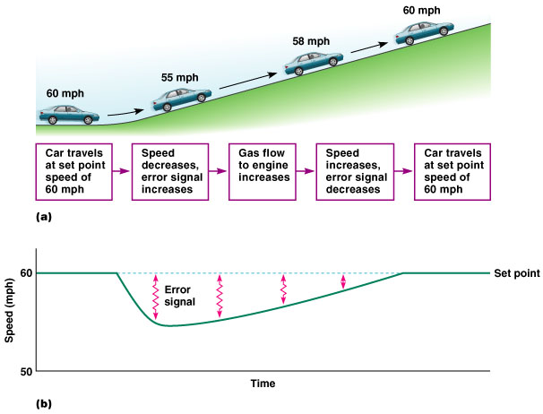
Cruise Control of Car Speed
Figure 1.6a, b

Slide 12
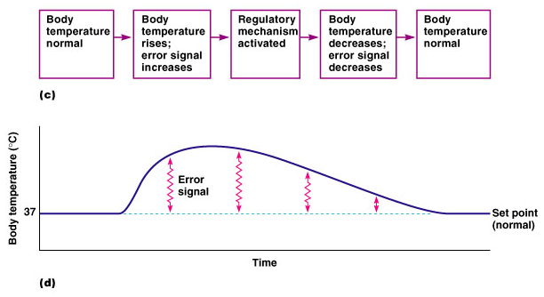
Negative Feedback Control of Body Temperature
Figure 1.6c, d

Slide 13
Four components of a negative feedback loop
  Controlled variable
  Sensor
  Control center
  Effector

Slide 14
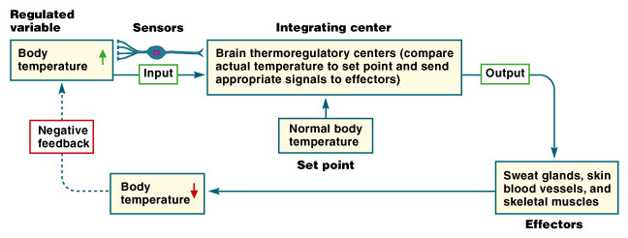
Negative Feedback Loop
Figure 1.7

Slide 15
Other examples
Blood Pressure
Hormones- short loop feedback & long loop feedback
O2 & CO2 concentration in ECF

Slide 16
Gland
Hormone
Target
Product
-
Negative feedback

Slide 17
Gain
Effectiveness of the system
BP Regulatory system gain = -2
Temp Regulatory system gain = -33
GAIN = CORRECTION
ERROR

Slide 18
Positive feedback
Vicious cycle
Usually harmful
Continues increasing an change
Controlled variable moves in one direction

Slide 19
Examples
In health
Clot formation
Child birth
Generation of nerve signal
LH surge
In disease
Acute MI
Circulatory shock
Cardiac failure
Brain edema

Slide 20
Gland
Hormone
Target
Product
+
Positive feedback

Slide 21
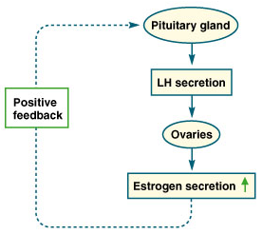
Positive Feedback Loop
  Positive feedback loops cause a rapid change in a variable.
Figure 1.8

Slide 22
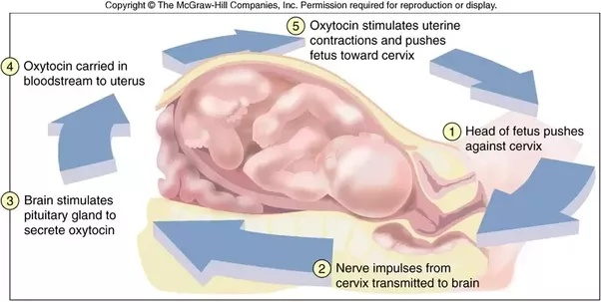

Slide 23
Feed forward mechanisms
This is adaptive control system
Delayed type of negative feedback
Seen in CNS: rapid movement
Anticipate change and responds to that change before it happens

Slide 24
Homeostasis
Each cell benefits
Each cell contributes
Reciprocal interplay provides continuous automaticity

Slide 25
Factors influencing:
Internal: genetic predisposition
External: lifestyle modification {diet, exercise, sleep}

Slide 26
Lets summarize……
The maintenance of a stable & constant internal environment is homeostasis
Each organ system contributes to homeostasis
Feedback mechanisms are important to maintain homeostasis

Slide 27
THANK YOU

