Slide 1
Transport across the cell membrane
Dr. Swati Mahajan

Slide 2
1 min revision
Difference between passive & active transport
Simple diffusion
Gating of channels
Facilitated diffusion
Osmosis

Slide 3
Active transport

Slide 4
Learning Objectives
Primary active transport
Secondary active transport
Other mechanisms

Slide 5
Active transport
Against the electrochemical gradient
Uphill movement
Energy utilized
Mechanism:
Carrier mediated (different from facilitated diffusion)
Specificity ; Saturation; Competition
Types:
Primary active
Secondary active

Slide 6
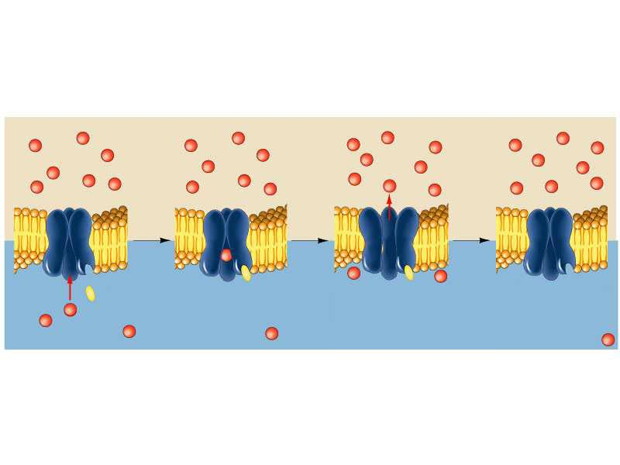
(extracellular fluid)
transport protein
recognition
site
ATP
ATP binding site
Transport protein uses energy from ATP to change shape and move
ion across membrane.
Transport protein resumes original shape.
Transport protein binds ATP and Ca²⁺.
Ca²⁺
(cytoplasm)
Notes:
Figure: 03-06
Title:
Active transport.
Caption:
Active transport uses cellular energy to move molecules across the plasma membrane, often against a concentration gradient. An active-transport protein binds ATP and the molecule to be transported, and then changes shape to move the ion across the membrane.

Slide 7
Primary active transport
Energy is derived directly from ATP
Some imp pumps are:
Na⁺-K⁺ ATPase pump
Ca²⁺ pump
K⁺-H⁺ pump

Slide 8
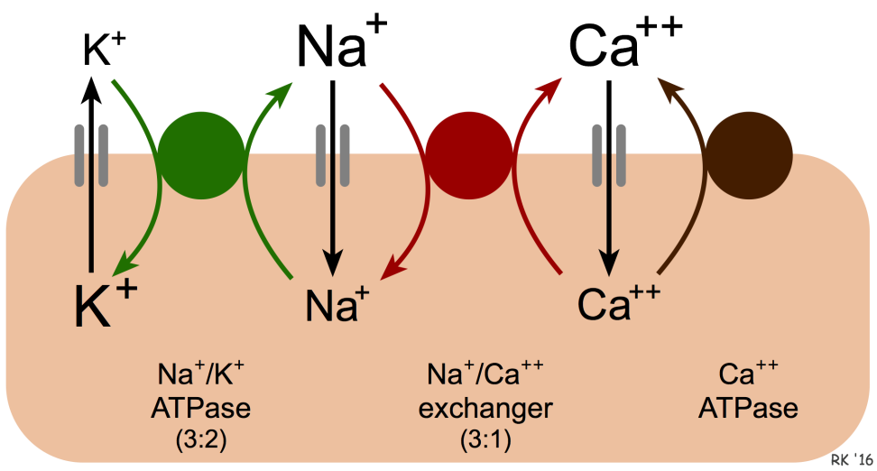

Slide 9
Na⁺-K⁺ ATPase pump
Present in all cells of body
Maintains RMP
Structure:
carrier protein consists of α & β subunits 3 Intracellular sites (Na, ATP, phosphorylation) &
2 Extracellular sites (K, ouabain)

Slide 10
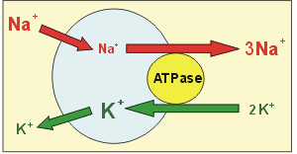
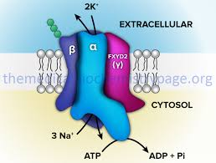

Slide 11
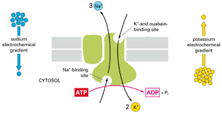

Slide 12
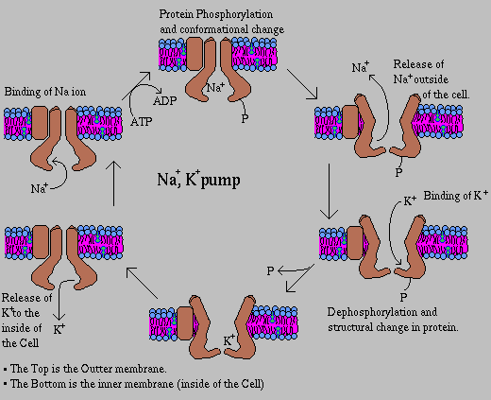
MOA

Slide 13
Function of Na⁺-K⁺ ATPase pump
Creating and maintaining unequal concentrations of Na⁺ and K ⁺ ions inside and outside the cell.
Control the cell volume
Electrogenic activity: RMP
Recharging- After the passage of impulses along the nerve fibre, Na⁺-K ⁺ pump brings the ionic concentration of the fibre back to normal.

Slide 14
Regulation of Na⁺-K⁺ ATPase pump
Increased
cAMP
DAG
Decreased
Low temp
Thyroid hormone
Aldosterone
Insulin
G-actin
O₂ lack
Dopamine
Oubain
Digitalis

Slide 15
Ca²⁺ pump
Carrier protein with ATPase activity
Maintains low ICF Ca²⁺ions
2pumps:
Pump Ca²⁺ out of the cell into ECF
Pump Ca²⁺ into organelles like mitochondria & Sarcoplasmic Reticulum

Slide 16
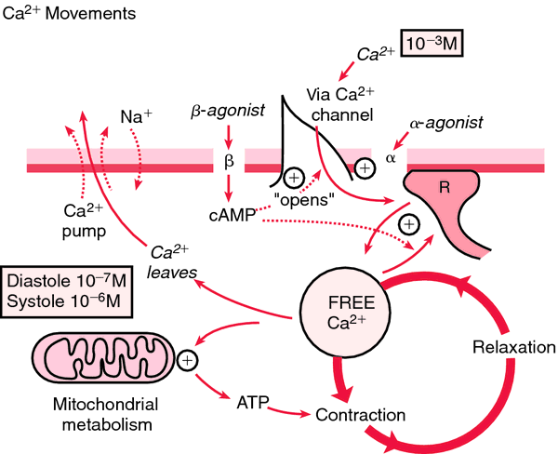

Slide 17
K⁺-H⁺ pump
ATPase activity
Present at :
Parietal cells of gastric glands: HCl secretion
Renal tubules (intercalated cells): pH balance

Slide 18
Secondary active transport
Energy is derived directly from that created by primary active transport.
Same carrier protein is involved
Co-Transport: Na⁺-glucose, Na⁺-aminoacid
Counter-Transport: Na⁺- Ca²⁺(in all cells) , Na⁺- H⁺ (in PCT) etc.

Slide 19
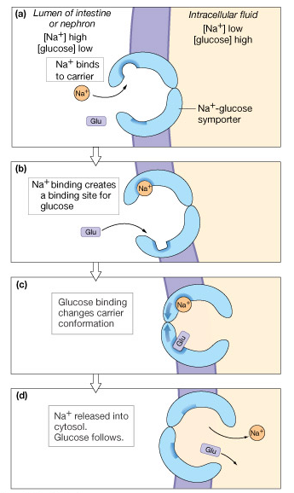
Secondary Active
(Indirect):
e.g.,
Na⁺/Glucose transporter
Symport

Slide 20
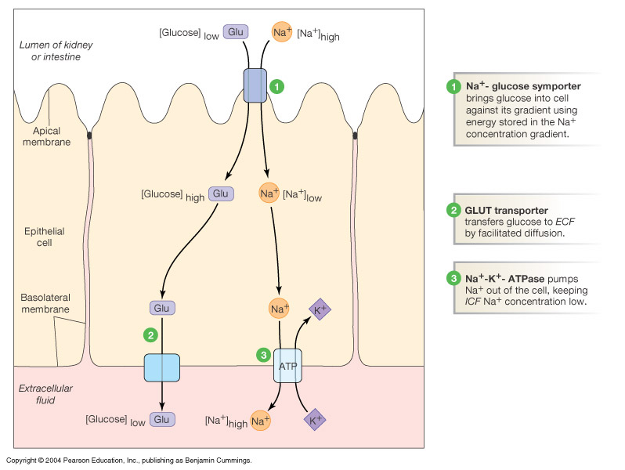

Slide 21
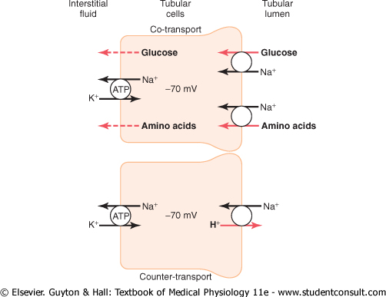

Slide 22
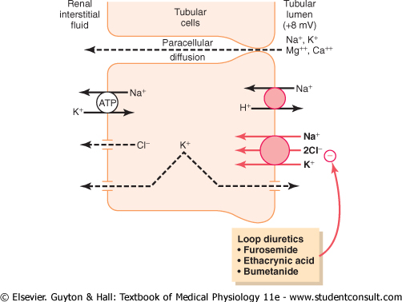

Slide 23
Vesicular transport
For macromolecules
Steps :
Vesicle formation
Vesicle transport to CM
Docking in the cell
Types :
Endocytosis
Exocytosis
Transcytosis (within cell)

Slide 24
Endocytosis
Pinocytosis: cell drinking
Phagocytosis: cell eating(bacteria, dead tissue, FB)
Receptor mediated (iron& cholesterol)
Role of clathrin ; dynamin ; actin

Slide 25
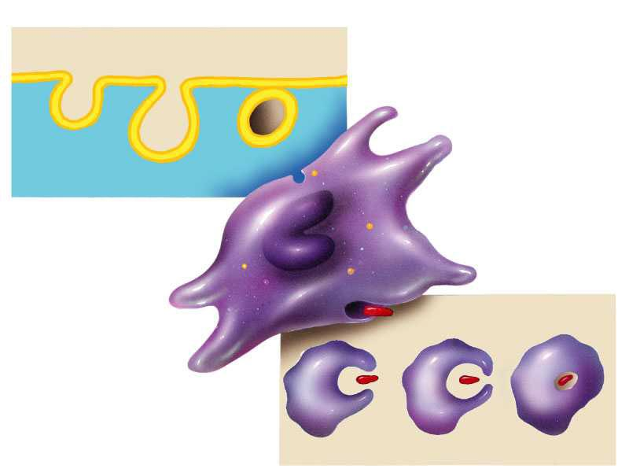
(a)
(extracellular fluid)
pinocytosis
1
3
3
2
vesicle containing
extracellular
fluid
(cytoplasm)
cell
(b)
phagocytosis
food particle
pseudopod
1
2
3
particle
enclosed in vesicle
Notes:
Figure: 03-07
Title:
Two types of endocytosis.
Caption:
(a) To capture drops of liquid, a dimple in the plasma membrane deepens and eventually pinches off as a fluid-filled vesicle, which contains a random sampling of the extracellular fluid. (b) Pseudopodia encircle an extracellular particle. The ends of the pseudopodia fuse, forming a large vesicle that contains the engulfed particle.

Slide 26
Exocytosis
Expulsion of substances from cell to exterior
Release of hormones, enzymes, Neurotransmitters (at synapse)
Ca²⁺ ions; energy ; docking proteins required.

Slide 27
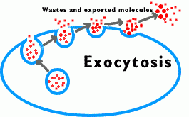
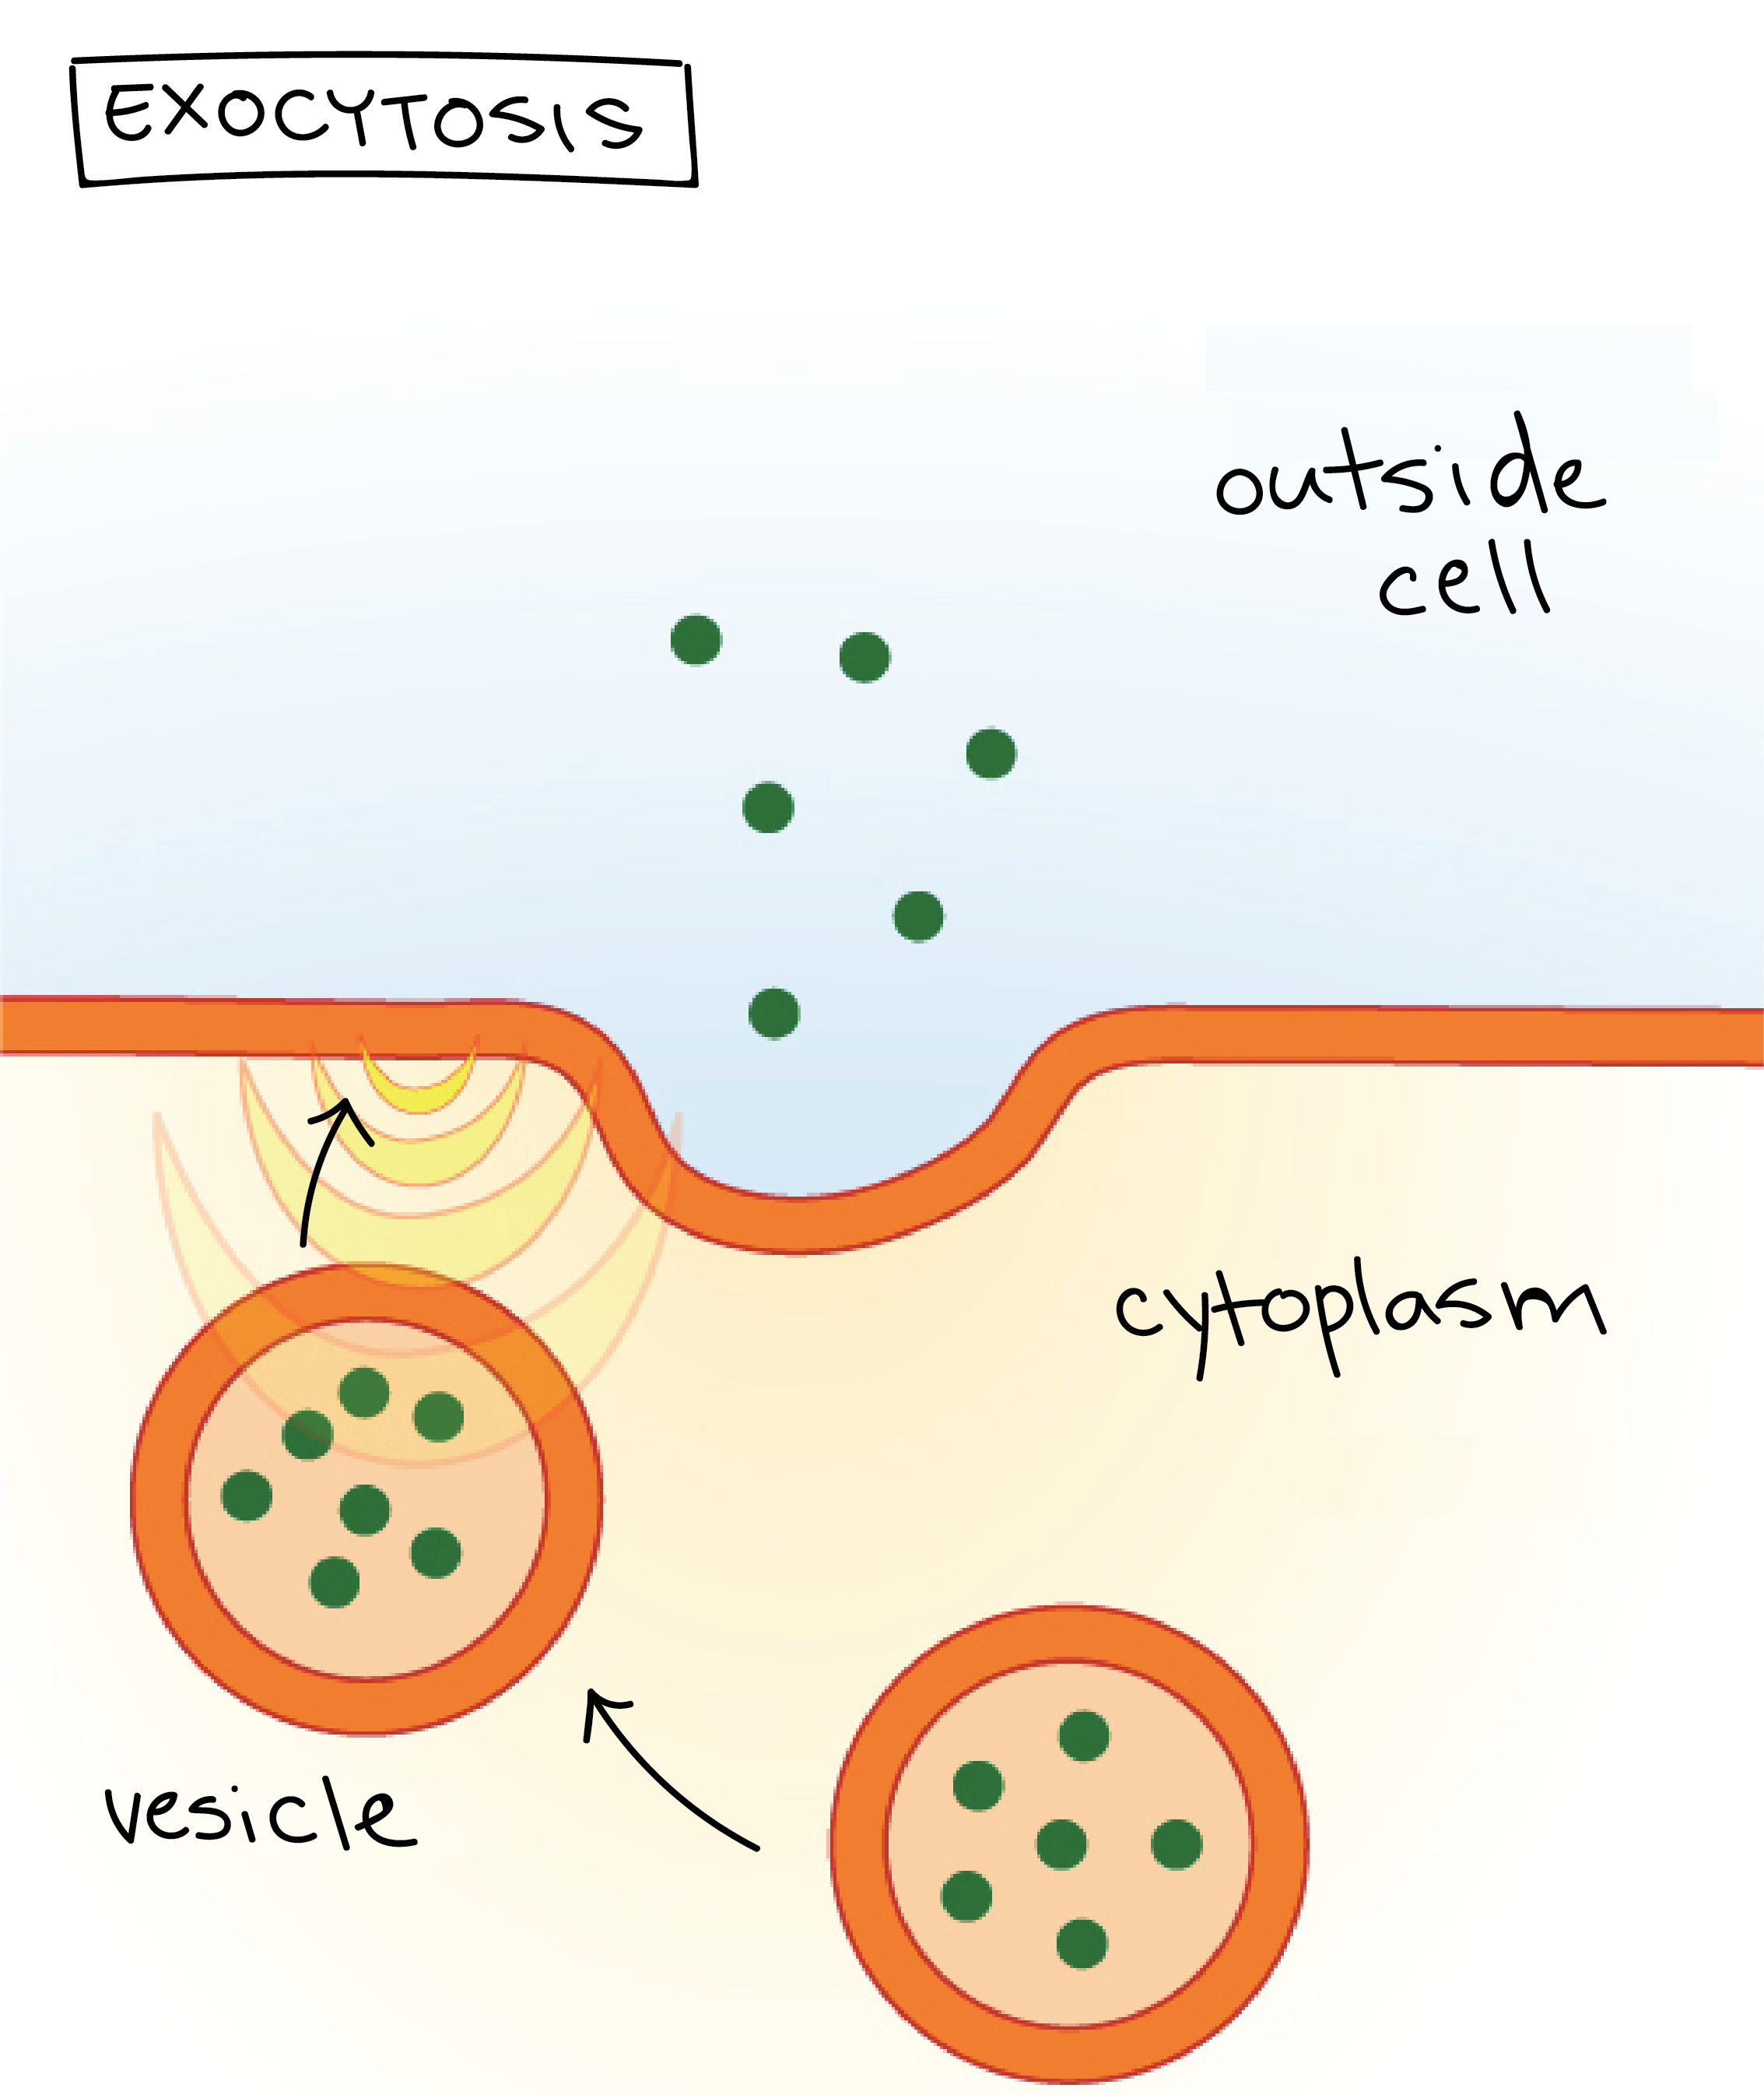

Slide 28
Transepithelial transport
In GIT, renal epithelial cells
Active transport across apical membrane & simple diffusion at basal border

Slide 30
THANK YOU

Slide 31
Home assignment
Endocytosis- pinocytosis, phagocytosis
Locomotion of cell- ciliary & ameboid
What do you mean by the following terms:
Protoplasm, cytoplasm, cytosol, endoplasm, ectoplasm
Apoptosis

