Slide 1
CLASSIFICATION
OF
NEurons

Slide 2
Neurons are classified according to:
The arrangement of axons
The length of axon
Function

Slide 3
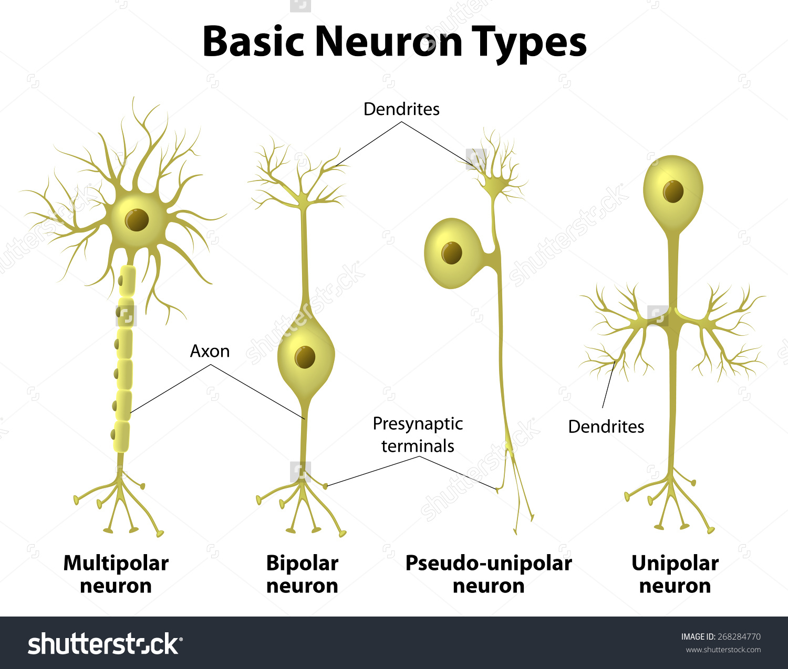
4
3
2
1

Slide 4
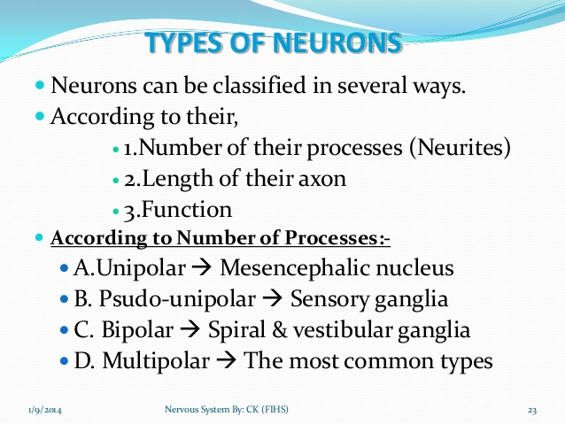
Motor neuron of spinal cord

Slide 5
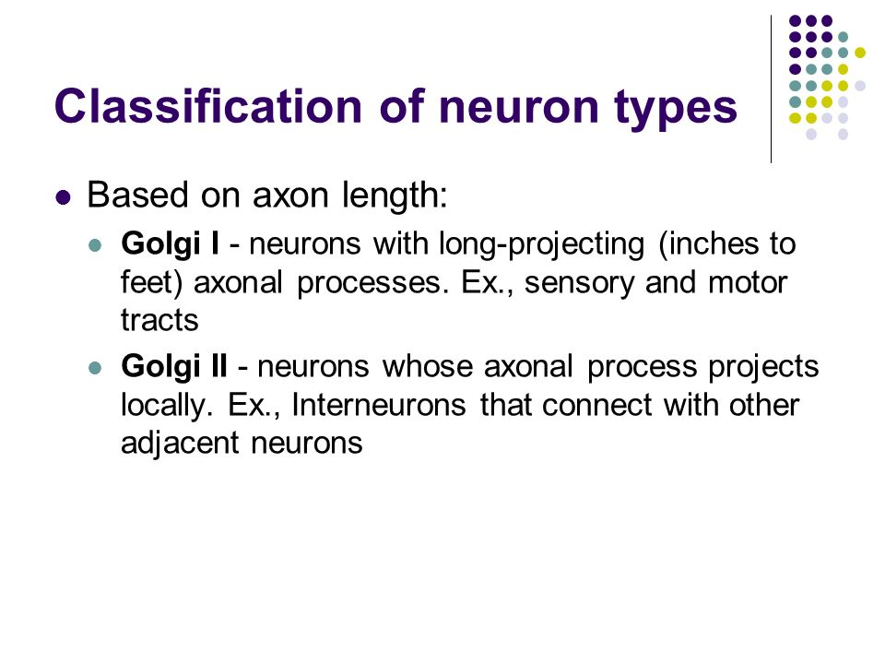

Slide 6
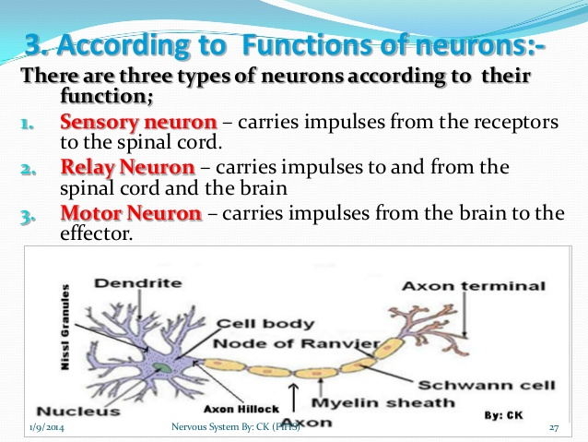

Slide 7
BASIS
OF CLASSIFICATION
DEPENDING UPON DISTRIBUTION
ERLANGER AND GASSER’S CLASSIFICATION
NUMERICAL CLASSIFICATION
DEPENDING UP ON STRUCTURE
2
1
3
4

Slide 8
Depending upon
STRUCTURE
1

Slide 9
MYELINATED NERVE FIBERS
UNMYELINATED NERVE FIBERS
NERVE FIBERS THOSE ARE COVERED BY MYELIN SHEATH
THOSE ARE NOT COVERED BY MYELIN SHEATH

Slide 10
Depending upon
DISTRIBUTION
2

Slide 11
SOMATIC NERVE FIBERS
VISCERAL OR AUTONOMIC NERVE FIBERS
Supply the skeletal muscles of the body.
Supply the various internal organs of body.

Slide 12
These are α type motor nerve fibers.
The neurotransmitter released at the neuron endings is acetylcholine(Ach).
It always leads to muscles excitation. Inhibition takes place centrally due to participation of interneurons.
SOMATIC NERVE FIBERS

Slide 13
They innervate smooth muscles , cardiac muscles and glands.
Their main work is to maintain homeostasis with the help of autonomic nervous system.
they can lead to either excitation or inhibition of effector organs.
Autonomic nerve fibers
Sympathetic nerve fibers
Parasympathetic nerve fibers
AUTONOMIC NERVE FIBERS

Slide 14
PREGANGLIONIC | POSTGANGLIONIC
Release acetylcholine in both. | Release acetylcholine in case of parasympathetic.
 | Release either acetylcholine or norepinephrine in case of sympathetic.
Myelinated B fibers. | Unmyelinated C fibers are present in the case of sympathetic .
Terminate on the postganglionic nerve fibre | Terminate on visceral effector.
In case of sympathetic it is smaller than postganglionic nerve fiber and vice versa for parasympathetic nerve fiber. | In case of parasympathetic it is smaller than preganglionic nerve fibre and vice versa for sympathetic nerve fibre
SYMPATHETIC AND PARASYMPATHETIC NERVE FIBERS

Slide 15
Depending upon
Diameter and Velocity of conduction
(Erlanger and Gasser’s classification)
3

Slide 16

ERLANGER AND GASSER’S CLASSIFICATION
Erlanger and Gasser studied the action potential of mixed nerve trunk by means of cathode ray oscilloscope and they obtained the compounded spike.
So they divided nerve fibers into 3 groups.
They observed that the main cause of difference in nerve fibers is diameter
*Nobel prize in Physiology or Medicine for the year 1944

Slide 17
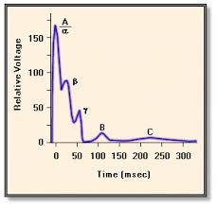

Slide 18
PROPERTIES CORELATED WITH DIAMETER
As Diameter increases
Velocity of conduction increases.
Magnitude of electrical response increases.
Threshold of excitation decreases.
Duration of response decreases.
Refractory period decreases.

Slide 19
SPEED OF CONDUCTION………
IN MYELINATED NERVE FIBERS:
  Speed of conduction= 6 times Diameter of NF
  As the Diameter of myelinated fibers ranges from 1-20 µm, therefore, conduction velocity varies from 6-120 m/s.
IN UNMYELINATED NERVE FIBERS:
  Speed of conduction= square root of diameter of NF
  As the largest diameter of unmyelinated fibers are approximately 1 µm, therefore, its maximum conduction velocity is 1 m/s.

Slide 20
GROUPS OF NERVE FIBERS
A GROUP
B GROUP
C GROUP

Slide 21
A GROUP
A group is composed of largest fibers.
The fibers of this group are myelinated.
Both sensory and motor in function.
It is found in somatic nerves as SCIATIC AND SAPHENOUS nerve.
It is further classified into 4 sub groups.
Aα (afferent and efferent fibers) (supply extrafusal muscle fiber)
Aβ (afferent and efferent fibers)
Aγ (efferent fibers) (supply intrafusal muscle fiber)
Aδ (afferent fibers)

Slide 22
B GROUP
The fibers of this group are myelinated.
The B fibers are found solely in preganglionic autonomic nerve.

Slide 23
C GROUP
It is composed of smallest fibers.
All the fibers of this group are unmyelinated.
Mostly found in visceral and cutaneous nerve.
They have high threshold i.e. 30 folds that of A group.
Generally they are found in postganglionic sympathetic nerve.

Slide 25
And the location of different nerve fibre are…..
Aα: Golgi tendon organ, muscle spindle, extrafusal muscle fibers
Aβ: muscle spindle, skin mechanoreceptors,
Aγ: intrafusal muscle fibers
Aδ: Skin receptors
B: Preganglionic autonomic fibers
C: Postganglionic autonomic, skin receptors

Slide 26

About the nerve fibers

Slide 27
SENSITIVITY TO HYPOXIA
HYPOXIA: O₂ lack at tissue level.
It is associated with alteration of autonomic functions such as rise in heart rate, blood pressure, respiration etc. as the pre-ganglionic autonomic fibers are mostly ‘B’ type which are most susceptible to it.

Slide 28
SENSITIVITY TO PRESSURE
Pressure on a nerve can produce temporary paralysis due to loss of conduction in motor, touch and pressure fibers (in group ‘A’) while pain sensations remain relatively intact.
This is commonly seen after sitting crossed- legged for long periods or after sleeping with arm under the head.

Slide 29
SENSITIVITY TO LOCAL ANAESTHETICS
LOCAL ANAESTHETICS are used for stitching cut wounds and for other minor surgical procedures as these agents can block transmission of pain sensations in group ‘C’ fibers before they affect touch fibers in group ‘A’.

Slide 30
Numerical classification
4

Slide 31
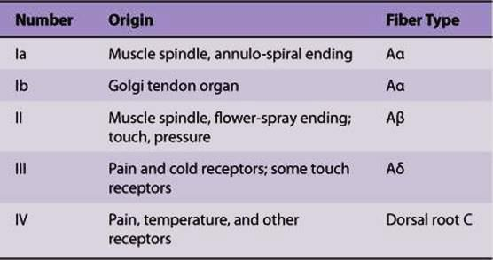
NUMERICAL CLASSIFICATION OF SENSORY NERVE FIBERS

Slide 32
PROPERTIES OF MIXED NERVE
Peripheral nerves are made up of many axons of various types, bound together in fibrous envelop called the epineurium
With sub-threshold stimuli, none of the axons are stimulated and no response occurs.
With Threshold- axon with low threshold fire and a small potential change recorded
With maximal stimulus axons with higher threshold will also fire and all fiber in nerve are stimulated.
With Supra-threshold, no further increase in size of the potential change occurs.

Slide 33
COMPOUND ACTION Potential- Appearance of multiple peaks in AP

Slide 34
Factors affecting compound Action potential
Types of fibers: Number and size of the peaks vary with the types of fiber in particular nerve
Strength of stimulus: the number and types of NF stimulated by a given strength

Slide 35
CLINICAL ASPECTS

Slide 36
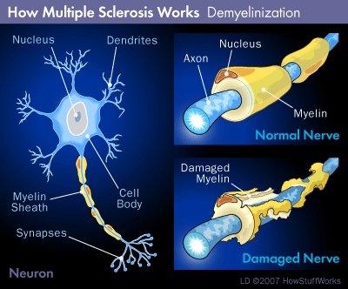
MULTIPLE SCLEROSIS
-It is autoimmune disorder.
-Causes may be genetic or environmental.
-Antibodies & white blood cells in the immune system attack myelin causing inflammation and injury of sheath.
So the loss of myelin leads to leakage of k⁺ through voltage gated channels, -hyperpolarization and failure to conduct action potential.

Slide 37
NO TREATMENT of this disease but some drug like β-INTERFERON suppresses the immune response, reduce the severity & slow the progression of disease.
Treatment for multiple sclerosis

Slide 38
PERIPHERAL NEUROPATHY
Peripheral neuropathy is damage to nerves of peripheral nervous system which may be caused by diseases or trauma.
It is classified according to number of nerves affected or types of nerve cells affected (motor ,sensory, autonomic).
MONONEUROPATHY
It is a type of neuropathy that only affects single nerve.
The most common cause of mononeuropathy is physical compression of the nerve known as compression neuropathy.

Slide 39
POLYNEUROPATHY
It is pattern of nerve damage which is a quite different from mononeuropathy and often more serious and affecting more areas of body.
AUTONOMIC NEUROPATHY
It is a form of polyneuropathy which affects the involuntary system i.e. autonomic nervous system affecting mostly the internal organs. Most commonly it is seen in person with long standing diabetes mellitus type1 and 2.
NEURITIS
It is a general term of inflammation of a nerve or the general
inflammation of the peripheral nervous system.

Slide 40
CCES

Slide 41
1.Greater the diameter of a given nerve fiber, greater is the
speed of conduction
spike duration
magnitude of spike
both a & c

Slide 42
2. The fiber which is the thickest in human nerve is
Touch
Pain
Temperature
Propioception

Slide 43
3. Which of the fibers are affected by local anesthetic first?
a. C
b. A
c. B
d. parasympathetic

Slide 44
4. When nerve leave its myelination and converted into knob like structure, k/as
vacuoles
terminal pads
Terminal buttons
terminals

Slide 45
5. If a mix nerve is stimulated with increasing strength of current, magnitude of potential
a. doesn’t change
b. increases
c. show multiple peaks
d. decreases

Slide 46
THANK YOU

Slide 47
EBES
EVIDENCE 1
Human intraretinal myelination: Axon diameters and axon/myelin thickness ratios.
FitzGibbon T, Nestorovski Z
Indian J Ophthalmology 2013 Oct;61(10):567-75.

Slide 48
Human intraretinal myelination: Axon diameters and axon/myelin thickness ratios.
REFERENCE | INTERVENTION | SUBJECT | RESULT | CONCLUSION
FitzGibbon T, Nestorovski Z Indian J Ophthalmology 2013 Oct;61(10):567-75. | 2eyes containing myelinated patches were prepared for electron microscopy. 2 areas were examined in one retina and five in the second retina. Measurements were compared to normal retinal and optic nerve samples and the rabbit retina, which normally contains myelinated axons. Measurements were made using a graphics tablet. | Human intraretinal myelination of ganglion cell axons occurs in about 1% of the population. They examined myelin thickness & axon dia in human retinal specimens containing myelinated retinal ganglion cell axons. | Mean axon diameter of myelinated axons at all locations were significantly larger than unmyelinated axons. Myelinated axons within the patches were significantly larger than axons within the optic nerve. The relationship between axon dia/fiber dia (the G-ratio) seen in the retinal sites differed from that in the nerve. G-ratios were higher and myelin thickness was positively correlated to axon diameter in the retina but negatively correlated to axon diameter in the nerve. | Intraretinally myelinated axons are larger than non-myelinated axons from the same population and suggests that glial cells can induce diameter changes in retinal axons that are not normally myelinated. This effect is more on intraretinal axons compared with the normal transition zone as axons enter the optic nerve and these changes are abnormal.

