Slide 1
properties of nerve

Slide 2
Properties of Nerve Fiber
Excitability
Conductivity
Unfatigability
Refractory period
All or none law
Summation
Accommodation

Slide 3
NERVE EXCITABILITY
It is the ability of generating electrochemical impulse (action potentials) at the cell membrane in response to any stimulus.

Slide 4
Stimulus
Definition: It is any change in the surrounding environment.
Types
1
Chemical
2
Physical
3
Electrical
Chemical transmitters
- Hormones.
- Drugs.
-Ions (Na+, K+, .... etc).
- Gases (O2 and CO2).
Thermal.
e.g. cooling
or warming.
- Mechanical.
e.g. stretch, touch,
pressure and injury.
- Electromagnetic.
e.g. light rays
- Galvanic Current:
Low intensity
Long Duration
- Faradic Current:
High intensity
Short duration

Slide 5

Intensity of the Stimulus
Maximal
Maximal stimulus:
It is the least stimulus which produces a maximal response and above which there is no further increase in the response.
Superminimal (superthreshold) stimuli:
Group of stimuli having intensities higher than minimal & lower than the maximal which show gradual increase in response with gradual increase in the intensity.
Subminimal (subthreshold) stimuli:
They are all stimuli of low intensity which produce no response even if applied for a very long time.
Minimal (threshold) stimulus:
It is the weakest stimulus which produces a response & below which no response occurs.
Supermaximal stimuli:
They are all stimuli of greater intensities than the maximal stimulus but produce the same maximal response.
Supermaximal
Superminimal
Minimal
Subminimal
V
0.8
1
1.5
2
3
5
8
20

Slide 6
EFFECTIVENESS OF STIMULUS

Slide 7
STIMULUS + NERVE = RESPONSE
Response of
NERVE
STIMULUS
TO
Depends on
Excitability
of
the nerve
Effectiveness
of
The stimulus
Intensity of
Stimulus
Duration of
Stimulus
Rate of rise

Slide 8
Strength – Duration Curve
Aim: to study the relation between the strength and duration of a stimulus
Obtained by: stimulating the nerve with electrical stimuli of different intensities and recording the time needed by each stimulus to start the response.

Slide 9
The stronger the stimulus, the shorter will be the duration up to a certain duration, below which no response can occur whatever the strength of the stimulus may be. This is called the “minimal time”.
It is the minimal intensity (threshold intensity) of a stimulus which can produce response if applied for long period of time & below which no response occurs.
The chronaxie (time factor):
- It is the time needed to stimulate the tissue by a stimulus which is double the
rheobase.
Utilization time:
Time needed for rheobase to produce response.(= rheobase excitation time).
Strength
2R
t
Rheobase
Duration
Chronaxie

Slide 10
Factors affecting effectiveness of a stimulus
1- Strength:
Rheobase is the minimal stimulus needed to excite the nerve and produce action potential.
2- Duration:
Utilization time is the minimal time needed by Rheobase to give a response.
Chronaxie is the time needed by a stimulus of strength twice of Rheobase to excite the nerve.
It is a measure of nerve excitability.

Slide 11
So, the effective stimulus (produce a response) is:
Intensity: minimal or higher than minimal.
Duration: enough excitation time according to the
intensity (longer time is better).

Slide 12
Resting membrane potential
(RMP)
Definition:
The difference in potential between the inside and outside of the nerve fibers during resting states (no stimulation).
During rest, the nerve fiber membrane shows a polarized state in which the inner surface of the membrane is negatively charged compared with outer surface which is positively charged.

Slide 13
Causes of the resting membrane potential:
I- Unequal Distribution of ions inside and outside the nerve fiber:
Outside the nerve fiber
(Cations) (Anions)
Na+ K+ Protein¯ Cl¯
(140 mEq./L) (4 mEq./L) (2 gm %) (100 mEq./L)
Na+ K+ Protein¯ Cl¯
(14 mEq./L) (140 mEq./L) (16 gm %) (4 mEq./L)
Inside the nerve fiber

Slide 14
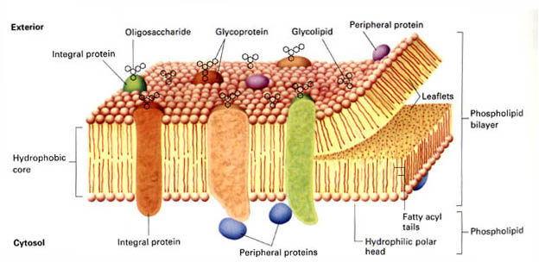
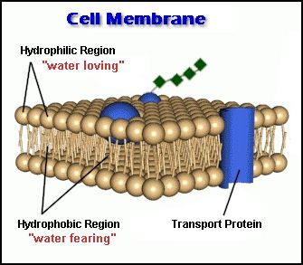
II- Selective permeability of the cell membrane:
The cell membrane
is made up of double
layers of lipids
with specialized proteins
penetrating the double
Layers.

Slide 15
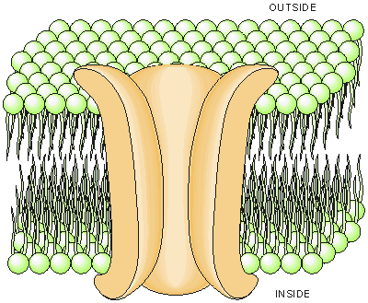
These proteins form pores or channels which regulate the movements of water-soluble ions (Na+, K+, Cl¯) across the membrane.

Slide 16
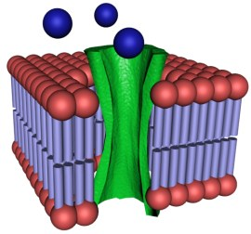
There are three basic types of ion channels:
1
Passive ion Channels
Site:
found in the membrane of the
whole nerve cell.
Gates:
no gates (just a pore)
Function:
involved in generation of RMP.

Slide 17
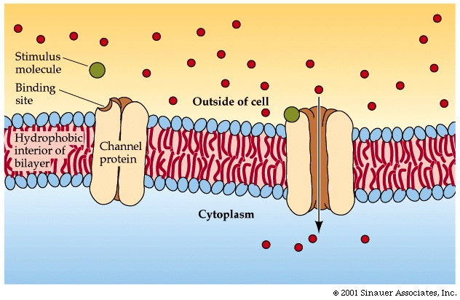
2
Chemically activated ion channels
Site:
found in the membrane of the
Dendrites and soma.
Gates:
has a gate-like process which
open by binding of a chemical
stimulus (transmitter) to a
specific site (receptor)
on the channel.
Function:
involved in neuromuscular
transmission.

Slide 18
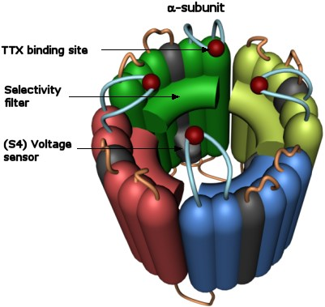
3
Voltage activated ion channels
Site:
found in the membrane of the
Soma and axon.
Gates:
has a gate-like process which
open by when a certain change
In the membrane potential.
Function:
involved in generation of
Action potential

Slide 19
Voltage-activated ion channels | Chemically-activated ion channels | Passive ion channels
found in the mem. of the axon and soma. has a gate-like process which open by detection of a certain change in the membrane potential. involved in generation & propagation of action potential. | found in the mem. of dendrites and soma. has a gate-like process which open by binding of a chemical stimulus (transmitter) to a specific site (receptor) on the channel. - involved in neuro-muscular trans-mission. | found in the mem. of the whole nerve cell. no gates (just a pore). involved in generation of RMP.

Slide 20
So, the nerve membrane is:
Freely permeable to lipid-soluble substances.
Impermeable to proteins (organic anions), due to their large size.
Semipermeable to water-soluble ions (regulated by ion channels)
N.B.: In the resting neuron, Na⁺ ions pass through the passive Na⁺ channels with difficulty, while K⁺ ions pass through the passive K⁺ channels more easily. The cell membrane is about 100 times more permeable for K⁺ ions than for Na⁺ ions.

Slide 21
Cl- | Na+ | Protein | K+
Tend to diffuse: from outside to inside of the cell. | Tend to diffuse: from outside to inside of the cell. | Tend to diffuse: from inside of the cell to outside following K+. | Tend to diffuse: from inside of the cell to outside
According to: Concentration gradient: (outside is 25 times more concentrated than inside). | According to: 1)Concentration gradient: (out-side is 10-15 times than in-side). 2) Electric gradient (inside is electro -negative). | According to: 1) Concentration gradient. 2) Electric gradient: (attracted to the +ve charges outside). | According to: 1) Concentration gradient: (inside is 30-40 times more than outside). Favored by: the high permeability of the membrane to K+ ions.
Diffusion of ions through the cell membrane

Slide 22
Cl- | Na+ | Protein | K+
Prevented by: * Repulsion force: by the –ve charges inside. * Attraction force: between Cl- ions and Na+. | Limited by: the low permeability of the resting membrane to these ions. | Prevented by: the impermeability of the membrane to proteins. | Antagonized by: * Repulsion forces: between the diffusing ions and the +ve charges outside the mem. * Na+ - K+ pump.
 | Net diffusion: Small amounts of Na+ ions diffuse inside then pumped again to outside the cell by Na+ - K+ pump. | Net diffusion: Protein ions (-ve) are held on the inner surface of the membrane. & K+ ions (+ve) are held on the outer surface attracted to the proteins inside. | Net diffusion: K+ ions diffusion continue until an equilibrium occurs between the diffusion force and the antagonistic forces

Slide 23
Sodium-potassium pump (Na+- K+ ATPase)
Site: Present in the cell membranes.
Function: Transports Na⁺ from ICF to ECF & K⁺ from ECF to ICF; it maintains low intracellular [Na⁺] and high intracellular [K⁺].
Energy used: It utilizes about 40% - 50% of energy of basal metabolic rate (BMR).
Composition: - Formed of 4 subunits (2α and 2β).
- The α subunit has an ATPase activity (can cleave ATP and release energy).
- It contains binding sites for 3 Na⁺ and an ATP molecule on its intracellular face & 2 K⁺ on its extracellular face.

Slide 24
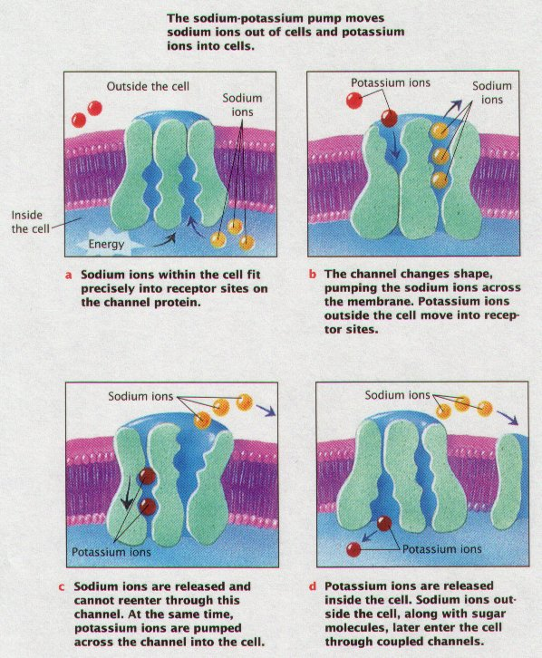

Slide 25
Activation of the pump:
1- High intracellular [Na⁺].
2- High extracellular [K⁺].
3- Availability of energy (ATP).
Inhibition of the pump:
1- Too low intracellular [Na⁺].
2- Too low extracellular [K⁺].
3- Too low intracellular ATP.
4- Cardiac glycosides as: digitalis and Quabain, which are used in treatment of heart failure. They cause specific inhibition of Na⁺-K⁺ ATPase.
They bind to the extracellular face of the pump (preventing binding to K⁺) thereby interfere with dephosphorylation process.

Slide 26
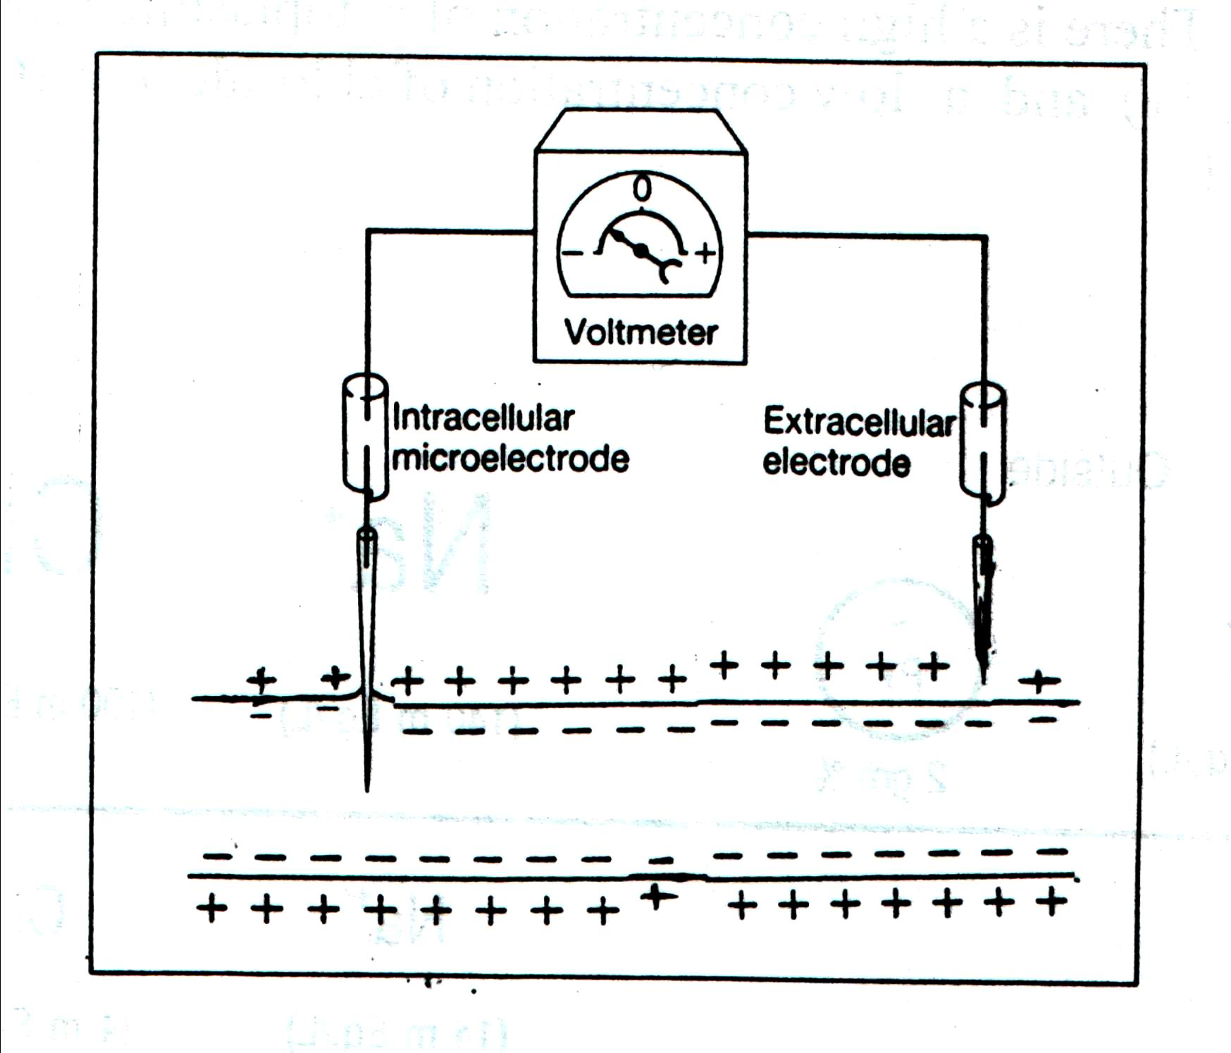
Measurement of RMP:
RMP is recorded by the use of two microelectrodes with very fine tips (less than 1 µm) connected with a special voltmeter.
If we put the two electrodes on the outer surface of the membrane, there is no potential difference between them indicating that all points on the outer surface of the membrane are at the same potential.
If one electrode is introduced inside the nerve fiber and the other electrode is placed on its outer surface, a potential difference is recorded (-70 m.v) which is the RMP. (the –ve charge indicates that the inner surface is negatively charged relative to the outer surface (interstitial fluid).

Slide 27
ACTION POTENTIAL
The sequence of changes which occur in the membrane potential following excitation.
Or
It is the electrical changes which occur in the resting membrane potential as a result of its stimulation by an effective stimulus

Slide 28
Action potential
These electrical changes propagate along the nerve fibers to the effector organ producing the response or action (hence the name action potential).
The electrical changes of the action potential are:
Latent period
Firing level
Depolarization
Over shoot and Spike potential
Repolarization
Negative after potential
Positive after potential

Slide 29
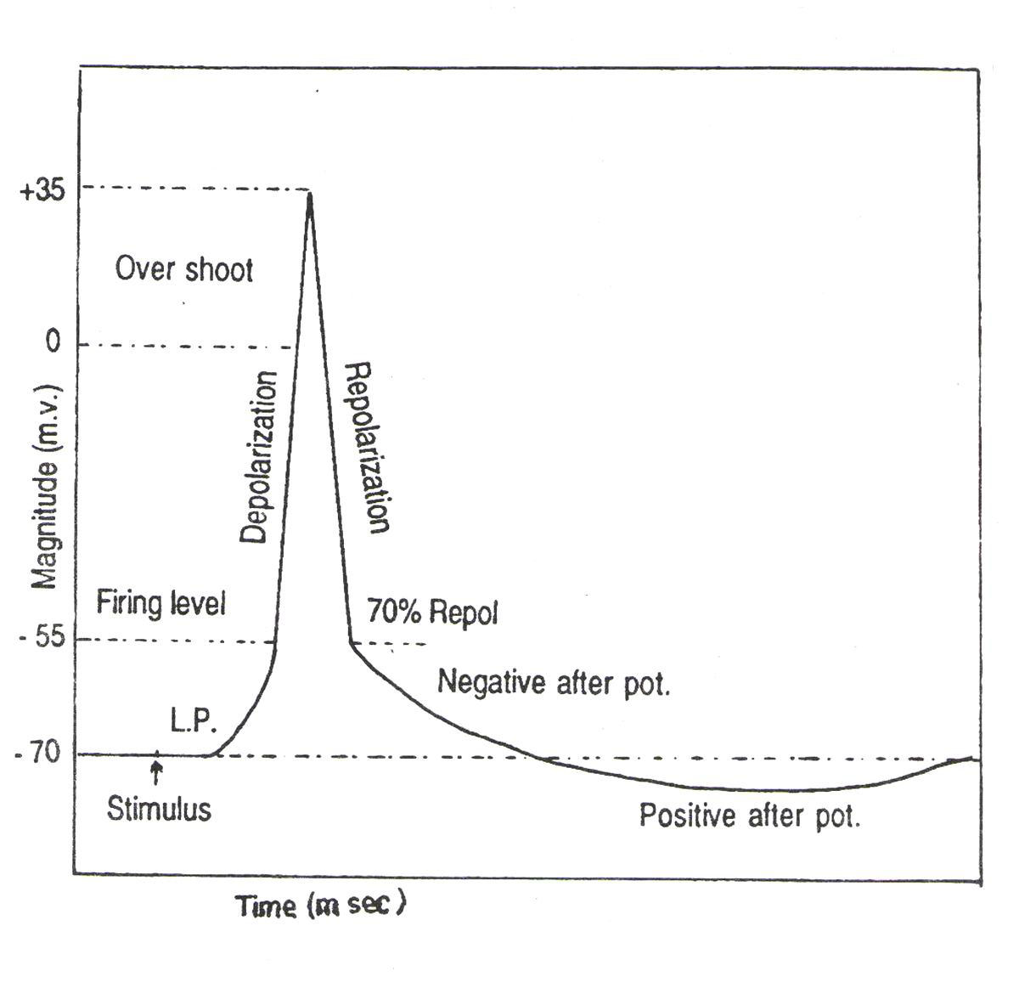

Slide 30
Latent period : It is a time taken by impulse to travel along the nerve fiber from the site of stimulation to the recording electrode.
It is a duration proportionate to the distance between the stimulating and recording electrodes
Inversely proportional to the speed of conduction of the axon.
B) Firing level : after initial rise in potential, a point comes after which there is a sudden rise in potential , this point is called as firing level.

Slide 31
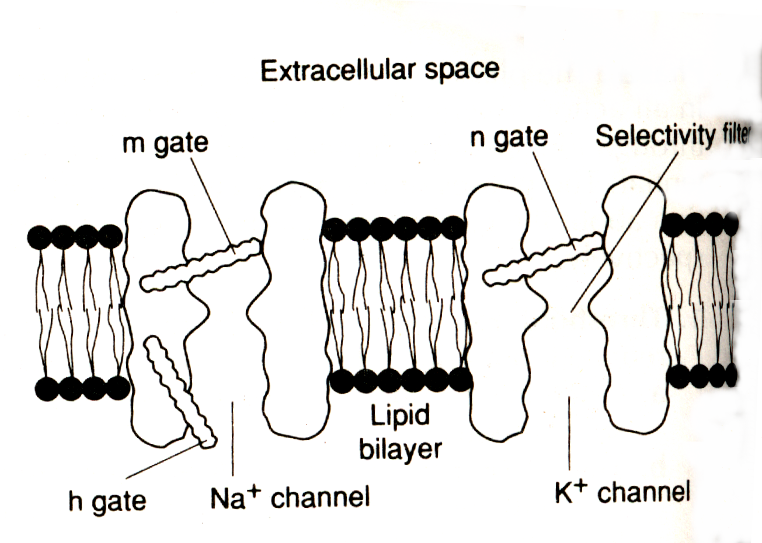
A) Depolarization:
Definition: ↓ negativity of the membrane potential.
Mechanism: The stimulus ↑ the permeability of the cell membrane (several hundred fold) to Na⁺ ions through opening of voltage-activated Na⁺ channels.
Na⁺ channels:
Has 2 gating particles:
- an m gate covers the extracellular surface (activation gate) .
- an h gate covers the intracellular surface (inactivation gate).

Slide 32
* Both the m and the h gate must be open for Na⁺ to flow through the Na⁺ channels.
* When m gate is open, Na⁺ ions can pass (the channel is said to be activated).
* When h gate is closed, Na⁺ ions can not pass the channel is said to be inactivated.

Slide 34
Na⁺ diffusion (Na⁺ influx):
At first, Na⁺ influx is Slow until the threshold potential due to gradual opening of Na⁺ channels Change of the membrane potential form the resting potential (-70 m.v.) to the threshold potential (-55 m.v.)
Then, Na⁺ influx becomes Rapid after the threshold potential due to sudden opening of most of voltage-gated Na⁺ channels Changes the membrane potential to zero.
With continuous Na⁺ influx, the membrane potential becomes positive (+ 35 m.v.) causing momentary reversal of polarity or Na⁺ overshoot.

Slide 35
B) Repolarization:
Definition: Restoration of the resting membrane potential.
Mechanism:
1- Stoppage of Na⁺ influx:
Due to:
a- Closure of the voltage-activated Na⁺ channels by closure of h (inactivation) gate which close at threshold potential but after a certain delay time.
b- Reversal of the electrical gradient as the inside becomes +ve charged which repel the diffusing Na⁺.

Slide 36
2- Opening of voltage-activated K⁺ channels:
At the threshold potential (-55 m.v), the voltage-activated K⁺ channels open but after a slight delay time.
K⁺ channels:
* In case of K+ channels, there is only one gate on the intracellular side called n-gate.
* The n-gate must be open for K+ to flow through the channel.

Slide 37
K⁺ diffusion (K⁺ efflux):
At first, K+ efflux is rapid due to sudden opening of most (about 70%) of K channels the membrane is 70% repolarized.
Then, K+ efflux becomes slow due to slow opening of the remaining of K+ channels RMP is restored (-70 m.v).
With continuous K efflux due to continuous opening (delayed closure) of K+ channels the membrane becomes hyperpolarized.

Slide 39
A) After depolarization or Negative after potential:
At termination of spike potential K+ efflux is slow down and thus a few milliseconds are delayed in restoring the membrane potential. This slow efflux of K+ ion is called as after depolarization.
B) After hyper-polarization or Positive after potential:
With disappearance of the after depolarization, through the RMP is achieved yet the resting ionic status is not established.
It is achieved by slow, prolonged K+ efflux and followed by the active Na- K pump mechanism along with K+ leaky channel

Slide 40
FACTORS AFFECTING EXCITABILITY
SD curve
Effect of extracellular Ca⁺² :
in ECF [Ca⁺²] ---- excitability of cell
in ECF [Ca⁺²] ---- stabilizes the mem. by Excitability
3. Effect of Extracellular K+:
In Hyperkalemia: excitability increases
In Hypokalemia: excitability decreases

Slide 41
Excitability of a nerve is increased by
a. Decrease in ECF calcium ion concentration
b. Increase in strength of stimulus
c. Increase in ECF calcium ion concentration
d. Increase in duration of stimulus
2. ___ point is called as firing level.
-70 mv
+35 mv
-55 mv
none of the above

Slide 42
3. If RMP of nerve cell falls, there is a net :
Gain of Na+ into the cells
Loss of K+ from cell
No loss of K+ from cell
Gain of Cl- into the cells
4. A decrease in ECF [Ca⁺² ] causes,
Decreased excitability
Hyperpolarization
Decreased membrane stability
None of the above

Slide 43
5. Value of which of the following is considered as unit of excitability,
Rheobase
Chronaxie
Utilization time
None of the above

Slide 44
NERVE CONDUCTIVITY
It is the ability to propagate action potential from the point of generation to the rest of the membrane.

Slide 45
Nerve Conductivity
Action potential once generated, it travels along the length of the nerve fiber in both directions.
Normally impulse travels in one direction i.e. Orthodromic conduction: from cell body along its axon to its termination.
Antiorthodromic conduction: is opposite.
  Seen in sensory nerve supplying the blood vessels
Velocity of conduction is increased by increased diameter of nerve fiber & myelin

Slide 46
Node of Ranvier: Saltatory Conduction
Flow of electrical current along a myelinated axon from node to node
  Importance
    Increases velocity of nerve transmission
    Conserves energy for axon
    Allow repolarization to occur with very little transfer of ions

Slide 47
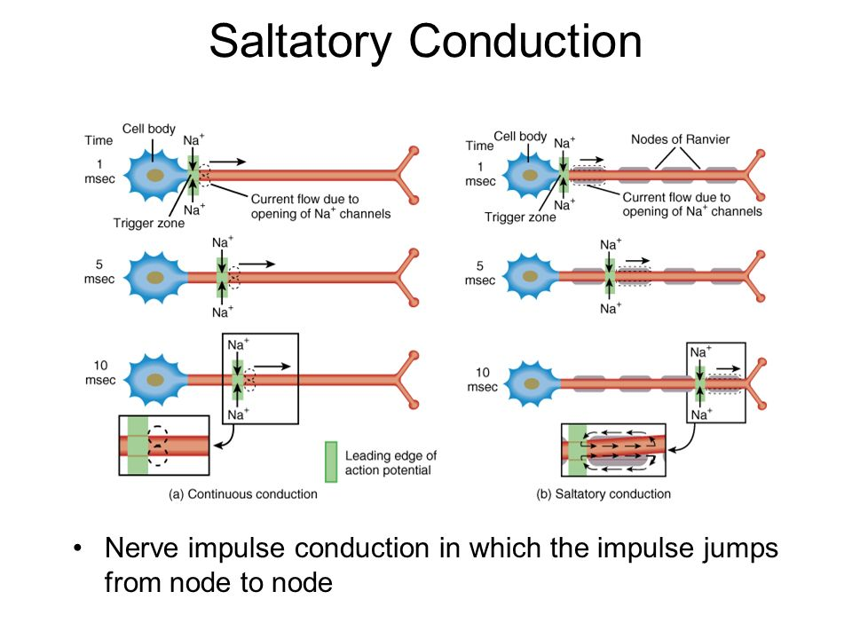

Slide 48
Saltatory conduction | Continuous conduction
It is propagation in myelinated nerve fibers. - Mechanism: 1- Generation of an action potential at the nearest node of Ranvier. 2- During the action potential, the nearest node becomes depolarized (membrane potential becomes +35m.v). | It is propagation in unmyelinated nerve fibers. - Mechanism: 1- Generation of an action potential at the site of stimulation. 2- During the action potential, the stimulated area becomes depolarized (membrane potential becomes +35m.v).

Slide 49
Saltatory conduction | Continuous conduction
3- This creates a potential difference between the depolarized (active) node (+ 35 mv) and the next polarized (resting) node (- 70 m.v). 4- current flows between the two nodes (in which the charges jump) causing the polarized (resting) node to become depolarized to the threshold level. 5- This generates an action potential at the resting node, which by turn becomes the stimulus for the adjacent nodes & so on. | 3- This creates a potential difference between the depolarized (active) area (+ 35 mv) and the adjacent polarized (resting) area (- 70 m.v). 4- current flows between the two areas causing the polarized (resting) area to become depolarized to the threshold level. 5- This generates an action potential at the resting area, which by turn becomes the stimulus for the adjacent region & so on.

Slide 50
Saltatory conduction | Continuous conduction
♦ Velocity of conduction: fast (may reach up to 120 met/sec). The greater the distance between nodes of Ranvier, the greater the velocity of conduction of the action potential. | ♦ Velocity of conduction: slow (0.5-2.0 meter/sec)

Slide 51
ALL OR NONE LAW
The action potential in a single nerve fiber is “all or none in character”.
That is when a stimulus is applies, either the axon does not respond with a spike production or it responds to the maximum of its ability.

Slide 52
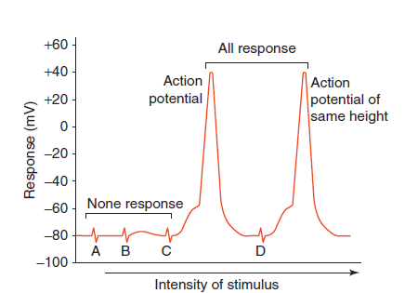
All or None law

Slide 53
REFRACTORY PERIOD

Slide 54
Absolute refractory period (ARP)
The excitability of the nerve fiber is completely lost. i.e., the nerve is refractory to further stimulation
- no other stimulus whatever its strength can excite the nerve.
- corresponds to: the ascending limb of the spike potential (after the firing level) and the early part of the descending limb (initial 1/3 of repolarization).

Slide 55
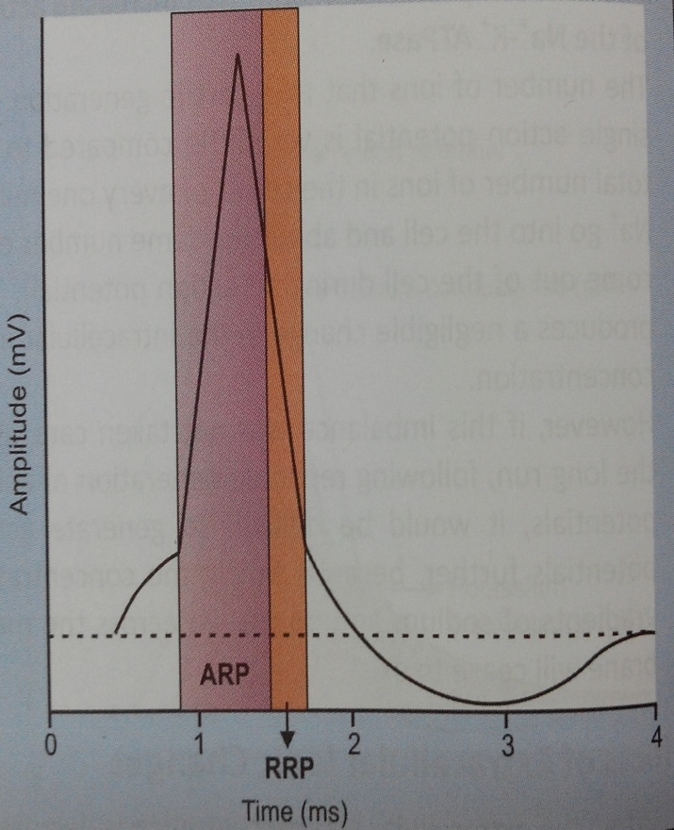
Absolute refractory period

Slide 56
Mechanism of ARP
At the peak of AP, the inactivation gates of the voltage gated Na+ channels close and they remain in that inactivated state for some time before returning to the resting state.
These Na+ channels can reopen in response to second stimulus, only after attaining the resting state.
Hence even if a stronger stimulus is applied during this interval, it will not produce a second AP and the membrane is said to be in its absolute refractory period.

Slide 57
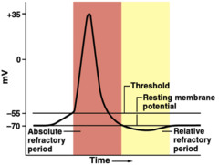
REFRACTOTY PERIOD

Slide 58
Relative refractory period (RRP)
The excitability of the nerve is partially recovered (but still below normal)
- Stronger stimuli are needed to excite the nerve.
- corresponds to the late part of the descending limb of the spike potential till the start of the negative after potential.

Slide 59
Summation
Application of subthreshold stimuli in rapid succession, they are summated and they produce an action potential.

Slide 60
ACCOMODATION
If a nerve is submitted to a repeatedly constant strength of current, the site of the nerve under stimulation shows decrease of excitability.
A similar feature at the nerve endings is called ADAPTATION i.e nerve fiber accommodate while nerve endings adapts.

Slide 61
Unfatigability
NERVE fibers cannot be fatigued, even when they are stimulated continuously due to absolute refractory period

Slide 62
1.All or None phenomena in nerve followed by
Nerve
Neuron
both
None

Slide 63
2. Nerve can be stimulated by supra-maximal current but not by threshold is
A. ARP
B. RRP
C. None
D. all

Slide 64
3. The sequence of changes which occur in the membrane potential following excitation
A. AP
B. RMP
C. Conduction
D. none

Slide 65
4.Propagation of impulse in one direction along to its termination is called:
A.Antidromic
B.Orthodromic
C.Antegrade
D.Saltatory

Slide 66
5.Minimum strength required to stimulate the nerve is k/as
Maximal
Sub-minimal
Supra-maximal
Threshold

Slide 67
EBES
EVIDENCE 1
Reconstruction of the action potential of frog sartorius muscle
Adrian RH, Peachey LD. J Physiol. 1973 Nov;235(1):103-31.

Slide 68
Reconstruction of the action potential of frog sartorius muscle
reference | PROBLEM | INTERVENTION | CONCLUSION | OUTCOME
Adrian RH, Peachey LD. J Physiol. 1973 Nov;235(1):103-31. | Propagated action potentials of striated muscle are calculated using an equivalent circuit that represents the transverse tubular system as a radial cable of sixteen elements. The membrane of the transverse tubules is assumed to have activatable ionic currents similar to those in the fibre surface. | The configuration of the after-potential and the conduction velocity are best accounted for by postulating a resistance of about 150Ω cm² separating the extracellular fluid from the lumen of the transverse tubules at the edge of the fibre, and a density of sodium channels in the tubular wall about a twentieth of that in the fibre surface. | Calculations with imposed voltage steps at the fibre surface suggest that the potential across the tubular membrane at the centre of the fibre is very far from clamped. | Currents providing charge for the tubular capacity can give rise to substantial errors in estimating the zero-current potential of the ionic currents.

Slide 69
EBES
EVIDENCE 2
The "Lillie transition": models of the onset of saltatory conduction in myelinating axons.
Young RG, Castelfranco AM, Hartline DK. J Comput Neurosci. 2013 Jun;34(3):533-46.

Slide 70
The "Lillie transition": models of the onset of saltatory conduction in myelinating axons.
REFERENCE | INTERVENTION | SUBJECT | RESULT | CONCLUSION
Young RG, Castelfranco AM, Hartline DK. J Comput Neurosci. 2013 Jun;34(3):533-46. | They examined in computer models simulating a segmented insulating sheath surrounding an axon having Hodgkin-Huxley squid parameters. | LILLIE TRANSITION MODEL reported that rapid saltatory conduction arose in an iron wire model of nerve impulse propagation when he covered the wire with insulating sections of glass tubing equivalent to myelinated internodes. Similar mechanism explaining rapidconduction in myelinated nerve. | With a wide gap under the sheath, conduction was continuous.The conduction velocity slowdown was little affected by the number of myelin layers or modest changes in the size of the "node," but strongly affected by the size of the "internode" and axon diameter. The steepness of the rise of rapidconduction was greatly affected by the number of myelin layers and axon diameter, variably affected by internode length and little affected by node length. The transition to saltatory conduction occurred at surprisingly wide gaps and the improvement in conduction speed persisted to surprisingly small gaps. | The study demonstrates that the specialized paranodal seals between myelin and axon, and indeed even the clustering of sodium channels at the nodes, are not necessary for saltatory conduction.

