Slide 1
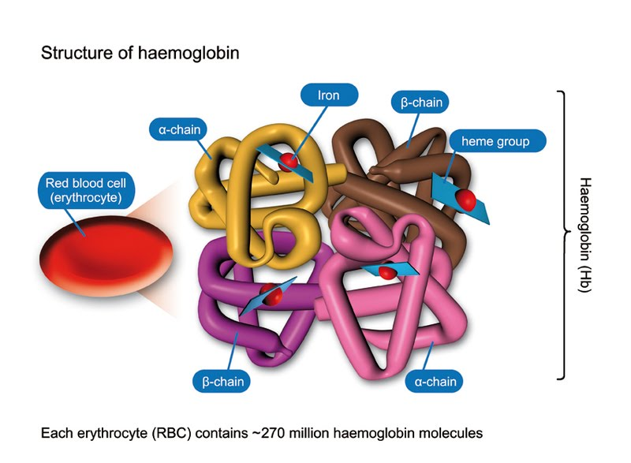
Hemoglobin….
Dr. Hemendra Suthar
Asst. Professor, Physiology
SBKS MI & RC

Slide 2
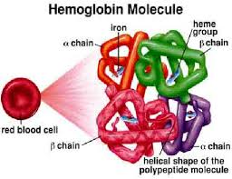
Learning objectives….
Haemoglobin
Structure, function, variations
Derivatives, synthesis and degradation of hemoglobin.
Applied

Slide 3
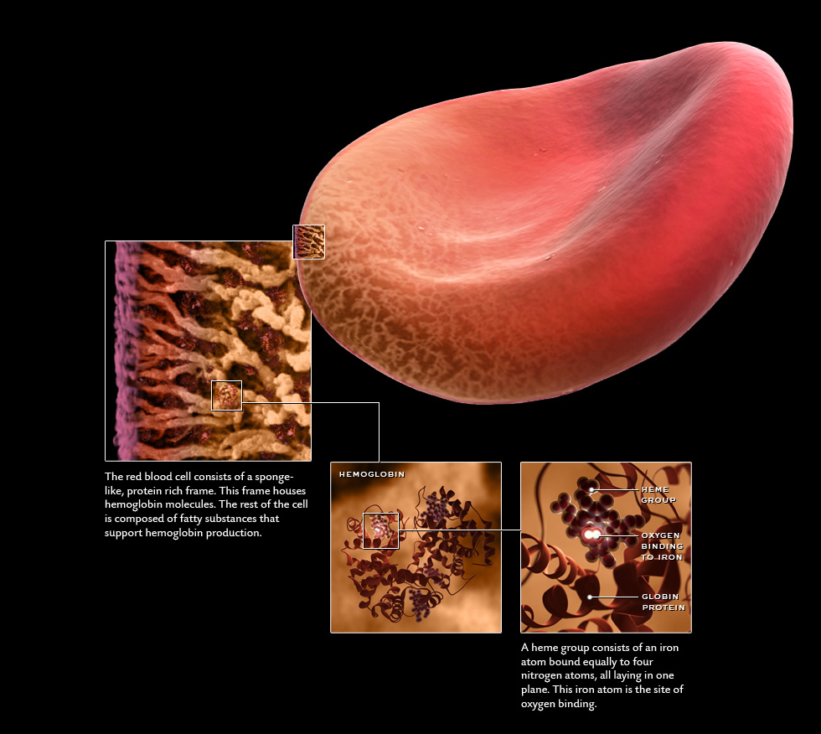
Haemoglobin
(C₇₁₂H₁₁₃₀O₂₄₅N₂₁₄S₂Fe)₄

Slide 4
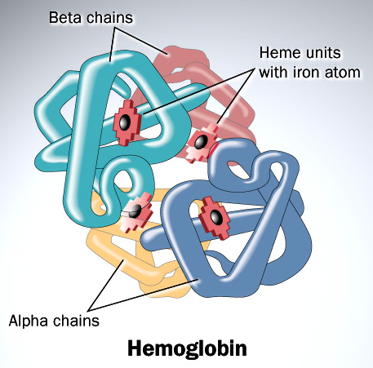
HAEMOGLOBIN
It is a Red pigment
Present in RBC of Blood.
It is a conjugated protein, & Chromoprotein.
It is made up of Iron and Protein

Slide 5
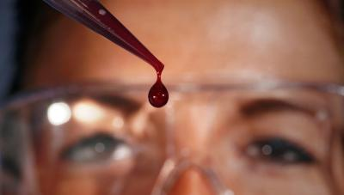
What will happen.. if haemoglobin present in plasma???
Increase viscosity.
Increase osmotic pressure.
Rapid destruction by reticuloendothelial system.
Haemoglobinuria
( excretion through kidney)

Slide 6
NORMAL VALUES OF HEMOGLOBIN…
The Normal Hb level:
Newborn – 16-22 gm/dl.
  Transfusion from placenta
  Haemoconcentration
1 year – 10-12 gm/dl
Males – 14-18 gm/dl
Females- 12-16 gm/dl

Slide 7
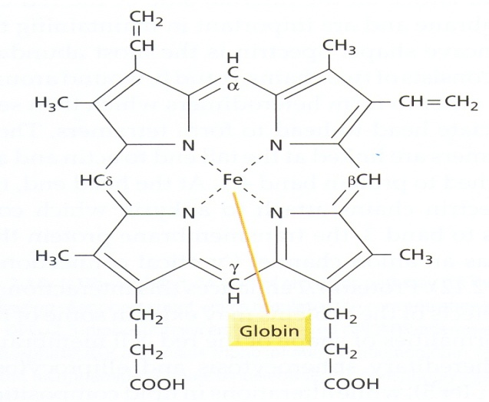
STRUCTURE OF HAEMOGLOBIN.
Iron containing pigment called Haem attached with protein – Globin.
Haeme is Iron – porphyrin complex called IRON-PROTOPORPHYRIN IX
Globin – Protein.

Slide 8
CONT…
IRON
  Ferrous form (Fe2+).
  Iron attached to nitrogen atom of each pyrole ring.
  On iron loose bond for
    Oxygen
* Binding of O2 with hemoglobin is known as oxygenation not OXIDATION, as no exchange of ions take place

Slide 9
Cont…
Porphyrin nucleus.
4 Pyrrole Rings (Tetrapyrrole)
Bridges – Methine (CH)
Side chains – 8
  Methyl (CH3) - 4
  Vinyl (CH.CH2) - 2
  Propionic acid - 2 (CH2.CH2.COOH)

Slide 10
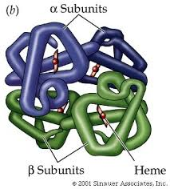
Cont…
Globin made up of 4 polypeptide chains.
Globin in HbA
2 alpha chains–
141 AA
2 Beta chains–
146 AA

Slide 11
Cont…
4 units of Heme attached to 1 unit of Globin.
So one Haemoglobin molecules contains 4 Iron Atoms which carry Four molecules of oxygen.

Slide 12
Synthesis of Hemoglobin
i) 2 succinyl – CoA + 2 glysine Pyrrole
ii) 4 Pyrrole Protoporphyrin IX
iii) Protoporphyrin IX + Fe2+ Heme
iv) Heme + Polypeptide Hemoglobin chain (α or β)
v) 2 α chains + 2 β chains Haemoglobin A.

Slide 13
Factors controlling Haemoglobin formation
Role Of Proteins – First class proteins provide amino acids.
Most imp – food of animal origin, liver, spleen, kidney & heart
Least – cereals, dairy products, veg & fruits.
IRON--Important for formation of Heme part of Hemoglobin.

Slide 14
Role of other metals
Copper – Promotes Absorption, Mobilization & Utilization of iron.
Cobalt – Increases production of Erythropoietin.
Calcium – conserve iron & subsequent utilization.
Role of vitamins.
  Vit B12, Folic acid help in synthesis of nucleic acid.
  & vit C helps in absorption of iron from gut. (Fe3+ to Fe2+)
Role of bile salts.
  Imp for proper absorption of copper & nickel.

Slide 15
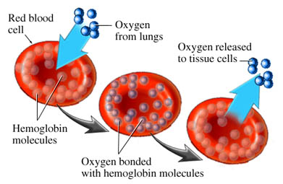
Functions of Haemoglobin
Transport oxygen to tissues: 1.34 ml/gm Hb
Transport Co2 to lungs
Maintains acid base balance ( As a Buffer)

Slide 16
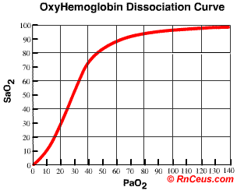
Haemoglobin – Oxygen Binding.
O2 is attached with haemoglobin reversibly at 6th covalent bond.
Oxygenation of 1st haem increases affinity for 2nd in turn 3rd & 4th.
Reason for O2-Hb DC Sigmoid shape.

Slide 17
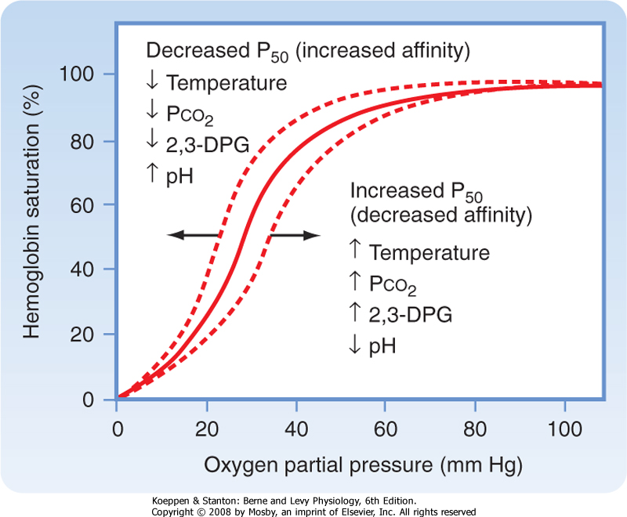
Oxygen – Haemoglobin Dissociation curve.
As affinity of Hb for O2 falls graph shifted to right.
As affinity of Hb for O2 rise graph shifted to left.

Slide 18
VARIETIES OF HAEMOGLOBIN.
Physiological.
Adult
  Haemoglobin A --
  4 polypeptide chains
  2 α (alpha) & 2 β (Beta)
  Haemoglobin A2 –
  2 α (alpha) & 2 δ (Delta)
Fetal (Hbf)
2 α (alpha) and 2 γ (Gamma)
Pathological (Haemoglobinopathies)
  Sickle Cell Haemoglobin.
  HbC, D,E
  Thallasemia.
  *Hb Barts- γ4

Slide 19
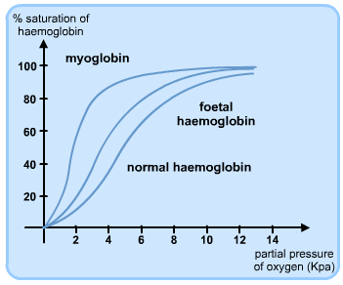
FETAL HAEMOGLOBIN (Hbf)
Present in fetal RBC & disappear in 2-3 months
after birth.
Structure
  4 polypeptide chains
  2 α(alpha) & 2 γ (gamma)
Characteristics.
  Affinity for oxygen – more
  Resistance to action of alkalies
  Life span – less.

Slide 20
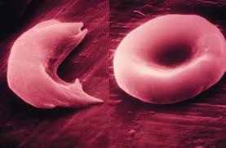
PATHOLOGICAL (HAEMOGLOBINOPATHIES)
Sickle cell haemoglobin.(HbS)
  Substitution of Valine for Glutamic Acid at 6th position in beta chain.
  When HbS is reduced (in low O2 tension) precipitate into crystals in RBC changes shape become Sickle shaped.
  Cells become more fragile, less flexible

Slide 21
Pathological (Haemoglobinopathies)
Haemoglobin C
  Similar to HbS but not associated with Sickling.
Other varieties are HbE, HbD
Thalassaemia
  Defect in synthesis of polypeptide chain.
  Types
  Major
  Minor

Slide 22
DIFFERENCE IN THALASSAEMIA MAJOR & MINOR.
β Thalassaemia Major
β Thalassaemia Minor.
Less common
Homozygous transmission
Complete absence of beta chain synthesis.
Anemia – moderate to severe
HbF – markedly increased
Life span – short
Cooley’s Anaemia
More common.
Heterozygous transmission.
Partial Absense.
Anemia- mild.
HbF – slightly elevated.
Life span – comparatively longer.

Slide 23
Hemoglobin ligands (complexes)
Hb + O₂ HbO₂ (Oxyhaemoglobin) Iron in ferrous state)
Hb + CO₂ Carbamino hemoglobin
Hb + CO Carboxy hemoglobin
Methaemoglobin (HbOH)- Iron in fe⁺³ state (Congenital Methhemoglobinemia- Absence of NADH reductase).
Hb + H₂S Sulphemoglobin.
Hb + Glucose Glycosylated ( attached to terminal Valine)

Slide 24
FATE OF HAEMOGLOBIN
HEMOGLOBIN
CHOLEGLOBIN
GLOBIN
IRON
BILIVERDIN (Bilirubin Reductase)
AMINO ACIDS
Reutilized in bone marrow for Hb synthesis
IRON
BILIRUBIN
Stored as Ferritin
Taken up by liver
Tetra pyrrole straight chain with Globin & Iron

Slide 25
MCQ’s
Hemoglobin iron combines with
Molecular O2
Superoxide
Molecular as well as ionic
Ionic

Slide 26
2. Exposure of Hb to oxidizing agents results in formation of
HbOH
Hbs
HbO2
HbCO

Slide 27
3. Normally more than 90% of HbF is replaced by HbA
Soon after birth
1-2 months after birth
3 months after birth
4 months after birth

Slide 28
4. Sickle cell anemia, false is
RBC fragility increases
RBC become sickle shaped
Blood Flow to tissues decreases
Manifest as mild anemia

Slide 29
5. Not true about free Hb
Increases the blood viscosity
Interfere with fluid exchange at capillary level
Damage the kidney
Decrease the osmotic pressure of plasma

Slide 30


