Slide 1
ENZYMOLOGY
DR. MIHIR MEHTA
MBBS; MD(BIOCHEMISTRY)
ASSOCIATE PROFESSOR
SBKS MI&RC

Slide 2
Learning Objectives
Definition
Characteristics and Classification
Structure
Enzyme Kinetics
Factors affecting Enzyme Activity
Enzyme Inhibition & Regulation
Diagnostic Use

Slide 3
Definition & Characteristics
Enzymes are substances which accelerate the rate of chemical reactions, but do not change the equilibrium.
Enzymes are biocatalysts
Almost all enzymes are proteins and follow their characteristics
Heat labile and water soluble
Not altered or consumed during reaction

Slide 4
Classification
International Union of Biochemistry and Molecular Biology (IUBMB) had classified enzymes into 6 classes.
In August 2018, seventh class has been identified and included in classification by IUBMB.

Slide 5
Classification
Enzymes are grouped into 7 major classes:
Oxidoreductases
Transferases
Hydrolases
Lysases
Isomerases
Ligases
Translocase

Slide 6
Oxidoreductases
This group will catalyse oxidation of one substrate with simultaneous reduction of another substrate.
AH2 + B → A + BH2
Alcohol + NAD⁺ → Aldehyde + NADH + H ⁺
May also oxidize substrate by adding oxygen
e.g. Oxidases, Oxygeanses and Dehydrogenases.

Slide 7
Transferases
This group of enzymes will transfer one group(other than hydrogen) from one substrate to another substrate.
A-X + B → A + B-X
E.g. Hexose + ATP → Hexose-6- Phosphate + ADP.

Slide 8
Hydrolases
This class can hydrolyse ester, ether, peptide or glycosidic bonds by adding water.
Acetylcholine + H2O → Choline Acetate.
Enzyme is Acetyle choline esterase.

Slide 9
Lysases
These enzymes can remove groups from substrates or break bonds by mechanisms other than hydrolysis.
E.g.
Fructose 1,6-bisphosphate → Glyceraldehyde-3- Phosphate + Dihydroxyacetone phosphate.

Slide 10
Isomerases
These enzymes can catalyze geometric or structural changes within a molecule.
Intramolecular transfers.
E.g. Racemase, epimerase, cis-trans isomerase.
Glyceraldehyde-3- Phosphate → Dihydroxy acetone phosphate
Enzyme is Triose phosphate isomerase.

Slide 11
Ligases
These enzymes link two substrates together, usually with the simultaneous hydrolysis of ATP.
ATP dependent condensation of two molecules.
Note: Synthetase and Synthase.
Acetyl-CoA + CO2 +ATP → Malonyl-CoA + ADP + Pi
Enzyme is Acetyl-CoA Carboxyalse.

Slide 12
Translocase
These enzymes catalyze the movement of ions or molecules across membranes or their separation within membranes.
This form of membrane transport is classified under active membrane transport, an energy-requiring process of pumping molecules and ions across membranes against a concentration gradient.

Slide 13
Translocase
ADP/ATP translocase imports adenosine diphosphate (ADP) from the cytosol and exports ATP from the mitochondrial matrix, which are key transport steps for oxidative phosphorylation in eukaryotic organisms.
ADP from the cytosol is transported back into the mitochondrion for ATP synthesis and the synthesised ATP, produced from oxidative phosphorylation, is exported out of the mitochondrion for use in the cytosol, providing the cells with its main energy currency.

Slide 14
Coenzymes
Enzymes may be simple proteins or complex enzymes containing a non-protein part called Coenzyme.
Protein part is then known as Apoenzyme.
Apoenzyme + Coenzyme → Holoenzyme.
The protein part gives the necessary three dimensional infrastructure for chemical reactions but the group is transferred from or accepted by coenzyme.

Slide 15
Coenzymes
Essential for the biological activity of the enzyme.
Combines loosely with enzymes and can be separated easily.
One molecule of the coenzyme is able to convert a large number of substrate molecules with the help of enzymes.
Most of them are derivatives of Vitamin B complex.

Slide 16
Coenzymes
Inside the body, when the reaction is completed, the coenzyme is released from the apo-enzyme, and can bind to another enzyme molecule.
The reduced coenzyme generated in first reaction can take part in second reaction.
E.g. Coupling of the two reactions become essential in anaerobic glycolysis.

Slide 17
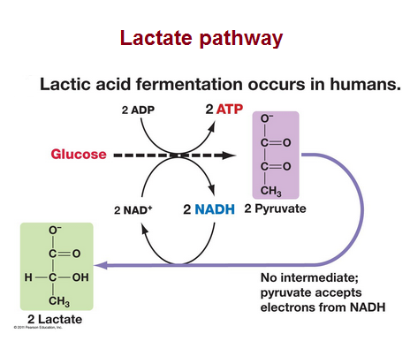

Slide 18
Coenzymes
Two groups:
Those taking part in reactions transferring hydrogen group. E.g. Reactions catalysed by Dehydrogenases (Oxidoreductases).
Those taking part in reactions transferring other than hydrogen group. E.g. Biotin, Co-A, ATP etc.

Slide 19
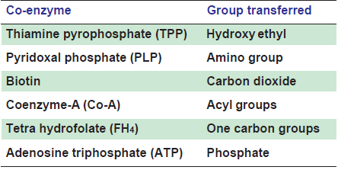

Slide 20
Adenosine Triphosphate
Energy source
Second and third phosphate bonds are high energy bonds – Squiggle bonds
Oxidation of food → energy is released → Stored as chemical energy in the form of ATP.
Energy is utilized when needed in the form of endergonic reactions.
E.g. Glucose + ATP → Glucose-6-Phosphate + ADP.

Slide 21
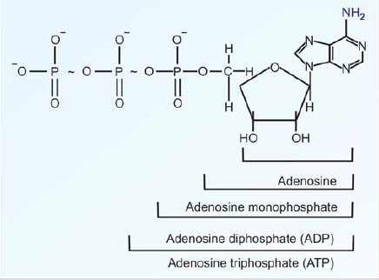
Structure of ATP

Slide 22
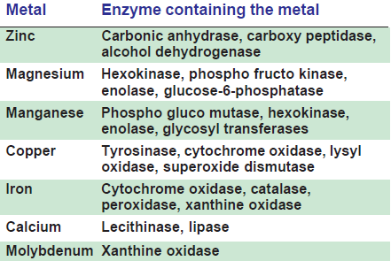
Metalloenzymes
Requires metal ions for their activity.
Activity is enhance when metal ion is added.

Slide 23
Active site/Active Center of Enzyme
The region of the enzyme where the substrate binds and catalysis occurs is referred to as active site or active center.
The reaction takes place at the active site. The active site occupies only a small portion of the whole enzyme.
Generally active site is situated in a cleft of the enzyme molecule.

Slide 24
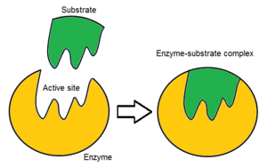
Active Site of Enzyme

Slide 25
Salient features of active centre of enzyme
The binding of substrate to active site depends on the alignment of specific groups or atoms at active site.
During binding, these groups may realign themselves to provide the unique conformational orientation so as to promote exact fitting of substrate to the active site.
The substrate binds to the enzyme at the active site by non-covalent bonds. These forces are hydrophobic in nature.

Slide 26
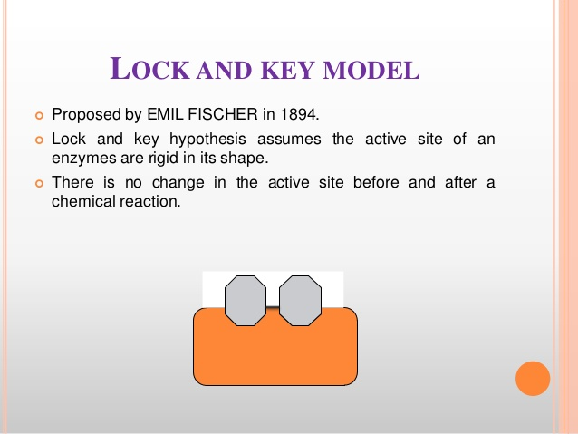

Slide 27
Fischer’s theory
Active site of the enzyme is complementary to the substrate
Enzyme and substrate fit each other – lock and key
Lock can only be opened by its own key.

Slide 28
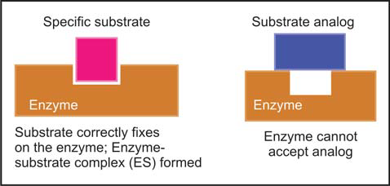
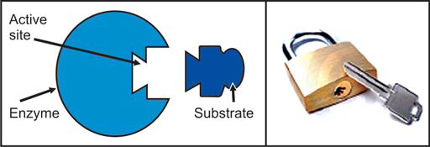
Fischer’s template theory

Slide 29
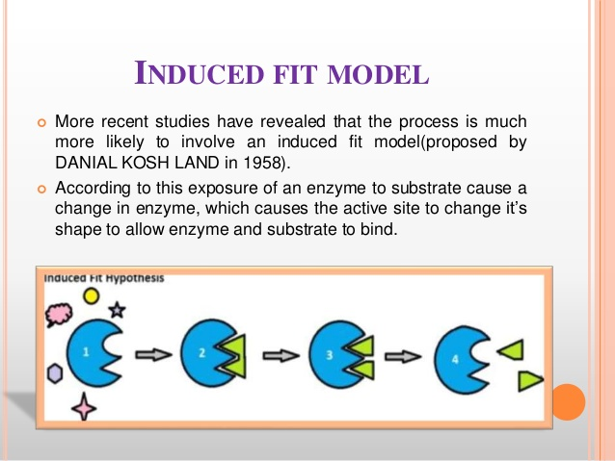

Slide 30
Koshland’s induced fit theory
Conformational changes occur at the active site of enzymes concomitant with the combination of the enzyme with the substrate.
At first, the substrate binds to a specific part of the enzyme, this leads to more secondary binding and conformational changes.
The substrate induces conformational changes in the enzyme, such that precise orientation of catalytic group is effected.

Slide 31
Koshland’s induced fit theory
A simplified explanation is that a glove is put on a hand. At first, the glove is in a partially folded position, but hand can enter into it. When the hand is introduced, the glove is further opened.
Similarly, conformational changes occur in the enzyme when the substrate is fixed.

Slide 32
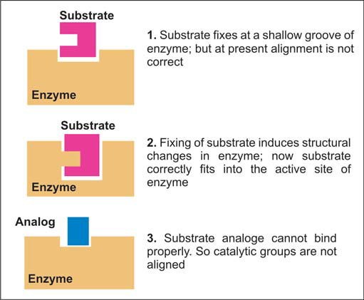

Slide 33
MCQs
1. True about active site of an enzyme except:
Occupies a small portion of enzyme
Catalysis occurs at active site
C. Conformational changes may occur in the enzyme when the substrate is fixed.
D. The substrate binds to the enzyme at the active site by covalent or hydrophilic interactions.

Slide 34
MCQs
2. Enzyme-substrate Lock and Key model was describe by:
Koshland
Fishcer
Michaelis-Menten
Dixon

Slide 35
MCQs
3. Which class of enzymes uses water in their activity?
Lyases
Oxidoreductases
Hydrolases
Dehydrogenases

Slide 36
MCQs
4. Correct about enzymes except:
Water soluble
Heat stable
Made up of proteins
Not utilized in the reactions

Slide 37
MCQs
5. True about coenzymes:
Essential for the biological activity of enzyme
One molecule of Coenzyme can convert only one molecule of substrate
Always requires metal ions for their activity
Heat labile

