Slide 1
ENZYME INHIBITION
DR. MIHIR MEHTA
MBBS; MD(BIOCHEMISTRY)
ASSOCIATE PROFESSOR
SBKS MI&RC

Slide 2

Enzyme Inhibition
Competitive Inhibition:
Here inhibitor molecules are competing with the normal substrate molecules for attaching with the active site of the enzyme
Since E-I (enzyme-inhibitor complex) can react only to reform the enzyme and inhibitor, the number of enzyme molecules available for E-S formation is reduced

Slide 3
Competitive Inhibition
Suppose 100 molecules of substrate and 100 molecules of inhibitor are competing for 100 molecules of the enzyme
So, half the enzyme molecules are trapped by the inhibitor and only half the molecules are available for catalysis to form the product
Since effective concentration of enzyme is reduced, the reaction rate is decreased initially.

Slide 4
Competitive Inhibition
In competitive inhibition, the inhibitor will be a structural analog of the substrate
There will be similarity in three-dimensional structure between substrate (S) and inhibitor (I)
E.g. succinate dehydrogenase reaction is inhibited by malonate

Slide 5
Competitive Inhibition
Competitive inhibition is usually reversible
Excess substrate abolishes the inhibition
In the previous example of 100 moles of E and 100 moles of I, if 900 moles of S are added
only 1/10th of enzyme molecules are attached to inhibitor and 90% are working with substrate
Thus 50% inhibition in the first example is now decreased to 10% inhibition

Slide 6
Competitive Inhibition
The Km is increased in presence of competitive inhibitor
So the affinity of the enzyme towards substrate is apparently decreased in presence of the inhibitor
But Vmax is not changed

Slide 7
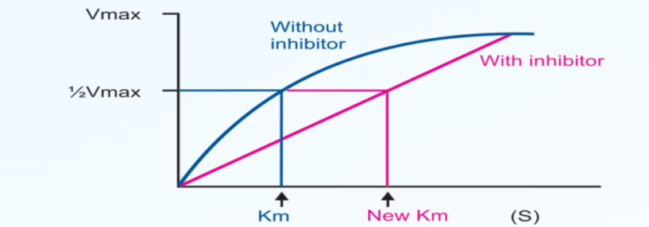
Competitive Inhibition

Slide 8
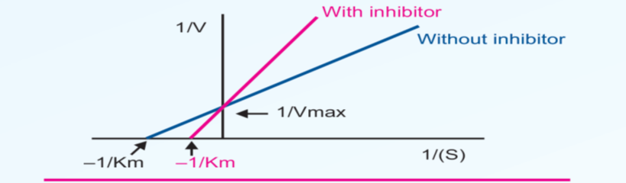
Competitive Inhibition

Slide 9
Competitive Inhibition
Pharmacological action of many drugs may be explained by the principle of competitive inhibition
E.g.
Sulfonamides: They are commonly employed antibacterial agents
Bacteria synthesize folic acid by combining PABA with pteroylglutamic acid
Sulfa drugs, being structural analogs of PABA, will inhibit the folic acid synthesis in bacteria, and they die
The drug is nontoxic to human cells, because human beings cannot synthesized folic acid

Slide 10
Competitive Inhibition
Methotrexate:
It is 4-amino-10 -methyl folic acid
It is a structural analog of folic acid
So can competitively inhibit folate reductase enzyme
This is essential for DNA synthesis and cell division
Therefore, methotrexate is used as an anticancer drug

Slide 11
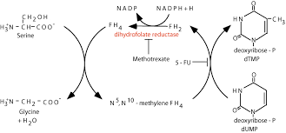

Slide 12
Competitive Inhibition
Dicoumarol:
It is structurally similar to vitamin K
Can act as an anticoagulant by competitively inhibiting the vitamin K activity
Isonicotinic acid hydrazide (INH):
It is a commonly used antituberculous drug.
It is structurally similar to pyridoxal
Prolonged use of Isoniazid may cause pyridoxal deficiency and peripheral neuropathy.

Slide 13
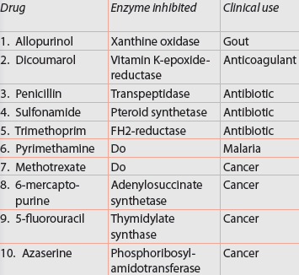
Clinically useful competitive inhibitors

Slide 14
Non-competitive Inhibition
A variety of poisons, such as iodoacetate, heavy metal ions (lead, mercury) and oxidizing agents act as irreversible non-competitive inhibitors
There is no competition between substrate and inhibitor
The inhibitor usually binds to a different domain on the enzyme, other than the substrate binding site

Slide 15
Non-competitive Inhibition
These inhibitors have no structural resemblance to the substrate
Increase in the substrate concentration generally does not relieve this inhibition
The inhibitor combines with the enzymes by forming a covalent bond and then the reaction becomes irreversible
The velocity (Vmax) is reduced
Km value is not changed, because the remaining enzyme molecules have the same affinity for the substrate

Slide 16
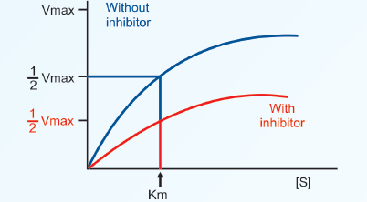
Non-competitive Inhibition

Slide 17
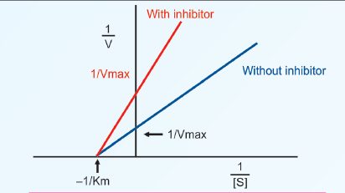
Non-competitive Inhibition

Slide 18
Non-competitive Inhibition
Cyanide inhibits cytochrome oxidase
Fluoride will inhibit the enzyme enolase (glycolysis)
Iodoacetate would inhibit enzymes having –SH group in their active centers
BAL (British Anti-Lewisite; dimercaprol) is used as an antidote for heavy metal poisoning
The heavy metals act as enzyme poisons by reacting with the SH group
BAL has several SH groups with which the heavy metal ions can react and thereby their poisonous effects are reduced

Slide 19
Non-competitive Inhibition
Acetylcholinesterase enzyme cleaves acetylcholine to form acetate and choline and therefore terminates the action of acetylcholine
Certain chemicals e.g. diisopropyl fluorophosphates (DFP) binds to the active site, serine of acetylcholinesterase
DFP forms an irreversible covalent bond with acetylcholinesterase, and activity can be regained only if new enzyme is synthesized

Slide 20
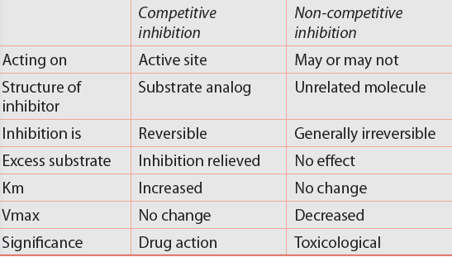
Comparison Of Two Types Of Inhibition

Slide 21
Uncompetitive Inhibition
Here inhibitor does not have any affinity for free enzyme
Inhibitor binds to enzyme–substrate complex; but not to the free enzyme
In such cases both Vmax and Km are decreased
e.g. Inhibition of placental alkaline phosphatase by phenylalanine

Slide 22
Suicide Inhibition
It is a special type of irreversible inhibition
It is also known as mechanism based inactivation
The inhibitor makes use of the enzyme's own reaction mechanism to inactivate it
In suicide inhibition, the structural analog is converted to a more effective inhibitor with the help of the enzyme to be inhibited
The substrate-like compound initially binds with the enzyme and the first few steps of the pathway are catalyzed

Slide 23
Suicide Inhibition
Allopurinol that is oxidized by xanthine oxidase to alloxanthine which is a more potent inhibitor of xanthine oxidase
The anti-inflammatory action of Aspirin is also based on suicide inhibition
Arachidonic acid is converted to prostaglandin by the enzyme Cyclo-oxygenase
Aspirin acetylates a serine residue in the active center of cyclo-oxygenase
prostaglandin synthesis is inhibited, and so inflammation subsides

Slide 24
Allosteric Regulation
Allosteric enzyme has
  one catalytic site where the substrate binds
  Another separate allosteric site where the modifier binds
Allosteric and substrate binding sites may or may not be physically adjacent
The binding of the regulatory molecule can either enhance the activity of the enzyme (allosteric activation)
The regulatory molecule is known as the positive modifier
Or inhibit the activity of the enzyme (allosteric inhibition)
The regulatory molecule is known as the negative modifier

Slide 25
Allosteric Regulation
The binding of substrate to one of the subunits of the enzyme may enhance substrate binding by other subunits
Positive cooperativity
If the binding of substrate to one of the subunits decreases the affinity of substrate binding by other sites, the effect is called negative cooperativity
In most cases, a combination is observed, resulting in a sigmoid shaped curve

Slide 26
Allosteric Inhibition

Slide 27
Action of allosteric enzymes

Slide 28
Allosteric Regulation
When an inhibitor binds to the allosteric site, the configuration of catalytic site is modified such that substrate cannot bind properly
Most allosteric enzymes possess quaternary structure
They are made up of subunits
  e.g. Aspartate transcarbamoylase has 6 subunits
  Pyruvate kinase has 4 subunits

Slide 29
Key Enzymes
Body uses allosteric enzymes for regulating metabolic pathways
Such a regulatory enzyme in a particular pathway is called the key enzyme or rate limiting enzyme
The allosteric inhibitor is most effective when substrate concentration is low
This is metabolically very significant

Slide 30

Key Enzymes
e.g.
This is the committed step in glycolysis
ATP acts as an allosteric inhibitor (negative modifier) of PFK1

Slide 31
Key Enzymes
When the cellular level of ATP rises, glycolysis can slow down and ATP binds to the allosteric site, thus inhibiting the reaction
A high level of AMP within the cell indicates a low level of ATP. Hence AMP acts as an allosteric activator (positive modifier) of the enzyme

Slide 32

Key Enzymes
This is the first step in heme biosynthesis
The end product, heme will allosterically inhibit the ALA synthase
This enzyme is the key enzyme of heme synthesis

Slide 33

Key Enzymes
This is the first step in the pathway which finally produces cytidine triphosphate (CTP)
CTP, the end product will allosterically inhibit aspartate transcarbamoylase
E.g. HMG CoA-reductase, Acetyl CoA-carboxylase, Pyruvate carboxylase, Citrate synthase

Slide 34

Feedback Inhibition
The term feedback inhibition or end-product inhibition means that the activity of the enzyme is inhibited by the final product of the biosynthetic pathway
In this pathway, if D inhibits E1, it is called feedback inhibition
E.g.
AMP inhibits the first step in purine synthesis
Inhibition of aspartate transcarbamoylase by CTP is an example for end product inhibition

Slide 35
Covalent Modification
The activity of enzymes may be increased or decreased by covalent modification
It means, either addition of a group to the enzyme protein by a covalent bond; or removal of a group by cleaving a covalent bond brings covalent modification
Zymogen activation by partial proteolysis is an example of covalent activation
This is a reversible reaction

Slide 36
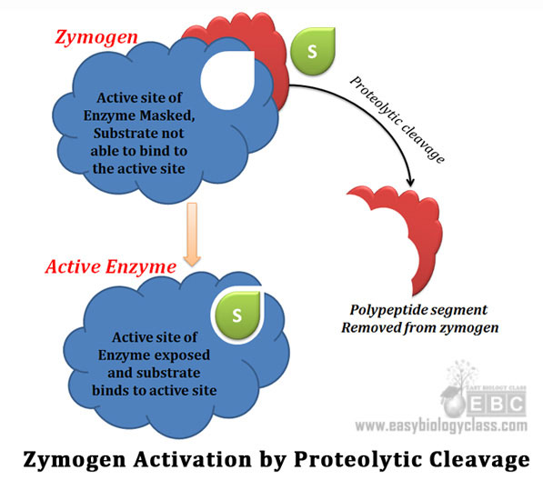
Covalent Modification

Slide 37
Covalent Modification
The most common type of covalent modification is the reversible protein phosphorylation and dephosphorylation.
The phosphate group may be attached to serine, threonine or tyrosine residues.
Phosphate group can be added by kinase enzyme whereas it can be removed by phosphatase enzyme.

Slide 38
Covalent Modification

Slide 39
Covalent Modification
When hormone binds to the membrane bound receptor, hormone-receptor complex (HR) is formed
The enzyme adenylate cyclase is activated
This activation is mediated through a G protein
The active adenylate cyclase converts ATP to cyclic AMP (cAMP), which acts as a second messenger
It activates protein kinase by binding to the regulatory subunit of the enzyme
The active catalytic subunit will phosphorylate the enzyme

Slide 40
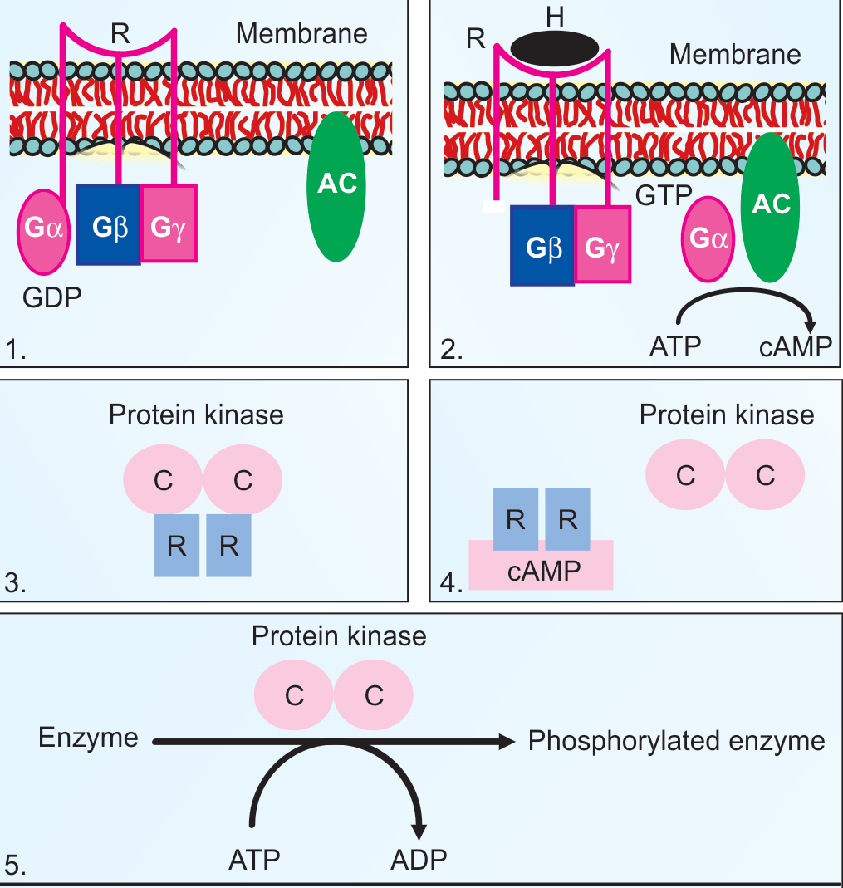

Slide 41
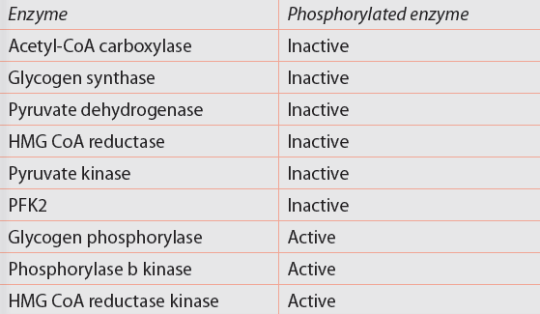
Covalent Modification

Slide 42
MCQs
1. In competitive inhibition, what happens to V_{max} and K_{m}?
a) V_{max} increases and K_{m} decreases.
b) V_{max} is unchanged and K_{m} increases.
c) Both V_{max} and K_{m} remains unchanged
d) V_{max} decreases and K_{m} increases.

Slide 43
MCQs
2. In non-competitive inhibition, what happens to V_{max} and K_{m}?
a) V_{max} increases and K_{m} decreases.
b) V_{max} is unchanged and K_{m} increases.
c) Both V_{max} and K_{m} remains unchanged
d) V_{max} decreases and K_{m} remains unchanged

Slide 44
MCQs
3. True about competitive inhibition except:
A. The inhibitor usually binds to a different domain on the enzyme, other than the substrate binding site
B. The inhibitor is a structural analogue of the substrate
C. Competitive inhibition is usually reversible
D. Excess substrate abolishes the inhibition

Slide 45
MCQs
4. Which of the following is a suicide inhibitor?
Dicoumarol
Isoniazid
Allopurinol
Iodoacetate

Slide 46
MCQs
5. Which of the following statement is not true:
A. Positive modifier can enhance the activity of the enzyme
B. Most allosteric enzymes possess quaternary structure
C. Inhibition of placental alkaline phosphatase by phenylalanine is an example of competitive inhibition
D. The most common type of covalent modification is the reversible protein phosphorylation

