Slide 1
Dr Trushna Shah
Associate Professor
Dept. of Biochemistry
SBKSMI&RC

Slide 2
MUCOPOLYSACCHARIDES or glycosamino glycans (GAG)
Mucopolysaccharides or glycosamino glycans (GAG) are heteropolysaccharides, containing uronic acid and amino sugars. Because of the presence of these charged groups, they attract water molecules and so they produce viscous solutions.

Slide 3
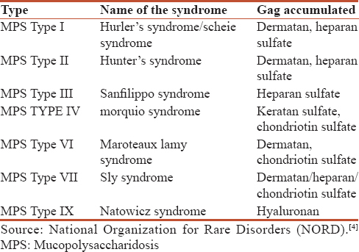

Slide 4
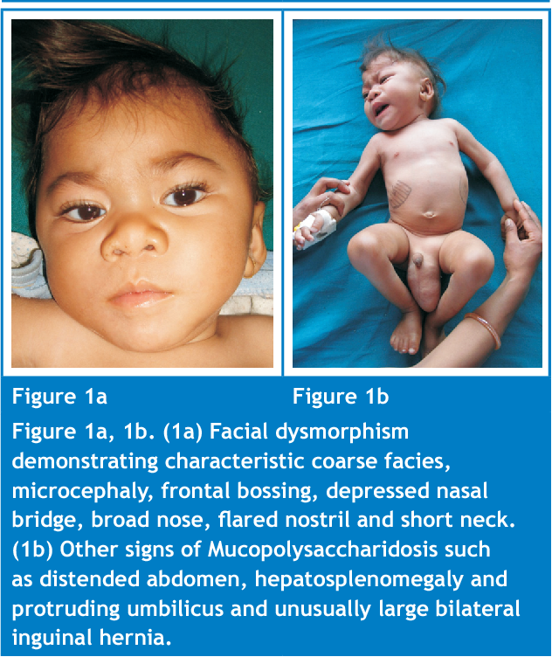

Slide 5
CLASSIFICATION:
Acidic :
a) sulphur containing : 1) Keratan sulphate
2) Dermatan sulphate
3) Chodrotin sulphate
b) Non sulphur containing: Hyaluronic acid.
Neutral: Blood group substances

Slide 6
Non sulphur containing:
Hyaluronic Acid
Chemistry:
Contains N-acetyl glucoseamine & glucuronic acid.
Linkage is β -(1-4) linkage.
Present in connective tissue, tendons, synovial fluid, vitreous humour of eye.
Hyaluronic acid is a natural substance found in the fluids in the eyes and joints.
It acts as a cushion and lubricant in the joints and other tissues. Different forms of hyaluronic acid are used for cosmetic purposes.

Slide 7
Hyaluronic Acid Benefits
Hyaluronic acid provides a cushion effect between the joints.
Hyaluronic acid provides a "reservoir of water" within the skin. Elasticity of skin is maintained by it
Hyaluronic acid reduces bacterial infections. Hyaluronic Acid has been found to raise the white cell count in your bloodstream.

Slide 8
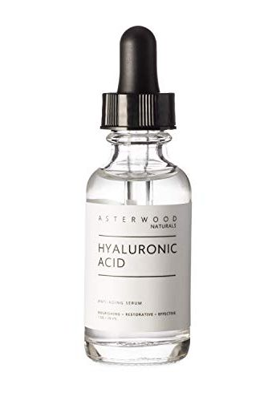
Non sulphur containing:
Some people apply hyaluronic acid to the skin for healing wounds,
Diabetic foot ulcers,
Dry eyes, burns,
Skin ulcers, and as a moisturizer.
Prevent the effects of aging(Anti wrinkle)

Slide 9
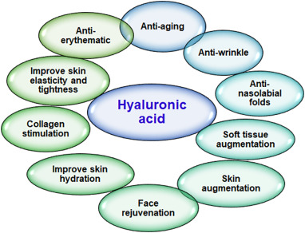

Slide 10

Acidic polysaccharides associated with the connective tissue. It gives joint lubrication

Slide 11
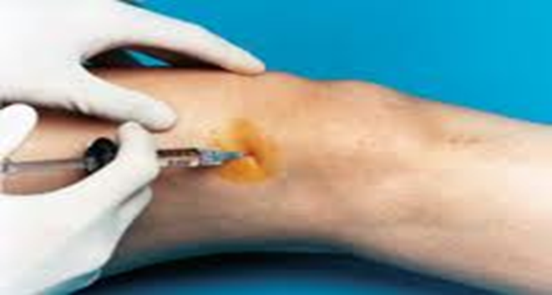
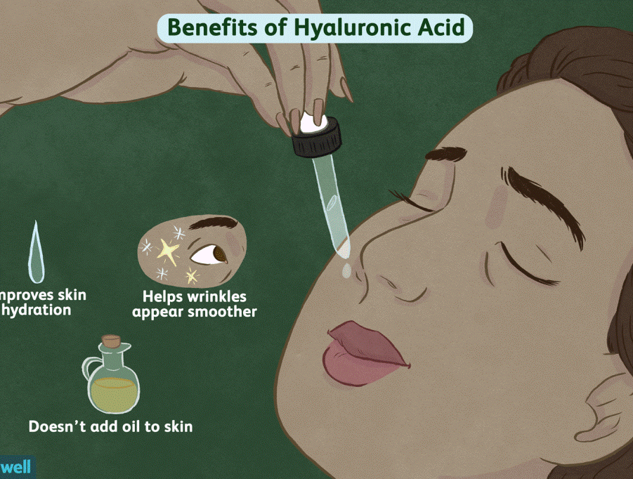
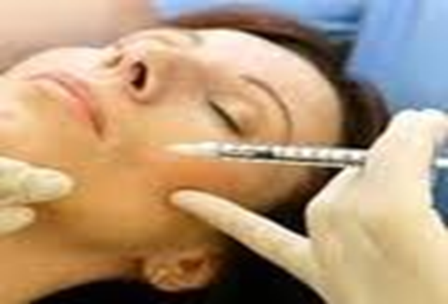

Slide 12
HEPARIN:-
It is an anticoagulant widely used when taking blood in vitro for clinical studies.
It is also used in vivo in suspected thromboembolic conditions to prevent intravascular coagulation.(MI Or Angina)
It activates antithrombin III, which in turn inactivates thrombin, factor X and factor IX.

Slide 13
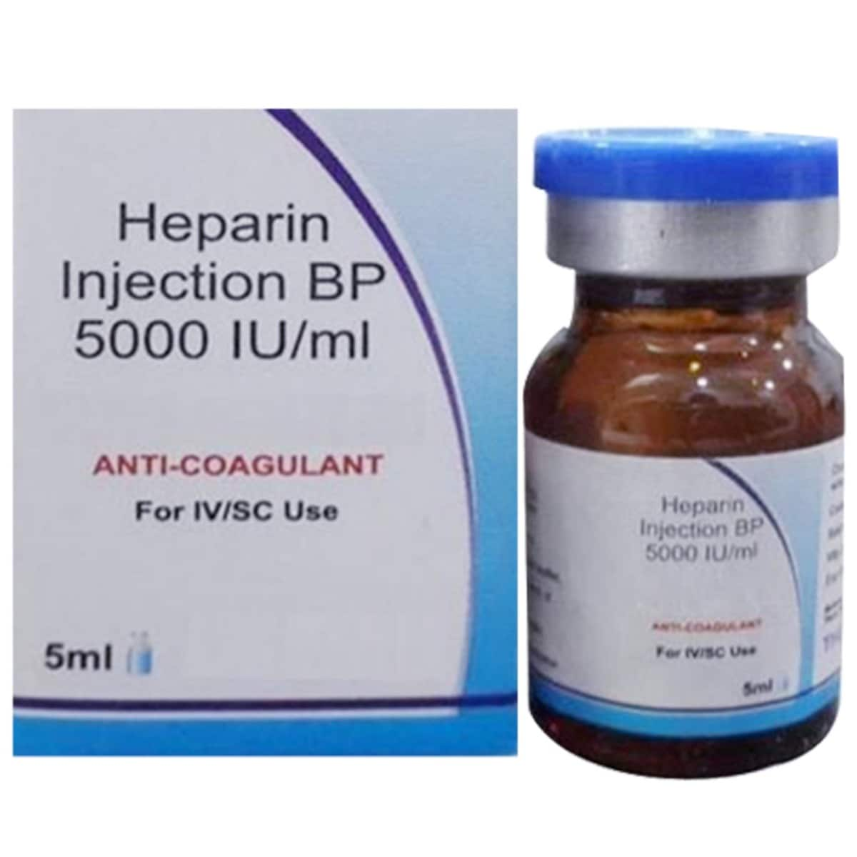
Composed of
Sulphated glucosamine & sulphated iduronic acid.
Linkage: α-(1-4)
Occurs in lung, liver, spleen.
It is an anticoagulant used both in vitro & in vivo
Uses: Present in liver, lung, spleen etc. it is an anticoagulant used both in vitro & in vivo

Slide 14
2. CHONDROITIN SULPHATE:-
Composed of sulphated glucuronic acid & sulphated N-acetyl galactoseamine
Linkage: β -(1-4)
major constituent of connective tissue.
Occurs widely in bones, tendons & cartilages.

Slide 15
3. KERATAN SULPHATE:-
only GAG which does not contain uronic acid. Instead of uronic acid there is Galactose.
composed of galactose & N- acetyl gucoseamine.
occurs in cornea & tendons.

Slide 16
4. DERMATAN SULPHATE:-
composed of iduronic acid & N-acetyl galactosamine.
occurs in skin, blood vessels & heart valves.

Slide 17
GAG | Uronic acid | Amino sugar
Hyluronic acid | N-acetyl glucoseamine | glucuronic acid
Heparin | Sulphated glucosamine | sulphated iduronic acid
Keratan sulphate | Galactose | N- acetyl Gucoseamine.
Dermatan sulphate | iduronic acid | N-acetyl galactosamine.
Chondroitin sulphate | sulphated glucuronic acid | sulphated N-acetyl galactoseamine

Slide 18
Mucopolysaccharides are excreted in urine in abnormal amounts in the group of lysosomal storage disorders known as mucopolysaccharidoses.
They can be detected by 2D gel electrophoresis techniques; some mucopolysaccharides can also be detected by simple urine screening tests like CPC test, Cetavlon test and Alcian blue staining

Slide 19
1.The glycosaminoglycan which does not contain uronic acid is
(A) Dermatan sulphate
(B) Chondroitin sulphate
(C) Keratan sulphate
(D) Heparan sulphate

Slide 20
2. N–Acetylglucosamnine is present in
(A) Hyaluronic acid
(B) Chondroitin sulphate
(C) Heparin
(D) All of these

Slide 21

3. The constituent unit of inulin is
(A) Glucose (B) Fructose
(C) Mannose (D) Galactose

Slide 22
4. Keratan sulphate is found in abundance in
(A) Heart muscle
(B) Liver
(C) Adrenal cortex
(D) Cornea

Slide 23
5.The polysaccharide used in assessing the glomerular fittration rate (GFR) is
(A) Glycogen (B) Agar
(C) Inulin (D) Hyaluronic acid

