Slide 1
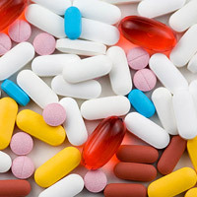
Antifungal drugs

Slide 2
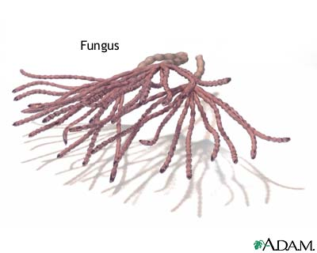
Fortunately, only 400 fungi cause disease in animals, and even fewer cause significant human disease

Slide 3
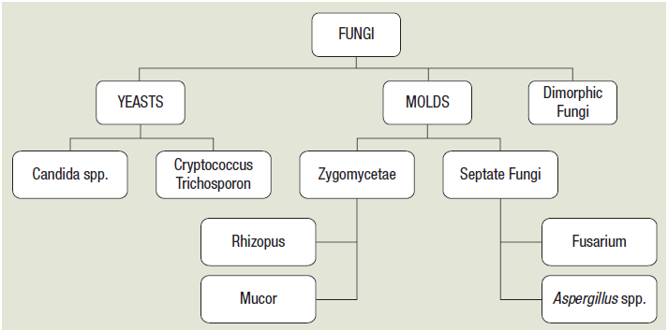
Types

Slide 4
Fungal infections
Superficial mycoses
Subcutaneous mycoses
Systemic mycoses
Dermatophytosis,
Superficial candidiasis,
Pityriasis
Mycetoma,
Sporotrichosis

Slide 5
Superficial : Affect skin – mucous membrane
  Tinea versicolor
  Dermatophytes : Fungi that affect keratin layer of skin, hair, nail.e.g.tinea pedis ,ring worm infection
  Candidiasis : Yeast-like, oral thrush, vulvo-vaginitis , nail infections.

Slide 6
Disease | Organism
Histoplasmosis | Histoplasma capsulatum
Coccidioidomycosis | C. immitis and C. posadasii
Blastomycosis | B. dermatitidis
Cryptococcosis | Cryptococcus neoformans
Candidiasis | C. albicans, C. guilliermondii, C. krusei, C. parapsilosis, C. tropicalis, C. kefyr, C. lusitaniae, C. dubliniensis, and C. glabrata
Aspergillosis | A. fumigatus , A. flavus , A. niger , A. terreus
Mucormycosis | Rhizopus and Rhizomucor
Pneumocystis | P. jirovecii

Slide 7
The incidence of serious secondary systemic fungal infections is rising steadily ………….
  Widespread use of broad-spectrum antibiotics
  Other causes include
    AIDS and the use of immunosuppressant or cancer chemotherapy agents
    Diabetics, pregnant women and burn wound victims

Slide 8
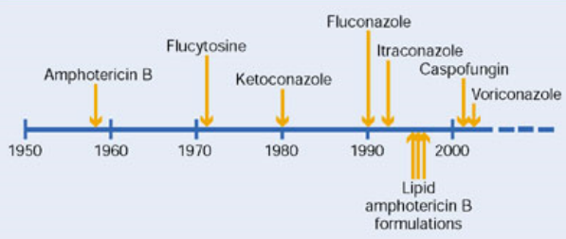
History of antifungal agents

Slide 9
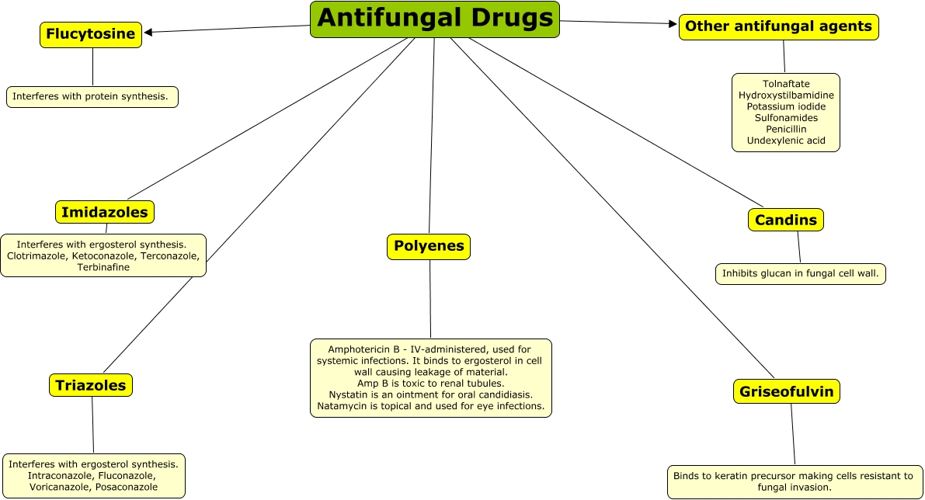

Slide 10
Antifungals
Polyenes
Imidazoles
Triazole
Allylamines
β-3-glucan
synthase
inhibitors
Other
Nystatin
Miconazole
Fluconazole
Naftifine
Caspofungin
Griseofulvin
Amphotericin
B
Clotrimazole
Itraconazole
Terbinafine
Micafungin
Flucytosine
Ketoconazole
Voriconazole
Butenafine
Anidulafungin
Tolnaftate
Posaconazole

Slide 11
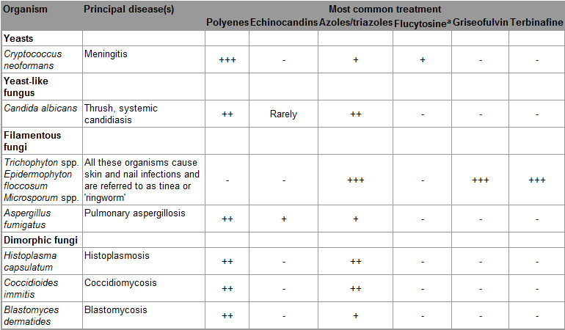
+

Slide 12
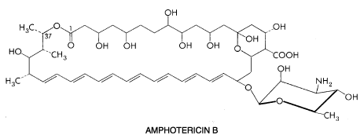
Amphotericin B
  It is obtained from Streptomyces nodosus
Notes:
Amphotericin B is one of a family of some 200 polyene macrolide compounds with antifungal activity. Those studied to date share the characteristics of four to seven conjugated double bonds, an internal cyclic ester, poor aqueous solubility, substantial toxicity on parenteral administration, and a common mechanism of antifungal action. Amphotericin B (see following structure) is a heptaene macrolide containing seven conjugated double bonds in the trans position and 3-amino-3,6-dideoxymannose (mycosamine) connected to the main ring by a glycosidic bond. The amphoteric behavior for which the drug is named derives from the presence of a carboxyl group on the main ring and a primary amino group on mycosamine; these groups confer aqueous solubility at extremes of pH. X-ray crystallography has shown the molecule to be rigid and rod-shaped, with the hydrophilic hydroxyl groups of the macrolide ring forming an opposing face to the lipophilic polyenic portion.

Slide 13
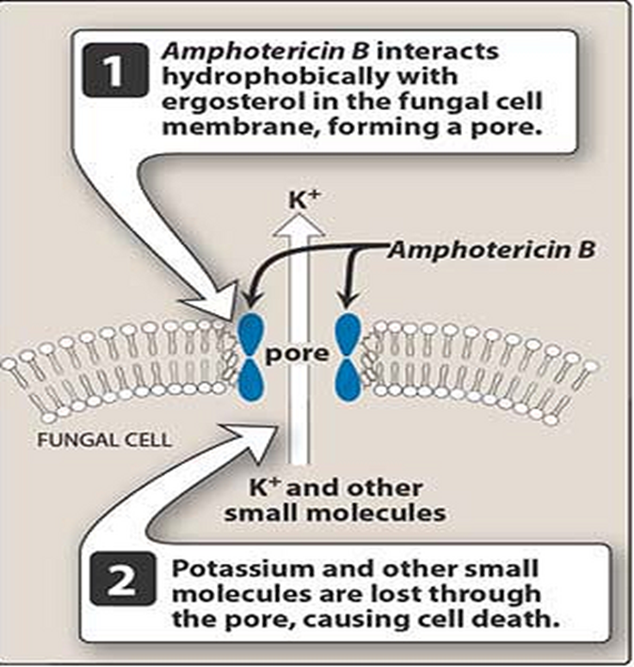
Mechanism of action

Slide 14
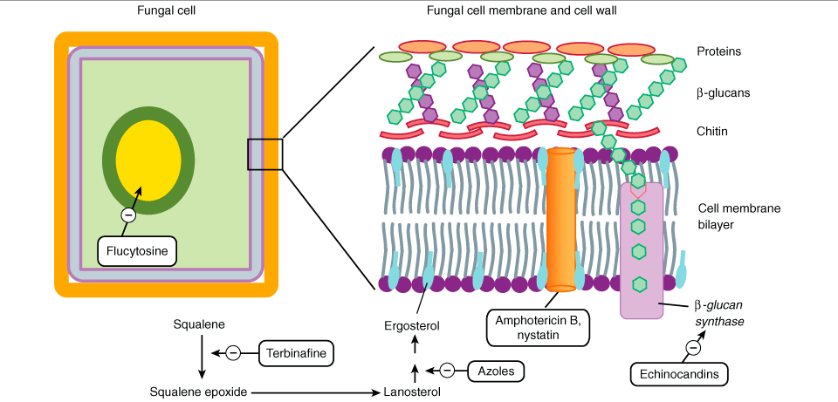
Mechanism of actions

Slide 15
kinetics
Poorly absorbed from gut.
Amphotericin B is insoluble in water but is formulated for intravenous infusion by complexing it with the bile salt deoxycholate- C-AMB
It binds to sterols in tissues and to lipoproteins in plasma and stays in the body for long periods
Elimination t1/2 is 15 days
About 60% of AMB is metabolized in the liver.

Slide 16
  The total dose of AMB for majority of cases is 3-4 g given over 2-3 months.
administered orally (50-100 mg QID) for intestinal moniliasis;
also topically for vaginitis, otomycosis, etc

Slide 17
New amphotericin B formulations
Amphotericin B lipid complex (ABLC)
  Contains 35% AMB incorporated in ribbon like particles of dimyristoyl phospholipids
Amphotericin B colloidal dispersion (ABCD)
  Disc shaped particles containing 50% AMB and cholesteryl sulfate, prepared as aqueous dispersion
Liposomal amphotericin B
  Consists of 10% AMB incorporated in uniform sized (60-80 nM) unilamellar liposomes made up of lecithin and other biodegradable phospholipids.

Slide 18
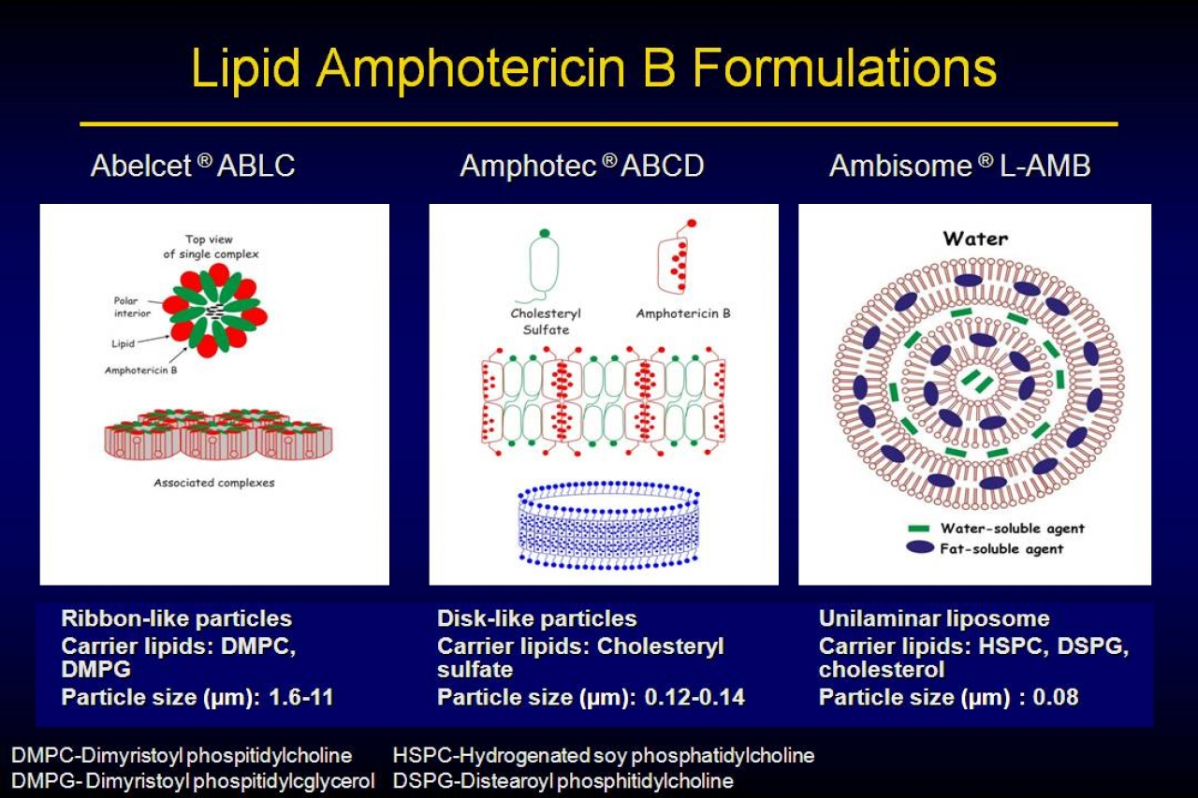

Slide 19
ABLC and ABCD. produce lower AMB levels and their clinical efficacy is relatively low to convention preparation
Liposomal AMB…….
has similar efficacy with less acute reaction and renal toxicity
Not tolerating conventional amb
reticuloendothelial cells in liver and spleen----especially valuable for kala azar

Slide 20
Untoward effects
  nephrotoxicity
  Hypokalemia and Hypomagnesaemia
  Hypochromic, normocytic anemia is usual with C-AMB
  Acute reactions to intravenous B formulations is fever and chills.
  Headache, nausea, vomiting, malaise, weight loss
Notes:
An increase in intrarenal vascular resistance is the major cause of nephrotoxicity in amphotericin B-treated rats. In patients and experimental animals, saline loading has decreased nephrotoxicity, even in the absence of water or salt deprivation. Administration of 1 L of normal saline intravenously on the day that C-AMB is to be given has been recommended for adults who are able to tolerate the Na⁺ load and who are not already receiving that amount in intravenous fluids. Azotemia occurs much less frequently with lipid preparations of amphotericin, and saline loading is not recommended.
Hypochromic, normocytic anemia is usual with C-AMB; the average hematocrit declined to 27% in one study. Decreased production of erythropoietin is the probable mechanism.
Infusion-related reactions are worst with ABCD, slightly less with C-C-AMB, even less with ABLC, and least with L-AMB

Slide 21
interactions
supra_additive action with AMB in the case of fungi sensitive to both (AMB increases the penetration of 5-FC into the fungus
Arninoglycosides, vancomycin, cyclosporine

Slide 22
Therapeutic uses
Topically
  Applied topically for oral, vaginal and cutaneous candidiasis and otomycosis
Systemic therapy
  Most effective drug for various types of systemic mycoses.
  Dose is 1mg/kg/day
  Leishmanias

Slide 23
Nystatin
  similar in structure to amphotericin and with the same mechanism of action
  its use is mainly limited to Candida infections of the skin, mucous membranes and the gastrointestinal tract
  monilial diarrhoea
it is used for corneal, conjunctival and cutaneous candidiasis in the form of an ointment.

Slide 24
Hamycin
similar to nystatin
Hindustan Antibiotics at Pimpri
Natamycin (Pimaricin)
Fusarium solani keratitis

Slide 25
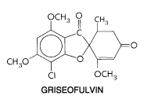
Griseofulvin
Extracted from Penicillium griseofulvum
active against most dermatophytes, including Epidermophyton, Trichophyton, Microsporum

Slide 26
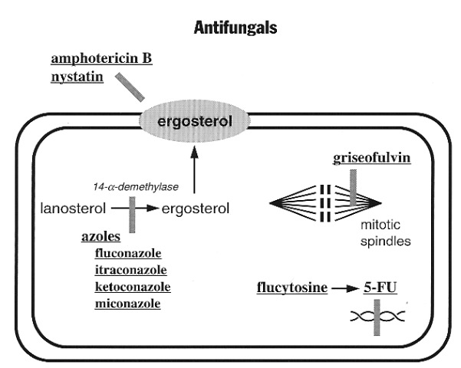
Mechanism of action
Griseofulvin interferes with mitosis-
  Binds to polymerized microtubules and disorients them
Griseofulvin gets deposited in keratin forming cells of skin, hair and nails; it is especially concentrated and retained in tinea infected cells
Notes:
It also causes abnormal metaphase configurations.However, unlike the typical mitotic inhibitors (colchicine, vinca alkaloids), it does not cause metaphase arrest; rather the daughter rruclei fail to move apart or move only a short distance. It does not inhibit polymerization of tubulin (microtubular protein which pulls the chromosomes apart), but binds to polymerized microtubules and somehow disorients them.
Thus, the duration of treatrnent dependent upon the site of infection, thickness of infected keratin and its tumover rate.

Slide 27
kinetics
absorption from g.i.t. is somewhat irregular
very low water solubility
Ultra microfine particle preparations
taking it with fats

Slide 28
Headache is the commonest complaint, followed by g.i.t. disturbances and peripheral neuritis are occasional. Rarely causes hepatotoxicity
hepatic CYPs, thus increasing the rate of metabolism of warfarin
for dermatophytosis
  125-250 mg QID with meals; duration depends on site of infection (turnover rate of keratin)
  Body skin - 3 weeks
  Palm, soles - 4 to 6 weeks
  Finger nails - 4 to 6 months
  Toe nails - 8 to 12 months

Slide 29
Tinea capitis- ringworm of the scalp
Tinea barbae- infection of beard
Tinea cruris- groin
Tinea corporis –body
Tinea pedis- feet
Tinea manus-hands
Onychomycosis- nails

Slide 30

Flucytosine
Flucytosine is a fluorinated pyrimidine related to fluorouracil
It is effective against a limited range (mainly yeasts) of systemic fungal infections Cryptococcus neoformans, Candida spp., and the agents of chromoblastomycosis

Slide 31
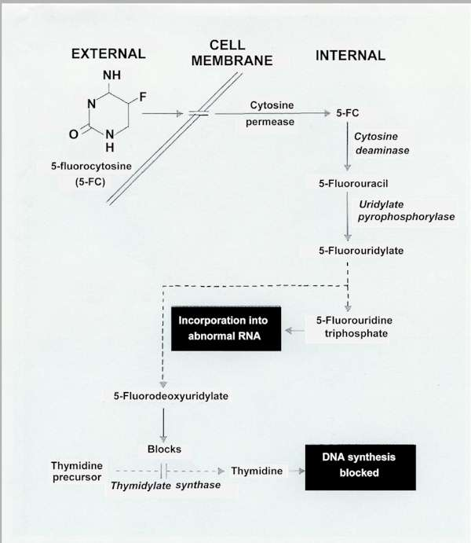

Mechanism of action
Notes:
Flucytosine is transported by cytosine permease into the fungal cell, where it is deaminated to 5-fluorouracil (5-FU). The 5-FU is then converted to 5-fluorouracil-ribose monophosphate (5-FUMP) and then is either converted to 5-fluorouridine triphosphate (5-FUTP) and incorporated into RNA or converted by Ribonucleotide reductase to 5-fluoro-2'-deoxyuridine-5'-monophosphate (5-FdUMP), which is a potent inhibitor of thymidylate synthase. 5-FUDP, 5-fluorouridine-5'-diphosphate; dUMP, deoxyuridine-5'-monophosphate; dTMP, deoxythymidine-5'-monophosphate.

Slide 32
Pharmacokinetics
Plasma half-life is 3-5 h.
Flucytosine is absorbed rapidly from GI tract
Widely distributed in the body, with a volume of distribution that approximates total body water
Approximately 80% of a given dose is excreted unchanged in the urine

Slide 33
Untoward Effects
Flucytosine may depress the bone marrow and lead to leukopenia and thrombocytopenia
Hepatotoxicity (dose dependent)
Other untoward effects—including rash, nausea, vomiting, diarrhea, and severe enterocolitis—have been noted

Slide 34
Therapeutic Uses
If given alone, drug resistance commonly arises during treatment, so it is usually combined with amphotericin for severe systemic infections such as candidiasis and cryptococcal meningitis
Given orally at 100-200 mg/kg per day, in four divided doses

Slide 35
Inhibition of adrenocortical steroid and testosterone synthesis has been recorded with high doses, and results in gynaecomastia in some male patients
contraindicated in pregnant and nursing women

Slide 36
References
Tripathi KD, Essentials of medical pharmacology, 6th edition, Jaypee publication New Delhi
Lauraence DR, Bennett TN and Brown MJ. Unwanted effects and adverse drug reactions. Clinical Pharmacology 8th edn. Churchill Livingstone 1997

Slide 37
Author | Results | Journal
Shyam Sundar, M.D., Jaya Chakravarty, M.D., Dipti Agarwal, M.D., Madhukar Rai, M.D., and Henry W. Murray, M.D. | Single-Dose Liposomal Amphotericin B for Visceral Leishmaniasis in India | N Engl J Med 2010; 362:504-512

