Slide 1
Antifungal drugs part 2

Slide 2
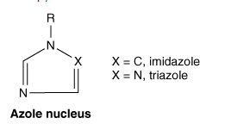
Azoles
The azoles are a group of synthetic fungistatic agents with a broad spectrum of activity

Slide 3
Imidazoles and Triazoles
Imidazole (clotrimazole, econazole, fenticonazole, ketoconazole, miconazole, tioconazole and sulconazole) or
Triazole nucleus (itraconazole, voriconazole and fluconazole, posaconazole).

Slide 4
Ketoconazole
first azole that could be given orally to treat systemic fungal infections
It is, however, toxic, and relapse is common after apparently successful treatment

Slide 5
Mechanism of action
lenosterol 14α-demethylase-ergosterol synthesis
cytochrome P450 enzyme
Notes:
and lead to the accumulation of 14--methylsterols. These methylsterols may disrupt the close packing of acyl chains of phospholipids, impairing the functions of certain membrane-bound enzyme systems, thus inhibiting growth of the fungi

Slide 6
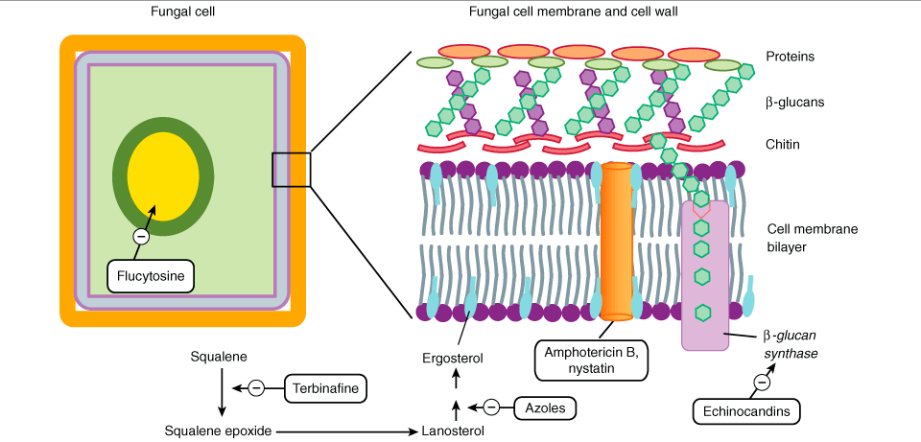
Mechanism of actions

Slide 7
RESISTANCE
lenosterol 14α-demethylase
CANDIDA INFECTIONS IN AIDS PTS

Slide 8
kinetics
Oral absorption facilitated by gastric acidity because it is more soluble at lower pH
metabolites are excreted in urine and faeces
T ½ varies from 1 to 6 hours
therapeutic concentrations are attained in the skin and vaginal fluid.

Slide 9
ADRs
much less toxic than AMB
The main hazard of ketoconazole is liver toxicity, liver function is monitored before and during treatment
nausea and vomiting
loss of appetite, headache,
paresthesia, rashes and hair loss.

Slide 10
interactions
H2 blockers, proton pump inhibitors-decreases oral absorption
inhibits cytochrome P450,CYP3A4-Phenytoin Digoxin
Astemizole, terfenadine-polymorphic ventricular tachycardia
Rifampicin—induce KTZ metabolism
Notes:
f

Slide 11
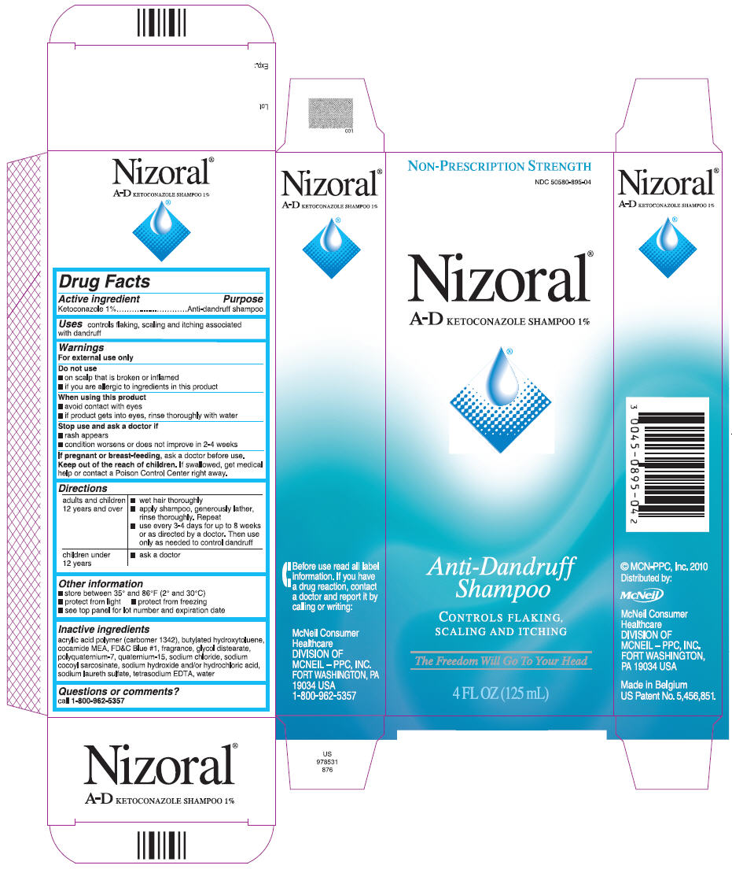
uses
DERMATOPHYTOSIS-ORAL-200MG OD OR BD
SEBORRHOEA OF SCALP AND DANDRUFF-SHAMPOO

Slide 12
monilial vaginitis
Systemic mycosis-itraconazole and fluconazole, being more active
dermal leishmaniasis and kala azar
Cushing's syndrome

Slide 13
Clotrimazole
Topical treatment of tinea inf. like ringworm
BD for 2-4 weeks
otomycosis, oral/cutaneous/vaginal candidiasis
Vaginitis-most favored as long lasting residual effects
Local irritation and burning

Slide 14
Triazoles
 | Fluconazole | Itraconazole | Voriconazole | Posaconazole
Absorption | IV and PO Good bioavailability | PO Capsule ≠ Suspension Capsules best absorbed with food. Suspension best absorbed on empty stomach. | IV and PO 90% oral bioavailability | PO--Absorption enhanced with high fat meal
Distribution | Wide. Good CNS penetration | Low urinary levels Poor CNS penetration | Wide. Good CNS penetration | Widely distributed into tissues
Metabolism | Hepatic/Renal | Hepatic | CYP 2C9, 2C19, 3A4 Saturable metabolism | Not a substrate of or metabolized by P450, but it is an Inhibitor of 3A4
Elimination | 80% excreted unchanged in the urine | Excreted in feces | Minimal renal excretion | Minimal renal excretion of parent compound 66% excreted in feces

Slide 15
 | Dose | Therapeutic uses | Untoward effects
Itraconazole | Loading dose of 200 mg tds for the first 3 days followed by 100mg bd 200 mg once daily is used 200 mg once daily for 12 weeks | Aspergillosis histoplasmosis, blastomycosis and sporotrichosis. For maintenance therapy of HIV-infected patients with disseminated histoplasmosis Onychomycosis | QT prolongation, C/I in CHF due to negative inotropic effect Hepatotoxicity Rash Hypokalemia Nausea and vomiting
Fluconazole | 200 mg on the first day and then 100 mg daily for 2weeks 400 mg daily, is used for 8 weeks followed by 200mg 200mg/day fungal keratitis | Oropharyngeal candidiasis tinea infections and cutaneous candidiasis disseminated candidiasis, cryptoc occal / coccidioidal meningitis and other systemic fungal infections | Well tolerated Nausea Vomiting Elevated LFTs Teratogenic in rodent Cryptococcal meningitis in patients with AIDS Other mycoses

Slide 16
 | Dose | Therapeutic uses | Untoward effects
Voriconazole | 6 mg/kg IV for 2 doses, then 3 to 4 mg/kg IV every 12 hours followed by 200 mg orally 12 hourly | Candidemia and invasive aspergillosis | Teratogenic in animals Prolongation of the QTc interval Transient visual or auditory hallucinations are frequent Nausea, flushing, feverishness
Posaconazole | Orally 200 mg four times daily and changed to 400 mg twice | Oropharyngeal candidiasis Prophylaxis against candidiasis and aspergillosis who have prolonged neutropenia or severe graft-vs-host disease | Nausea and vomiting, Diarrhea, Abdominal pain Headache Teratogenic in rodents
Notes:
Voriconazole exhibits nonlinear metabolism so that higher doses cause greater-than-linear increases in systemic drug exposure
Posaconazole Bioavailability is significantly enhanced by the presence of food . a large volume of distribution (331-1341 L),

Slide 17
Advantages of Triazoles over imidazoles….
Does not inhibit steroid synthesis
Affect hepatic drug metabolism to lesser extent
PPIs and H2 blockers do not affect its absorption

Slide 18
Echinocandins
Screening natural products of fungal fermentation in the 1970s led to the discovery that echinocandins had activity against Candida
caspofungin, anidulafungin, and micafungin

Slide 19
Mechanism of actions

Slide 20
Echinocandins
 | Caspofungin | Micafungin | Anidulafungin
Absorption | Not orally absorbed. IV only
Distribution | Extensive into the tissues, minimal CNS penetration
Metabolism | spontaneous degradation, hydrolysis and N-acetylation |  | Chemical degradated Not hepatically metabolized
Elimination | Limited urinary excretion.
Half-life | 9-23 hours | 11-21 hours | 26.5 hours

Slide 21
Drug | Untoward effects | Dosage | Therapeutic uses
Caspofungin | Well tolerated, with the exception of phlebitis at the infusion site | 70mg daily over 1 hour | Approved for initial therapy of deeply invasive candidiasis and as salvage therapy for patients with invasive aspergillosis
Micafungin | Well tolerated | 100 mg daily over 1 hour for adults | Approved for the treatment of deeply invasive candidiasis
Anidulafungin | Well tolerated | Loading dose of 200 mg followed by 100 mg daily | Approved for the treatment of esophageal candidiasis.
Notes:
In normal volunteers, micafungin appears to be a mild inhibitor of CYP3A4, increasing AUC of nifedipine by 18% and sirolimus by 21%. Micafungin has no effect on tacrolimus clearance.
They all are teratogenic, with excretion of the metabolites in the urine and feces
Caspofungin increase tacrolimus levels by 16%, which should be managed by standard monitoring

Slide 22
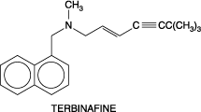
Terbinafine
Terbinafine is a synthetic allylamine
It acts by inhibiting the enzyme squalene epoxidase and bloking ergosterol biosynthesis

Slide 23
Mechanism of actions

Slide 24
Extensively metabolized in liver
Drug accumulates in skin, nails, and fat
The initial t_{1/2} is 12 hours but extends to 200-400 hours at steady state
Drug is teratogenic

Slide 25
Therapeutic uses
Effective orally and topically
  For onychomycosis orally 250 mg daily for 12 weeks
  Topically used for dermatophytes skin infection
Well tolerated adverse effects include GI disturbance, headache and rashes

Slide 26
Topical Antifungal Agents
Topical treatment is useful in many superficial fungal infections, i.e., those confined to the
  Stratum corneum,
  Squamous mucosa
  Cornea
Diseases include dermatophytosis (ringworm), candidiasis, tinea versicolor, piedra, tinea nigra, and fungal keratitis

Slide 27
Drugs | Indication | Untoward effects
Topical Imidazoles and Triazoles Clotrimazole, Econazole , Miconazole, Terconazole Butoconazole and Ketoconazole | Ringworm, tinea versicolor, and mucocutaneous candidiasis | Stinging, erythema, edema, vesication, desquamation, pruritus, and urticaria
Ciclopirox Olamine | Cutaneous candidiasis and for tinea corporis, cruris, pedis, and versicolor, seborrheic dermatitis | Irritation, pruritus
Haloprogin | Tinea pedis, tinea cruris, tinea corporis, tinea manuum, and tinea versicolor | Irritation, pruritus, burning sensations, vesiculation, increased maceration
Tolnaftate | Tinea cruris and tinea corporis | Little irritation

Slide 28
Author | Results | Journal | level
Oliver A. Cornely, M.D., Johan Maertens, M.D., Drew J. Winston, M.D., John Perfect, M.D., Andrew J. Ullmann, M.D., Thomas J. Walsh, M.D., David Helfgott, M.D., Jerzy Holowiecki, M.D., Dick Stockelberg, M.D., Yeow-Tee Goh, M.D., Mario Petrini, M.D., Cathy Hardalo, M.D., Ramachandran Suresh, Ph.D., and David Angulo-Gonzalez, M.D. | Posaconazole vs. Fluconazole or Itraconazole Prophylaxis in Patients with Neutropenia | N Engl J Med 2007 | Level 1

Slide 29
Tripathi KD, Essentials of medical pharmacology, 6th edition, Jaypee publication New Delhi
Goodman and Gilman's the Pharmacological Basis of Therapeutics. 11th ed. New York, NY: McGraw-Hill; 2006

