Slide 1
CIRRHOSIS
Dr Jasmin Jasani
Professor, department of pathology
SBKSMIRC

Slide 2
It represents the irreversible end-stage of several diffuse diseases causing hepatocellular injury and is characterized by the following 4 features:
1. It involves the entire liver.
2. The normal lobular architecture of hepatic parenchyma is disorganised.
3. There is formation of nodules separated from one another by irregular bands of fibrosis.
4. It occurs following hepatocellular necrosis of varying etiology so that there are alternate areas of necrosis and regenerative nodules.

Slide 3
PATHOGENESIS
Irrespective of the etiology, cirrhosis involves a combination of a few processes:
hepatocellular necrosis,
healing by fibrosis,
formation of compensatory regenerative nodules
changes in vascular pattern of the hepatic parenchyma.

Slide 4
CLASSIFICATION
MORPHOLOGIC
Micronodular (nodules less than 3 mm)
Macronodular (nodules more than 3 mm)
Mixed

Slide 5
B. ETIOLOGIC
  Alcoholic cirrhosis (the most common, 60-70%)
  Post-necrotic cirrhosis (10%)
  Biliary cirrhosis (5-10%)
  Pigment cirrhosis in haemochromatosis (5%)
  Cirrhosis in Wilson’s disease
  Cirrhosis in alpha-1-antitrypsin deficiency
  Cardiac cirrhosis
  Indian childhood cirrhosis (ICC)
  Cirrhosis in autoimmune hepatitis
  Cirrhosis in non-alcoholic steatohepatitis
  Miscellaneous forms of cirrhosis (metabolic, infectious, GI, infiltrative) diseases

Slide 6
A. MORPHOLOGIC CLASSIFICATION
1. Micronodular cirrhosis In micronodular cirrhosis, the nodules are usually regular and small, less than 3 mm in diameter. There is diffuse involvement of all the hepatic lobules forming nodules by thick fibrous septa which may be portalportal, portal-central, or both.

Slide 7
2. Macronodular cirrhosis In this type, the nodules are of variable size and are generally larger than 3 mm indiameter. The pattern of involvement is more irregular than in micronodular cirrhosis
3. Mixed cirrhosis In mixed type, some parts of the liver show micronodular appearance while other parts show macronodular pattern

Slide 8
SPECIFIC TYPES OF CIRRHOSIS
Alcoholic Liver Disease and Cirrhosis
Alcoholic liver disease is the term used to describe the spectrum of liver injury associated with acute and chronic alcoholism.
There are three sequential stages in alcoholic liver disease:
alcoholic steatosis (fatty liver),
alcoholic hepatitis and
alcoholic cirrhosis.

Slide 9
ETHANOL METABOLISM
One gram of alcohol gives 7 calories.
But alcohol cannot be stored in the body and must undergo obligatory oxidation, chiefly in the liver.
Thus, these empty calories make no contribution to nutrition other than to give energy.
Ethanol after ingestion and absorption from the small bowel circulates through the liver where about 90% of it is oxidised to acetate by a two-step enzymatic process involving two enzymes:
alcohol dehydrogenase (ADH) present in the cytosol,
acetaldehyde dehydrogenase (ALDH) in the mitochondria of hepatocytes

Slide 10
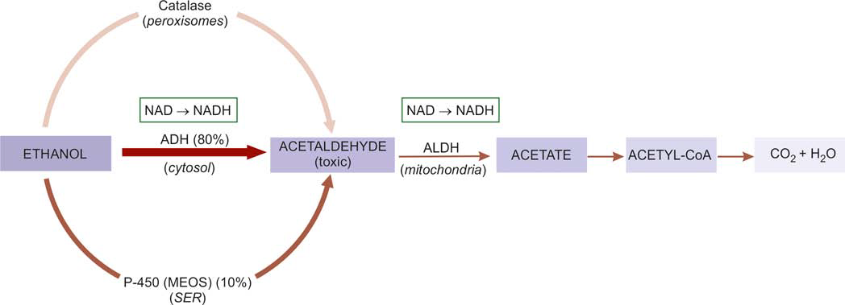
Metabolism of ethanol in the liver. Thickness and intensity of colour of arrows on left side of figure corresponds to extent of metabolic pathway followed (ADH = alcohol hydrogenase; ALDH or ACDH = hepatic acetaldehyde dehydrogenase; NAD = nicotinamide adenine dinucleotide; NADH = reduced NAD).

Slide 11
RISK FACTORS FOR ALCOHOLIC LIVER DISEASE
All those who indulge in alcohol abuse do not develop liver damage.
Drinking patterns
Gender Women have increased susceptibility
Malnutrition Absolute or relative malnutrition of proteins and vitamins is regarded as a contributory factor
Infections Intercurrent bacterial infections are common in cirrhotic patients and may accelerate the course
Genetic factors
Hepatitis B and C infection Concurrent infection with either HBV or HCV is an important risk factor for progression of alcoholic liver disease.

Slide 12
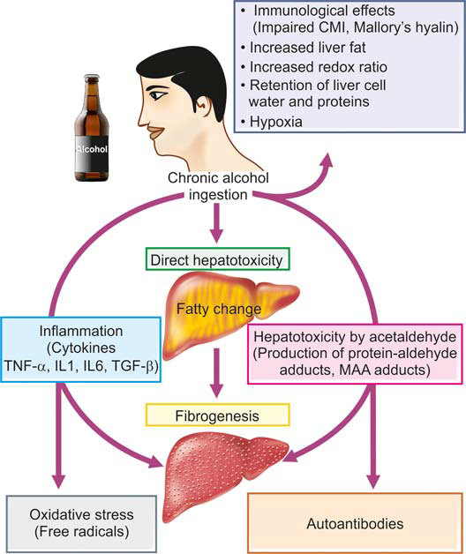
Pathogenesis of alcoholic liver disease

Slide 13
MORPHOLOGIC FEATURES
Three types of morphologic lesions are described in alcoholic liver disease—
alcoholic steatosis (fatty liver),
alcoholic hepatitis and
alcoholic cirrhosis

Slide 14
1. ALCOHOLIC STEATOSIS (FATTY LIVER)
Grossly,
the liver is enlarged,
yellow,
greasy and
firm with a smooth and glistening capsule.

Slide 15
Microscopically, the features consist of initial microvesicular droplets of fat in the hepatocyte cytoplasm followed by more common and pronounced feature of macrovesicular large droplets of fat displacing the nucleus to the periphery
Fat cysts may develop due to coalescence and rupture of fat-containing hepatocytes.

Slide 16
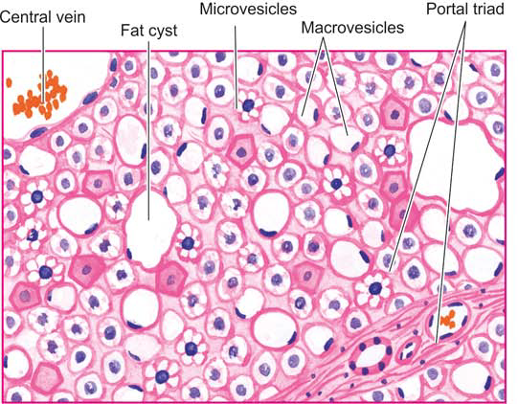
Fatty liver (alcoholic steatosis). Most of the hepatocytes are distended with large lipid vacuoles with peripherally displaced nuclei.

Slide 17
2. ALCOHOLIC HEPATITIS
Alcoholic hepatitis develops acutely, usually following a bout of heavy drinking. Repeated episodes of alcoholic hepatitis super imposed on pre-existing fatty liver are almost certainly a forerunner of alcoholic cirrhosis.
Histologically,
Hepatocellular necrosis:
Mallory bodies or alcoholic hyalin
Inflammatory response
Fibrosis:

Slide 18
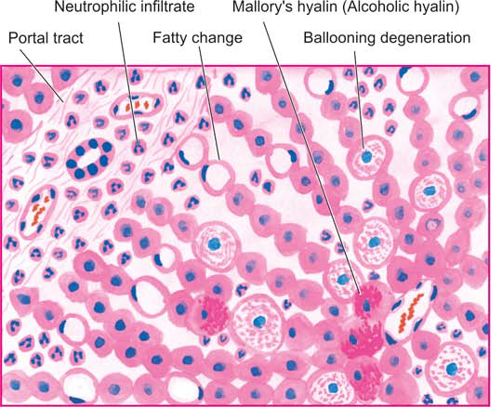
Alcoholic hepatitis. Liver cells show ballooning degeneration and necrosis with some containing Mallory’s hyalin (Inbox). Fatty change and clusters of neutrophils are also present.

Slide 19
3. ALCOHOLIC CIRRHOSIS
Alcoholic cirrhosis is the most common form of lesion, constituting 60-70% of all cases of cirrhosis.
Several terms have been used for this type of cirrhosis such as Laennec’s cirrhosis, portal cirrhosis, hobnail cirrhosis, nutritional cirrhosis, diffuse cirrhosis and micronodular cirrhosis.

Slide 20
Grossly, alcoholic cirrhosis classically begins as micronodular cirrhosis (nodules less than 3 mm diameter), the liver being large, fatty and weighing usually above 2 kg.
Eventually over a span of years, the liver shrinks to less than 1 kg in weight, becomes non-fatty, having macronodular cirrhosis (nodules larger than 3 mm in diameter), resembling post-necrotic cirrhosis.
The nodules of the liver due to their fat content are tawny-yellow, on the basis of which Laennec in 1818 introduced the term cirrhosis first of all (from Greek kirrhos = tawny).

Slide 21
The surface of liver in alcoholic cirrhosis is studded with diffuse nodules which vary little in size, producing hobnail liver (because of the resemblance of the surface with the sole of an old-fashioned shoe having short nails with heavy heads).
On cut section, spheroidal or angular nodules of fi brous septa are seen.

Slide 22
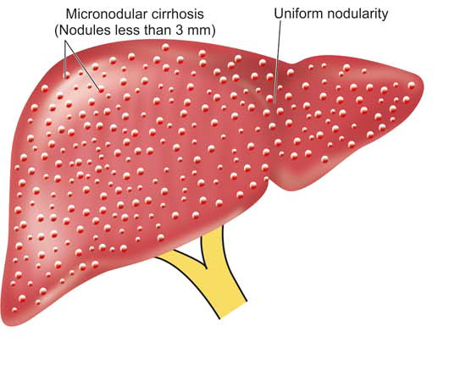
Alcoholic cirrhosis, showing the typical micronodular pattern in gross specimen. There is diff use nodularity (nodules less than 3 mm diameter) on sectioned surface of the liver

Slide 23
Microscopically,
alcoholic cirrhosis is a progressive alcoholic liver disease.
Nodular pattern:
Fibrous septa
Hepatic parenchyma
Necrosis, inflammation and bile duct proliferation:

Slide 24
LABORATORY DIAGNOSIS
1. Elevated transaminases; increase in SGOT (AST) is more than that of SGPT (ALT).
2. Rise in serum Gamma-glutamyl transpeptidase (-GT).
3. Elevation in serum alkaline phosphatase.
4. Hyperbilirubinaemia.
5. Hypoproteinaemia with reversal of albumin-globulin ratio.
6. Prolonged prothrombin time and partial thromboplastin time.
7. Anaemia.
8. Neutrophilic leucocytosis

Slide 25
Post-necrotic Cirrhosis
Post-necrotic cirrhosis, also termed post-hepatitic cirrhosis, macronodular cirrhosis and coarsely nodular cirrhosis, is characterised by large and irregular nodules with broad bands of connective tissue and occurring most commonly after previous viral hepatitis.

Slide 26
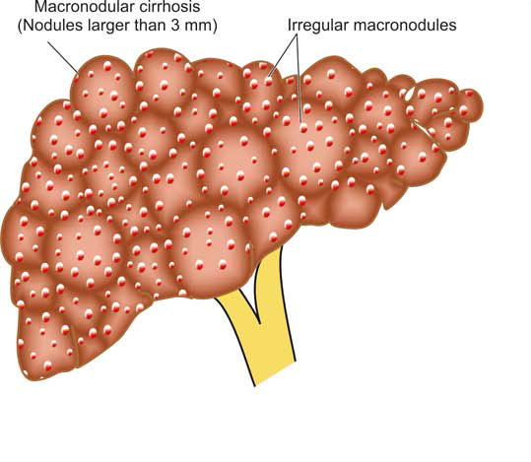
Post-necrotic cirrhosis-GROSS
showing the typical irregular macronodular pattern (nodules larger than 3 mm diameter). Externally the liver is small, distorted and irregularly scarred.

Slide 27
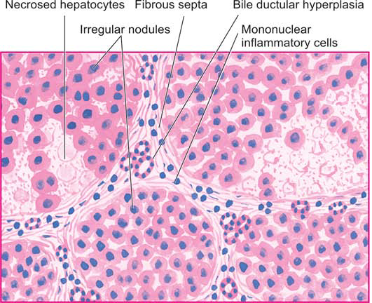
Post-necrotic cirrhosis-MICROSCOPIC
Fibrous septa dividing the hepatic parenchyma into nodules are thick and contain prominent mononuclear inflammatory cell infiltrate and bile ductular hyperplasia. A few intact hepatic lobules remain.

Slide 28
PORTAL HYPERTENSION

Slide 29
Increase in pressure in the portal system usually follows obstruction to the portal blood flow anywhere along its course. Portal veins have no valves and thus obstruction anywhere in the portal system raises pressure in all the veins proximal to the obstruction.
However, unless proved otherwise, portal hypertension means obstruction to the portal blood flow by cirrhosis of the liver. The normal portal venous pressure is quite low (10-15 mm saline).
Portal hypertension occurs when the portal pressure is above 30 mm saline.

Slide 30
Measurement of intrasplenic pressure reflects pressure in the splenic vein; the percutaneous trans-hepatic pressure provides a measure of pressure in the main portal vein; and wedged hepatic venous pressure represents sinusoidal pressure.
Measurement of these pressures helps in localising the site of obstruction and classifying the portal hyper tension.

Slide 31
CLASSIFICATION Based on the site of obstruction to portal venous blood flow, portal hypertension is categorised into 3 main types—
intrahepatic,
posthepatic and
prehepatic

Slide 32
Major causes of portal hypertension.
A. INTRAHEPATIC
1. Cirrhosis
2. Metastatic tumours
3. Budd-Chiari syndrome
4. Hepatic veno-occlusive disease
5. Diff use granulomatous diseases
6. Extensive fatty change
B. POSTHEPATIC
1. Congestive heart failure
2. Constrictive pericarditis
3. Hepatic veno-occlusive disease
4. Budd-Chiari syndrome
C. PREHEPATIC
1. Portal vein thrombosis
2. Neoplastic obstruction of portal vein
3. Myelofi brosis
4. Congenital absence of portal vein

Slide 33
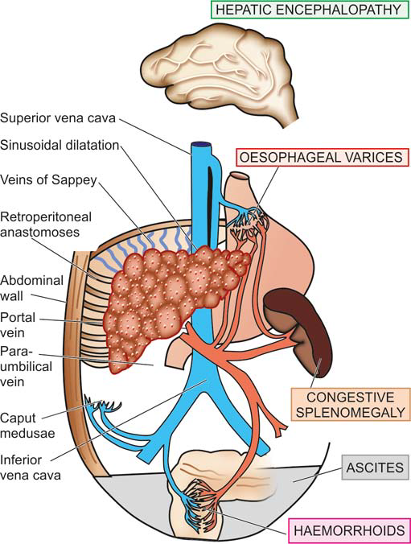
Major clinical consequences of portal hypertension.

Slide 34
MAJOR SEQUELAE OF PORTAL HYPERTENSION
Irrespective of the mechanisms involved in the pathogenesis of portal hypertension, there are 4 major clinical consequences—
ascites,
varices (collateral channels or portosystemic shunts),
splenomegaly and
hepatic encephalopathy

Slide 35
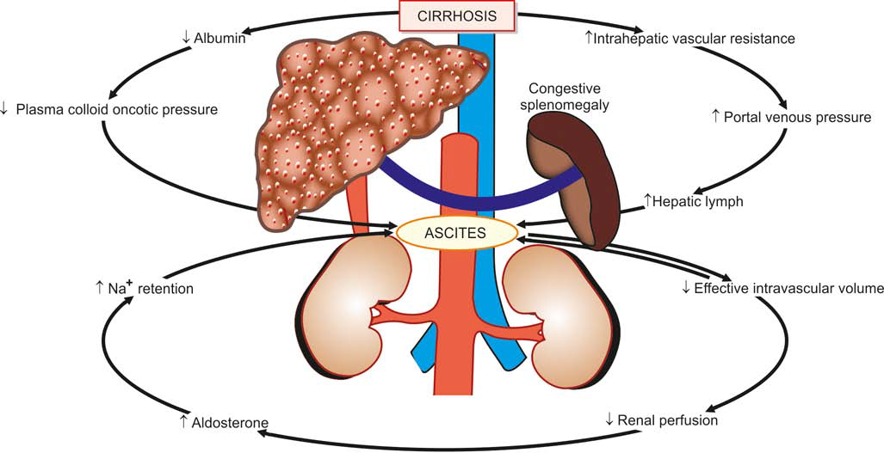
Mechanisms of ascites formation in cirrhosis.

Slide 36
THANK YOU ☺

