Slide 1
CHRONIC INFLAMMATION
DR. DEVANSHI GOSAI
ASSISTANT PROFESSOR, SBKSMI&RC

Slide 2
TYPES OF TUBERCULOSIS
Lung is the main organ affected in tuberculosis while amongst the extra-pulmonary sites, lymph node involvement is most common.
Depending upon the type of tissue response and age, the infection with tubercle bacilli is of 2 main types: primary and secondary tuberculosis.

Slide 3
A. Primary Tuberculosis
The infection of an individual who has not been previously infected or immunised is called primary tuberculosis or Ghon’s complex or childhood tuberculosis.
Primary complex or Ghon’s complex is the lesion produced in the tissue of portal of entry with foci in the draining lymphatic vessels and lymph nodes.

Slide 4
The most commonly involved tissues for primary complex are lungs and hilar lymph nodes.
Other tissues which may show primary complex are tonsils and cervical lymph nodes, and in the case of ingested bacilli the lesions may be found in small intestine and mesenteric lymph nodes.

Slide 5
Primary complex or Ghon’s complex in lungs consists of 3 components:
1. Pulmonary component Lesion in the lung is the primary focus or Ghon’s focus. It is 1-2 cm solitary area of tuberculous pneumonia located peripherally under a patch of pleurisy, in any part of the lung but more often in subpleural focus in the upper part of lower lobe.

Slide 6
2. Lymphatic vessel component The lymphatics draining the lung lesion contain phagocytes containing bacilli and may develop beaded, miliary tubercles along the path of hilar lymph nodes.
3. Lymph node component This consists of enlarged hilar and tracheo-bronchial lymph nodes in the area drained.

Slide 7
The primary complex is composed of 3 components:
Ghon’s focus, draining lymphatics, and hilar lymph nodes.

Slide 8
Microscopically, the lesions of primary tuberculosis have following features:
i) Tuberculous granulomas with peripheral fibrosis.
ii) Extensive caseation necrosis in the centers of granulomas.
iii) Old lesions have fibrosis and calcification.

Slide 9
FATE OF PRIMARY TUBERCULOSIS
Primary complex may have one of the following sequelae:
1. The lesions of primary tuberculosis of the lung commonly do not progress but instead heal by fibrosis, and in time undergo calcification and even ossification.

Slide 11
2. In some cases, the primary focus in the lung continues to grow and the caseous material is disseminated through bronchi to the other parts of the same lung or the opposite lung. This is called progressive primary tuberculosis.
3. At times, bacilli may enter the circulation through erosion in a blood vessel and spread by haematogenous route to other tissues and

Slide 12
organs. This is called primary miliary tuberculosis and the lesions may be seen in organs like the liver, spleen, kidney, brain and bone marrow.
4. In certain circumstances like in lowered resistance and increased hypersensitivity of the host, the healed lesions of primary tuberculosis may get reactivated.

Slide 13
The bacilli lying dormant in acellular caseous material or healed lesion are activated and cause progressive secondary tuberculosis. It affects children more commonly but immunocompromised adults may also develop this kind of progression.

Slide 14
B. Secondary Tuberculosis
The infection of an individual who has been previously infected or sensitised is called secondary, or post-primary or reinfection, or chronic tuberculosis.
The infection may occur from :
Endogenous source such as reactivation of dormant primary complex; or

Slide 15
Exogenous source such as fresh dose of reinfection by the tubercle bacilli.
Secondary tuberculosis occurs most commonly in lungs. Other sites and tissues which can be involved are lymph nodes, tonsils, pharynx, larynx, small intestine and skin.

Slide 16
Progressive secondary tuberculosis.

Slide 17
Secondary Pulmonary Tuberculosis
The lesions in secondary pulmonary tuberculosis usually begin as 1-2 cm apical area of consolidation of the lung, which, in time, may develop a small area of central caseation necrosis and peripheral fibrosis.
It occurs by lymphohaematogenous spread of infection from primary complex.

Slide 18
Microscopically, the appearance is typical of tuberculous granulomas with caseation necrosis.
Patients with HIV infection previously exposed to tuberculous infection have particularly high incidence of reactivation of primary tuberculosis.

Slide 19
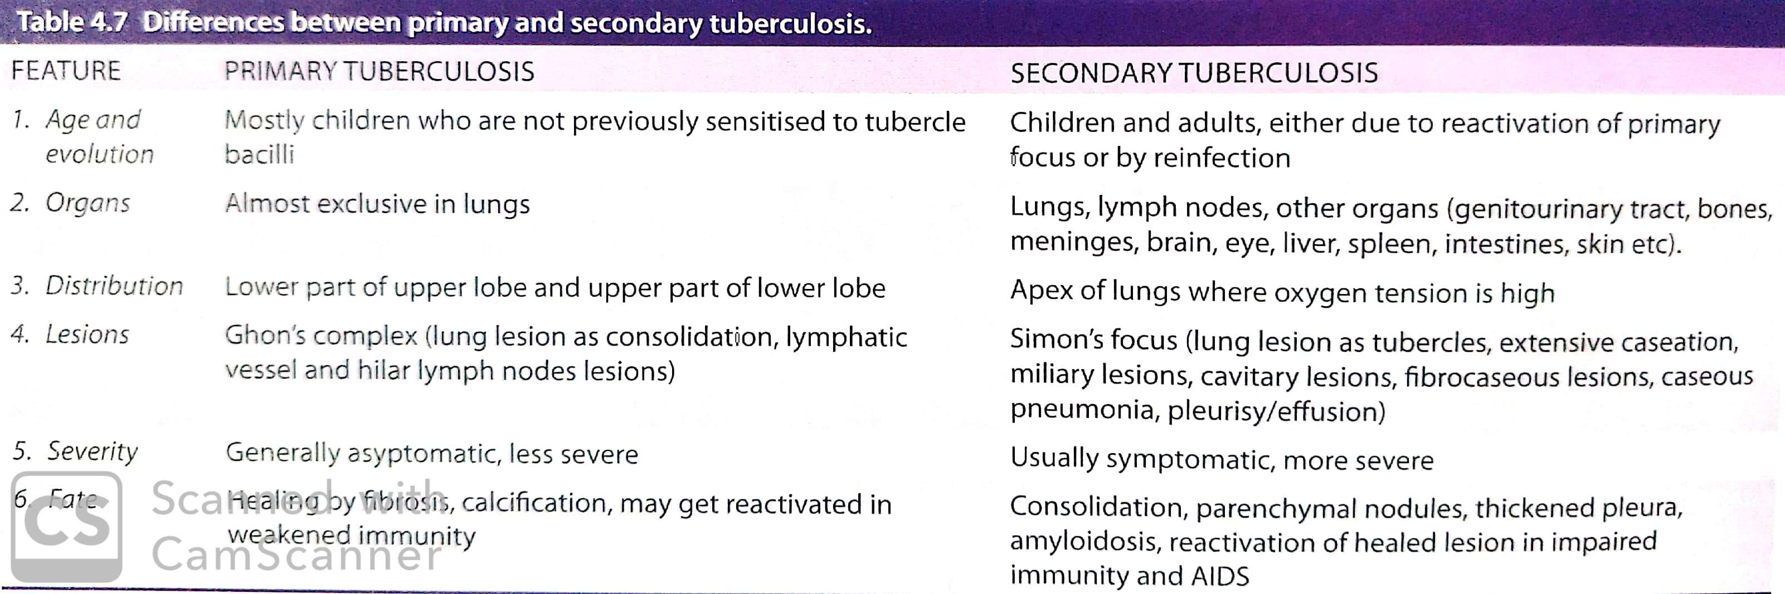

Slide 20
FATE OF SECONDARY PULMONARY TUBERCULOSIS
The subapical lesions in lungs can have the following course:
1. The lesions may heal with fibrous scarring and calcification.
2. The lesions may coalesce together to form larger area of tuberculous pneumonia and

Slide 21
produce progressive secondary pulmonary tuberculosis with the following pulmonary and extrapulmonary involvements:
Fibrocaseous tuberculosis
Tuberculous caseous pneumonia
Miliary tuberculosis
Tuberculous empyema

Slide 22
i) FIBROCASEOUS TUBERCULOSIS
The original area of tuberculous pneumonia undergoes peripheral healing and massive central caseation necrosis which may:
  either break into a bronchus from a cavity (cavitary or open fibrocaseous tuberculosis); or
  remain, as a soft caseous lesion without drainage into a bronchus or bronchiole to produce a non-cavitary lesion (chronic fibrocaseous tuberculosis).

Slide 23
The cavity provides favourable environment for proliferation of tubercle bacilli due to high oxygen tension. The cavity may communicate with bronchial tree and becomes the source of spread of infection (‘open tuberculosis’).
The open case of secondary tuberculosis may implant tuberculous lesion on the mucosal lining of air passages producing endobronchial and endotracheal tuberculosis.

Slide 24
ii) TUBERCULOUS CASEOUS PNEUMONIA
The caseous material from a case of secondary tuberculosis in an individual with high degree of hypersensitivity may spread to rest of the lung producing caseous pneumonia.
Microscopically, the lesions show exudative reaction with oedema, fibrin, polymorphs and monocytes but numerous tubercle bacilli can be demonstrated in the exudates.

Slide 25
iii) MILIARY TUBERCULOSIS
This is lympho-haematogenous spread of tuberculous infection from primary focus or later stages of tuberculosis.
The spread may occur to systemic organs or isolated organ. The spread is either by entry of infection into pulmonary vein producing dissemi nated or isolated organ lesion in different extra-pulmonary sites (e.g. liver, spleen, kidney, brain, meninges, genitourinary tract and bone marrow)

Slide 26
Grossly, the miliary lesions are millet seed-sized (1 mm diameter), yellowish, firm areas without grossly visible caseation necrosis.
Microscopically, the lesions show the structure of tubercles with minute areas of caseation necrosis.

Slide 27
iv) TUBERCULOUS EMPYEMA
The caseating pulmonary lesions of tuberculosis may be associated with pleurisy (pleuritis, pleural effusion) as a reaction and is expressed as a serous or fibrinous exudates.
Pleural effusion may heal by fibrosis and obliterate the pleural space (thickened pleura by chronic pleuritis).

Slide 28
ATYPICAL MYCOBACTERIA (NON-TUBERCULOUS MYCOBACTERIA)
The term atypical mycobacteria or nontuberculous mycobacteria (NTM) is used for mycobacterial species other than M. tuberculosis complex and M. leprae.
NTM are widely distributed in the environment and are, therefore,also called as environmental mycobacteria. They too are acid fast.

Slide 29
NTM are classified on the basis of colour of colony produced in culture and the speed of growth in media:
Rapid growers These organisms grow fast on solid media (within 7 days) but are less pathogenic than others. Examples include M. abscessus, M. fortuitum, M. chelonae.

Slide 30
Slow growers These species grow mycobacteria on solid media (in 2-3 weeks).
Based on the colour of colony formed, they are further divided into following:
Photochromogens: These organisms produce yellow pigment in the culture grown in light.
Scotochromogens: Pigment is produced, whether the growth is in light or in dark.

Slide 31
Non-chromogens: No pigment is produced by the bacilli and the organism is closely related to avium bacillus.
The examples of slow growers are M. avium-intracellulare, M. kansasii, M. ulcerans and M. fortuitum.
The infection by NTM is acquired directly from the environment, unlike person-to-person transmission of classical tuberculosis.

Slide 32
They produce human disease, atypical mycobacteriosis,similar to tuberculosis but are much less virulent. The lesions produced may be granulomas, nodular collection of foamy cells, or acute inflammation.
Five patterns of the disease are recognised:
i) Pulmonary disease produced by M. kansasii or M. aviumintracellulare.

Slide 33
ii) Lymphadenitis caused by M. avium-intracellulare or M.scrofulaceum.
iii) Ulcerated skin lesions produced by M. ulcerans or M.marinum.
iv) Abscesses caused by M.fortuitum or M. chelonae.
v) Bacteraemias by M. avium-intracellulare as seen in immunosuppressed patients of AIDS.

Slide 34
LEPROSY
Leprosy or Hansen’s disease affects mainly the cooler parts of the body such as the skin, mouth, respiratory tract, eyes, peripheral nerves, superficial lymph nodes and testis.
The earliest and main involvement in leprosy is of the skin and nerves.

Slide 35
Causative Organism
The disease is caused by Mycobacterium leprae which closely resembles Mycobacterium tuberculosis but is less acid-fast.
The organisms in tissues appear as compact rounded masses (globi) or are arranged in parallel fashion like cigarettes-in-pack.

Slide 36
Lepra bacilli in LL are seen as globi and cigarettes-in-a-pack appearance inside the foam macrophages

Slide 37
M. leprae can be demonstrated in tissue sections, in split skin smears by splitting the skin, scrapings from cut edges of dermis, and in nasal smears by the following techniques:
1. Acid-fast (Ziehl-Neelsen or ZN) staining. The staining procedure is similar as for demonstration of M. tuberculosis but can be decolourised by lower concentration (5%) of sulphuric acid (less acid-fast).

Slide 38
2. Fite-Faraco staining procedure is a modification of Z.N. procedure and is considered better for more adequate staining of tissue sections (Fig. 5.33).
3. Gomori methenamine silver (GMS) staining can also be employed.
4. Molecular methods e.g. PCR.
5. IgM antibodies to PGL-1 antigen seen in 95% cases of lepromatous leprosy.

Slide 39
The slit smear technique gives a reasonable quantitative measure of M. leprae when stained with Z.N. method and examined under 100x oil objective for determining the density of bacteria in the lesion (bacterial index, BI).
B.I. is scored from 1+ to 6+ (range from 1 to 10 bacilli per 100 fields to > 1000 per field) as multibacillary leprosy while B.I. of 0+ is termed paucibacillary.

Slide 40
Mode of Transmission
Leprosy is a slow communicable disease and the incubation period between first exposure and appearance of signs of disease varies from 2 to 20 years (average about 3 years).
The infectivity may be from the following sources:
1. Direct contact with untreated leprosy patients who shed numerous bacilli from damaged skin,

Slide 41
nasal secretions, mucous membrane of mouth and hair follicles.
2. Materno-foetal transmission across the placenta.
3. Transmission from milk of leprosy affected mother to infant.

Slide 42
Immunology of Leprosy
Like in tuberculosis, the immune response in leprosy is also T cell-mediated delayed hypersensitivity (type IV reaction) but the two diseases are quite dissimilar as regards immune reactions and lesions.
1. Antigens of leprosy bacilli Lepra bacilli have several antigens. The bacterial cell wall contains large amount of M. leprae-specific phenolic glycolipid (PGL-1) and

Slide 43
another surface antigen, lipo-arabinomannan (LAM). These antigens of the bacilli determine the immune reaction of host lymphocytes and macrophages.
Another unique feature of leprosy bacilli is invasion in peripheral nerves which is due to binding of trisaccharide of M. leprae to basal lamina of Schwann cells.

Slide 44
2. Genotype of the host Genetic composition of the host as known by MHC class (or HLA type) determines which antigen of leprosy bacilli shall interact with host immune cells.
3. T cell response There is variation in T cell response in two main forms of leprosy:
i) Unlike tubercle bacilli, there is not only activation of CD4+ T cells but also of CD8+ T cells.

Slide 45
ii) CD4+ T cells in lepra bacilli infected persons act not only as helper and promoter cells but also assume the role of cytotoxicity.
iii) The two subpopulations of CD4+ T cells (or T helper cells)— TH 1 cells and TH 2 cells, elaborate different types of cytokines in response to stimuli from the lepra bacilli and macrophages.

Slide 46
iv) In tuberculoid leprosy, the response is largely by CD4+ T cells, while in lepromatous leprosy although there is excess of CD8+ T cells (suppressor T) but the macrophages and suppressor T cells fail to destroy the bacilli due to CD8+ T cell defect.
4. Humoral response Though the patients of lepromatous leprosy have humoral components such as high levels of immunoglobulins (IgG, IgA, IgM) and antibodies to mycobacterial antigens but these antibodies do not have any protective role against lepra bacilli.

Slide 47
LEPROMIN TEST
It is not a diagnostic test but is used for classifying leprosy on the basis of immune response.
Intradermal injection of lepromin, an antigenic extract of M. leprae, reveals delayed hypersensitivity reaction in patients of tuberculoid leprosy:

Slide 48
1) An early positive reaction appearing as an indurated area in 24-48 hours is called Fernandez reaction.
2) A delayed granulomatous lesion appearing after 3-4 weeks is called Mitsuda reaction.
Patients of lepromatous leprosy are negative by the lepromin test.

Slide 49
The test indicates that cell-mediated immunity is greatly suppressed in lepromatous leprosy while patients of tuberculoid leprosy show good immune response.
Delayed type of hypersensitivity is conferred by T helper cells. The granulomas of tuberculoid leprosy have sufficient T helper cells and fewer T suppressor cells at the periphery while the cellular infiltrates of lepromatous leprosy lack T helper cells.

Slide 50
Classification
RIDLEY AND JOPLING’S CLASSIFICATION Traditionally, two main forms of leprosy are distinguished:
1. Lepromatous type representing low resistance; and
2. Tuberculoid type representing high resistance.
Cases not falling into either of the two are classified as borderline and indeterminate types.

Slide 51
Based on clinical, histologic and immunologic features, modified Ridley and Jopling’s classification divides leprosy into 5 groups as under:
TT—Tuberculoid Polar (High resistance)
BT—Borderline Tuberculoid
BB—Mid Borderline (dimorphic)
BL—Borderline Lepromatous
LL—Lepromatous Polar (Low resistance)

Slide 52
VARIANTS
Indeterminate leprosy. This is an initial non-specific stage of any type of leprosy.
Pure neural leprosy. In these cases, skin lesions which are the cardinal feature of leprosy are absent but instead neurologic involvement is the main feature.
Histoid leprosy. this is a variant of LL in which the skin lesions resemble nodules of dermatofibroma and is the lesions are highly positive for lepra bacilli.

Slide 53
Histopathology of Leprosy
For histopathologic evaluation in all suspected cases of leprosy the following general features should be looked for:
i) Cell type of granuloma
ii) Nerve involvement
iii) Bacterial load
iv) Presence and absence of lymphocytes
v) Relation of granuloma with epidermis and adenexa.

Slide 54
1. Lepromatous leprosy:
The following features characterise lepromatous polar leprosy:
i) In the dermis, there is proliferation of macrophages with foamy change, particularly around the blood vessels, nerves and dermal appendages. The foamy macrophages are called ‘lepra cells’ or Virchow cells.

Slide 55
ii) The lepra cells are heavily laden with acid-fast bacilli demonstrated with AFB staining. (cigarettes-in-pack’)
iii) The dermal infiltrate of lepra cells characteristically separated from epidermis by a subepidermal uninvolved clear zone.
iv) The epidermis overlying the lesions is thinned out, flat and may even ulcerate.

Slide 57
2. Tuberculoid leprosy
The polar tuberculoid form presents the followinghistological features:
i) The dermal lesions show granulomas resembling hard tubercles composed of epithelioid cells, Langhans’ giant cells and peripheral mantle of lymphocytes.
ii) Lesions of tuberculoid leprosy have predilection for dermal nerves which may be destroyed and infiltrated by epithelioid cells and lymphocytes.

Slide 58
iii) The granulomatous infiltrate erodes the basal layer of epidermis i.e. there is no clear zone.
iv) The lepra bacilli are few and seen in destroyed nerves.

Slide 60
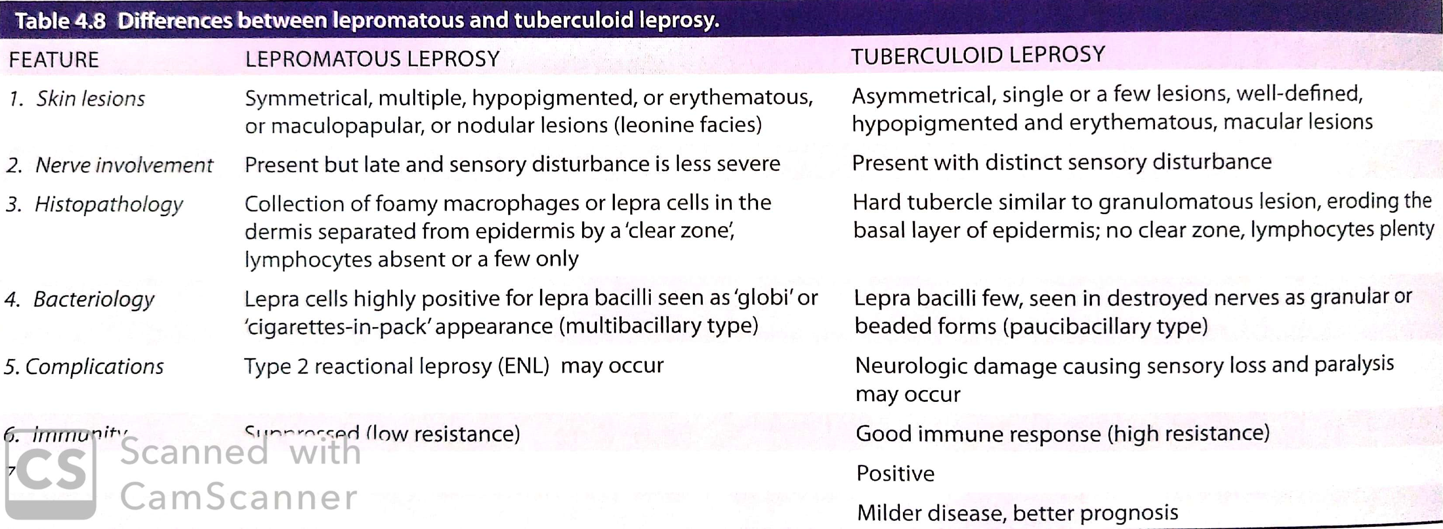

Slide 61
3. Borderline leprosy
The histopathologic features of the three forms of borderline leprosy are as under:
i) Borderline tuberculoid (BT) form shows epithelioid cells and plentiful lymphocytes. There is a narrow clear subepidermal zone. Lepra bacilli are scanty and found in nerves.

Slide 62
ii) Borderline lepromatous (BL) form shows predominance of histiocytes, a few epithelioid cells and some irregularly dispersed lymphocytes. Numerous lepra bacilli are seen.
iii) Mid-borderline (BB) or dimorphic form shows sheets of epithelioid cells with no giant cells. Some lymphocytes are seen in the peri-neurium. Lepra bacilli are present, mostly in nerves.

Slide 63
Clinical Features
1. Lepromatous leprosy:
i) The skin lesions in LL are generally symmetrical, multiple, slightly hypopigmented and erythematous macules, papules, nodules or diffuse infiltrates.
ii) The lesions are hypoaesthetic or anaesthetic but the sensory disturbance is not as distinct as in TT.

Slide 64
2. Tuberculoid leprosy:
i) The skin lesions in TT occur as either single or as a few asymmetrical lesions which are hypopigmented and erythematous macules.
ii) There is a distinct sensory impairment.

Slide 65
THANK YOU

Slide 66
MCQs

Slide 67
Leprosy bacilli are:
A. Not acid fast
B. As acid fast as tubercle bacilli
C. Less acid fast compared to tubercle bacilli
D. More acid fast compared to tubercle bacilli

Slide 68
Lepromin test is always positive in:
A. Lepromatous leprosy
B. Borderline lepromatous leprosy
C. Tuberculoid leprosy
D. Indeterminate leprosy

Slide 69
IgM antibody against PGL-1 antigen is used for the diagnosis of:
A. Leprosy
B. Tuberculosis
C. Syphilis
D. Brucellosis

Slide 70
4. Which category of leprosy is not included in Ridley-Jopling classification?
A. Mid borderline leprosy
B. Borderline tuberculoid leprosy
C. Indeterminate leprosy
D. Tuberculoid polar leprosy

Slide 71
5. Which of the following is atypical mycobacteria?
A. Mycobacterium microti
B. Mycobacterium canneti
C. Mycobacterium africanum
D. Mycobacterium ulcerans

Slide 72
ANSWERS

Slide 73
1 – C
2 – C
3 – A
4 – C
5 – D

