Slide 1
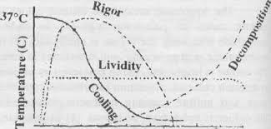
POSTMORTEM CHANGES
IN DEADBODY

Slide 2
Thanatology – branch of science that deals with death and its various aspects
Forensic Taphonomy
- study of postmortem processes of human deadbody/human remains in dispositional context.
= changes occur in deadbody after death

Slide 3
IMMIDIATE PHASE (=Somatic death)
  Insensibility, loss of voluntary power, absent brainstem reflexes
  Cessation of respiration
  Cessation of circulation
EARLY PHASE (=Cellular death)
  Skin changes
  Eye changes
  Primary flaccidity in muscles
  Algor mortis
  Livor mortis
  Rigor mortis
LATE PHASE (= Decomposition & Decay)
  Autolysis
  Putrefaction
  Adipocere formation
  Mummification

Slide 4
SKIN CHANGES
Pallor
Loss of elasticity
Drying

Slide 5
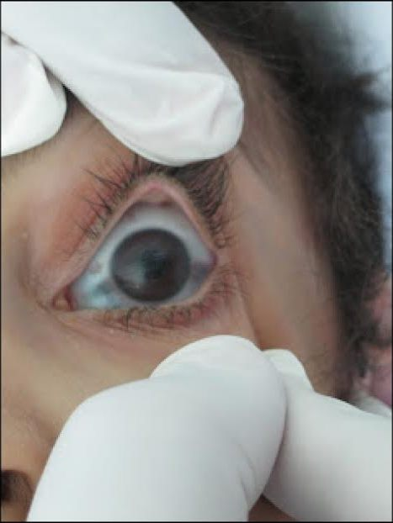
EYE CHANGES
Pupils – dilated, fixed
Loss of reflexes - corneal, conjunctival
Opacity of Cornea
– 30mins to 2hrs
‘Tache noir’
Flaccidity of eyeball
IOP in Life – 14 to 25mmHg
soon after death – <12mmHg
30 mins - < 3mmHg
2 hours – nil

Slide 6
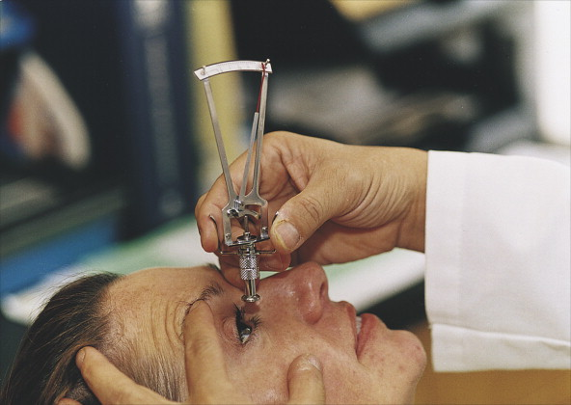

Slide 7
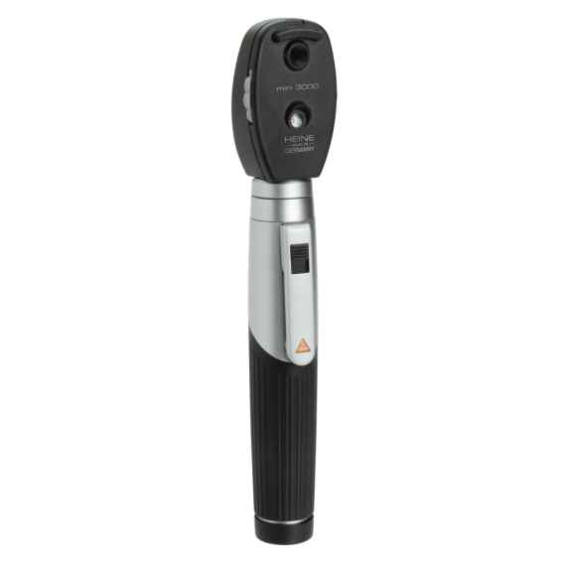
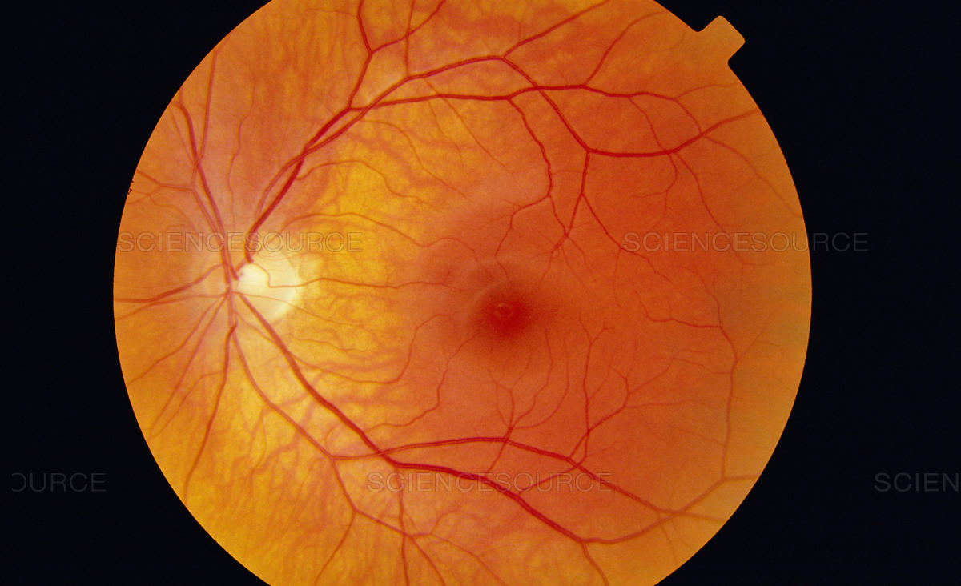
Retina - tucking or segmentation of retinal blood vessels is first observable sign after death(Kevorkian sign)
Chemical changes – Sodium, Potassium levels in Vitreous Humour

Slide 8
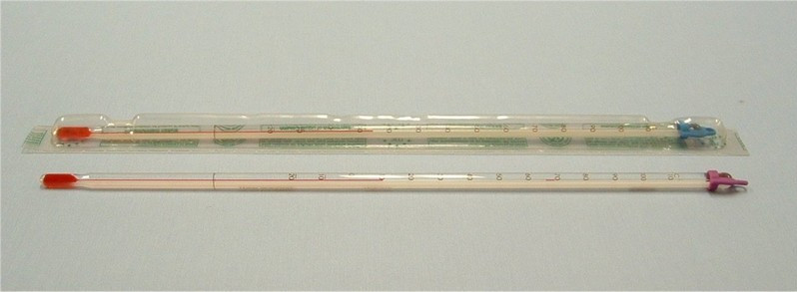
ALGOR MORTIS
‘Postmortem Cooling’, ‘chill of death’
Heat generation in body stops – metabolism & thermoregulatory mechanisms
Heat exchange by conduction & convection after death
Method to measure body temperature

Slide 9
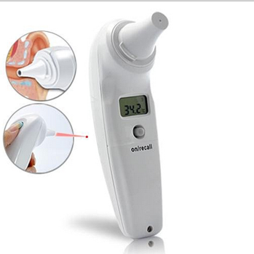
Core body temperature
- Rectal, Abdominal Cavity, Deep nasal, Middle ear
  30min to 1hr – Minor change
  1hr to 12-16hrs – 0.4 to 0.6 °C/hr fall
  Than slower, average adult naked body - 15-20hrs
Sigmoid /inverted ‘S’ shaped curve
PMI = Normal Body Temp(°C) – Rectal Temp(°C)
Rate of temp fall(°C/hr)

Slide 10
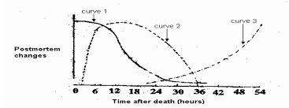

Slide 11
Factors affecting rate of cooling
  Climate – 0.4-0.6°C/hr in tropical countries, 1°C/hr in temperate
  Contact medium – soil, water, moisture
  Covering of deadbody – cloths, wraping
  Build of deadbody
  Fat composition of deadbody

Slide 12
Medicolegal Importance
  Determination of time since death(TSD/PMI)
  More accurate in cold & temperate climate and indoor;
  not reliable in warm/tropical climate & outdoor deaths
  Exceptions – ‘PM Caloricity’
  sunstroke, tetanus, strychnine poisoning, septicemia, cholera, high grade bacteraemia

Slide 13
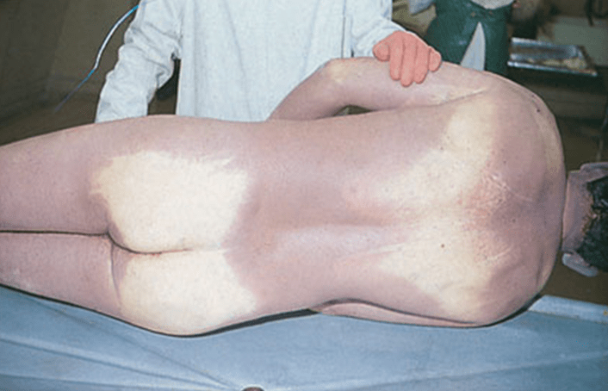
LIVOR MORTIS
‘Postmortem Lividity’, ‘Postmortem Hypostasis’
Definition- PM Lividity is Bluish-purple discolouration of skin in superficial layers of dermis of dependent parts of body after death due to capillo-venous distension.

Slide 14
Mechanism
Stoppage of circulation
Stagnation of blood
in toneless blood vessels - veins & cappillaries
Gravitational pull/sink of blood
in dependent body parts (except pressure areas)
Gradual bluish-purple skin discoloration over dependent body parts
DeoxyHb blood – dark red

Slide 15
Development
Starts to develop few minutes after death
Visible in half to 1hr
Dull red patches(1-2cms) – 30mins to 2hrs
Patches deepen & large -> Confluent in 1 to 4hrs
Well developed - 4 hrs
Maximum(Primary lividity) – 6 to 12hrs
‘Fixed’ after 6hrs
‘Shifting of lividity’ – body movement before fixation -> new position -> Secondary lividity in new dependent parts – lighter than primary

Slide 16
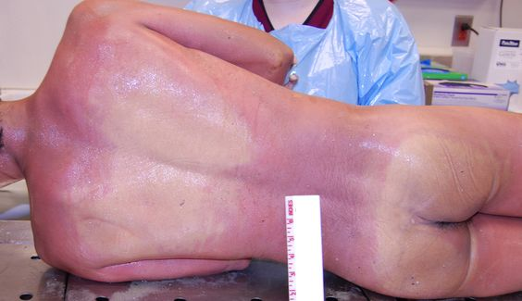
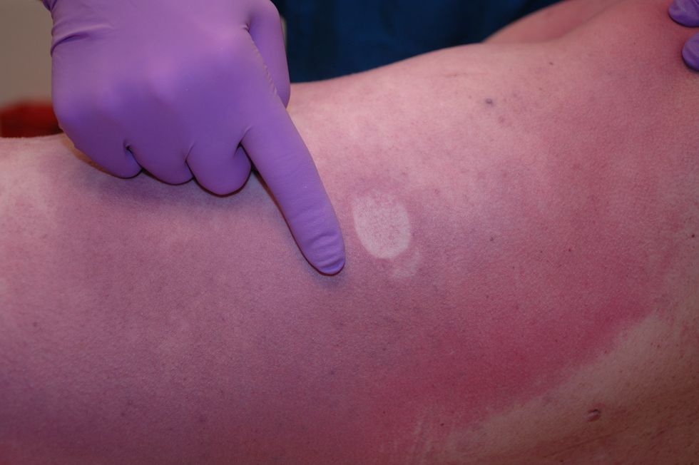

Slide 17
Appearance & Distribution
If body lying supine – PM lividity on neck, back, lower parts of thighs & limbs; except pressure contact areas – occiput, shoulderblades, buttocks, tight cloth/bands
If body prone – PM lividity on face, front of chest, shoulders, abdomen, thighs & limbs
If body on one side – PM lividity on dependent bodyparts of that side
If body inverted position – PM lividity on head, face, neck, chest & shoulders
If body suspended verticle(hanging) – PM lividity on lower legs & forehands[Glove & stocking pattern]
In drowning deaths in stagnant water - PM lividity on face, neck, shoulders, arms, chest & upper back; if deadbody rolling in flowing water – no PM lividity

Slide 18
Colour patterns
Asphyxial deaths – deep bluish/purple
Septicemia – greenish brown
Hypothermia, cold water, refrigerated bodies - bright pink
Decomposition – dusky brown, greenish black
Mummification – brownish black
Poisoning cases
  CO poisoining – cherry red
  HCN poisoning – bright red
  Phosphorus poisoning – dark brown/yellow brown
  Nitrite, Potassium chlorate/bicarbonate, bromate poisoning(MethHbnemia) – copper brown/chocolate
  H2S poisoning – bluish green

Slide 19
Medicolegal Importance
  Sign of death
  Estimation of time since death(TSD/PMI)
  Position & movement of deadbody after death
  Cause of death

Slide 20
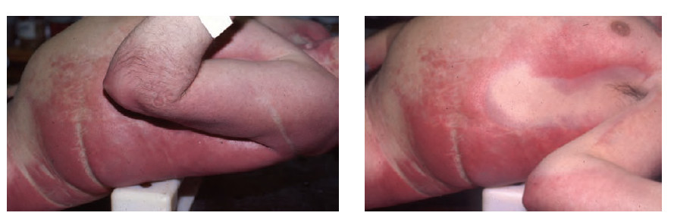
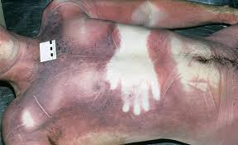

Slide 21
SKELETAL MUSCLES
Primary relaxation/flaccidity [death to 1-2hrs]
Rigor Mortis [1-2hrs to 24-48hrs]
Secondary relaxation/flaccidity [24-48hrs onwards]

Slide 22
Medicolegal Importance
  To know & link time of death & time of crime
  It gives a starting point of time to the police for investigation
  To link suspected offender with chronology of offence
  To exclude an innocent suspect for the offence
  To confirm or disprove an alibi of a suspected person
  Presumption of Death – IEA S.107,108
  Presumption of Survivorship

Slide 23
Any query?
MCQs

Slide 24
MCQ 1
Maggots may be seen in a decomposing deadbody earliest at what time after death?
2hrs
6hrs
24hrs
4 days

Slide 25
MCQ 2
Putrefaction starts earliest in which of following organ?
Kidney
Brain
Heart
Liver

Slide 26
MCQ 3
What is the first external sign of putrefaction?
Marbling of skin
Greenish discoloration over right iliac fossa
Bluish purple discoloration over dependent parts
Eggs of flies in natural orifices

Slide 27
MCQ 4
What among following describes the rule for ‘duration of decomposition of a deadbody in air, water and earth’?
Casper’s dictum
Nysten’s rule
Locard’s principle
Puppe’s rule

Slide 28
MCQ 5
Casper’s dictum describes what among following in a deadbody?
Rate of putrefaction
Rate of cooling
Development of rigor mortis
Duration for fixation of suggilation

