Slide 1
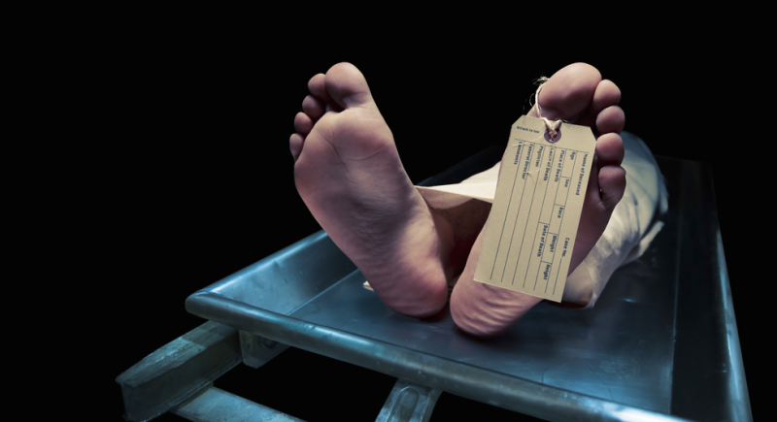
Medico-legal Autopsy

Slide 2
Topics covered in last session
Autopsy – definition and different types
Objectives of Medicolegal Autopsy
Prerequisites documents of Medicolegal Autopsy
Infrastructure, equipment-instruments, staff at PM room for Medicolegal Autopsy
General procedure, rules for Medicolegal Autopsy

Slide 3
Today’s topics
Skeleton examination
Virtopsy, Psychopsy
Exhumation
Negative autopsy
Obscure autopsy

Slide 4
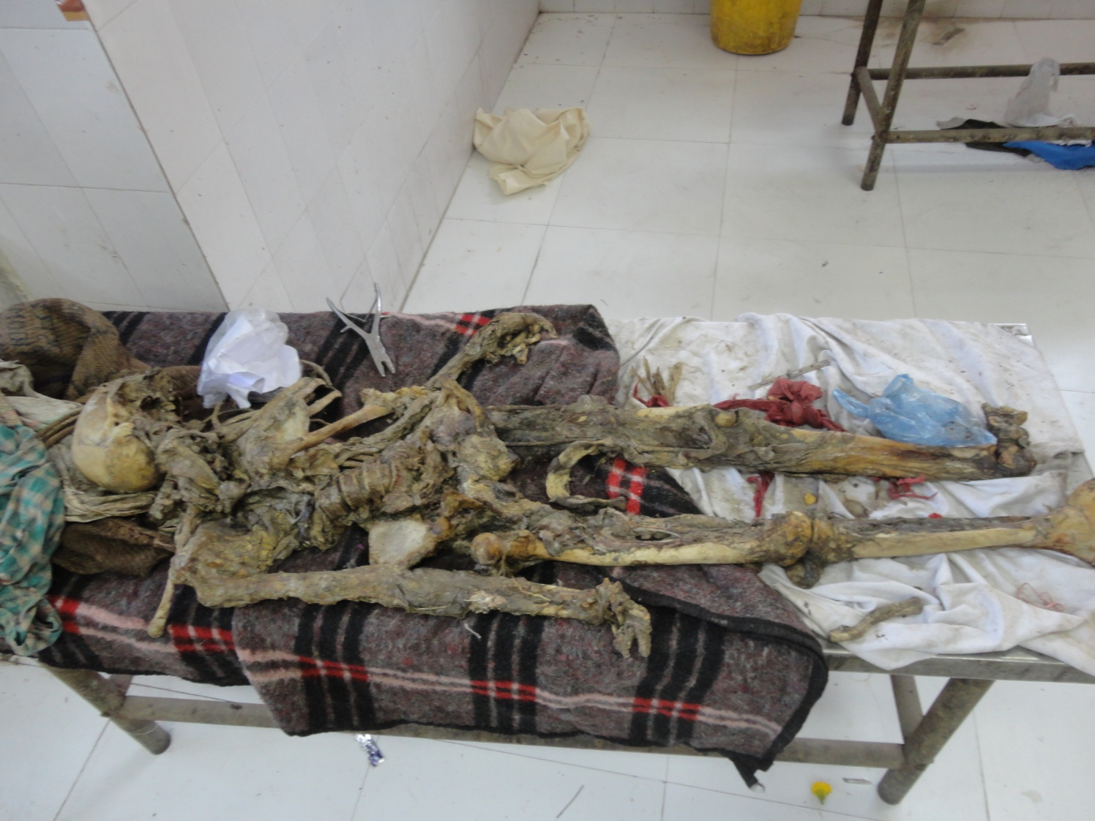
Examination of Skeleton

Slide 5
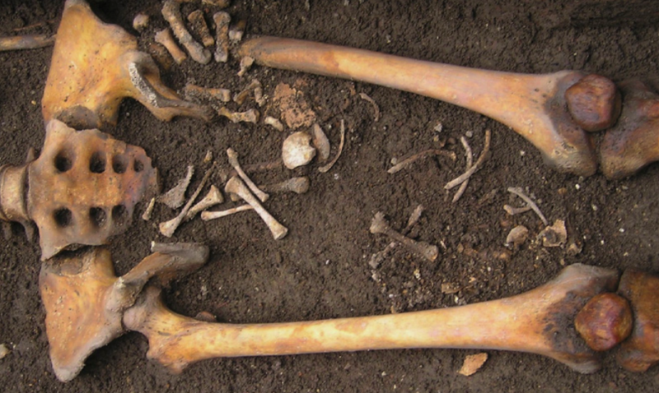
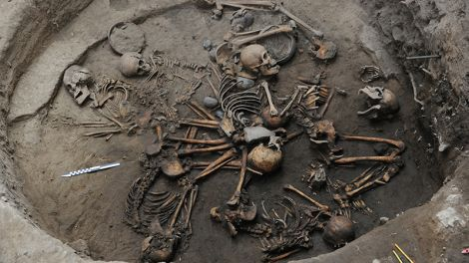

Slide 6
Points to examine & opine
Human or animal
One or more deadbodies
Identification
  Age
  Sex
  Stature
  DNA, Bl group
Injuries – type, time, weapon
Cause of death
Manner of death
Time since death

Slide 7
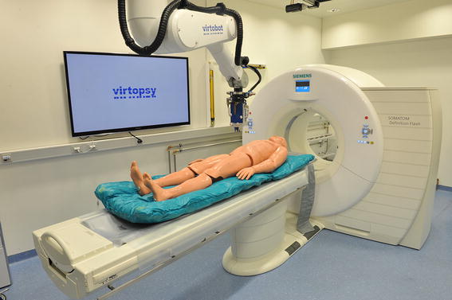
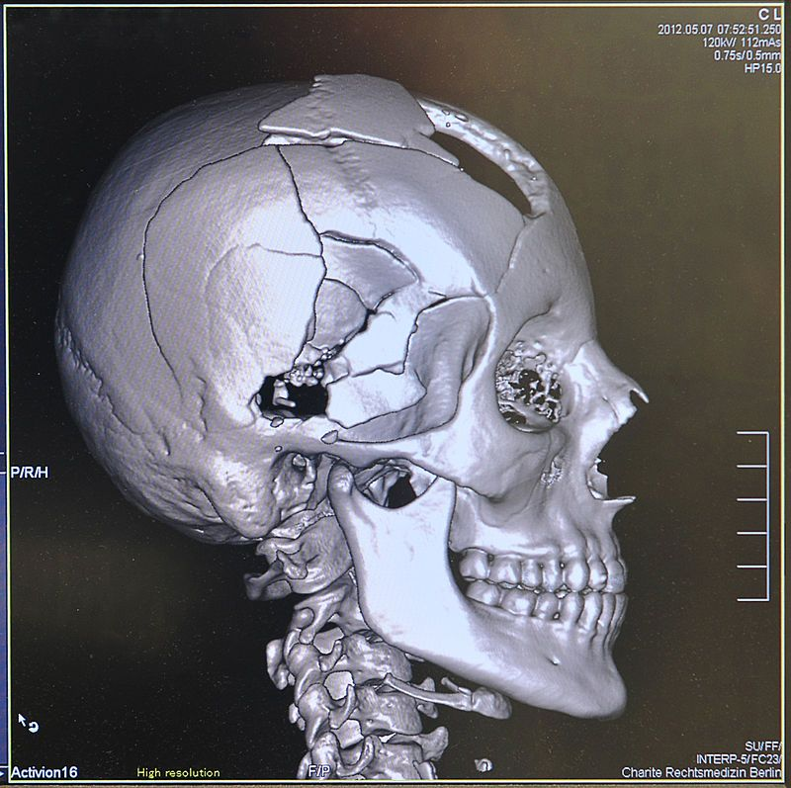
Virtopsy
Autopsy with non invasive radio-imaging techniques
  CT Scan, MRI, X-ray, USG, MR Spectroscopy, ...
  3D restructuring compilation
  ‘Virtopsy’ set up

Slide 8
Psychopsy
Psychological examination and analysis to determine the manner of death.
Relatives, friends, contact persons of dead person - structured interviews, psychological tests
Psychological analysis of dead person’s personal belongings , daily habits & work, personality, past history,..

Slide 9
EXHUMATION
Legally digging out of a buried dead body for legal investigation.
Cases:
Disputed legal cases – criminal & civil
Who can order – Executive Magistrate on request of investigating police officer

Slide 10
Procedure
Detailed information about deceased person- at & before time of death and burial
Time of exhumation
Persons present at time – Executive Magistrate, Govt. RMP, FSL staff, Police IO & staff, technical staff, Close relatives
Identification of grave site & note down
Photography/ Videography
Area screening

Slide 11
Condition of soil, sample
Careful digging up to casket/ deadbody
Measurements – depth, length, width
Careful retrieval of dead-body with casket
Samples & evidences preservation
Dead-body identification by relatives
Magistrate inquest (S.176 CrPC)

Slide 12
Autopsy
  Documents, History, photographs
  Identification
  Changes of decomposition
  Artefacts

Slide 13
Obscure autopsy
When gross PME & microscopic examination, toxicological analysis and all possible laboratory investigations fail to reveal a definitive cause of death, only minor/minimal/inconclusive findings are there which are insufficient to form definitive opinion, the autopsy is called ‘obscure autopsy’.
Need reevaluation of history & other information of incidence, meticulous PME & lab work to reveal the actual cause of death

Slide 14
Negative Autopsy
When gross PME & microscopic examination, toxicological analysis and all possible laboratory investigations fail to reveal a definitive cause of death, the autopsy is considered ‘negative autopsy’.

Slide 15
Contributing factors:
  Non-availability of history & info of incidence
  Non-availability of proper instruments, equipments, lab facilities.
  Incomplete & hastily autopsy
  Improper samplings, rare poison
  Poor knowledge & experience of autopsy staff
  Advanced decomposition, partial deadbody
  Unknown science/ factors still to be revealed by science
2 to 5% of all autopsy
More in young age(<35yrs)

Slide 16
MCQs

Slide 17
MCQ 1
Which of the following is an objective of a medico legal autopsy?
Determination of Cause of Death
Identification of unknown dead body
Elucidation of time since death
All of the above

Slide 18
MCQ 2
The actual dissection & examination of the dead body during autopsy should be carried out by whom?
The doctor himself
A junior assistant of the doctor
Mortuary technician
Mortuary attendant

Slide 19
MCQ 3
Which of the following incisions is not employed during a medico-legal autopsy?
‘I’ shaped
Modified ‘I’ shaped
‘Y’ shaped
Modified ‘Y’ shaped

Slide 20
MCQ 4
Incision on the scalp in medico-legal autopsy is done along which of following?
Saggital plane
Coronal plane
Circumference of Scalp
Suture lines of skull

Slide 21
MCQ 5
To conduct a medico-legal postmortem, which of the following is not an essential pre-requisite?
Inquest report
Dead body challan
Consent of relative
Identification by police & relative

Slide 22
Answer Key
d
a
b
b
c

