Slide 1
MECHANICAL ASPHYXIA
- Dr Kalpesh Zanzrukiya

Slide 2
In this session
No. | COMPETENCY | Domain (K/S/A/C) | Level (K/KH/S/SH/P) | Core (Y/N)
FM2.20 | Mechanical asphyxia: Introduction Define, classify and describe asphyxia and medico-legal interpretation of post-mortem findings in asphyxial deaths | K | KH | Y
FM2.21 | Describe and discuss different types of Hanging including clinical findings, causes of death, post-mortem findings and medico-legal aspects of death due to hanging including examination, preservation and dispatch of ligature material | K | KH | Y

Slide 3
SPECIFIC LEARNING OBJECTIVES At the end of this session, the 2nd MBBS student.... | Integration
1. should able to define and classify asphyxial deaths. 2. should be able to describe medico-legal interpretation of post-mortem findings in asphyxial deaths. | N
1. should able to Define Hanging, describe and discuss different types of Hanging. 2. should able to describe clinical findings, causes of death, post-mortem findings and medico-legal aspects of death due to hanging. 3. should able to describe and demonstrate examination, preservation and dispatch of ligature material | N

Slide 4
Asphyxia
A ‘condition’ caused by interference with respiration or O2 availability which leads to deprivation of O2 to organs & tissues & causes unconsciousness or death.
Types/ Causes of Asphyxia
  Mechanical
  Pathological
  Toxic
  Environmental
  Traumatic
  Postural asphyxia
  Iatrogenic

Slide 5
Mechanical Asphyxia
Asphyxia caused by mechanical pressure to neck, chest or other areas of body OR whole body is positioned in such a way that respiration is difficult or impossible.
Includes following all
  Hanging
  Strangulation
  Throttling
  Smothering
  Gagging
  Choking
  Traumatic Asphyxia
  Postural Asphyxia
  Drowning

Slide 6
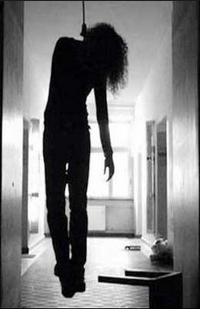
HANGING
‘Self’ suspension
Form of asphyxia which is caused by suspension of the body by a ligature which encircles the neck, the constricting force being the weight of the body.

Slide 7
Classification
According to degree of suspension
  Complete Hanging
  Partial Hanging
According to position of ‘knot’
  Typical Hanging
  Atypical hanging

Slide 8
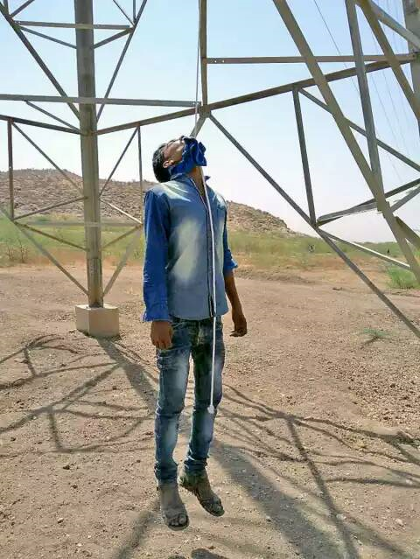
Complete Hanging – body is completely suspended without any part of the body touching the ground.

Slide 9

Partial hanging – Body is partially suspended with one or more parts of the body touching the ground or ground-contact object.
Sitting, kneeling, lying supine, lying prone etc.

Slide 10
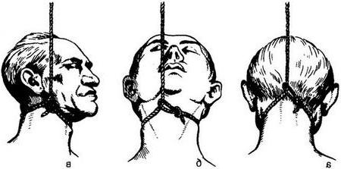
Typical Hanging –
The knot is over the central part of beck of neck and the ligature runs from the midline of neck in front above the thyroid cartilage level to both sides of neck symmetrically upwards, backwards to the occipital region.
Atypical Hanging – The knot is over any other part of neck of neck or no knot at all.

Slide 11
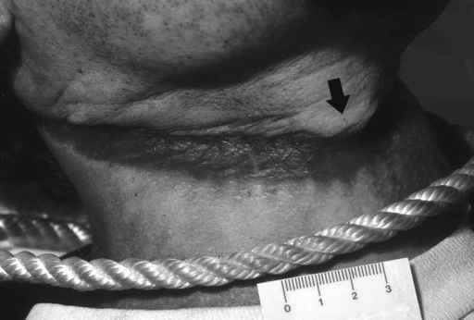
Ligature
Hard materials – rope, wire, metallic chain, leather straps/ belts
Soft materials – saree, dupatta, dhoti, gamchha
Doctor should note down
  In situ or removed?
  Texture, nature, pattern
  Length, width, loops
  Neck circumference in cm
  Strength for suspension
  Knot – type, location, number
  Damage, stains

Slide 12
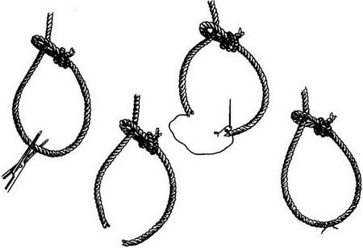
Method to cut and preserve ligature material

Slide 13
Symptoms after suspension
Loss of power
Subjective sensations – flashes of light, ringing noises
Intense mental confusion – irrelavant thoughts, cognition lost, incapability to do any logical thing to save oneself
Unconsciousness & death (15sec in rope)
Painless death
Respiration failure first than heart stops in 10-15mins.

Slide 14
Cause of Death
Asphyxia – hard ligature, laryngeal/tracheal narrowing, trauma, air entry block, tension of 15kg
Venous congestion – higher knot/ligature, soft ligature material, jugular vein blockage, tension of 2kg
Asphyxia & Venous congestion combined - MC
Cerebral anaemia (ischemia) – arterial + venous blockage, tension of 5-6kg for carotid arteries, 20kg for vertebral arteries
Reflex vagal inhibition
Fracture-dislocation of cervical vertebra – spinal shock – judicial hanging, high fall jurk hanging
Delayed death – aspiration pneumonia, infection, pulmonary edema, laryngeal edema, hypoxic encephelopathy, brain infarction, brain edema

Slide 15
Secondary effects – hemiplegia, epilepsy, amnesia, dementia, cervical cellulitis, retropharyngeal abscess.
FATAL PERIOD –
usually 3 to 5 mins
Immediately if cervical spine injury, vagal inhibition
Treatment if person saved in nick of time
  Immediate cut loose the ligature
  Lie down supine position
  ABCD, CPR
  Oxygen support, Artificial respiration

Slide 16
Post mortem findings - External
Neck – strached, elongated
Ligature material in situ – cut & preserve
Ligature mark over neck – ‘pressure abrasion’, oblique, inverted ‘V’ pattern, incomplete
site, size, loops, knotmarks, skin over base
[Pseudo-ligaturemark – obese, infants, decomposed]
Congestion above ligature mark level
Petechial hemorrhages
Cyanosis
PM staining – over hands & forehands, legs & feet with petechial hemorrhages - Glove & Stocks pattern

Slide 17
Face – tongue protrude, drooling saliva stains, pupils dilated (le facie sympathique)
Bleeding from nose, ears, mouth – not common
Urine, feces discharge – not common
Penile engorgement & semen discharge

Slide 18
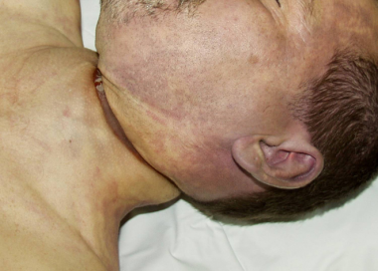

Slide 19
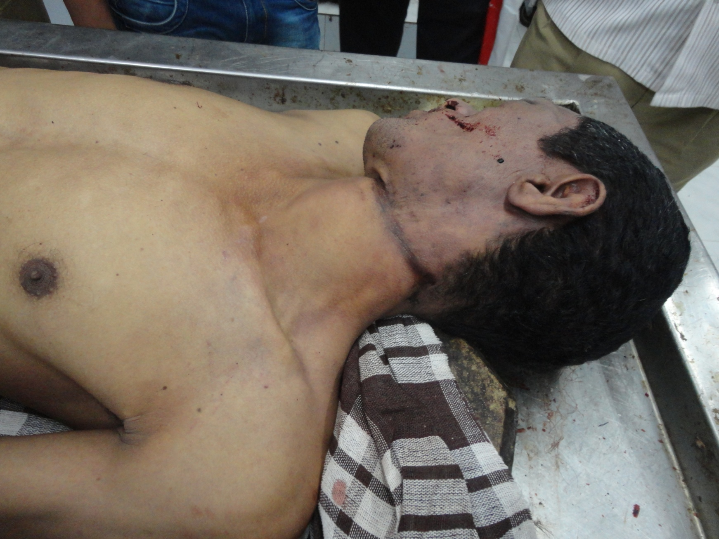

Slide 20
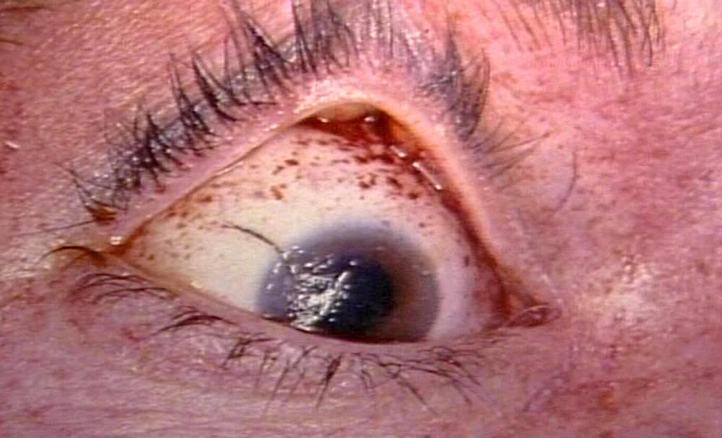
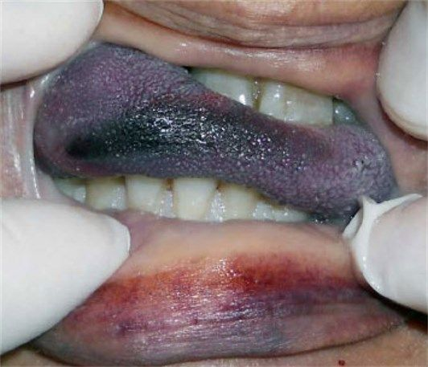

Slide 21
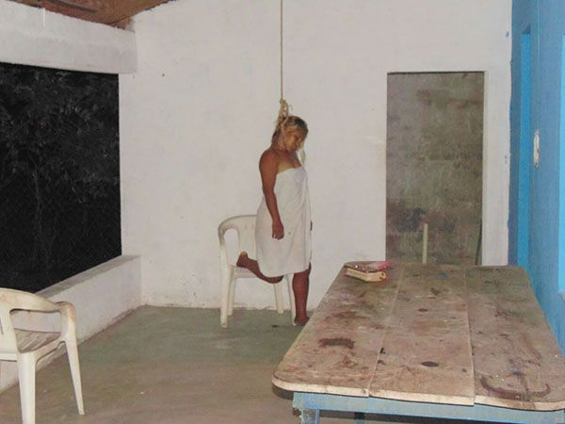
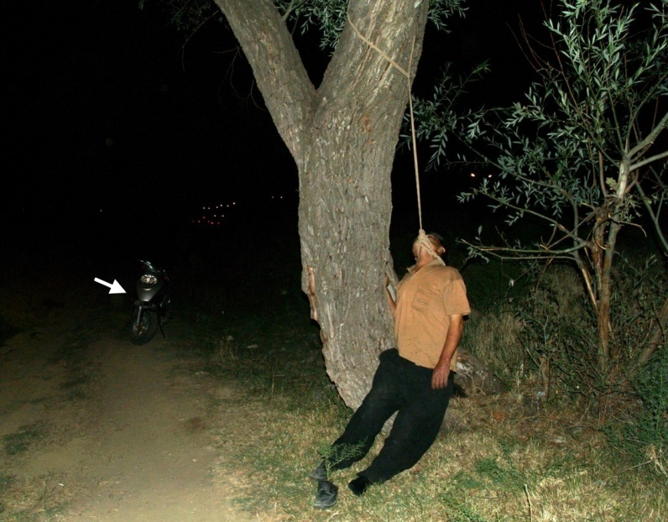

Slide 22
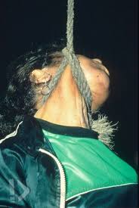
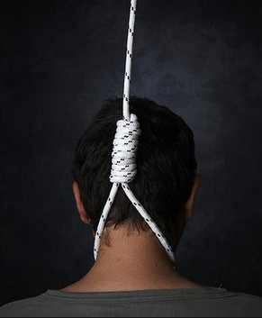

Slide 23
Post mortem findings - Internal
Cranial cavity open first
NECK -
  Subcutaneous tissue beneath ligature mark
  Neck muscles ecchymosed, hemorrhages, ruptures
  Carotid, vertebral arteries, jugular veins – tears
  Fracture of hyoid bone(antero-posterior compression type), thyroid cartilage, cricoid cartilage
  Tears over laryngeal, tracheal tissues
  Fracture of cervical vertebra with tear of spinal cord

Slide 24
Post mortem findings - Internal
Lungs – congested, edema, petechial hemorrhages, subpleural echhymoses
Brain – pale/congested, petechial hemorrhages, subarachnoid hemorrhages
Stomach, Liver, Other organs

Slide 26
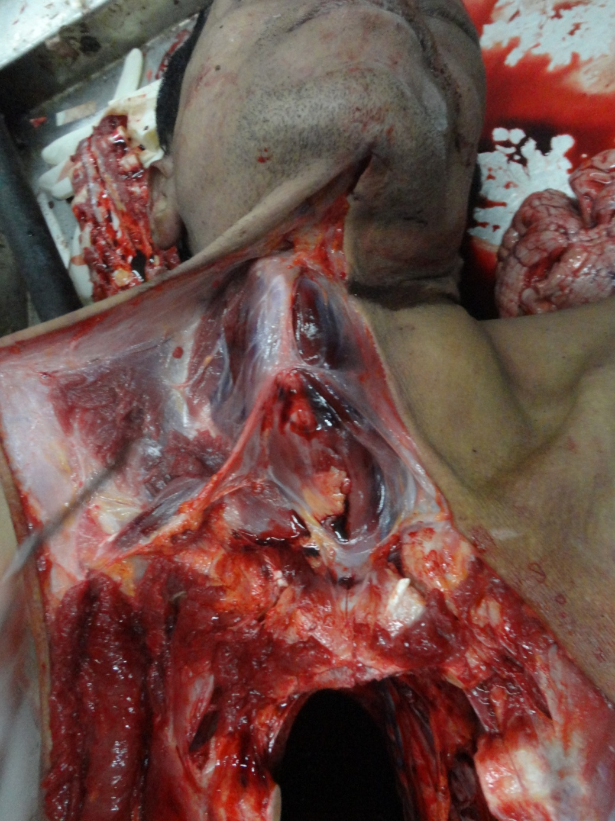

Slide 27
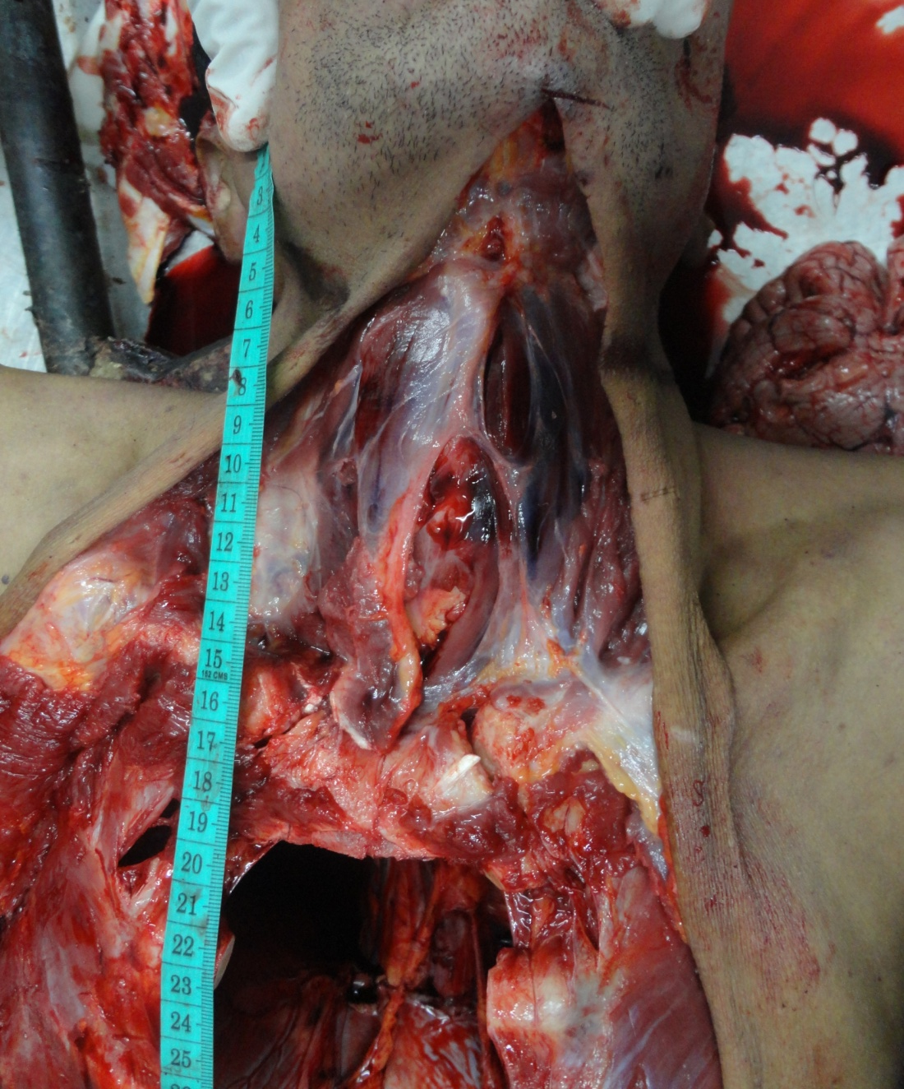

Slide 28
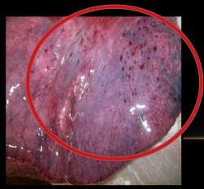
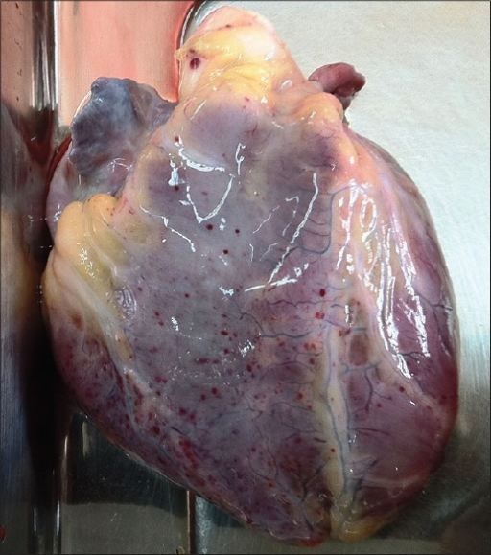

Slide 29
MCQs

Slide 30
MCQ 1
Hanging with feet touching the ground is seen in which of following?
Partial hanging
Complete hanging
Homicidal hanging
Suicidal hanging

Slide 31
MCQ 2
15 kg pressure on neck can cause death by what mechanism?
Cerebral anoxia
Asphyxia
Both a and b
Fracture of cervical vertebrae

Slide 32
MCQ 3
In hanging post-mortem lividity is observed on what part of body?
Distal half of upper and lower limbs
Anywhere on the body
Head and chest
Posterior aspect of body

Slide 33
MCQ 4
In typical hanging, the ligature compresses what structures of neck?
Carotid arteries
Vertebral arteries
Trachea
All of above

Slide 34
MCQ 5
‘La facie sympathique’ is seen in which condition?
Road traffic accident
Hanging
Strangulation
Myocardial infarction

Slide 35
Patel AP, Bhoot RR, Patel DJ, Patel KA. Study of violent asphyxial death. International journal of medical toxicology and forensic medicine. 2013 Apr 3;3(2 (Spring)):48-57.
Patel AP, Bhoot RR, Patel DJ, Patel KA | Study of violent asphyxial death | A prospective study of autopsies performed between 2008 to 2010 at Civil Hospital, B.J.Medical College, Ahmedabad, Gujarat. | Incidence of violent asphyxia deaths is 5.63% of total autopsies. Hanging (82.48%) is the most common violent asphyxia death. 312 out of 320 cases (97.5%) of hanging were suicidal and rest 8 (2.5%) were accidental in nature. Homicidal hanging is not recorded in present study. All 12 strangulation cases were of homicide, 32 out of 56 (57.14%) cases of drowning were accidental and remaining 24 (42.86%) were suicidal.

Slide 36
In this session
No. | COMPETENCY | Domain (K/S/A/C) | Level (K/KH/S/SH/P) | Core (Y/N)
FM2.21 | Describe and discuss Strangulation including clinical findings, causes of death, post-mortem findings and medico-legal aspects of death due to hanging and strangulation including examination, preservation and dispatch of ligature material | K | KH | Y
FM2.22 | Describe and discuss patho-physiology, clinical features, postmortem findings and medico-legal aspects of throttling, suffocation, traumatic asphyxia, obstruction of nose & mouth. | K | KH | Y

Slide 37
SPECIFIC LEARNING OBJECTIVES At the end of this session, the 2nd MBBS student.... | Integration
1. should able to define Strangulation. 2. should able to describe clinical findings, causes of death, post-mortem findings and medico-legal aspects of death due to strangulation. 3. should able to describe and demonstrate examination, preservation and dispatch of ligature material | N
1. should able to define Throttling, suffocation, traumatic asphyxia 2. should able to describe clinical findings, causes of death, post-mortem findings and medico-legal aspects of death due to Throttling, suffocation, traumatic asphyxia. 3. should able to describe and demonstrate examination, preservation and dispatch of ligature material | N

Slide 38
Medico-legal aspects of Hanging
SUICIDAL – most common
HOMICIDAL HANGING
rare
unconsciousness, incapacitating drugs, child, weak persons
signs of violence, struggle, defence injuries
LYNCHING
Captain William Lynch
used to order hanging on spot in public

Slide 39
JUDICIAL HANGING
  In India – capital punishment, CrPC S.354
  Dark face cover
  Knot under chin (submental) on rightside
  Drop of 5-7 meters
  Fracture-dislocation of C2/ C3/C4 vertebra (Hangman’s facture)
  Spinal cord compression, tear-> spinal shock
  Immidiate unconsciousness,
  heart-lungs may continue to beat 10-15 mins, spasmodic muscle jerkings.
  Asphyxial signs may not seen.
  RMP declares & certifies death

Slide 40
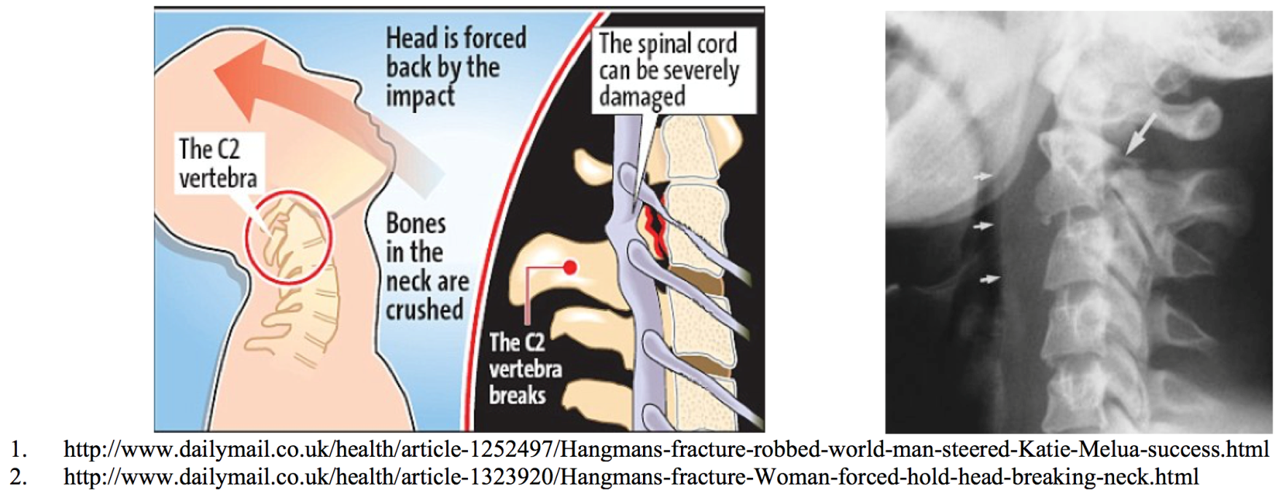

Slide 41
SELF STUDY
Antemortem hanging V/s Postmortem hanging
ANTEMORTEM Hanging
POSTMORTEM HANGING
  Ligature within 2 hrs of death may produce ligature mark
  Signs of dragging
  On beam- rope moved from below upwards as the body pulled up
  Fibres of rope – cellophane tape samples

Slide 42
STRANGULATION
Asphyxia caused by constriction of neck by ligature or other means but without suspending the body.
E.g. Ligature strangulation, Throttling, Garroting, Mugging, Bansdola

Slide 43
Mechanism – sudden & violent compression (forceful constriction) of neck structures -> immediate insensibility, asphyxia, coma, death.
Cause of Death
  Asphyxia
  Venous congestion
  Combined asphyxia + congestion
  Vagal inhibition
  Fracture dislocation of cervical vertebra

Slide 44
Post mortem findings - External
Ligature mark in neck – ‘pressure abrasion’
horizontally, completely encircling neck, round– ‘O’ shape pattern, more distinct than hanging
Ligature material usually absent or away from body
if in situ – cut & preserve
Congestion above ligature mark level more profound
Petechial hemorrhages
Cyanosis
PM staining – over back or dependent parts
Defence wounds, Signs of struggle, Cadaveric spasm

Slide 45
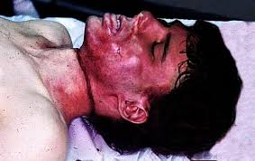

Slide 46
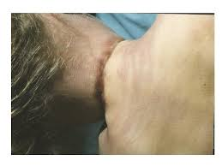

Slide 47
Post mortem findings - External
Neck – not stretched, nail marks(defensive)
Face – tongue protrude, saliva stains, blood stains
Bleeding from nose, ears, mouth – more common
Urine, faeces discharge – more common
Penile engorgement & semen discharge
Other defensive injuries if homicidal

Slide 48
Post mortem findings - Internal
Cranial cavity open first
NECK -
  Subcutaneous tissue beneath ligature mark
  Neck muscles extensively ecchymosed, hemorrhages, ruptures
  Carotid, vertebral arteries, jugular veins – tears
  Fracture of hyoid bone(avulsion type), thyroid cartilage, cricoid cartilage – more common, inwards
  Tears over laryngeal, tracheal tissues
  Fracture of cervical vertebra with tear of spinal cord

Slide 49
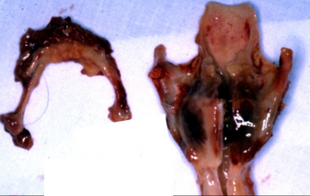

Slide 50
Post mortem findings - Internal
Lungs – congested, edema, petechial hemorrhages, emphysematous bullae, subpleural echhymoses
Brain – pale/congested, petechial hemorrhages, subarachnoid hemorrhages
Stomach, Liver, Other organs

Slide 51
Medicolegal importance
  Homicidal - usually
  Accidental – children, cot constriction, under influence of alcohol, industrial/workplace accident, vehicular accident, strangulation in utero, Choking games, Sexual asphyxia
  Suicidal –rare
  Strangulation of penis, hernia, other organs
  Pseudostrangulation

Slide 52
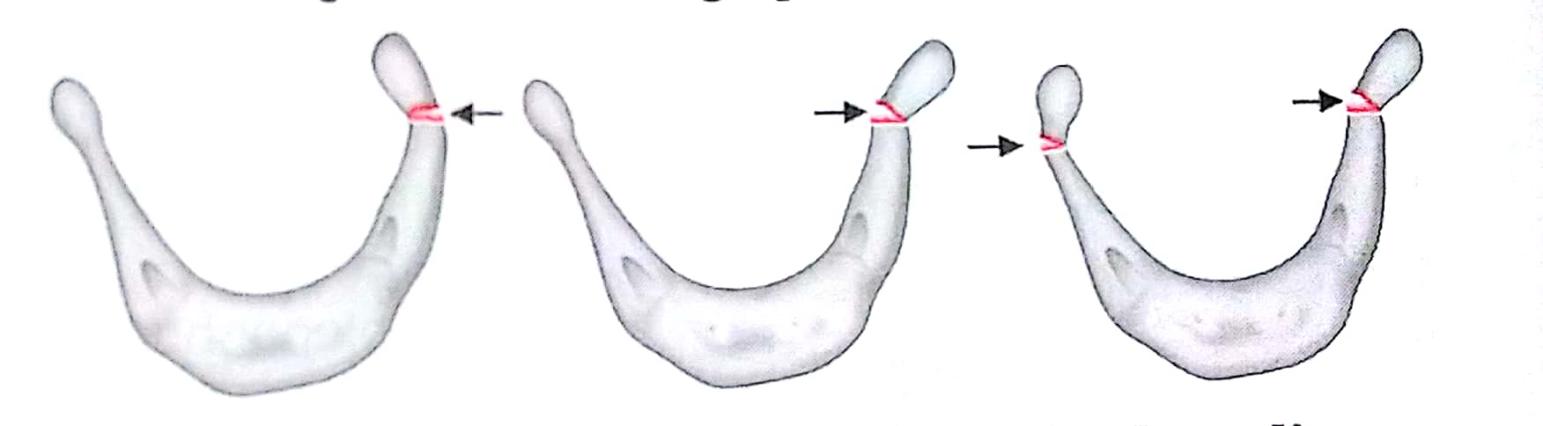
Hyoid bone fractures
Antero-posterior compression #: Hanging
Avulsion (tug & tracheal) #: Ligature Strangulation
Inward compression # : Manual Strangulation/Throttling
Not seen in children

Slide 53
Throttling(Manual Strangulation)
Asphyxia caused by constriction of neck by manual force using one or both hands.
Death mainly due to carotid artery occlusion-> cerebral ischemia .
airway obstruction - minor role.

Slide 54
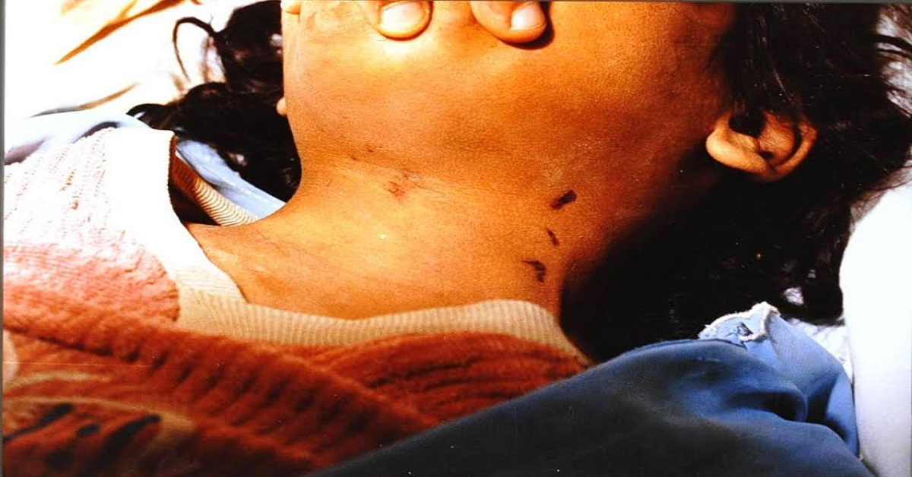

Slide 55
PM Appearance:
  Bruices & abrasions on neck – nail marks, finger bruices, web space bruice, palm pressure
  Fractures – Thyroid cartilage, Hyoid bone (inward compression type), cricoid cartilage
  Hemorrhagic bruices in paraphyaryngeal-laryngeal muscles, pharynx, epiglotis, tonsils, base of tongue, retropharyngeal muscles
  Signs of asphyxia, congestion, cerebral ishemia
  Defence wounds & struggle marks

Slide 56
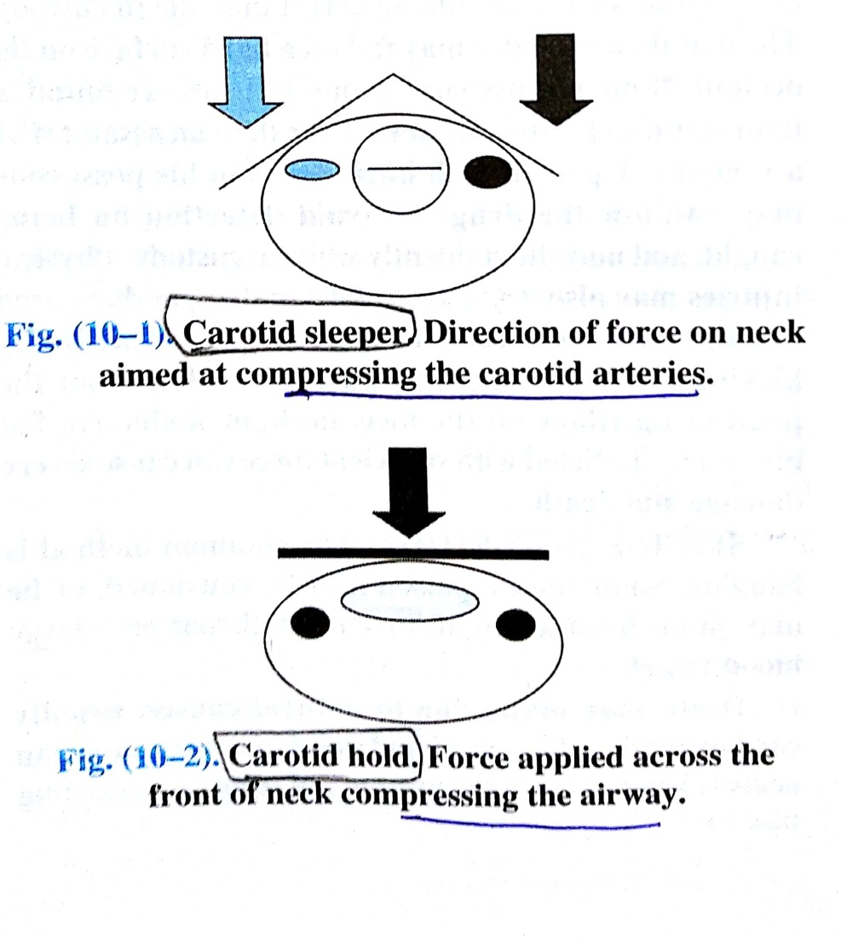
Carotid Sleeper Hold
Chok/Bar Hold
Karate blow
Commando punch

Slide 57
GARROTING – victim attacked suddenly from behind without warning with ligature (/manually) and strangulated.
BANSDOLA – neck squeezed from between two horizontal bamboos front & back and tied together tightly.
MUGGING – constriction of neck of victim with bend of elbow(carotid sleeper hold) OR knee

Slide 58
SUFFOCATION
Asphyxia by respiratory failure due to blockage of airway openings which makes inspiration & expiration difficult OR lack of oxygenated air in surrounding including poisonous gases and environmental pollutants.
Smothering
Gagging
Choking
Toxic/ Poisonous gases
Environmental pollutants

Slide 59
SMOTHERING
Asphyxia by obstructing external respiratory orifices. Either by hand or by foreign stuffs.
Hands, pillows, heavy cloth, plastic/nylon bags, large quantity of fine material(sand, ashes, grain, floor, cotton...)
PM findings – S/o asphyxia, pressure injuries
Circumstances – accidental in children & intoxicated person, homicidal, suicidal

Slide 60
GAGGING – Asphyxia by forcing a piece of cloth or other object into the mouth cavity or pharynx.
CHOKING - Asphyxia due to objects ‘stucked in’ larynx & trachea causing obstruction of airways.
  Children, alcoholics, vomit aspiration
  ‘Café coronary’
  Heimlich Manoeuvre
  Removal by direct laryngoscopy, endoscopy, Sx

Slide 61
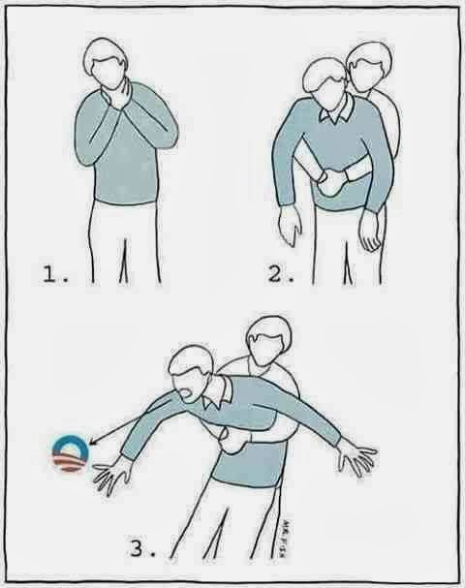

Slide 62
OVERLAYING
TRAUMATIC ASPHYXIA
Earthquake, stampede, mine/building collapse, landslide, crush injury to chest, rib fractures
‘Stomping’
‘Burking’ – homicidal smothering + traumatic asphyxia
POSTURAL/POSITIONAL ASPHYXIA
intoxicated person, jack knife position

Slide 63
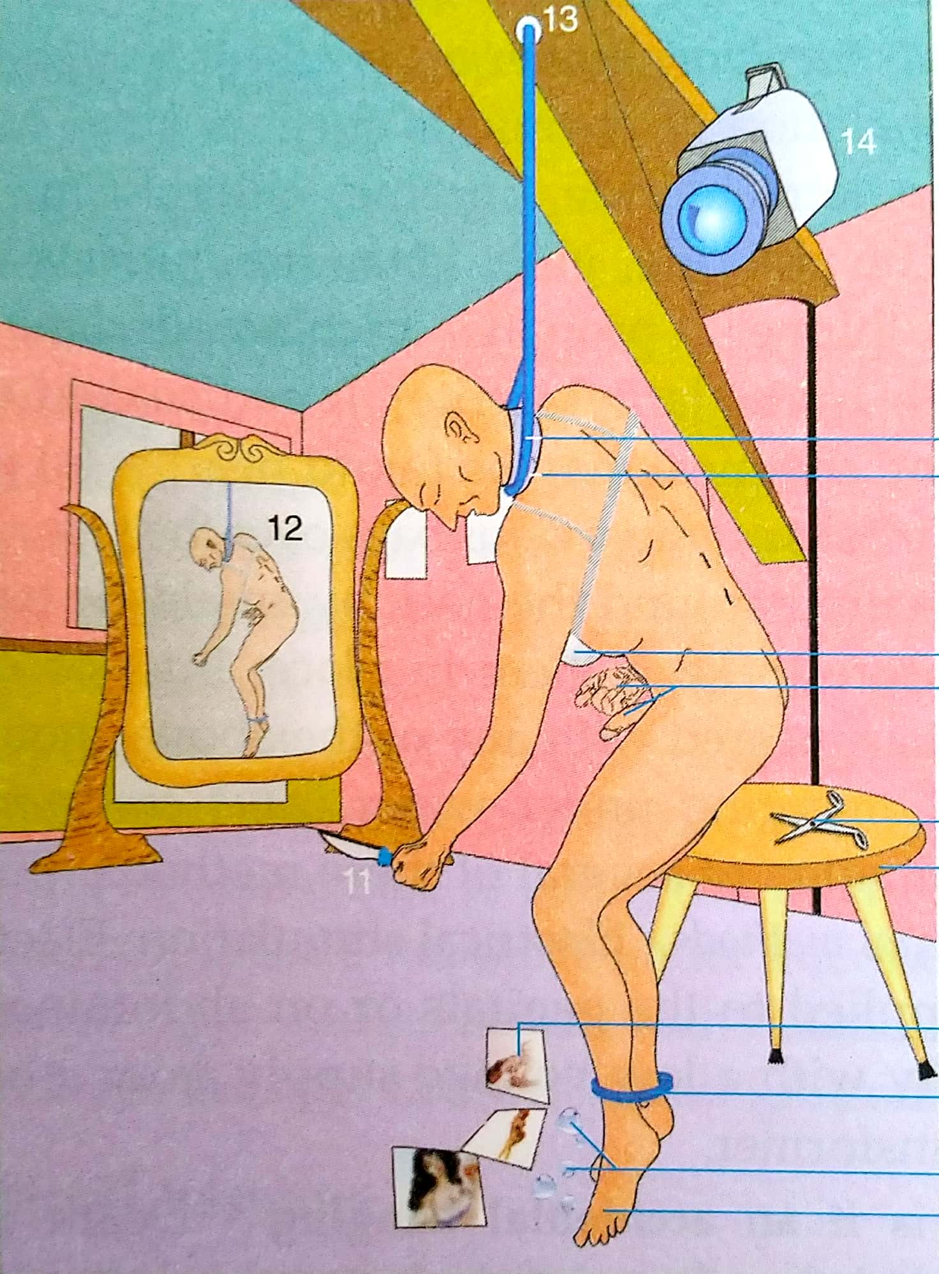
Sexual Asphyxia
‘Autoerotic asphyxia’, ‘Asphyxiophilia’
Partial asphyxia caused by controlled pressure on carotid vessels or airways -> transient cerebral ischemia + asphyxia -> hallucinations & erotic pleasure in some persons

Slide 64
Usually associated with sexual paraphilia, personality disorders – transvestism, masochism, sadism, BDSM, masturbation
Control mechanism
If gone out of control -> coma & death (accidental strangulation/hanging/suffocation)
Crime scene – home, bedroom, erotic objects, ligature with padding, drugs-alcohol, no suicidal or homicidal circumstances or intents
‘Choking game’, ‘Bagging’

Slide 65
SELF STUDY
Hanging V/s Strangulation
MCQs

Slide 66
MCQ 1
Which of following terms depicts ‘strangulation by compressing neck of the victim with bend of elbow or knee’?
Bansdola
Mugging
Throttling
Garrotting

Slide 67
MCQ 2
Which of following options correctly mentions ‘Garroting’ ?
Throwing a ligature over the neck from behind and quickly tightening it
Compression of the neck by forearm band
Pressing hardly over mouth & nose of the victim by hand
Compressing the neck between one bamboo stick across the front and another behind

Slide 68
MCQ 3
‘Extensive bruising of neck muscles or subcutaneous tissues in neck’ is characteristic of which of following death case?
Gagging
Hanging
Burking
Strangulation

Slide 69
MCQ 4
‘Café coronary’ commonly occurs in which of following conditions?
Sleeping prone with heavy blankets
Eating food while intoxicated
Sneezing while micturating
During buccal coitus(oral sex)

Slide 70
MCQ 5
Hyoid bone fracture is more commonly seen in which of following deaths?
Throttling
Hanging
Choking
Strangulation

Slide 71
Sharma BR, Harish D, Sharma A, Sharma S, Singh H. Injuries to neck structures in deaths due to constriction of neck, with a special reference to hanging. Journal of forensic and legal medicine. 2008 Jul 1;15(5):298-305.
Sharma BR, Harish D, Sharma A, Sharma S, Singh H | Injuries to neck structures in deaths due to constriction of neck, with a special reference to hanging | This prospective study aimed at examining various injuries to the neck structures in deaths due to constriction of neck. Neck dissection technique, as advocated by Prinsloo and Gordon was undertaken. | 1746 medico-legal autopsies, conducted during the study period, 5% were due asphyxia, of which 82% were of constriction of neck. Injury to the sternocleido-mastoid muscle (54%) was the commonest injury to the neck structures. The hyoid bone was fractured in 21% cases, while the thyroid cartilage was fractured in 17% cases. Most cases of the fracture of the laryngo-hyoid complex were in the 41–60 year age group.

Slide 72
In this session
No. | COMPETENCY | Domain (K/S/A/C) | Level (K/KH/S/SH/P) | Core (Y/N)
FM2.23 | Describe and discuss types, patho-physiology, clinical features, postmortem findings and medico-legal aspects of drowning, diatom test and gettler test. | K | KH | Y

Slide 73
SPECIFIC LEARNING OBJECTIVES At the end of this session, the 2nd MBBS student.... | Integration
1. should able to define Drowning and describe different types of drowning. 2. should able to describe pathophysiology, clinical findings, causes of death, post-mortem findings and medico-legal aspects of death due to drowning in sea water and fresh water. 3. should able to describe and demonstrate examination, preservation and dispatch of autopsy samples in death due to drowning. 4. Should be able to describe Diatom test and Gattler test and its medicolegal applications. | N

Slide 74
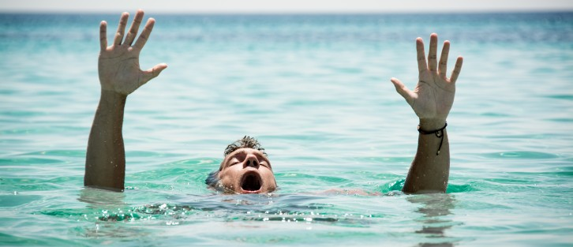
DROWNING
Asphyxia due to submersion into water or other fluid bodies and aspiration of it in respiratory tracks.
Sea – salt water
River, ponds, lacks, swimming pools, bath tubs, water tanks – fresh water
Specific gravity – water – 1.0
Adult body – 1.08, Fat-0.92, Bone-2.01, Muscle-1.08, Soft organs-1.05

Slide 75
Stages of Drowning (Animal study in dogs)
Stage of Surprise – 5-10 sec
Stage or 1st respiratory arrest – 1 min
violent agitation, fight to reach surface, voluntary respiration stop
Stage of deep respiration – 1 min
some deep inspirations, frothing, eyes-mouth open
Stage of 2nd respiratory arrest – 1 min
no thoracic movements, corneal reflexes lost, hypoxic convulsion
Stage of terminal gasps – 30 sec
few gasping efforts, lips-jaw muscle fibrilations

Slide 76
Chronology deaths due to drowning
Person falls deep in water body
Reflex stimulation from skin, vagus stimulation – neurological shock/vagal inhibition -> cardiac arrest
Hold breath -> PaCO2 rises -> stimulation of respiratory centres -> reflex respi stimulation -> inhale water in airways & swallow in esophagus
Cough reflex, Vomiting
Struggle for life, Violent respiratory efforts-> water churning with alveolar air & mucus -> frothing
Alveolar filling - > cerebral hypoxia, convulsions
Unconsciousness, coma, death
Fatal Period - Freezing cold water – 5 to 10 mins
Fresh water – body sinks
sea water – body floats under surface
Decomposition – Casper’s Dictum, Body floating

Slide 77
TYPES
Wet drowning/ Primary drowning/ Typical drowning – water is inhaled into lungs, death – cardiac arrest/VF + asphyxia
Dry drowning – sudden laryngeal spasm & edema, water not enters lungs, Death – asphyxia/vagal inhibition
Secondary drowning/ Near drowning/ Post-immersion Syndrome – victim resuccitated & after 24hrs hypoxemia, pul. Edema, electrolyte imbalance, brain damage, metabolic acidosis, sepsis, arrythmia..
Immersion syndrome/ Hydrocution/ Submersion inhibition – cardiac arrest due to sudden vagal inhibition

Slide 78
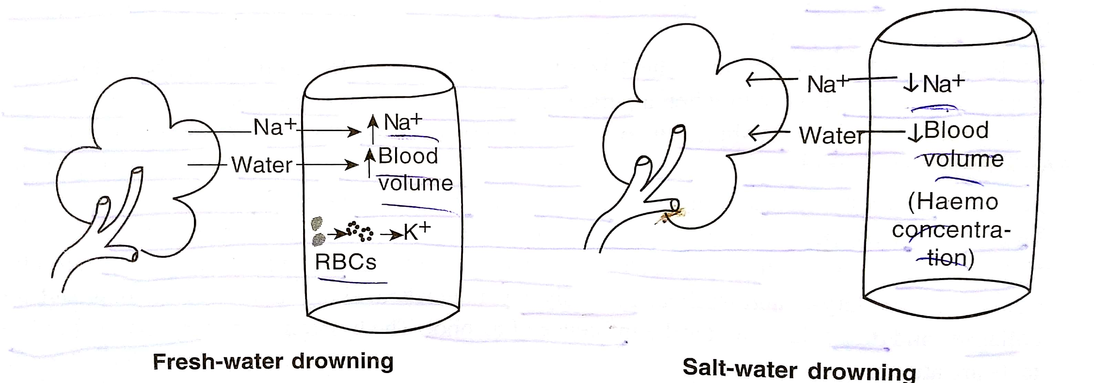
Pathophysiology in wet drowning –

Slide 79
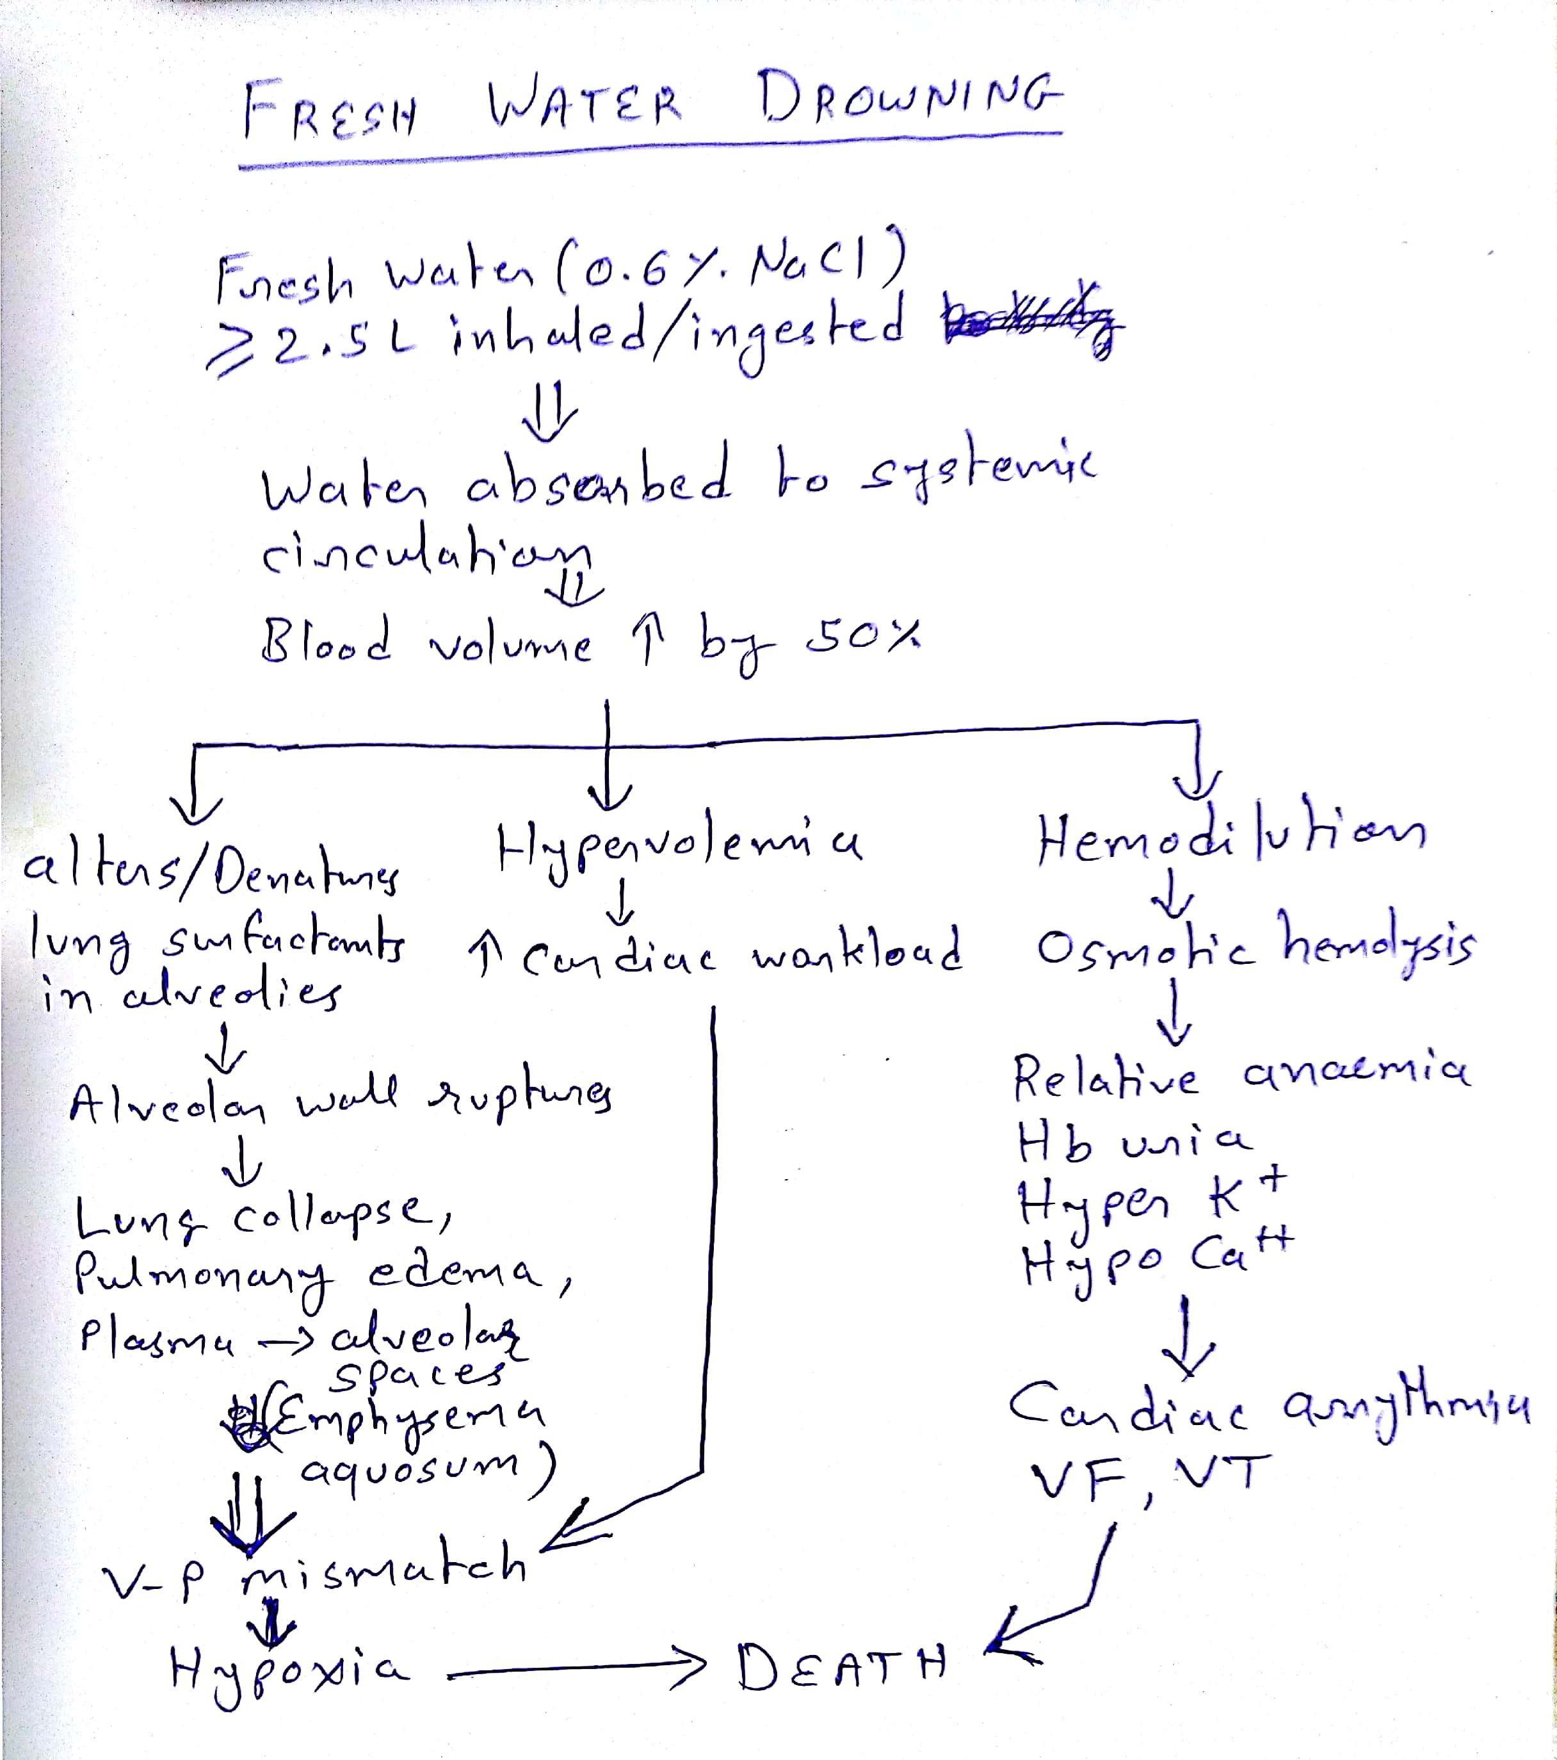

Slide 80
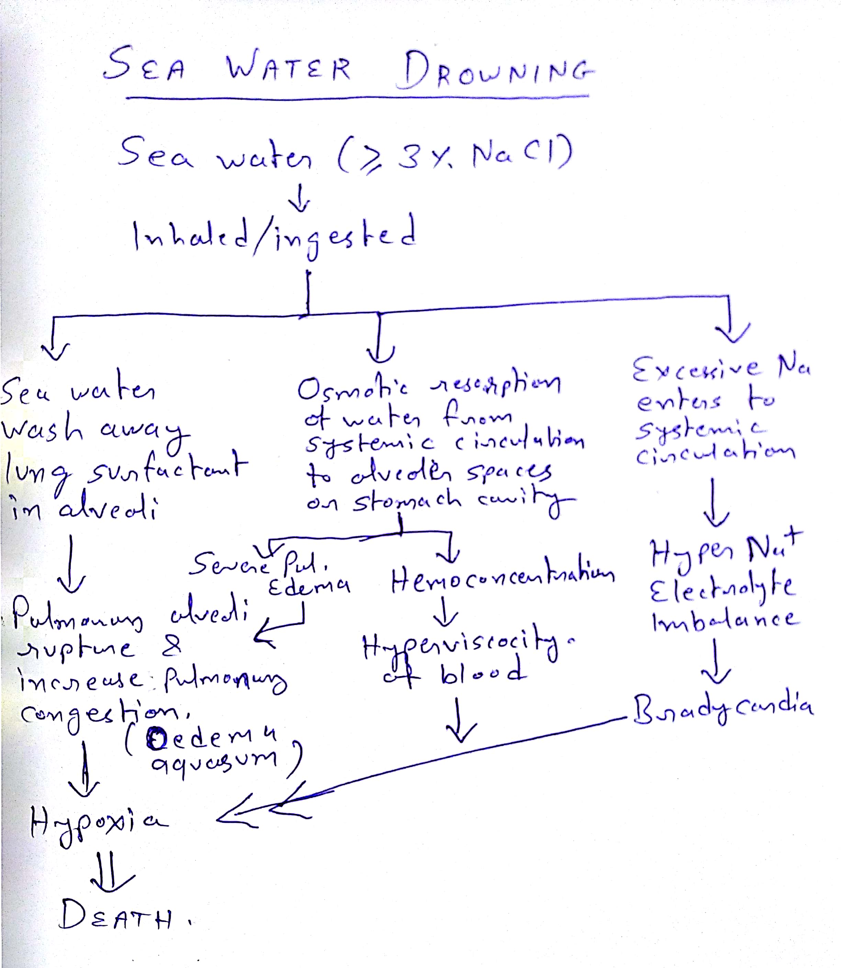

Slide 81
Treatment
ABCD
Hemlich Menuver
Artificial respiration [+ CPR]
Electrolyte fluids
Sea water drowning – hypotonic saline
Warm blankets, CNS stimulant drugs
Careful observation for secondary complications (pulmonary oedema, pneumonia, laryngeal spasm, cardiac arrhythmia, cerebral ischemia)

Slide 82
Postmortem Findings - External
Circumstances
Cloths, Hairs – wet, mud, sand, weeds, algae
Skin – Soden, Cutis ancerina, Washerman’s hands like skin over palms & soles
Rigor mortis - Cadaveric clench
PM lividity – upper part of body
Froth over mouth, nose, face – fine, copious, lathery, comes out more on pressing chest
Signs of asphyxia – cyanosis, congestion, petechiae
Artefacts – aquatic animal bites(postmortem)
Decomposition – Casper’s dictum

Slide 83
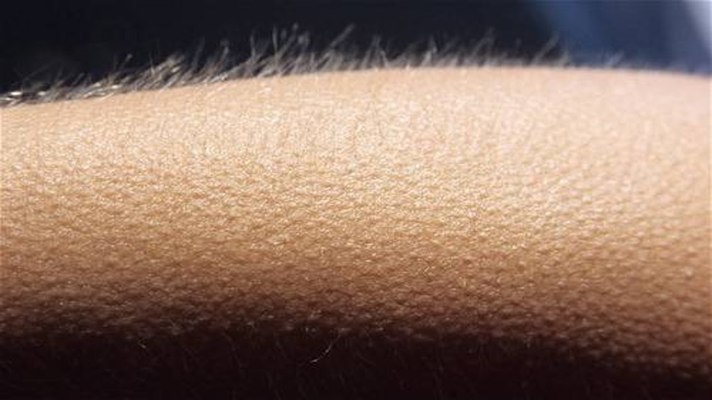
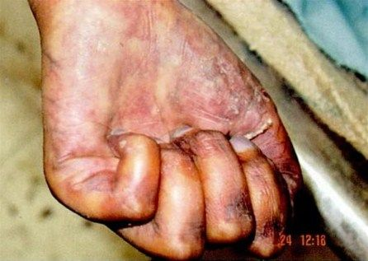
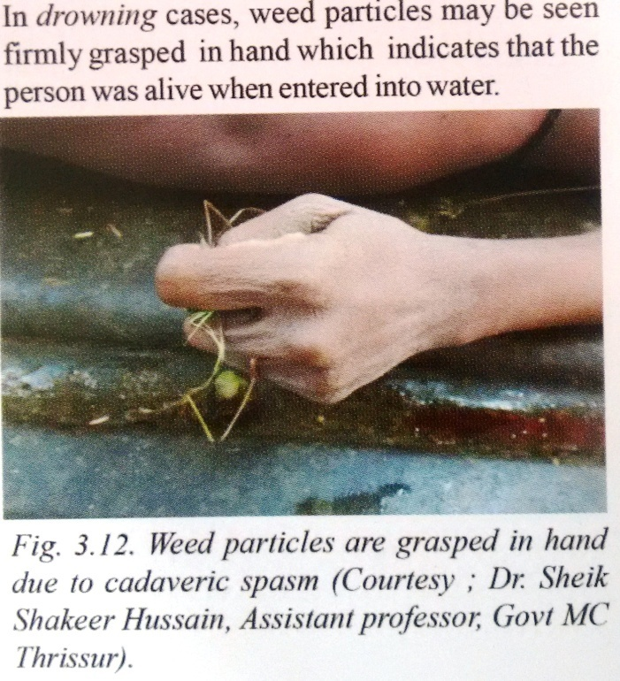
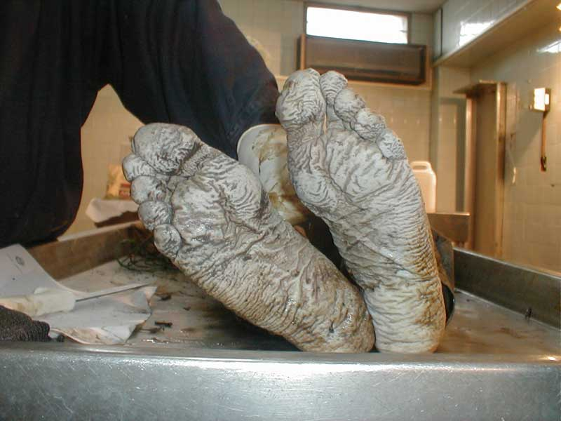

Slide 84
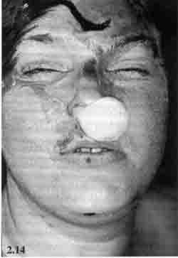
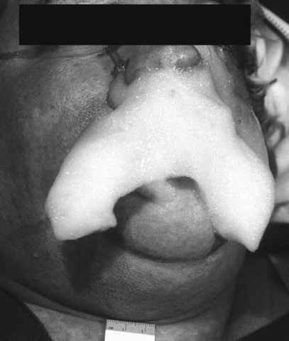
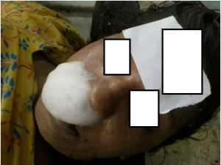
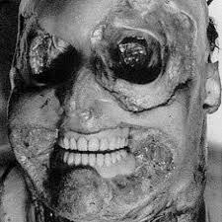

Slide 85
Postmortem Findings - Internal
Airway - Trachea & Bronchi – froth, water
Lungs – heavy, edematous, patacheae, Pultauf’s hemorrhages
Heart - Gattler test
Stomach – water
Asphyxial signs – congestion, petechiae in internal organs
Samples
  Vicera for chemical analysis (5 bottles)
  Long bone/ sternum for Diatom test
  Water sample(2L) from crime scene for diatom test

Slide 86
GETTLER TEST:
Chloride content in blood of heart chambers – normal 600mg%, equal in both side chambers
Fresh water drowning -
blood gets diluted up to 72% in 3 mins -> blood in left side chambers less chloride upto 50%
Sea water drowning –
water loss upto 42% -> hemoconcentration -> blood in left side chambers chloride increse upto 30-40%
Difference >25% significant
Other tests : Plasma specific gravity test, Mg test, Serum Strontium test

Slide 87
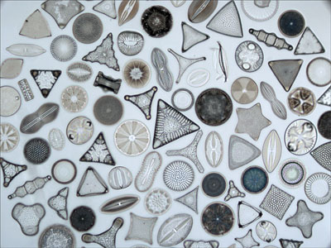
Diatom Test
Microscopic unicellular or colonial algae with complex structured cell walls made of silica.
Cell wall contains chlorophill & diatomin pigments.
Resist heat and acid

Slide 88
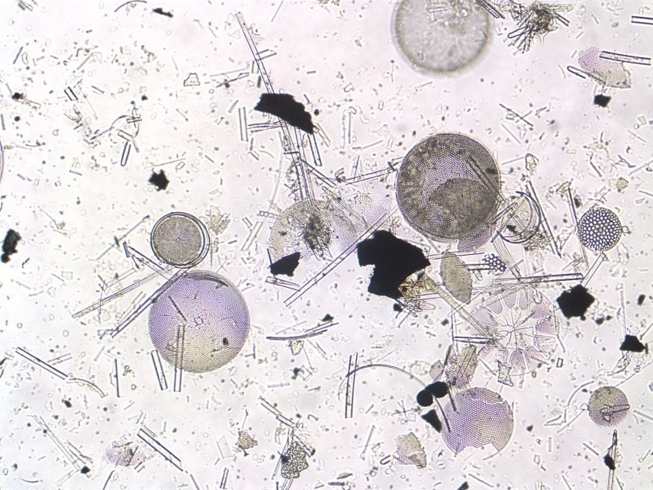
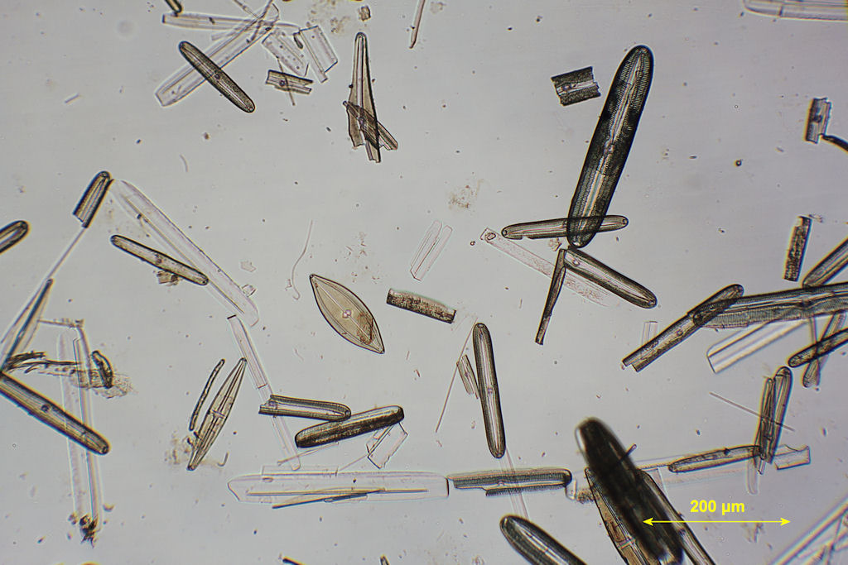
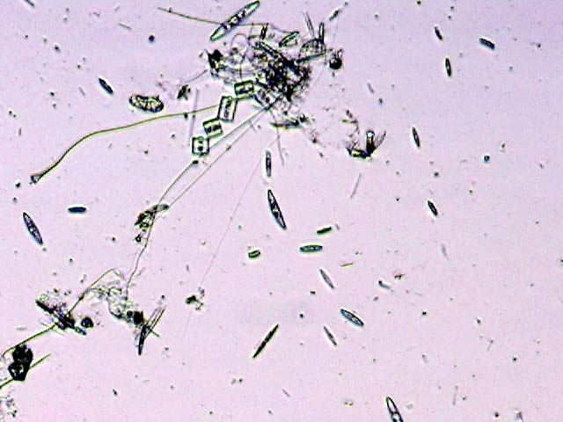
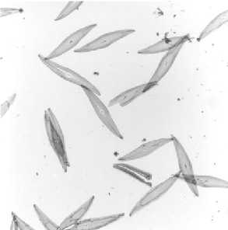

Slide 89
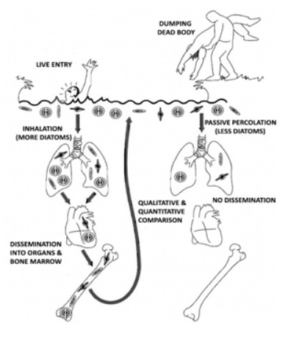
Size – 2 micron to 1mm
< 60 micron – enters pulmonary circulations -> heart -> organs, Bone marrow, muscles

Slide 90
Technique:
  5 gm bone marrow, Liver, Lung, Kidney, Brain in separate test tubes
  Add concentrated HNO3 & wait 24-48hrs – ‘Acid digestion’
  Centrifuge -> remove supernant water -> add distilled water -> centrifuge [repeat 2-3 times]
  Sediment material under phase contrast/dark illumination microscopy
  Same species diatoms in source water sample – positive test
Medicolegal importance
1) Positive indication of death due to drowning
2) Antemortem Or Postmortem drowning
3) Place of death
4) Time of death

Slide 91
Medicolegal significance:
Suicidal
Homicidal
Accidental
Duration of submersion – body floats after death – 12-18hrs in summer, 18-36hrs in winter
Casper’s Dictum – Decomposition rate of Body in air = 2 x in water = 8 x burried in earth
Antemortem drowning V/s Postmortem

Slide 92
SELF STUDY
Antemortem Drowning V/s Postmortem Drowning
MCQs

Slide 93
MCQ 1
Which of following sign in drowning cases positively indicate that the death occured due to antemortem drowning?
Cutis anserina
Water in trachea & lungs
Weeds grasped in the hands
Washer women’s skin phenomena

Slide 94
MCQ 2
In case of death due to drowning, flotation of the body occurs in how much time during summer in India?
6-8 hours
12-18 hours
24-36 hours
3-5 days

Slide 95
MCQ 3
What is the specific gravity of an average adult human body?
0.92
1.00
1.08
2.01

Slide 96
MCQ 4
‘Acid digestion technique’ is used in which of following forensic analysis tests?
Detection of corrosive poisons
Detection of diatoms
Detection of blood sodium level
Detection of latent fingerprints

Slide 97
MCQ 5
Gettler’s test may show positive results in which of following death cases?
Hanging
Poisoning
Strangulation
Drowning

Slide 98
Barranco R, Castiglioni C, Ventura F, Fracasso T. A comparative digital morphometric study of lung tissue in saltwater and freshwater drowning. Forensic science international. 2019 Mar 12.
Barranco R, Castiglioni C, Ventura F, Fracasso T | A comparative digital morphometric study of lung tissue in saltwater and freshwater drowning | The study investigates whether Acute Pulmonary Edema is present in both fresh and saltwater drowning. •Alveolar spaces was calculated by means of image analysis software. | •Mean alveolar area in FWD was significantly higher than in SWD and controls. •No statistical differences were observed between SWD and controls. •The results suggest that APE is not a typical sign of death by saltwater drowning.

