Slide 1
MECHANICAL ASPHYXIA

Slide 2
In this session
No. | COMPETENCY | Domain (K/S/A/C) | Level (K/KH/S/SH/P) | Core (Y/N)
FM2.23 | Describe and discuss types, patho-physiology, clinical features, postmortem findings and medico-legal aspects of drowning, diatom test and gettler test. | K | KH | Y

Slide 3
SPECIFIC LEARNING OBJECTIVES At the end of this session, the 2nd MBBS student.... | Integration
1. should able to define Drowning and describe different types of drowning. 2. should able to describe pathophysiology, clinical findings, causes of death, post-mortem findings and medico-legal aspects of death due to drowning in sea water and fresh water. 3. should able to describe and demonstrate examination, preservation and dispatch of autopsy samples in death due to drowning. 4. Should be able to describe Diatom test and Gattler test and its medicolegal applications. | N

Slide 4
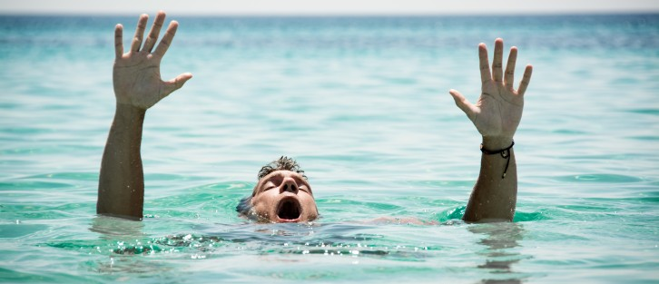
DROWNING
Asphyxia due to submersion into water or other fluid bodies and aspiration of it in respiratory tracks.
Sea – salt water
River, ponds, lacks, swimming pools, bath tubs, water tanks – fresh water
Specific gravity – water – 1.0
Adult body – 1.08, Fat-0.92, Bone-2.01, Muscle-1.08, Soft organs-1.05

Slide 5
Stages of Drowning (Animal study in dogs)
Stage of Surprise – 5-10 sec
Stage or 1st respiratory arrest – 1 min
violent agitation, fight to reach surface, voluntary respiration stop
Stage of deep respiration – 1 min
some deep inspirations, frothing, eyes-mouth open
Stage of 2nd respiratory arrest – 1 min
no thoracic movements, corneal reflexes lost, hypoxic convulsion
Stage of terminal gasps – 30 sec
few gasping efforts, lips-jaw muscle fibrilations

Slide 6
Chronology deaths due to drowning
Person falls deep in water body
Reflex stimulation from skin, vagus stimulation – neurological shock/vagal inhibition -> cardiac arrest
Hold breath -> PaCO2 rises -> stimulation of respiratory centres -> reflex respi stimulation -> inhale water in airways & swallow in esophagus
Cough reflex, Vomiting
Struggle for life, Violent respiratory efforts-> water churning with alveolar air & mucus -> frothing
Alveolar filling - > cerebral hypoxia, convulsions
Unconsciousness, coma, death
Fatal Period - Freezing cold water – 5 to 10 mins
Fresh water – body sinks
sea water – body floats under surface
Decomposition – Casper’s Dictum, Body floating

Slide 7
TYPES
Wet drowning/ Primary drowning/ Typical drowning – water is inhaled into lungs, death – cardiac arrest/VF + asphyxia
Dry drowning – sudden laryngeal spasm & edema, water not enters lungs, Death – asphyxia/vagal inhibition
Secondary drowning/ Near drowning/ Post-immersion Syndrome – victim resuccitated & after 24hrs hypoxemia, pul. Edema, electrolyte imbalance, brain damage, metabolic acidosis, sepsis, arrythmia..
Immersion syndrome/ Hydrocution/ Submersion inhibition – cardiac arrest due to sudden vagal inhibition

Slide 8
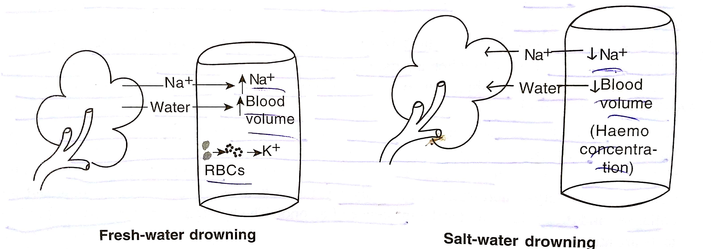
Pathophysiology in wet drowning –

Slide 9
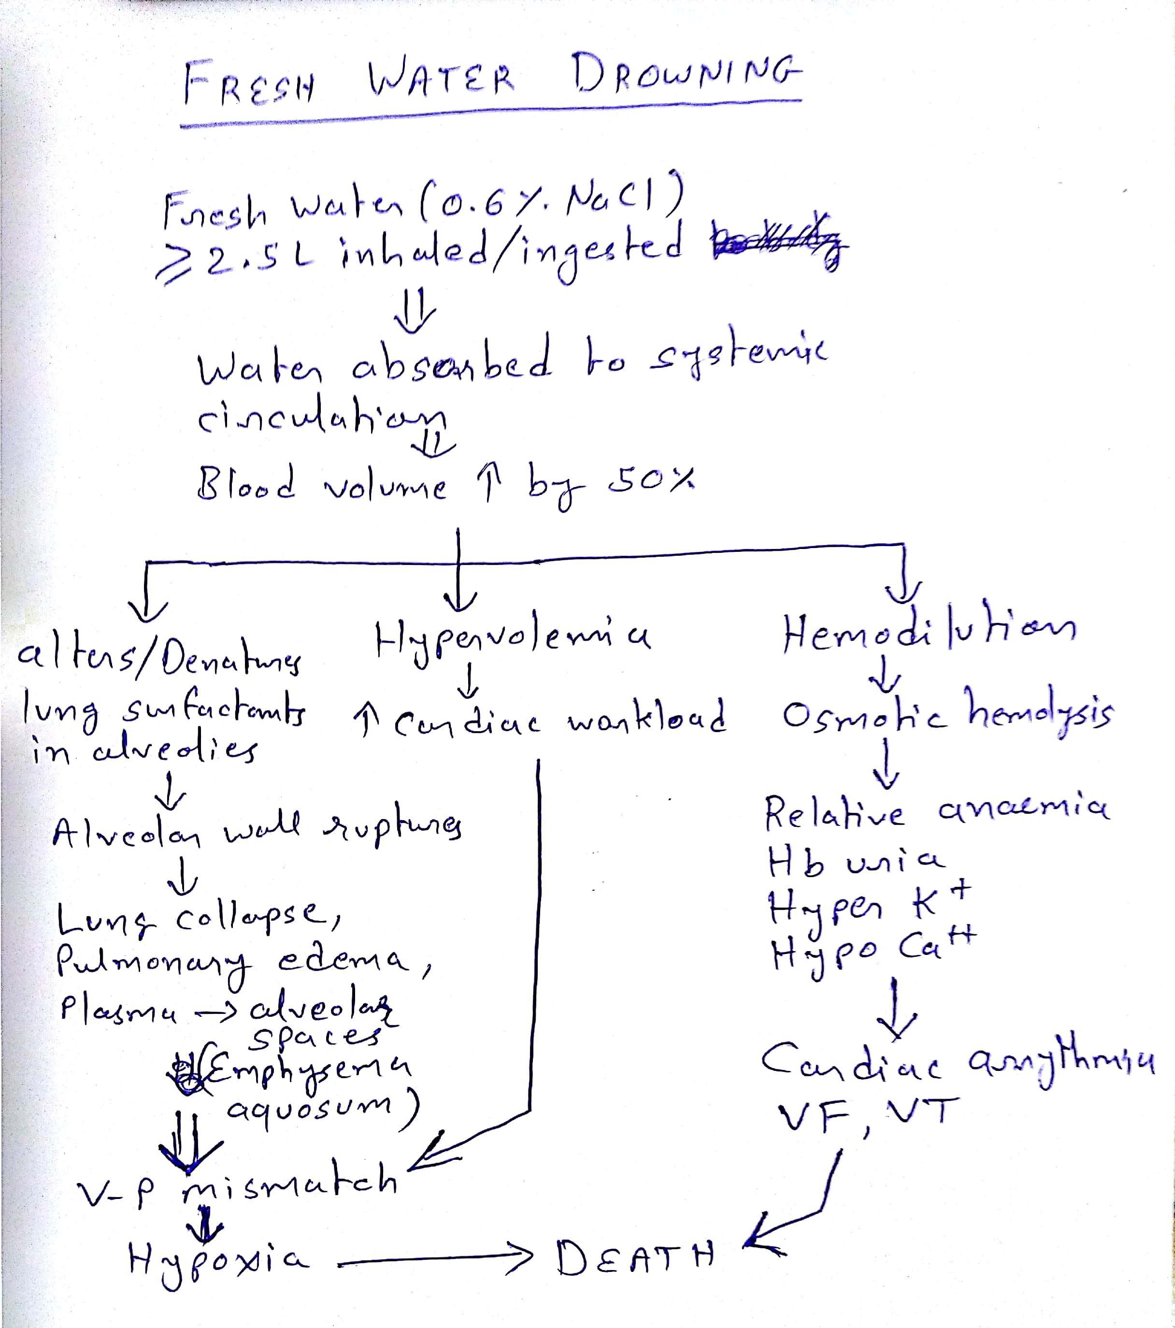

Slide 10
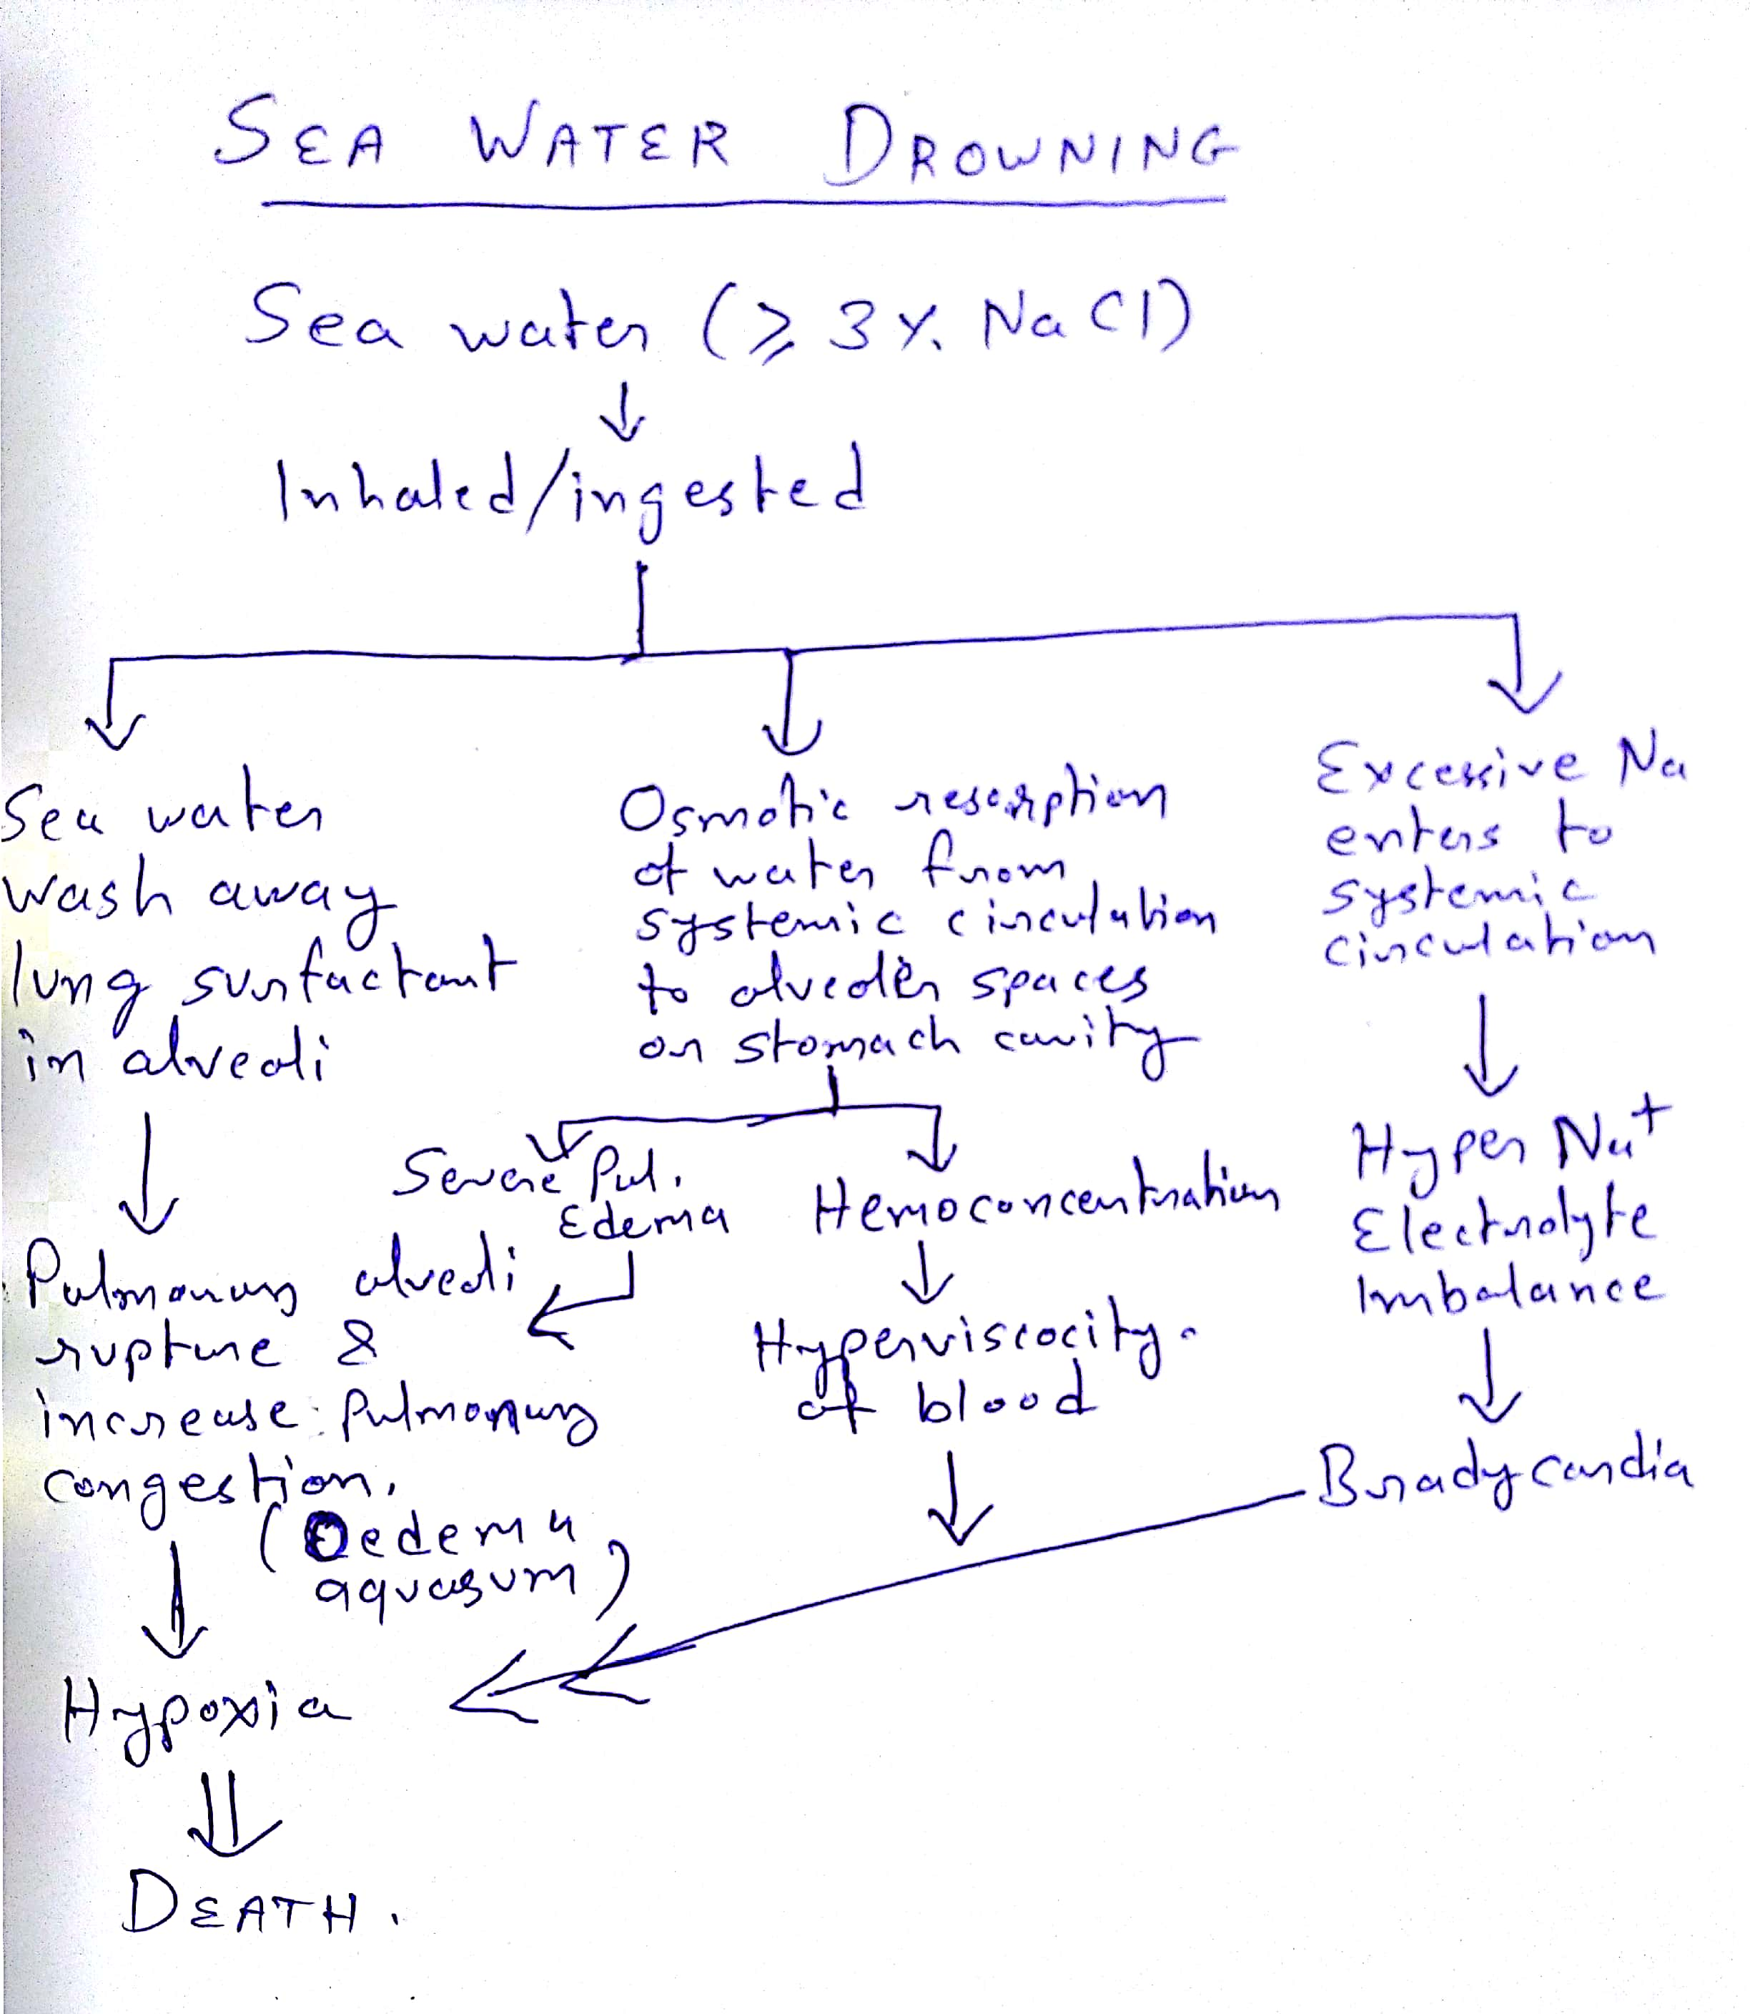

Slide 11
Treatment
ABCD
Hemlich Menuver
Artificial respiration [+ CPR]
Electrolyte fluids
Sea water drowning – hypotonic saline
Warm blankets, CNS stimulant drugs
Careful observation for secondary complications (pulmonary oedema, pneumonia, laryngeal spasm, cardiac arrhythmia, cerebral ischemia)

Slide 12
Postmortem Findings - External
Circumstances
Cloths, Hairs – wet, mud, sand, weeds, algae
Skin – Soden, Cutis ancerina, Washerman’s hands like skin over palms & soles
Rigor mortis - Cadaveric clench
PM lividity – upper part of body
Froth over mouth, nose, face – fine, copious, lathery, comes out more on pressing chest
Signs of asphyxia – cyanosis, congestion, petechiae
Artefacts – aquatic animal bites(postmortem)
Decomposition – Casper’s dictum

Slide 13
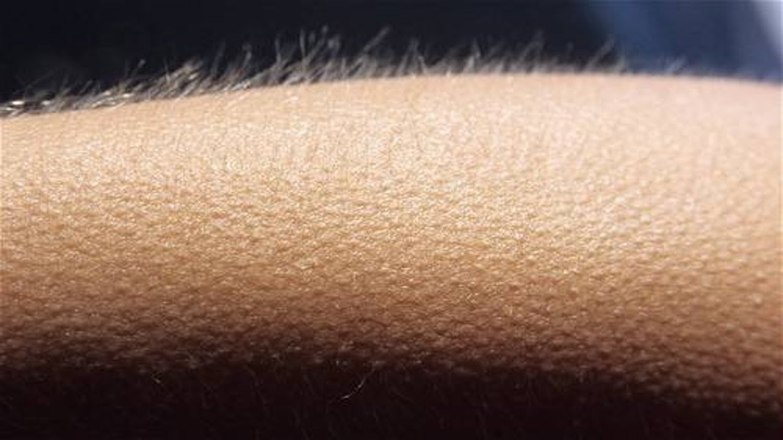
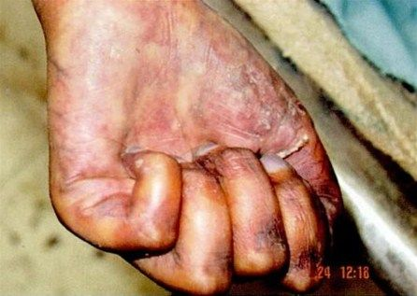
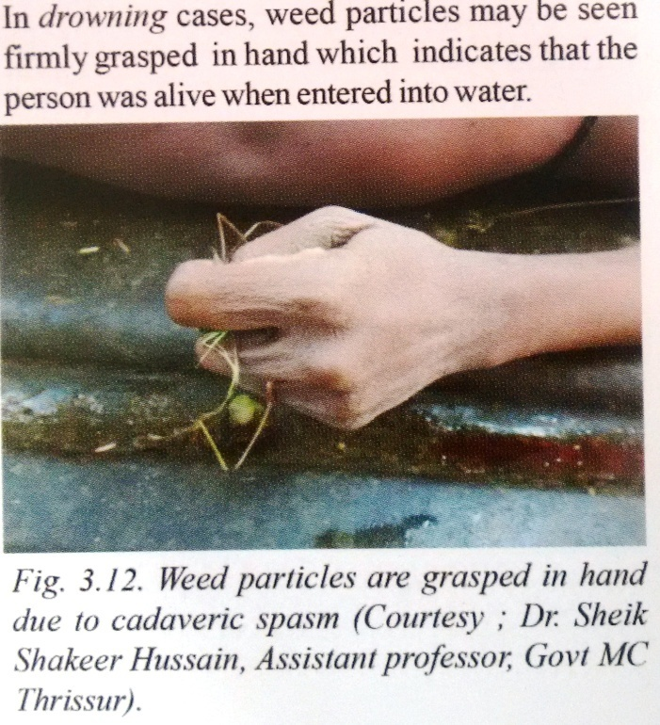
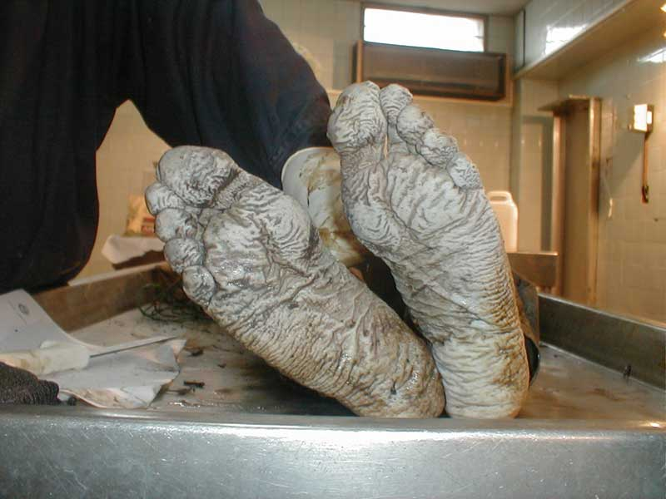

Slide 14
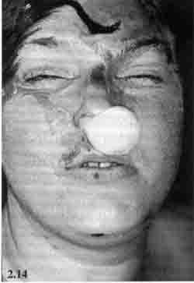
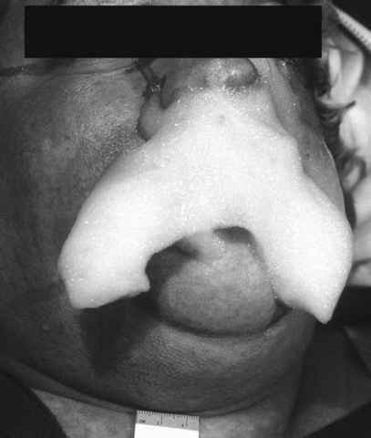
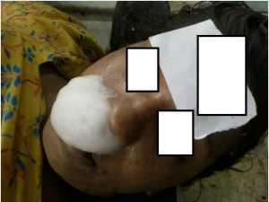
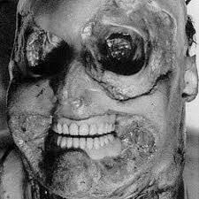

Slide 15
Postmortem Findings - Internal
Airway - Trachea & Bronchi – froth, water
Lungs – heavy, edematous, patacheae, Pultauf’s hemorrhages
Heart - Gattler test
Stomach – water
Asphyxial signs – congestion, petechiae in internal organs
Samples
  Vicera for chemical analysis (5 bottles)
  Long bone/ sternum for Diatom test
  Water sample(2L) from crime scene for diatom test

Slide 16
GETTLER TEST:
Chloride content in blood of heart chambers – normal 600mg%, equal in both side chambers
Fresh water drowning -
blood gets diluted up to 72% in 3 mins -> blood in left side chambers less chloride upto 50%
Sea water drowning –
water loss upto 42% -> hemoconcentration -> blood in left side chambers chloride increse upto 30-40%
Difference >25% significant
Other tests : Plasma specific gravity test, Mg test, Serum Strontium test

Slide 17
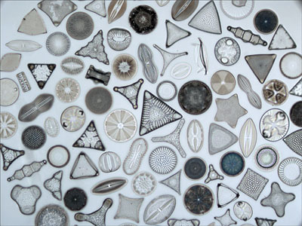
Diatom Test
Microscopic unicellular or colonial algae with complex structured cell walls made of silica.
Cell wall contains chlorophill & diatomin pigments.
Resist heat and acid

Slide 18
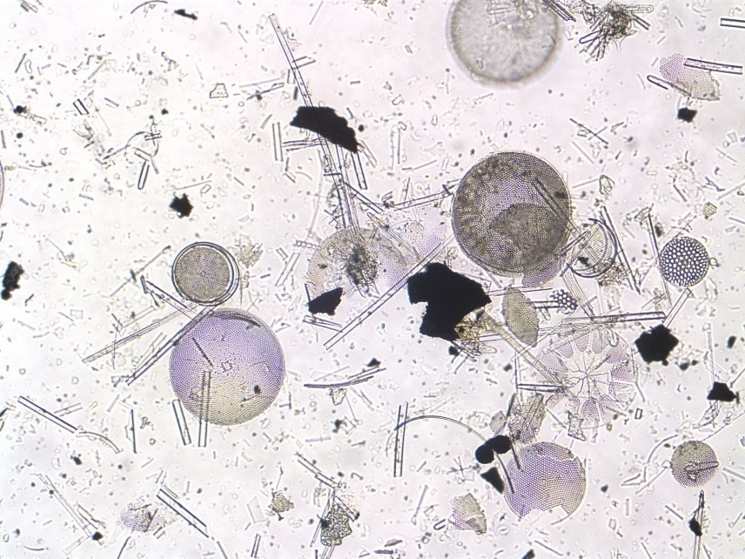
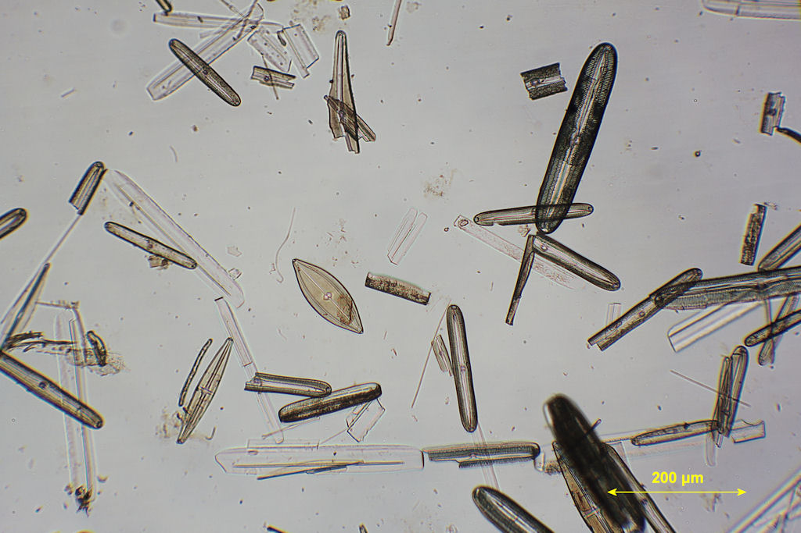
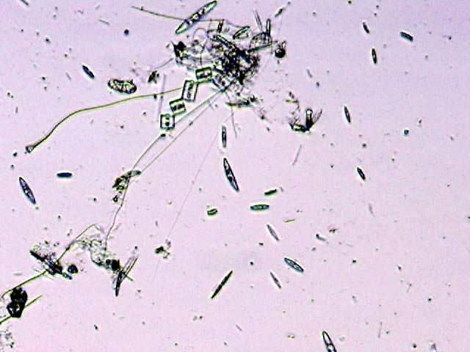
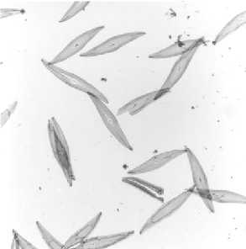

Slide 19
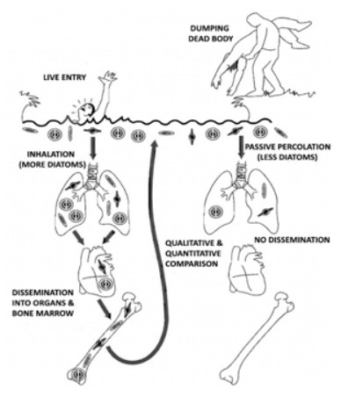
Size – 2 micron to 1mm
< 60 micron – enters pulmonary circulations -> heart -> organs, Bone marrow, muscles

Slide 20
Technique:
  5 gm bone marrow, Liver, Lung, Kidney, Brain in separate test tubes
  Add concentrated HNO3 & wait 24-48hrs – ‘Acid digestion’
  Centrifuge -> remove supernant water -> add distilled water -> centrifuge [repeat 2-3 times]
  Sediment material under phase contrast/dark illumination microscopy
  Same species diatoms in source water sample – positive test
Medicolegal importance
1) Positive indication of death due to drowning
2) Antemortem Or Postmortem drowning
3) Place of death
4) Time of death

Slide 21
Medicolegal significance:
Suicidal
Homicidal
Accidental
Duration of submersion – body floats after death – 12-18hrs in summer, 18-36hrs in winter
Casper’s Dictum – Decomposition rate of Body in air = 2 x in water = 8 x burried in earth
Antemortem drowning V/s Postmortem

Slide 22
SELF STUDY
Antemortem Drowning V/s Postmortem Drowning
MCQs

Slide 23
MCQ 1
Which of following sign in drowning cases positively indicate that the death occured due to antemortem drowning?
Cutis anserina
Water in trachea & lungs
Weeds grasped in the hands
Washer women’s skin phenomena

Slide 24
MCQ 2
In case of death due to drowning, flotation of the body occurs in how much time during summer in India?
6-8 hours
12-18 hours
24-36 hours
3-5 days

Slide 25
MCQ 3
What is the specific gravity of an average adult human body?
0.92
1.00
1.08
2.01

Slide 26
MCQ 4
‘Acid digestion technique’ is used in which of following forensic analysis test?
Detection of corrosive poisons
Detection of diatoms
Detection of blood sodium level
Detection of latent fingerprints

Slide 27
MCQ 5
Gettler’s test may show positive results in which of following death cases?
Hanging
Poisoning
Strangulation
Drowning

Slide 28
Barranco R, Castiglioni C, Ventura F, Fracasso T. A comparative digital morphometric study of lung tissue in saltwater and freshwater drowning. Forensic science international. 2019 Mar 12.
Barranco R, Castiglioni C, Ventura F, Fracasso T | A comparative digital morphometric study of lung tissue in saltwater and freshwater drowning | The study investigates whether Acute Pulmonary Edema is present in both fresh and saltwater drowning. •Alveolar spaces was calculated by means of image analysis software. | •Mean alveolar area in FWD was significantly higher than in SWD and controls. •No statistical differences were observed between SWD and controls. •The results suggest that APE is not a typical sign of death by saltwater drowning.

