Slide 1
NATIONAL VECTOR BORNE DISEASE CONTROL PROGRAM
Dr. Grishma Chauhan Professor,
Department of Community Medicine SBKS MI RC, SVDU

Slide 2


Slide 3
INTRODUCTION
Vector borne diseases:
➢Pose an immense public health concern
➢Major impediments in the path of socio- economic development

Slide 4
Historical perspective
National Malaria Eradication Programme (NMEP) which was being implemented in the country since 1958, was reviewed in 1977 and revised guidelines for Modified Plan of Operation (MPO) were issused to all States & UTs

Slide 5
Historical perspective
Due to various outbreaks in the country malaria situation was reviewed in 1994 by an Expert Committee.
In pursuance of the Expert Committee's recommendations, the Directorate of NMEP brought out operational manual for Malaria Action Programme (MAP) in 1995

Slide 6
Historical perspective
The Directorate of NMEP was renamed as Directorate of National Anti Malaria Programme (NAMP) in March, 1999.
Directorate of NAMP was dealing with three centrally sponsored schemes namely Malaria, Filaria and Kala-azar control and in addition, was looking after the prevention and control of Dengue and Japanese Encephalitis.

Slide 7
Historical perspective
With a view to converge Dengue/Dengue Haemorrhagic feverand Japanese Encephalitis with the three on-going centrally sponsored schemes [National Anti-Malaria Programme (NAMP), National Filaria Control Programme (NFCP) and Kala-azar Control Programme], the integrated scheme was renamed as National Vector Borne Disease Control Programme (NVBDCP) from 2nd December, 2003.

Slide 8
Historical perspective
In 2006, Chikungunya re-emerged in the country and this was also brought within the purview of Directorate of NVBDCP.

Slide 9
NVBDCP – National Vector Borne Disease Control Program
Earlier the Vector Borne Diseases were managed under separate National Health Programs
NVBDCP is an umbrella program for prevention and control of 6 vector borne diseases namely:
➢ Malaria
➢ Dengue
➢ Chikungunya
➢ Japanese Encephalitis
➢ Kala-Azar
➢ Filaria (Lymphatic Filariasis)

Slide 10
NVBDCP
It is an integral component of NHM and is implemented under the overall umbrella of NHM
The Programme is monitored at the National level through the mechanisms established under NHM.

Slide 11
NVBDCP
The Directorate is responsible for framing technical guidelines & policies as to guide the states for implementation of Program strategies.
Responsible for budgeting and planning the logistics pertaining to central sector.
Monitoring of implementation through regular reports and returns of MIS is done.

Slide 12
NVBDCP
The Directorate carries out evaluation of Program implementation from time to time.
The resource gap is also assessed as to provide an equitable support based on the magnitude of the problem.
Under the Union Ministry of H&FW, GoI, 17 ROH & FW are functioning.

Slide 13
NVBDCP
Every state has state vector borne diseases control component under the Directorate of Health Services
There is a system of coordination between the state and centre for effective implementation and monitoring of Program.

Slide 14
NVBDCP
At the district level, District Malaria Offices have been established under District Chief Medical and Health Offices by the states.
Key unit for planning and monitoring of Program under a technical officer.
At present, 565 District Malaria Units are functioning.

Slide 15
Program objectives and strategies
NVBDCP strategies comprise
➢Early diagnosis, prompt and complete treatment
➢Integrated vector management including promotion of personal protective measures and biological measures
➢BCC, capacity building through integrated training at all tiers of health care delivery system
➢Monitoring and evaluation

Slide 16
Program objectives and strategies
Partnerships
➢Other national health programs
➢Non-health sector departments
➢Civil society organizations (NGOs, CBOs, self- help groups, panchayati raj institutions)
➢Corporate sectors
➢Medical academia and professional bodies

Slide 17
Program objectives and strategies
LLINs
➢Having efficacy of 3-5 years have been introduced

Slide 18
Program objectives and strategies
Improve efficiency and quality of services at primary, secondary and tertiary levels
Primary level
➢ASHA under NHM, Anganwadi workers of ICDS and Community Volunteers of NGOs would be trained to serve Fever Treatment Depots (FTDs)
➢PHCs, CHCs: equipped to manage PF malaria
➢Lab surveillance enhanced

Slide 19
Program objectives and strategies
Improve efficiency and quality of services at primary, secondary and tertiary levels
Secondary level
➢Training of Medical Officers, Lab Technicians and Community Volunteers of public and private sector
➢District level hospitals: equipped with ventilators and lab services
➢Medical audit

Slide 20
Program objectives and strategies
Improve efficiency and quality of services at primary, secondary and tertiary levels
Tertiary level
➢Medical college hospital: manage all referrals
➢Undertake therapeutic efficacy studies of combi-pack and effectiveness of rapid diagnostic kits
➢Rapid diagnosis for management of severe malaria cases

Slide 21
Program objectives and strategies
Environmental Management
➢Proper drainage and sanitation

Slide 22
Program objectives and strategies
Government of India provides technical support as well as logistics
State governments ensure program implementation
The centre and the states monitor the program closely and high-risk areas are identified for focused attention

Slide 23
Malaria – problematic states
Chattisgarh, Jharkhand, Maharashtra, West Bengal and Orissa – have registered maximum malaria cases in India (since 2007)
Out of them, Orissa and Maharashtra have contributed to most of the deaths due to malaria
Other high malaria burden states – MP, UP, Gujarat, Rajasthan, Karnataka

Slide 24
MALARIA
The program aims to maintain Annual Blood Examination Rate (ABER) of > 10% by active and passive surveillance and bring down Annual Parasite Incidence (API) to 1.3 or less by 2012
25% reduction in morbidity and mortality by 2010 and 50% by 2012 (baseline year 2006)

Slide 25
MALARIA
To strengthen malaria control, GoI is providing cash assistance to states for engaging multi- purpose workers (MPWs) on contractual basis in about 200 identified high endemic districts during the XI Five Year Plan

Slide 26
MALARIA
Provision has been made under external assistance for positioning Malaria Technical Supervisors (MTS) in high endemic areas to strengthen supportive supervision and micro- level monitoring
Each MTS to cover a population of 2.5 lacs in selected areas of the high endemic districts

Slide 27
MALARIA
Under NVBDCP, all fever cases are required to be immediately examined
Positive cases are provided prompt and complete treatment
Incentives have been considered for ASHAs for performing Rapid Diagnostic Tests (RDTs), preparation of slides and administering complete treatment

Slide 28
MALARIA
ASHA can also arrange to transport severe malaria cases to the referral centers with the expenditure borne out of funds from untied grants of NHM
Funds available with the Village Health and Sanitation Committee (VHSC) can also be utilized (this grant may also be utilized for source reduction of mosquito breeding sites)

Slide 29
GUIDELINES UNDER NVBDCP: MALARIA
Surveillance and case management
➢Conventional diagnostic method through microscopy remains the gold standard
➢However, rapid diagnostic kits (Pf kits) are provided for quick treatment in difficult and inaccessible areas with P. falciparum predominance

Slide 30
GUIDELINES UNDER NVBDCP: MALARIA
Integrated Vector Control Management
➢IRS: 2 rounds of DDT/synthetic pyrethroid or 3 rounds of malathion based on the insecticide resistance studies and epidemiological information.
➢IRS to be done in all areas with API>2 or above.
➢Priority of spray to be given to high risk areas with API or SPR 5 and above

Slide 31
GUIDELINES UNDER NVBDCP: MALARIA
Integrated Vector Control Management (contd.)
➢Use of ITMN
➢Reduction of breeding sites: use of larvivorous fish – Gambusia and Poecilia (Guppy)

Slide 32
GUIDELINES UNDER NVBDCP: MALARIA
Epidemic preparedness and Response (EPR)
➢Objectives are early identification and control of epidemic
➢Early warning signals which include epidemiological & entomological parameters , climatic factors (rain fall, temperature and humidity), operational factors (inadequacy and lack of trained manpower) are monitored

Slide 33
GUIDELINES UNDER NVBDCP: MALARIA
Epidemic preparedness and Response (EPR)
➢Proper linkage with Integrated Diseases Surveillance Programme (IDSP) at district level for obtaining early warning signals on regular basis
➢District should have rapid response team consisting of epidemiologist, entomologist, lab technician, Medical Officer, health workers, supervisors, community volunteers

Slide 34
GUIDELINES UNDER NVBDCP: MALARIA
Supportive interventions
➢Training and capacity building
✓Integrated training programme have been designed for different categories of health care functionaries

Slide 35
GUIDELINES UNDER NVBDCP: MALARIA
Supportive interventions
➢Behaviour Change Communication
✓Empowers people to take rational and informed decisions through appropriate knowledge
✓Inculcates necessary skills and optimism
✓Stimulates pertinent action
✓Reinforces the same through peers and influencers.

Slide 36
GUIDELINES UNDER NVBDCP: MALARIA
Supportive interventions
➢Inter-sectoral Collaboration
✓Anti Malaria Month is being observed with enhanced level of campaigning just before the peak transmission season

Slide 37
GUIDELINES UNDER NVBDCP: MALARIA
Innovations/modifications have been proposed to be intensified during XI Five Year Plan
➢For focused interventions, 206 districts have been identified as high malaria endemic
➢Of which, 100 districts – high API and Pf rate>30%
➢Further out of these 100, 61 districts identified as very high malaria endemic districts

Slide 38
GUIDELINES UNDER NVBDCP: MALARIA
Innovations/modifications have been proposed to be intensified during XI Five Year Plan
➢Geographical Information System (GIS) mapping for focused intervention in high risk prioritized districts

Slide 39
GUIDELINES UNDER NVBDCP: MALARIA
Innovations/modifications have been proposed to be intensified during XI Five Year Plan
➢Linkage with NHM and use of NHM Institutions for prevention and control of VBDs
➢Up-scaling use of bed nets /Long Lasting Insecticide Treated Nets (LLINs)

Slide 40
GUIDELINES UNDER NVBDCP: MALARIA
Innovations/modifications have been proposed to be intensified during XI Five Year Plan
➢Early diagnosis and treatment by
✓Strengthening of human resource
✓Scaling up of Rapid Diagnostic Kit (RDK)
✓Scaling up of Artemisinin-based Combination Therapy (ACT)

Slide 41
GUIDELINES UNDER NVBDCP: MALARIA
Monitoring of drug resistance and insecticide resistance:
➢15 studies are conducted in a year through Pf monitoring teams through ROH&FWs and National Institute of Malaria Research (NIMR) at different places
➢Based on their report, resistance areas are identified and their drug policy changed

Slide 42
FILARIA (endemicity)
Indigenous cases have been reported from about 250 districts in 20 states/Union Territories.

Slide 43
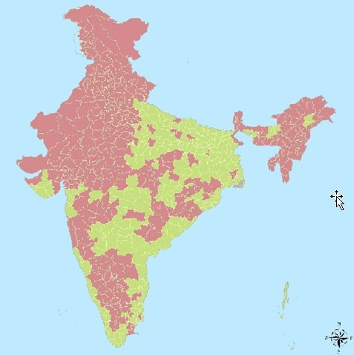
FILARIA (endemicity)

Slide 44
FILARIA (endemicity)
Indigenous filaria cases have been recorded from Andhra Pradesh, Assam, Bihar, Chhattisgarh, Goa, Jharkhand, Karnataka, Gujarat, Kerala, Madhya Pradesh, Maharashtra, Orissa, Tamil Nadu, Uttar Pradesh, West Bengal, Pondicherry, Andaman & Nicobar Islands, Daman & Diu, Dadra & Nagar Haveli and Lakshadweep.

Slide 45
FILARIA (endemicity)
States free from indigenously acquired filarial infection: North-Western States/UTs namely Jammu & Kashmir, Himachal Pradesh, Punjab, Haryana, Chandigarh, Rajasthan, Delhi and Uttaranchal and North-Eastern States namely Sikkim, Arunachal Pradesh, Nagaland, Meghalaya, Mizoram, Manipur and Tripura

Slide 46
FILARIA
Population living in endemic countries is now covered with annual MDA with DEC + Albendazole, with aim of elimination of Filaria by 2015
Patients suffering from hydrocele are motivated for surgery
ASHA and other volunteers, after due training, would be involved in MDA by the local health authority

Slide 47
FILARIA
ELF by 2015:
➢LF ceases to be a public health problem i.e. the number of microfilaria carriers is less than one per cent in endemic population
➢Children born after initiation of ELF are free from circulating antigenaemia.
➢Absence of antigenaemia among children is considered as evidence for absence of transmission and new infection.

Slide 48
GUIDELINES UNDER NVBDCP: FILARIA
National Filaria Control Program is being implemented in the country through 206 filaria control units, 199 filaria clinics and 27 survey units
Strategies under NFCP:
➢Detection and treatment to the patients with anti-filaria drug
➢Anti-larval work in urban areas covered under NFCP

Slide 49
GUIDELINES UNDER NVBDCP: FILARIA
Filaria has been targeted for elimination globally by 2020
National Health Policy (2002) aims to eliminate lymphatic filariasis (ELF) by 2015
MDA being implemented since 2004 in 250 districts in 15 states and 5 UTs
➢MDA to be undertaken by District Malaria Officer or District Vector Borne Disease Control Officer with staff and officials of NFCP

Slide 50
Major activities under ELF
Sensitization and training of district and state level officers
Media sensitization and District Co-ordination Committee meeting under the chairmanship of district collector
Microfilaria survey by trained technicians (especially for collection of blood in the night and its examination) before MDA in sentinel and random sites in each district

Slide 51
Major activities under ELF
Identification of manifestations (lymphedema or hydrocele), line-listing of cases and updating every year with addition or deletion on yearly basis to provide services for morbidity management
Collection, compilation and analysis of data and feedback to state as well as centre
Assessment through involvement of medical college faculty, ROH&FW and ICMR institutions

Slide 52
Major activities under ELF
Hydrocele operations for relief of the patients
Training on home based care for morbidity management
Vector control: one or two rounds of IRS with DDT (1g/m²) in endemic areas
Anti-larval measures: temphos in water tanks every week and application of Mineral Larvicidal Oils (MLO) on water surface
Biological control; Environmental engineering

Slide 53
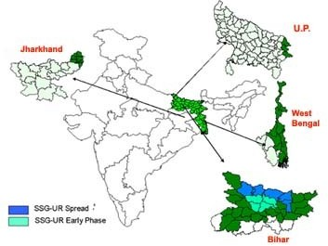
Kala Azar endemicity

Slide 54
Kala Azar endemicity
Endemic in eastern States of India namely Bihar, Jharkhand, Uttar Pradesh and West Bengal
48 districts endemic; sporadic cases reported from a few other districts
Estimated 129 million population at risk in 4 states
Mostly poor socio-economic groups of population primarily living in rural areas are affected

Slide 55
KALA AZAR
Annual incidence of Kala Azar will be reduced to less than 1 per 10,000 population at sub- district level with the aim of eliminating Kala Azar by 2010
Kala Azar Technical Supervisors (KTS) are provided in affected districts to strengthen early detection, complete treatment and prevention and control including residual spray (supported under World Bank assisted project)

Slide 56
KALA AZAR
It is proposed that ASHA workers will be involved in identification of Kala azar cases and ensuring their complete treatment

Slide 57
GUIDELINES UNDER NVBDCP:
KALA AZAR
Main strategic components for elimination:
➢Case detection and treatment: done through the existing Primary health care system supplemented by periodic annual active searches (Kala azar fortnight)
➢Interruption of transmission through vector control: undertaking 2 rounds of DDT spray annually in PHC areas reporting kala azar incidence under direct supervision and monitoring by NHM institutions

Slide 58
GUIDELINES UNDER NVBDCP:
KALA AZAR
First round of IRS: february-march
Second round: may-june
➢Just before the onset of monsoon as some parts of Bihar become inaccessible in monsoon
IRS (with DDT 50%) is supplemented with efforts to improve sanitation
In addition, environmental measures and personal protection from sandfly bites are encouraged

Slide 59
GUIDELINES UNDER NVBDCP:
KALA AZAR
IEC & inter-sectoral convergence
Diagnosis: Suspected cases as per the standard case definition are referred for clinical case examination and tested with rapid dipstick test rK39

Slide 60
GUIDELINES UNDER NVBDCP:
KALA AZAR
Treatment: as per the drug policy of GoI, Sodium Stibo Gluconate (SSG) is the first line treatment of Kala azar
➢The oral drug, Miltefosine has been introduced on a pilot basis in 6 districts of Bihar and 2 districts each of Jharkhand and West Bengal
➢Paramomycin has also been approved

Slide 61
GUIDELINES UNDER NVBDCP:
KALA AZAR
Vector control:
➢Selection of areas to be sprayed: all villages within a PHC which reported Kala azar cases in the past 5 years; all villages which reported cases during the year of spray
➢Dosage: 1g/m² of the wall surface; upto 6 feet height
Cattle sheds and kala azar positive and suspected cases to be given priority

Slide 62
Kala azar – Patient Coding Scheme
The patient and his relatives are counseled properly at the time of registration at the health institution (CHC/PHC/district hospital) about the importance of full treatment
The coding would be arranged in the order of Country Code cum State Code- District Code- PHC Code, Sub-Centre / NGO Code- Patient Code.

Slide 63
Kala azar – Patient Coding Scheme
As per the patient coding scheme, each Kala- azar case will have the country code IND along with the state code and have a 10 digit numerical code. (IND2-01-01-01-001...... IND2- 01-01-01-999).
No two patients will have the same 10 digit numerical code during a period of 5 years / Kala-azar Elimination Program period.

Slide 64
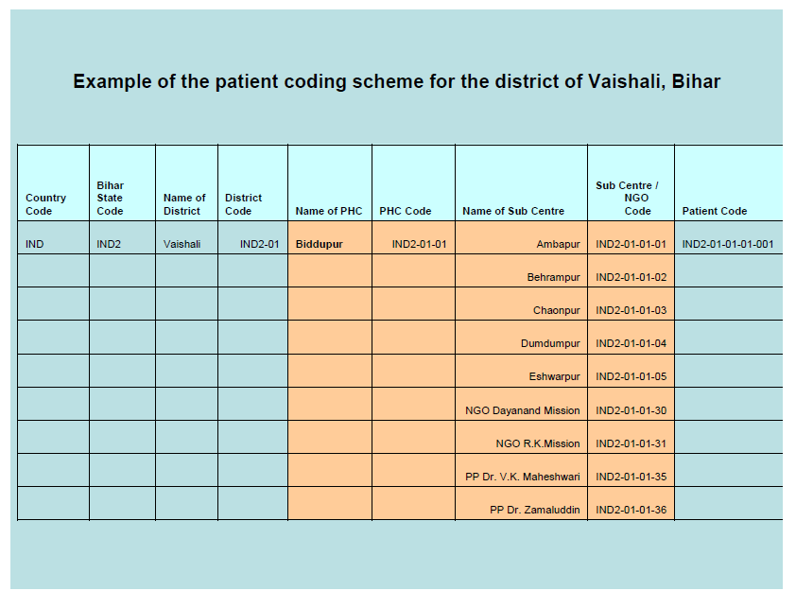
Example of Patient Coding System

Slide 65
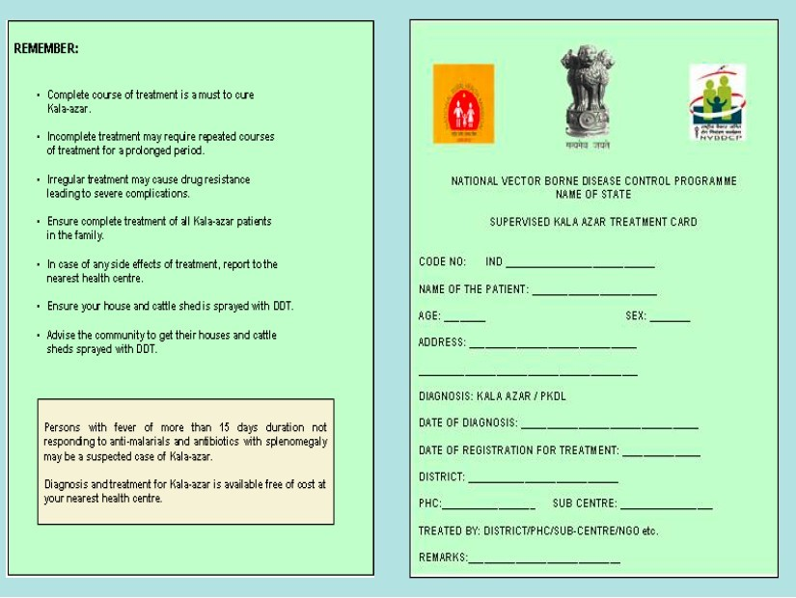

Slide 66
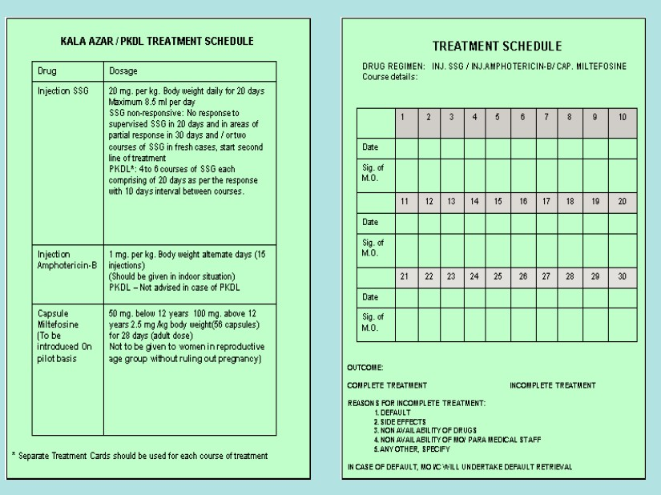

Slide 67
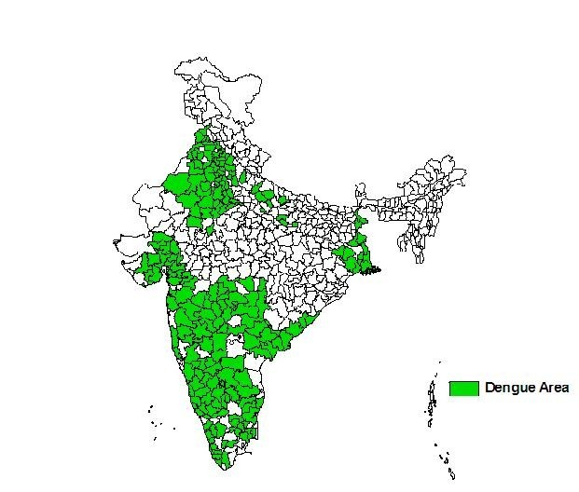
Dengue endemicity

Slide 68
Dengue endemicity
Disease is prevalent throughout India in most of the metropolitan cities and towns
Outbreaks have also been reported from rural areas of Haryana, Maharashtra & Karnataka

Slide 69
GUIDELINES UNDER NVBDCP: DENGUE/DHF
Early case reporting and management
➢Disease surveillance through grass root level health workers, sentinel surveillance sites with laboratory support
➢Case management including early referral of cases
➢Epidemic preparedness and rapid response
➢No specific anti-viral drug; symptomatic Rx

Slide 70
GUIDELINES UNDER NVBDCP: DENGUE/DHF
Integrated vector management:
➢Larval surveys – entomological surveillance
➢Source reduction
➢Personal protection

Slide 71
GUIDELINES UNDER NVBDCP: DENGUE/DHF
Larval surveys: containers in house-holds are examined for presence of mosquito larvae and pupae
Four indices:
➢ House index: percentage of houses infected
= no. of houses infected with larvae/pupae x 100 no. of houses inspected

Slide 72
GUIDELINES UNDER NVBDCP: DENGUE/DHF
Larval surveys:
➢Container index: percentage of water holding containers infected with larvae/pupae
= no. of positive containers x 100 no. of containers inspected

Slide 73
GUIDELINES UNDER NVBDCP: DENGUE/DHF
Larval surveys:
➢Breteau Index: no. of positive containers per 100 houses inspected
= no. of positive containers x 100 no. of houses inspected

Slide 74
GUIDELINES UNDER NVBDCP: DENGUE/DHF
Larval surveys:
➢Pupae Index: no. of pupae per 100 houses
= no. of pupae x 100 no. of houses inspected

Slide 75
GUIDELINES UNDER NVBDCP: DENGUE/DHF
An HI >5% &/or a BI >20 for any locality is an indication that the locality is dengue sensitive and therefore adequate preventive measures should be taken

Slide 76
GUIDELINES UNDER NVBDCP: DENGUE/DHF
Adult surveys:
➢Landing/biting collection: presence of aedes aegypti mosquito can be reliable indicator of clear proximity to hidden larvae habitats
✓Laborious
✓Expressed in terms of landing/biting counts per man hour

Slide 77
GUIDELINES UNDER NVBDCP: DENGUE/DHF
Adult surveys:
➢Resting collection: mosquitoes typically rest indoors, especially in bedrooms and mostly in dark places, such as cloth closets and other sheltered sites
✓Mosquito searched with the aid of flashlight
✓Recorded as number of adults per house per man hour of human efforts

Slide 78
GUIDELINES UNDER NVBDCP: DENGUE/DHF
Adult surveys:
➢Oviposition traps: Ovitraps are devices used to detect presence of Aedes aegypti where population density is low (BI < 5) (urban areas)
✓Used to evaluate impact of adulticidal space spraying on female adult mosquito population

Slide 79
GUIDELINES UNDER NVBDCP: DENGUE/DHF
Following points were emphasized in the strategic action plan:
➢Suspected cases should be referred at the earliest for diagnosis and its proper management
➢Strengthening through 110 Sentinel Surveillance Hospitals (SSHs) and 13 Apex Research Laboratories (ARLs)

Slide 80
GUIDELINES UNDER NVBDCP: DENGUE/DHF
Following points were emphasized in the strategic action plan (contd.):
➢Diagnostic kits are supplied by NIV (Pune), for which the cost is borne by NVBDCP
➢Monitoring of larval density of Aedes mosquitoes in urban and rural areas regularly

Slide 81
GUIDELINES UNDER NVBDCP: DENGUE/DHF
Following points were emphasized in the strategic action plan (contd.):
➢Involvement of NHM institutions namely Rogi Kalyan Samiti for facilitating emergency cases in referral and transportation
➢Involvement of VHSC for improvement in sanitation and reduction in breeding sites
➢ASHA should be involved in educating the community to avoid the stagnation of stored water kept in and around houses

Slide 82
GUIDELINES UNDER NVBDCP: DENGUE/DHF
Legislative measures
➢Model civic by-laws: fine/punishment is imparted, if breeding is detected.
Strictly imposed by Mumbai, Navi Mumbai, Chandigarh and Delhi Municipal Corporations.
➢Building construction regulation act: for overhead/underground tanks, etc.
In Mumbai, builders deposit a fee for controlling mosquitogenic conditions at site

Slide 83
GUIDELINES UNDER NVBDCP: DENGUE/DHF
Legislative measures
➢Environmental Health Act: by-laws for proper disposal/storage of junk, discarded tins, old tyres and other debris
➢Health Impact Assessments: prior to any development projects/major constructions

Slide 84
CHIKUNGUNYA
No specific anti-viral drug; symptomatic Rx
Strategies for prevention and control are the same as for dengue

Slide 85
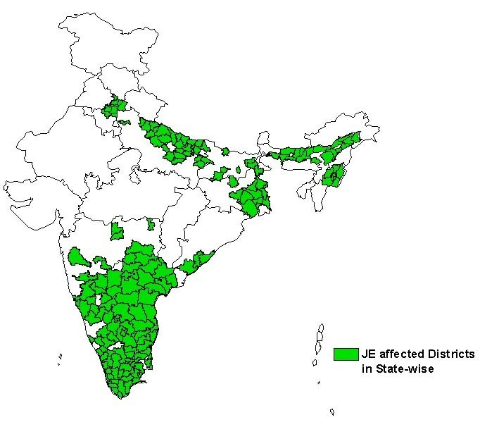
Japanese encephalitis endemicity

Slide 86
JE - Extent of problem
JE viral activity has been widespread in India.
The first evidence of presence of JE virus dates back to 1952.
First case was reported in 1955
During recent past (1998-2004), 15 states and Union Territories have reported JE incidence

Slide 87
GUIDELINES UNDER NVBDCP: JE
Early diagnosis and case management
➢Strengthening of referral services: available at district/sub-district levels
➢Proper case management:
✓No specific anti-viral drug for JE and cases are managed symptomatically
✓Improved care by medical and para-medical health care providers, improved lab services for diagnosis, availability of drugs

Slide 88
GUIDELINES UNDER NVBDCP: JE
Proper case management (contd.):
➢Management of sequel: rehab at district
➢Epidemic preparedness and rapid response:
team constituted in all JE endemic districts
Vaccination:
Vaccination of children between 1-15 yrs age:
➢Initiated since 2006 with single dose live attenuated SA-14-14-2 vaccine under UIP in a phased manner

Slide 89
GUIDELINES UNDER NVBDCP: JE
Integrated vector Management
➢Fogging with Malathion for outdoor is recommended during outbreaks for immediate killing of infected mosquitoes
➢Anti- larval operations
➢Personal protective measures for using insecticides treated bed nets and curtains, wearing full sleeve clothes during evening hours etc.
➢Biological control using larvivorous fishes

Slide 90
GUIDELINES UNDER NVBDCP: JE
Supportive interventions:
➢Training and capacity building
✓Through training of clinicians and nurses in case management and laboratory technicians and laboratory in charge/microbiologists in all sentinel laboratories in diagnosis by MAC ELISA method in a phased manner.

Slide 91
GUIDELINES UNDER NVBDCP: JE
Supportive interventions:
➢Behaviour Change Communication
✓Early case reporting and early referral of patients
✓Increasing awareness of clinical signs
✓Personal protection including segregation of pigs away from human population
✓Mosquito proofing of pigsties

Slide 92
GUIDELINES UNDER NVBDCP: JE
Supportive interventions:
Supervision and monitoring
➢Periodic reviews/reports and field visits for proper monitoring for JE

Slide 93
Incentives to ASHAs under NVBDCP

Slide 94
S.No
Activities
Incentive
Remarks
1 Preparation of slides
Rs.5/- per slide
Irrespective of RDT based or slide based confirmation
2. Taking slides to
PHC Rs.5O/- per positive
This incentive is to facilitate the transportation cost
laboratories, getting reports and _{case for complete}
providing complete treatment to _{Treatment}
malaria positive case
3.
RDT testing and complete treatment of Pf malaria cases
Rs.20/-per positive Pf malaria case for
In remote and inaccessible areas, for
complete treatment complete treatment of
Pf malaria cases

Slide 95
Incentives for filaria
Under the ELF program, MDA is administered by health workers (male/female) and volunteers
ASHAs could also be involved by local health authorities
Payment of Rs.100/- to each volunteer/worker/ASHA for drug distribution to 250 persons in approx 50 houses

Slide 96
Incentives for Kala azar
Identification of case – Rs. 50/- per case
For follow up and ensuring complete treatment – Rs. 150/- per case
From funds allocated for operational costs under cash grant of NVBDCP (kala azar) funds

Slide 97
Dengue/Chikungunya/JE
The untied funds available with the subcentres for referral to district hospitals can be utilized for transportation of the severe cases to the identified referral centres

Slide 98
Public Private Partnership
Categories: NVBDCP initiatives for PPP are classified into 2 categories
➢Category 1: with local self government (panchayat) or panchayat level CBO (population coverage – minimum 5000 population)
➢Category 2: block level NGO/FBO (population coverage – minimum 100000 population)

Slide 99
Public Private Partnership
Schemes:
Provision of EDPT
➢Scheme 1: Provision of outreach services – Fever Treatment Depot & Drug Distribution Centre
➢Scheme 2: Provision of microscopy and treatment services
➢Scheme 3: Hospital based treatment and care of severe complicated malaria cases

Slide 100
Public Private Partnership
Integrated Vector Control
➢Scheme 4: Promotion of ITMN, insecticide treatment of community owned bed nets and distribution of ITMN in selected areas
➢Scheme 5: Promotion of larvivorous fish
➢Scheme 6: Indoor Residual Spray

Slide 101
THANK YOU

Slide 102
Author Puneet Kumar Arali1 *, Deepthi N. Shanbhag2 Int J Community Med Public Health. 2019 Feb;6(2) | Study Cross-sectional study (low level of evidence) | Method Quantitatively retrospective data was collected from Directorate office Department of Health and Family Welfare, NVBDCP section from April 2016 to March 2017. Qualitatively questionnaire based protocol was made and interviews were conducted with District programme officer, PHC medical officer and grass root level health workers like ANM, ASHA with reference to one each of selected least performing districts and good performing districts in the state. | Result We surveyed 11 cold chain centers, 25 subcenters, 14 sessions, and interviewed 180 mothers. Dropouts were supposed to be tracked using vaccination card counterfoils and tracking registers. The dropout rate from BCG to DPT3 was 30%. Lack of knowledge (adjusted odds ratio (AOR) 6.6,95% confidence interval (CI) 2.6–16.7), mother not being decision maker (AOR 4.0,95%CI 1.7–9.2), lack of contact by Accredited Social Health Activist (ASHA; AOR 3.0,95%CI 1.1–7.7), not being given four post-vaccination messages (AOR 7.7, 95% CI 2.9–20.2), and longer duration of stay in Haridwar (AOR 3.0 95% 1.9–7.6) were risk factors for nonimmunization. The reasons stated by mothers included lack of awareness of session site location (67%) and belief that child should only be vaccinated in their resident district (43%). | Conclusion The result of this investigation revealed that Dakshina Kannada has got highest number of cases with greater proposition and high prevalence rate of vector borne diseases due to lack of sufficient human resources and geographical factors. Strengthening the surveillance activities along with integrated vector control programmes will improves the outcome of the programme.
Notes:
102

