Slide 1
National Nutritional Programmes
By Dr. Grishma Chauhan,
Professor,
Community Medicine dept.

Slide 2
National Nutritional Programmes
Large scale supplementary programmes
Aim: To provide additional nutrients to target groups to fulfill the gap between food intake and requirement .
To overcome specific diseases through various ministries to combat malnutrition
Beneficiaries :
Pre-school children
School children
Pregnant women
Lactating mother

Slide 3
Nutritional programmes in india
Ministry of Rural Development
Applied nutrition programme
Ministry of Social Welfare
Integrated child development services programme (ICDS)
Balwadi nutrition programme
Special nutrition programme (SNP)
Ministry of Health and Family Welfare
National Nutritional Anemia Prophylaxis Programme
National prophylaxis programme against nutritional blindness due to vitamin A deficiency
National Iodine Deficiency Disorder Control Programme
Ministry of Education
Mid-day meal programme (School lunch Programme)

Slide 4
Applied nutrition programme
One of the earliest nutritional programmes.
This project was started in Orissa on 1963
Later extended to Tamilnadu and UP
The programme maintained by Ministry of Rural Development.
In1973 it was extended to all states in INDIA
-Beneficiaries:
Children between 2-6 years
Pregnant & lactating women

Slide 5
Objectives
 To provide supplementary nutrition to vulnerable groups through locally produced protective foods such Vegetables and fruits for 52 days in a year
To combat malnutrition and improvement in nutritional status in vulnerable groups, particularly mothers & children in rural area.
 To make people conscious of their Nutritional needs.
 To increase production of Nutritional food
Ensure their consumption by pregnant & lactating women and children.

Slide 6
Activities
 Kitchen garden, school garden, & community garden set up to promote the concept of balanced diet, as well as to increase production.
 Fishry units and poultry units are set up to give
employment added income and more production of food.
 Providing better seeds as well as bred cattle.
 Panchayat, yuvak & mahila mandals were to be involved to promotr community participation.

Slide 7
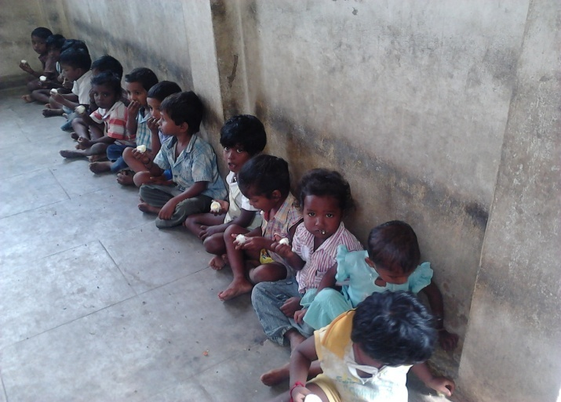
Balwadi nutrition programme
This was started in 1970 under the department of social welfare through voluntary organisations.
Voluntary organisations receiving the grants are responsible for the running of this program
Beneficiary group
Preschool children 3-6 years of age.
Services
300kcal and 10gm protein for 270 days in a year.
Also provide with pre school education
Balawadis are being phased out because universalization of ICDS

Slide 8
Special nutrition programme (SNP)
Started in 1970 by Ministry of Social Welfare.
Operation in urban slums, tribal areas and backward rural areas.
Operated under minimum need programme
Main aim is to improve nutritional status in targeted group.
Beneficiary group
Children below 6 years
Pregnant and lactating women
Services
1) Supplementary nutrition for 300 days per year
Preschool children : 300kcal and 10-12gm protein per day
Pregnant & lactating mothers :500kcal and 25 gm protein per day
2) Provide health service - supply vitamin A solution - Iron & folic acid
Fund for nutrition component of ICDS programme was shared with SNP budget
This programme is gradually being merged into ICDS

Slide 9

Integrated child development service(ICDS)
Initiated-Oct.2,1975, in 33 Blocks under 5th Five Year Plan
Under aegis of Ministry of social welfare
World’s largest program for early childhood development
All works – by Anganwadi workers
Each anganwadi unit covers a population of about 400- 800 and mini anganwadi centres about 150-300.
CDPO (Child Development Project Officer) is overall in charge of ICDS Programme.
Rationale
Routine MCH services not reaching target Population
Nutritional component not covered by Health services
Need for community participation

Slide 10
Objectives:
To improve the nutritional and health status of children in the age-group 0-6 years;
To lay the foundation for proper psychological, physical and social development of the child;
To reduce the incidence of mortality, morbidity, malnutrition and school dropout;
To achieve effective co-ordination of policy and implementation amongst the various departments to promote child development; and
To enhance the capability of the mother to look after the normal health and nutritional needs of the child through proper nutrition and health education.

Slide 11
Services:
The above objectives are sought to be achieved through a package of services comprising:
Supplementary nutrition,
Immunization
Health check-up
Referral services
Pre-school non-formal education and
Nutrition & health education.

Slide 12
Beneficiaries
Children < 6 years
Pregnant & Lactating women
Women in Reproductive age group (15-44 yr)
Adolescent Girls (in selected Blocks)

Slide 13
Services and beneficiaries
Services | Target Group | Service Provided by
Supplementary Nutrition | Children below 6 years: Pregnant & Lactating Mother (P&LM) | Anganwadi Worker and Anganwadi Helper
Immunization* | Children below 6 years: Pregnant Women | ANM/MO
Health Check-up* | Children below 6 years: Pregnant & Lactating Mother (P&LM) | ANM/MO/AWW
Referral Services | Children below 6 years: Pregnant & Lactating Mother (P&LM) | AWW/ANM/MO
Pre-School Education | Children 3-6 years | AWW
Nutrition & Health Education | Women (15-45 years), Children 3-6 years Pregnant & Lactating Mother (P&LM) | AWW/ANM/MO

Slide 14
Supplementary Nutrition
This includes supplementary feeding and growth monitoring; and prophylaxis against Vitamin A deficiency and control of Nutritional Anaemia.
Growth Monitoring and Nutrition surveillance are two important activities that are undertaken.
  Children <3 years of age of age are weighed once a month
  Children 3-6 years of age are weighed quarterly
According to Revised Nutritional Norms in ICDS (since February, 2009);
Beneficiaries | Calories (Kcal) | Protein (g)
Children (6-72 months) | 500 | 12-15
Severely Malnurished Children (SAM) (6-72 months) | 800 | 20-25
Pregnant women and Lactating mothers | 600 | 18-20

Slide 15
Cont..
Under the revised Nutritional and Feeding norms (February 2009), State Governments/UTs have been directed to provide 300 days of supplementary food to the beneficiaries in a year.
For children from 3-6 years who visit AWCs, more than one meal is given. This includes morning snacks in the form of milk/ banana/ egg/seasonal fruits/micro-nutrient fortified food followed by a Hot Cooked Meal (HCM).
For children below 3 years of age, pregnant and lactating mothers, Take Home Rations (THRs) in the form of pre-mixes/ ready-to-eat food are provided.
For severely underweight children in the age group of 6 m - 6 yrs, additional food items in the form of micronutrient fortified food and/or energy dense food as THR is provided.

Slide 16
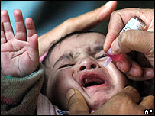
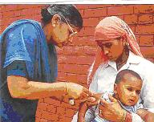
Immunization:
Immunization of pregnant women and infants protects children from Vaccine preventable diseases-Poliomyelitis, Diphtheria, Pertussis, Tetanus, Tuberculosis, Measles,Rubella ,Vitamin A deficiency, Heaptitis B and H.Influenza, Rota, Japanese encephalitis etc...
Immunization of pregnant women against Tetanus also reduces maternal and neonatal mortality

Slide 17
Health Check-ups
This includes health care of children less than six years of age, antenatal care of expectant mothers and postnatal care of nursing mothers
Recording of weight, immunization, management of malnutrition, treatment of diarrhoea, de-worming and distribution of simple medicines etc.

Slide 18
Referral Services:
During health check-ups and growth monitoring, sick or malnourished children, in need of prompt medical attention, are referred to the Primary Health Centre or its sub-centre

Slide 19
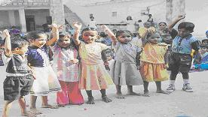
Non-formal Pre-School Education (PSE)
PSE is considered the backbone of the ICDS programme.
Its for the 3-6 years old children is directed towards providing and ensuring a natural, joyful and stimulating environment.
And provide opportunity to develop desirable attitude, behavioural pattern among children.
Inexpensive toys and material are used in play and creative activity.

Slide 20
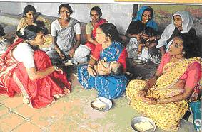
Nutrition and Health Education
It is a key element of the work of the anganwadi worker.
This forms part of BCC (Behaviour Change Communication) strategy

Slide 21
THE ICDS TEAM:
The ICDS team comprises
Anganwadi Workers,
Anganwadi Helpers,
Supervisors,
Child Development Project Officers (CDPOs) and
District Programme Officers (DPOs).

Slide 22
Role of AWW
To elicit community support
Participation in running the program
Weigh & record each child every month and maintain Growth chart of each child
Refer cases which is needed
Organize non-formal pre-school activities
Provide supplementary nutrition
Provide health & nutrition education and counseling

Slide 23
Cont..
Make home visits
Assist PHC staff
Guide ASHA
Assist in implementation of Kishori Shakti Yojana (KSY)

Slide 24
Scheme for Adolescent girls
(kishori sakti yojana)

Slide 25
Services provided in kishori sakti yojana
Watch over menarche
Educational activities through non-formal & functioned literacy pattern.
Immunization
A general health check up every six months
Treatment for minor ailments
De worming 6 monthly
Prophylaxis measures against anemia, goiter, vitamin deficiencies etc.
Referral to PHC/District Hospital in the case of acute need
Convergence with Reproductive Child Health Scheme.

Slide 26
Objectives of kishori sakti yojana
To improve the nutritional and health status of girls in the age group of 10-19 years.
To provide the required literacy and innumeracy skills through the non-formal stream of education, to stimulate a desire for more social exposure and knowledge and to help them improve their decision making capabilities.
To train and equip the adolescent girls to improve/upgrade home-based and vocational skills.
To promote awareness of health, hygiene, nutrition and family welfare, home management and child care, and to take all measure as to facilitate their marrying only after attaining the age of 18 years and if possible, even later,
To gain a better understanding of their environment related social issues and the impact on their lives and
To encourage adolescent girls to initiate various activities to be productive and useful members of the society.

Slide 27
National nutritional anemia prophylaxis programme
Programme was launched during 4th 5-year plan in 1970 by the Ministry of Health and Family Welfare
Prevention of Nutritional anemia in mothers and children
Rationale
Supplementary iron on daily basis is considered necessary in developing countries because approaches like food fortification and dietary modification are long term options.
Requirements during 2nd and 3rd trimester can’t be made by daily intake.
Majority of girls are anemic , even in their adolescence.
Deleterious effect on neural tube development due to folic acid deficiency during 1st 4 weeks of pregnancy

Slide 28
In the pursuit of prevention of anemia in country….
1991-Renamed as ‘National Nutritional Anemia Control Programme’.
Beneficiaries redefined- extended to both anemic and non-anemic ,lactating& expecting mothers and 1-5years children.
Dosage of iron- from 60 mg to 100mg of elemental iron daily.
IEC regarding increase consumption of iron-rich food
1992-programme was made integral part of CSSM programme
100mg Fe+0.5 folate for 100days started along 1st dose of inj T.T
Therapeutic dose- 2 tabs of Irofol for 100 days.
1997- Programme is integrated with RCH…..
2005- Programme is integrated with NRHM……
Now it is with NHM.
Pregnant, lactating mother, acceptor of family planning | 1 tab of Iron & Folic acid -100mg elemental iron -0.5 mg folic acid | 100 days
Children 1-12 years | 1 tab of Iron & Folic acid -20 mg elemental iron -0.1 mg folic acid | 100 days

Slide 29
National Iron Plus Initiative (NIPI)
The National Iron Plus Initiative (NIPI) is an attempt to look at the Iron Deficiency Anaemia comprehensively across all life stages including adolescents and women in reproductive age group who are not pregnant or lactating.
NIPI is the broader umbrella which encompasses all the programmes for all the categories of population for addressing anemia holistically.
Vision 2025: Anaemia Free India • Reduction of Anaemia by 50%
Total Beneficiaries : 45 crore (VHND & RBSK Data)
Category | Anaemia status in 2015-16 (%) | Expected Anaemia status in 2025 (%)
Children 6 months to 59 months age | 59 | 29
Children 5 to 9 years age | 21 | 11
Adolescent Girls 10 to 19 years age | 35 | 18
Adolescent Boys 10 to 19 years age | 16 | 8
Women of reproductive age group | 53 | 27
Pregnant women | 50 | 25
Lactating mothers | 50 | 25

Slide 30
interventions
IFA Supplementation and Deworming
BCC for consumption of Iron Rich Food and IFA & Albendazole Compliance
Use of Iron Fortified Food in Public Health facilities
Test and treat nutritional anemia in school going adolescents 10-19 years and pregnant women
Test and treat non-nutritional anemia (Malaria, sickle cell anemia etc)
Delayed cord clamping at institutional delivery

Slide 31
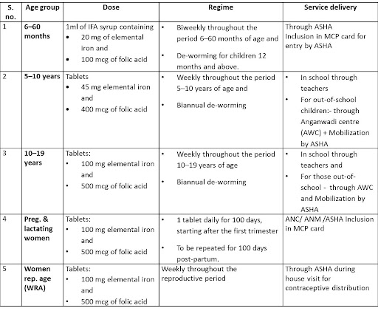
IFA supplementation programme & service delivery

Slide 32
Weekly Iron and Folic acid supplimentation programme for adolescents
Also known as WIFS-Blue campaign.
Nodal agency- Ministry of H&FW
Beneficiaries-
Adolescent girls/boys enrolled in school, 6th- 12th std.
Adolescent girls not enrolled in schools
Services
IFA tablet to target population on weekly basis on a fixed day(Monday) for 52 weeks.
Biannual deworming (February and August)
IMPLEMENTATION
Out of school students
Ministry of Social Welfare
In-school students
Ministry of education

Slide 33
Deworming
• 241 million children at risk of intestinal worms
• Result of poor sanitation and hygiene
• Soil transmitted helminthes (commonly referred to as worms, including roundworms, whipworms and hookworms. ) are the major cause anemia and under- nutrition
• Almost 7 in 10 children in the 6-59 month age-group are anemic.

Slide 34
National Deworming Day
Launched on February 2015.
• It is a single fixed-day approach to treating intestinal worm infections in all children aged 1- 19 years, and
It is held on 10 February and 10 August each year.
• It aims to create mass awareness about the most effective and low-cost STH treatment administering albendazole tablets.
Objective:
• To deworm all preschool and school-age children between the ages of 1-19 years through the platform of schools and anganwadi centers in order to improve their overall health, nutritional status, access to education and quality of life.

Slide 35
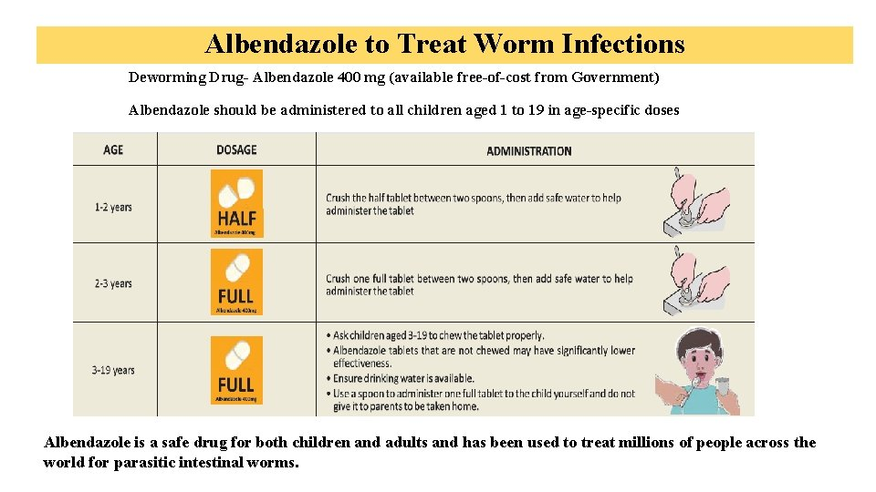
Dosage of Albendazole
: If syrup is supplied,
5ml for 1-2 years, on a bi-annual basis.
10ml for 2-5 years, on a bi-annualbasis

Slide 36
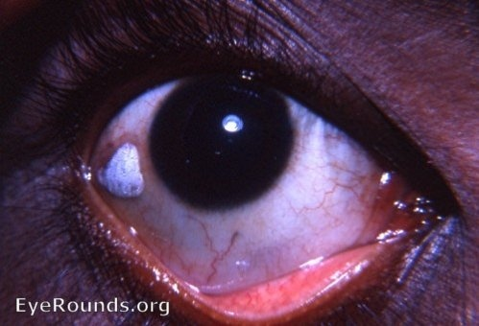
National prophylaxis programme against nutritional blindness due to vitamin A deficiency
Launched in 1970 as a centrally sponsored scheme by Ministry of H&FW, GoI.
Objective is for reduction of blindness & prevention of blindness due to vit-A.
Target group- all children 1-3 years of age.
Activity –Megadose of vit.A i.e 1 lakh IU at 6-12 month & subsequently 2 lakhs IU at 6 month interval till the child is 5 yrs old.
Rationale
Human liver can store vitamin A when consumed in excess of daily requirements. The stored Vitamin A is released when in need.

Slide 37
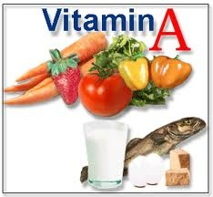
In the run……
8th 5-year plan- vitamin A supplementation linked with immunization programme.
10th 5-year plan- Megadoses to given biannually in pre-summer & pre-winter period. ( In the month of February & August)
To cover all the children in 6months to 5 years age.
Short term strategy
Administration of supplemental dose of Vit. A in Arachis oil.
6-11months-1 dose of 1 lac IU.
1-5 years- 2 lac IU bianually.
Long term strategy
Promotion of regular intake of Vit A- rich food.
Feeding locally available food.
Kitchen gardening of Vit A-rich food.
Treatment of Vit A deficiency
Immediately after diagnosis-2 lac IU followed by another dose of 2 lac IU 1-4 weeks later.

Slide 38
Strategies
Health and nutrition education to encourage colostrums feeding, exclusive breast feeding for the first six months, introduction of complementary feeding thereafter and adequate intake of Vitamin A rich foods.
Early detection and proper treatment of infections
Prophylactic Vitamin A as per the following dosage schedule:
-100000 IU at 9 months with MR vaccine.
-200000 IU at 16-18 months, with DPT booster
-200000 IU every 6 moths, up to the age of 5 years

Slide 39
Cont..
Thus a total of 9 mega doses are to be given from 9 months of age up to 5 years.
Sick Children:
All children with xerophthalmia are to be treated at health facilities.
All children having measles, to be given 1 dose of Vitamin A if they have not received it in the previous month.
All cases of severe malnutrition to be given one additional dose of Vitamin A.

Slide 40
Cont..
Children should be encouraged to Consume vitamin “A” rich foods.
Promote exclusive breast feeding of with colostrum.
Promote intake of easily available
vitamin “A” rich food such
green leafy vegetables [spinach, methi, &capsicum]
yellow fruits [ pumpkin, papaya, mango] and
roots like carrot
And animal foods like liver, eggs, butter, cheese, milk, fish , meat etc.

Slide 41

National iodine deficiency disorder control programme
National Goitre Control Programme launched in 1962, at the end of 2nd 5-year plan by Ministry of H&FW ,GoI.
The turning point- meeting of prime minister in 1983; Universal Iodisation of salt (30 ppm at manufacture level and 15ppm at consumption level), replacement of common salt with iodised salt, Cheapest method to control IDD.
1992- programme renamed as ‘National iodine deficiency disorder control programme’.
Use of Iodized oil Injection to those suffering from IDD, Oral administration as prophylaxis in IDD severe areas
To bring the prevalence of IDD to below 5% in the country
To ensure 100% consumption of adequately iodated salt (15ppm) at the household level

Slide 42
Cont..
Objectives
Surveys to assess the magnitude of the Iodine Deficiency Disorders.
Supply of Iodised salt in place of common salt.
Resurvey after every 5 years to assess the extent of Iodine Deficiency Disorders and the Impact of Iodised salt.
Laboratory monitoring of Iodised salt and urinary Iodine excretion.
Health education & Publicity
Rationale:
No State or UT in India is free from IDD, as evident from the surveys carried by ICMR
Iodine deficiency leads to a spectrum of disorders mostly affecting physical and mental development
The fact that human brain development is completed by 3 years of age , iodine deficiency in early age leads to permanent and irreversible damage.
Fortification of salt is a preventive programme, can be considered as a ‘vaccine’

Slide 43
Cont..
Activities:
1. Iodisation
Iodisation Salt USI- Universal Salt Iodisation- Policy
Adequate Iodisation of salt consumed by human and animals.
Universal Salt Iodization (USI) is key strategy for control of IDD. • According to PFA Act, Ban of non-iodised salt under PFA act (1954).
Standards for Salt Iodisation was originally prescribed under PFA act, Now its been covered under FSSAI, 2006.
Packed in HDPE lined jute bags for 50 kg if wholesale, plastic pouches for 500 or 1000 g/pack in retail.
Iodine Content: Not less than 30 ppm at production level Not less than 15 ppm at household level.
Moisture: Not more than 6% of the salt weight.
Na Cl: Not less than 96% of the salt weight on dry basis.
Anti-caking agent: Not more than 2% of salt weight
Punishment: 10 lakhs fine and/or 3 years imprisonment
Transport: The Salt Commissioners Office (SCO) is responsible for ensuring the production of Iodised salts and its transport to the states. About 57 per cent of salt for human consumption moves by rail and the rest by road.
Railways shift the salt under priority districts.
Salt transport for human consumption requires certificate by SCO/authorised agents.

Slide 44
Cont..
2. Surveys: • Population: 6-12 years old children. • Sample size- 2700 (30 clusters*90 samples) for Goitre • Data collected- Goitre rate, Salt iodisation level, • Frequency- Once in 5 years
3. Monitoring and Reporting: Lab Monitoring of NIDDCP- 3 level • Primary- estimation of iodine in salt •Secondary- Estimation of urinary iodine content (for bio-availability of iodine) •Tertiary- Neonatal monitoring for TSH
4. IEC activities: • October 21 World IDD day • TV/Radio broadcasts • 10 minutes video clip on IDD • Pamphlets • Posters depicting manifestations of IDDs • Awareness programmes among General public • Art of song and drama are also employed in collaboration with Doordarshan and All India Radio
Achievements: • According to MoH&FW, there is no gap between supply and demand of iodised salt • NIDDCP has been included in the 20 point program of the prime minister.

Slide 45
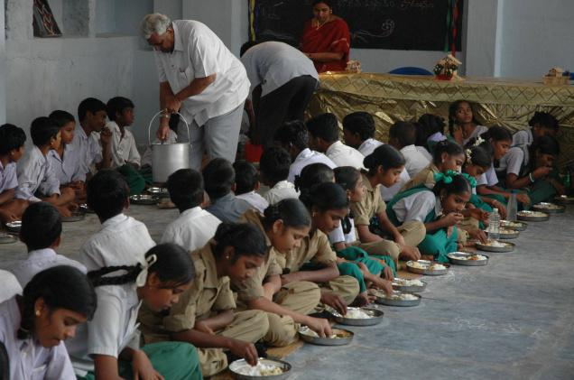
Mid-day meal programme
First started in Tamilnadu.
Also known as School lunch programme.
Programme in operation since 1961 under Ministry of Education.
BENEFICIARIES :Primary School children(6-11 years)
Given for 250 days per year are given.
Important Goals
• Re-orientation of eating habits
• Nutrition education into school curriculum
• Encouraging use of local commodities
• Improving school attendance & education performance of students
Aim
To provide at least one nourishing meal to school going children per day.

Slide 46
Cont..
Major Objectives:
Improve the School attendance
Reduce school drop outs
Beneficial impact on Childs nutrition
Principles
1. Supplement, not substitute to home diet
2. Supply 1/3 total energy requirement/day and
½ total protein requirement /day.
3. Reasonably low cost
4. Easily prepared at schools
5. As for as possible locally available food
6. Change menu frequently to avoid monotony.
Food stuffs | g/ day/child
Cereals & Millets | 75
Pulses | 30
Oils & fats | 8
Non leafy vegetables | 30
Leafy vegetables | 30

Slide 47
Mid-day meal scheme
Started in 1995 august 15 and revised in 2004.
Also known as National programme of nutritional support to primary education
Objectives:
Universalization of primary education by increasing enrollment (class 1 to 5) and
Improve nutritional status of children.
A cooked mid day meal with minimum calories of 350 to 500 kcal and 8-12gm protein per day for a minimum of 200 days is given.
In October 2007, the Scheme was extended to cover children of upper primary classes (i.e. class VI to VIII) Educationally Backwards Blocks (EBBs) and the name of the Scheme was changed from to ‘National Programme of Mid Day Meal in Schools’.
The nutritional norm for upper primary stage was fixed at 700 Calories and 20 grams of protein. The Scheme was extended to all areas across the country from 1.4.2008.

Slide 48
Drawbacks
Programme is good as for as improving nutrition of the underprivileged children
But it requires sustainability and for this it requires political will, community participation, monitoring and evaluation
Repeated incidence of food poisoning in the mid day meal causing serious threat to existence of this programme.

Slide 49

Akshaya patra
Started in 2000, feeding 1500 children in 5 schools in Bangalore.
Successfully involved private sector participation in the programme.
Programme managed with a centralized kitchen that runs through a public/private partnership.
Food delivered to schools in sealed and heat retaining containers just before the lunch break every day
Objectives
Providing underprivileged children with a healthy, balanced meal .
Reduce the dropout rate and increases classroom attendance.
Improve socialization among castes, address malnutrition
Empower women through employment.
Assam is the 8th state in the run
Launched on 19 feb 2010
20 thousand students of 260 schools of the district in the first phase.
Notes:
the main objective of Akshaya Patra's Mid-Day Meal Scheme is to help underprivileged children by providing them with a healthy, balanced meal that they would otherwise have to work for. The meal is an incentive for them to continue their education. It helps reduce the dropout rate to an enormous extent and increases classroom attendance.^{[8]}
Other objectives include improve socialization among castes, address malnutrition and empower women through employment.

Slide 50
THANK YOU

Slide 51
Author Ashish Kumar Sinha, Kamlesh Jain, Aditi Chandrakar, Srishti Dixit Int J Community Med Public Health. 2016 Jul;3(7):1940-1944 | Study Cross-sectional study (low level of evidence) | Method Cross sectional Observational study was done based on IDD survey guidelines by Government of India during July-Oct 2015 | Result Present study results showed Goiter prevalence among 6-12 years children was in the range of 3.37-17.56% (Highest in Rajnandgaon). Iodine deficiency reflected by urinary iodine excretion (UIE) was found unacceptable limit maximum (87%) in Rajnandgaon. Half of the surveyed districts had subnormal (<100 mcg/L), median urinary iodine excretion (MUIE). Our Study reveals that iodized salt coverage was in the range of 70-82 % in all the surveyed Districts. | Conclusion Among the 4 surveyed district, Goiter is a public health problem in 3 districts (prevalence >5%). The adequately Iodized salt coverage which should have been more than 90 % is not fulfilled in all the 4 districts.
Notes:
51

Slide 52
MCQ Test

Slide 53
Google form link for mcqs
https://forms.gle/fTroyJTwY9KXQD1m7

Slide 54
Which nutritional programme is not run by Ministry of Health & Family Welfare?
Vit A Prophylaxis prog
ICDS
IDDCP
Nutritional anemia prophylaxis prog

Slide 55
2. The main beneficiaries of ICDS are:
Children < 6 yrs, Lactating & pregnant mothers
Children < 5 yrs, Adolescent girls
Children < 5 yrs, Pregnant mothers
All school going children, mothers and adolescent girls

Slide 56
3. Dosage schedule of vit A under vit A Prophylaxis programme:
2,00,000 IU orally every 6 months to pre schoolchild
1,00,000 IU orally every 1 year to pre school child
50,000 IU orally every 3 months to pre school child
1,00,000 IU orally every 6 months to pre school child

Slide 57
4. One tablet of iron and folic acid given to the mothers to prevent anemia containing, elemental iron and folic acid respectively,
a. 100mg and 5mg
b. 100mg and 0.5 ug
c. 100mg and 5 ug
d. 100mg and 500 ug

Slide 58
5. All of the followings are infectious diseases whose control is solely based on active immunization, except
Polio
Yellow fever
Diphtheria
Measles

