Slide 1


National TB Elimination Programme
Dr. Piyush Parmar
Associate Professor,
Dept. of PSM
SBKS MI & RC

Slide 2
Introduction
Introduction
TB burden in India
Presumptive TB Case definitions
Algorithm for the diagnosis of TB
Treatment of TB
Challenges to control TB

Slide 3
TB-KSHAYA ROG (India)
PTHISIS (WESTERN)
ROBERT KOCHS Birthday ON MARCH 24TH
( WORLD TB DAY)

Slide 4
1962- National tuberculosis control program.
1993- WHO adopted DOTS strategy for control.
RNTCP started in india
1997- DOTS included officially in RNTCP.
2006-11 SECOND PHASE OF RNTCP
2007- DOTS PLUS for MDR
2012-2017 ( TB free India) national strategic plan
2017-2025(DETECT-TREAT-PREVENT -BUILD)NATIONAL STRATEGIC PLAN to eliminate TB

Slide 5
In 2020 RNTCP program name changed to NTEP

Slide 6
TB Burden in India 2017
Estimates of TB Burden (2017) | Global | India | % of Global
Incidence TB cases | 100 lakhs | 27.4 lakh | 27%
Mortality of TB | 13 lakh | 4.21 lakh | 31%
Incidence HIV TB | 9.2 lakh | 86000 | 9%
Mortality of HIV-TB | 3 lakh | 11,000 | 4%
MDR-TB | 5.58 lakh | 1.35 lakh | 24%
Children with TB | 10 lakh | 2.2 lakh | 22%
National Drug Resistance Survey has been competed : MDR in New patients 2.8% and Previously treated patients 11.6%
The National Tuberculosis Prevalence Survey has been planned in 2018 to provide robust estimates of TB Burden up to State level

Slide 7
one sputum positive case infects nearly 10-15 persons /yr if left untreated
Annual risk of infection(ARI)-most informative index of magnitude of problem of TB.

Slide 8

Sustainable Development Goals (SDG)
Vision: A world free of TB
Zero TB deaths, Zero TB disease, and Zero TB suffering
Goal: End the Global TB Epidemic (<10 cases per 100,000 population)
INDICATORS | TARGETS
 | SDG 2030
Reduction in number of TB deaths compared with 2015 (%) | 90%
Reduction in TB incidence (new case) rate compared with 2015 (%) | 80%
TB-affected families facing catastrophic expenditures due to TB (%) | Zero

Slide 9
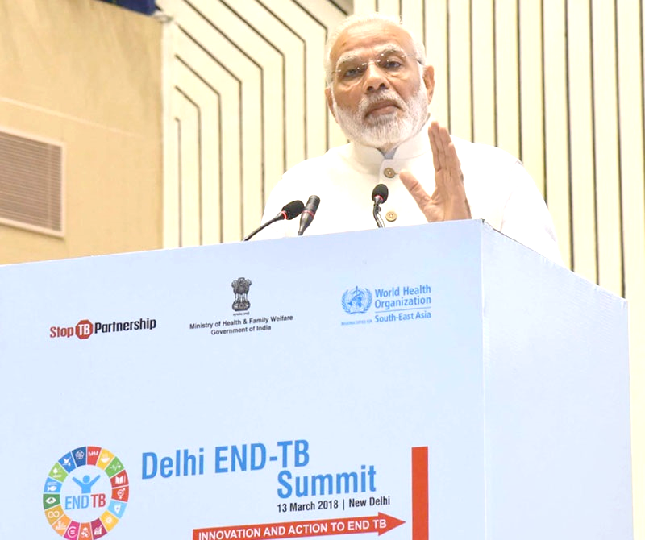

TB Free India
India has committed to End TB by 2025, 5 years ahead of the global SDG target
Prime Minister of India launched TB Free India campaign at ‘Delhi End TB Summit’ on 13th March, 2018
The campaign calls for a social movement focused on patient-centric and holistic care driven by integrated actions for TB Free India

Slide 10
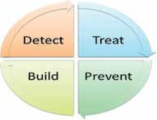
TB scenario in India
National Strategic Plan aims to achieve TB elimination by 2025. During plan period, targets for TB are:
  80% reduction in TB incidence (i.e. reduction from 211 per lakh to 43 per lakh)
  90% reduction in TB mortality (i.e. reduction from 32 per lakh to 3 per lakh)
  0% patient having catastrophic expenditure due to TB
Key Strategies:
  Private sector engagement
  Active Case finding
  Drug resistant TB case management
  Addressing social determinants including nutrition
  Robust Surveillance system
  Community engagement & Multi-sectoral approach

Slide 11
Approach
  Find a TB cases with an emphasis on reaching every TB patient in the private sector
Treat
Build
Detect
Prevent
  Treat a TB cases with high quality anti TB drugs
  Prevent the emergence of TB in susceptible populations and stop catastrophic expenditure due to TB
  Build and strengthen supportive systems including enabling policies, empowered institutions and human resources with enhanced capacities

Slide 12
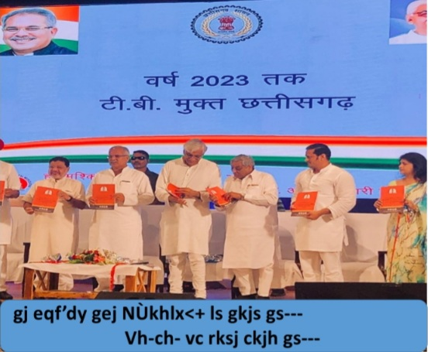
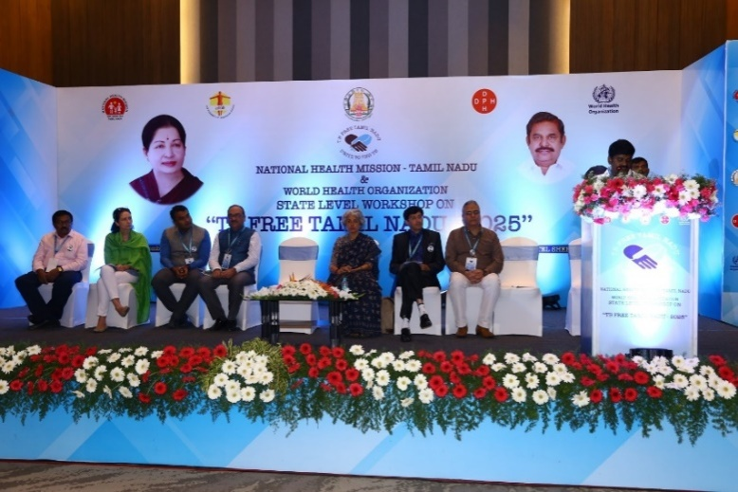
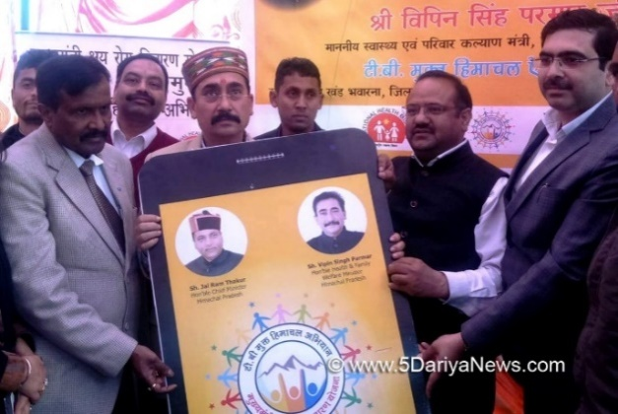
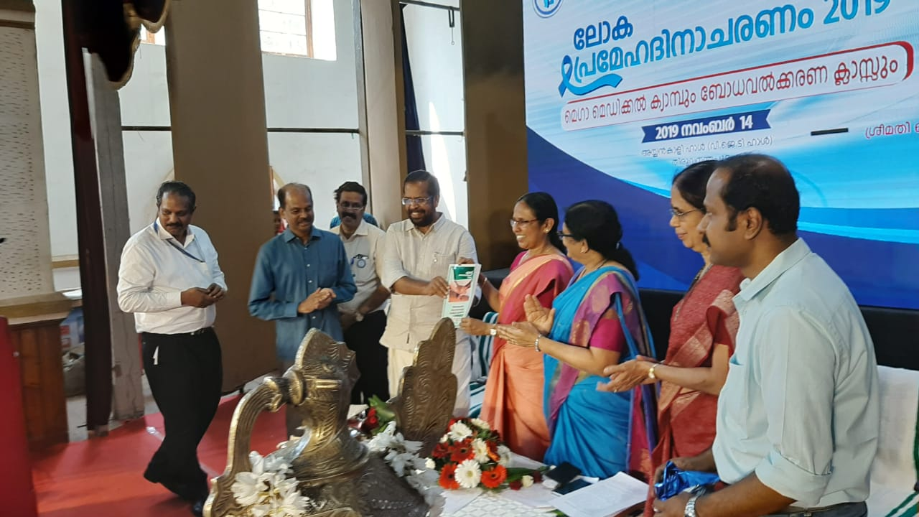
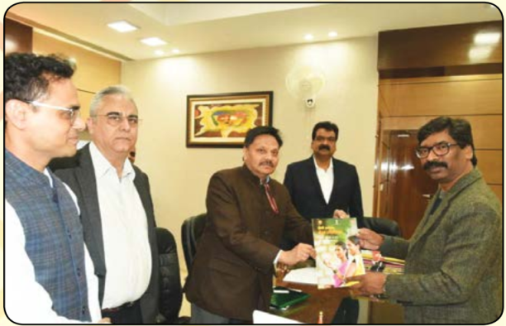
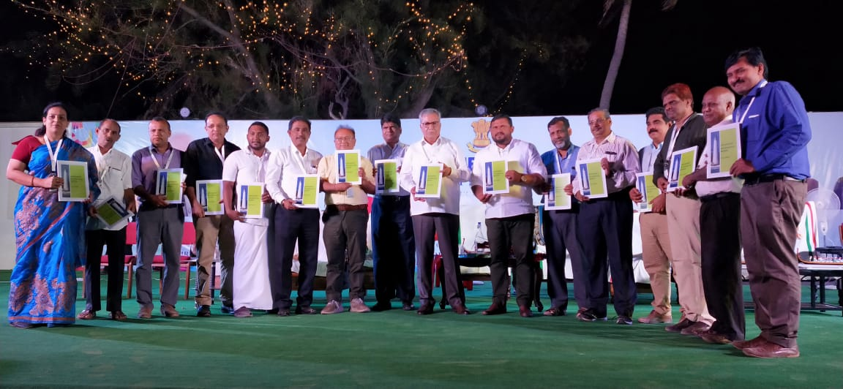
More & more States committing to Ending TB
Chhattisgarh
State level commitment 14 State/UT
Tamil Nadu
2020- Kerala
2021- Himachal Pradesh
2022- Gujarat, Lakshadweep & Sikkim
2025- Bihar, Chhatisgarh, Daman & Diu and Dadra & Nagar Haveli, Jammu & Kashmir, Jharkhand, Madhya Pradesh, Puducherry, Tamil Nadu and Andaman & Nicobar Islands
Himachal Pradesh
Kerala
Jharkhand
Lakshadweep

Slide 13

National Strategic Plan (2017-25)
Strategies
Private sector engagement
Active Case Finding
ICT Tools for adherence and monitoring
Preventive Measures
TB
Co-morbidities
Drug Resistant TB
Multi-sectoral response
Community Engagement
Notes:
For programme to way forward for End TB Strategy is Technical and Operational Guidelines. It encompasses all those systems outlined for 3 pillars of end tb strategy. The key areas are reflected in the figure here. Which I shall take your trough in next few slides. And then, in the subsequent plennary session we shall have more time to discuss and deliberate upon how to execute these components in medical colleges under the programme.

Slide 14
Newer initiatives
Active TB Case Finding in vulnerable population
CBNAAT expansion
Increase notification of TB patients from private sector – use of Schedule H1
Private sector – Free drugs and diagnostics
Daily Regimen implementation for treatment of TB
Universal Drug Susceptibility Testing
Newer Drugs – Bedaquiline and Delamanid
Direct Benefit Transfer Scheme (DBT) – nutrition support for TB patients, incentives for notification, treatment support
NIKSHAY Enhancement – DBT, IT enabled adherence, NIKSHAY Aushadhi

Slide 15
Evolving Strategies – Case Finding
Slums
Linkages
Passive
Intensified
Active
Migrants
Co morbidities
Communities
Molecular diagnostics
Key Populations
Culture & DST
Radiology
ZN & LED Microscopy

Slide 16
Intensified TB Case Finding in Key Population
Clinical | Social | Geographical
Clients attending HIV Care Settings | Prisoners | Urban Slums
Substance abuse including smokers | Occupations with risk of developing TB | Hard to reach areas
Co-morbidities like Diabetes Mellitus, Malignancies, patients on dialysis and on long term immunosuppressant therapy | People in Congregated settings – night shelters, De-addiction centers, Old age homes | Indigenous and tribal populations
Health Care Workers
Household & Workplace Contacts
Patients with Past History of TB
Malnourished
Antenatal mothers attending ANC/MCH
Notes:
The programme is explicitly putting forward intensified and active TB case finding as an effort to early detection and reaching the unreached or missing TB cases.
Clinical, social and geographical high risk groups (key populations) are identified. Systematic active TB screening approach is advocated by the programme in these group of population.

Slide 17
Presumptive Pulmonary TB
TB Suspect
Presumptive Pulmonary TB refers to a person with any of the symptoms and signs suggestive of TB including:-
-Cough for > 2 weeks
-Haemoptysis
-Fever >2 weeks
-Significant weight loss
-Any pulmonary abnormality in chest radiograph
Note: In addition , contacts of microbiologically confirmed TB patients, PLHIV , Diabetics, Malnourished, cancer patients, patients on immuno- suppressants or steroids should be regularly screened for sign and symptoms of TB
Notes:
Cough usually productive but not always so has been found to be present in about 85% of all bacillarry PTB cases and may be accompanied by other symptoms. Sometimes, it may however be absent. Criteria of 2 weeks vs 3 weeks increased case yield by 46%. Elicited cough cf spontaneously reported further increases case yield by about 7%.
Fever: Infections remain most common causes of fevers followed by auto-immune disorders, Ca, drug induced etc. And TB is one of the infectious causes of fever. Why not 3 weeks which is cut-off for PUO: We are not trying to establish a cause of PUO which in any case could be attributable to typical or atypical presentation of a common or rare disease.
Weight loss: >10% in last 6 months / >5% in last 1 month: Unintentional; absence of reduced caloric intake and unexplained: absence of an obvious disease state or therapy
In case of haemoptysis, also seek history of ATT – current / recent past
Though there could be other causes of these symptoms but evaluation for TB must be done so that we do not miss cases.
Chest pain: could be attributable to many causes pertaining to CVS, digestive, musculo-skeletal symptoms and respiratory systems-purticularly pleuritis (sharp, gets worse on deep breathing or coughing), pneumothorax, pneumonia, COPD. If you suspect TB as a cause, then evaluate to rule out.

Slide 18
Presumptive Extra Pulmonary TB
Presumptive Extra Pulmonary TB refers to the presence of organ specific symptoms and signs like swelling of lymph node, pain and swelling in joints, neck stiffness, disorientation , etc.,
and/or
constitutional symptoms like significant weight loss, persistent fever for ≥ 2 weeks, night sweats.
Notes:
Night sweats: sweating a thermo-regulatory mechanism; elicited/volunteered, defn vary: excessive/drenching/require change of clothing/bed linen/face wash/previous month/past 24 hours/last3 out of 4 weeks in a study in S africa in HIV; High prev in OPD, take room temp in consideration, common causes: menopause, hyperthyroidism, testosterone def, panic attacks, neoplasias, DM, HIV; TB->in EPTB, HIV+, younger adults. That is why we have it for EPTB and HIV and not PTB. However, 2 studies that included TB as initial predictor for TB did not include night sweats in final analysis.

Slide 19
Presumptive Paediatric TB
Presumptive Paediatric TB refers to children with
- Persistent fever and / or cough for more than 2 weeks
- Loss of weight*/no weight gain
and/or
- History of contact with infectious TB case**.
*History of unexplained weight loss or no weight gain in past 3 months ; loss of weight is defined as loss of >5% body weight as compared to highest weight recorded in last 3 months.
**In a symptomatic child contact with a person with any form of active TB within last 2 years may be significant.

Slide 20
Diagnostic Algorithm

Slide 21
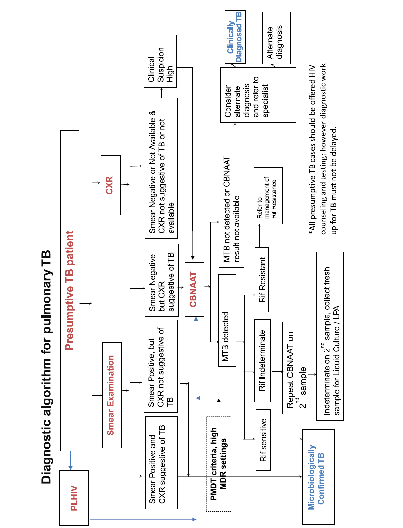
Diagnostic Algorithm for Pulmonary TB
Notes:
Why direct CBNAAT in HIV: need for earlier diagnosis and TTT due to higher CFR; smear has lower sensitivity;

Slide 22
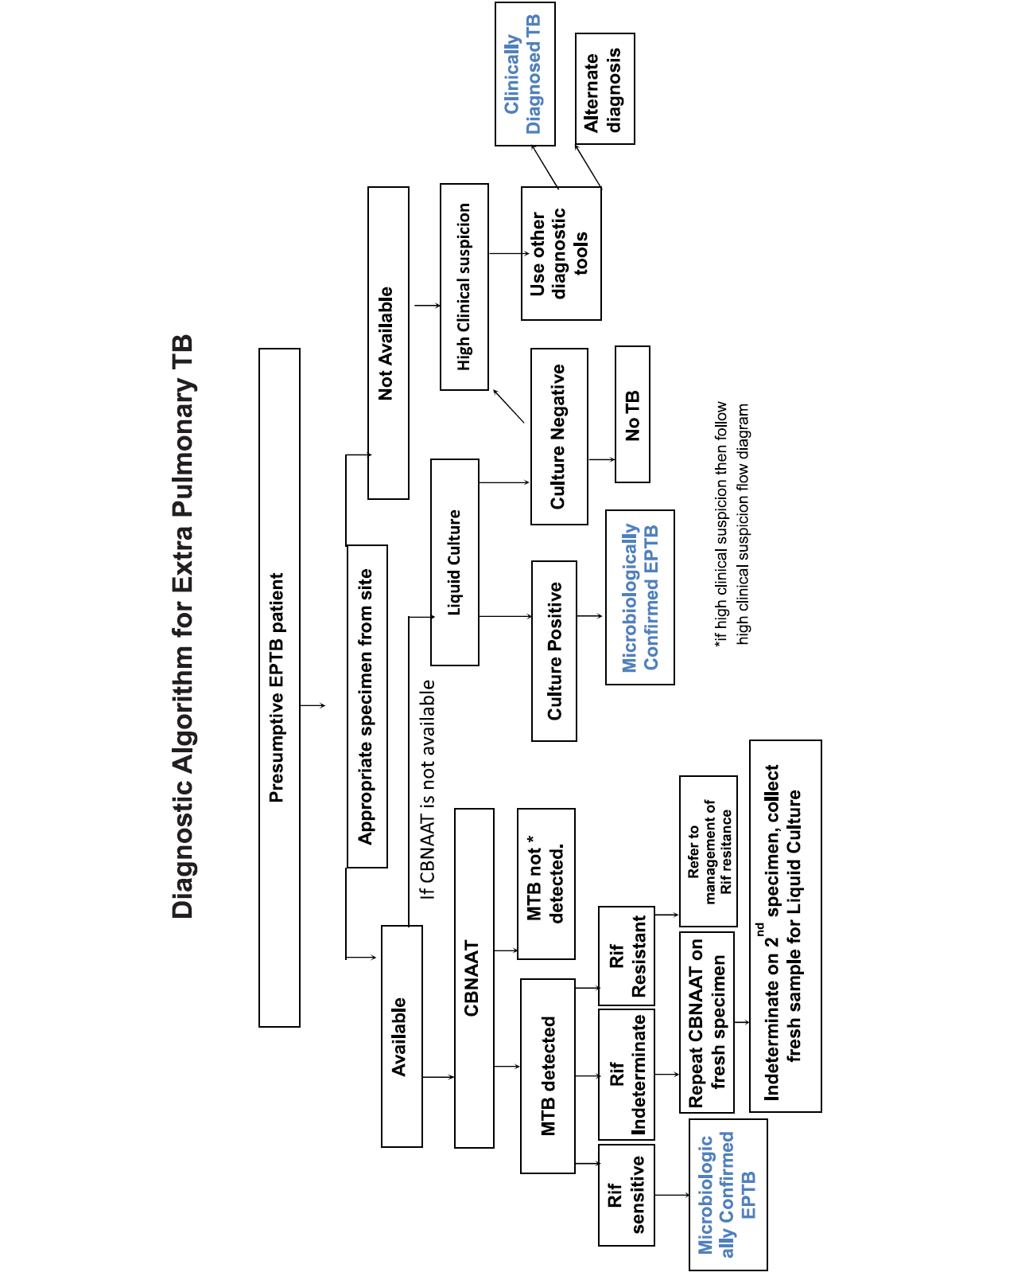
Diagnostic Algorithm for Extra Pulmonary TB
Notes:
For suspected cases of EPTB, appropriate specimen from suspected sites of involvement must be obtained for microbiological & histopathology by FNAC of LN/open or closed biopsy, though it may be difficult to obtain the specimen. In the event of Xpert negativity, culture may be advised. However, ATT can be initiated based on clinical judgement in the event of likely delay in receiving culture results. In TBM, there is need for early diagnosis, thus Xpert is preferred.

Slide 23
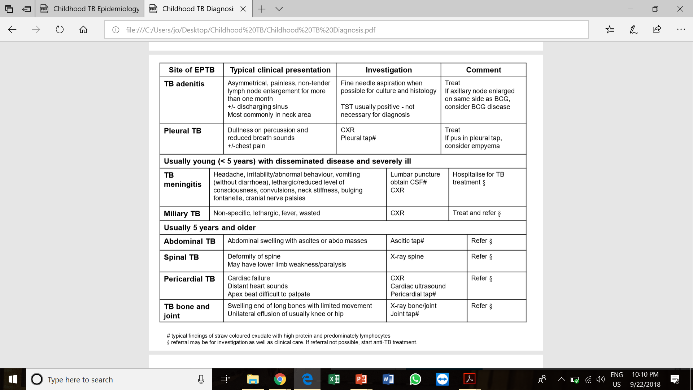


Extrapulmonary TB

Slide 24
Diagnosis

Slide 25

Diagnosis of TB
Clinical Diagnosis
Based on symptoms
Radiological ( X-Ray, CT Scan/MRI)
FNAC/Tissue Biopsy ; Histopathology
Microbiological Confirmation
Microscopy (ZN/LED FM)
Phenotypic Tests
  Solid Culture (LJ)
  Liquid Culture ( MGIT)
Genotypic Tests :Rapid Molecular Tests
  1st Line LPA ( R&H), 2nd Line LPA ( Group of FQ and SLI)
  CBNAAT/ GeneXpert
  True NAAT/ RTPCR
Notes:
UATLD study
N = 1100 X-ray films. 90 experienced radiologists and chest physicians from 9 countries, WHO. Is the film abnormal?
Cavity present?
Abnormality in lung, probably tuberculous?
Calcification?
Index of disagreement ranged from 26% to 62%.
Many diseases mimic TB
TB can take any radiographic picture
TB cannot be diagnosed by CXR alone
A good screening tool
Further examination like bacteriology required for firm diagnosis
Non-calcified abnormality, probably tuberculous?
Abnormality in lymph nodes?
Need for medical action?
.

Slide 26

Turnaround time
  Solid LJ media- of up to 84 days,
  Liquid Culture (MGIT) up to 42 days,
  LPA up to 72 hours
  CBNAAT/ Gene Xpert - 2 hours
  RTPCR/ TRUENAAT – 90 min

Slide 27
Sensitivity & Specificity of Diagnostic tools
Diagnostic tests | Sensitivity (%) | Specificity (%)
Conventional sputum-smear Microscopy | 60 (31-89) | 98 (93-100)
Xpert MTB/RIF | 88 | 98
Test | Over all Sensitivity | Sensitivity in Smear postive patients | Specificity
Smear | 64.70%
TruNat/RT-PCR | 94.70% | 99% | 99%
Gene Xpert | 96 | 100% | 99%
Nikam C, Kazi M, Nair C, Jaggannath M, Manoj M, Vinaya R, Shetty A, Rodrigues C. Evaluation of the Indian TrueNAT micro RT-PCR device with GeneXpert for case detection of pulmonary tuberculosis. Int J Mycobacteriol 2014;3:205-10
Notes:
% of smear positive cases out of all cases likely to be lower in field surveys due to disease being less severe.

Slide 28
Treatment

Slide 29
Regimen
Type of TB case | Treatment regimen in IP | Treatment regimen in CP
New | (2) HRZE | (4)HRE
Previously treated | (2) HRZES+(l) HRZE | (5) HRE

Slide 30
Daily Dose Schedule for Adults
(as per weight bands)
Weight band | Number of tablets |  | Inj. Streptomycin
 | Intensive phase | Continuation phase
 | HRZE | HRE
 | 75/150/400/275 mg | 75/150/275 mg | gm
25-39 kg | 2 | 2 | 0.5 gm
40-54 kg | 3 | 3 | 0.75 gm
55-69 kg | 4 | 4 | 1 gm
≥70 | 5 | 5 | 1 gm

Slide 31
Drug dosages for anti-TB drugs
Drugs | Adult | Children upto 25kg
Isoniazid | 5 mg/kg (4 to 6 mg/kg) daily | 10 mg/kg (7-15 mg/kg) daily
Rifampicin | 10 mg/kg (8-12 mg/kg) daily | 15 mg/kg (10-20 mg/kg) daily
Pyrazinamide | 25 mg/kg (20-30 mg/kg) daily | 35 mg/kg (30-40 mg/kg) daily
Ethambutol | 15mg/kg (12-18 mg/kg) daily | 20 mg/kg (15-25 mg/kg) daily
Streptomycin | 15 mg/kg (15-20 mg/kg) daily | 15 mg/kg (12-18 mg/kg) daily
Note also other revisions to recommendations:
Four drugs (RHZE) in intensive phase for all new cases in HIV endemic setting
No intermittent regimens in HIV-endemic
12-month regimens for TBM and osteo-articular TB

Slide 32
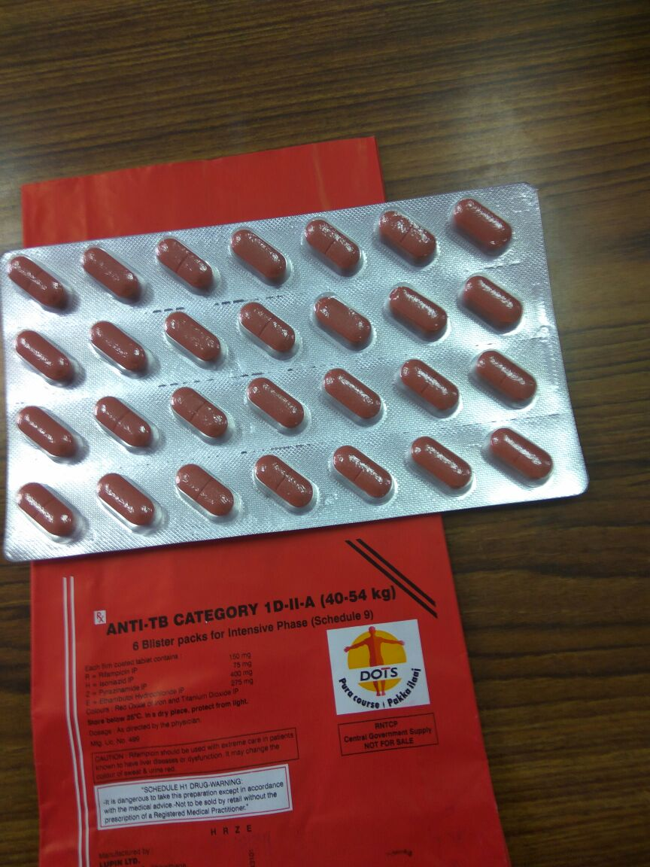
4FDC

Slide 33
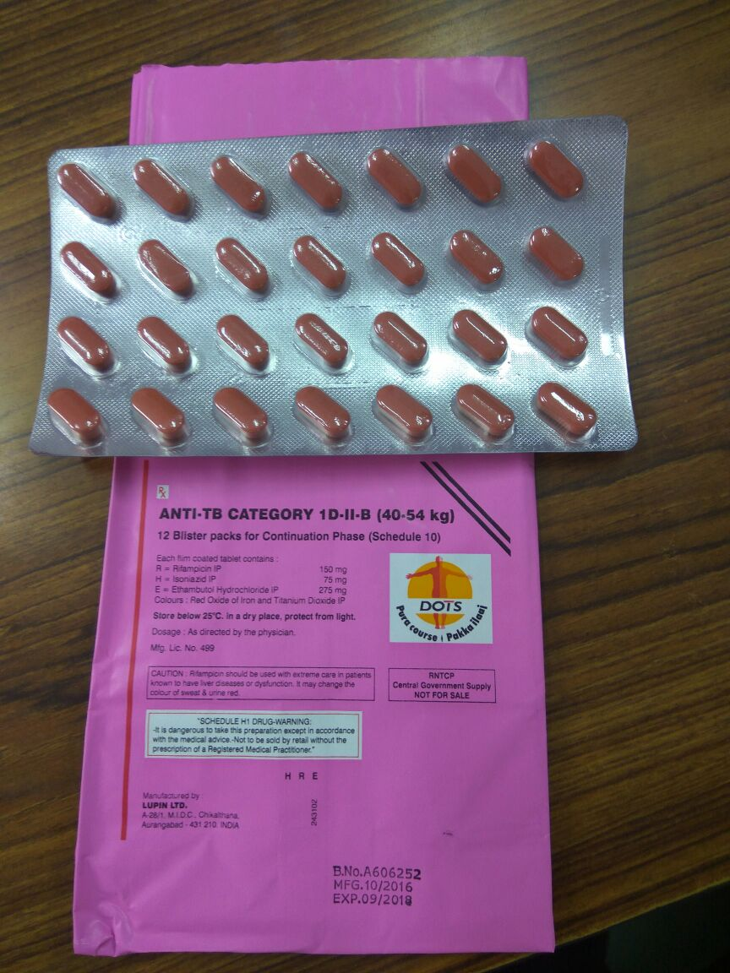
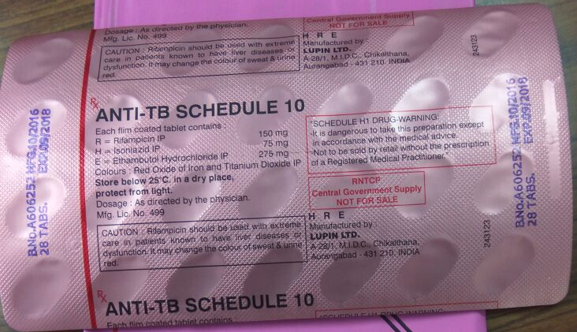
3FDC

Slide 34
Inj. Streptomycin
15 mg/kg (12–18 mg/kg) daily
Maximum daily dose 1000 mg
Patients aged over 50 years may not be able to tolerate more than 750 mg daily
Similarly, patients weighing less than 50 kg may not tolerate doses above 500-750 mg daily

Slide 35
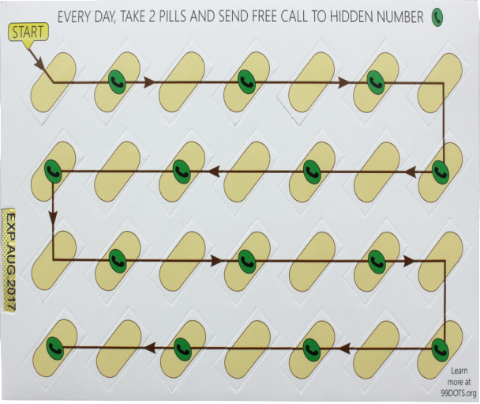
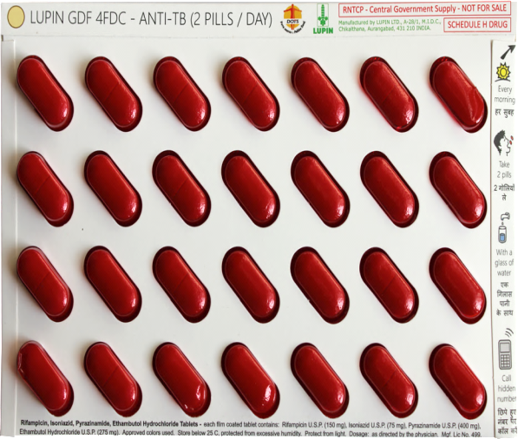

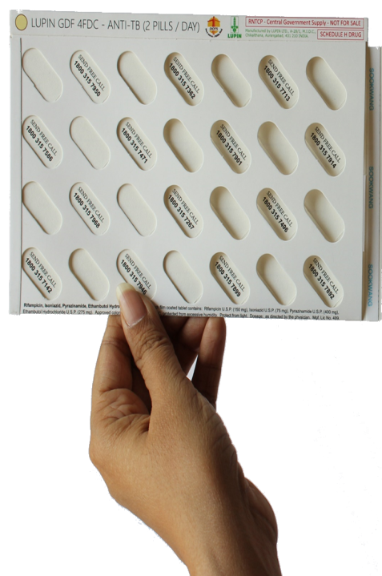
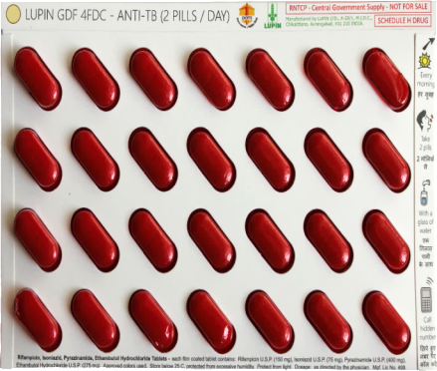

99dots: Accurate monitoring at very low cost
Notes:
Trainer’s notes:

Slide 36
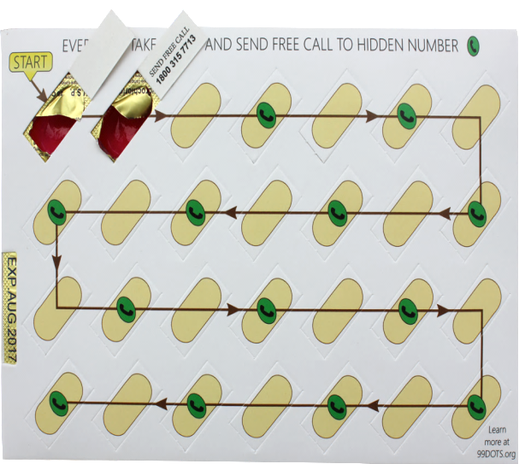

99 DOTS
Combination of Caller ID and numbers called shows that doses are in patient’s hands.
Notes:
Trainer’s notes:

Slide 37
Pyridoxine in TB Regimen
Tab pyridoxine not required for all TB patients
To prevent INH related neuropathy in persons at high risk of Vitamin B6 deficiency
  Alcoholics
  Malnourished persons
  Pregnant and lactating women
  Patients with conditions such as chronic renal failure, diabetes,
  HIV infection
While treating NTM
Notes:
Trainer’s notes:

Slide 38
Follow up of Treatment
Components of follow up:
  Clinical follow up
  Laboratory follow up
Clinical follow up
  at least monthly (Patient visits the clinical facility or the MO reviews during home visit
  Improvement on chest symptoms, increase in weight etc. may indicate good prognosis
  Control of co-morbid conditions like HIV and diabetes
  Symptoms and signs of adverse reactions to drugs should be specifically asked

Slide 39
Long term follow up
After completion of treatment, the patients should be followed up at the end of 6, 12, 18 & 24 months.
In presence of any clinical symptoms and/or cough, sputum microscopy and/or culture should be considered. This is important in detecting recurrence of TB at the earliest.

Slide 40
Contact Tracing & Screening
All close contacts, especially household contacts should be screened for TB
In case of paediatric TB patients, reverse contact tracing for search of any active TB case in the household of the child must be undertaken.
Particular attention should be paid to contacts with the highest susceptibility to TB infection

Slide 41
Isoniazid Preventive Therapy
Children < 6 years of age, who are close contacts of a TB patient, should be evaluated for active TB by a medical officer/ paediatrician
After excluding active TB he/she should be given INH preventive therapy irrespective of their BCG or nutritional status
The dose of INH for preventive therapy is 10 mg/kg body weight administered daily for a minimum period of six months
The contacts should be closely monitored for TB symptoms

Slide 42
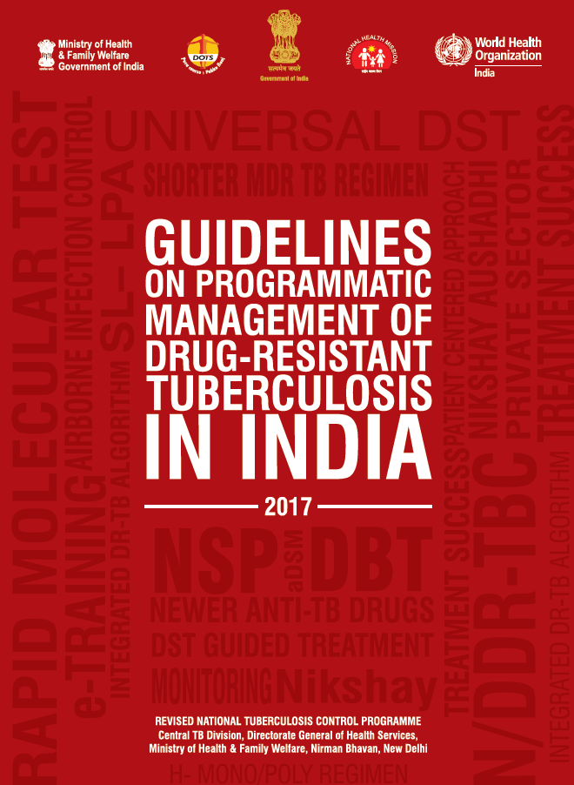
Drug Resistance Tuberculosis

Slide 43

Classification of patients based on drug resistance pattern
Mono-resistance (MR):A TB patient, whose biological specimen is resistant to one first-line anti-TB drug only.
Poly-Drug Resistance (PDR):A TB patient, whose biological specimen is resistant to more than one first-line anti-TB drug, other than both H and R.
Rifampicin Resistance (RR):A TB patient, whose biological specimen is resistant to rifampicin, detected using phenotypic or genotypic methods, without resistance to other anti-TB drugs. It includes any resistance to rifampicin, in the form of mono-resistance, poly-resistance, MDR or XDR.
Multi Drug Resistance (MDR): A TB patient, whose biological specimen is resistant to both isoniazid and rifampicin with or without resistance to other first line drugs.
  MDR-TB patients may also have additional resistance to any/all FQ OR any/all SLI anti-TB drug.
Extensive Drug Resistance (XDR):A MDR TB patient whose biological specimen is additionally resistant to at least a FQ(Ofx, Lfx,Mfx) and a SLI anti-TB drug (Km, Am, Cm).

Slide 44
Integrated Drug Resistant TB Algorithm
Presumptive TB
All diagnosed TB patients
Key/Vulnerable populations
Paediatric age group
People living with HIV
EPTB sites
Smear negative/NA with X-ray suggestive of TB
Non responders to treatment
DR-TB contacts
Previously treated TB
TB-HIV co-infection
New TB cases $
CBNAAT
RR TB
For discordance on LPA for RR-TB – repeat CBNAAT at LPA lab
RS TB
Shorter MDR TB Regimen (9-11 m)#
First line treatment
SL - LPA**
FL-LPA*
FQ and SLI Sensitive
FQ and/or SLI Resistance
H Resistant
H Sensitive
Continue same regimen (shorter MDR or H mono/poly regimen)
Newer Drugs & DST guided treatment
H mono/poly resistant TB regimen
Continue First line treatment
In case of addl resistance, failing regimen, drug intolerance, return after interruption (>1 m) or emergence of any exclusion criteria
# Conventional MDR TB Regimen (24 m) for pregnant women or for EP TB patients those who are not eligible for shorter regimen.
*Offer molecular testing and treatment for H mono/poly resistance to TB patients prioritized by risk as per the available lab capacity
**LC DST (Mfx 2.0, Km, Cm, Lzd) will be done only for patients with any resistance on baseline SL-LPA. DST to Z, Cfz, Bdq & Dlm would be considered for policy in future, whenever available, standardized & WHO endorsed.
$ States to advance in phased manner as per PMDT Scale up plan for universal DST based on lab capacity and policy on use of diagnostics

Slide 45
Classes of Anti TB Drugs recommended for treatment of DR-TB
New Grouping of Drugs
A. Fluoroquinolones | Levofloxacin Moxifloxacin Gatifloxacin |  | Lfx Mfx Gfx
B. Second-line injectable agents | Amikacin Capreomycin Kanamycin (Streptomycin) |  | Am Cm Km (S)
C. Other second-line agents | Ethionamide / Prothionamide Cycloserine / Terizidone Linezolid Clofazimine |  | Eto/Pto Cs/Trd Lzd Cfz
D. Add-on agents (not part of the core MDR-TB regimen) | D1 | Pyrazinamide Ethambutol High-dose isoniazid | Z E H^{h}
 | D2 | Bedaquiline Delamanid | Bdq Dlm
 | D3 | p-aminosalicylic acid Imipenem-cilastatin Meropenem Amoxicillin-clavulanate (Thioacetazone) | PAS Ipm/Cls Mpm Amx-Clv (T)

Slide 46
Standard regimen for initiating treatment of MDR/RR-TB at district DR-TB centre based on CBNAAT or FL-LPA
Resistance Pattern | Regimen Class | Intensive Phase | Continuation Phase | Principle of regimen design
Shorter MDR-TB Regimen
R resistant + H sensitive/ unknown Or MDR -TB | Shorter MDR-TB Regimen | (4-6) Mfx^{h} Km* Eto Cfz Z H^{h} E | (5) Mfx^{h} Cfz Z E | As per WHO recommendation
Regimen for MDR/RR-TB
R resistant + H sensitive/ unknown Or MDR -TB | Conventional MDR-TB Regimen | (6-9) Lfx Km Eto Cs Z E | (18) Lfx Eto Cs E | 1 GpA + 1GpB + 2 GpC + Z + add on 1 GpD1
*If the intensive phase is prolonged, the injectable agent is only given three times a week in the extended intensive phase.

Slide 47
Duration of regimen
Regimen | Intensive Phase | Extended Intensive Phase | Continuous Phase | Total duration
H mono-poly DR-TB regimen & Mixed pattern H mono/poly | 3 months | +3 months | 6 months | 9-12 months
Shorter MDR-TB regimen | 4 months | +2 months | 5 months | 9-11 months
Conventional MDR-TB regimen (Regimen with or without new drugs for MDR-TB + FQ / SLI resistance) | 6 months | +3 months | 18 months | 24-27 months
XDR-TB regimen (Regimen with or without new drugs for XDR-TB, mixed pattern XDR- TB) | 6 months | +6 months | 18 months | 24-30 months

Slide 48
Newer anti-TB drugs
Bedaquiline The new drug with anti-TB effect, was approved for treatment of multidrug resistant TB by US FDA in late 2012
Strong bactericidal and sterilizing activities against M.tb
The drug has an extended half-life up to 5.5 months post stopping BDQ due to high volume of distribution, with extensive tissue distribution, highly bound to plasma proteins
shown significant benefits in improving the time to culture conversion in MDR-TB patients
Active drug safety monitoring (aDSM)
Cross-resistance with Clofazimine.
Indication: pulmonary adult MDR-TB patients
  when an effective treatment regimen containing at least four second-line drugs in addition to Z cannot be designed or
  when there is documented evidence of resistance to any FQ and/or SLI in addition to MDR TB
  In March 2016, RNTCP introduced BDQ through CAP at six DR-TB centres

Slide 49
Eligibility for Bedaquiline
Bdq is indicated in adult MDR-TB patients not eligible for the newly WHO-recommended shorter regimen.
These may include:
MDR/RR-TB patients with resistance to any/all FQ OR to any/all SLI
XDR-TB patients
Mixed pattern resistant TB patients
Treatment failures of MDR-TB + FQ/SLI resistance OR XDR-TB
MDR/RR-TB patients with extensive pulmonary lesions, advanced disease and others deemed at higher baseline risk for poor outcomes

Slide 50
Bedaquiline: Dosage
Week 0–2: BDQ 400 mg (4 tablets of 100 mg) daily (7 days per week) + OBR
Week 3–24: BDQ 200 mg (2 tablets of 100 mg) 3 times per week (with at least 48 hours between doses) for a total dose of 600 mg per week + OBR
Week 25 (start of month 7) to end of treatment: Continue other second-line anti-TB drugs only as per RNTCP recommendations
The dosage of BDQ would apply to all weight bands while the dosage of other drugs in the OBR would be as per the weight bands in accordance to the RNTCP PMDT guidelines.

Slide 51
Delamanid (1)
Excludes paediatric cases with reported QTc prolongation (greater than 500msec);
Paediatric patients with HIV co-infection were excluded from the analysed studies; drug has not been tested in patients with extra-pulmonary MDR-TB
Studies are underway, currently there are no data on the effect of delamanid in children younger than 6 years of age and weighting under 20 kg.

Slide 52
DST guided regimen with or without newer drugs for initiating treatment of MDR/RR-TB patients with additional resistance to FQ class and/or SLI class, at nodal DR-TB centre based on SL-LPA
Resistance Pattern | DST Guided Regimen class | Intensive Phase | Continuation Phase | Principle of regimen design
Regimen with New drugs for MDR-TB + FQ / SLI resistance
MDR/RR + resistance to FQ class / SLI¹ class | MDR/RR + resistance to FQ class | (6-9) Km Eto Cs Z Lzd³ Cfz + (6) Bdq | (18) Eto Cs Lzd³ Cfz | 0 GpA + 1GpB + 2 GpC + Z + add on 2 GpC + 1 GpD2
 | MDR/RR+ resistance to SLI¹ class | (6-9) Lfx Cm¹ Eto Cs Z Lzd³ Cfz + (6) Bdq | (18) Lfx Eto Cs Lzd³ | 1 GpA + 1 GpB¹ + 2 GpC + Z + add on 2 GpC + 1 GpD2
Regimen MDR-TB + FQ / SLI resistance: (without new drugs)
MDR/RR + resistance to FQ class / SLI¹ class | MDR/RR + resistance to FQ class | (6-9) Mfx^{h2} Km Eto Cs Z Lzd³ Cfz | (18) Mfx^{h2} Eto Cs Lzd³ Cfz | 1 GpA² + 1GpB + 2 GpC + Z + add on 2 GpC
 | MDR/RR+ resistance to SLI¹ class | 6-9) Lfx Cm¹ Eto Cs Z Lzd³Cfz | (18) Lfx Eto Cs Lzd³ | 1 GpA + 1 GpB¹ + 2 GpC + Z + add on 2 GpC
1 If only Km resistant (at eis mutation), then add Cm in IP upfront in the regimen design.
2. In patients with MDR/RR + FQ Class resistance, XDR-TB and Mixed pattern resistance where a new drug is not considered in the regimen for any reason, Mfx^{h} would be added upfront in the regimen design and the decision to continue or replace it would be taken based on LC-DST results to Mfx (2.0) by NDR-TBC
3. Lzd to be replaced with a suitable drug if found to be resistant on LC-DST. In such situation the patient must be reclassified as mixed pattern DR-TB

Slide 53
Organizational structure

Slide 54
Key Services
Free diagnosis and treatment for TB patient
Public health action- contact tracing, testing for co-morbidities etc.
Treatment adherence support
Nutrition assistance to TB patients (DBT-Nikshay Poshan Yojana)
Preventive measures

Slide 55
Treat
Treatment
Daily Regimen
Patient Centric Care
IT Enabled Adherence Support
Reduce Out-of-pocket Expenditure
Financial incentives
Direct Benefit Transfer
Shorter Regimen
Newer Drugs
Comorbidity management

Slide 56
Direct Benefit Transfer (DBT) schemes
  Honorarium to Treatment Supporters – For provision of treatment support to TB patients (Adherence, ADR monitoring, counselling @Rs.1000/- to Rs.5000/-)
  Patient Support to Tribal TB Patients (Financial Patient Support @Rs750/-)
  Nutritional Support to All TB patients (Financial Support to Patients @Rs.500/-month)
  Incentives to Private Providers (Rs.500/- for Notification & Rs.500/- for reporting of Treatment Outcome
  Incentives to Informant (Rs. 500/- is given on diagnosis of TB among referrals from community to public sector health facility)
Notes:
In RNTCP, one of the first health programs to move to DBT, will be using it to transfer monetary benefits to eligible patients and providers. We would be using Nikshay to identify the beneficiaries and the transfer of funds will be through the Public Financial Management System or PFMS

Slide 57



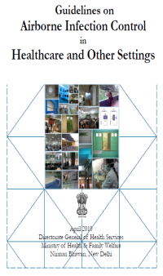
Prevent
Air borne infection control measures
Strengthen Contact Investigation
Preventive treatment in high risk groups
Manage Latent TB Infection
Address determinants of disease

Slide 58
Multi-sectoral Engagement
Infection Prevention
Address Determinants
Information Education Communication
Corporate
Social Responsibility
Socio-economic support & Empowerment
TB care services in health infrastructure
Prevention and Care at Work Place
Indian Post
Home Affairs
Panchayati Raj
Defence
Labour & Employment
Financial Services
TB - A social problem & needs multi-sectoral approach

Slide 59

Community Engagement
TB Forums at the National, State and District level to provide a platform for all stakeholders, including the community, to voice their views
Transformation of TB survivors to TB champions
Capacity building and mentoring programme
Engagement of existing community groups like PRI, SHG, VHSNC, MAS, Youth Club
Grievance redressal mechanism
Involvement of community representatives in different forums

Slide 60
Call Centre- Nikshay Sampark
Counselling
Treatment Adherence
TB Notification
Nikshay Poshan Yojana
Follow Up
Information
Grievance Redressal
1800-11-6666
Outbound & Inbound
Time – 7 to 11
Languages – 14
100 call centre agents
Pan-India coverage
Citizen – Patient - Providers
Policy Update in RNTCP, 2018

Slide 61
Sub-National Disease Certification
District
Accelerate efforts
Contextual strategies
Generate healthy competition
Monetary and non-monetary awards
Award | Criteria Decline in incidence rate compared to 2015 | Monetary Award for District (in Rs.)
Bronze | 20% | 2 lakhs
Silver | 40% | 3 lakhs
Gold | 60% | 5 lakhs
TB Free Status | 80% | 10 lakhs
State
Award | State/Uts with population <50 lakh | State/Uts (population 50 lakh – 5 Cr | State/Uts population >5 Cr
Bronze | 10 lakhs | 15 lakhs | 25 lakhs
Silver | 20 lakhs | 35 lakhs | 50 lakhs
Gold | 40 lakhs | 60 lakhs | 75 lakhs
TB Free Status | 60 lakhs | 75 lakhs | 1 Crore

Slide 62
Key Challenges
Under reporting and uncertain care of TB patients in private sector
Reaching the unreached – Slums, Tribal, vulnerable
Drug Resistant TB
Co-morbidities – HIV, Diabetes
Undernutrition, overcrowding
Lack of awareness and poor health seeking behaviour lead to delay in diagnosis

Slide 63

Bending the Curve
Accelerating towards a TB free India
Thank You
Thank You

Slide 64
Treatment in Special Situations

Slide 65
Management of DR-TB patients with Pregnancy
Duration of pregnancy
<20 weeks
>20 weeks
Start/Continue modified conventional MDR-TB Regimen
- Omit Km; add PAS till delivery
- Replace PAS with Km after delivery and continue till end of IP
Advised MTP
MTP done
Pt. unwilling for MTP
Start/ Continue shorter MDR- TB Regimen
Start/ Continue modified Conventional regimen
- <12 weeks: Omit Km & Eto; add PAS
- >12 weeks: Omit Km only; add PAS
- Replace PAS with Km after delivery and continue till end of IP

Slide 66
DR-TB in pregnancy
Avoid aminoglycosides as it is particularly toxic to the developing fetal ear
Ethionamide can increase the risk of nausea and vomiting associated with pregnancy
  If the injectable agents & ethionamide/ prothionamide or other drugs were withheld because of the pregnancy, they can be added back postpartum to make a more complete regimen.

Slide 67
Addressing Co-morbidity

Slide 68


WHO recommendations for reduction in the burden of TB among PLHIV
The 3“I”s
Intensified Case Finding (ICF)
Isoniazid Preventive Therapy (IPT)
Infection Control in HIV care settings (IC)

Slide 69
4 symptom complex for TB screening among PLHIV
Adult
Current cough
Fever
Weight loss
Night Sweats
Children
Current cough
Fever
Poor weight gain
Contact with TB case
Getahun H et al. Development of a standardized screening rule for tuberculosis in people living with HIV in resource constrained settings: individual participant data meta-analysis of observational studies. PLoS Medicine, 2011, 8(1): e1000391. doi:10.1371/journal.pmed.1000391.
Meta analysis over 8000 patients, the NPV 97.7% (95% CI 97.4–98.0)
Notes:
Trainer’s notes:

Slide 70
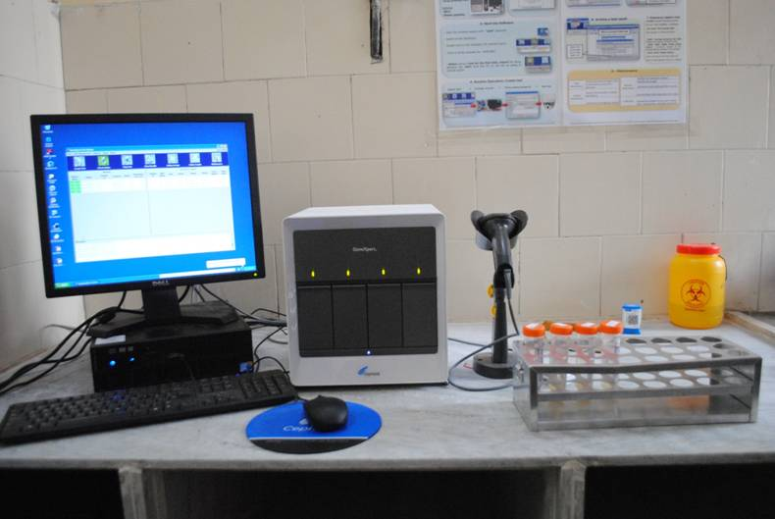
Newer TB Diagnostics: CBNAAT
RNTCP has also endorsed the policy of prioritizing to offer rapid molecular test Cartridge Based Nucliec acid amplification Test (CBNNAT) to all presumptive TB cases among PLHIV for early diagnosis of TB as well as Rif resistance. Currently 89 such CBNAAT machines deployed across the country.

Slide 71
Initiating ART in patients with DR- TB
The use of ART in HIV infected patients with TB improves survival for both drug resistant and susceptible disease.
HIV infected DR-TB patients without the benefit of ART may experience mortality rates exceeding 90%.
.
Second-line anti-TB drugs should be initiated first, followed by ART as soon as second-line anti-TB drugs are tolerated.
  Generally this should be within the first two weeks of initiating DR-TB treatment.
  Undue delay in starting ART could result in significant risk of HIV related death amongst DR-TB patients.
If the CD4 cell count is below 50 cell/cmm,
  start ART simultaneously with ATT, with strict clinical and laboratory monitoring.

Slide 72
IRIS Syndrome
Patients with HIV-related TB may experience a paradoxical reaction of temporary exacerbation of symptoms, signs/ radiographic manifestations of TB after beginning TB treatment.
It is a result of Immune Restitution due to the simultaneous administration of antiretroviral and tuberculosis medication (IRIS Syndrome)

Slide 73
TB HIV Services
Perform provider-initiated HIV testing and counselling in all Presumptive PLHIV and TB patients
Xpert MTB/RIF molecular assay in HIV-positive TB suspects: TB in HIV-infected patients is more likely to be smear-negative or extrapulmonary.
Initiate ART promptly in drug-resistant TB/HIV patients:
  ART should be started promptly in all HIV-infected patients with MDR-TB regardless of CD4 cell count.
  Anti-TB drugs should be initiated first, followed by ART as soon as second-line anti-TB drugs are tolerated.

Slide 74
TB HIV services …
4. Provide co-trimoxazole preventive therapy for patients with active TB and HIV
5. Implement sound patient follow up and monitoring system:
6. Provide integrated TB and HIV services:
These patients should receive treatment for TB and HIV – and any other comorbidities –at the same place and time as possible.
7. Ensure effective TB infection control

Slide 75
TB-Diabetes Joint Collaborative Framework
Goal
To reduce morbidity and mortality due to TB and diabetes through prevention, bidirectional screening for early detection and prompt management of TB and diabetes.
Implementation strategy The following strategy is proposed for collaboration between NPCDCS and RNTCP:
Activities to improve diagnosis and management of diabetes among TB patients:
Screening of all registered TB patients for diabetes
Intensified detection of active TB disease among diabetes patients
Ensuring TB infection control measures
Ensuring TB treatment and management in diabetes patients

Slide 76
TB-Tobacco Joint Collaborative Framework
Objectives:
To establish mechanisms of collaboration between RNTCP and NTCP
To provide ‘Brief Advice’ for tobacco cessation
To screen for active TB symptoms in tobacco users registered at Tobacco Cessation Centres (TCC) and National Tobacco Quitline;

Slide 77
Implementation plan
Initial phase, programme will be implemented where NTCP is functional
  in selected districts where both programmes has well developed infrastructure
Second phase, inclusion of National Tobacco Quitline for pan India implementation
Third phase, inclusion of mCessation services

Slide 78
Private sector engagement
& DBT
(Patients, Private providers & Treatment supporters)

Slide 79
Reaching to TB patients in Private Sector
Engagement with Providers
Access to Services
Patient Support
Incentives to Patients and Providers
Regulations
Policy support
Enabling Tools
Surveillance

Slide 80
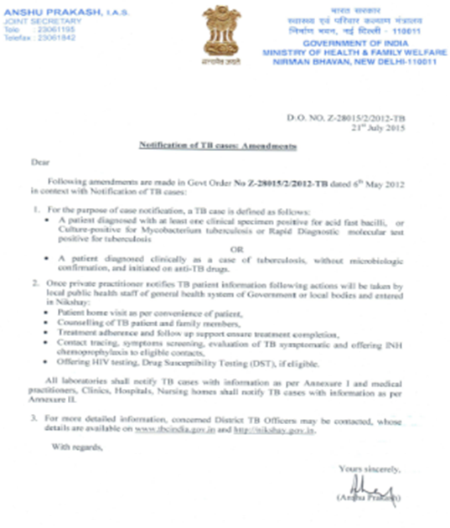
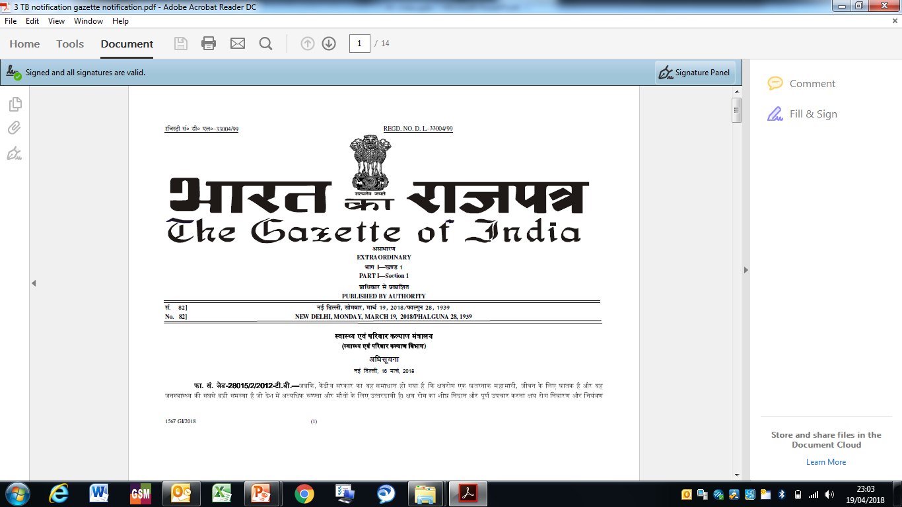
TB is a Notifiable Disease from 2012 in India
7th May 2012
First Order
21st July 2015
First Amendment
19th March 2018
Second Amendment
Laboratories
Practitioners / hospitals
Public Health action
Chemist
Self notification by patient

Slide 81
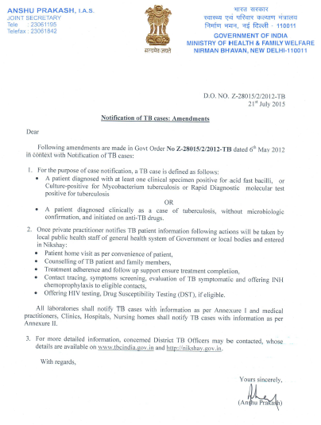
Public health action
Patient home visit as per convenience of patient,
Counselling of TB patient and family members,
Treatment adherence and follow up support ensure treatment completion,
Contact tracing, symptoms screening, evaluation of TB symptomatic and offering INH chemoprophylaxis to eligible contacts,
Offering HIV testing, Drug Susceptibility Testing (DST), if eligible.

Slide 82
NIKSHAY Poshan Yojana (Scheme detail)
Beneficiary:
All notified TB patients are the beneficiary of the scheme
Eligibility:
All TB patients notified on or after 1st April 2018 and all existing TB patient on treatment
Duration of benefit:
Incentives will be extended to TB patients as long as the patient is on anti-TB treatment
Arrangement for payment
Payment will be made direct to bank account detail of patient, once s/he is notified in NIKSHAY
On notification of TB patient the first incentive is given as advance and then till the patient is on anti-TB treatment.
Also, to reduce the number of transactions, two months incentives will be clubbed. To ensure treatment adherence, after first installment, conditionality of follow-up examination is applicable.

Slide 83
Incentives to Providers
Incentives of Rs. 1000/- for notification and reporting treatment outcome will be given in two instalments.
  Rs. 500/- at notification of TB patient
  Rs. 500/- at reporting treatment outcome
Incentive for Treatment support
  New Case: Rs. 1000/- at completion of treatment
  Previously Treated Case: Rs. 1500/- at completion of treatment
  Drug Resistant Case: Rs. 2000/- at completion of intensive phase, Rs. 3000/- at completion of treatment

Slide 84
  Pre-requisites for DBT
  (Nikshay ←→ PFMS←→Bank)
TB Patient to be notified in NIKSHAY with required details
Bank Account Details are required of beneficiaries
AADHAAR details are required

Slide 85

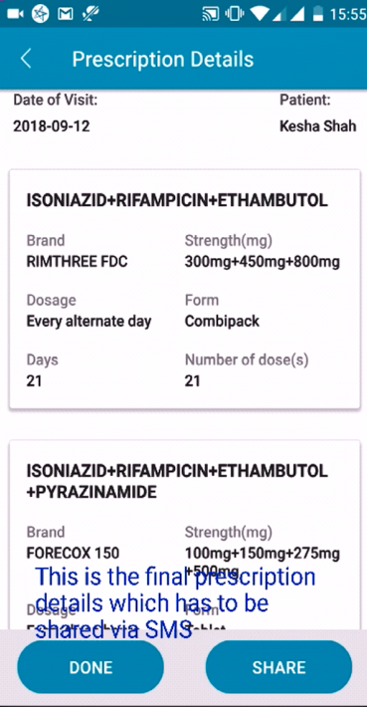
App based Prescription & Dispensation of ATT
“AP-eRx “
Doctor | Pharmacy | Patient
Reduces Irrational Use – Usage with our prescription Prevents prescription drug errors Drop-Down lists of medicines and their strengths Patient’s medication history Prescription fulfillment tracking Improves medication adherence | Reduced Medication Abuse - Usage not as per prescription Better monitoring of dispensations Easier to verify the authenticity of the prescription Less time responding to prescriptions Direct reimbursement of benefits form Govt. | Improved Patient Safety Reduces the cases of lost prescriptions Improves medication adherence Enables auto maintenance of medication history – accessible to any doctor
Data from the server linked to CM ‘CORE’ Dashboard
https://play.google.com/store/apps/details?id=org.gov.ap.doctor
APeRx_Doctor App.mp4
https://play.google.com/store/apps/details?id=org.gov.ap.pharmacy

Slide 86





App based Prescription & Dispensation of ATT
“AP-eRx “
Launched in September 2018, Hosted on Govt. of AP server In Google play store
APeRx
Prescription ID
Doctor writes prescription through APeRx doctors application
Message / Share “Prescription Id” to patient
Patient visits pharmacy with “Prescription ID” before prescription validity is expired.
Doctor can see the status of the dispensation through APeRx doctors app. (Not Dispensed. Partially / completely dispensed)
APeRx
Pharmacy dispenses medicines Partially or Completely based on patient request
Pharmacy access prescription using Prescription ID through APeRx pharmacy application
https://play.google.com/store/apps/details?id=org.gov.ap.doctor
APeRx_Doctor App.mp4
https://play.google.com/store/apps/details?id=org.gov.ap.pharmacy

Slide 87

Thank You
The WTBD 2019 theme will ensure the world is reminded of the commitments made and the timely need for action in scale up, research, funding, human rights and accountability.
The World TB Day 2019 Theme is: It’s Time...
...to keep the promises made at the UN HLM on TB
...for a world without TB
...to treat 40 million people affected by TB by 2022
...to know your TB status
...and many more!

Slide 88
REFERENCES.
WHO GOI Index-TB Guidelines for EPTB 2016.pdf
JUGGAL KISHORE TEXT BOOK.(2017 EDITION)
PARK TEXTBOOK.(24TH EDITION)
WHO-NEW TECHNICAL AND OPERATIONAL GUIDELINES 2017
WHO-NEW PMDT GUIDELINES.
GLOBAL TUBERCULOSIS REPORT-2017
APeRX CM DASHBOARD.

Slide 89
Padmapriyadarsini C, Shobana M, Lakshmi M, Beena T, Swaminathan S. Undernutrition & tuberculosis in India: Situation analysis & the way forward. The Indian Journal of Medical Research [Internet]. 2016 Jul 1 [cited 2021 Dec 10];144(1):11. Available from: /pmc/articles/PMC5116882/ | Cross sectional study (situational analysis) | Undernutrition and tuberculosis (TB) are linked and have a bidirectional relationship. Undernutrition increases the risk of TB which in turn, can lead to malnutrition. Undernutrition not only is a risk factor for progression of latent TB infection to active disease, but also increases the risk of drug toxicity, relapse and death once TB develops. The dietary intake of TB patients in the country is inadequate. Nutritional supplementation in patients with TB is associated with faster sputum conversion, higher cure and treatment completion rates, significant gain in body weight and body composition as well as better performance status. The Government of India has various social support schemes (including nutrition supplementation schemes) and policies, at the Centre as well as State levels. Here we discuss some successful examples and suggest a few solutions to address this gap; like considering TB patients as a vulnerable group for “Targeted Public Distribution System” and providing extra rations for the duration of treatment. Recommendations for the research community, civil societies, government organizations, non-governmental and corporate sector on the actions needed to achieve the goals of the End TB Strategy are also provided. Ultimately, reduction of TB burden in India and its elimination will require improving the nutritional status of the community as a whole

Slide 90
Padmapriyadarsini C, Shobana M, Lakshmi M, Beena T, Swaminathan S. Undernutrition & tuberculosis in India: Situation analysis & the way forward. The Indian Journal of Medical Research [Internet]. 2016 Jul 1 [cited 2021 Dec 10];144(1):11. Available from: /pmc/articles/PMC5116882/

