Slide 1
Anatomy of the Eye
By:-
Dr. NAMRATA GUPTA

Slide 2
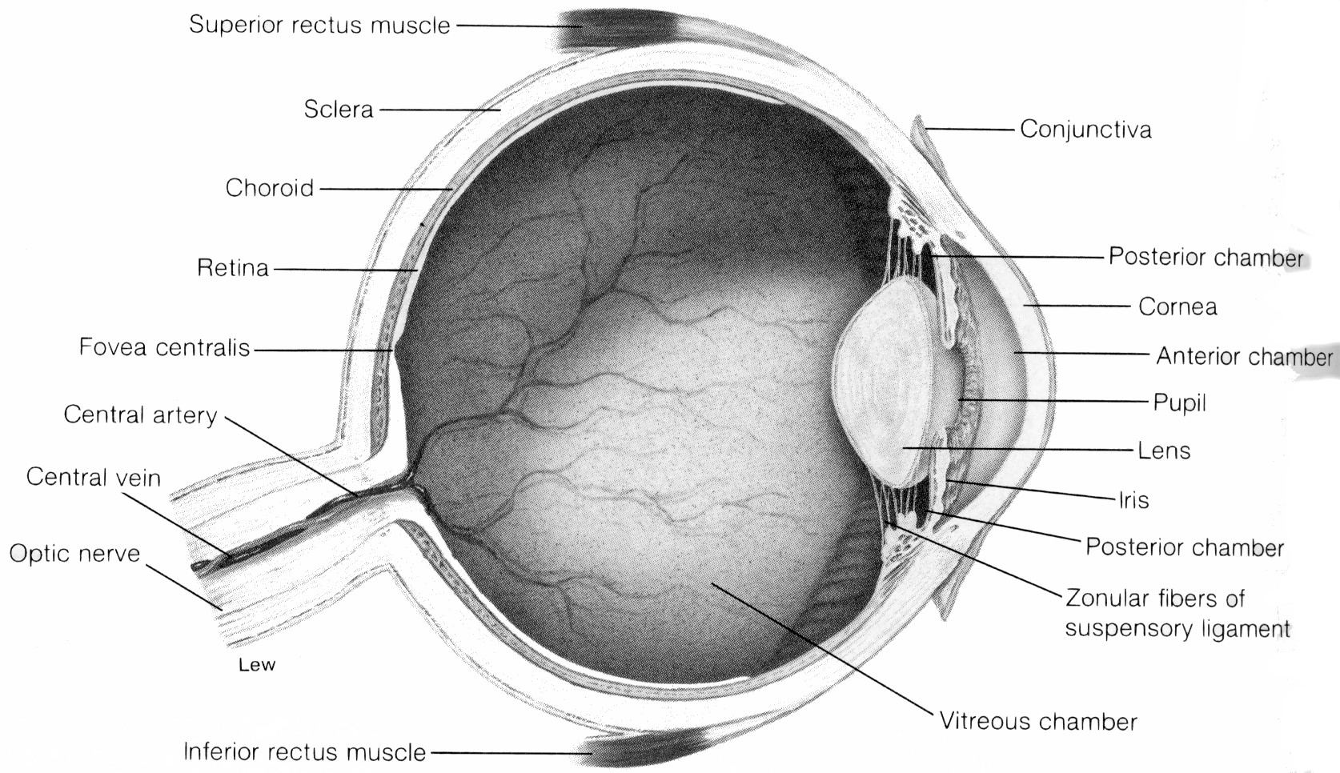
Eye Parts - Diagram

Slide 3
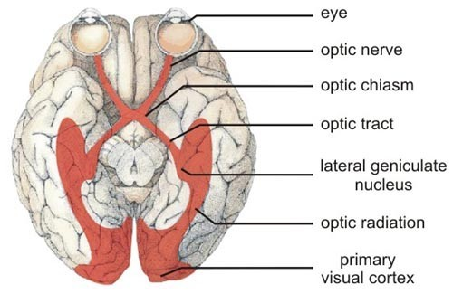
Introduction
The eye is a specialized sense organ that helps us to understand our environment. It is a sensory unit composed of three parts: receptor, sensory pathway, and a brain center.

Slide 4
It is spherical in shaped
It is about 2.5 cm in diameter
situated in the orbital cavity

Slide 5
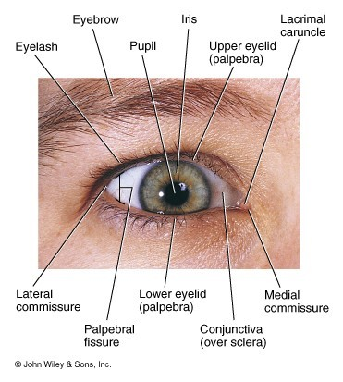
External Anatomy of the Eye

Slide 6
Accessory Organs & Eye Protection
Orbital cavities (bony sockets) –
house & protect the eye
Adipose tissue – cushions the eye

Slide 7
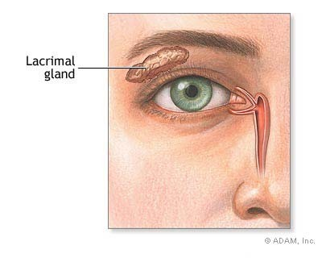
Lacrimal glands – produce tears that
lubricate & have a germicidal effect
Eyebrows – protect against foreign
articles, perspiration, & direct rays of light

Slide 8
Eyelids – folds of skin that cover the
surface of the eye; close by reflex action when an object approaches
Eyelashes – secrete oils that prevent
lids from sticking together

Slide 9
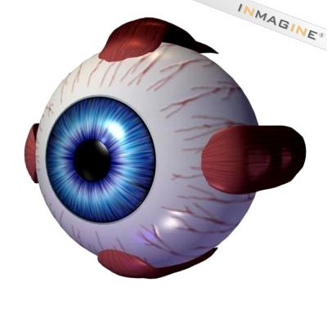
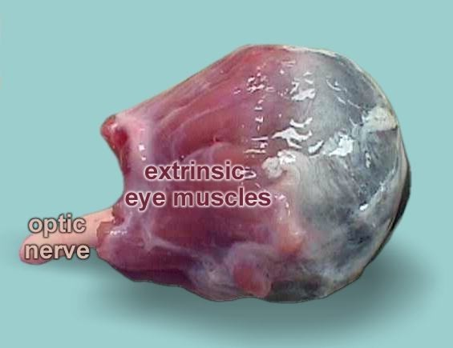
Muscles of eye:-
Extrinsic muscles – muscles located
outside of the eye that control certain eye movements such as moving
the eyeball from
side to side or rolling the eyes

Slide 10
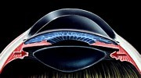
Intrinsic muscles – muscles located
inside the eye that help hold the lens in place & modify its shape

Slide 11
Layers:- There are three layer of the eye
1.Sclera – white, outer layer of the eyeball; tough, fibrous membrane that helps to maintain the spherical shape of the eyeball
Cornea – part of sclerotic coat;
transparent, front part of eyeball through which light waves pass – no blood vessels but lots of nerve endings

Slide 12
Canals of Schlem – venous passages
that drain the fluid that accumulates behind the cornea; located where the sclera & cornea meet
Conjuctiva – thin, transparent mucous
membrane that covers the eyeball

Slide 13
2.Choroid layer – middle layer of the
eye; supplies blood vessels to the eye and
contains dark pigment granules that
prevent the reflection of light in the eye

Slide 14
Ciliary body – intrinsic muscle; smooth
muscle fibers support & modify lens shape
Iris – colored portion of eye formed by circularly and radially arranged smooth muscle fibers; regulates amount of light entering they eye by constricting or dilating the pupil

Slide 15
Pupil – rounded opening of the iris through which light passes
3.Retina – innermost layer of the eye; lines its surface and contains photoreceptors (cells responsible for converting light into nerve impulses – rods & cones)

Slide 16
Eye Parts
Rods – cylindrical photoreceptors found in greatest concentration on the edges of the retina; most common type of receptor;
allow us to see in low light and provide for peripheral vision

Slide 17
Cones – Conical photoreceptors found in greatest concentration near the center of the retina; there are three varieties of cones, each most sensitive
to a particular wavelength (color) of light – blue, green, & red; allow for visual acuity (sharp vision) and color vision

Slide 18
Fovea centralis – a depression, or pit, in the center of the retina that contains only cones; provides for the most acute vision & color sensitivity
Optic disk (blind spot) – area where optic
nerve attaches to the retina; does not contain any photorecptors

Slide 19
Lens – flexible, biconvex, crystal-like structure that brings rays of light into focus and produces an image on the retina

Slide 20
Suspensory ligament – holds the lens
in place; attached to
the ciliary body, which controls
the amount of
tension exerted on the lens

Slide 21
Fluid in eye:-
Aqueous humor – watery fluid that
provides nutrition and helps maintain
the shape of the cornea; found in the
smaller, anterior chamber of the eye

Slide 22
Vitreous humor – thick, gel-like
substance that fills the largest chamber
of the eye and helps to hold its spherical
shape

Slide 23



Blood supply:-
Carotid artery
Ophthalmic artery
Cilliary artery & Central retinal artery Eye

Slide 24
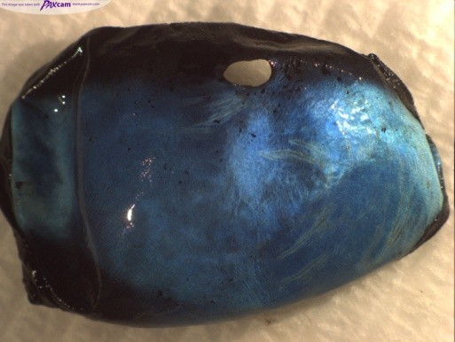
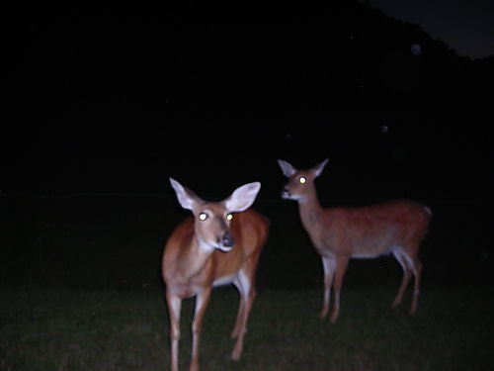
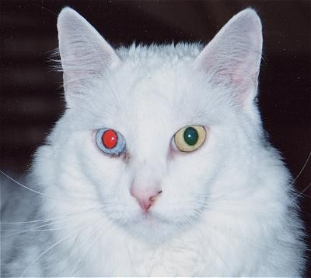
Tapetum
Iridescent layer in eye that causes glow in dark appearance when light shines in - many animals have this

Slide 25
The End

