Slide 1
SCLERA
Dr.SUJATA CHAREL

Slide 2
ANATOMY
Opaque, 5/6th of outer coat, 2/3 LAYERS
EPISLERA -
SCLERA PROPER
LAMINA FUSCA
1mm/0.5mm: lamina cribrosa

Slide 3
Inflammations(non-infective)
Infections
Staphylomas
Tumors
Congenital – Blue sclera

Slide 4
Inflammation(non-infective)
EPISCLERITIS
SCLERITIS

Slide 5
EPISCLERITIS
DEFI : Benign / Selflimiting / Recurrent
ETIOPATHO : Allergic reaction to endogenous toxin
Asso. Collagenous diseases
Lymphocytic infiltration
C/F : History : Reccurence / Age / Female
Symptoms : Red eye / mild pain /discomfort

Slide 6
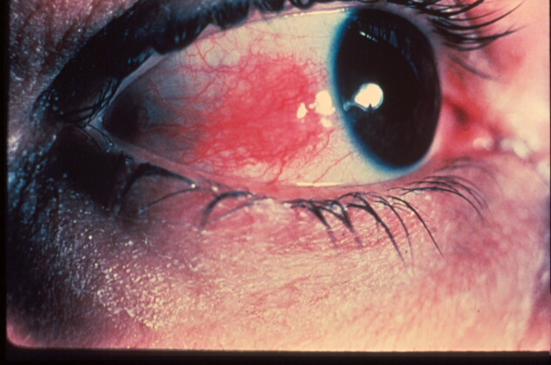

Slide 7
SIGNS : 2 types
Simple : Diffuse / Sectoral
Nodular : localised/raised/congested/hard/tender/site
Episcleritis Periodica Fugax ; fleeting/frequent

Slide 8
DD (Differential Diagnosis)
Phlycten
Scleritis
Conjunctivitis
Pingiculitis

Slide 9
Management
Depending on severity
Topical
Lubricants
NSAIDs
Mild steroids
Systemic
Oral NSAIDs
R x of rhematism

Slide 10
SCLERITIS
DEFI : Infiltration all layers
ETIO :
Connective tissue disease(50%)
Surgically induced
Infections

Slide 11
CLASSIFICATION
Anterior Scleritis(98%) :
Non Necrotising (85): Nodular / Diffuse
Necrotising (13%) :
with inflammation
without inflammation(Scleromalacia perforans)
Posterrior Scleritis (2%)

Slide 12
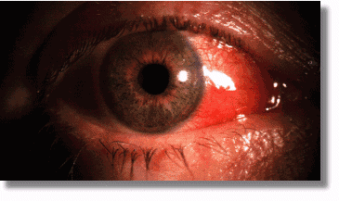

Slide 13
Clinical presentation
Bilateral / females / painful
Nodular : less circumscribed/dark red
Annular scleritis
Necrotising : with inflamm. – red painful eye
without inflamm.- painless/melting/seroRA

Slide 14
COMPLICATIONS
Anterior uveitis
Sclerosing Keratitis : opacity/tongue/vasculari
Secondary glaucoma
Cataract
Corneal perforation

Slide 15
Posterior scleritis
Posterior sclera
Variable presentation(dv/proptosis restricted movements/vitritis/odema disc/choroidal folds,exudative RD)
B – scan / CT

Slide 16
INVESTIGATIONS
Full BC
RA
ANA
ANCA
VDRL/FTA-ABS
Mantoux
LE/ANF

Slide 17
MANAGEMENT
ANTERIOR : NSAIDs / Steroids Topi/sys ;
Immunosupressives
In necrotising-Lubricants / Scleral patch graft
POSTERIOR : Same/intravenous methy pred

Slide 18
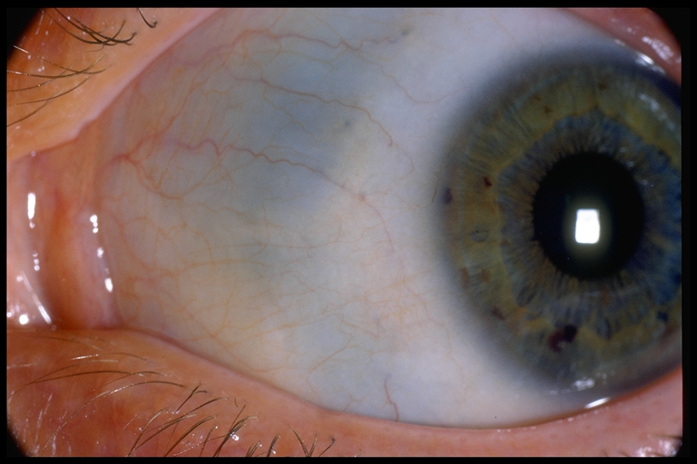
STAPHYLOMAS
Ectasia outer coats / incarceration of uveal

Slide 19
CLASSIFICATION
Anterior : partial/total ; cornea
Intercalary : at limbus ; (surg/peri ulcer/scleroperforans/sec.glaucoma)
Ciliary : cilary zone ;(sec.glaucoma/scleritis/trauma)
Equatorial : 14mm behind limbus (scleritis/glaucoma/degenerative myopia)
Posterior: (degenerative myopia)

Slide 20
Management
R x of cause
Mild anterior : staphylectomy&keratoplasty
Scleral thinning : Scleral patch graft
Blind eye : cosmetic surg

Slide 21
Thank you

